Slide 1

Stagnation Theory for Compressible Flow Turbomachinery
P M V Subbarao
Professor
Mechanical Engineering Department
Speed of the Sound is a Thermo-fluid Property!!

Slide 2


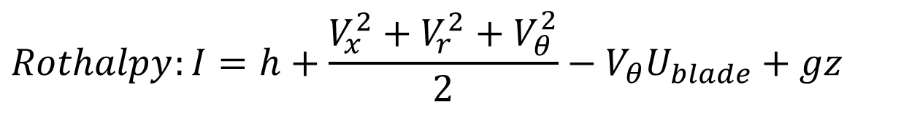
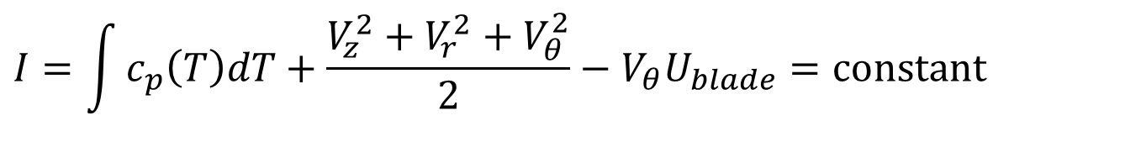
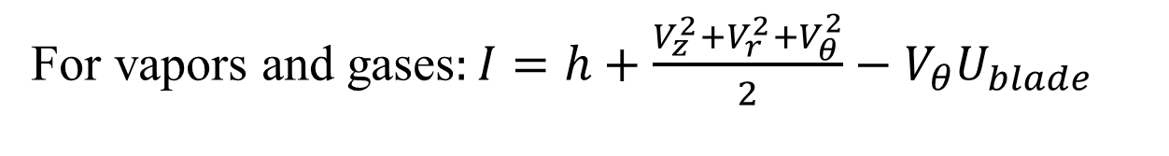
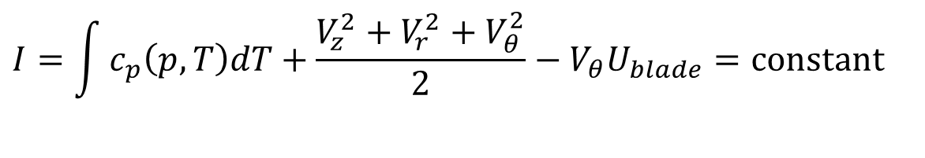

Turbomachines working with Vapors/Gas
$$Rothalpy:I=h+\frac{V_{x}^{2}+V_{r}^{2}+V_{θ}^{2}}{2}−V_{θ}U_{blade}+gz$$
$$gz≈\text{constant}$$
For vapors and gases$:I=h+\frac{V_{z}^{2}+V_{r}^{2}+V_{θ}^{2}}{2}−V_{θ}U_{blade}$
$$I=\int{c_{p}\left(p,T\right)dT}+\frac{V_{z}^{2}+V_{r}^{2}+V_{θ}^{2}}{2}−V_{θ}U_{blade}=\text{constant}$$
For an ideal gas as a working fluid:
$$I=\int{c_{p}\left(T\right)dT+\frac{V_{z}^{2}+V_{r}^{2}+V_{θ}^{2}}{2}}−V_{θ}U_{blade}=\text{constant}$$

Slide 3




Broad Classification of Forms of Energy
Energy
Potential Energy
Kinetic Energy
Microscopic Potential Energy
Macroscopic Potential Energy
Microscopic Kinetic Energy
Macroscopic Kinetic Energy
Sum of Microscopic Potential and Kinetic Energies
$$Internal \text{Energy}\text{, }U$$
$$\text{Gibbs} \text{Free} \text{Energy}\text{, }G$$
$$Enthalpy,H$$
$$\text{Helmholtz} \text{Energy}\text{, }Ω$$

Slide 4
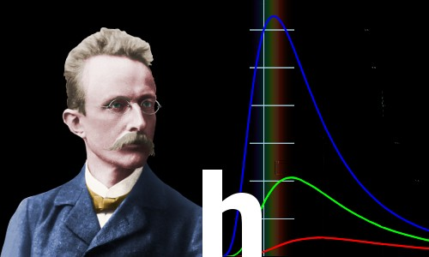
Microscopic View of A Fluid
Hermann Müller taught his receptive young student how to visualize the laws of physics in his mind
– A vital weapon in the armory of the great physicists
Max Planck changed physics and our understanding of the world forever

Slide 5
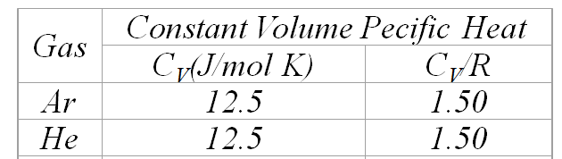
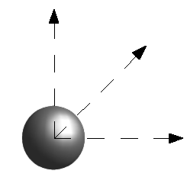
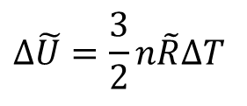
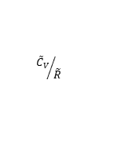

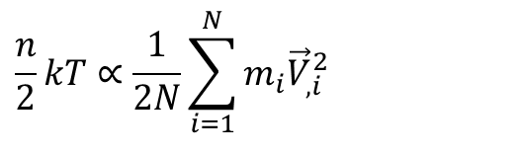
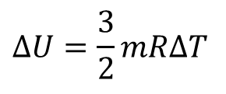
Plank’s World of Gas &
Internal (Microscopic) Energy
For an ideal monatomic gas, the translational kinetic energy of the linear motion of the "hard sphere" type atoms contributes to Internal Energy, ΔU=mc_{v}ΔT.
Measurements generated following results:
For a monatomic ideal and inert gas this change in internal energy is given by :
$${\tilde{C}}_{V}$$
$${{\tilde{C}}_{V}}/{\tilde{R}}$$
$$Δ\tilde{U}=\frac{3}{2}n\tilde{R}ΔT$$
$$\frac{n}{2}kT∝\frac{1}{2N}\sum_{i=1}^{N}{m_{i}{\vec{V}}_{,i}^{2}}$$
$$ΔU=\frac{3}{2}mRΔT$$

Slide 6
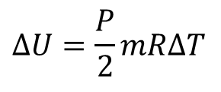
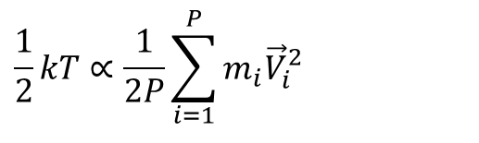
Plank’s World of Gas &
Internal (Microscopic) Energy
For an ideal monatomic gas, the translational kinetic energy of the linear motion of the "hard sphere" type atoms contributes to Internal Energy.
For any atom with P number of DoF:
$$\frac{1}{2}kT∝\frac{1}{2P}\sum_{i=1}^{P}{m_{i}{\vec{V}}_{i}^{2}}$$
For a gas if mass m :
$$ΔU=\frac{P}{2}mRΔT$$

Slide 7
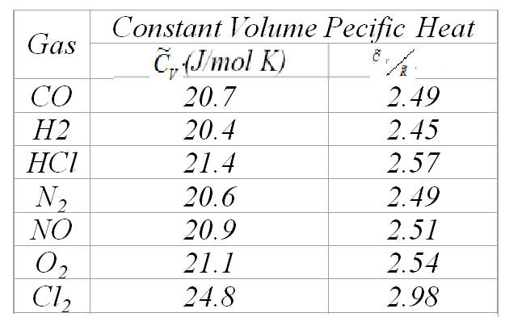
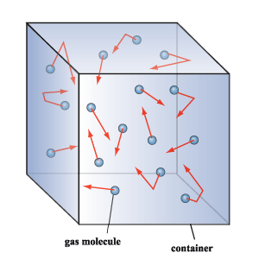
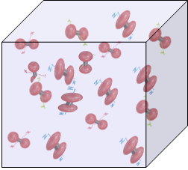
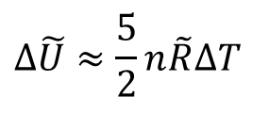
Internal (Microscopic) Energy : Diatomic Ideal Gas
For a diatomic ideal gas this change in internal energy is given by :
$$Δ\tilde{U}≈\frac{5}{2}n\tilde{R}ΔT$$

Slide 8
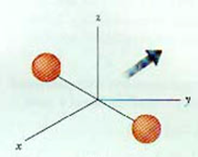
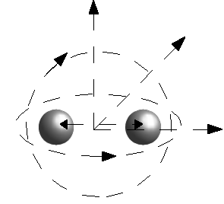
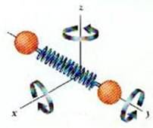
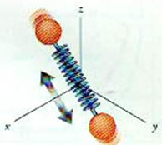


Internal (Microscopic) Energy : Diatomic Ideal Gas
For polyatomic gases there are rotational and vibrational kinetic energy as well.

Slide 9
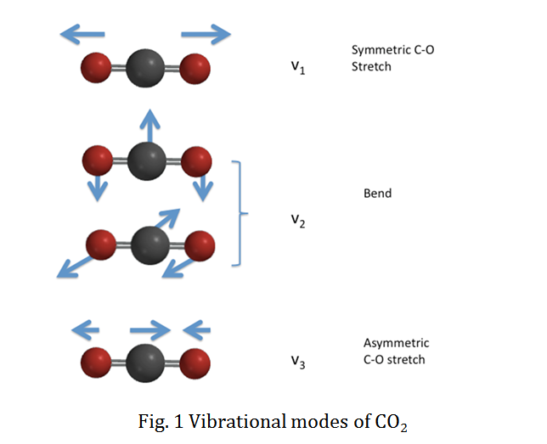
Internal (Microscopic) Energy : Polyatomic Gas

Slide 10
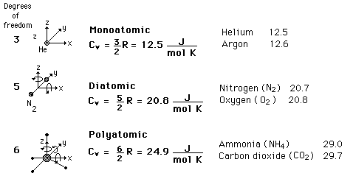
C_{V} Specific Heats of Ideal Gases
Experimental results

Slide 11
Gas
Constant Volume Pecific Heat
C_{V}(J/mol K)
C_{V}/R
Ar
12.5
1.50
He
12.5
1.50
CO
20.7
2.49
H2
20.4
2.45
HCl
21.4
2.57
N₂
20.6
2.49
NO
20.9
2.51
O₂
21.1
2.54
Cl₂
24.8
2.98
CO₂
28.2
3.40
CS₂
40.9
4.92
H₂S
25.4
3.06
N₂O
28.5
3.42
SO₂
31.3
3.76

Slide 12
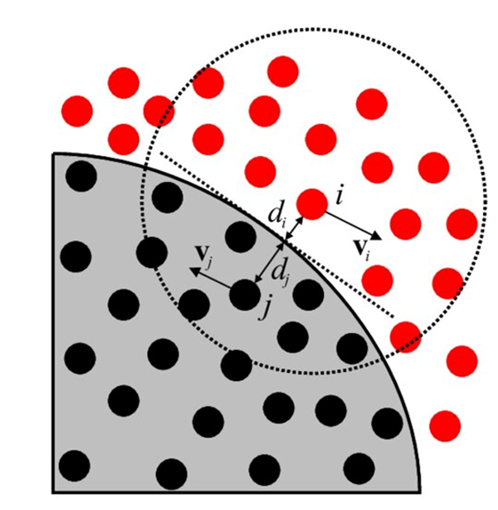

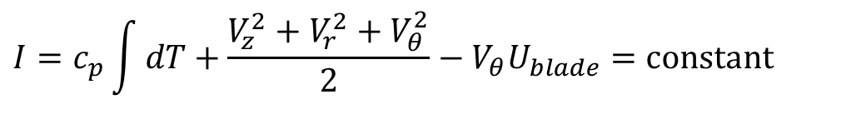
High Speed Gas Parcels Coming to Rest
$$I=c_{p}\int{dT}+\frac{V_{z}^{2}+V_{r}^{2}+V_{θ}^{2}}{2}−V_{θ}U_{blade}=\text{constant}$$
Fluid Particles
Consider a case of a high velocity fluid system is approaching a finite size moving object.
Relative to the object, the far field fluid particles are moving at a relative velocity of the object.
The fluid particles attain a state of relative stagnation at solid surface.
This is known as no-slip condition in all viscous (real) flows.
Solid object

Slide 13

High Speed Gas Parcels Coming to Rest
$$I=c_{p}\int{dT}+\frac{V_{z}^{2}+V_{r}^{2}+V_{θ}^{2}}{2}−V_{θ}U_{blade}=\text{constant}$$
Due to no-slip condition the fluid particle reaches zero relative velocity (stagnation) condition at the wall of the object.
Stagnation property is defined as property of a highspeed fluid, when it is entropically come to rest (relative to surface).
Stagnation enthalpy, it is defined as the maximum available microscopic energy of a fluid.

Slide 14
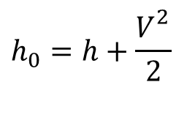
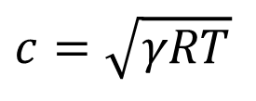
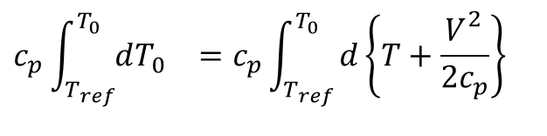
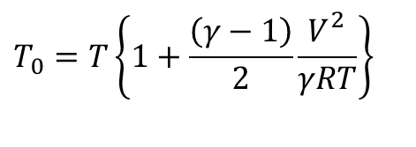
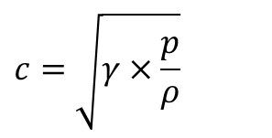
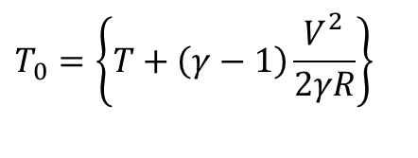
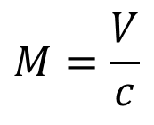
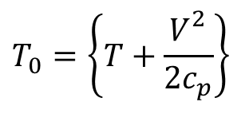
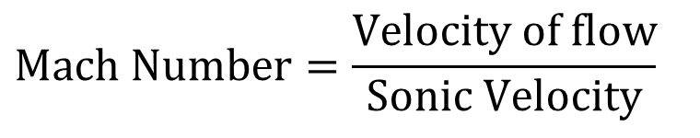
Stagnation Properties (Perfect Gas)
Define Stagnation Enthalpy is due to conversion of entire macroscopic kinetic energy into microscopic kinetic energy:
$$h_{0}=h+\frac{V_{}^{2}}{2}$$
$$c_{p}{\int_{T_{ref}}^{T_{0}}{dT_{0}}}_{}=c_{p}{\int_{T_{ref}}^{T_{0}}{d\left\{T+\frac{V_{}^{2}}{2c_{p}}\right\}}}_{}$$
$$T_{0}=\left\{T+\frac{V_{}^{2}}{2c_{p}}\right\}$$
$$T_{0}=\left\{T+\left(γ−1\right)\frac{V_{}^{2}}{2γR}\right\}$$
$$T_{0}=T\left\{1+\frac{\left(γ−1\right)}{2}\frac{V_{}^{2}}{γRT}\right\}$$
$$\text{Mach} \text{Number}=\frac{\text{Velocity} \text{of} \text{flow}}{\text{Sonic} \text{Velocity}}$$
$$M=\frac{V}{c}$$
For a perfect gas, the speed of sound is :
$$c=\sqrt{γ×\frac{p}{ρ}}$$
$$c=\sqrt{γRT}$$

Slide 15
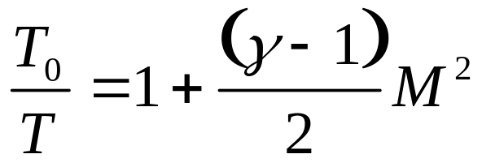
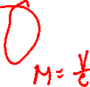
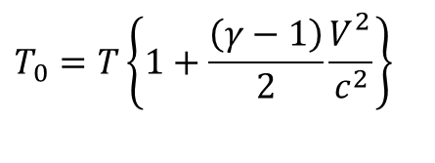
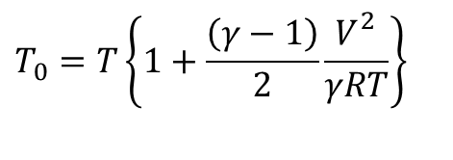
Stagnation Temperature of A Gas Flow
$$T_{0}=T\left\{1+\frac{\left(γ−1\right)}{2}\frac{V_{}^{2}}{γRT}\right\}$$
$$T_{0}=T\left\{1+\frac{\left(γ−1\right)}{2}\frac{V_{}^{2}}{c^{2}}\right\}$$
In general, for an adiabatic Flow Field at M, the Stagnation Temperature is defined by the relationship
Stagnation Temperature is constant throughout an adiabatic flow field.
This is the maximum possible temperature.
T₀ is also sometimes referred to at Total Temperature
T is sometimes referred to as Static Temperature

Slide 16
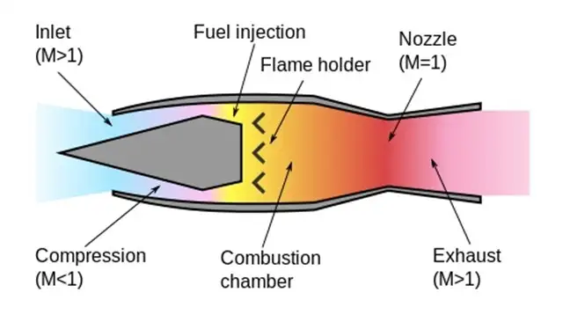
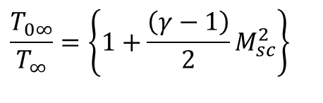
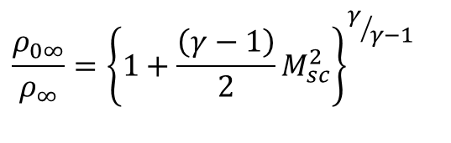

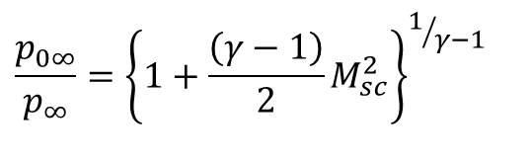
Engineering Importance of Stagnation Temperature
• Stagnation temperature is a measure of the Global (Microscopic total and Macroscopic Kinetic Energy of the flow Field.
• Largely responsible for generation of high-pressure in supersonic ramjet.
$$\frac{T_{0∞}}{T_{∞}}=\left\{1+\frac{\left(γ−1\right)}{2}M_{sc}^{2}\right\}$$
For a reversible ram effect:
$$\frac{p_{0∞}}{p_{∞}}={\left\{1+\frac{\left(γ−1\right)}{2}M_{sc}^{2}\right\}}^{1/{γ−1}}$$
$$\frac{ρ_{0∞}}{ρ_{∞}}={\left\{1+\frac{\left(γ−1\right)}{2}M_{sc}^{2}\right\}}^{γ/{γ−1}}$$

