Slide 1

Through Flow Theory in Turbomachinery
P M V Subbarao
Professor
Mechanical Engineering Department
Utilization of the Principle of Rothalpy Conservation!!

Slide 2


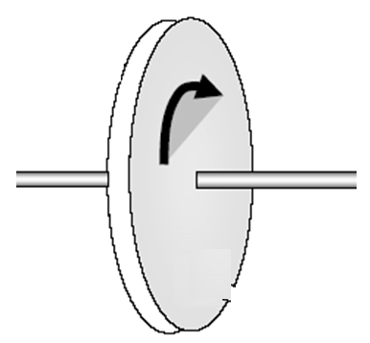
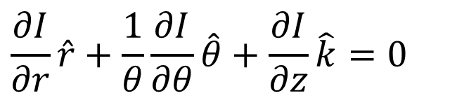

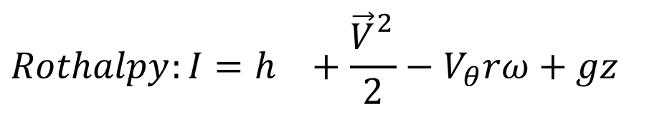

An Exclusive Theory for
Turbomachines
A Turbomachine
Along meridional path
$$∇I=0$$
$$\dot{P}$$
Fluid in
$$\frac{∂I}{∂r}\hat{r}+\frac{1}{θ}\frac{∂I}{∂θ}\hat{θ}+\frac{∂I}{∂z}\hat{k}=0$$
Through flow Theory
Fluid out
$$Rothalpy:I=h_{}+\frac{{\vec{V}}_{}^{2}}{2}−V_{θ}rω+gz$$

Slide 3
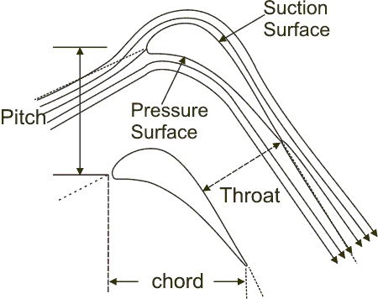
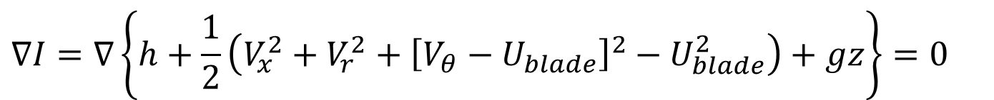
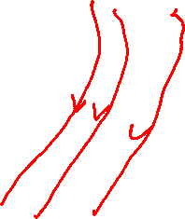
Blade Velocity Vs Tangential Component of Fluid Velocity
Through Flow Theory
$$∇I=∇\left\{h+\frac{1}{2}\left(V_{x}^{2}+V_{r}^{2}+{\left[V_{θ}−U_{blade}\right]}^{2}−U_{blade}^{2}\right)+gz\right\}=0$$
U_{b}
In maridional plane at mean radius of rotor
V_{θ}
U_{b}
V_{r}
V_{f}
V_{a}

Slide 4
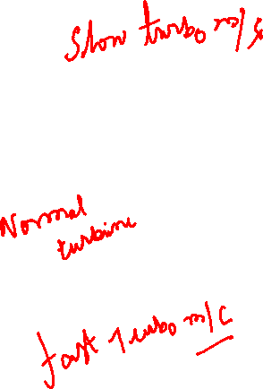
Rotor Speed Vs Inlet Whirl Velocity
V_{θi}
U_{b}
V_{ri}
V_{fi}
V_{ai}
V _{θ i}
U_{b}
V_{ri}
V_{ai}
V_{fi}
U_{b}
V _{θ} i
V_{fi}
V_{ai}
V_{ri}

Slide 5
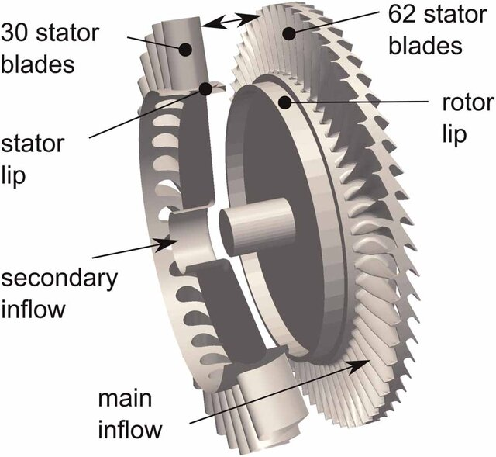
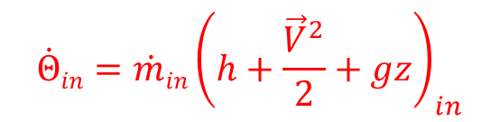
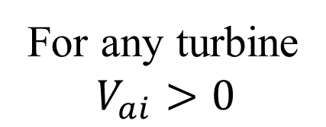

Need For A Stator/Nozzle
U_{b}
V _{θ i}
V_{ri}
For any turbine
$$V_{ai}>0$$
V_{fi}
V_{ai}
Potential of A Resource:
$${\dot{Θ}in=\dot{m}in\left(h+\frac{{\vec{V}}^{2}}{2}+gz\right)}_{in}$$
Wind Power Potential:
$${\dot{Θ}in=\dot{m}in\left(\frac{{\vec{V}}^{2}}{2}\right)}_{in}$$
No need of stator/Nozzle!

Slide 6
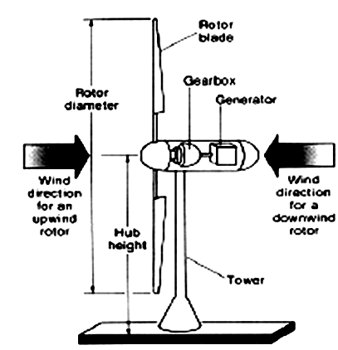
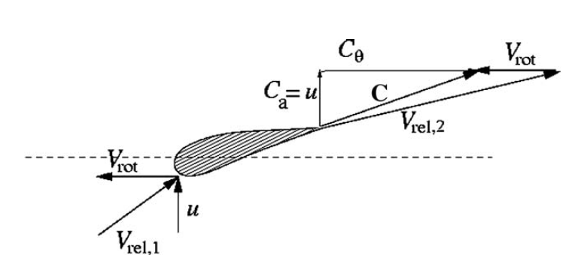
Structure of Modern Wind Turbines

Slide 7
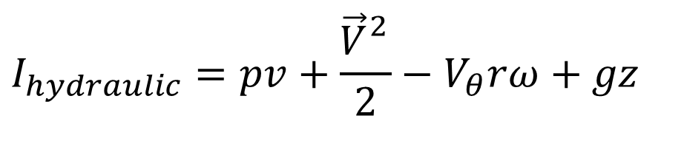
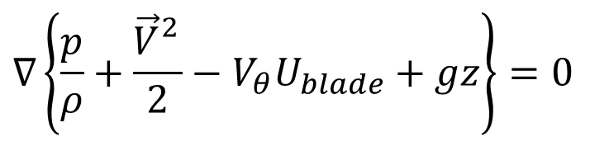
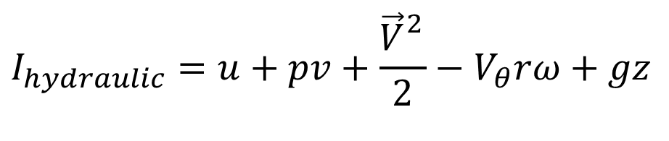
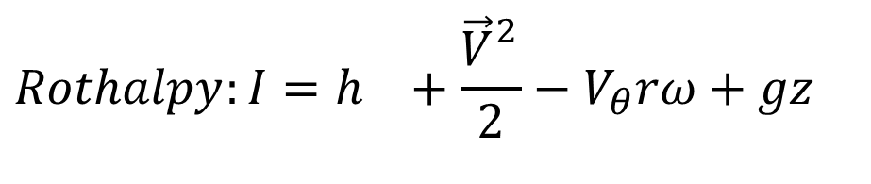
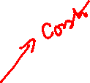
Throughflow Analysis of Hydraulic Turbomachinery
$$Rothalpy:I=h_{}+\frac{{\vec{V}}_{}^{2}}{2}−V_{θ}rω+gz$$
A turbomachine working with incompressible fluid will be isothermal and hence u(T) is constant throughout the machine.
$$I_{hydraulic}=u+pv+\frac{{\vec{V}}_{}^{2}}{2}−V_{θ}rω+gz$$
$$I_{hydraulic}=pv+\frac{{\vec{V}}_{}^{2}}{2}−V_{θ}rω+gz$$
For an Ideal Hydro Turbomachine :
$$∇\left\{\frac{p}{ρ}+\frac{{\vec{V}}_{}^{2}}{2}−V_{θ}U_{blade}+gz\right\}=0$$

Slide 8
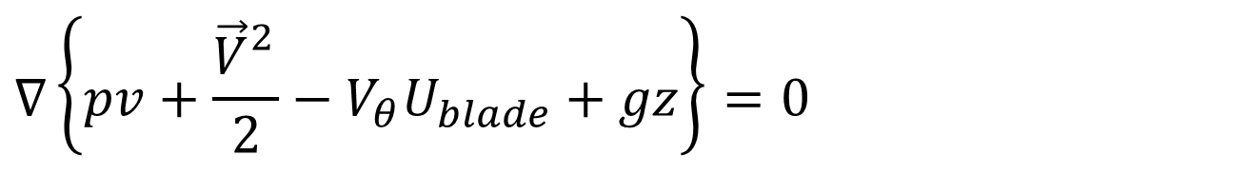
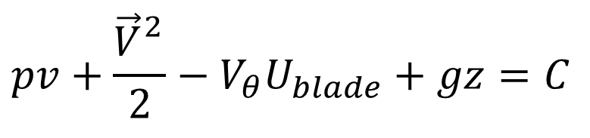
Throughflow Analysis of Hydraulic Turbomachinery
$$∇\left\{pv+\frac{{\vec{V}}_{}^{2}}{2}−V_{θ}U_{blade}+gz\right\}=0$$
For an Ideal Hydraulic Turbine:
$$pv+\frac{{\vec{V}}_{}^{2}}{2}−V_{θ}U_{blade}+gz=C$$
Principle of Controlled Utilization of Hydraulic Resource:
Potential energy of a Hydraulic source can be stored for long time, whereas Kinetic energy is to be utilized at the instant.

Slide 9
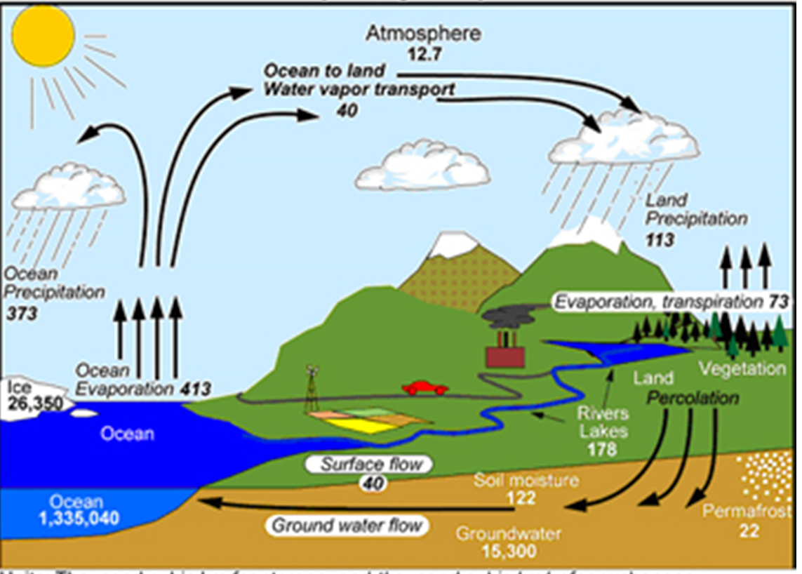
Hydrological Cycle

Slide 10
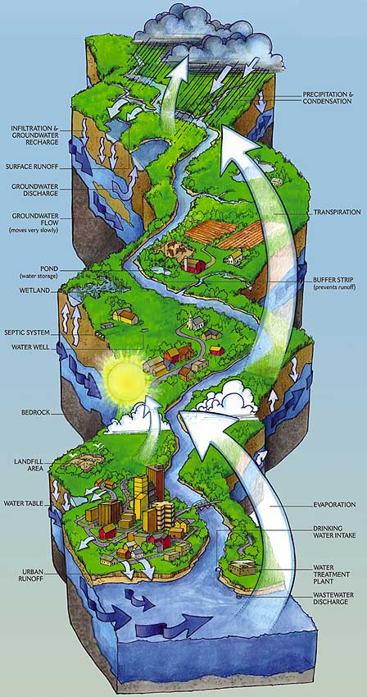
Catchment Area of A River

Slide 11
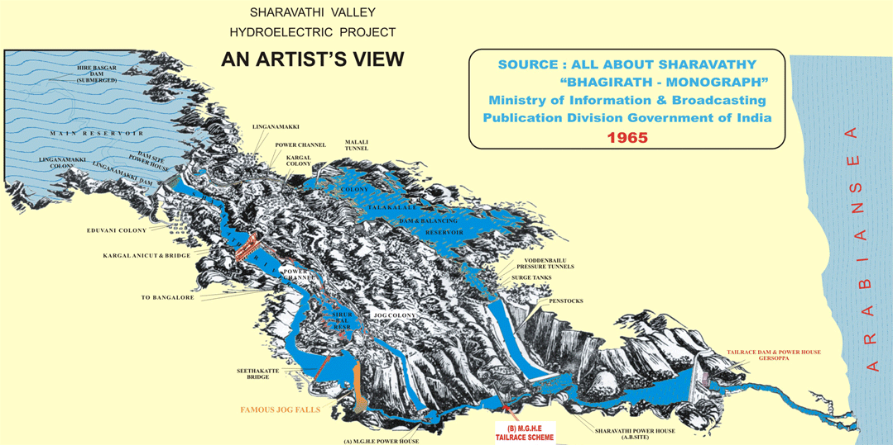

The West Flowing River: The Sharavathi
The river Sharavathi originates at a height of 730m near Ambuthirtha, in Shimoga district.
It flows in a north-west direction, in its long, 132-km journey.

Slide 12
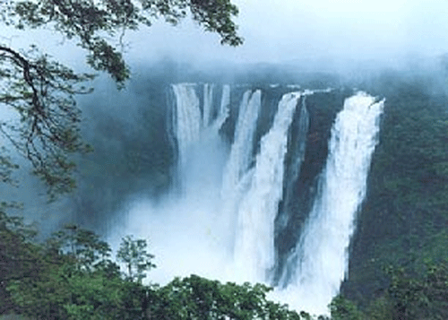
Jog Falls

Slide 13
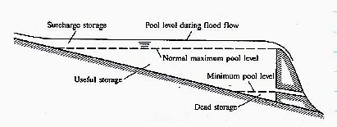
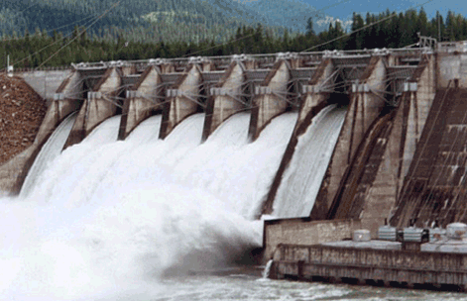

Creation of Reservoir of Potential Energy

Slide 14
Reservoirs
A reservoir is a manmade lake or structure used to store water.
A reservoir with dam has an uncontrolled inflow but a largely controlled outflow.
The water available for storage is totally a function of the natural stream flow.
Reservoir capacity is the max. volume of water that can be stored in the particular reservoir.
It is the normal maximum pool level behind a dam.
This can be calculated by using a topographic map of the region.

Slide 15
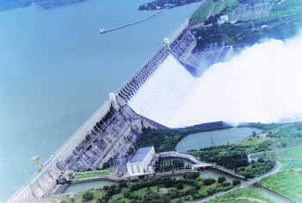
Reservoir Created using A DAM

Slide 16
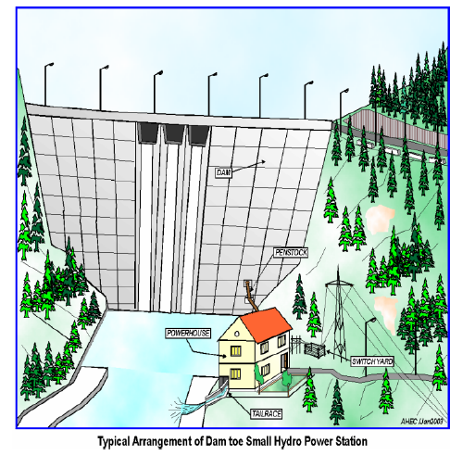
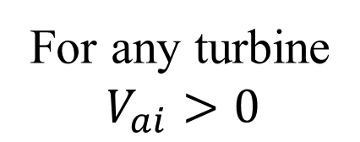
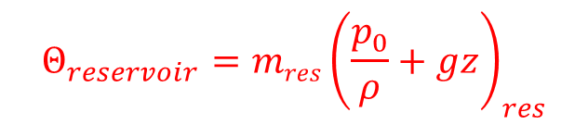
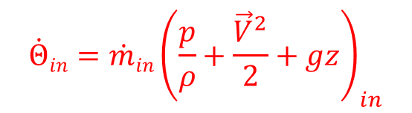
Storage plant (Impoundment plant)
Potential of A Hydraulic Resource:
$${\dot{Θ}in=\dot{m}in\left(\frac{p}{ρ}+\frac{{\vec{V}}^{2}}{2}+gz\right)}_{in}$$
$${Θ_{reservoir}=mres\left(\frac{p_{0}}{ρ}+gz\right)}_{res}$$
For any turbine
$$V_{ai}>0$$
An energy conversion device to convert potential energy to kinetic energy is essential.
This is known as Nozzle/stator.

Slide 17
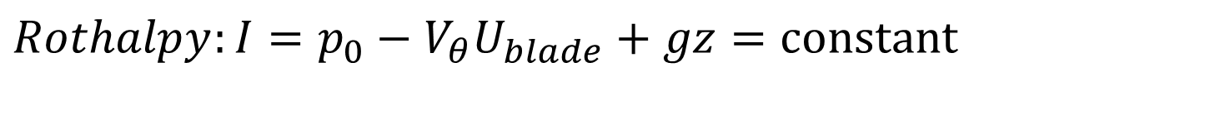
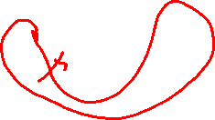
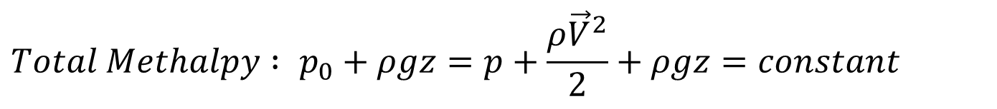
Stator & Rotor Pair in a Hydraulic Turbomachine
For stator/Nozzle U_{blade} =0
$$Total Methalpy : p_{0}+ρgz=p+\frac{{ρ\vec{V}}^{2}}{2}+ρgz=constant$$
For rotors :
$$Rothalpy:I=p_{0}−V_{θ}U_{blade}+gz=\text{constant}$$

Slide 18
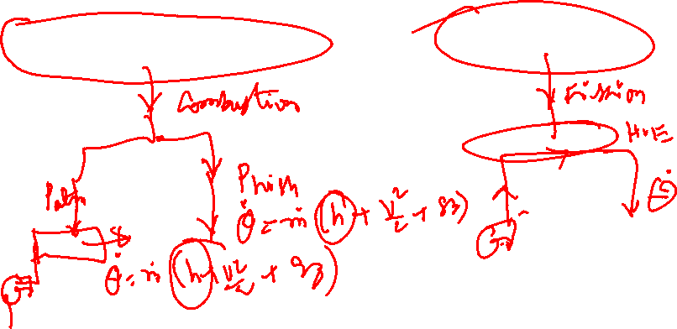
Turbomachines working with Vapors/Gas
Energy Resources: Fossil Fuels, Nuclear Fuels, Geothermal Energy, Solar Thermal Energy, Biomass, Waste Heat…
Fossil Fuels & Biomass
Nuclear Fuels

