Slide 1

A Novel Conservation Variable for Ideal Turbo Machines
P M V Subbarao
Head & Professor
Mechanical Engineering Department
Conservation Variable for Design Principle for Turbomachines !!!

Slide 2


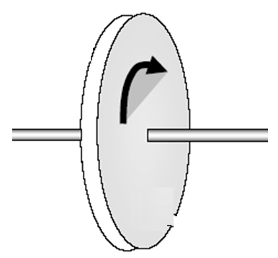

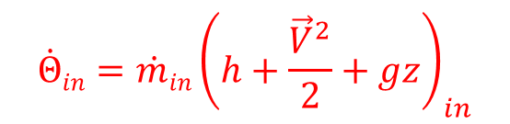
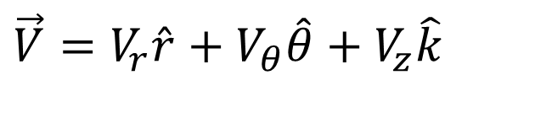
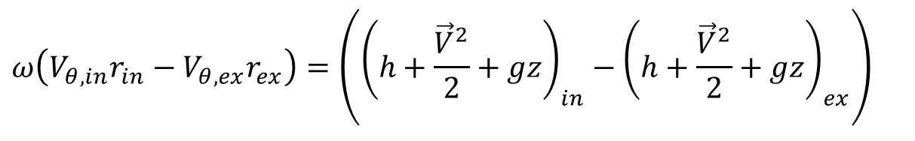

An Essential Action Across of A Fluid-machine
A Turbomachine
$$ω\left(V_{θ,in}r_{in}−V_{θ,ex}r_{ex}\right)=\left({\left(h+\frac{{\vec{V}}^{2}}{2}+gz\right)}_{in}−{\left(h+\frac{{\vec{V}}^{2}}{2}+gz\right)}_{ex}\right)$$
$${P=\dot{Θ}}_{in}−{\dot{Θ}}_{out}$$
Fluid in
$${\dot{Θ}in=\dot{m}in\left(h+\frac{{\vec{V}}^{2}}{2}+gz\right)}_{in}$$
Fluid out
$${\dot{Θ}out=\dot{m}out\left(h+\frac{{\vec{V}}^{2}}{2}+gz\right)}_{out}$$
$$\vec{V}=V_{r}\hat{r}+V_{θ}\hat{θ}+V_{z}\hat{k}$$

Slide 3
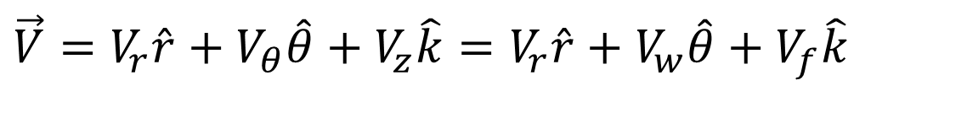
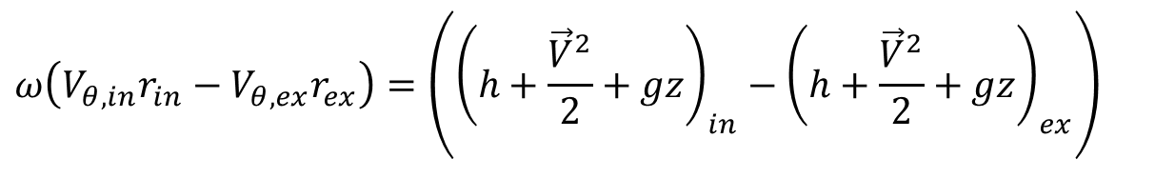
Read Through Euler Turbo-machinery Equation: Axial Flow:
$$\vec{V}=V_{r}\hat{r}+V_{θ}\hat{θ}+V_{z}\hat{k}=V_{r}\hat{r}+V_{w}\hat{θ}+V_{f}\hat{k}$$
$$ω\left(V_{θ,in}r_{in}−V_{θ,ex}r_{ex}\right)=\left({\left(h+\frac{{\vec{V}}^{2}}{2}+gz\right)}_{in}−{\left(h+\frac{{\vec{V}}^{2}}{2}+gz\right)}_{ex}\right)$$
$$ω\left(V_{θ,in}r_{in}−V_{θ,ex}r_{ex}\right)=\left({\left(h_{o}+gz\right)}_{in}−{\left(h_{o}+gz\right)}_{ex}\right)$$
A Change in methalpy is proportional to change rate of angular momentum.
For machines with little change in mean radius (inlet to exit), the change in methalpy is due to change in tangential flow velocity of the fluid.
Can Create a small change in enthalpy of fluid.
Higher the speed of a turbomachine, higher will be the change in methalpy.

Slide 4
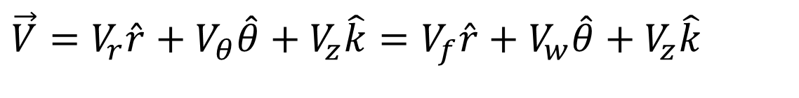
Read Through Euler Turbo-machinery Equation: Radial Flow
$$ω\left(V_{θ,in}r_{in}−V_{θ,ex}r_{ex}\right)=\left({\left(h_{o}+gz\right)}_{in}−{\left(h_{o}+gz\right)}_{ex}\right)$$
$$\vec{V}=V_{r}\hat{r}+V_{θ}\hat{θ}+V_{z}\hat{k}=V_{f}\hat{r}+V_{w}\hat{θ}+V_{z}\hat{k}$$
For turbomachines with large change in radius (inlet to exit), the change in methalpy is to a large degree due to the change in radius.
The centrifugal/centripetal effect.
Creates Large change in enthalpy of fluid.
How to select a suitable type of action for a resource/demand.

Slide 5
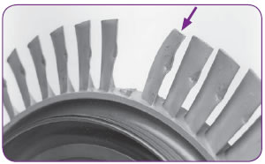
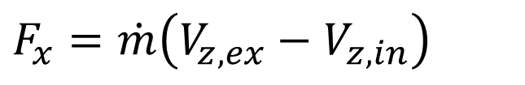
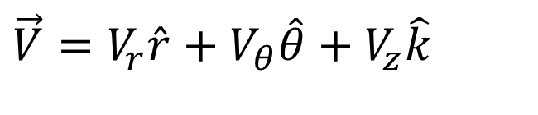
The Side Effect: Axial Momentum Equations
Axial Momentum Equation:
$$F_{x}=\dot{m}\left(V_{z,ex}−V_{z,in}\right)$$
A turbomachine cannot tolerate this force doing any work.
The axial force should be completely absorbed by a thrust bearing.
Any remaining traces of this force can cause mechanical or aerodynamic damages.
$$\vec{V}=V_{r}\hat{r}+V_{θ}\hat{θ}+V_{z}\hat{k}$$

Slide 6
What is the Signature of flow along meridional plane in an Isentropic Turbomachine?
An ideal (isentropic) turbomachine must conserve an unknown parameter!!!???!!!

Slide 7
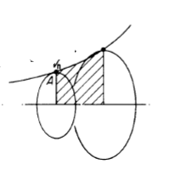
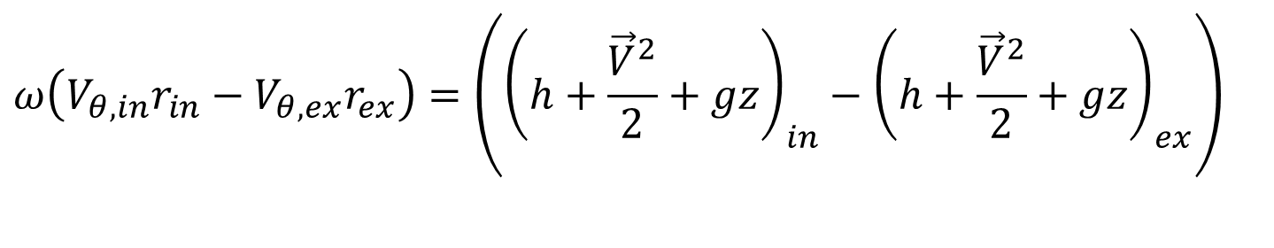
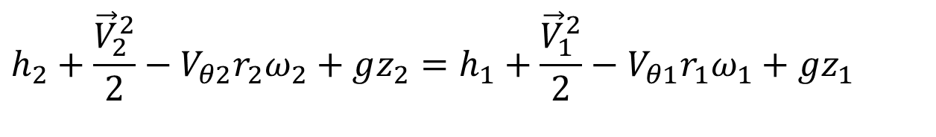
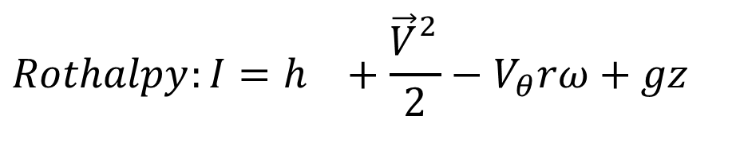

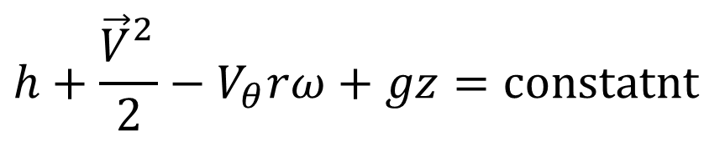
Fusion of Euler and SSFS Equations
$$ω\left(V_{θ,in}r_{in}−V_{θ,ex}r_{ex}\right)=\left({\left(h+\frac{{\vec{V}}^{2}}{2}+gz\right)}_{in}−{\left(h+\frac{{\vec{V}}^{2}}{2}+gz\right)}_{ex}\right)$$
$$h_{2}+\frac{{\vec{V}}_{2}^{2}}{2}−V_{θ2}r_{2}ω_{2}+gz_{2}=h_{1}+\frac{{\vec{V}}_{1}^{2}}{2}−V_{θ1}r_{1}ω_{1}+gz_{1}$$
For an isentropic Turbomachine:
$$h+\frac{{\vec{V}}_{}^{2}}{2}−V_{θ}rω+gz=\text{constatnt}$$
On meridional plane of an ideal turbomachine blade along flow direction Rothalpy remains constant
$$Rothalpy:I=h_{}+\frac{{\vec{V}}_{}^{2}}{2}−V_{θ}rω+gz$$

Slide 8
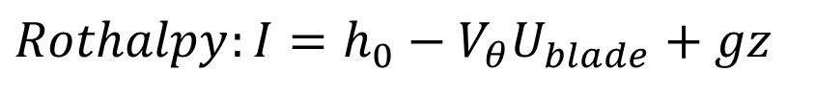
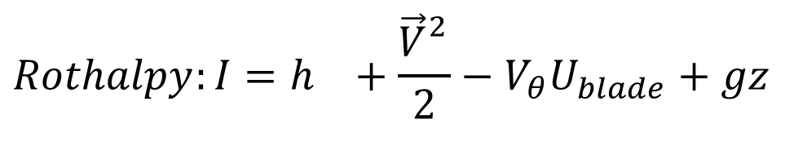
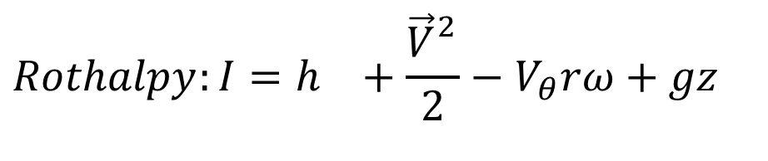
Conservation of Rothalpy
$$Rothalpy:I=h_{}+\frac{{\vec{V}}_{}^{2}}{2}−V_{θ}rω+gz$$
$$Rothalpy:I=h_{}+\frac{{\vec{V}}_{}^{2}}{2}−V_{θ}U_{blade}+gz$$
$$Rothalpy:I=h_{0}−V_{θ}U_{blade}+gz$$
A cornerstone of the analysis of steady, relative flows in rotating systems has, for many years, been the immutable nature of the fluid mechanical property rothalpy.
"In a moving passage the rothalpy is therefore constant provided:
  the flow is steady in the rotating frame;
  no friction from the casing;
  there is no heat flow to or from the flow.

Slide 9
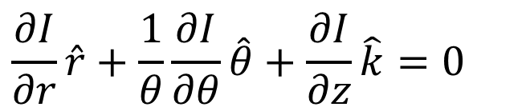
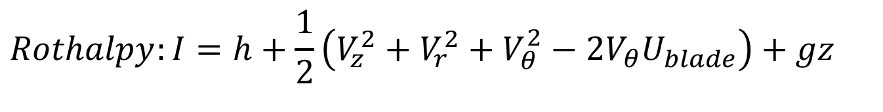

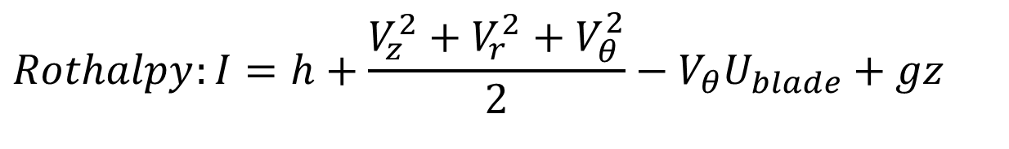
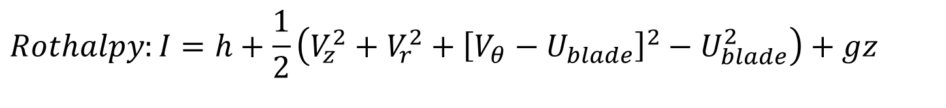
Novel Idea for Creation of Variety
$$Rothalpy:I=h+\frac{V_{z}^{2}+V_{r}^{2}+V_{θ}^{2}}{2}−V_{θ}U_{blade}+gz$$
$$Rothalpy:I=h+\frac{1}{2}\left(V_{z}^{2}+V_{r}^{2}+V_{θ}^{2}−2V_{θ}U_{blade}\right)+gz$$
$$Rothalpy:I=h+\frac{1}{2}\left(V_{z}^{2}+V_{r}^{2}+{\left[V_{θ}−U_{blade}\right]}^{2}−U_{blade}^{2}\right)+gz$$
Ideas for creation of a variety in turbo-machine.
$$∇I=0$$
$$\frac{∂I}{∂r}\hat{r}+\frac{1}{θ}\frac{∂I}{∂θ}\hat{θ}+\frac{∂I}{∂z}\hat{k}=0$$
Through flow Theory

Slide 10
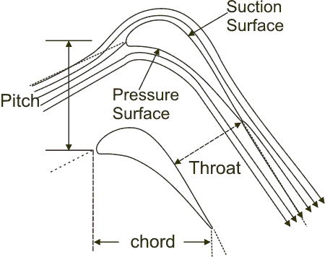
Blade Velocity Vs Tangential Component of Fluid Velocity
Through Flow Theory
$$∇I=∇\left\{h+\frac{1}{2}\left(V_{x}^{2}+V_{r}^{2}+{\left[V_{θ}−U_{blade}\right]}^{2}−U_{blade}^{2}\right)+gz\right\}=0$$
U_{b}
In maridional plane at mean radius of rotor
V_{wi}
U_{b}
V_{ri}
V_{fi}
V_{ai}

Slide 11
Rotor Speed Vs Whirl Velocity
V_{wi}
U_{b}
V_{ri}
V_{fi}
V_{ai}
V_{wi}
U_{b}
V_{ri}
V_{ai}
V_{fi}
U_{b}
Vwi
V_{fi}
V_{ai}
V_{ri}

Slide 12
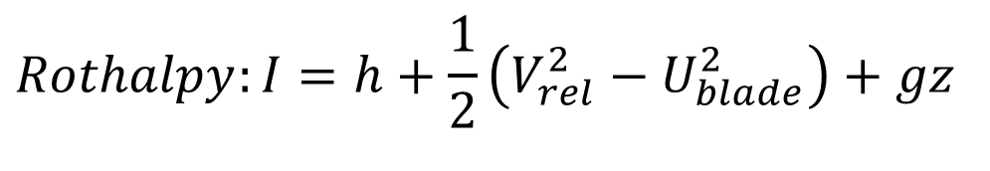
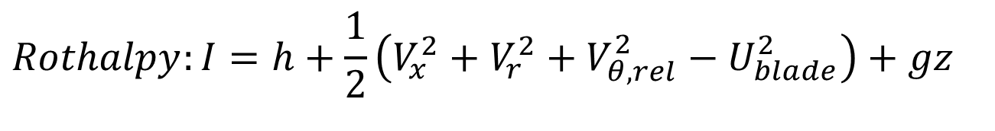
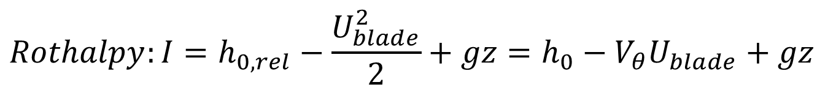
Relative Whirl Velocity
$$Rothalpy:I=h+\frac{1}{2}\left(V_{x}^{2}+V_{r}^{2}+V_{θ,rel}^{2}−U_{blade}^{2}\right)+gz$$
$$Rothalpy:I=h+\frac{1}{2}\left(V_{rel}^{2}−U_{blade}^{2}\right)+gz$$
$$Rothalpy:I=h_{0,rel}−\frac{U_{blade}^{2}}{2}+gz=h_{0}−V_{θ}U_{blade}+gz$$
Constant in an ideal turbo-machine

Slide 13
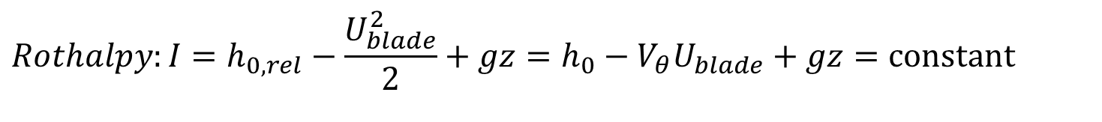
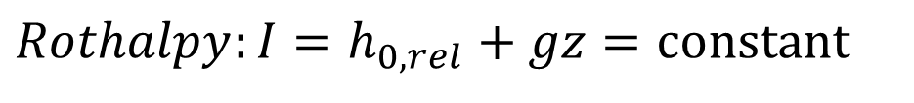
Stator & Rotor
For stator U_{blade} =0
$$Stagnation Enthalpy:h_{0,rel}+gz=h_{0}+gz=\text{constant}$$
For rotors :
$$Rothalpy:I=h_{0,rel}−\frac{U_{blade}^{2}}{2}+gz=h_{0}−V_{θ}U_{blade}+gz=\text{constant}$$
For a true axial flow machines: U_{blade} constant
$$Rothalpy:I=h_{0,rel}+gz=\text{constant}$$

Slide 14
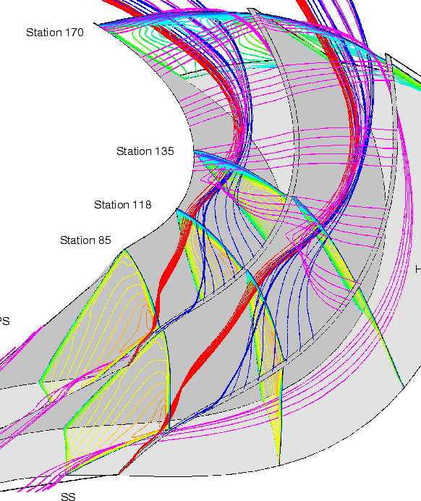
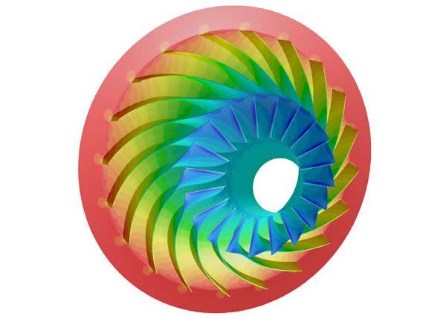
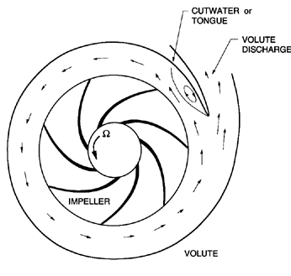

Complex Geometrical Features of A
Turbomachine

Slide 15
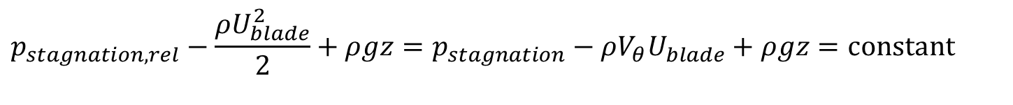
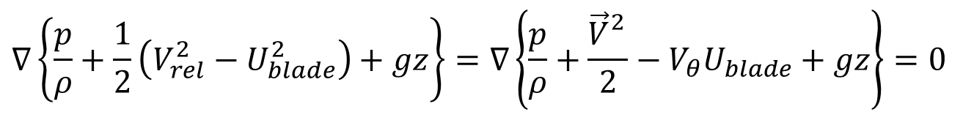
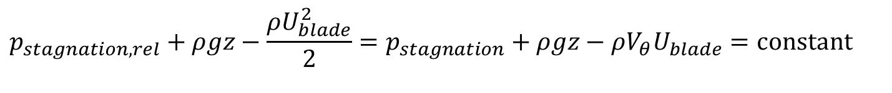
Throughflow Analysis of Incompressible Turbomachinery
A turbomachine working with incompressible fluid will be isothermal and hence U(T) is constant throughout the machine.
$$∇\left\{\frac{p}{ρ}+\frac{1}{2}\left(V_{rel}^{2}−U_{blade}^{2}\right)+gz\right\}=∇\left\{\frac{p}{ρ}+\frac{{\vec{V}}_{}^{2}}{2}−V_{θ}U_{blade}+gz\right\}=0$$
$$p_{stagnation,rel}−\frac{ρU_{blade}^{2}}{2}+ρgz=p_{stagnation}−ρV_{θ}U_{blade}+ρgz=\text{constant}$$
For an Ideal Hydro Turbomachine :
$$p_{stagnation,rel}+ρgz−\frac{ρU_{blade}^{2}}{2}=p_{stagnation}+ρgz−ρV_{θ}U_{blade}=\text{constant}$$

Slide 16
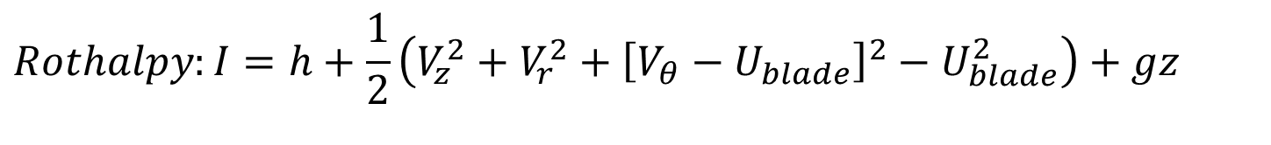
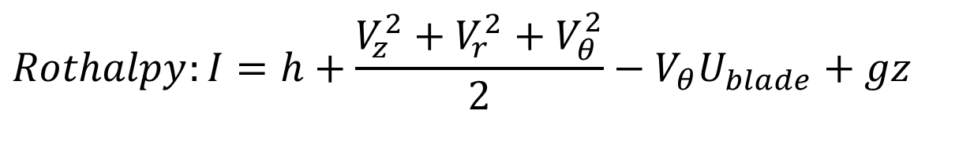
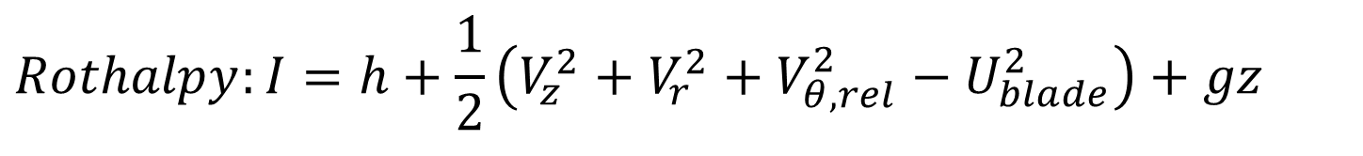
Conservation of Rothalpy
$$Rothalpy:I=h+\frac{V_{z}^{2}+V_{r}^{2}+V_{θ}^{2}}{2}−V_{θ}U_{blade}+gz$$
$$Rothalpy:I=h+\frac{1}{2}\left(V_{z}^{2}+V_{r}^{2}+{\left[V_{θ}−U_{blade}\right]}^{2}−U_{blade}^{2}\right)+gz$$
$$Rothalpy:I=h+\frac{1}{2}\left(V_{z}^{2}+V_{r}^{2}+V_{θ,rel}^{2}−U_{blade}^{2}\right)+gz$$
Ideas for creation of a variety in turbo-machine.
$$∇I=0$$
$$\frac{∂I}{∂r}\hat{r}+\frac{1}{θ}\frac{∂I}{∂θ}\hat{θ}+\frac{∂I}{∂z}\hat{k}=0$$
Throughflow Theory

