Slide 1

Confluence of Euler Turbomachinery Equation with First Law of Thermodynamics
P M V Subbarao
Head & Professor
Mechanical Engineering Department
Development of Basic Design Principle for Turbomachines !!!

Slide 2


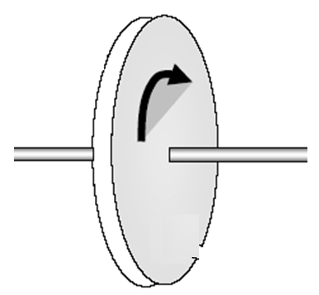

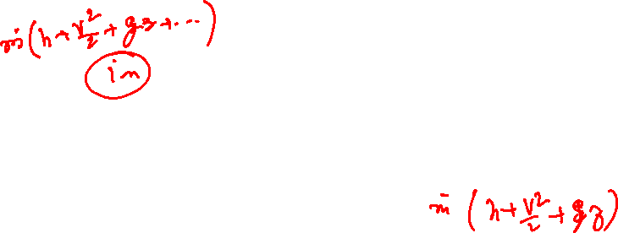
An Essential Action Across of A Fluid-machine
A Turbomachine
Fluid in
Fluid out
Many innovations… What is the most suitable???

Slide 3


Eulerian View of Flow Momentum in A Turbomachine
For a given flow through a turbo-machine:
Inlet rate of angular momentum :
$${\dot{L}}_{in}={\dot{m}}_{in}V_{θ,in}r_{in}$$
Exit rate of angular momentum at exit:
$${\dot{L}}_{ex}={\dot{m}}_{ex}V_{θ,ex}r_{ex}$$
Change in Rate of angular momentum:
$${∆\dot{L}}_{turbo}={\dot{m}}_{ex}V_{θ,ex}r_{ex}−{\dot{m}}_{in}V_{θ,in}r_{in}$$
For a Steady flow through a turbo-machine:
$${∆\dot{L}}_{turbo}=\dot{m} \left\{V_{θ,ex}r_{ex}−V_{θ,in}r_{in}\right\}$$

Slide 4
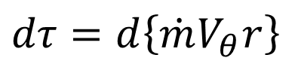
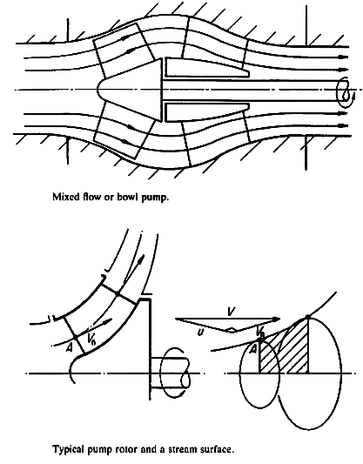
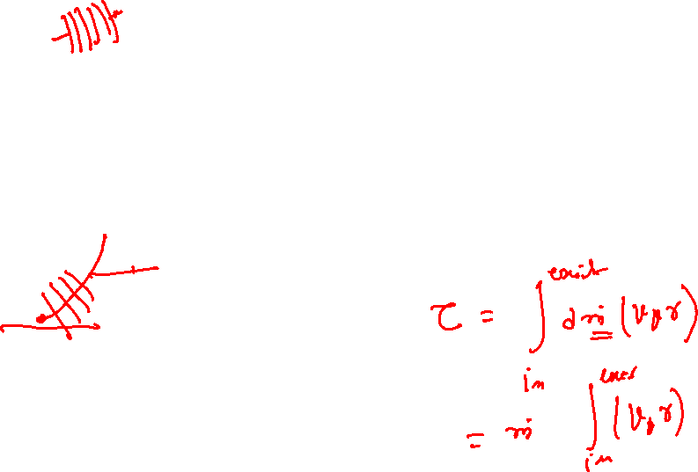
Infinitesimal interaction Kinetics along the Meridional Plane
For an infinitesimal interaction between fluid and the blade along a Meridional Plane,
Euler Differential Turbomachine Equation is written as:
$$dτ=d\left\{\dot{m}V_{θ}r\right\}$$

Slide 5
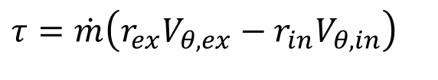
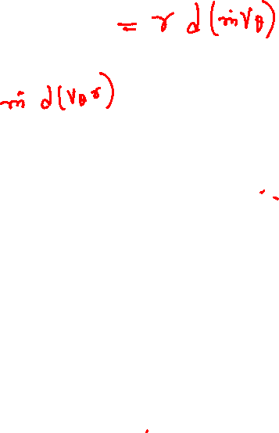

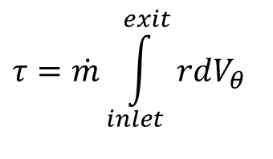
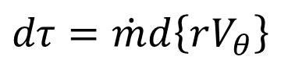
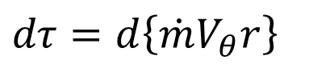
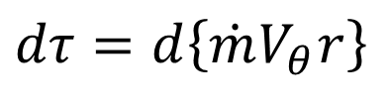
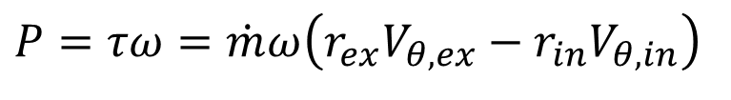
Euler Turbomachine Equation for a Quasistatic Process
$$dτ=d\left\{\dot{m}V_{θ}r\right\}$$
For an axial flow machine.
$$dτ=d\left\{\dot{m}V_{θ}r\right\}$$
For a SSSF flow Turbomachine
$$dτ=\dot{m}d\left\{rV_{θ}\right\}$$
$$τ=\dot{m}\int_{inlet}^{exit}{rdV_{θ}}$$
Torque developed by an turbo-machine
For an ideal flow machine along Meridional Path
Euler Theory:
$$τ=\dot{m}\left(r_{ex}V_{θ,ex}−{r_{in}V}_{θ,in}\right)$$
Torque experienced by flowing fluid from rotor : Action
Power lost/gained by flowing fluid: Action :
$$P=τω=\dot{m}ω\left(r_{ex}V_{θ,ex}−{r_{in}V}_{θ,in}\right)$$

Slide 6
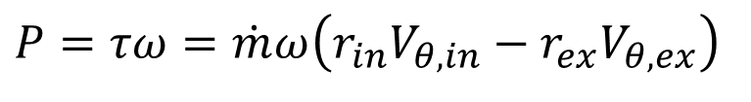
Euler Turbomachine Theory
A change in Whirl Velocity of fluid can only establish Power Exchange between fluid and rotor in a Turbomachine !
A successful Turbomachine must generate a net change in angular velocity by appropriate means…..
Power lost/gained by Rotor: Reaction :
$$P=τω=\dot{m}ω\left({r_{in}V}_{θ,in}−r_{ex}V_{θ,ex}\right)$$

Slide 7
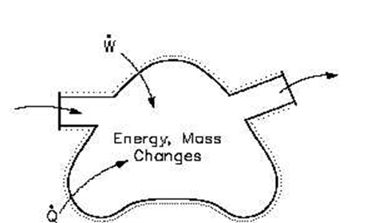
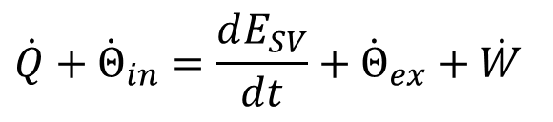
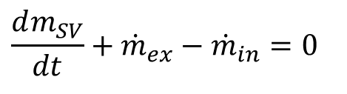
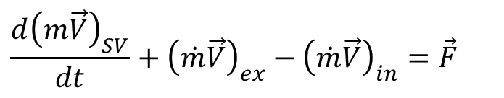
Laws of Nature for A Control Volume
Conservation of mass:
$$\frac{dm_{SV}}{dt}+{\dot{m}}_{ex}−{\dot{m}}_{in}=0$$
Conservation of momentum:
$$\frac{d{\left(m\vec{V}\right)}_{SV}}{dt}+{\left(\dot{m}\vec{V}\right)}_{ex}−{\left(\dot{m}\vec{V}\right)}_{in}=\vec{F}$$
Conservation of energy:
$$\dot{Q}+{\dot{Θ}}_{in}=\frac{dE_{SV}}{dt}+{\dot{Θ}}_{ex}+\dot{W}$$
E=me: is the total energy of the substance present inside the boundary of SV.
Θ : mθ = Total energy flow rate of A Flowing substance

Slide 8
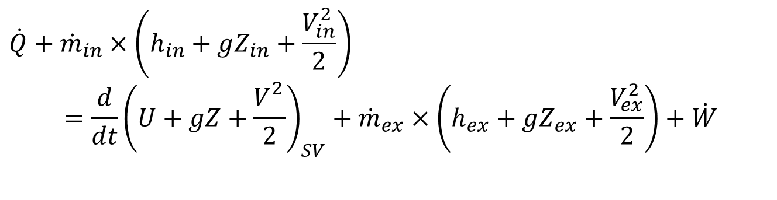
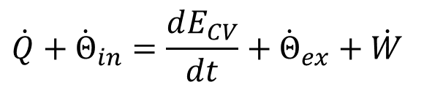
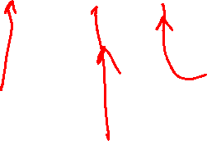
Energy Audit of A Simple CV
The first law of thermodynamics for a E/E Control Volume:
$$\dot{Q}+{\dot{Θ}}_{in}=\frac{dE_{CV}}{dt}+{\dot{Θ}}_{ex}+\dot{W}$$
Net Rate of Work Transfer (+ve/-ve)
Net Rate of Heat Transfer (-ve)
Outflow Rate of Methalpy
Inflow Rate of Methalpy
Rate of Change in Total Energy of SV of CV
$$\dot{Q}+{\dot{m}}_{in}×\left(h_{in}+gZ_{in}+\frac{V_{in}^{2}}{2}\right) \\ =\frac{d}{dt}{\left(U+gZ+\frac{V_{}^{2}}{2}\right)}_{SV}+{\dot{m}}_{ex}×\left(h_{ex}+gZ_{ex}+\frac{V_{ex}^{2}}{2}\right)+\dot{W}$$

Slide 9
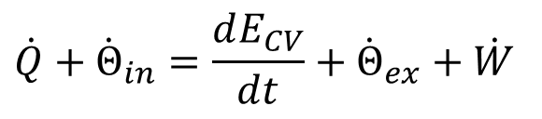

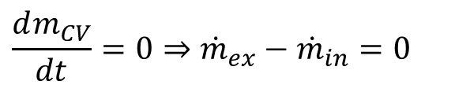
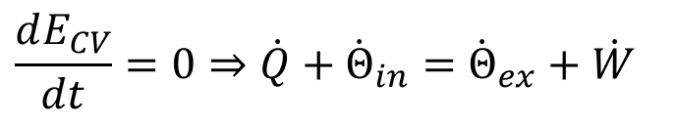
First Law for A CV: Steady State Steady Flow
Properties of CV are Invariant: not varying with time.
Conservation of mass:
$$\frac{dm_{CV}}{dt}=0⇒{\dot{m}}_{ex}−{\dot{m}}_{in}=0$$
NO accumulation or depletion of mass inside SV. However, there is a Rotor inside SV of a turbomachine.
First Law:
$$\dot{Q}+{\dot{Θ}}_{in}=\frac{dE_{CV}}{dt}+{\dot{Θ}}_{ex}+\dot{W}$$
$$\frac{dE_{CV}}{dt}=0⇒\dot{Q}+{\dot{Θ}}_{in}={\dot{Θ}}_{ex}+\dot{W}$$
No accumulation or depletion of fluid energy inside SV.

Slide 10


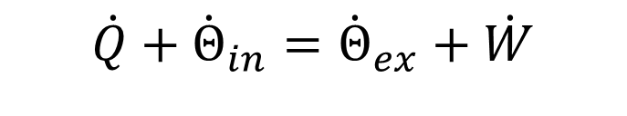
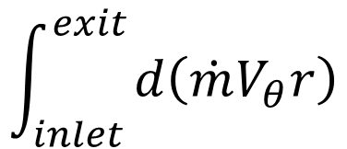

Conservation of Energy for SSSF
First Law for Steady Flow Steady State Turbomachine:
$$\dot{Q}+{\dot{Θ}}_{in}={\dot{Θ}}_{ex}+\dot{W}$$
Consider an isentropic Turbomachine
$${\dot{Θ}}_{in}={\dot{Θ}}_{ex}+\dot{W}$$
$${P=\dot{Θ}}_{in}−{\dot{Θ}}_{ex}$$
$$\int_{inlet }^{exit}{d\left(\dot{m}V_{θ}r\right)}$$

Slide 11
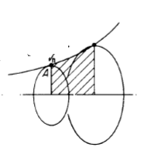

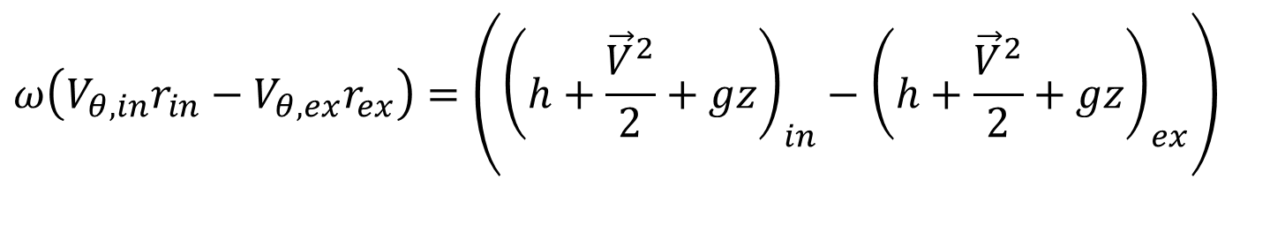
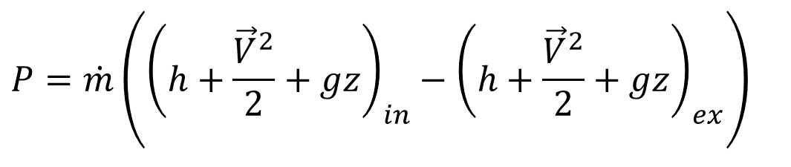
Conservation of Energy for an Isentropic Turbomachine
$${P=\dot{Θ}}_{in}−{\dot{Θ}}_{ex}$$
$$P=\dot{m}\left({\left(h+\frac{{\vec{V}}^{2}}{2}+gz\right)}_{in}−{\left(h+\frac{{\vec{V}}^{2}}{2}+gz\right)}_{ex}\right)$$
Euler Turbo-machinery Power Equation.
$$P=τω=\dot{m}ω\left(V_{θ,in}r_{in}−V_{θ,ex}r_{ex}\right)$$
$$ω\left(V_{θ,in}r_{in}−V_{θ,ex}r_{ex}\right)=\left({\left(h+\frac{{\vec{V}}^{2}}{2}+gz\right)}_{in}−{\left(h+\frac{{\vec{V}}^{2}}{2}+gz\right)}_{ex}\right)$$

Slide 12
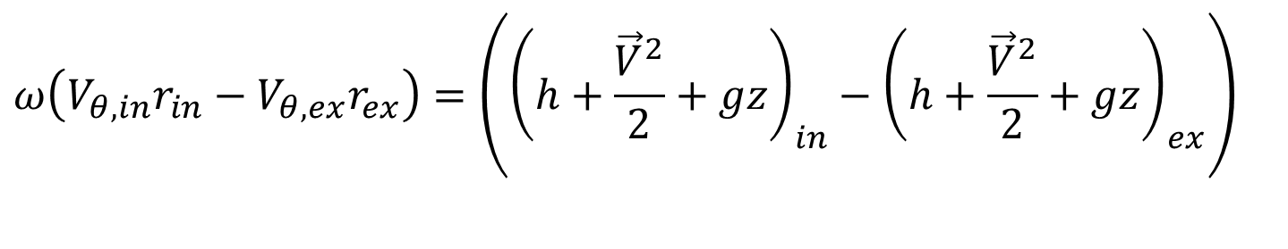
Read Through Euler Turbo-machinery Equation: Axial Flow
$$ω\left(V_{θ,in}r_{in}−V_{θ,ex}r_{ex}\right)=\left({\left(h+\frac{{\vec{V}}^{2}}{2}+gz\right)}_{in}−{\left(h+\frac{{\vec{V}}^{2}}{2}+gz\right)}_{ex}\right)$$
$$ω\left(V_{θ,in}r_{in}−V_{θ,ex}r_{ex}\right)=\left({\left(h_{o}+gz\right)}_{in}−{\left(h_{o}+gz\right)}_{ex}\right)$$
A Change in methalpy is proportional to change rate of angular momentum.
For engines with little change in mean radius (inlet to exit), the change in methalpy is due to change in tangential flow velocity of the fluid.
Can Create a small change in enthalpy of fluid.
Higher the speed of a turbomachine, higher will be the change in methtalpy.

