Slide 1

Microturbines for ORC
P M V Subbarao
Professor
Mechanical Engineering Department
New Muscles to Utilize Low Quality Resource……

Slide 2


Types of Turbines for ORC
Radial Inflow Turbine.(RIT)
Axial Turbine (AT)
Radial outflow turbine (ROT)

Slide 3
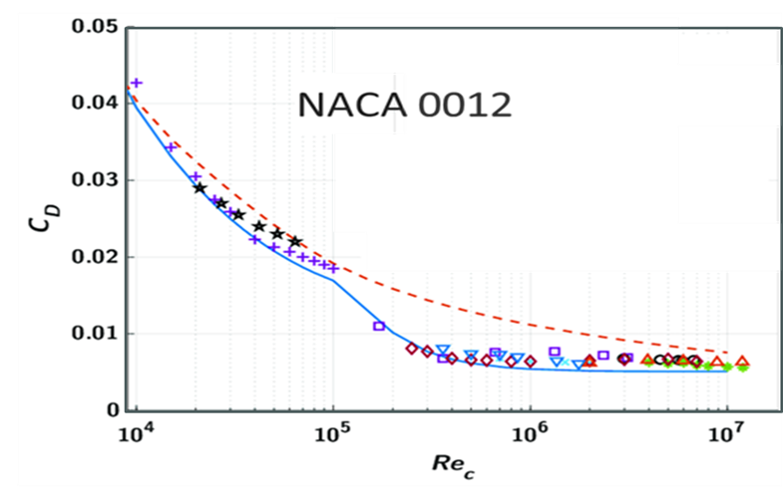
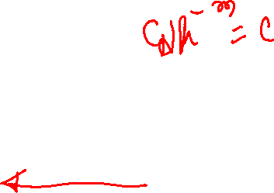
Natural Characteristic of Viscous Flow:
Challenge to Micro Systems

Slide 4
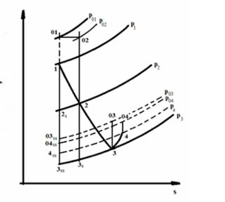
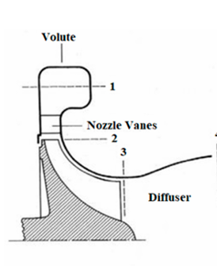
Natural Characteristic of Viscous Flow: Challenge to Micro Systems

Slide 5
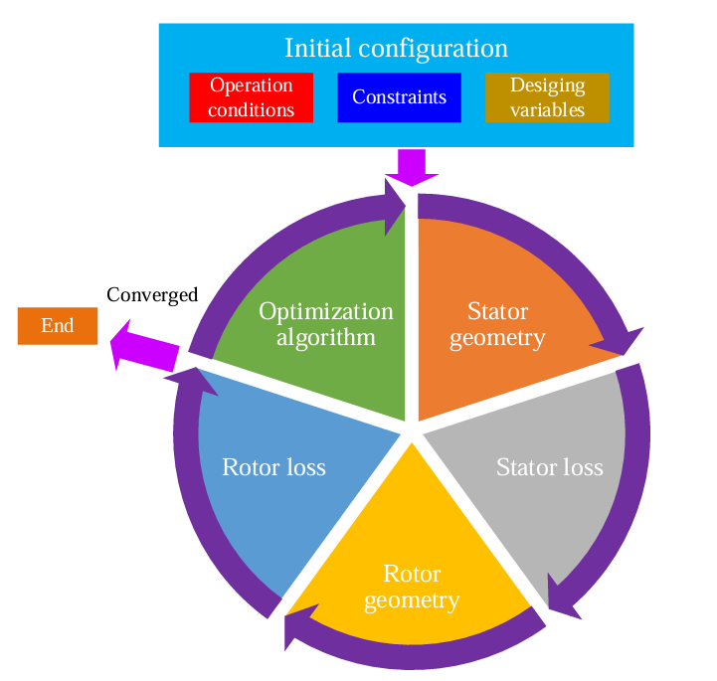
Procedure for the Preliminary Design of ORC turbines.

Slide 6
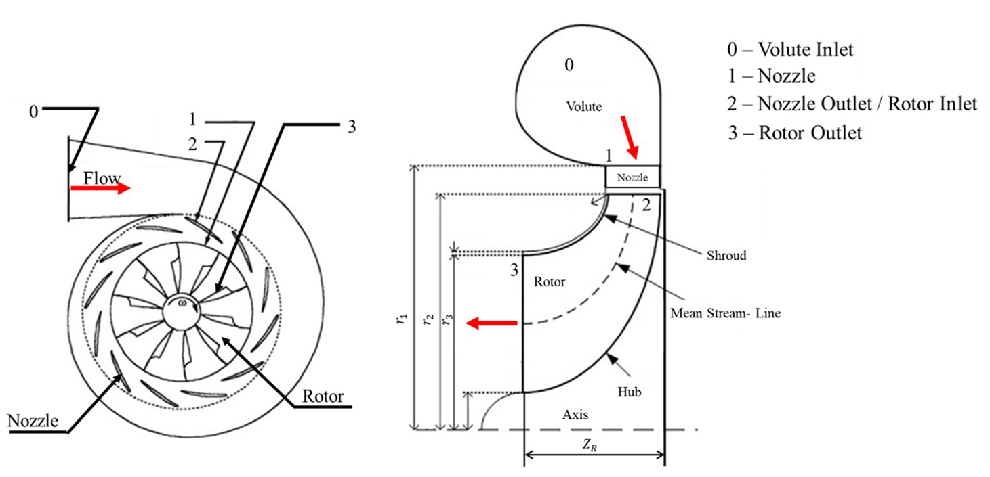
Radial Inflow Turbine

Slide 7
Radial Inflow Turbine
The performances of RITs were investigated widely for small-scale ORCs.
General capacities in the range of 9.3–684.26 kW.
The maximum efficiency arrived at 91.75%.
Different working fluids were employed, including refrigerants (R245fa, R1234yf, R143a, R152a), hydrocarbons (toluene, propane, isobutane), and siloxanes (D4, MM).
The designed turbine speed ranged from 3000 to 114,000 r/min.
The expansion pressure ratios (EPRs) were in the range of 1.997–7.95 for most turbines.
A high EPR is possible with a large molecular weight, such as toluene, MM, and D4, which were 25, 72.3, and 49.43, respectively.

Slide 8
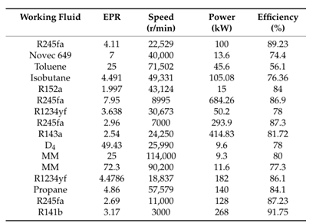
Performances of the RITs

Slide 9
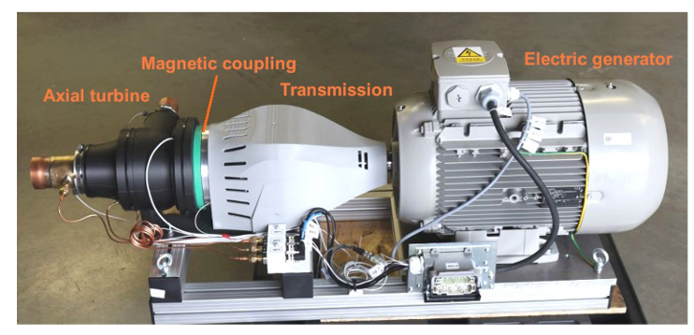
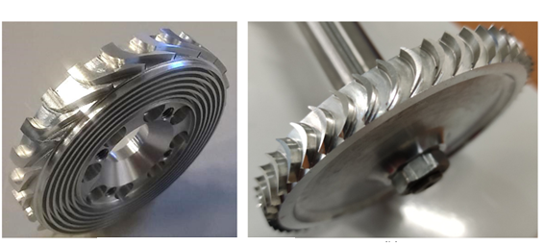
13 kW Axia Flow Turbogenerator
Stator
Rotor

Slide 10
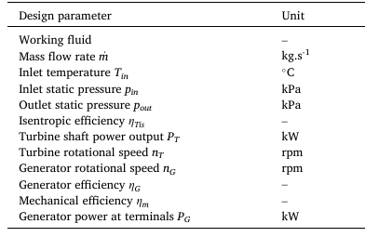
Design Parameters of the Turbogenerator

Slide 11
Axial Turbine
AT is generally employed for ORCs with a large mass flow rate and a power output ranging from hundreds of kW to several MW.
An impulse turbine is suitable for ORCs with a small massflow.
The impulse turbine can connect with a high-speed generator directly with a high EPR, and no axial force occurs.
For large ATs, the power spanned the range of 440kW–2.446MW with an efficiency of 0.81–0.891.
The corresponding EPR varied from 1.7 to 6.4.
The designed turbine speed was located in are latively narrow interval of 3000–9998r/min.

Slide 12
Axial Turbine
The turbine speed exhibited a decreasing tendency as the power output increased.
For small ATs, the power ranged from 3kW to 26.3kW with an efficiency of 0.63–0.80.
The EPRs were relatively large (5.62–77.2), and the turbine speed increased significantly to18,000 – 91,800 rpm.

Slide 13
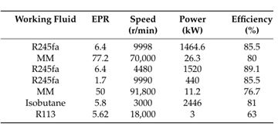
Performances of ORC ATs

Slide 14
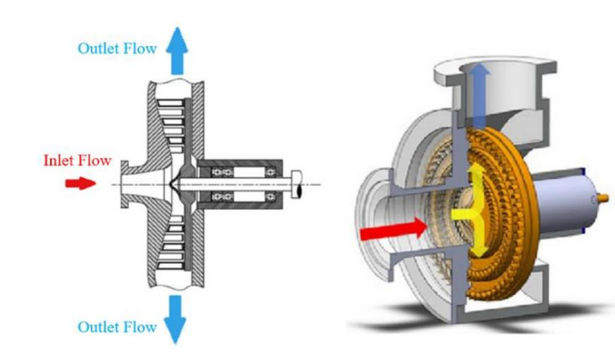
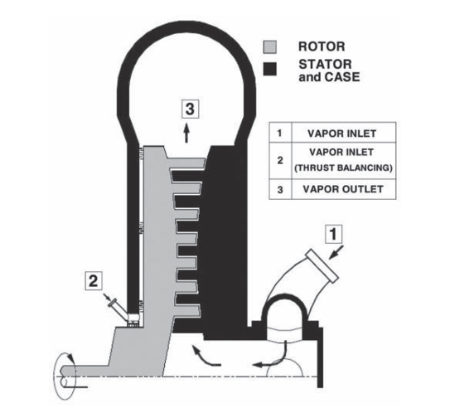
Radial Outflow Turbine

Slide 15
Radial Outflow Turbine
The nozzle and the rotor blades are arranged in aring on the disk, respectively.
The organic working fluid flows from the center of the disk through the nozzle and the rotor.
Compared with AT, ROT has a more compact size.
The high EPR of organic working fluid can be implemented by multistage expansion and a proper configuration of the blade heights.
The power outputs of the designed ROTs ranged from10 kW to 400kW with an efficiency of 0.687 –0.85.
The designed speed varied from7200 rpm to 42,700 rpm.
The minimum EPR was 1.47 for R134a and For 35-45 for siloxanes.

Slide 16
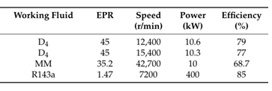
.Performances of ORC ROTs

Slide 17
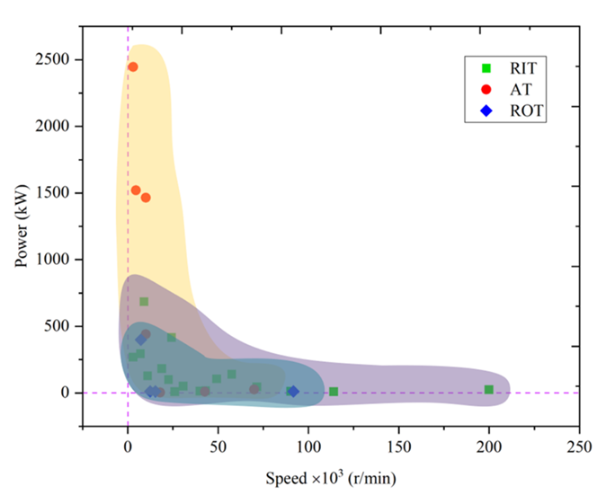
Distribution of power output and speed for different turbines

Slide 18
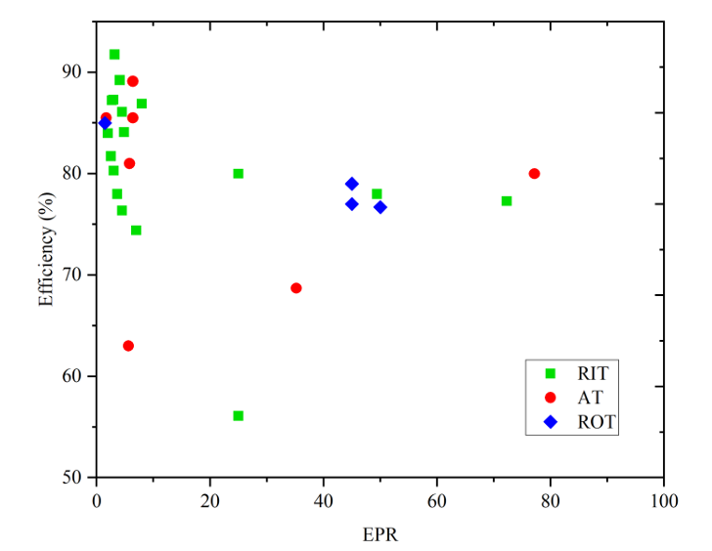
Distribution of corresponding Efficiency and EPR

