Slide 1

Micro-Expanders for ORC
P M V Subbarao
Professor
Mechanical Engineering Department
New Muscles to Utilize Low Quality Resource……

Slide 2


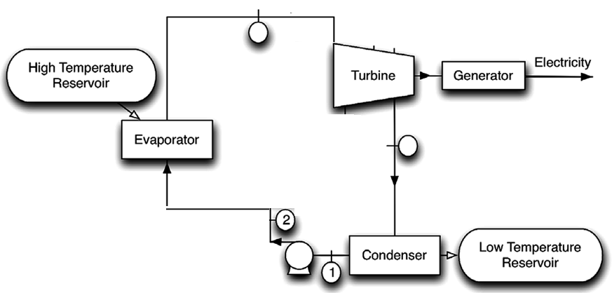
Simple Organic Rankine Cycle
3
4
Geo-thermal
Solar thermal
Waste thermal sources
Biomass
Municipal waste

Slide 3
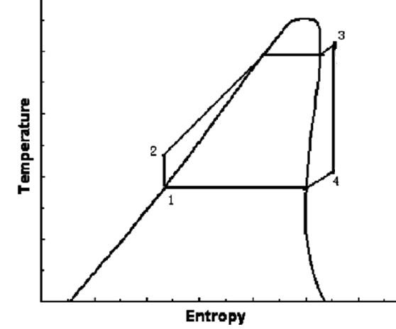
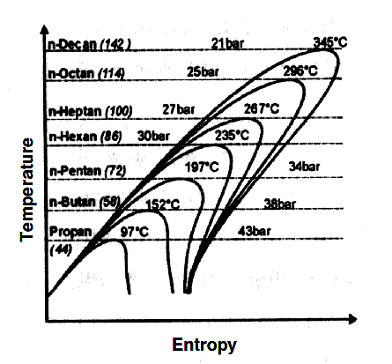
T-s Diagram for ORC with Dry Working Fluid

Slide 4
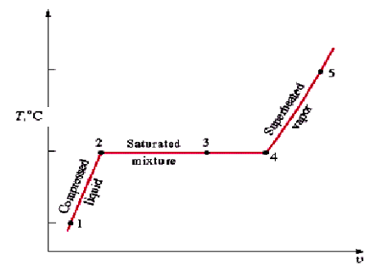
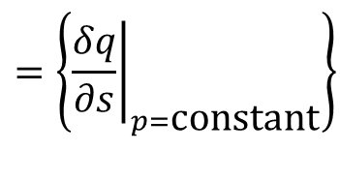

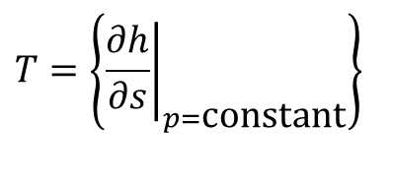
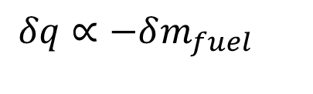
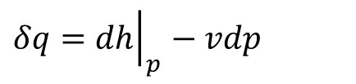
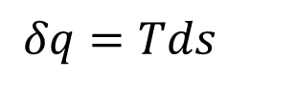


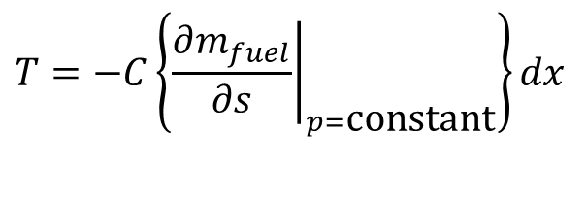
Constant Pressure Vapor Generation Process
Theory of flowing vapor Generation
$$η_{SG}δm_{waste}×HV=δq$$
Quasi-static supply of this heat to a flowing liquid-vapor
$$δq=Tds$$
Constant Pressure Vapor Generation:
$$δq={\left.dh\right|}_{p}−vdp$$
$$T=\left\{{\left.\frac{∂h}{∂s}\right|}_{p=\text{constant}}\right\}$$
$$=\left\{{\left.\frac{δq}{∂s}\right|}_{p=\text{constant}}\right\}$$
$$δq∝−δm_{fuel}$$
$$T=−C\left\{{\left.\frac{∂m_{fuel}}{∂s}\right|}_{p=\text{constant}}\right\}dx$$
A clue to creation of high temperature with same amount of burnt fuel

Slide 5
Vapor Generation : Expenditure vs Wastage
Vapour
h
Liquid +Vapour
Liquid
s

Slide 6
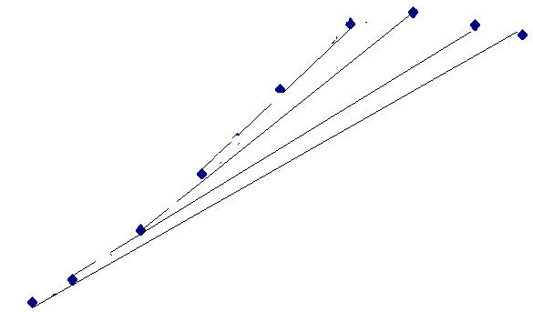
High Pressure Vapor Generation
h
s

Slide 7

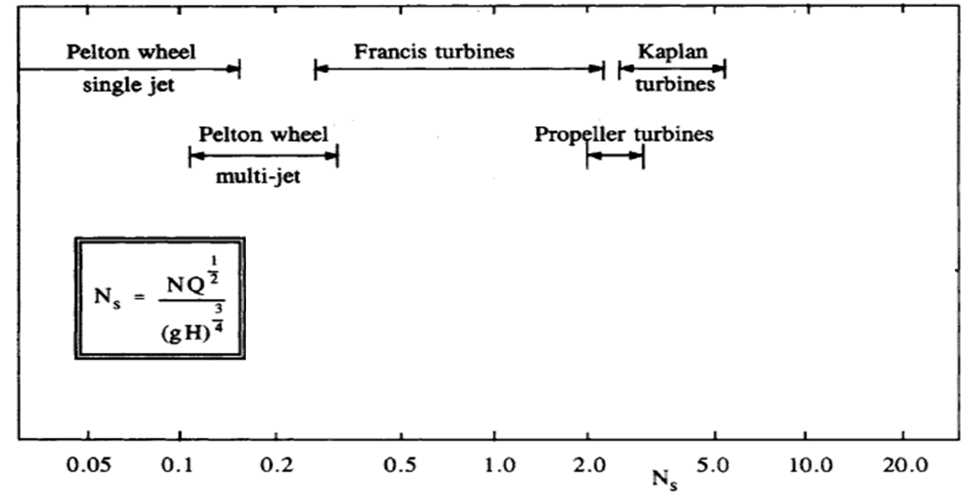
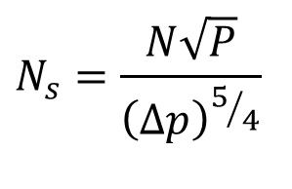
Working Fluids vs Machine vs Resource
Geo-thermal
Solar thermal
Waste thermal sources
Biomass
Municipal waste
$$N_{s}=\frac{N\sqrt{P}}{{\left(∆p\right)}^{5/4}}$$

Slide 8
Types of turbines and expanders
Expanders, in general, can be categorized into two types:
One is the velocity type: Turbines.
The other is the volume type, such as screw expanders, scroll expanders and reciprocal piston expanders.
Radial Turbines are promising option.
Volume type are also called as Positive displacement expanders.
Compared with positive displacement expanders, turbines have the advantages of high-pressure ratio, high efficiency, large volumetric power density, and compact size.

Slide 9
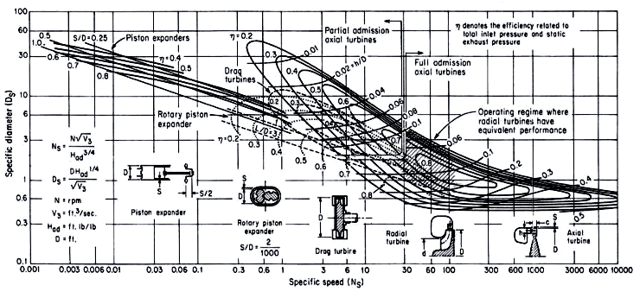
Balje Diagram

Slide 10
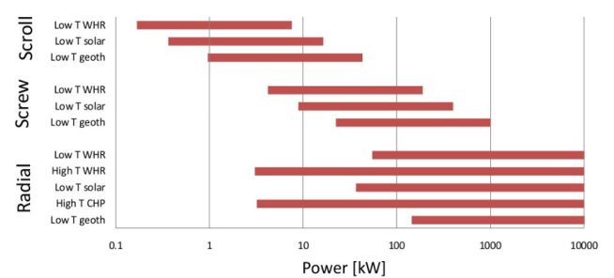
Choice of the Expander Configuration
.

Slide 11
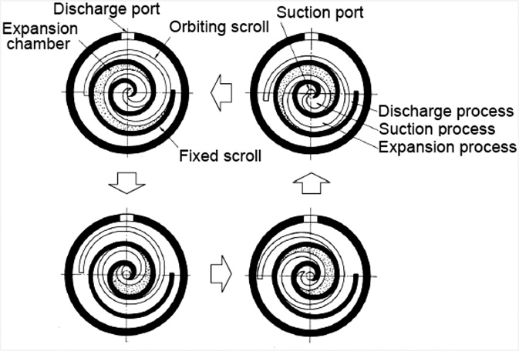
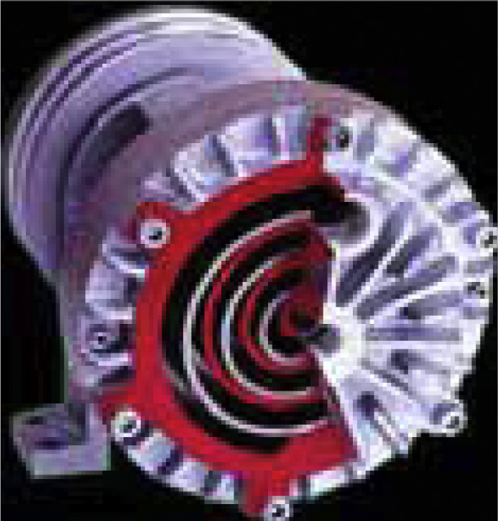
Scroll expander

Slide 12
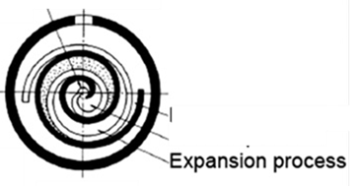
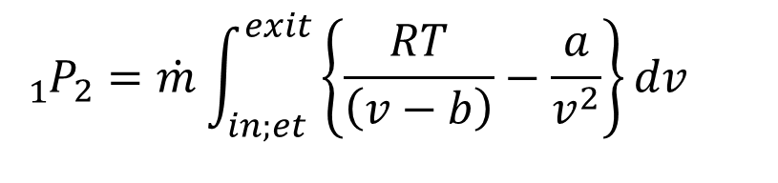
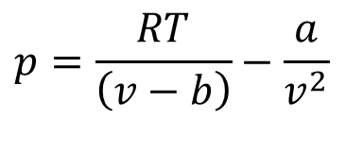
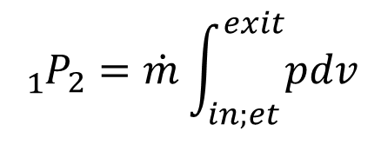
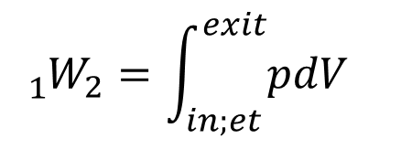
Scroll Expanders & Positive Displacement Work
Displacement work in an Open System:
$${{}_{1}^{}W}_{2}=\int_{in;et}^{exit}{pdV}$$
$${{}_{1}^{}P}_{2}=\dot{m}\int_{in;et}^{exit}{pdv}$$
For an Organic vapor (Real Gas) undergoing a process.
$$p=\frac{RT}{\left(v−b\right)}−\frac{a}{v^{2}}$$
$${{}_{1}^{}P}_{2}=\dot{m}\int_{in;et}^{exit}{\left\{\frac{RT}{\left(v−b\right)}−\frac{a}{v^{2}}\right\}dv}$$

Slide 13
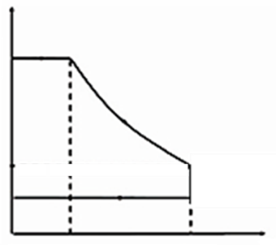
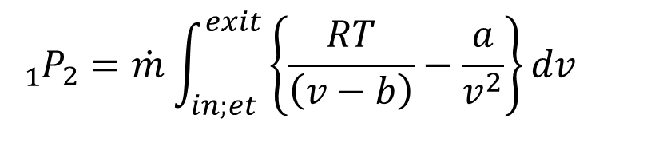
Scroll Expanders & Positive Displacement Work
p
v
For an Organic vapor (Real Gas) undergoing a process.
$${{}_{1}^{}P}_{2}=\dot{m}\int_{in;et}^{exit}{\left\{\frac{RT}{\left(v−b\right)}−\frac{a}{v^{2}}\right\}dv}$$
$$p=\frac{RT}{\left(v−b\right)}−\frac{a}{v^{2}}$$

Slide 14
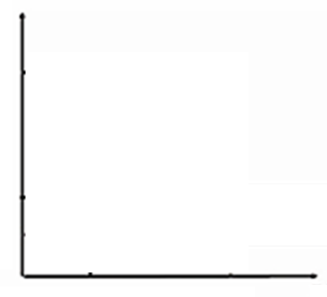
Scroll Expanders & Positive Displacement Work
v
Direction of Flow
For an Organic vapor (Real Gas) undergoing a process.
$${{}_{1}^{}P}_{2}=\dot{m}\int_{in;et}^{exit}{\left\{\frac{RT}{\left(v−b\right)}−\frac{a}{v^{2}}\right\}dv}$$
$$p=\frac{RT}{\left(v−b\right)}−\frac{a}{v^{2}}$$

Slide 15
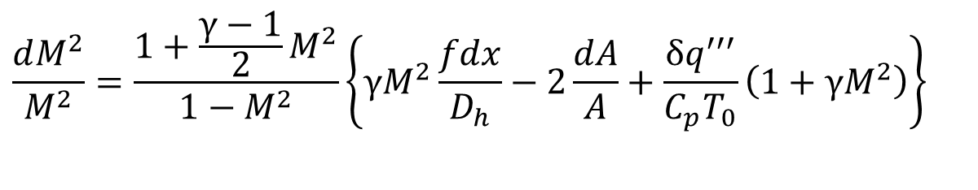
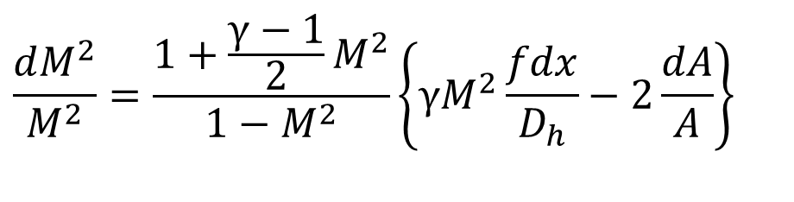
Momentum Equation of Compressible Frictional Flow
Combine conservation and state equations– to get design equations for steady one-dimensional frictional flow :
$$\frac{dM^{2}}{M^{2}}=\frac{1+\frac{γ−1}{2}M^{2}}{1−M^{2}}\left\{γM^{2}\frac{fdx}{D_{h}}−2\frac{dA}{A}+\frac{δq^{′′′}}{C_{p}T_{0}}\left(1+γM^{2}\right)\right\}$$
– Variation of local flow area leads to all other changes.
Heat transfer also leads to change in these parameters.
For an adiabatic flow through variable area:
$$\frac{dM^{2}}{M^{2}}=\frac{1+\frac{γ−1}{2}M^{2}}{1−M^{2}}\left\{γM^{2}\frac{fdx}{D_{h}}−2\frac{dA}{A}\right\}$$

Slide 16
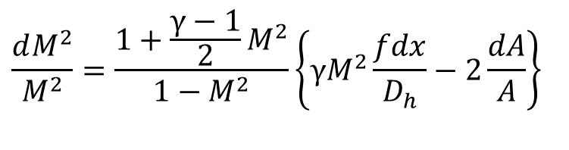
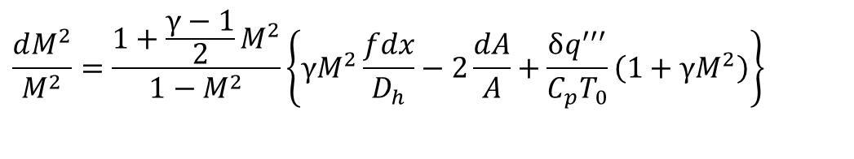
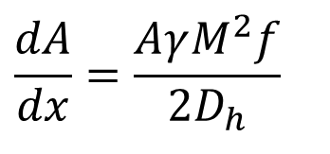
Frictional Adiabatic Flow in A Variable Area Passage
0
$$\frac{dM^{2}}{M^{2}}=\frac{1+\frac{γ−1}{2}M^{2}}{1−M^{2}}\left\{γM^{2}\frac{fdx}{D_{h}}−2\frac{dA}{A}+\frac{δq^{′′′}}{C_{p}T_{0}}\left(1+γM^{2}\right)\right\}$$
$$\frac{dM^{2}}{M^{2}}=\frac{1+\frac{γ−1}{2}M^{2}}{1−M^{2}}\left\{γM^{2}\frac{fdx}{D_{h}}−2\frac{dA}{A}\right\}$$
Constant Mach number frictional flow
$$\frac{dA}{dx}=\frac{AγM^{2}f}{2D_{h}}$$

Slide 17

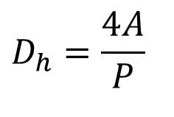
Friction Factor for Turbulent Flow
$$D_{h}=\frac{4A}{P}$$
Hydraulic Diameter
Friction factor for turbulent flow:

Slide 18

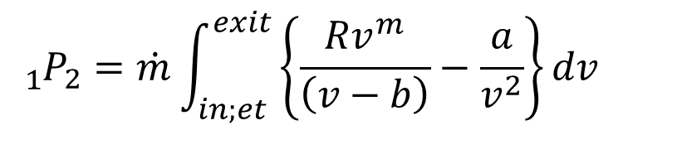

Scrool Expanders & Actual Positive Displacement Work
$$Tv^{m}=C$$
p
v
For an Organic vapor (Real Gas) undergoing a frictional flow process.
$$p=\frac{RT}{\left(v−b\right)}−\frac{a}{v^{2}}$$
$${{}_{1}^{}P}_{2}=\dot{m}\int_{in;et}^{exit}{\left\{\frac{Rv^{m}}{\left(v−b\right)}−\frac{a}{v^{2}}\right\}dv}$$

Slide 19
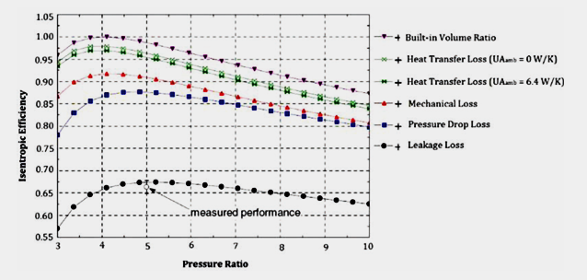
Losses in Scroll expander

Slide 20
R & D in Scroll Expanders
Facao and Oliveira reported that they had a 5 kWe in-house ORC-based power generation system.
ENEFCOGENPLUS range was still under tests and validation
ENEFCOGENGREEN range units are available commercially, such as module 010GRE-01 10 kWe output or 5 kWe output with the quoted unit cost of ς55,000.

Slide 21
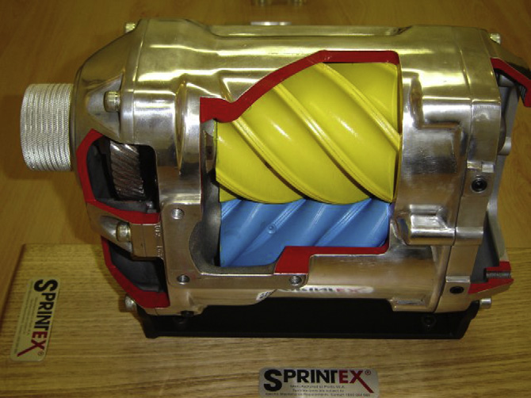
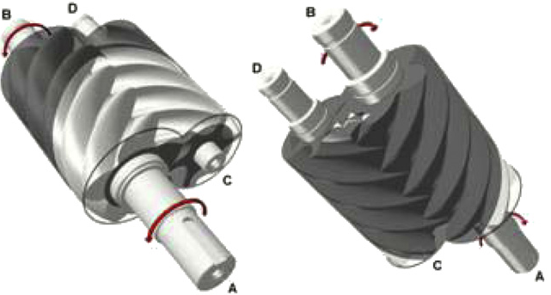
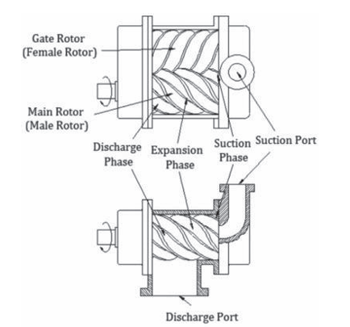
Screw Expanders

Slide 22
Screw expander
Screw expander is comprised of a pair of meshing helical rotors.
A male and a female rotor, contained in a casing which surrounds them with clearances in the order of 50 μm.
As the rotors rotate, the volume trapped between the rotors and the casing changes.
If a fluid is admitted into this space at one end of the rotors, its volume will either increase or decrease, depending only on the direction of rotation, until it is finally expelled from the opposite side of the rotors at the other end.
Power is transferred between the fluid and the rotor shafts by pressure on the rotors, which changes with the fluid volume.

Slide 23
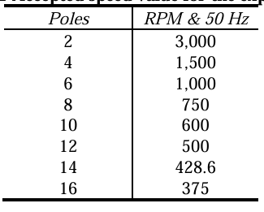
Accepted speed value for the Positive Displacement Expander
.

Slide 24
Research and Development
Prof. Ian K Smith in City University London and H. Leibowitz from ElectraTherm Inc. have developed and investigated screw machines as expanders for over 20 years.
They have developed the systems for cost effective power production at outputs within the range of 20 to 50 kWe.
The relatively low installation cost in the range of $1500 to £2000/kWe of net output .
Centre for Positive Displacement Compressor Technology of City University London had stated that micro-scale screw expander (<10 kWe) is hard to obtain in the current market.

Slide 25
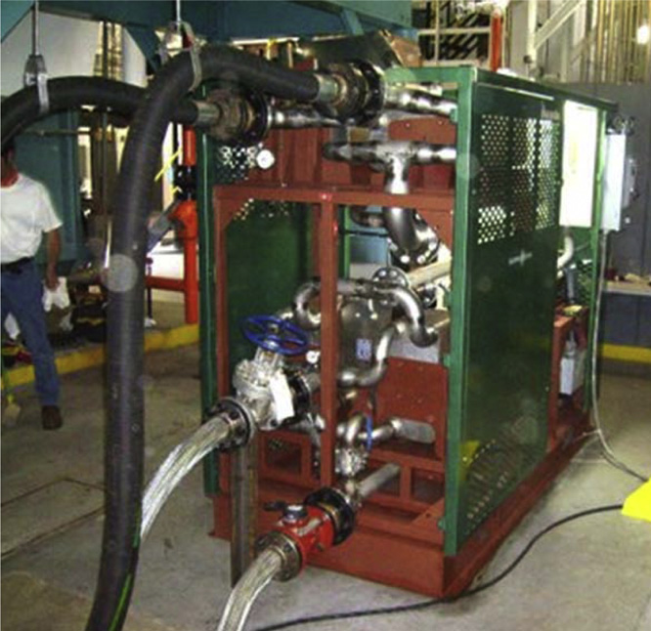
Green Machine
ElectraTherm green machine with patented twin screw expander
H1830 mm W1525 D2287 mm
The 50 kWe Green Machine with employs minimal heat (93 C fluid) to generate electricity.
Cost : $0.03e$0.04 per kWh during a three-year payback period and at $0.01 per kWh after that.

Slide 26
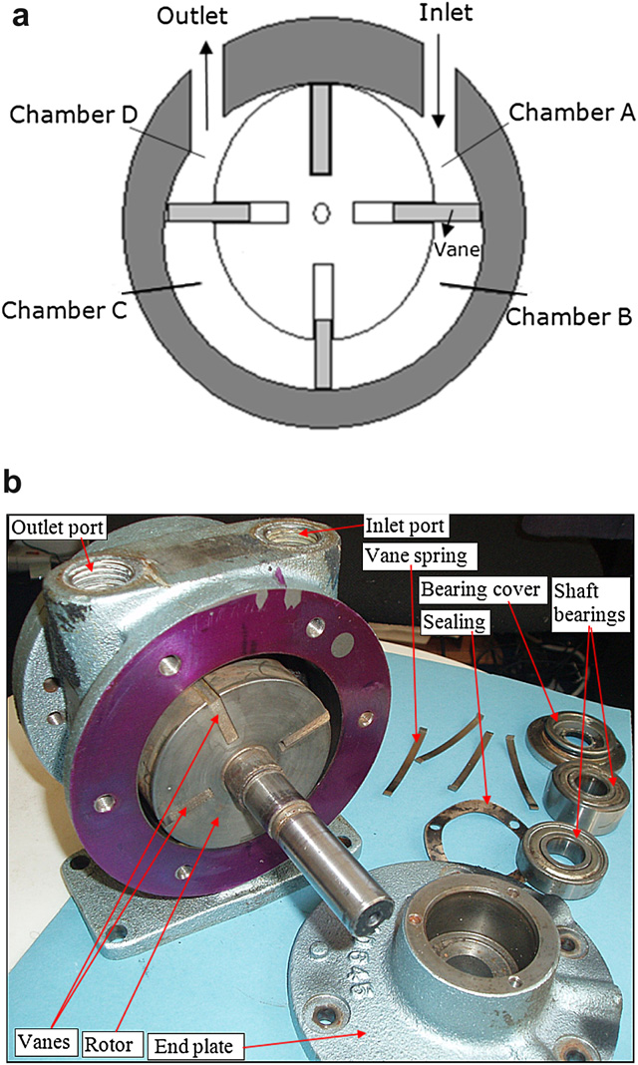
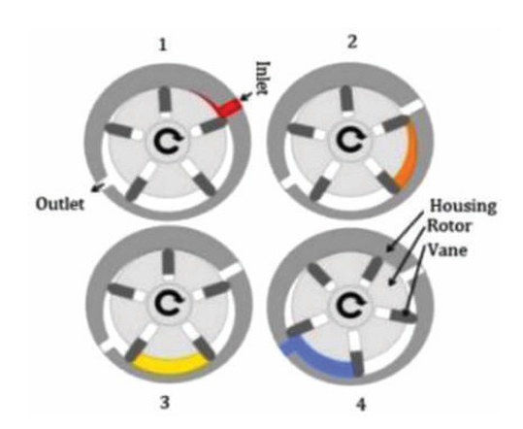
Gas motor as Expander
Gas motors are rotary vane machines originally designed to use compressed air to drive the rotors.
Compared with other expander concepts, the rotary vane expander has simpler structure, easier manufacturing and lower cost.

Slide 27
Gas motor as Expander

Slide 28
Selection and choices of expanders micro–Power Systems
Working temperatures and pressures:
The operating pressures and temperatures of the expanders are likely to be up to 10 bars and 200 °C respectively.
The vane expander can withstand 7 bars and 120 °C.
Leaking: the loss of organic working fluid due to leaking is unacceptable under any circumstances.
Noise and safety: excessive noises are not acceptable with building applications of micro-scale units.
Turbo expanders as velocity-type of expanders are driven by high velocity streams of vapour to rotate the turbine blades and hence makes considerable noise.
If a mixture of vapour with liquid droplets pushes the blades, the noise level will be greater and the blades can be deformed to become unsafe to continue the operation.
On the other hand, volume-type expanders are quieter than turbo expanders and allow the mixture of vapour and liquid droplets to enter with little harm to the rotor.

