Slide 1

Sustainable Power Generation Systems for Future
P M V Subbarao
Professor
Mechanical Engineering Department
Utilization of Low Quality Sources ……

Slide 2

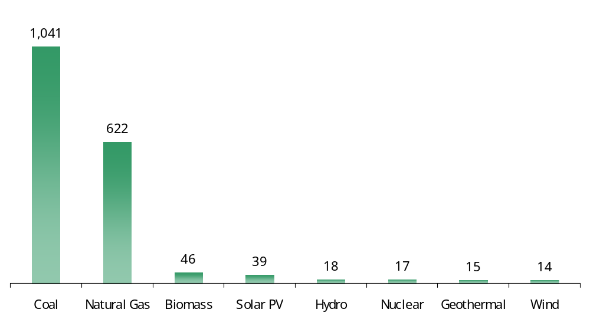
Comparison of Life-Cycle Emissions
Tons of Carbon Dioxide Equivalent per Gigawatt-Hour

Slide 3
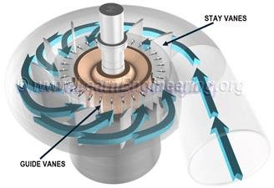
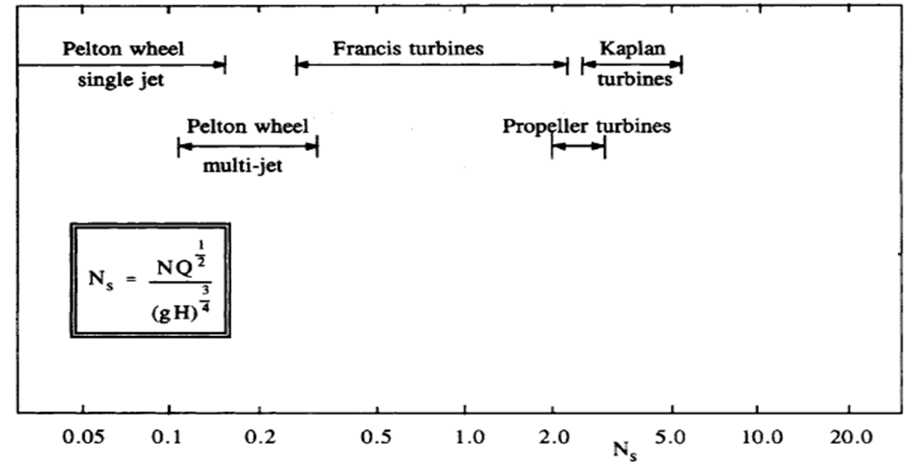
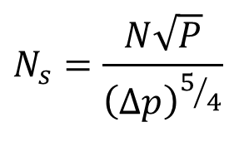
Sustainable Ideas
Several ideas have recently been investigated in an attempt to enhance the utility of low-quality energy resources.
The performance of radial turbines using special phase change working fluids had made it feasible.
Design for phase change liquid instead of water!!!!
$$N_{s}=\frac{N\sqrt{P}}{{\left(∆p\right)}^{5/4}}$$
Waste will be a Resource …..

Slide 4
Potential sources with Low Carbon Foot Print
It is a novel idea to find a renewable source to generate green power using Organic working fluid.
The burgeoning world demand cannot be met without utilizing all available sources.
The main sources of utility are as follows:
Geo-thermal
Solar thermal
Biomass
Municipal waste
Main deficiency of these resources is that they cannot generate High temperatures.

Slide 5
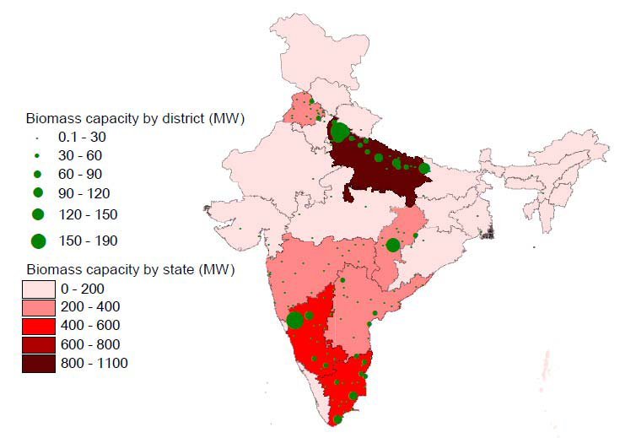

Existing biomass capacity in India
C

Slide 6
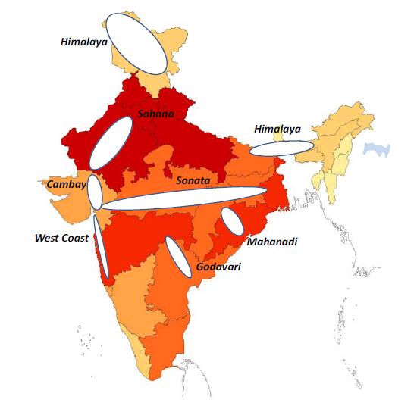
Geo-thermal Map of India

Slide 7
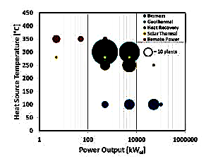
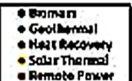
Few Low Temperature Resources and Their Capacities

Slide 8
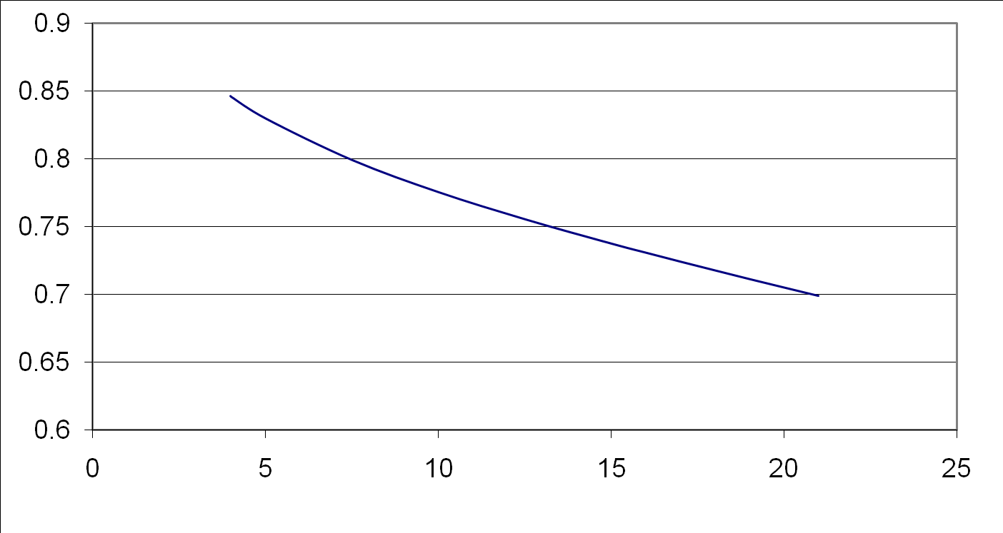
Negative Characterstic of Steam
T_{max} = 546°C &T_{min}=40 °C
Why should an isentropic expansion lead to condensation???
This demands high Live steam temperature
x
Pressure, MPa

Slide 9
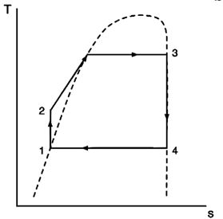
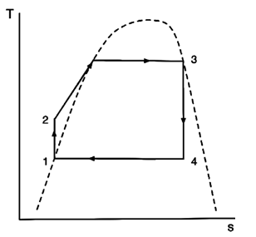
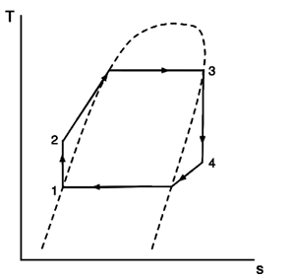
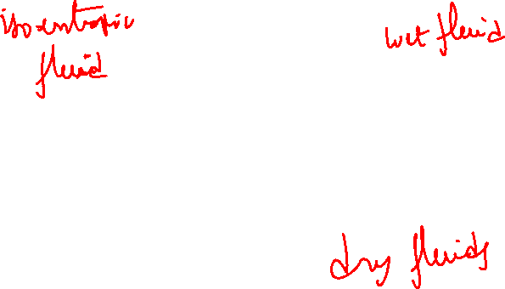
Characterization of Vapour Domes for Engineering of Rankine Cycle

Slide 10
Organic Rankine Cycle
The Organic Rankine Cycle (ORC) uses an organic fluid instead of water.
The selection of working fluids and operation conditions are very important to system performance.
The possibility to select the best working fluid depending on the available heat source and the plant size results in multiple advantages:
(i) more efficient turbomachinery,
(ii) limited vacuum at condenser and
(iii) higher performance compared to both steam Rankine cycles and gas cycles especially for heat sources lower than 400°C and power output lower than 20 MW.

Slide 11
Classification of Working Fluids for Power Generation
Basically, the working fluid can be classified into three categories.
Dry, isentropic, and wet depending on the slope of the T–S curve (dT/dS) to be positive, infinite, and negative, respectively.
The working fluids of dry or isentropic type are more appropriate for ORC systems.
This is because dry or isentropic fluids are superheated after isentropic expansion, thereby eliminating the concerns of impingement of liquid droplets on the turbine blades.
Moreover, the superheated apparatus is not needed.

Slide 12
Selection of Working Fluid
Working fluids can be selected from a long list of candidates including
hydrocarbons,
hydrofluorocarbons,
siloxanes and
mixtures of these components.
The distinctive characteristics make ORC the most reliable option for unconventional heat sources like
geothermal brines,
biomass combustion,
waste heat recovery from industrial processes and
thermal solar applications.

Slide 13
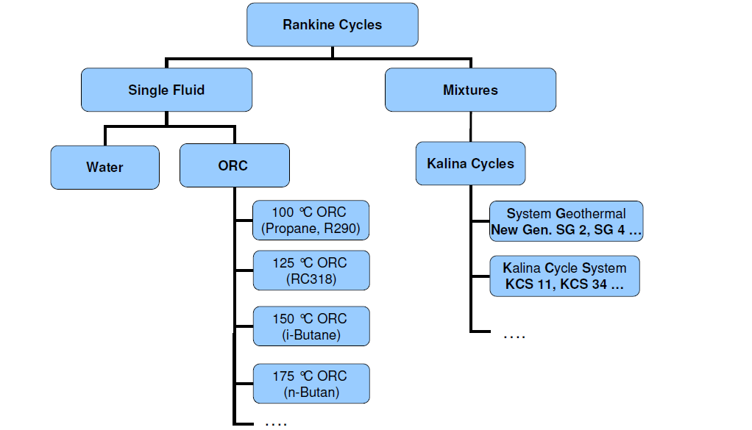
Library of Cycles

Slide 14
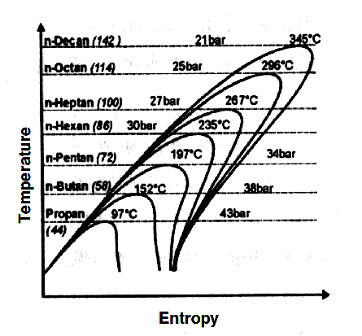
Working Fluids for Low Temperature Resources
Organic Substances must be selected
in accordance to the heat source
temperature level (T_{cr} < T_{in source})

Slide 15
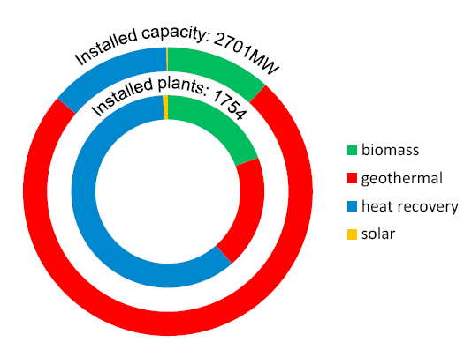
World Installed Capacity of ORC Plants : per application

Slide 16
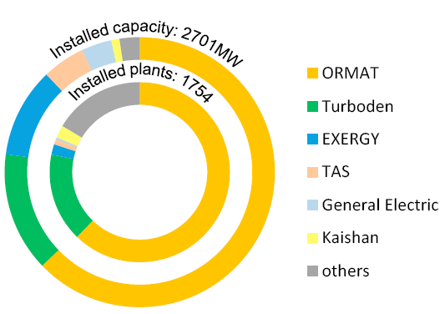
World Installed Capacity of ORC Plants : per manufacturer

Slide 17
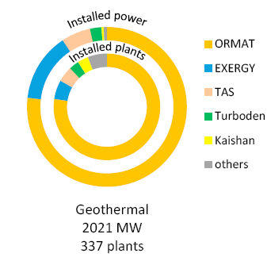
ORC Geothermal : Market share and per manufacturer

Slide 18
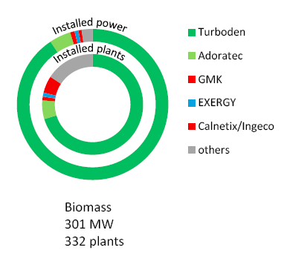
ORC Biomass : Market share and per manufacturer

Slide 19
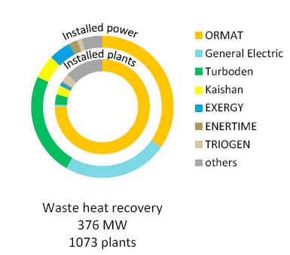
ORC Waste Heat Recovery : Market share and per manufacturer

Slide 20
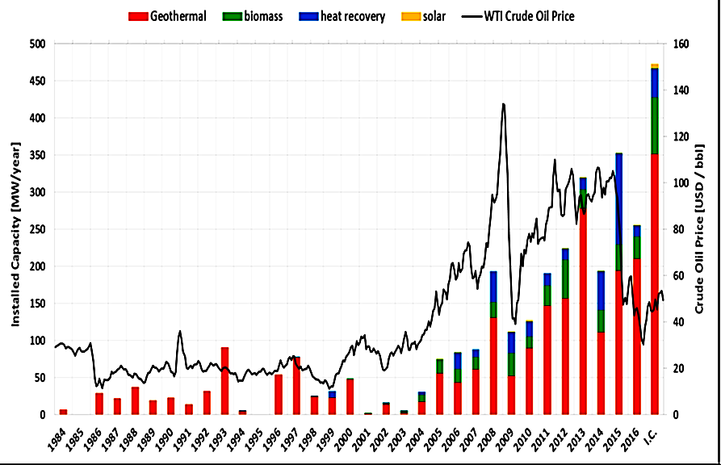
Evolution of installed capacity : per application

Slide 21
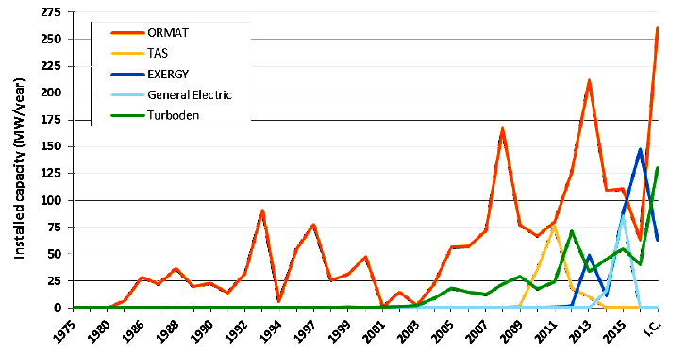
Evolution of installed capacity : per application

Slide 22

Gram Swaraj : A pivotal concept in Mahatama Gandhi's thinking
The fundamental concept of Gram swaraj is that every village should be its own republic,
"independent of its neighbours for its own vital wants and yet interdependent for many others in which dependence is necessary," according to Gandhi, writing in 1942.
Each village should be basically self-reliant, making provision for all necessities of life - food, clothing, clean water, sanitation, housing, education and so on ….
Micro Energy Systems are the Requirement of Gram Urjha Swaraj……

Slide 23
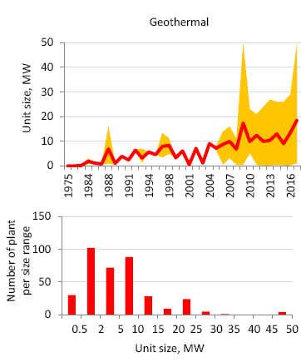
Micro Sized ORC Plants

Slide 24
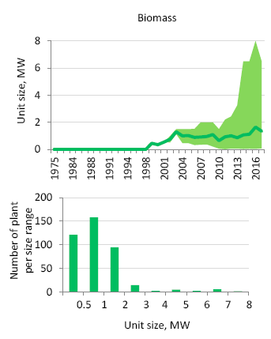
Micro Sized ORC Plants

Slide 25
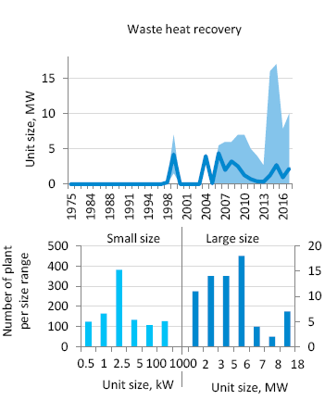
Micro Sized ORC Plants

Slide 26
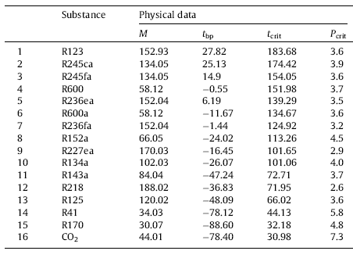

Methodology for Organic Working Fluid Selection : Thermodynamic Factors

Slide 27
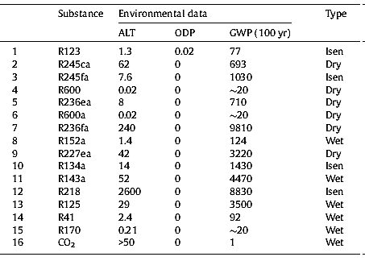
Methodology for Organic Working Fluid Selection : Critical Points

Slide 28
An Exclusive Working Fluid : R245fa
1,1,1,3,3– Penta-fluoro-propane.
CF₃CH₂CHF₂
Molecular weight : 134.05
Critical Temperature : 427.2 K
Critical Pressure : 3640 kPa
This is a non-ozone depleting working fluid.

Slide 29
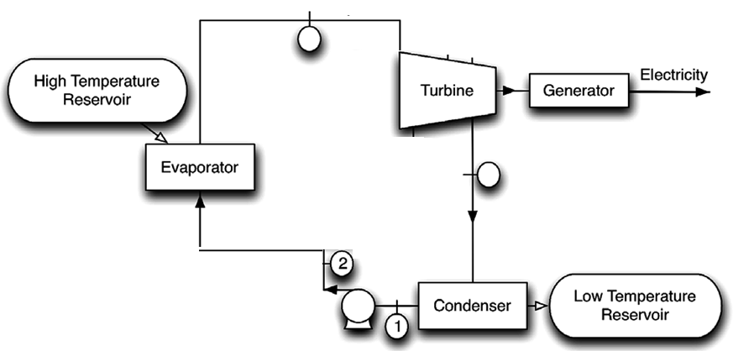
Simple Organic Rankine Cycle
3
4

Slide 30
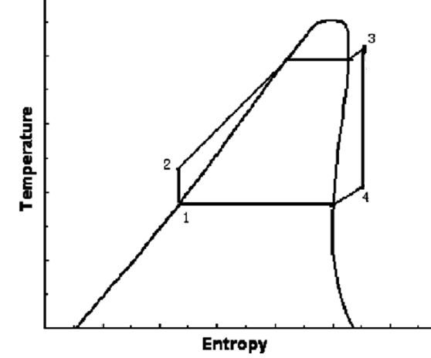
T-s Diagram for ORC with Dry Working Fluid

Slide 31
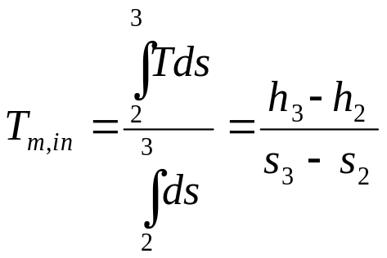
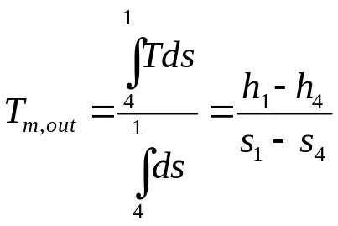
Methodology to evaluate Cycle Pressure
Estimate maximum possible TIT thru a known source.
Select an initial pressure.
Note local ambient conditions.
Mean effective temperature of heat addition for equivalent isothermal process or entropy averaged temperature is calculated using
Mean Effective Temperature of heat rejection for equivalent isothermal process is calculated using

Slide 32
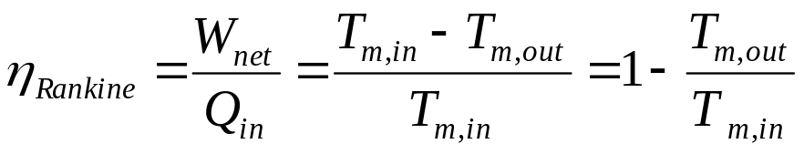
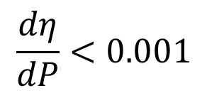
Methodology to evaluate Cycle Pressure
Calculate the efficiency
Repeat steps above for pressures varying from 2-20 MPa at 0.5 MPa intervals
Calculate slope of efficiency at various pressures.
The minimum pressure suitable for operation is taken when

Slide 33
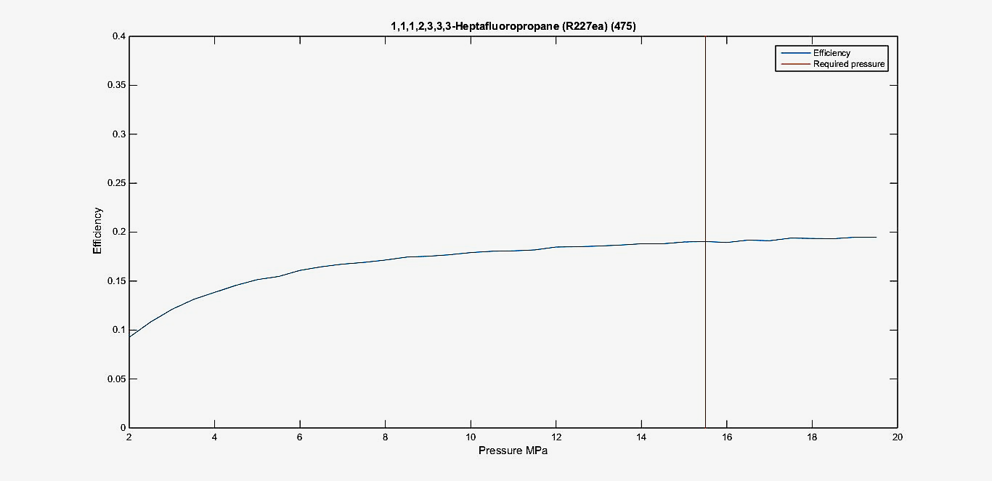
Performance of ORC :
Efficiency vs. Pressure for R227ea

Slide 34
Selection of Pressure for a Working Fluid
Methane | Too low | 2-Methylpentane | 3
Butane | 8 | Heptane | 2
Isobutane | 9 | Octane | 2
2-Methylbutane | 5 | Ethane, pentafluoro- (R125) | 18.5
2-2 Dimethylpropane | 9 | Ethane, 1,1,1,2-tetrafluoro- (R134a) | 10
Hexane | 2 | 1,1,1,2,3,3-Hexafluoropropane (R236ea) | 10.5
Ethane, 1,1,1-trifluoro- (R143a) | 17.5 | Dodecafluoropentane | 8
1,1,1,2,3,3,3-Heptafluoropropane (R227ea) | 15.5 | 1,1,1,3,3-Pentafluoropropane (R245fa) | 8
Decafluorobutane | 11 | Ethane, 1,1-difluoro- (R152a) | 13

Slide 35
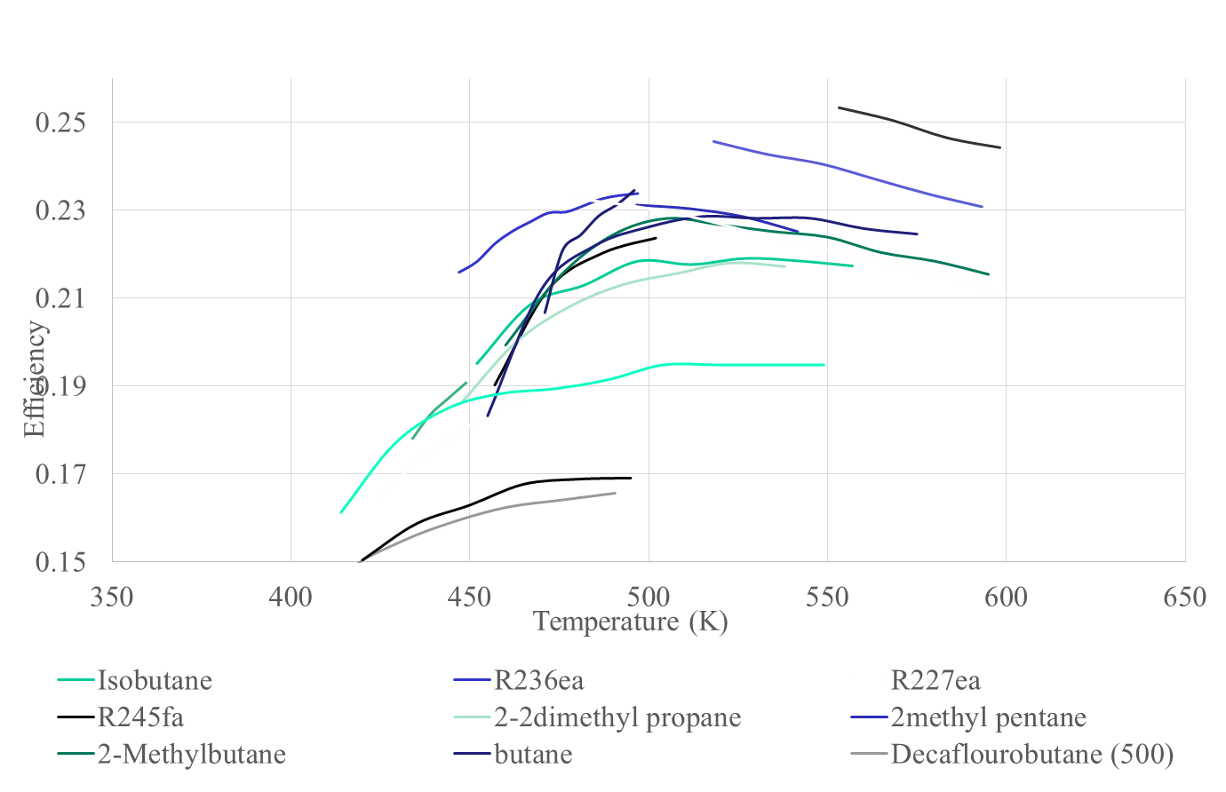
Performance of ORC : Efficiency

Slide 36
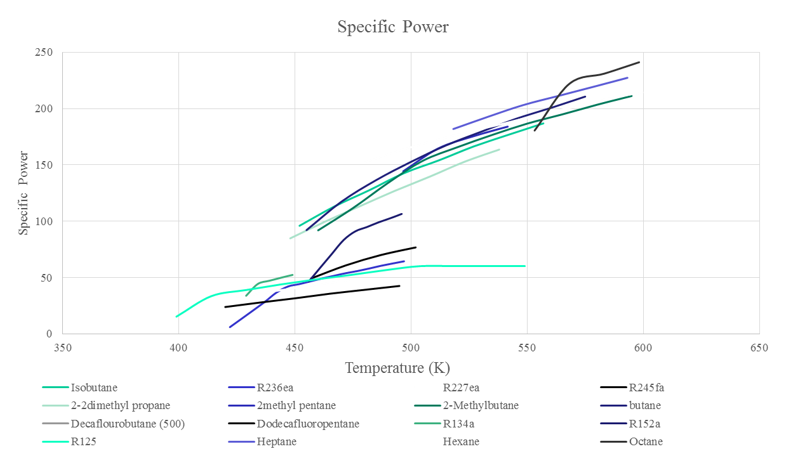
Performance of ORC : Compact Ness

Slide 37
T-s Diagram for ORC with Dry Working Fluid

Slide 38
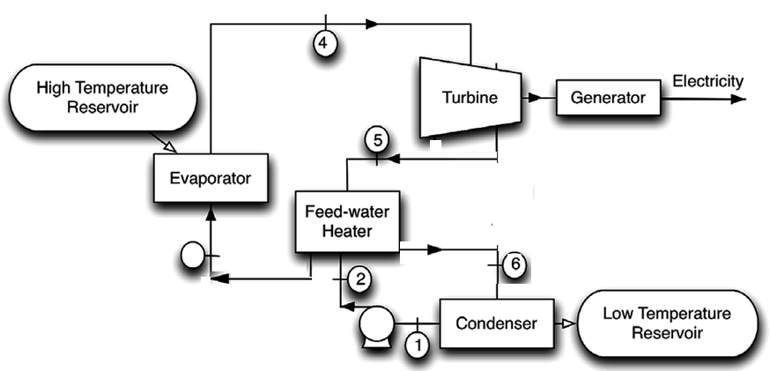
Regenerative ORC
3

Slide 39
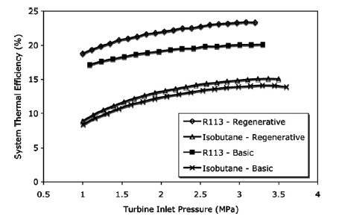
Better Utilization of Low Quality Resources

