Slide 1

Thermo-fluid Theory of Turbomachinery
P M V Subbarao
Head & Professor
Mechanical Engineering Department
Evaluation of Essential Action to be generated by A Successful Turbomachinery !!!

Slide 2


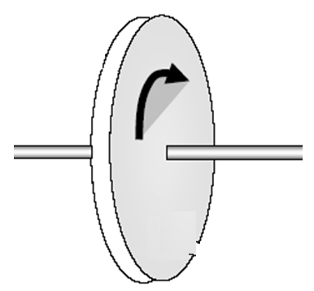

An Essential Action Across of A Fluid-machine
A Turbomachine
Fluid in
Fluid out
Many innovations… What is the most suitable???

Slide 3
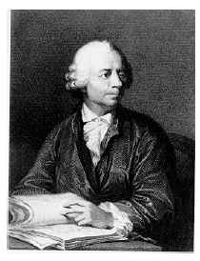
Leonhard Euler
Leonhard Euler (1707-1783) was arguably the greatest mathematician of the eighteenth century.
One of the most prolific writer of all time; his publication list of 886 papers and books fill about 90 volumes.
Remarkably, much of this output dates from the last two decades of his life, when he was totally blind.
Euler's prolific output caused a tremendous problem of backlog: the St. Petersburg Academy continued publishing his work posthumously for more than 30 years.

Slide 4
Theoretical and Rigorous Work of French
Bernoulli and Leonhard Euler.
1750:Euler offered a memoir containing analysis and equations for hydraulic turbines.
1754: An idealized theoretical application of Newton’s Law to centrifugal impellers.
Designated as Euler Equation.
Did much to help the development of hydraulic machinery.
1767: Relation between Torque and Change in moment of momentum of the fluid as it passed through the machine.

Slide 5
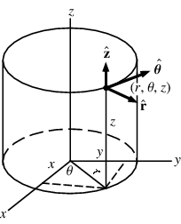
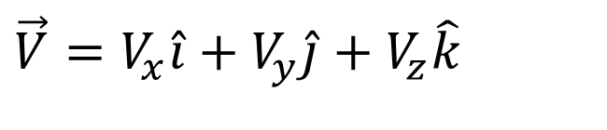
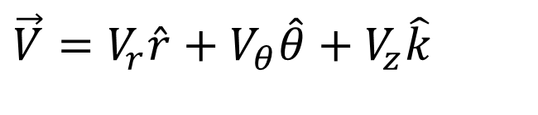
The Superiority of Vector Parameters
Cartesian Perspective:
$$\vec{V}=V_{x}\hat{i}+V_{y}\hat{j}+V_{z}\hat{k}$$
Cylindrical Perspective:
$$\vec{V}=V_{r}\hat{r}+V_{θ}\hat{θ}+V_{z}\hat{k}$$

Slide 6

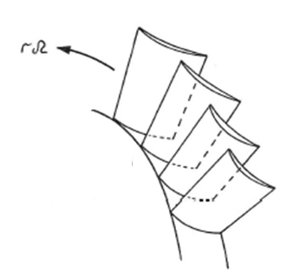


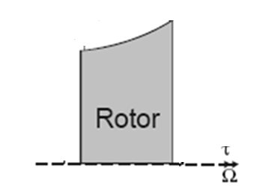
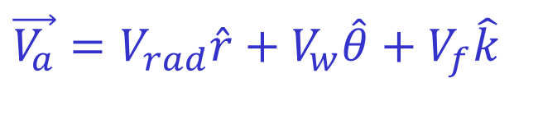
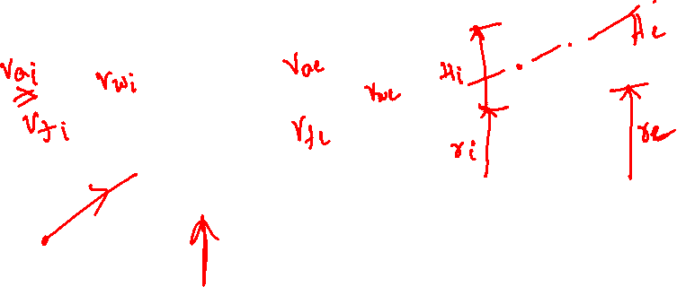
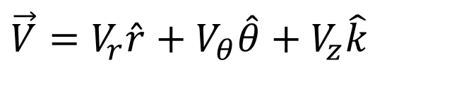
Euler’s Vision of Vector Interacting Solid Surface (sails)
Blade
$$\vec{V}=V_{r}\hat{r}+V_{θ}\hat{θ}+V_{z}\hat{k}$$
$$\vec{V_{a}}=V_{rad}\hat{r}+V_{w}\hat{θ}+V_{f}\hat{k}$$

Slide 7
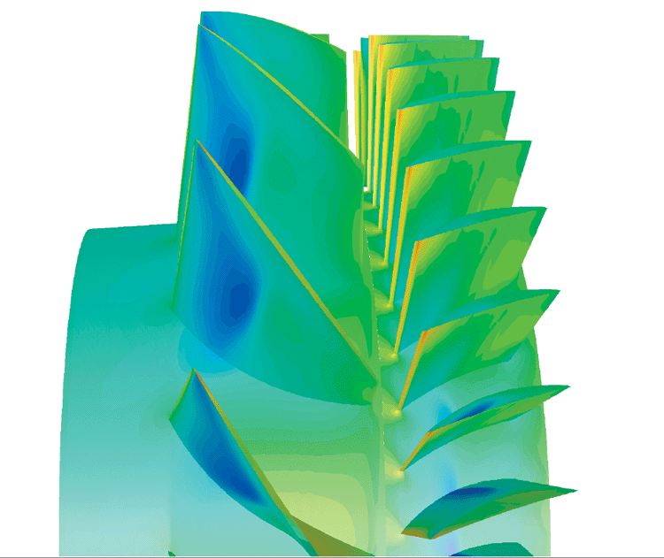

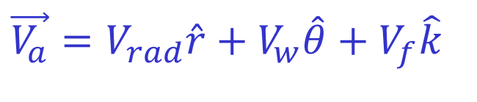
Role of Velocity Components
The real flow through any turbomachine is three dimensional.
Any component of velocity can vary along Axial, Radial and Circumferential directions.
Axial Flow Turbomachines:
Flow of fluid is facilitated by axial component of velocity.
Axial velocity is defined as flow velocity in an axial turbine.
$$\vec{V_{a}}=V_{rad}\hat{r}+V_{w}\hat{θ}+V_{f}\hat{k}$$

Slide 8
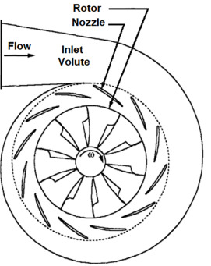
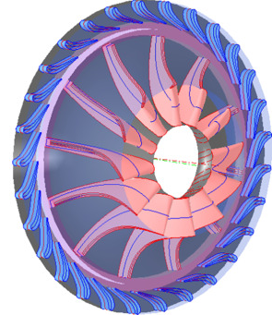
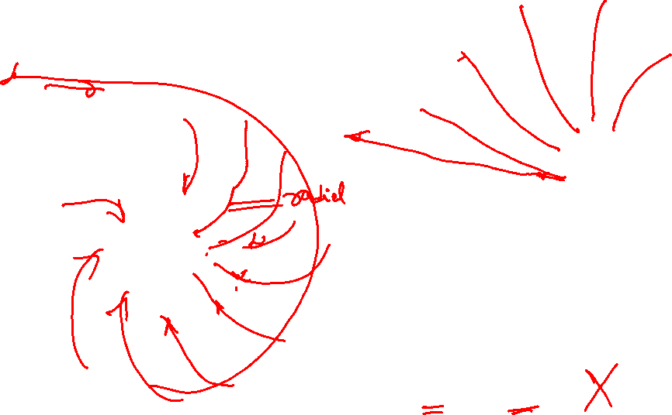
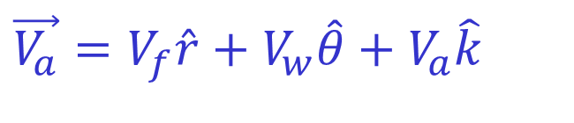
Role of Velocity Components
Radial Flow Turbomachines:
Flow of fluid is facilitated by Radial component of velocity.
Radial velocity is defined as flow velocity in an axial turbine.
Special casings are used to facilitated radial flow.
$$\vec{V_{a}}=V_{f}\hat{r}+V_{w}\hat{θ}+V_{a}\hat{k}$$

Slide 9
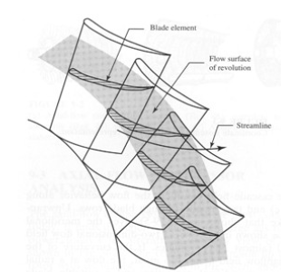
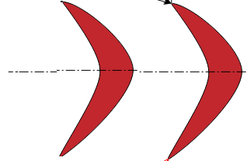
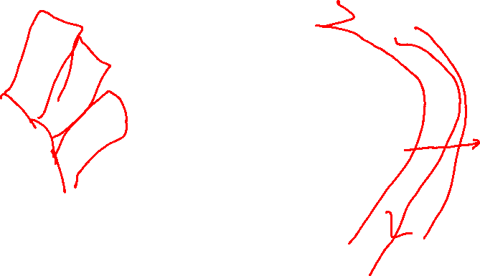
Axi-symmetric/Periodic Average Flow
Axi-symmetry : Inter blade row space.
Axi-symmetry assumes an average value to represent the state of working fluid in the blade-to-blade plane.
U

Slide 10
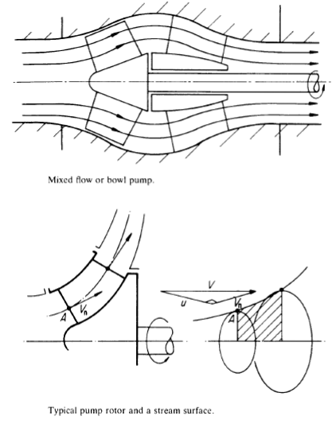
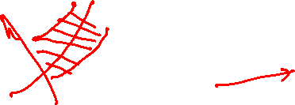
Quasistatic Process of Action/reaction
The momentum balance is considered in a plane constructed through axis of rotation and radial axis.
This Plane is called Meridional Plane.
A quasistatic interaction between fluid and rotor is leading to creation of Bulk Torque.

Slide 11
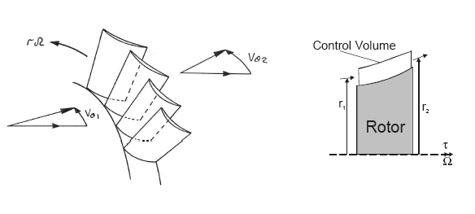
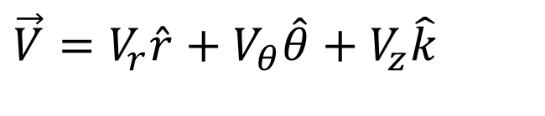
Euler’s Turbomachine Theory
Euler Model:
$$\vec{V}=V_{r}\hat{r}+V_{θ}\hat{θ}+V_{z}\hat{k}$$
Torque exerted by flow on A blade row = shaft output torque
= τ
= Rate of change of Angular momentum of fluid

Slide 12
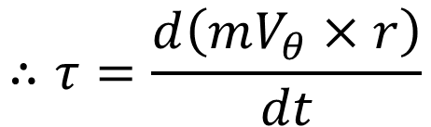

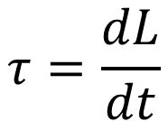
Rate of Change in Angular Momentum of A Fluid Flow
$$τ=\frac{dL}{dt}$$
Let L is Angular momentum
Angular momentum is moment of linear momentum of angular velocity, V_{θ}
$$L =mV_{θ}×r$$
$$∴τ=\frac{d\left(mV_{θ}×r\right)}{dt}$$
Newtons Second Law for a Control Volume….

Slide 13
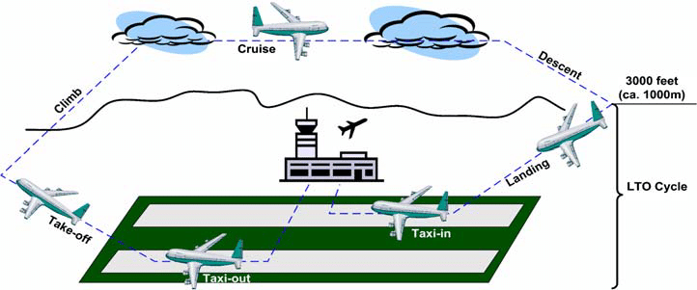
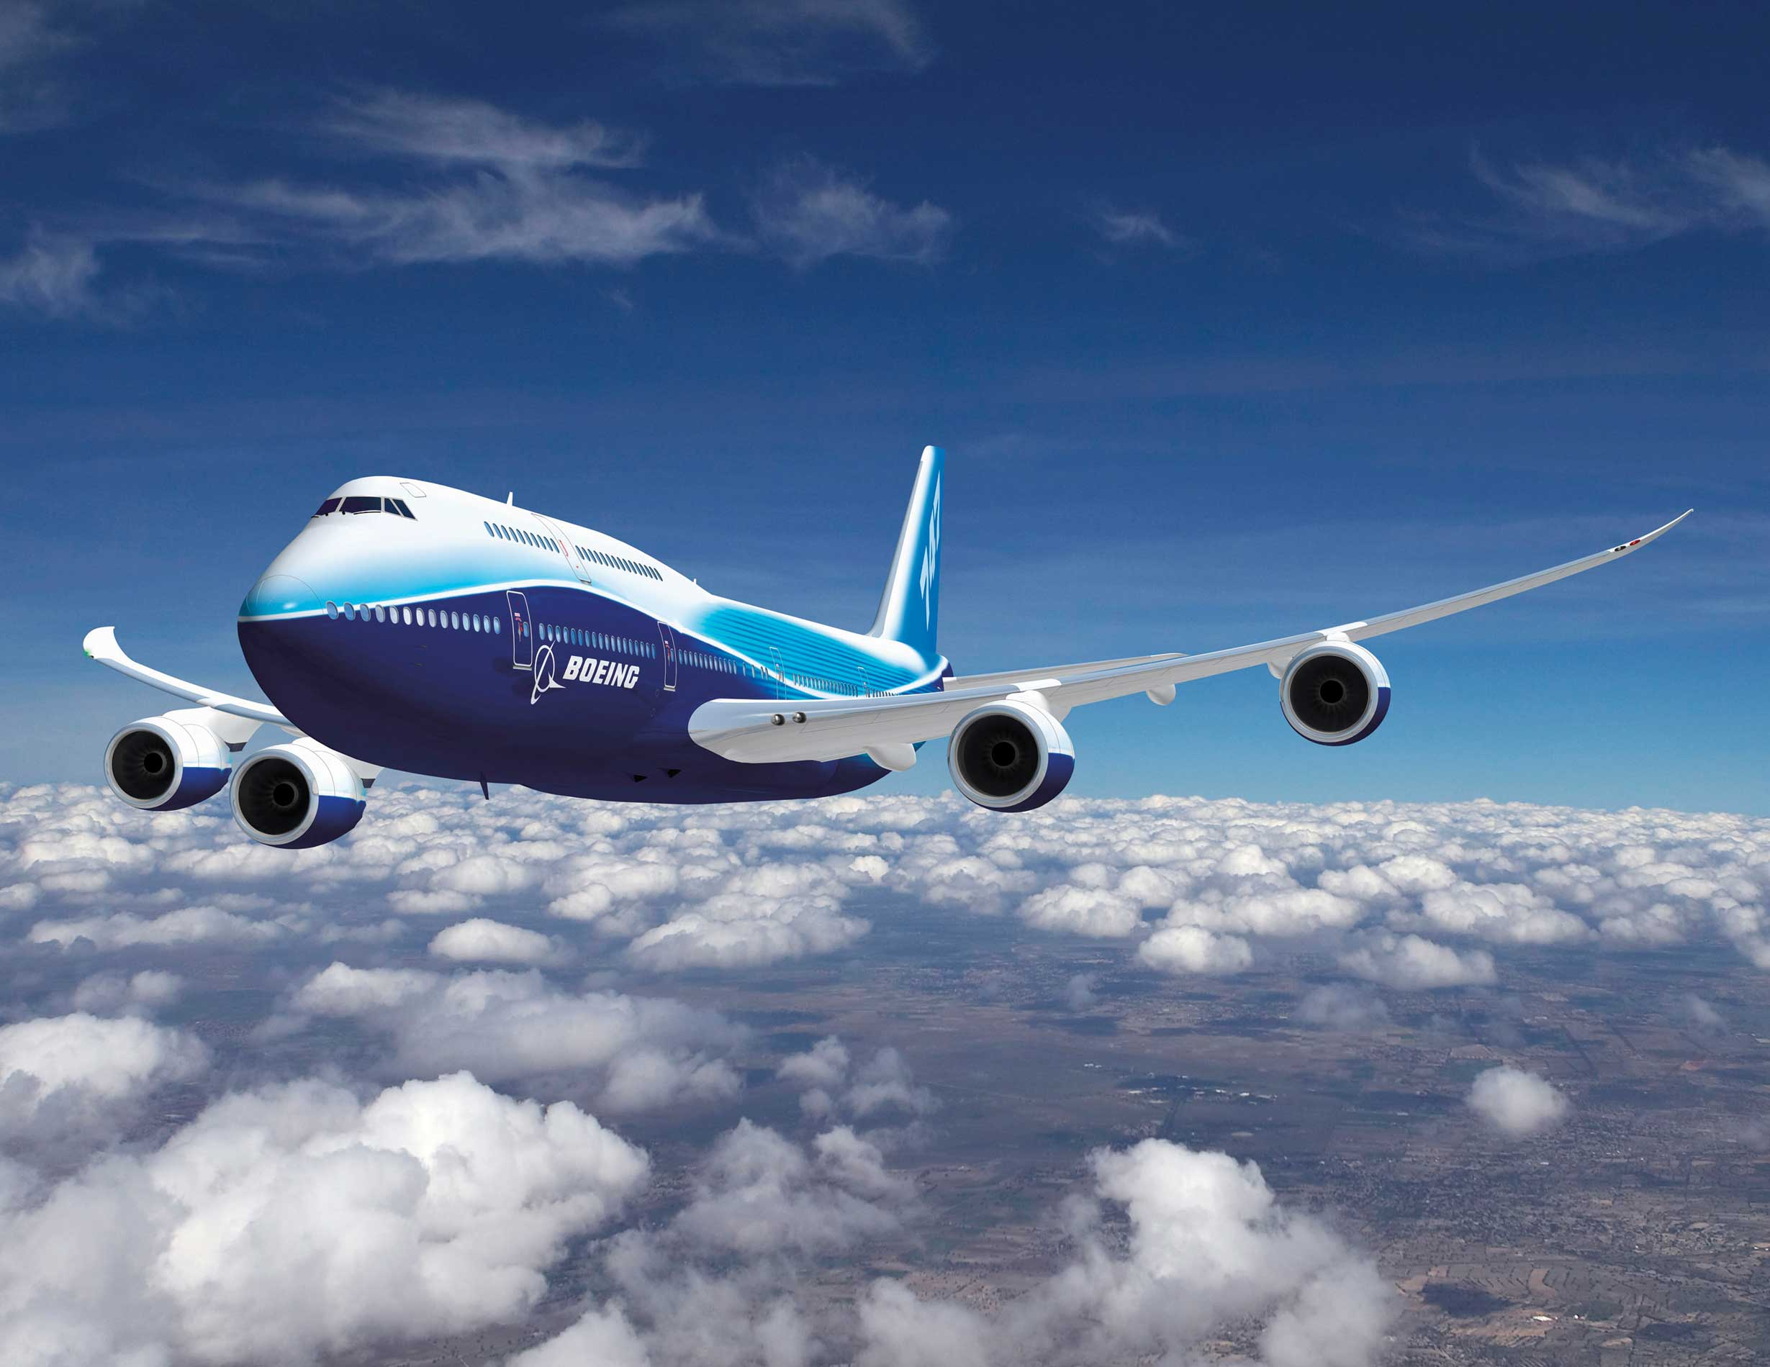
Travel Cycle of an Aircraft

Slide 14
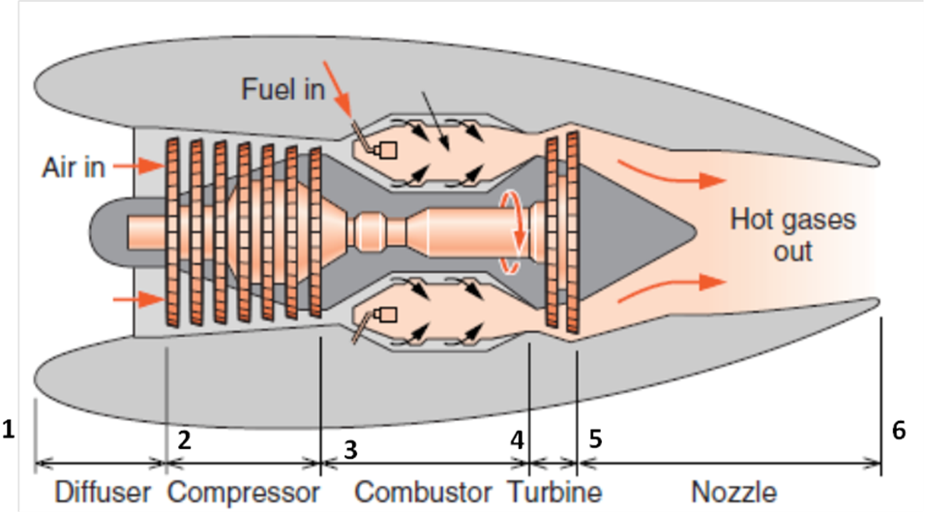
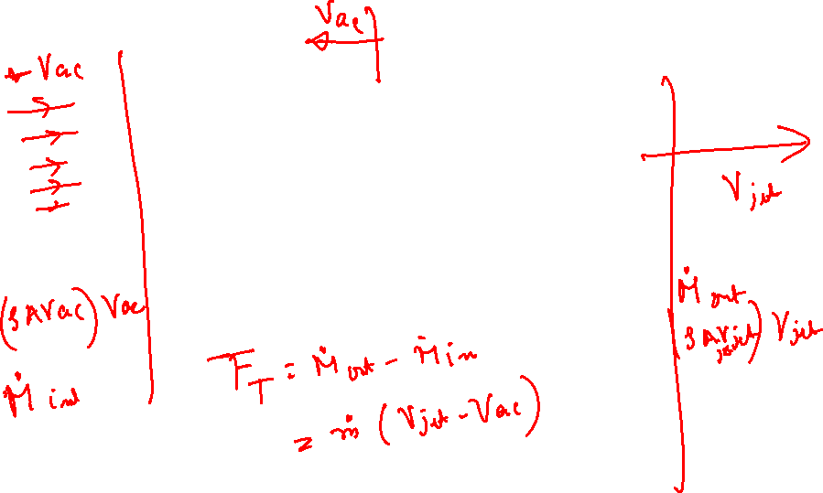
Flow across A Turbo-jet Engine

Slide 15


Eulerian View of Flow Momentum in A Turbomachine
For a given flow through a turbo-machine:
Inlet rate of angular momentum :
$${\dot{L}}_{in}={\dot{m}}_{in}V_{θ,in}r_{in}$$
Exit rate of angular momentum at exit:
$${\dot{L}}_{ex}={\dot{m}}_{ex}V_{θ,ex}r_{ex}$$
Change in Rate of angular momentum:
$${∆\dot{L}}_{turbo}={\dot{m}}_{ex}V_{θ,ex}r_{ex}−{\dot{m}}_{in}V_{θ,in}r_{in}$$
For a Steady flow through a turbo-machine:
$${∆\dot{L}}_{turbo}=\dot{m} \left\{V_{θ,ex}r_{ex}−V_{θ,in}r_{in}\right\}$$

Slide 16
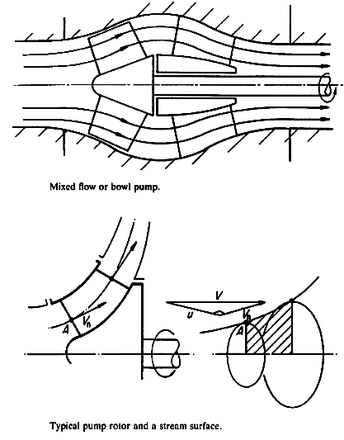
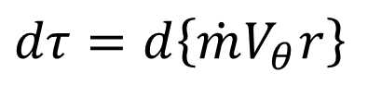
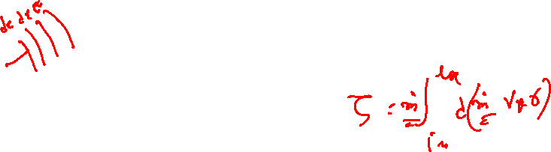
Infinitesimal Flow Kinematics in the Meridional Plane
In Meridional Plane.
Euler Differential Turbomachine Equation.
For an infinitesimal travel of fluid though a turbomachine
$$dτ=d\left\{\dot{m}V_{θ}r\right\}$$

Slide 17
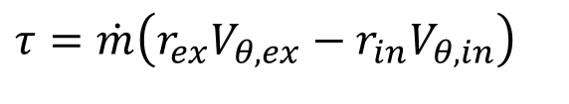

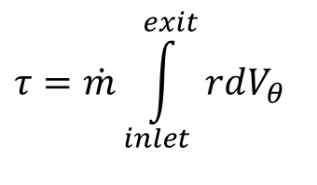
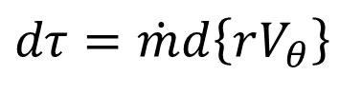
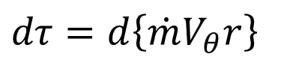
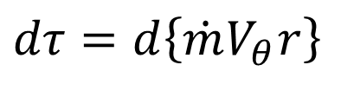
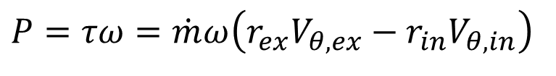
Euler Turbomachine Equation for a Quasistatic Process
$$dτ=d\left\{\dot{m}V_{θ}r\right\}$$
For an axial flow machine.
$$dτ=d\left\{\dot{m}V_{θ}r\right\}$$
For a SSSF flow Turbomachine
$$dτ=\dot{m}d\left\{rV_{θ}\right\}$$
$$τ=\dot{m}\int_{inlet}^{exit}{rdV_{θ}}$$
Torque developed by an turbo-machine
For an ideal flow machine along Meridional Path
Euler Theory:
$$τ=\dot{m}\left(r_{ex}V_{θ,ex}−{r_{in}V}_{θ,in}\right)$$
Torque experienced by flowing fluid from rotor : Action
Power lost/gained by flowing fluid: Action :
$$P=τω=\dot{m}ω\left(r_{ex}V_{θ,ex}−{r_{in}V}_{θ,in}\right)$$

Slide 18
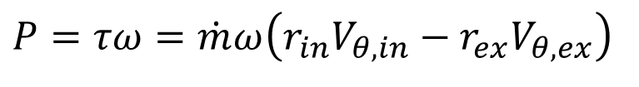
Euler Turbomachine Theory
A change in Whirl Velocity of fluid can only establish Power Exchange between fluid and rotor in a Turbomachine !
A successful Turbomachine must generate a net change in angular velocity by appropriate means…..
Power lost/gained by Rotor: Reaction :
$$P=τω=\dot{m}ω\left({r_{in}V}_{θ,in}−r_{ex}V_{θ,ex}\right)$$

