Slide 1

Salient Parts of A Centrifugal Pump
P M V Subbarao
Professor
Mechanical Engineering Department
Enhance the Performance thru Soft Skills……

Slide 2


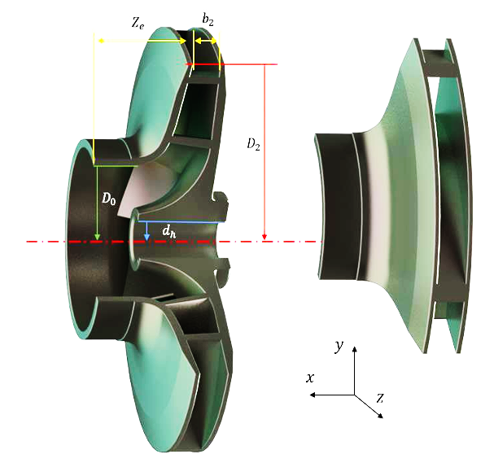
Impeller: The Heart of A CP

Slide 3
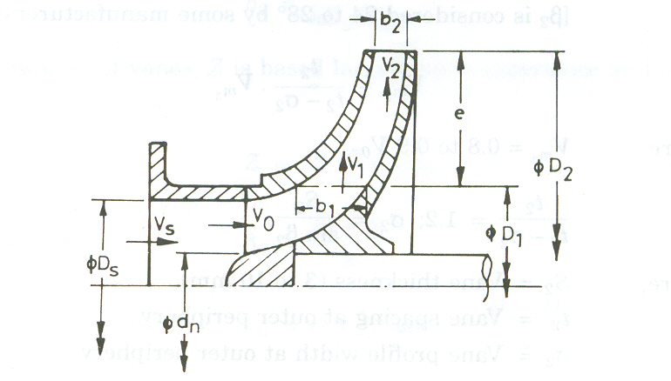

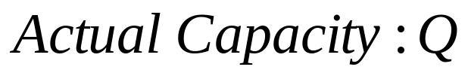
Control of NPSHr:
Geometric Details of Impeller

Slide 4
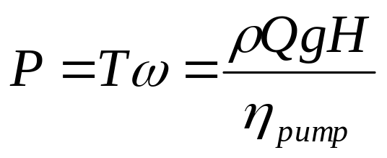
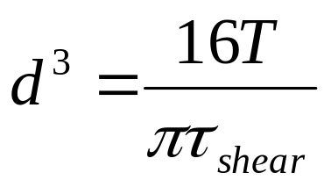
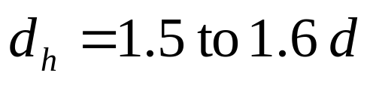
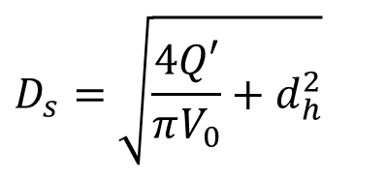
Geometric Details of Inlet Section of Impeller
Torque on Pump Shaft:
Shaft Diameter,d
Hub Diameter,d_{h}
$$D_{s}=\sqrt{\frac{4Q′}{πV_{0}}+d_{h}^{2}}$$
Suction Diameter:

Slide 5
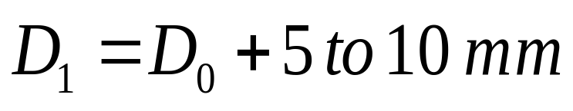
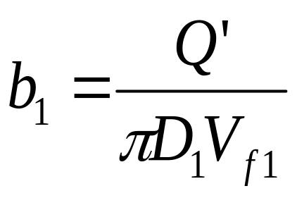
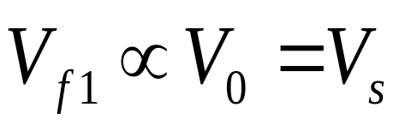
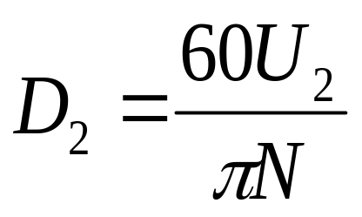
Geometric Details of Inlet Section of Impeller
Impeller Inlet Diameter:
Height of Vane at the Impeller inlet:
Impeller Exit Diameter:

Slide 6
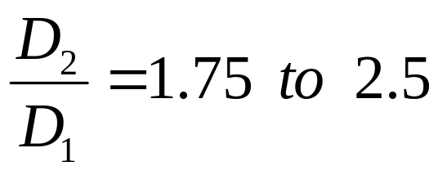
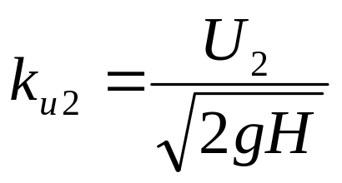
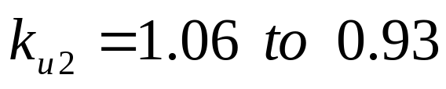
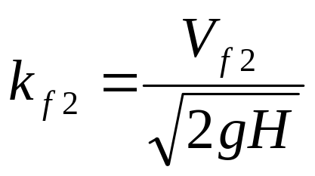
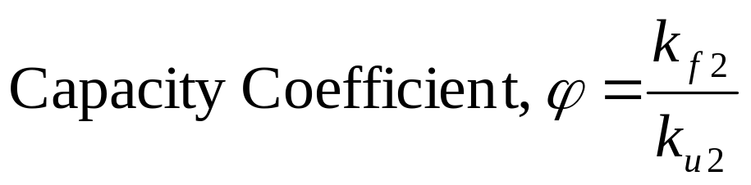
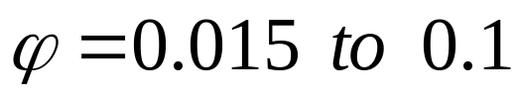
Geometric Details of Exit Section of Impeller
Pump Shape Factor:
Pump Speed Factor:
Pump Capacity Factor:

Slide 7
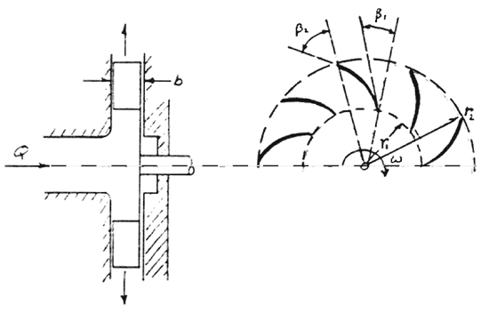
Geometric Details of A Low Head Impeller Vanes

Slide 8
DESIGN OF IMPELLER FLOW PATH
: 21st Century Methods
The design of the impeller flow path plays a critical role in fluid movement across the width of the impeller blades.
Flow path directly affects internal pressure distribution, blade load distribution, turbulent dissipation losses, partial load performance, and the stability of the external characteristic curve.
The parameterization of the flow path is very important for advanced design analysis.
Parameterization is achieved using a 5-point Bézier curve.

Slide 9
DESIGN OF IMPELLER FLOW PATH
: 21st Century Methods
The hydraulic efficiency is to be defined as the primary objective.
The cross-sectional area of the flow serving as the evaluation criterion.
Constraints are applied to the control points.
A genetic algorithm is employed to automatically optimize these points, thereby determining the optimal flow path structure.

Slide 10
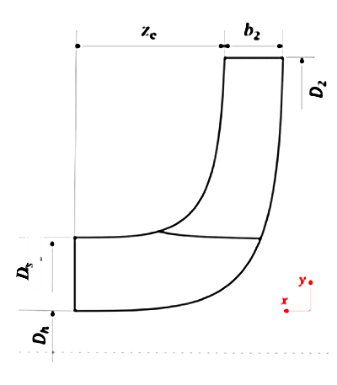
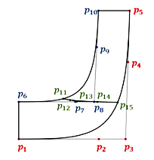
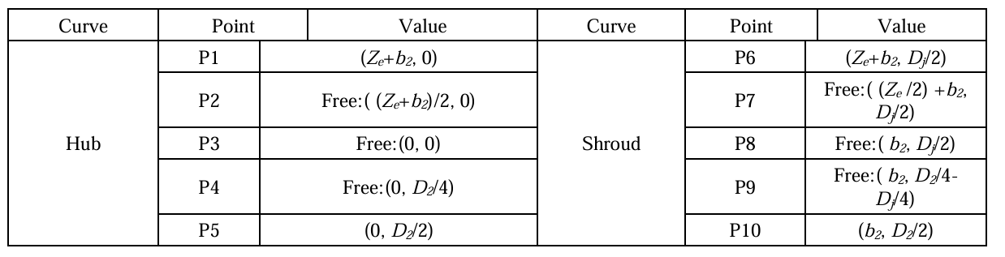
Main dimensions and control points of shaft section
Bézier curve is a mathematical curve tool widely used in two-dimensional graphic applications.
It enables the generation of complex and smooth curves with only a few control points.

Slide 11
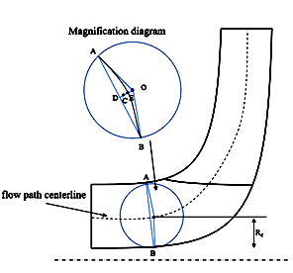
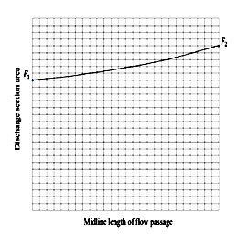
Principle of Flow section Calculation
The cross-sectional area of the flow channel is a parabolic surface generated by rotating the cross-sectional shape around the axis

Slide 12
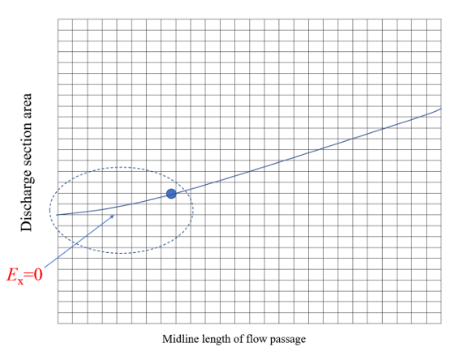
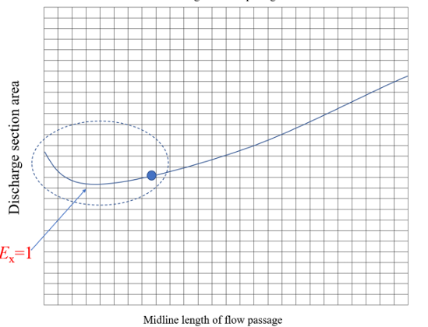
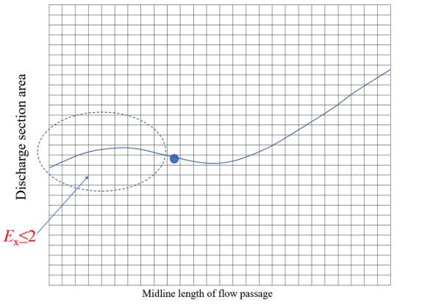
Several Main Flow Profiles

Slide 13
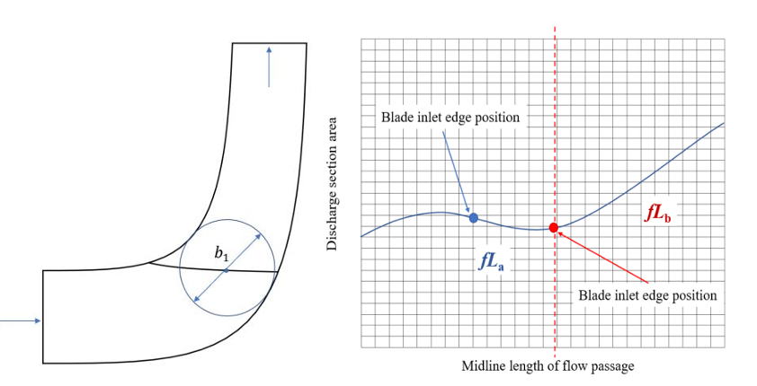
Sectional Evaluation Diagram

Slide 14
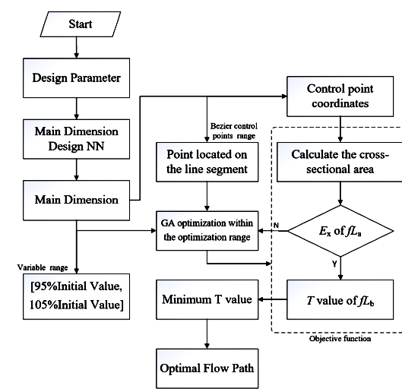
Flow channel control point optimization process

Slide 15
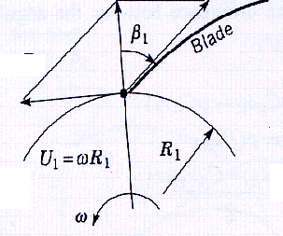
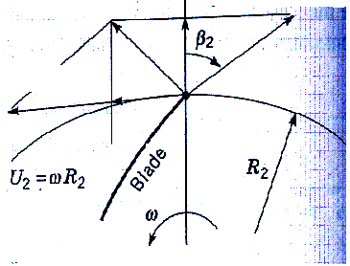
Impeller Velocity Diagrams
V_{f2}
V_{r1}
V_{a2}
V_{r2}
V_{a1}
V_{w2}
β₂ : 24⁰ −− 28⁰

Slide 16
DESIGN OF IMPELLER BLADES FOR CENTRIFUGAL PUMPS
The traditional blade design method is known as the blade angle preservation transformation method.
This method faces challenges in determining the blade streamline during the design process.
It often requires repeated iterations to define parameters such as the inlet angle, outlet angle, and wrap angle, φ.
Modern method of vane design used Machine Learning algorithms.
This method is known as RAPID DESIGN METHOD.

Slide 17
RAPID DESIGN METHOD
The specific speed range of the centrifugal pump was divided into 10 equally probable sub-intervals spanning from 10 to 40.
For each sub-interval, a flow rate was randomly selected.
The flow rate range for all sub-intervals was from 20 to 200, divided into 10 equal intervals.
The steps above were repeated until all representative flow rates were used, resulting in a sample set.

Slide 18
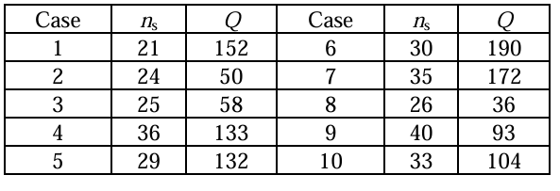
RAPID DESIGN METHOD
Apply Latin hypercube sampling to select samples to caryy out the rapid design of the impeller model.

Slide 19
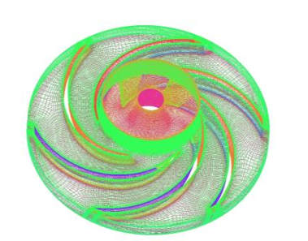
Valdation of RAPID DESIGN METHOD

Slide 20
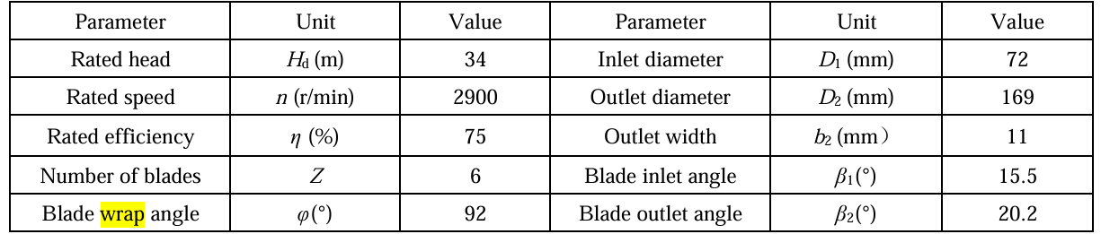
Design parameters of sample pump

Slide 21
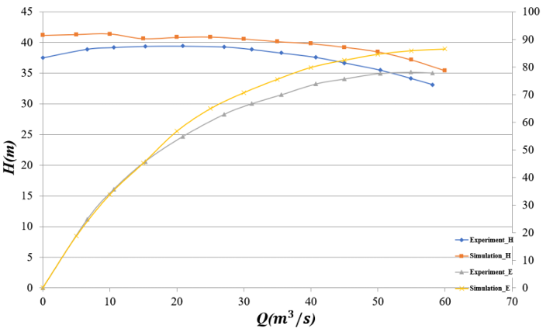
RAPID DESIGN METHOD

Slide 22
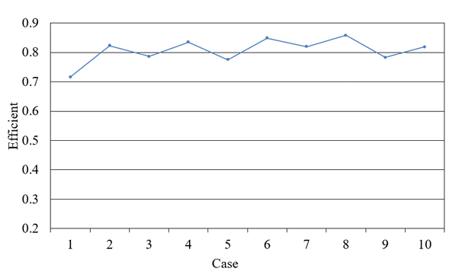
The impeller efficiency designed within the range of specific speed

Slide 23
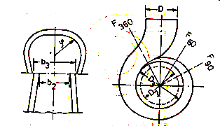
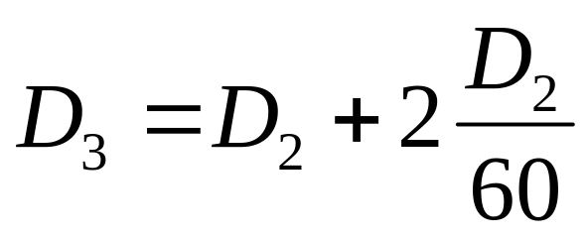
Design of Pump Casing
Volute casing
Volute Diameter at 360⁰: D₃

Slide 24
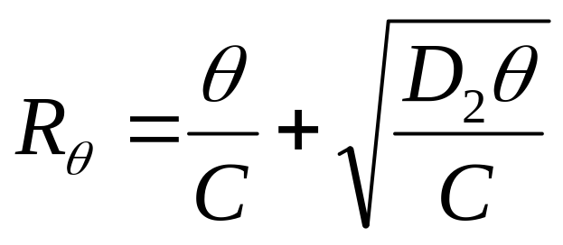
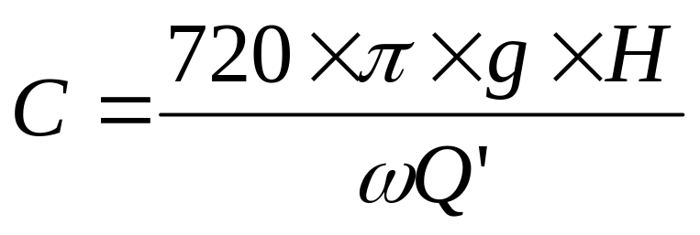
Design of Pump Casing
Volute width b₃ : 1.75 to 2.0 times the exit width of impeller
Volute radius:

Slide 25
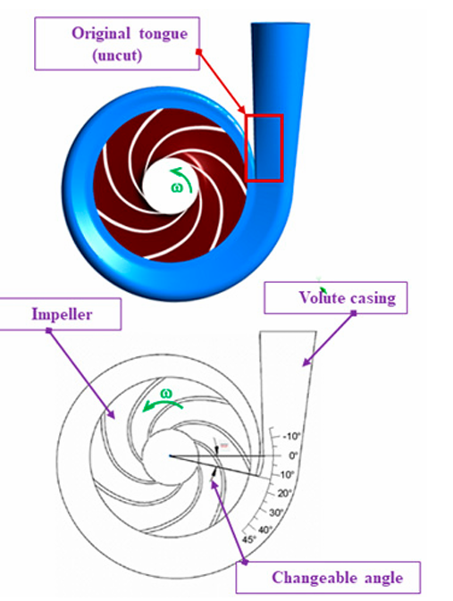
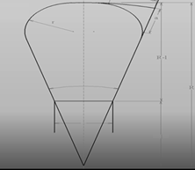
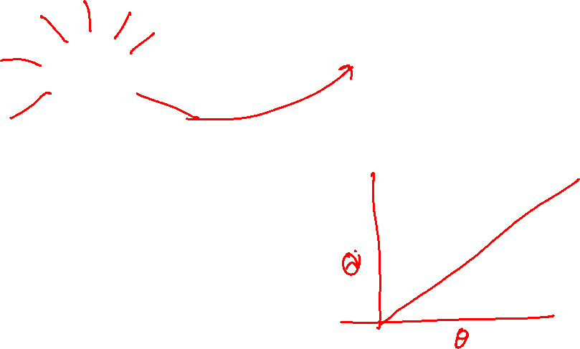
Finer Details of Volute Casing

Slide 26
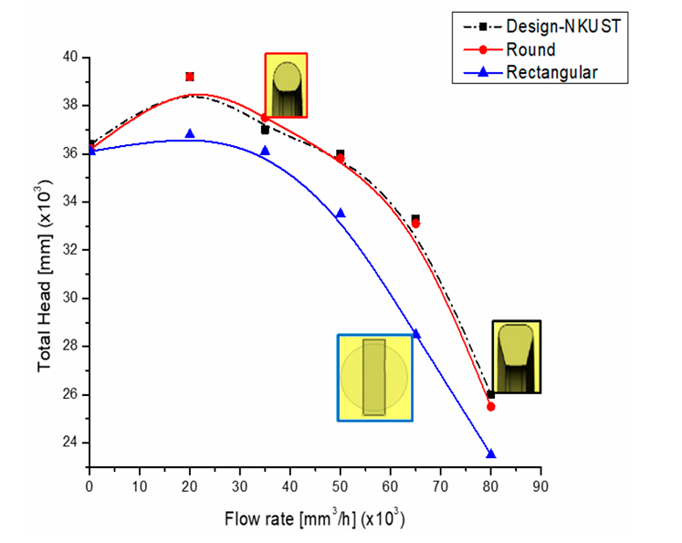
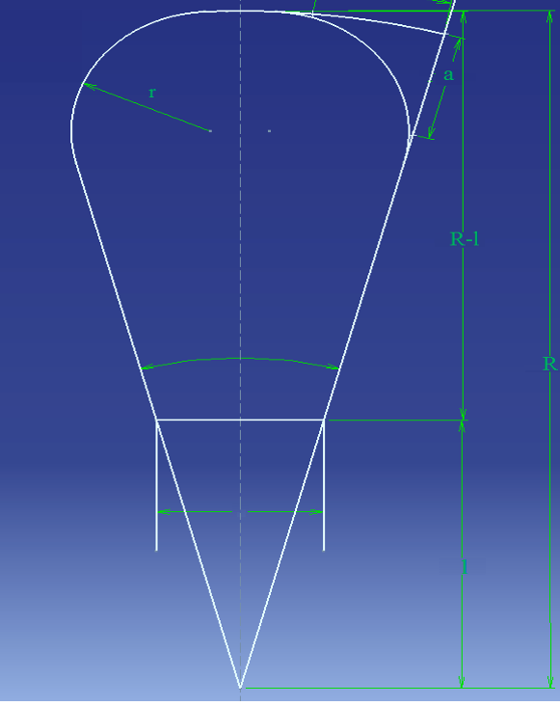
Internal cross-sectional area profile casing

Slide 27
Internal cross-sectional area profile casing

Slide 28

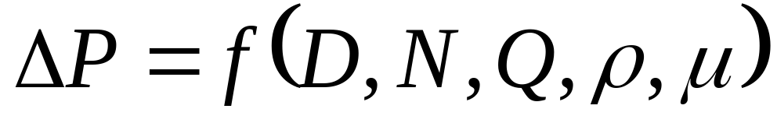
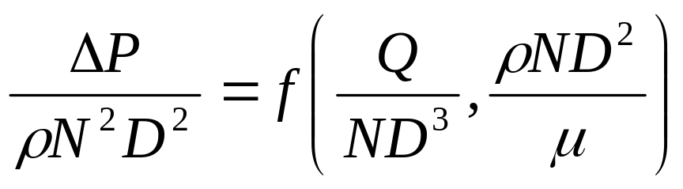
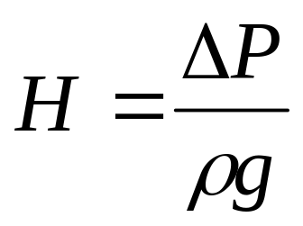
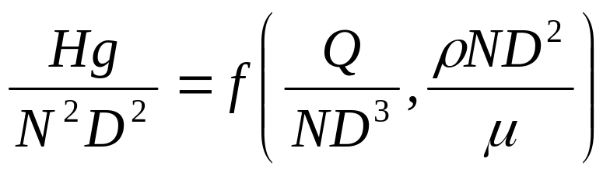
Performance Parameters
Differential head of pump:

Slide 29
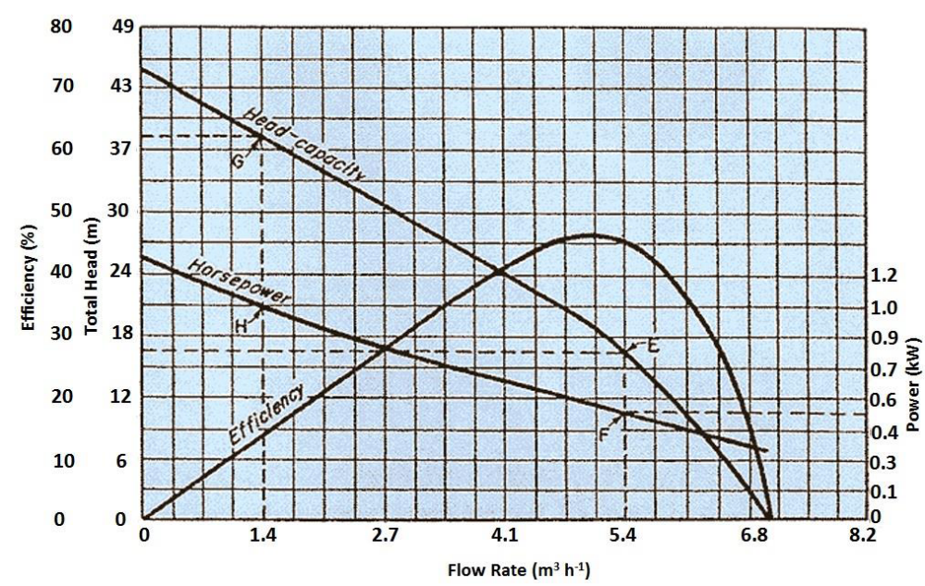
Pump Curves @ constant Speed

