Slide 1

Design of Centrifugal Pumps
P M V Subbarao
Professor
Mechanical Engineering Department
A Popular Liquid Lifting Device……

Slide 2

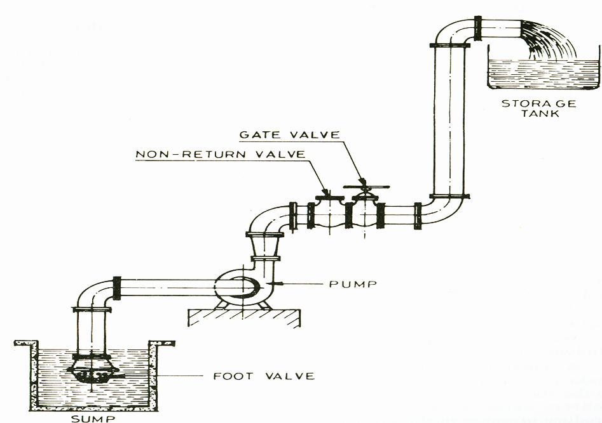
General Layout of A Pump

Slide 3



21st Century View of Developments in Pumps
The escalating environmental issues driven by energy consumption have underscored the urgent need to enhance energy efficiency across critical sectors.
As widely used general-purpose power machinery, centrifugal pumps account for substantial energy consumption, making their efficiency improvement highly significant.
With societal progress and the rising safety standards, pump design has evolved into a highly complex optimization problem.
PO is characterized as multi-objective, multi parameter, and multi-component integration under nonlinear and strongly constrained conditions.
Key challenges in this field include accurately predicting hydraulic performance and efficiently solving high-dimensional, nonlinear optimisation problems.

Slide 4
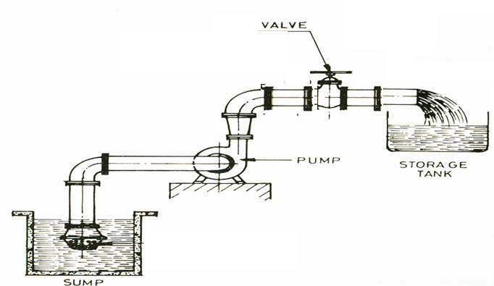
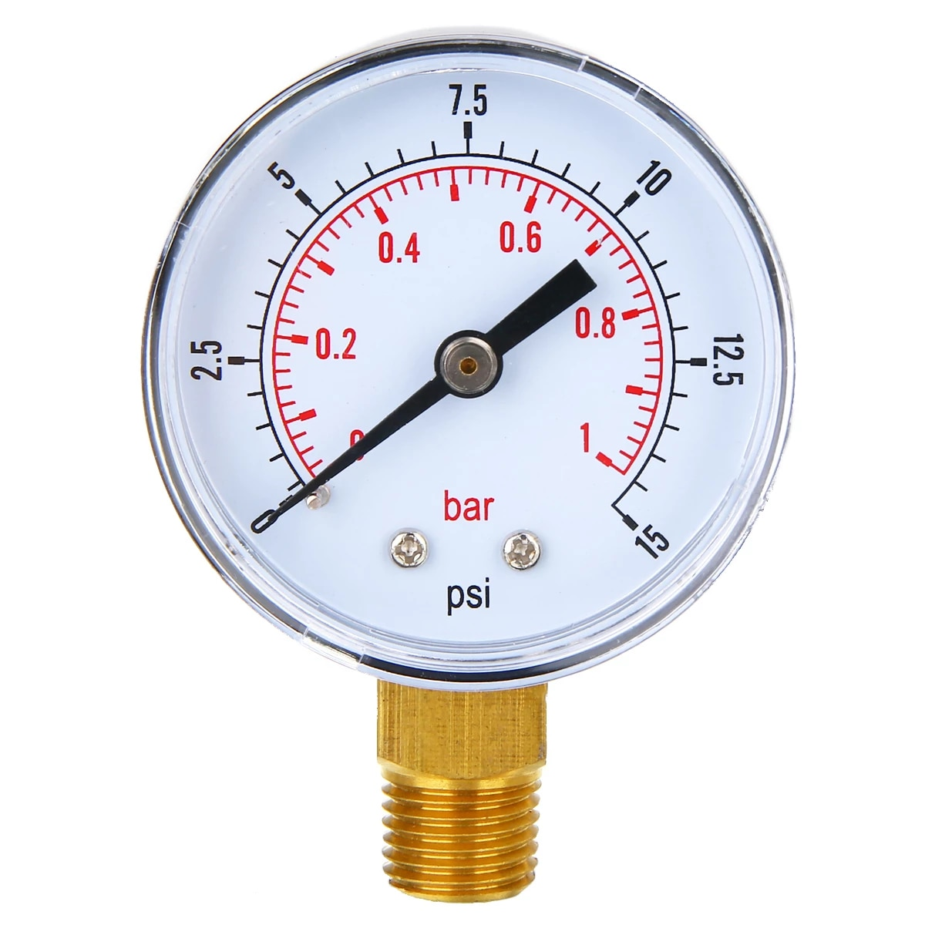
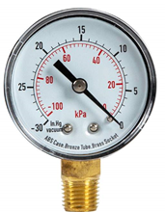
Layout of A Our Pump Test Rig

Slide 5
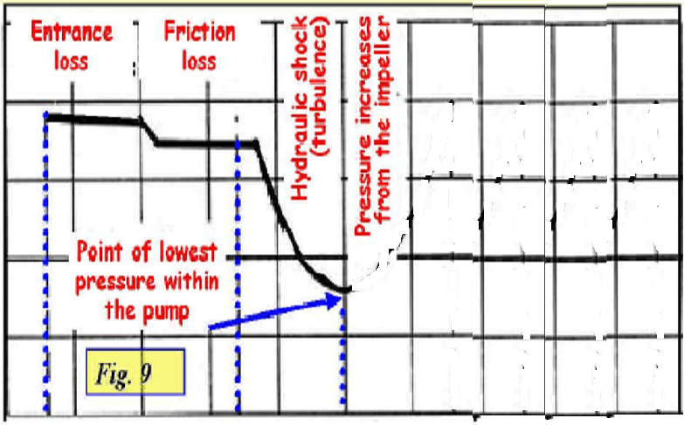
Variation of Absolute Pressure inside A Pump
p_{absolute}
Flow Path

Slide 6
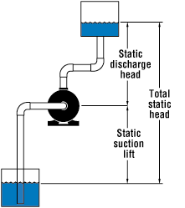
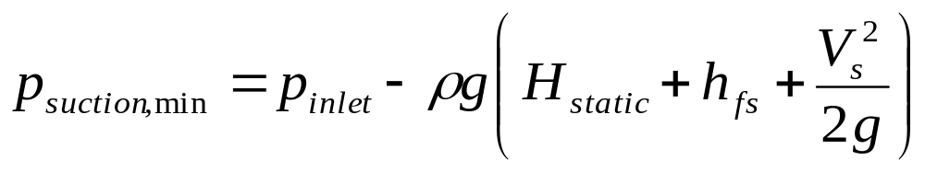
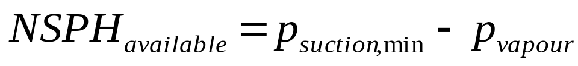
Available Suction Pressure At a Site
Kinetic power mV_{s}²/2
Frictional loss in suction piping

Slide 7
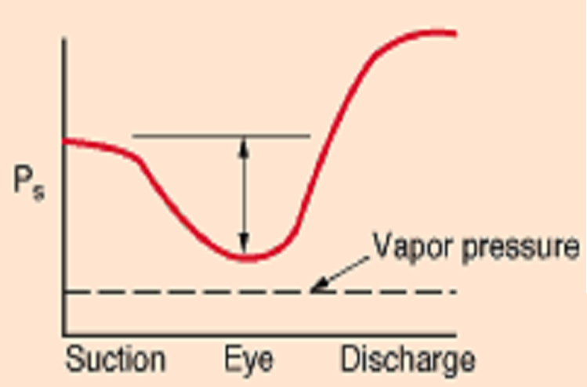
Definition of Net Positive Suction Head
NPSH is one of the most widely used and least understood terms associated with pumps.
NPSH

Slide 8
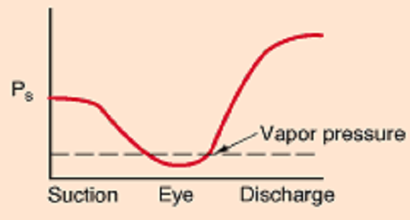
Loss of NPSH

Slide 9
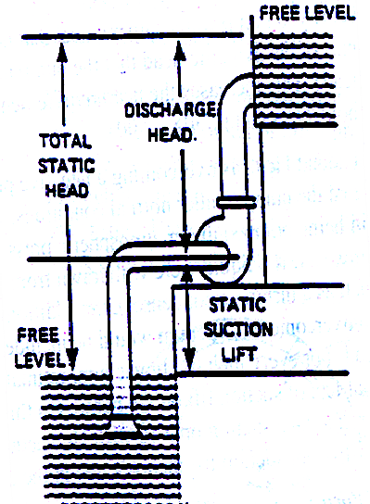
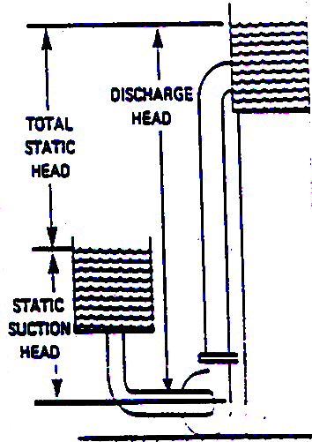
Strategies for Pump Erection

Slide 10
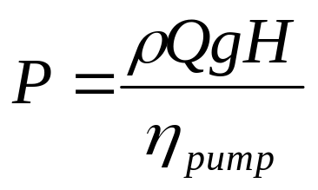
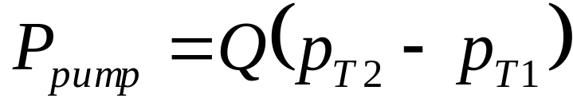
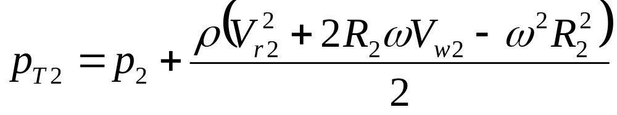
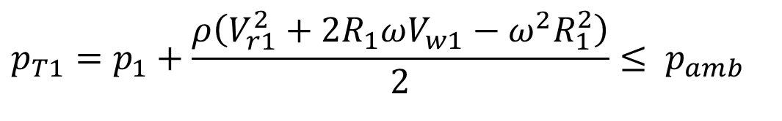
Power Consumed by A Pump
$$p_{T1}=p_{1}+\frac{ρ\left(V_{r1}^{2}+2R_{1}ωV_{w1}−ω^{2}R_{1}^{2}\right)}{2}≤ p_{amb}$$

Slide 11
Cavitation
As the liquid flows onto the impeller of the pump it is accelerated and initially its pressure falls (Bernoulli).
The pressure subsequently increases as the fluid leaves the impeller and as the kinetic energy is recovered in the volute chamber.
If the pressure of the liquid falls below the vapour pressure, p_{v}, the liquid boils, generating vapour bubbles or cavities-cavitation.
The bubbles are swept into higher pressure regions by the liquid flow, where they collapse creating pressure waves and cause mechanical damage to solid surfaces.
Moreover, pump discharge head is reduced at flow rates above the cavitation point.
Operation under these conditions is not desirable and damages the equipment.

Slide 12
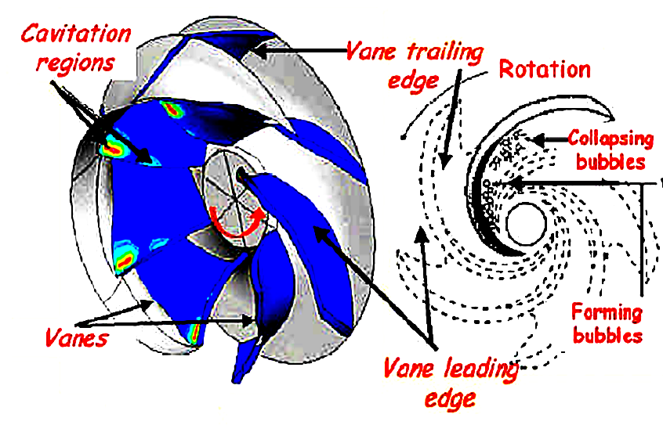
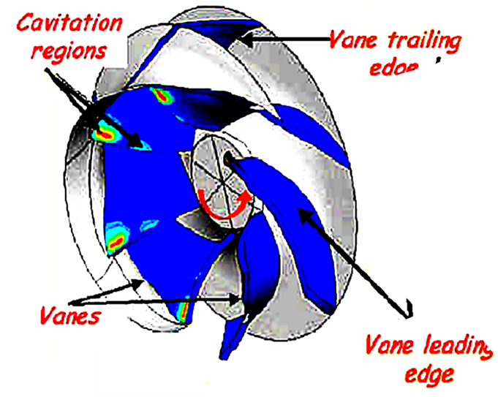
Cavitation regions in An Impeller

Slide 13
NPSH (Net Pressure Suction Head)
Net Positive Suction Head Required, NPSHr
Understanding the significance of NPSH is very much essential during design stage of the pumps.
Pumps can pump only liquids, not vapors!!!
Rise in temperature and fall in pressure induces vaporization
NPSH as a measure to prevent liquid vaporization
Net Positive Suction Head (NPSH) is the total head at the suction flange of the pump less the vapor pressure converted to fluid column height of the liquid.

Slide 14
Learnings from Machine:
NPSHr is a function of pump design
NPSH required is a function of the pump design and is determined based on actual pump test by the vendor.
As the liquid passes from the pump suction to the eye of the impeller, the velocity increases and the pressure decreases.
There are also pressure losses due to shock and turbulence as the liquid strikes the impeller.
The centrifugal force of the impeller vanes further increases the velocity and decreases the pressure of the liquid.
The NPSH required is the positive head in meters absolute required at the pump suction to overcome these pressure drops in the pump and maintain the majority of the liquid above its vapor pressure.
The NPSH is always positive since it is expressed in terms of absolute fluid column height.
The term "Net" refers to the actual pressure head at the pump suction flange and not the static suction head.

Slide 15
Learnings from Machine:
NPSHr increases as capacity increases
The NPSH required varies with speed and capacity within any particular pump.
The NPSH required increase as the capacity is increasing because the velocity of the liquid is increasing, and as anytime the velocity of a liquid goes up, the pressure or head comes down.
Pump manufacturer's curves normally provide this information.
The NPSH is independent of the fluid density as are all head terms.
Note: It is to be noted that the net positive suction head required (NPSHr) number shown on the pump curves is for fresh water at 20°C and not for the fluid or combinations of fluids being pumped.

Slide 16
Net Positive Suction Head available, NPSHa
Net Positive Suction Head Available is a function of the system in which the pump operates.
It is the excess pressure of the liquid in feet absolute over its vapor pressure as it arrives at the pump suction, to be sure that the pump selected does not cavitate.
It is calculated based on system or process conditions

Slide 17
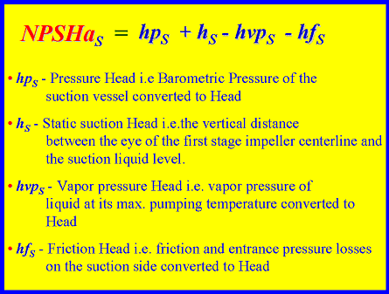
Net Positive Suction Head available, NPSHa

Slide 18
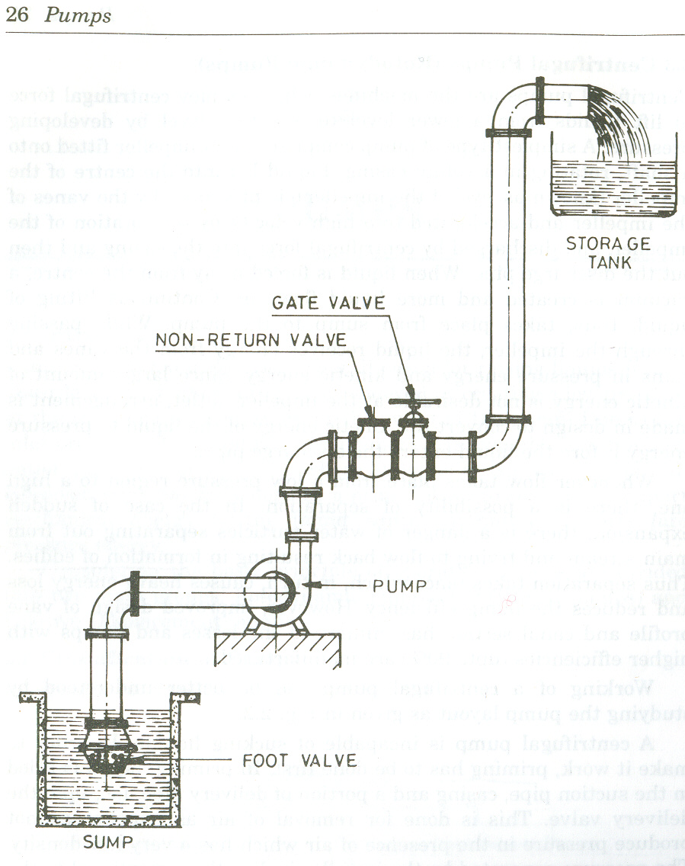
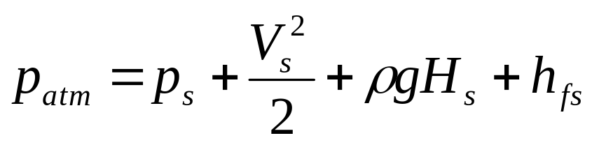
Erection of Pump
p_{s}
H_{s}

Slide 19
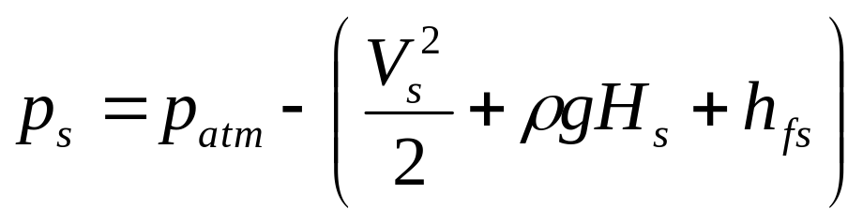
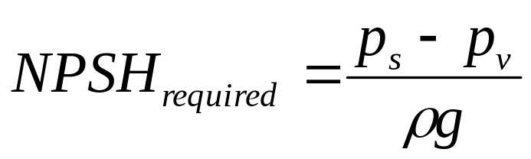
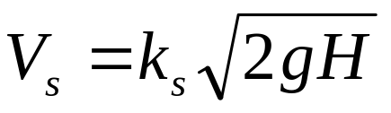
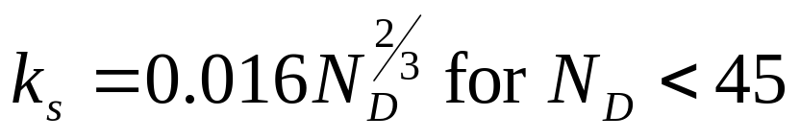
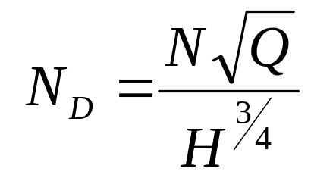
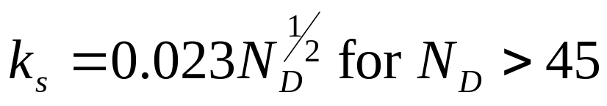
Learnings from Machine:
NPSHr is a Function of Pump Design
Suction Velocity:

Slide 20
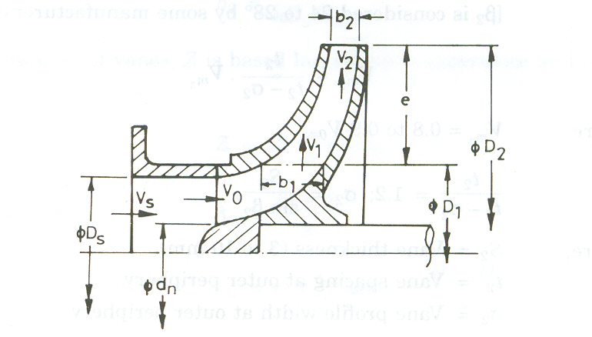
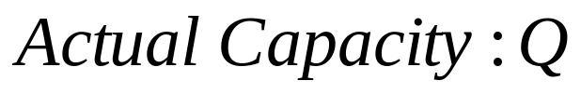
Control of NPSHr:
Geometric Details of Impeller

Slide 21
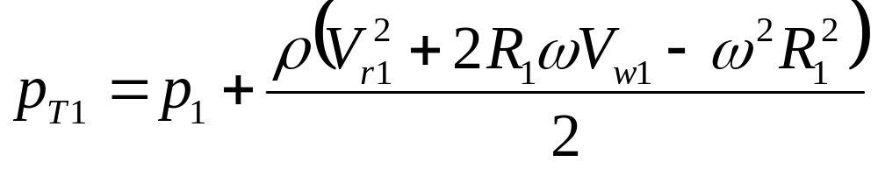
Power Developed by A Pump

Slide 22
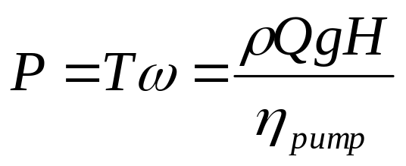
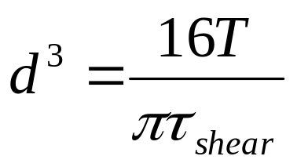
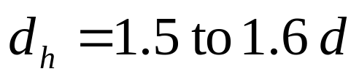
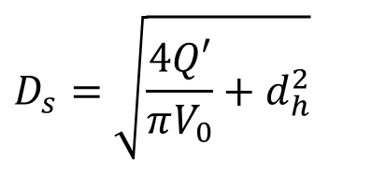
Geometric Details of Inlet Section of Impeller
Torque on Pump Shaft:
Shaft Diameter,d
Hub Diameter,d_{h}
$$D_{s}=\sqrt{\frac{4Q′}{πV_{0}}+d_{h}^{2}}$$
Suction Diameter:

Slide 23
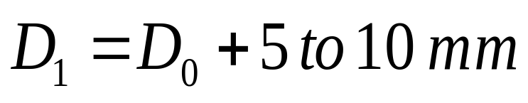
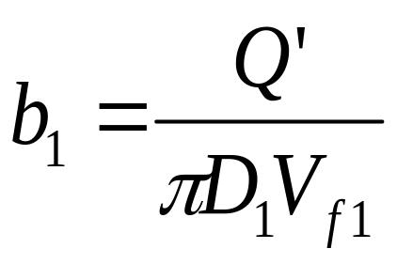
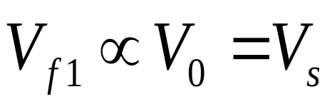
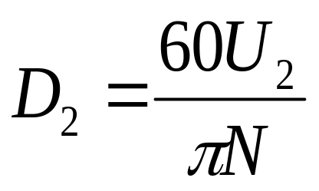
Geometric Details of Inlet Section of Impeller
Impeller Inlet Diameter:
Height of Vane at the Impeller inlet:
Impeller Exit Diameter:

Slide 24
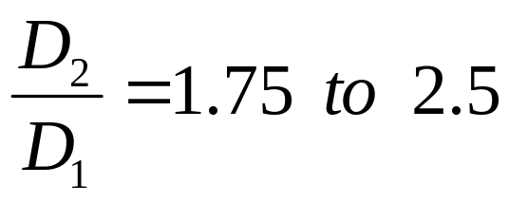
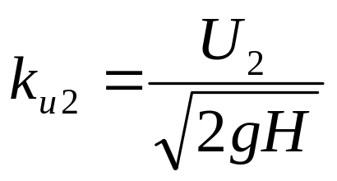
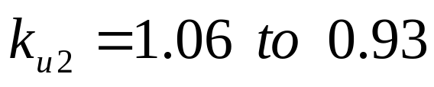
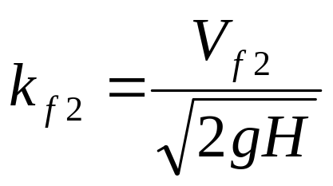
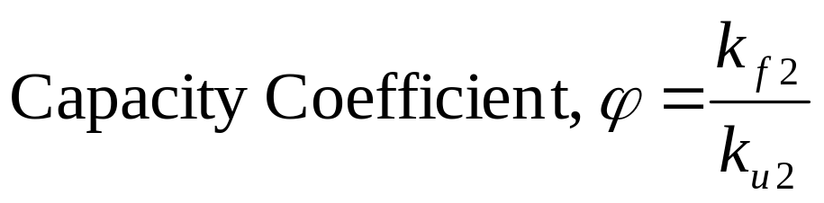
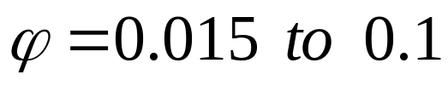
Geometric Details of Exit Section of Impeller
Pump Shape Factor:
Pump Speed Factor:
Pump Capacity Factor:

Slide 25
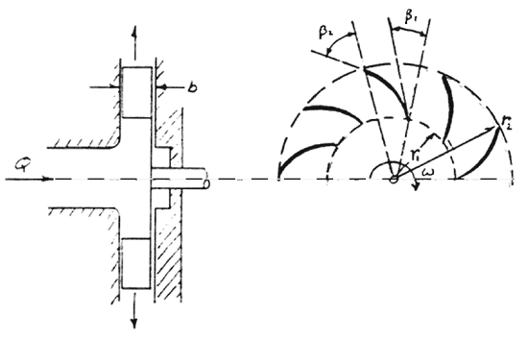
Geometric Details of Impeller Vanes

Slide 26
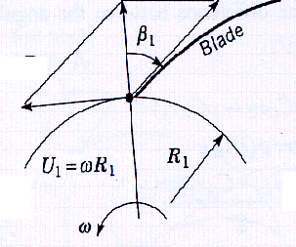
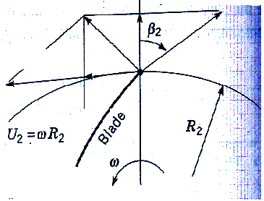
Impeller Velocity Diagrams
V_{f2}
V_{r1}
V_{a2}
V_{r2}
V_{a1}
V_{w2}
β₂ : 24⁰ −− 28⁰

Slide 27
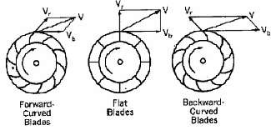
Types of Vanes
V_{r2}
V_{r2}
V_{r2}
V_{a2}
V_{a2}
V_{a2}

Slide 28
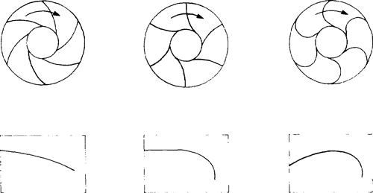
Types of Vanes
Exit Blade angle of the Impeller β₂
Backward Vanes
Radial Vanes
Forward Vanes

Slide 29
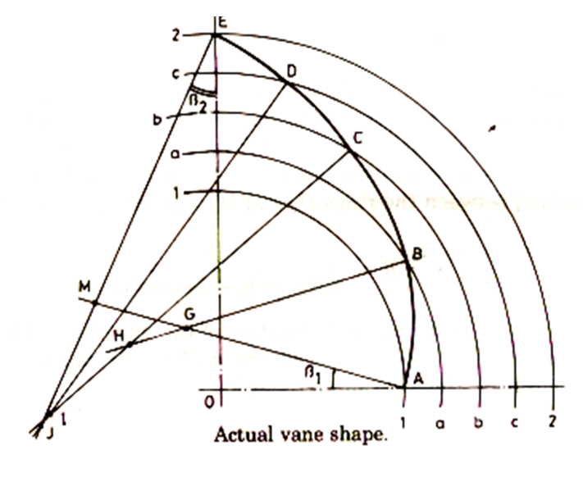
Construction of Vane Shape

Slide 30

Vane Shape for Better Performance
β₁₋₂
V_{f1-2}
V_{r}
V_{r1-2}

Slide 31


Design of Pump Casing
Volute casing
Volute Diameter at 360⁰: D₃

Slide 32


Design of Pump Casing
Volute width b₃ : 1.75 to 2.0 times the exit width of impeller
Volute radius:

Slide 33




Performance Parameters
Differential head of pump:

Slide 34

Pump Curves @ constant Speed

Slide 35



Variable Speed Operation
, C_{H} = head coefficient
, C_{Q} = flow coefficient

Slide 36


Slide 37


Head Vs Flow Rate & Selection of Operating Point

Slide 38

PUMPS Running Parallel

