Slide 1

Centrifugal Pumps
P M V Subbarao
Professor
Mechanical Engineering Department
An Inverse of Francis Turbine..
Domestic Appliance……

Slide 2


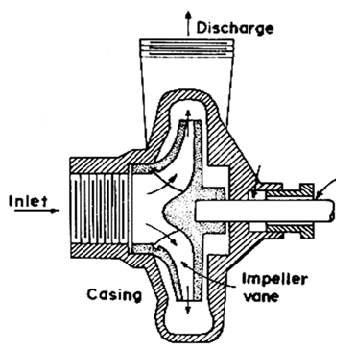
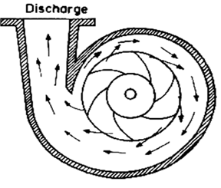

Impulse-Reaction Turbomachine
Reaction by Centrifugal Action

Slide 3
Centrifugal Pumps
Centrifugal pumps: the fluid enters the centre of a rotating impeller, where it is accelerated along the impeller blades.
The fluid gains kinetic energy which is converted in pressure energy in the diffuser.
The performance of centrifugal pumps depends on a big number of parameters and a satisfactory solution to face with the problem is dimensional analysis.
Two explicit variables are of our interest in the characteristics of pumps: the pressure rise and the power consumption.
It is expected the pressure rise, ΔP (N/m²), depends on:
Impeller size, D (m);
rotation rate, N (s ⁻¹);
volumetric flow rate, Q (m³/s);
fluid properties: density ρ (kg/m³) and viscosity µ (kg/ms);

Slide 4
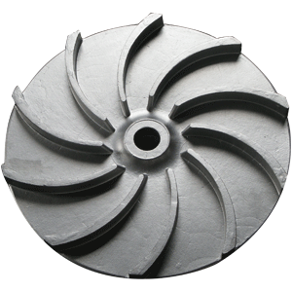
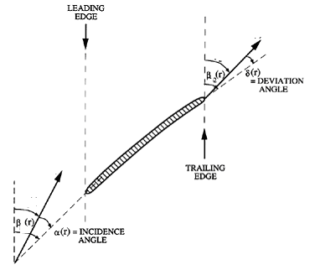
Fluid Dynamic Features of Reversed Idea
V_{re}(r)
A departure from this idealistic assumption is denoted by the deviation angle, δ(r),
V_{ri}(r)

Slide 5
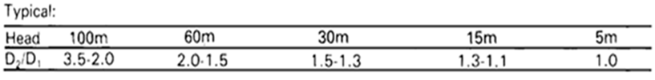
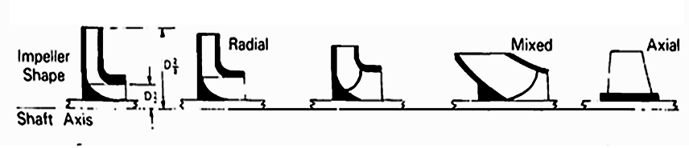

General Characteristics of Rotodynamic Pumps

Slide 6
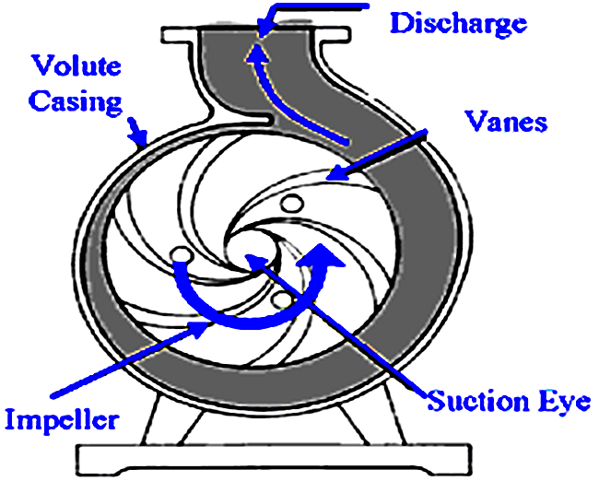

General Anatomy of A Pump

Slide 7
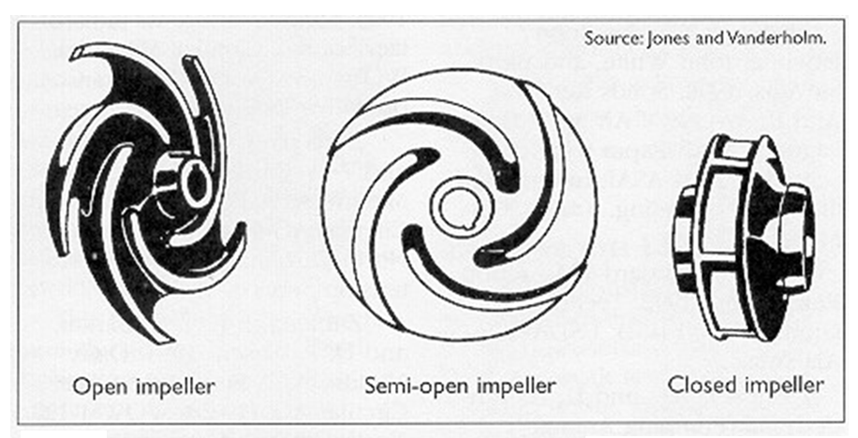
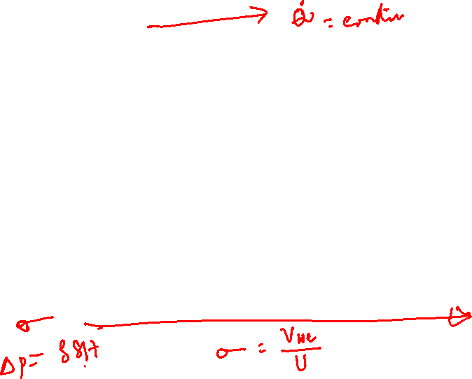
Basic Structure of Pump Impeller

Slide 8
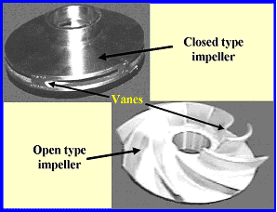
Slip Control in Pumps

Slide 9
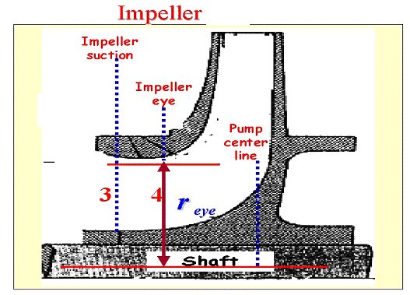
General Anatomy of A Pump

Slide 10



Speed Vs Size : Constant Head & Flow Rate
Demand Speed n_{f} = 492 rps
N=1000 rpm
N=1500 rpm
N=3000 rpm

Slide 11
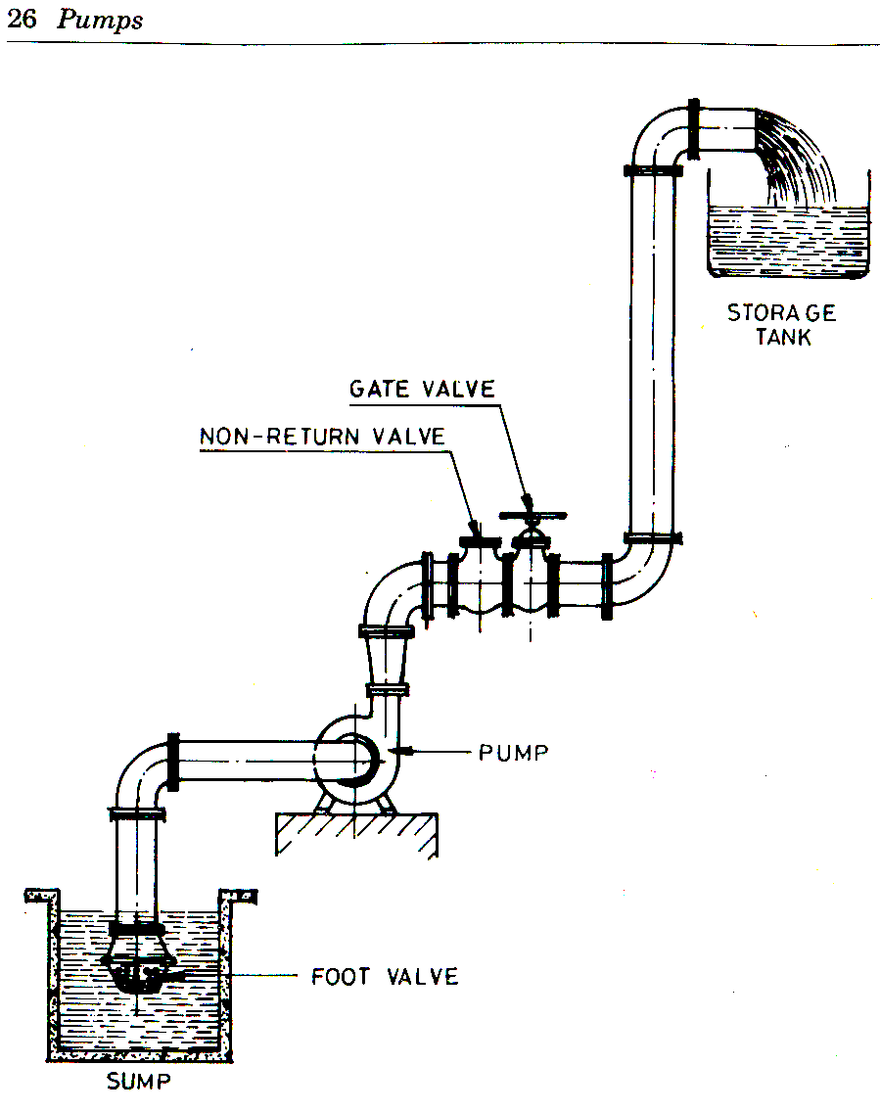
Pump at A Site
p_{s}
H_{s}

Slide 12
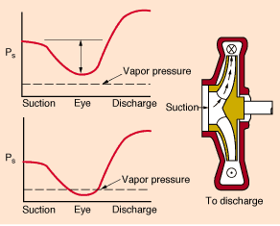
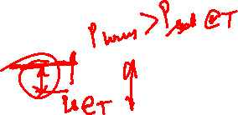

Slide 13
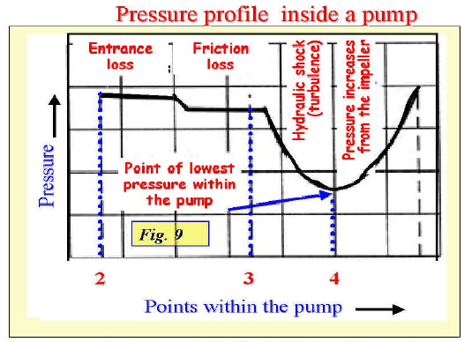

Slide 14
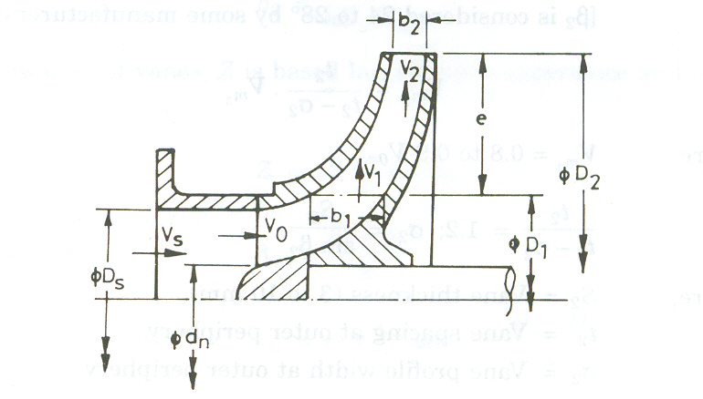
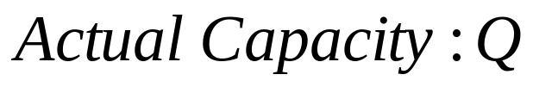
Geometric Details of Impeller

