Slide 1

Axial Flow Pumps
P M V Subbarao
Professor
Mechanical Engineering Department
An Inverse of Kaplan Turbine …
Better Choice for Pumping High Capacities……

Slide 2


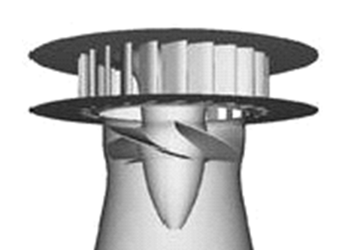
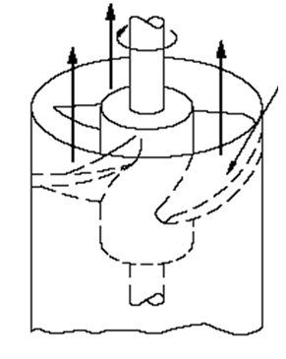
An Inverse of Axial Flow Pumps
Pump machinery consumes a significant proportion of the total energy consumption in society, among various high energy-consuming devices.
A Pump performs incompressible fluid transport functions.

Slide 3
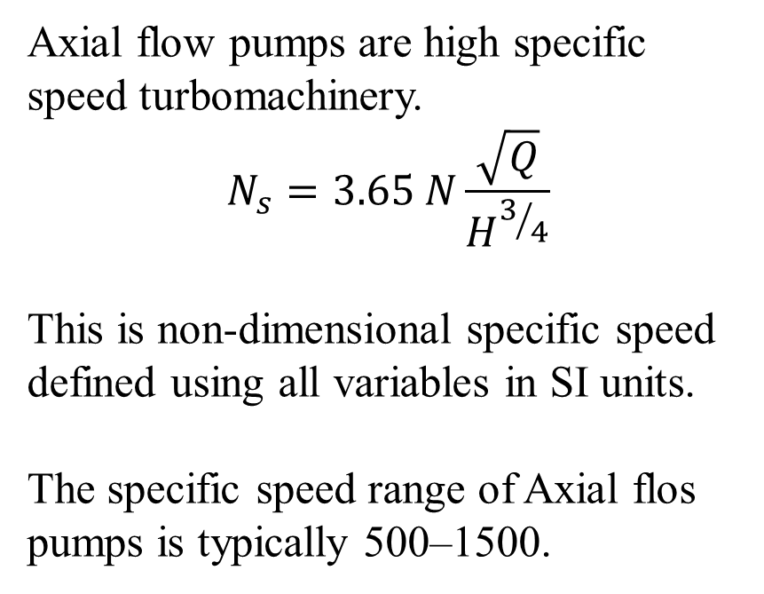
An Inverse of Axial Flow Pumps
Axial flow pumps are high specific speed turbomachinery.
$$N_{s}=3.65 N\frac{\sqrt{Q}}{H^{3/4}}$$
This is non-dimensional specific speed defined using all variables in SI units.
The specific speed range of Axial flos pumps is typically 500–1500.
These devices, with their high flow and low head transport characteristics, have irreplaceable application value in municipal water supply, petrochemical, and shipbuilding engineering sectors

Slide 4
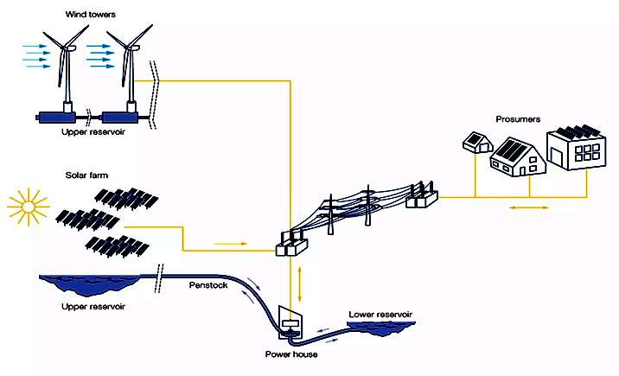
Sustainable Energy & Future Role of Pumps

Slide 5
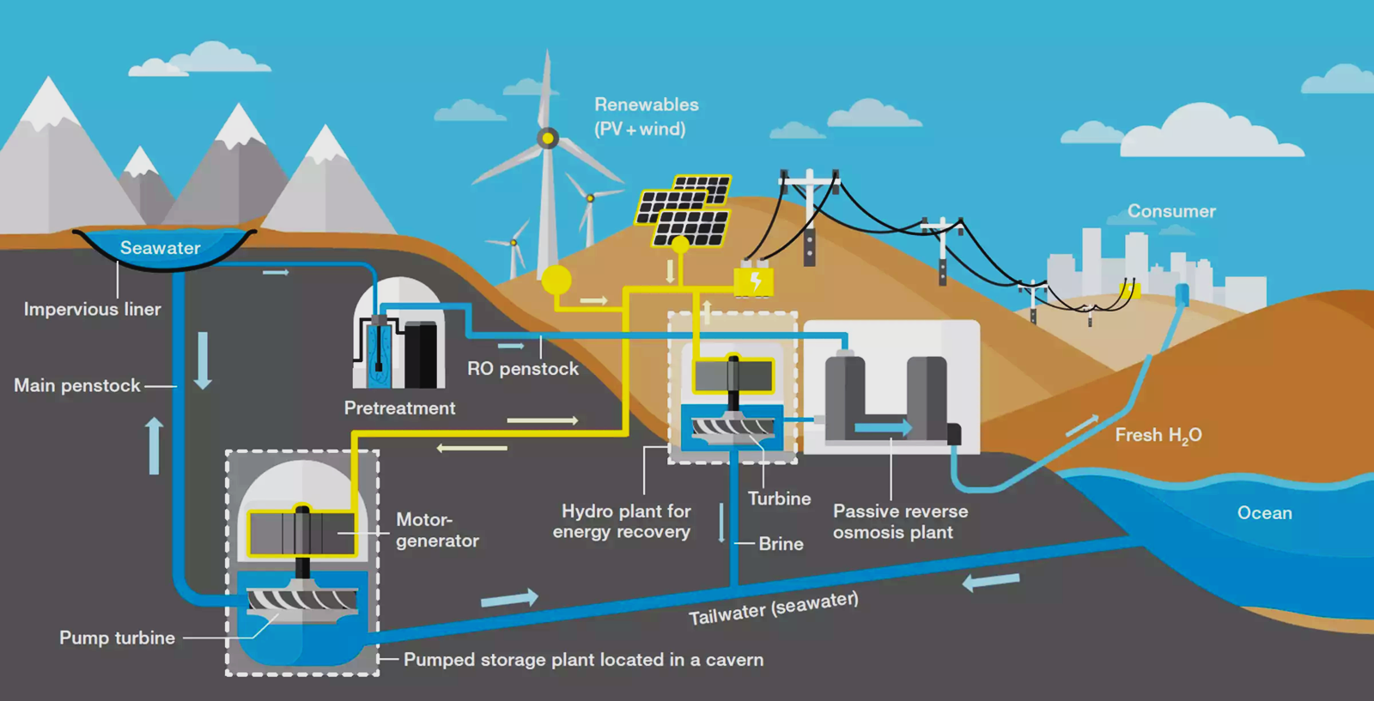
Sustainable Energy & Future Role Pumps

Slide 6
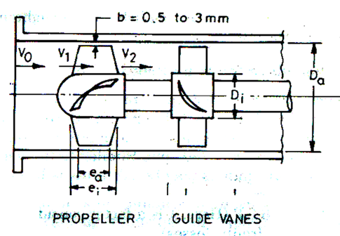
Axial Pump Stage : Basic Geometric Details
Runner
Stator

Slide 7
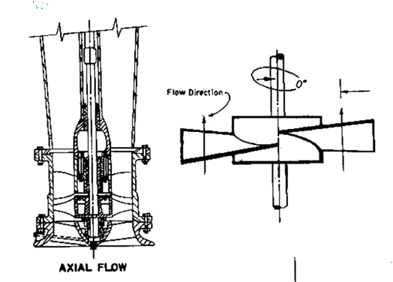
Vertical Axis Axial Flow Pump

Slide 8
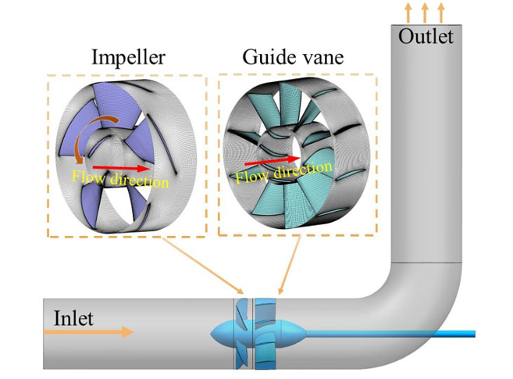
Horizontal Axis Axial Flow Pump

Slide 9
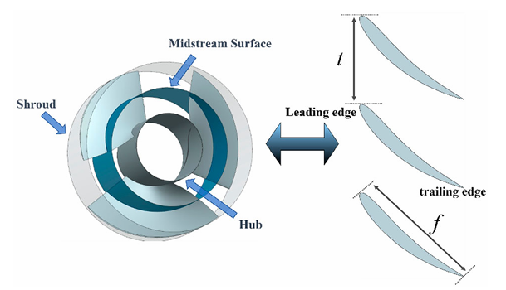

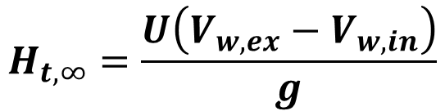
Euler Theory of Axial Flow Pumps
U
The Euler equation given an expression for the theoretical head for an axial flow pump with an infinite number of blades, defined, as
$$H_{t,∞}=\frac{U\left(V_{w,ex}−V_{w,in}\right)}{g}$$
$$p_{t,∞}=ρU\left(V_{w,ex}−V_{w,in}\right)$$

Slide 10
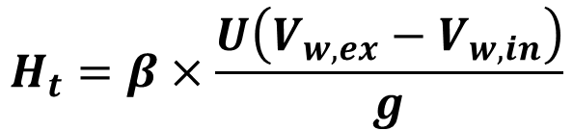
Modfied Euler Model for A Real Axial Flow Pumps
U
A real pump will have finite number of blades with a slip coefficient.
The Pfleiderer’s formula used a correction factor.
The Pfleiderer’s formula is as follows:
$$H_{t}=β×\frac{U\left(V_{w,ex}−V_{w,in}\right)}{g}$$
Value is in the range
0.69 to 0.74

Slide 11
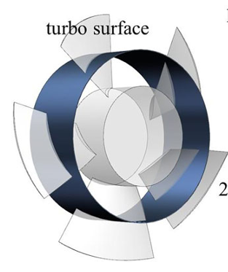
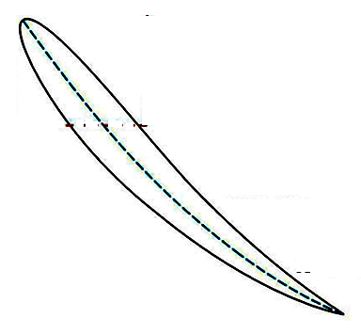
Hydrofoil for Pure Reaction type Rotor Blades
NACA standard profiles

Slide 12
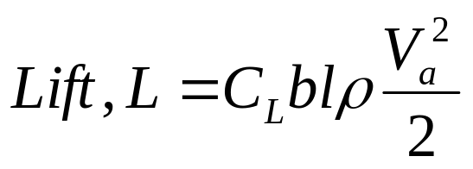
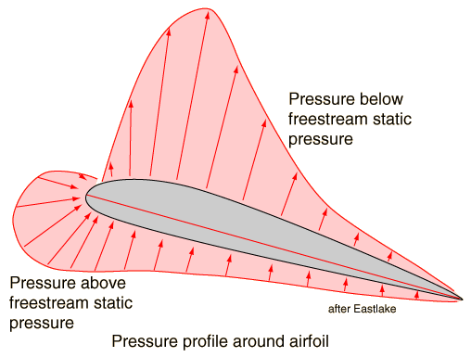
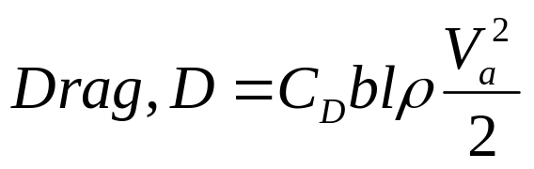
Pure Reaction type Rotor Blades
NACA standard profiles

Slide 13
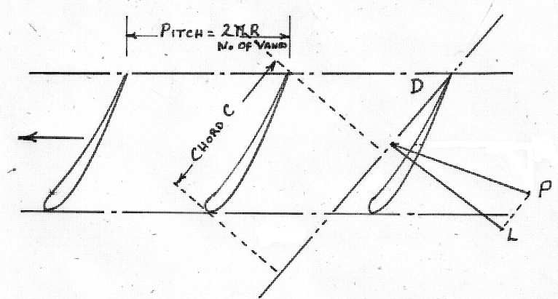
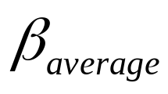
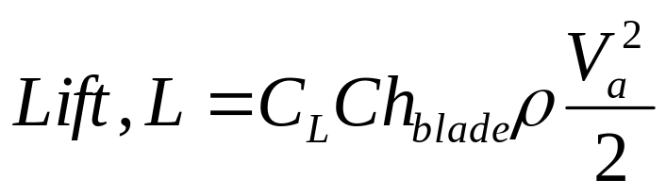
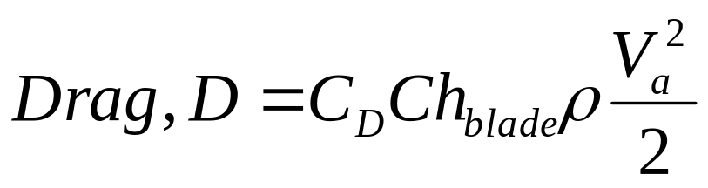
Mean Diameter Cascade & Direction of Lift & drag
F

Slide 14
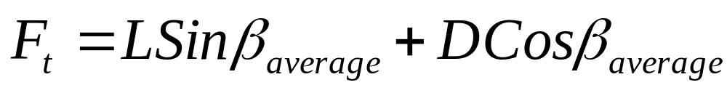
Mean Diameter Cascade & Tangential Driving Force
F
The components of F are F_{t} the driving force along Tangential Direction and F_{a} in the Axial Direction.

Slide 15
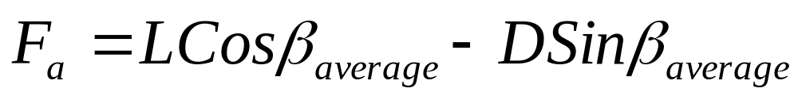
Mean Diameter Cascade & Tangential Driving Force
F
F_{a} in the Axial force:

Slide 16
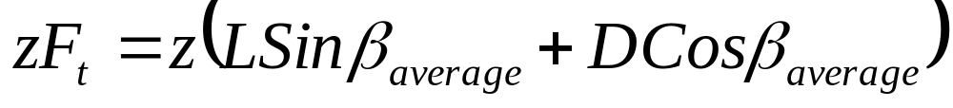
Mean Diameter Cascade & Tangential Driving Force
F
For z number of Vanes the Total Tangential Force

Slide 17
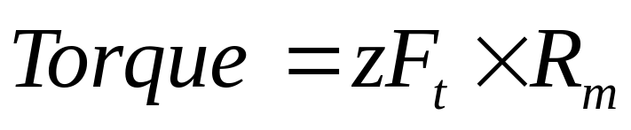
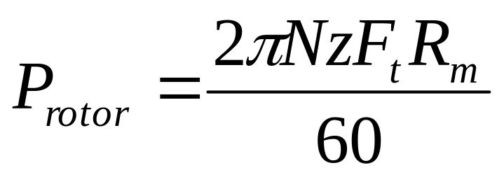
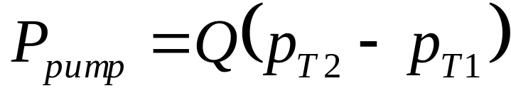
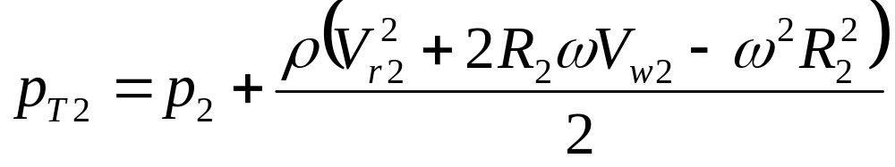
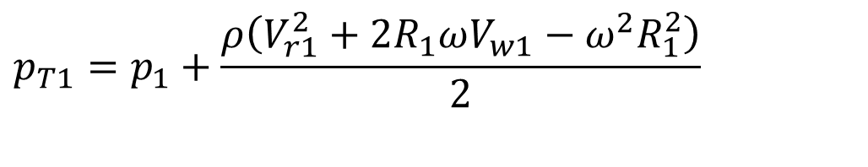
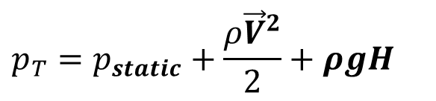
Realization of Euler Torque
For incompressible fluids, Total pressure is defined as:
$$p_{T}=p_{static}+\frac{ρ{\vec{V}}^{2}}{2}+ρgH$$
$$p_{T1}=p_{1}+\frac{ρ\left(V_{r1}^{2}+2R_{1}ωV_{w1}−ω^{2}R_{1}^{2}\right)}{2}$$

Slide 18
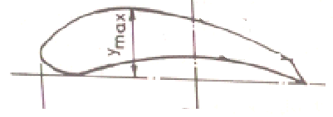
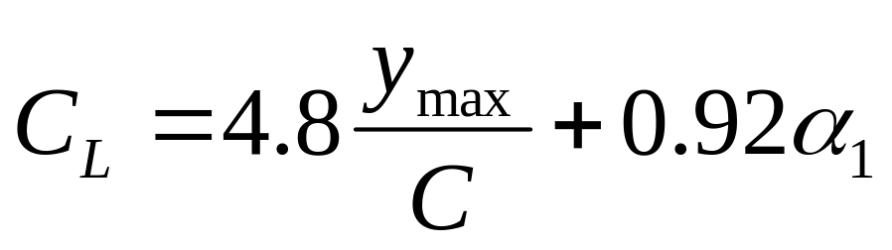
Standard Hydrofoils used for Rotor Blades
C
For NACA 428, 682, 364 & 480

Slide 19
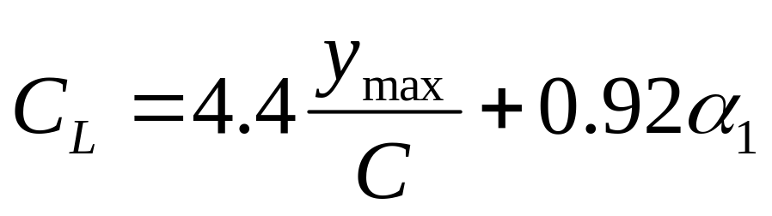

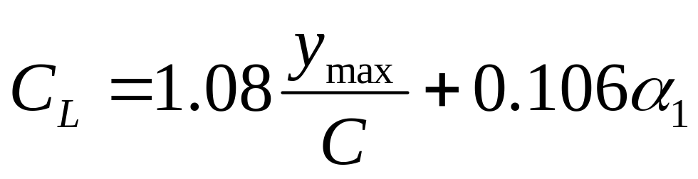
Standard Hydrofoils used for Rotor Blades
For NACA 408, 490, 436 & 387
For NACA 622, 623, 624 & 384
For NACA 23012

Slide 20
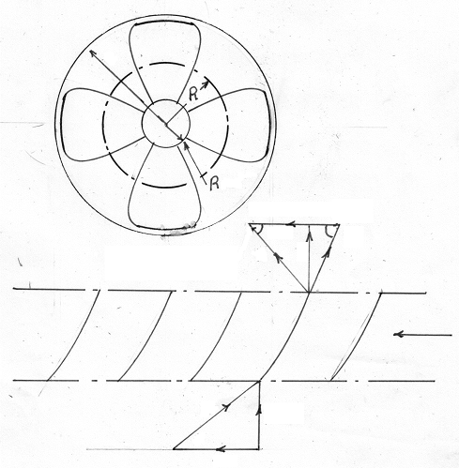

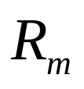
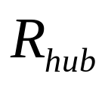
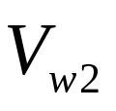

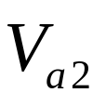
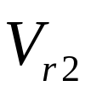
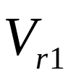
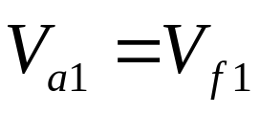


Kinematics of Flow in Cascade
Exit Velocity Triangle
Inlet Velocity Triangle

Slide 21
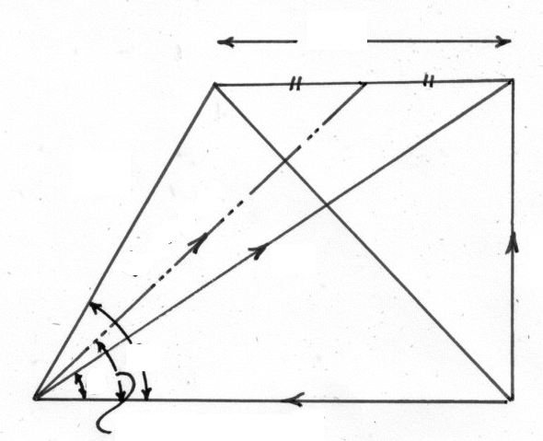
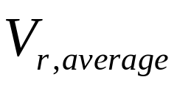
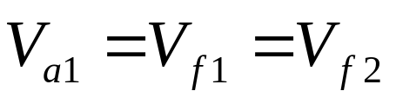
Combined Inlet & Exit Velocity Triangles : Rotor

Slide 22
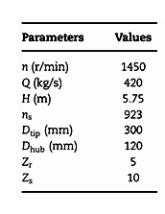
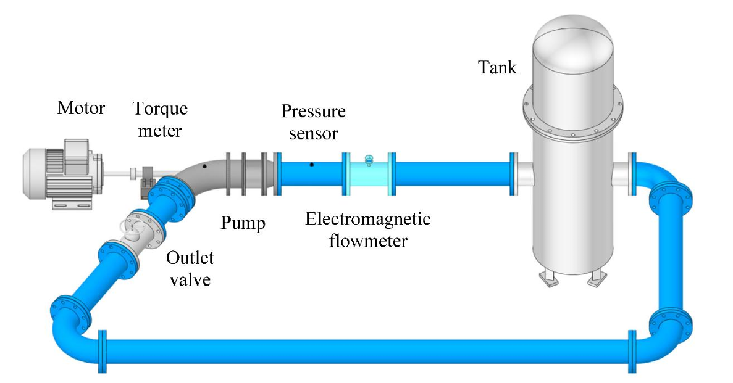
The Pumping System

Slide 23
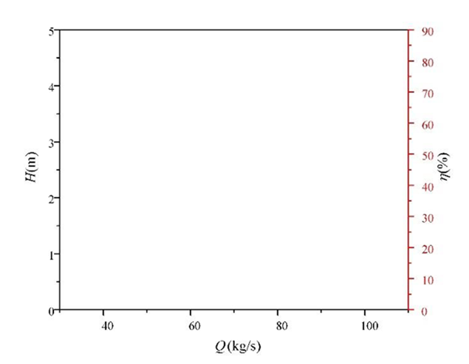
Characteristics of Axial Flow Pump
η
H
Head
Discharge

Slide 24
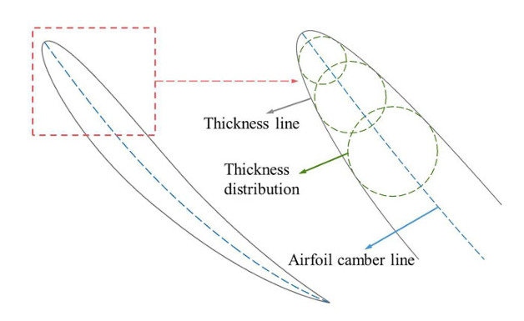
Machine Learning for Axial Flow Pumps
Selection of Efficient Muscles:

Slide 25
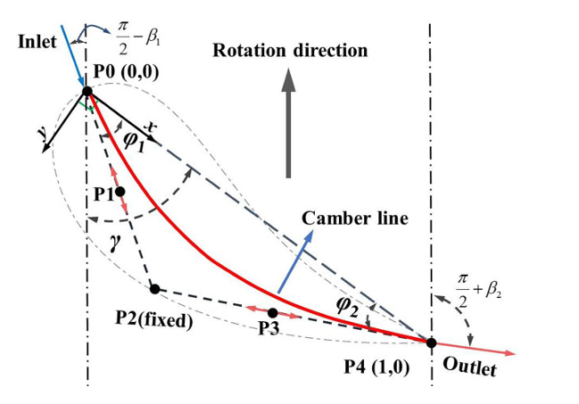
The construction of the airfoil camber line

Slide 26
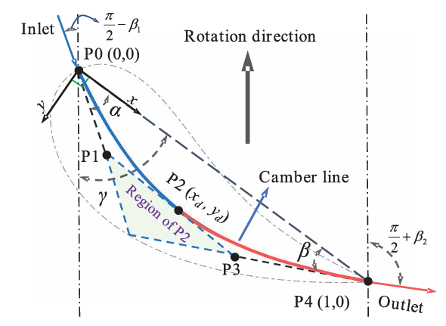
The construction of the airfoil camber line using a segmented Bezier curve

Slide 27
The construction of the airfoil camber line using a segmented Bezier curve
Major Design Variables
x_{d} : Horizontal component of P2
y_{d} Vertical component of P2
γ : Blade setting Angle

Slide 28


Thickness distribution superimposed onto the camber line.
T_{r}: Thickness coefficient
$$±\frac{y_{t}}{L_{c}}=±\frac{T_{r}}{0.2}\left\{\begin{aligned}0.29822773\sqrt{x}−0.127125232x \\ −0.357907906x^{2} \\ +0.291984971x^{3}−0.105174606 x^{4}\end{aligned}\right\}$$

Slide 29

General Characteristics of Rotodynamic Pumps
σ:Solidity

Slide 30


Parametric Set for Optimization

Slide 31

General Characteristics of Rotodynamic Pumps

Slide 32

Machine Learning for Creation of Optimal Rotor Blade

Slide 33

General Characteristics of Rotodynamic Pumps

