Slide 1
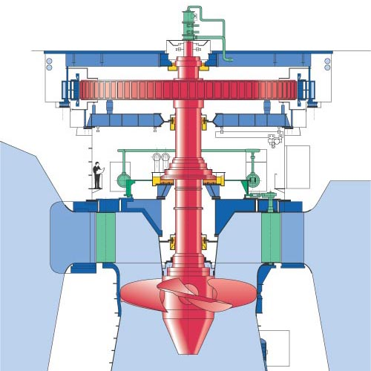
Kaplan Turbine
P M V Subbarao
Professor
Mechanical Engineering Department
Pure Axial Flow with Highest DoR….
Blades Use Aerofoil Theory….

Slide 2


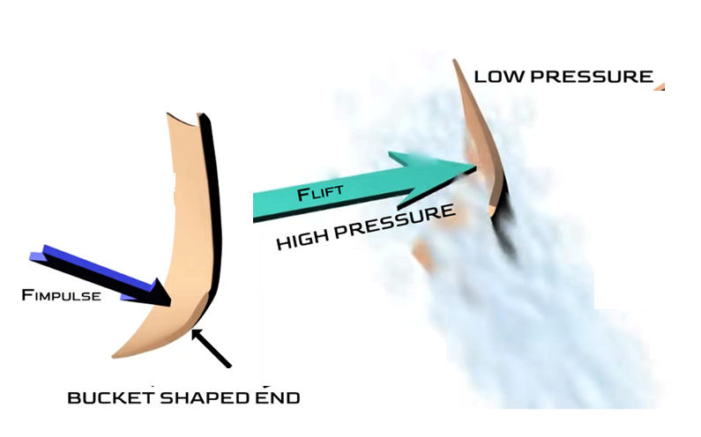
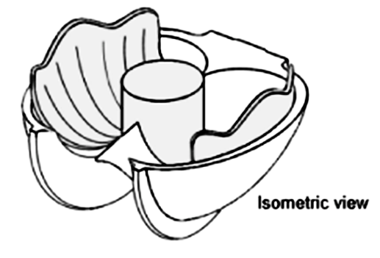
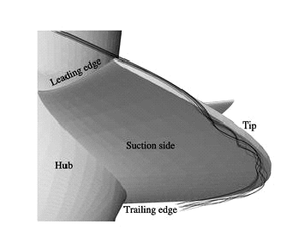
Specific Speed Vs Principle of Momentum Transfer
N_{s} < 55
55 < N_{s} < 450
+
N_{s} > 450

Slide 3
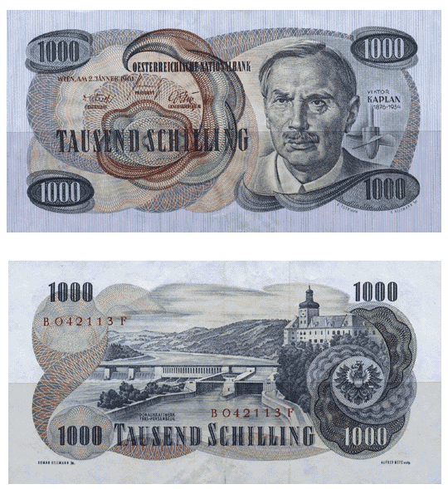
Viktor Kaplan of Austria during 1913 – 1922

Slide 4
Kaplan Turbine
The Kaplan turbine is a great development of early 20th century.
Invented by Prof. Viktor Kaplan of Austria during 1913 – 1922.
The Kaplan is of the propeller type, similar to an airplane propeller.
The difference between the Propeller and Kaplan turbines is that the Propeller turbine has fixed runner blades while the Kaplan turbine has adjustable runner blades.
It is a pure axial flow turbine uses basic aerofoil theory.
The kaplan's blades are adjustable for pitch and will handle a great variation of flow very efficiently.

Slide 5
Kaplan Turbine
They are 90% or better in efficiency and are used in place some of the old (but great) Francis types in a good many of installations.
They are very expensive.
The Kaplan turbine, unlike all other turbines, the runner's blades are movable.
The application of Kaplan turbines are from a head of 2m to 40m.

Slide 6
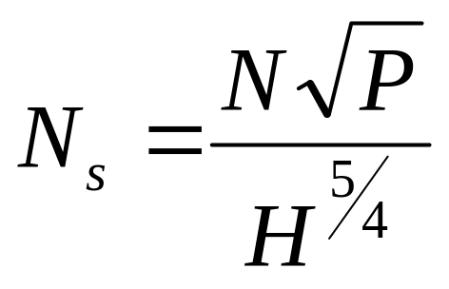
Selection of Kaplan Turbine
MORE ADAPTED TYPE OF TURBINA IN FUNCTION OF THE SPECIFIC SPEED.
Specific Speed in r.p.m. | Turbine type | Jump height in m
From 270 to 500 | Slow Kaplan | 50 to 15
From 500 to 800 | Quick Kaplan | 15 to 5
From 800 to 1100 | Extra-quick Kaplan | Less than 5
P in hp and H in meters.

Slide 7
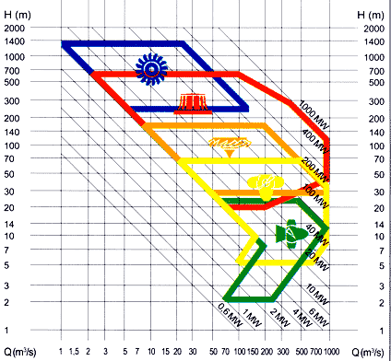
Type of Turbine vs Resource Details

Slide 8
The Fast Machine for A Low Head
U_{b}
V_{wi}
V_{ri}
V_{fi}
V_{ai}
Vwi
U_{b}
V_{fi}
V_{ai}
V_{ri}

Slide 9
The Fast Machine for A Low Head
Vwi
U_{b}
V_{fi}
V_{ai}
V_{ri}
Vwi
U_{b}
V_{fi}
Vwi
U_{b}
V_{ai}
V_{ri}
V_{fi}
V_{ri}
V_{ai}

Slide 10
The Fast Machine for A Low Head
U_{b}
Zero Vwi
V_{ai}
=V_{fi}
V_{ri}

Slide 11
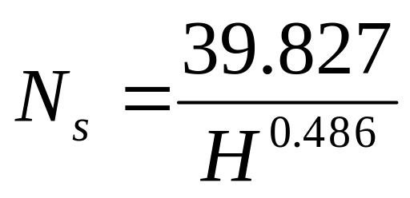
Specific Speed of Kaplan Turbine
Using statistical studies of schemes, F. Schweiger and J. Gregory established the following correlation between the specific speed and the net head for Kaplan turbines:
P in watts.

Slide 12
Ganga Hydro Elecrtic Scheme
Ten Kaplan Turbine Power units along Ganga Canal.
Ranipur, Pathri, Bahadrabad, Salawa, Chitaura, Nirganj, Mohammedpur, Sumera, Palra and Bhola.
Capacity Range: 400 hp to 10,000hp.
Head Range: 5.3 m to 9.6 m

Slide 13
Major Kaplan Plants in Karnataka, India
S.No. | Station | No. Units × unit Size, MW | Design Head | Speed rpm | Design Discharge, Cumecs
1 | LPH | 2 × 27.5 | 29.5 | 200 | 101
2 | Kadra | 3 × 50 | 32.0 | 142.86 | 175.5
3 | Kodasalli | 3 × 40 | 37.0 | 166.67 | 123
4. | Almatti | 1 × 15 5 × 55 | 24.09 | 187.50 | 26.69 115.4

Slide 14
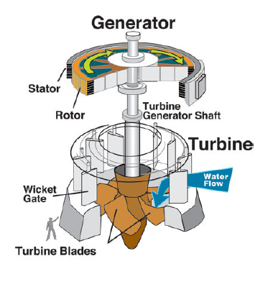
The Schematic of Kaplan Turbine

Slide 15
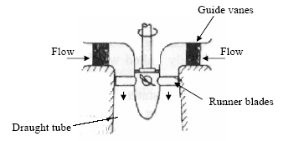

Major Parts of A Kaplan Turbine

Slide 16
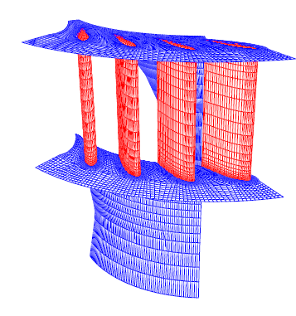
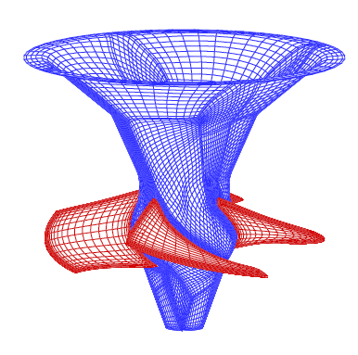
Superior Hydrodynamic Features
Essential for High Efficiency at low Heads
Section of Guide Wheel
Runner

Slide 17
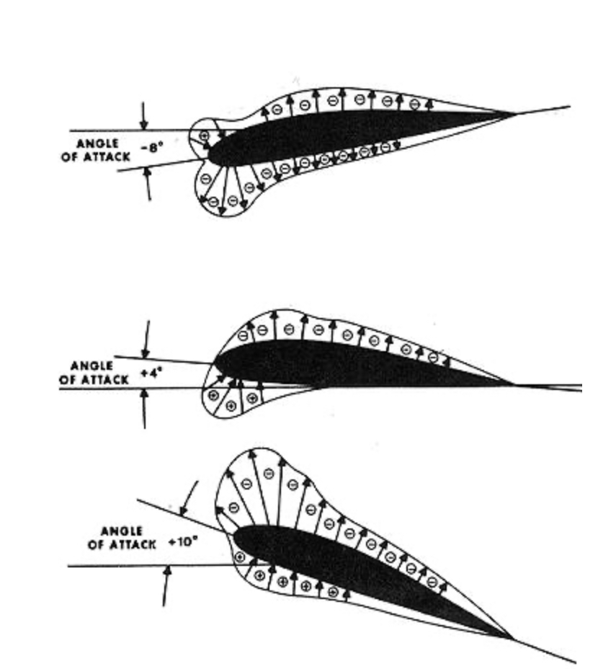
Classification of Kaplan Turbines
The Kaplan turbine can be divided in double and single regulated turbines.
A Kaplan turbine with adjustable runner blades and adjustable guide vanes is double regulated while one with only adjustable runner blades is single regulated.
The advantage of the double regulated turbines is that they can be used in a wider load range.
The double regulated Kaplan turbines can work between 15% and 100% of the maximum design discharge;
the single regulated turbines can only work between 30% and 100% of the maximum design discharge.

Slide 18
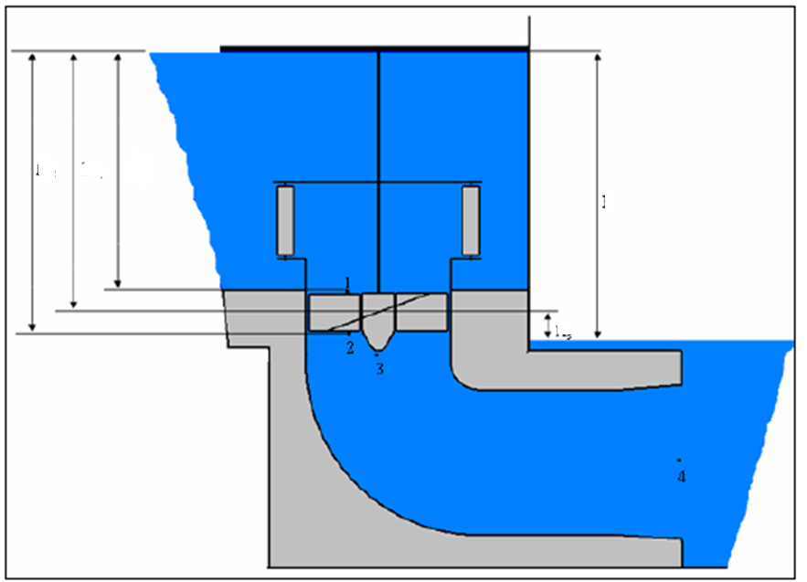
Hydraulic Energy Diagram
H_{m}
H_{re}
H_{ri}
H_{total}
H_{s}

Slide 19
The suction head
The suction head H_{s} is the head where the turbine is installed;
if the suction head is positive, the mean line of turbine is located above the trail water;
H_{s}

Slide 20
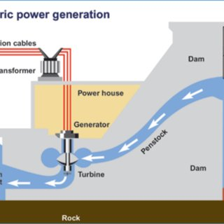
The suction head
If the suction head is negative, the mean line of turbine is located under the trail water.
Cavitation is an important consideration for design of Kaplan turbine for low heads.

Slide 21
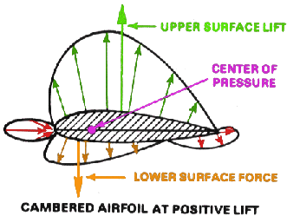
CAVITATION
Cavitation occurs especially at spots where the pressure is low.
In the case of a Kaplan turbine, the inlet of the runner is quite susceptible to it.
At parts with a high water flow velocity cavitation might also arise.
The major design criteria for blades is : Avoid Cavitation.
First it decreases the efficiency and causes crackling noises.
The main problem is the wear or rather the damage of the turbine’s parts such as the blades.

Slide 22
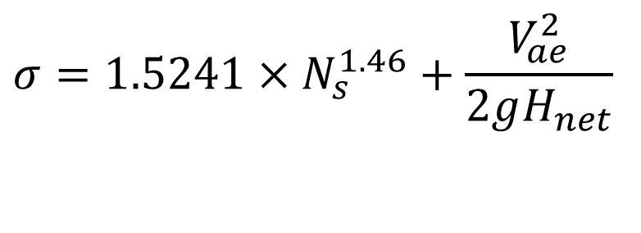
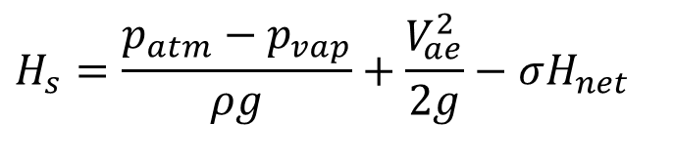
The suction head
To avoid cavitation, the range of the suction head is limited.
The maximum allowed suction head can be calculated using the following equation:
$$H_{s}=\frac{p_{atm}−p_{vap}}{ρg}+\frac{V_{ae}^{2}}{2g}−σH_{net}$$
$$σ=1.5241×N_{s}^{1.46}+\frac{V_{ae}^{2}}{2gH_{net}}$$

Slide 23
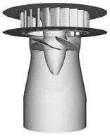
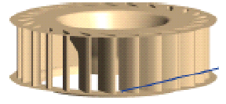
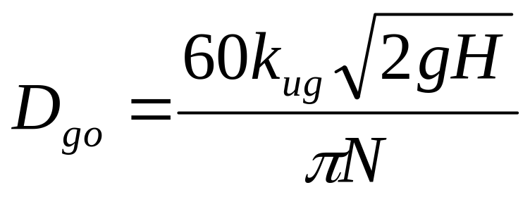
Design of Guide Wheel
D_{go}
k_{ug} 1.3 to 2.25 : Higher values for high specific speeds
Number of guide vanes : 8 to 24 : Higher number of vanes for large diameter of guide wheel.

Slide 24
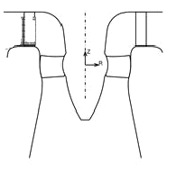
Outlines of Kaplan Runner
a
b
Guide Vanes
Whirl Chamber
The space between guide wheel outlet and kaplan runner is known as Whirl Chamber.
a=0.13 D_{runner} & b=0.16 to 0.2 D_{runner}.

Slide 25
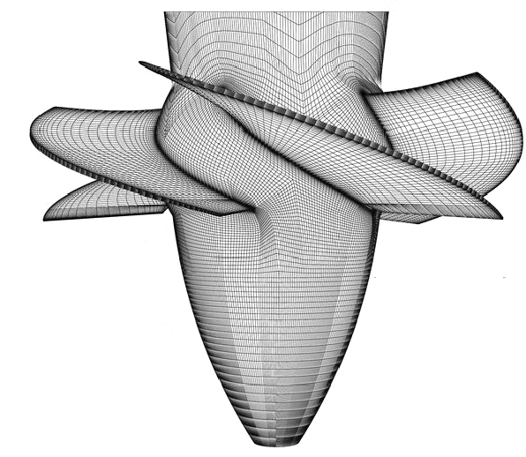
Design of Kaplan Runner
D_{runner}
D_{hub}

Slide 26
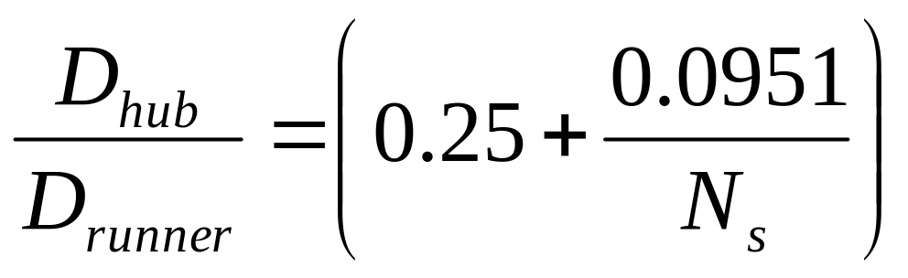
Hub diameter
The hub diameter D_{i} can be calculated with the following equation:

Slide 27
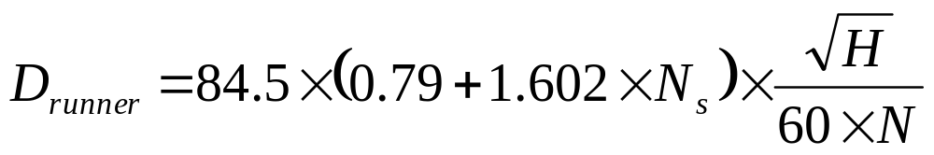
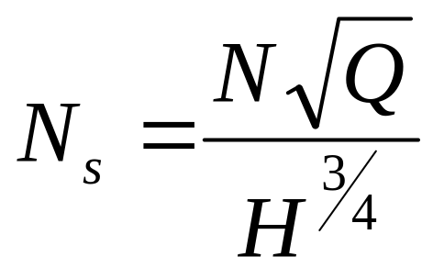
Runner Diameter
The runner diameter can be calculated by the following equation:

Slide 28
Hydrodynamics of Kaplan Blade

Slide 29
Mean Diameter Specifications of A
Kaplan Runner
D_{runner}
D_{hub}

Slide 30
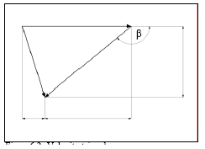
Distortion of the blade under ideal circumstances
The velocity triangles, which occur on the blade, play a significant role in determining its distortion.
U_{wheel}
V_{fi}
V_{ai}
V_{ri}

Slide 31
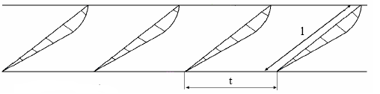

Details of Blade Arrangement
U_{wheel}
V_{ai}
V_{ri}
V_{fi}
U_{wheel}
V_{ae}
V_{re}

Slide 32
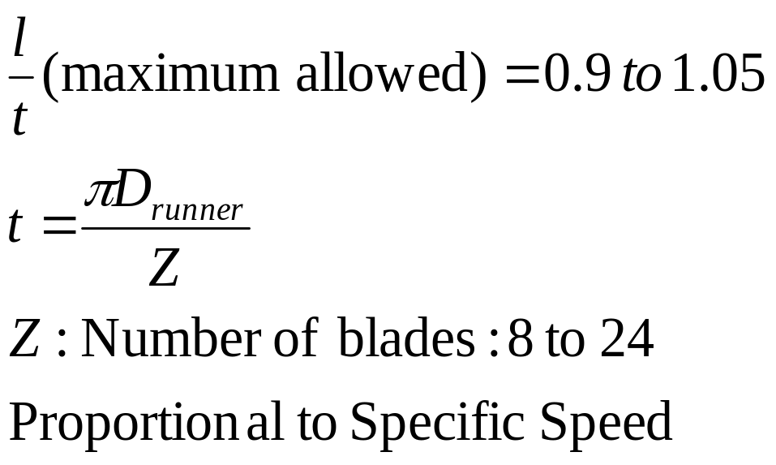
Details of Blade Arrangement

Slide 33
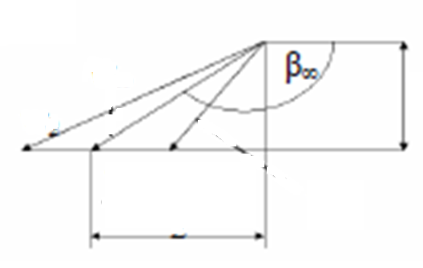
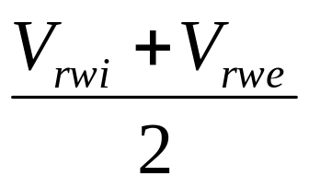
Method for Real Kaplan
Define Half Travel Point of a fluid particle as
The angles, however, are not 100% accurate. To get the exact angles of the distortion the “Tragflügletheorie” has to be considered
V_{fi}=V_{fe}
V_{re}
V∞
V_{ri}

Slide 34
The “Tragflügeltheorie” at Half Travel Point
The “Tragflügeltheorie” was developed by Ludwig Prandtl.
According to the “Tragflügeltheorie” :
A lifting force is generated at the blades of the runner due to the configuration of the flow stream and the whirling stream, which occur at the Center of Pressure of blade.
Values such as the lift coefficient and the attack angle δ also play a significant role in the design of the blade.
These coefficients can be determined via model tests.
Using these results the profile, the chord and the exact distortion of the blade can be determined.

Slide 35
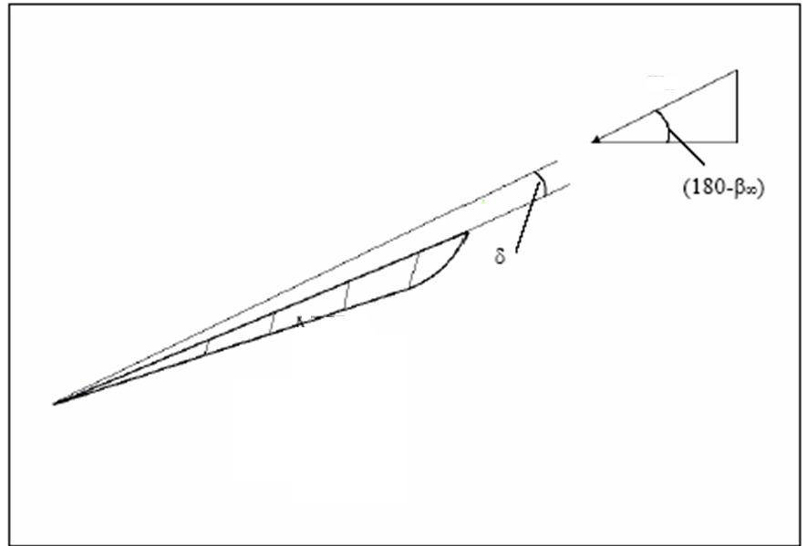
The “Tragflügeltheorie”
V∞
F_{ideal lift}
F_{actual lift}

Slide 36
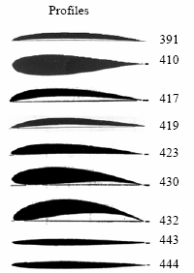
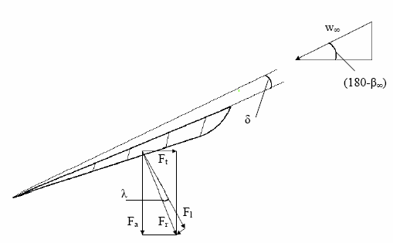
The “Tragflügeltheorie”
V_{ri}

Slide 37
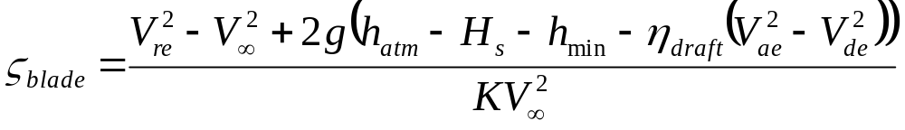
Characteristics of Blades
Ideal Blade lift coefficient at each radius:
η_{draft}: Efficiency of draft tube: 0.88 to 0.91
K : Profile characteristic number: 2.6 to 3.0
h_{min}=2.0 – 2.5

Slide 38
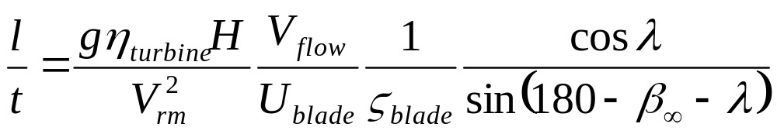
Characteristics of Blades
When the lifting coefficient is known, the sufficiency of ratio l/t can be established as follows:
Allowable values of angle of slip λ
2.5°-- 3°

Slide 39
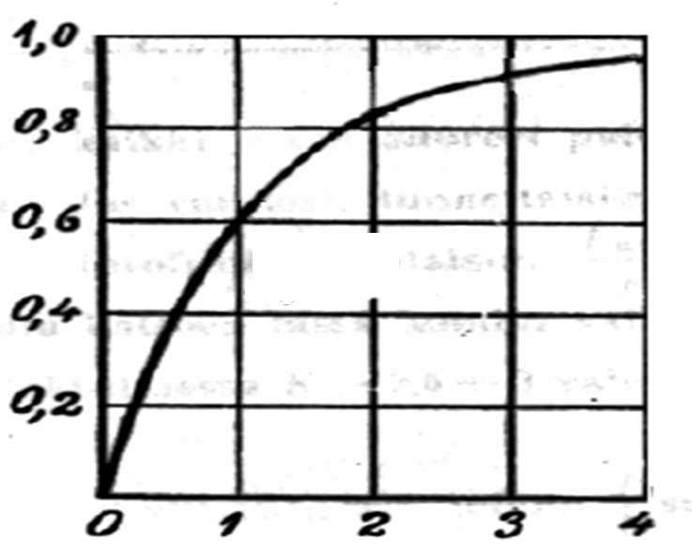
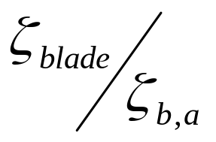
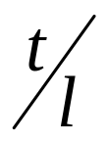
The actual Lifting Coefficient

Slide 40
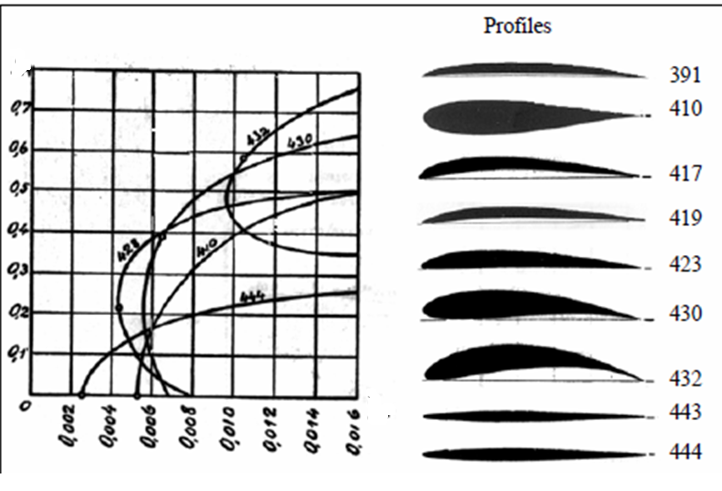
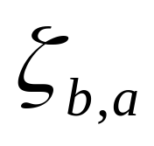
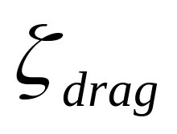
Drag Coefficient

Slide 41
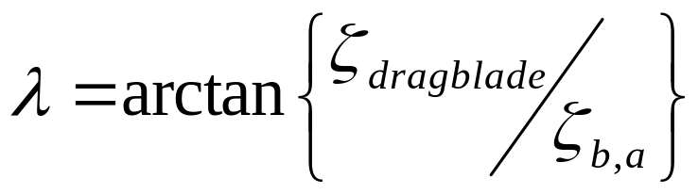
Calculation of Actual Angle of Slip

Slide 42
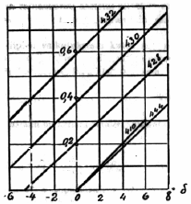
Actual Angle of Attack

Slide 43
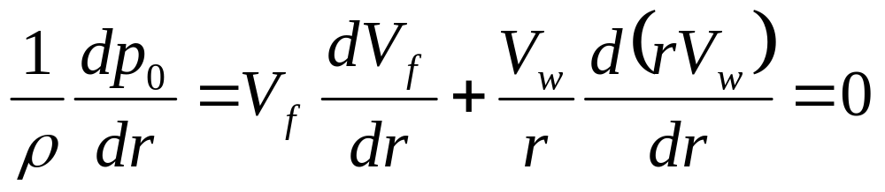
Radial Equilibrium
Radial Equilibrium Equation for Incompressible Fluid Machine

Slide 44
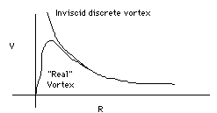
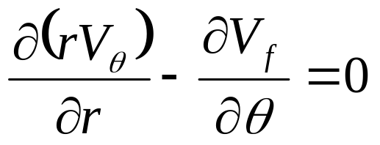
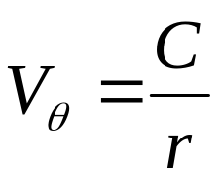
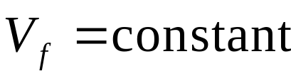
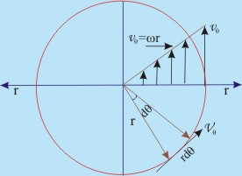


General Rules for Selection of Whirl Component
Free Vortex Whirl:
Forced Vortex Whirl :

Slide 45

Radial Variation Blade Geometry
To define the distortion of the blade, the velocity triangles of at least six different radiuses of the blade are to be determined.
The angle β of each radius gives conclusions on the distortion of the blade.
The angles should be corrected for real hydraulics.

Slide 46


Power Developed by the Runner
Power developed by an infinitesimal section of blade surface

Slide 47

Calculation of Driving & Non-driving Forces

