Slide 1
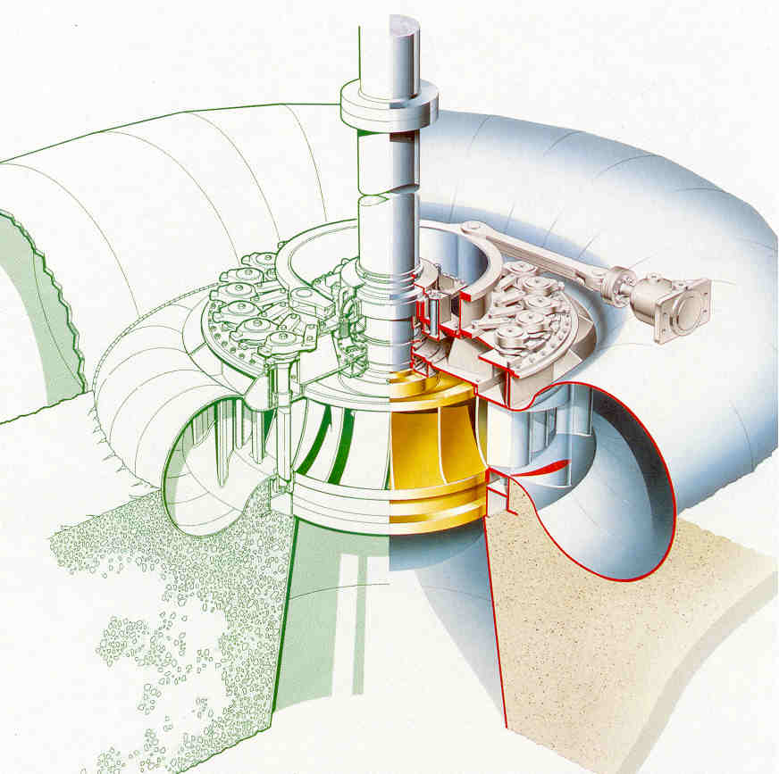

Design Analysis of Francis Turbine’s Organs
P M V Subbarao
Professor
Mechanical Engineering Department
Creation of Efficient Surrounding for the Runner…..

Slide 2


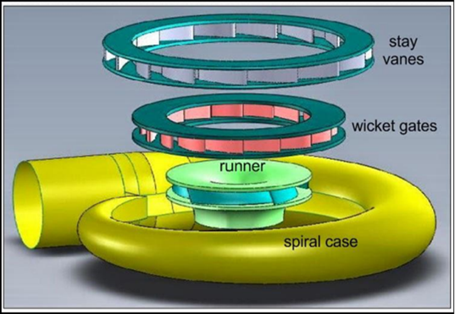
3D Geometric Model of A Francis Turbine

Slide 3
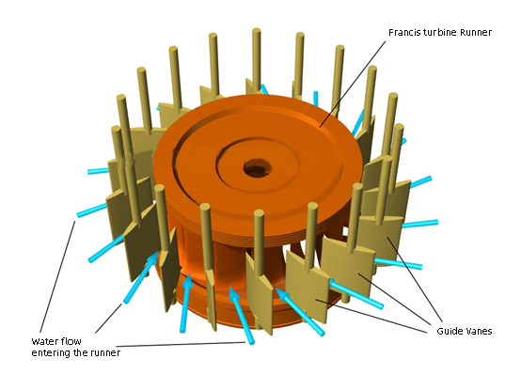
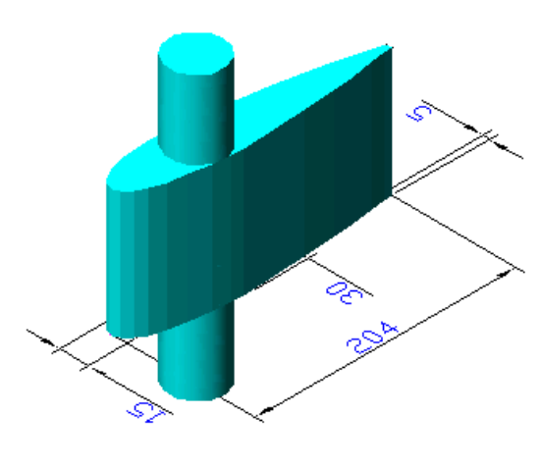
Guide Vanes
The guide vanes are pivoted and can be turned by a suitable governing mechanism to regulate the flow while the load changes.
The guide vanes are also known as wicket gates.
The guide vanes impart a tangential velocity and hence an angular momentum to the water before its entry to the runner.
The guide vanes are constructed using an optimal aerofoil shape, in order to optimize off-design performance.

Slide 4
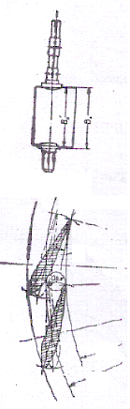
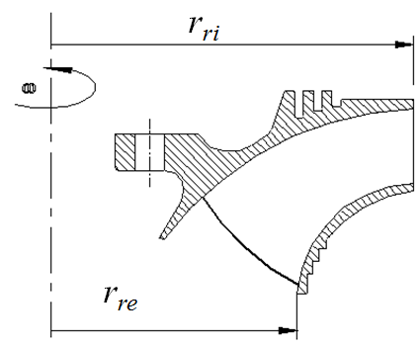
Design of Guide Wheel : Low Specific Speed

Slide 5
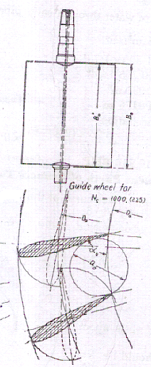
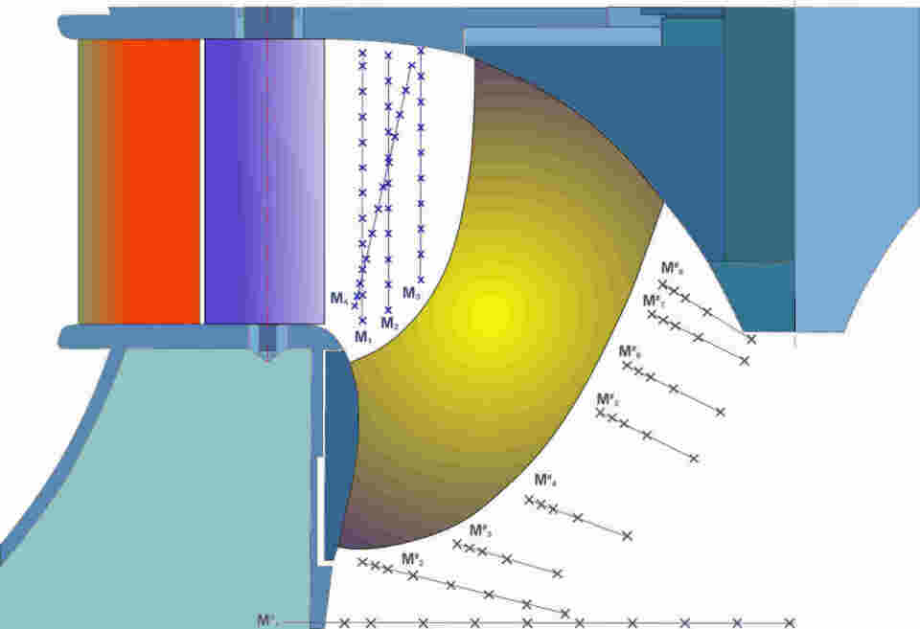
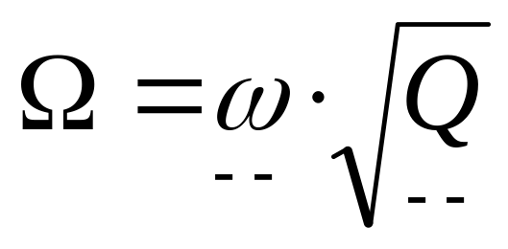
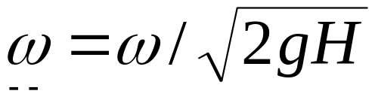
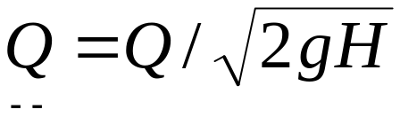
Design of Guide Wheel (Stator): High Specific Speed

Slide 6
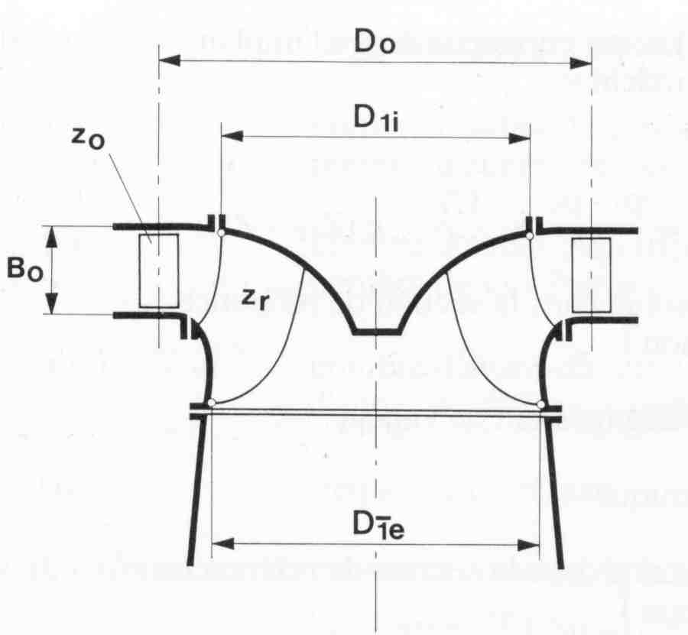
Design of Guide Wheel (Stator): High Specific Speed
D₁
Speed Number
Flow Number
D₂

Slide 7
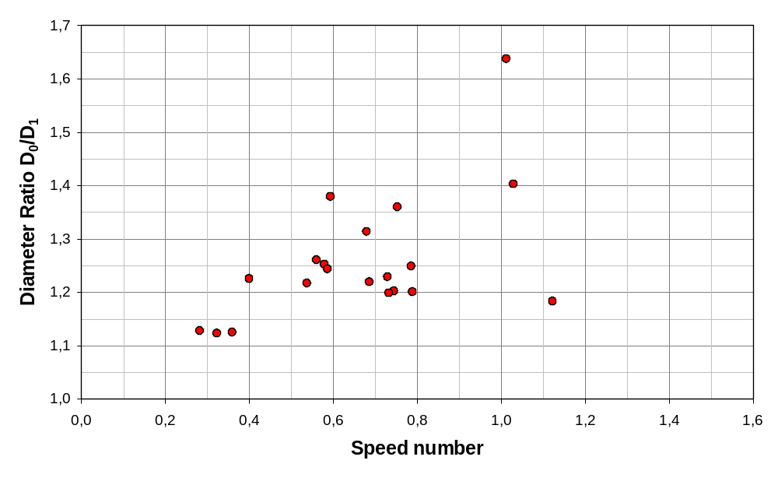
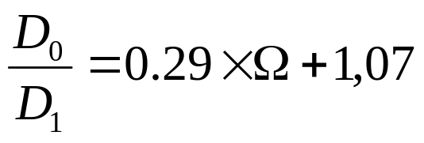
Design of the Guide Vanes
Diameter of guide vane shaft
D₁
D₂

Slide 8
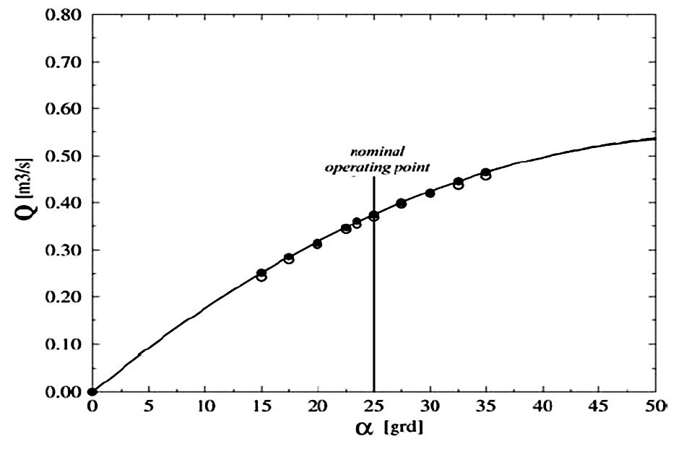
The correlation between the turbine discharge and the guide vane angle.

Slide 9
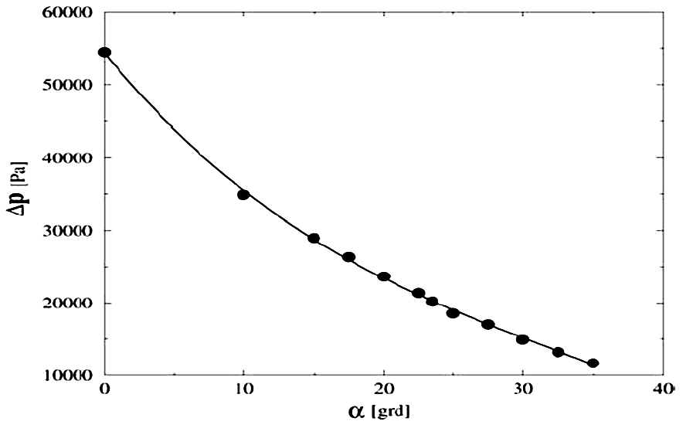
Pressure drop versus Guide Vane angle

Slide 10
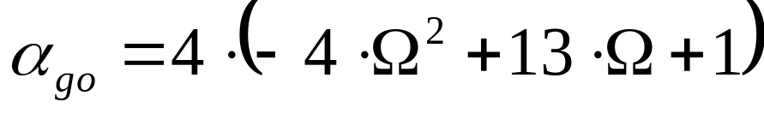
Design of the Guide Vanes
How to choose the guide vane maximum angle α₀ at full load ?
α_{ο}

Slide 11
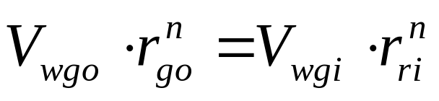
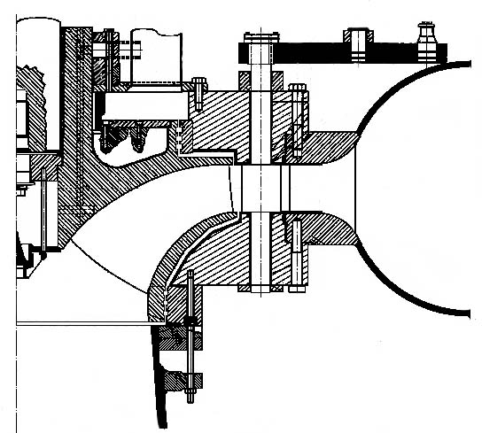
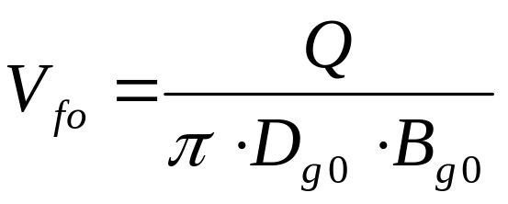
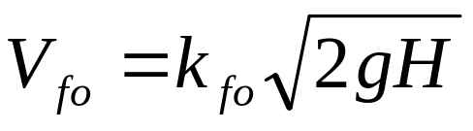
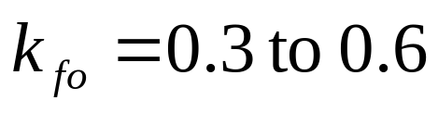

Design of the Guide Vane Outlet Angle
The outlet angle can be calculated by assuming a free vortex from the flow in the gap between the runner and the guide vanes
B_{g0}
r_{ri}
D_{g0}

Slide 12
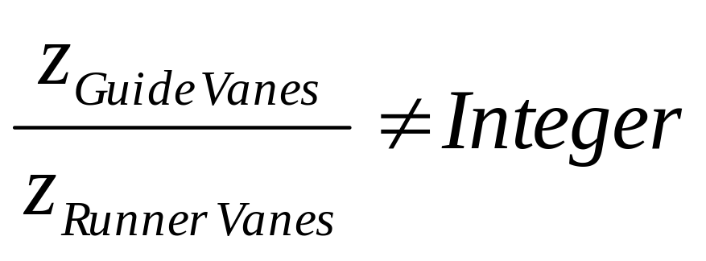
Design of the Guide Vanes
How to choose the number of vanes
The number of guide vanes has to be different from the number of runner vanes.

Slide 13
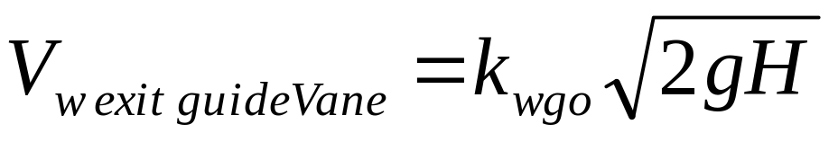
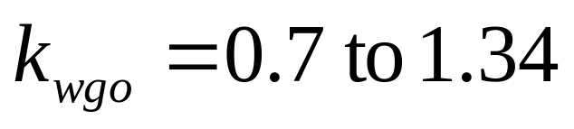
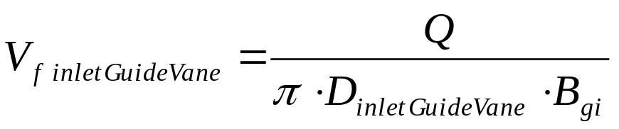
Design Rules for Guide Vane Wheels
Theory of Relatively free Whirling flow:
B_{gi}
B_{si}
The inlet angle can be calculated by assuming a free vortex from the flow coming from the spiral casing
r_{inlet Guide Vane}
r_{inlet Stay Vane}

Slide 14
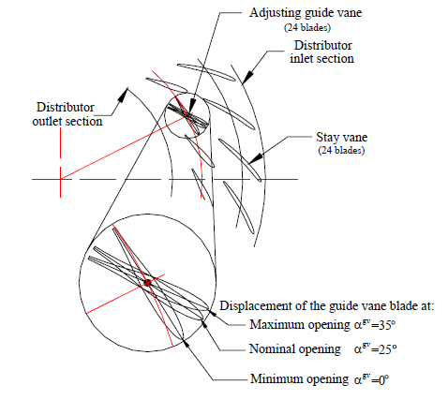
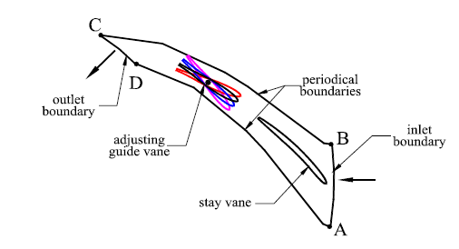
Operational Configurations of Guide Vanes

Slide 15
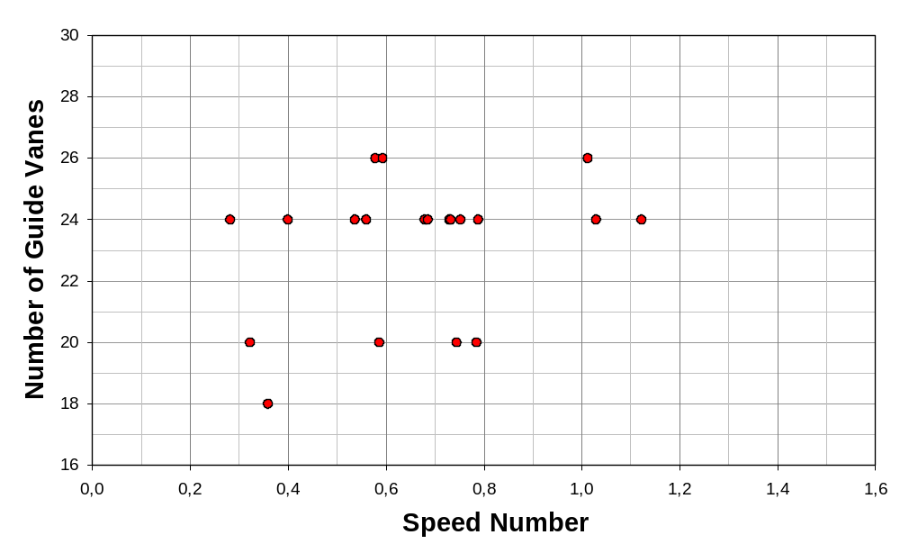
Number of guide vanes

Slide 16
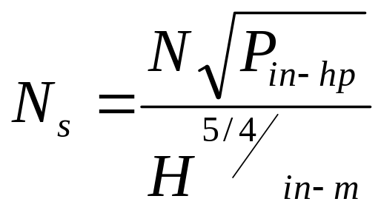
Number of Guide Vanes
N_{s} D_{ge},mm | Z=8 | 10 | 12 | 14 | 16 | 18 | 20 | 24
<200 | <250 | 250 - 400 | 400 - 600 | 600 - 800 | 800 - 1000 | 1000 1250 | 1250 1700 | >1700
>200 | <300 | 300 - 450 | 450 - 750 | 750 - 1050 | 1050 1350 | 1350 1700 | 1700 2100 | >2100

Slide 17
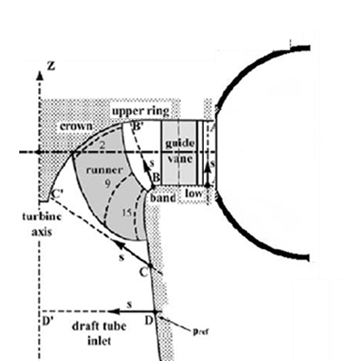
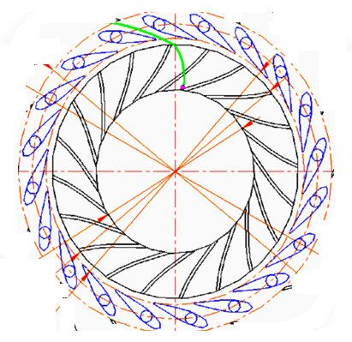
Geometrical Description of A Francis Turbine Parts
Very Low Head & High DoR >75%

Slide 18
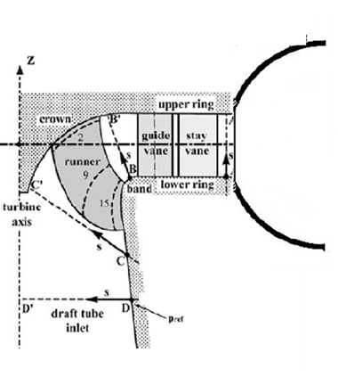
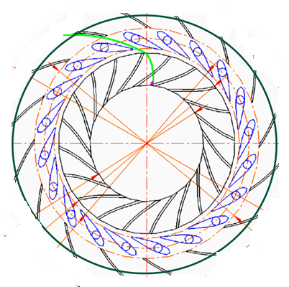
Geometrical Description of A Francis Turbine Parts
Medium Head & Normal DoR 45% to 65%

Slide 19
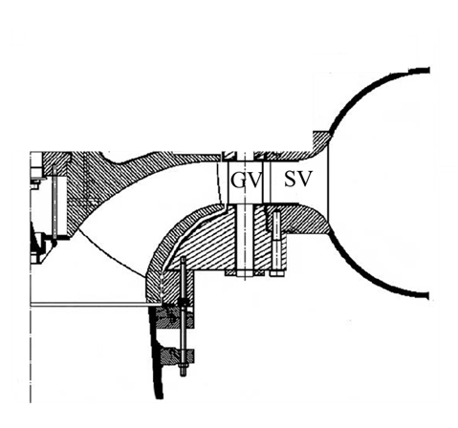
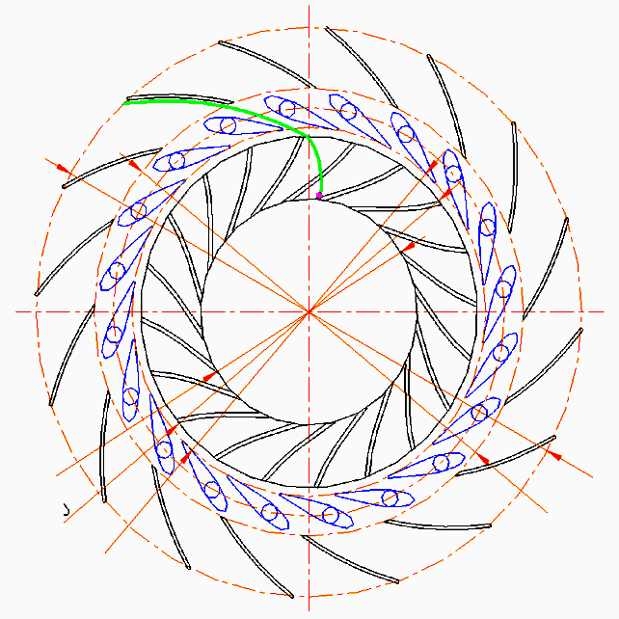
Geometrical Description of A Francis Turbine Parts
High Head & Low DoR < 40%

Slide 20
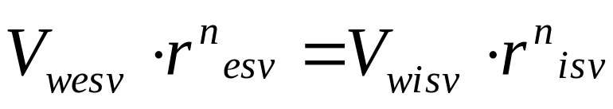
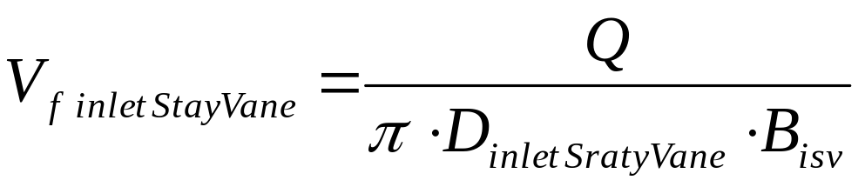
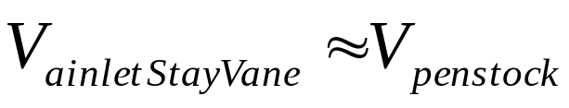
Design Rules for Stay Vanes
Theory of Relatively Whirling flow:
B_{esv}
B_{isv}
r_{exit stay Vane}
r_{inlet Stay Vane}

Slide 21
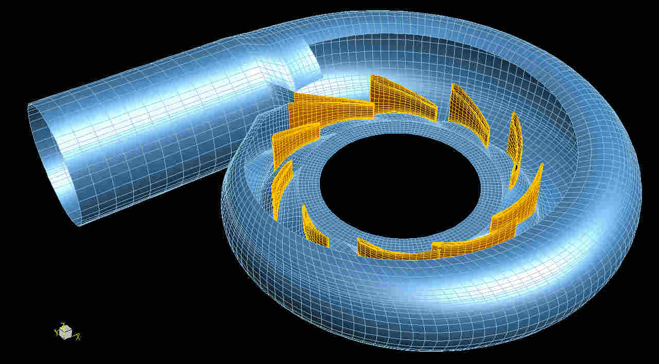
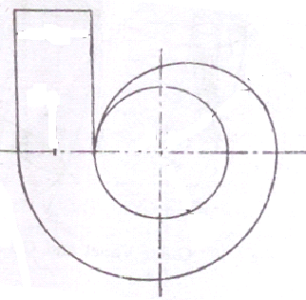
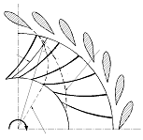
Design of Spiral Casing
d_{penstock}
R_{casing}
Q
How to select Q ?
R_{isv}

Slide 22
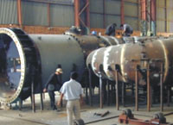
Spiral Casing for 35 MW Vertical Francis Turbine

Slide 23
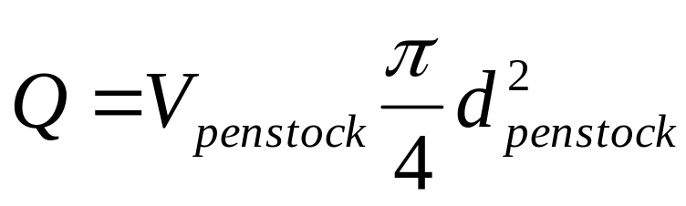
Design of Spiral Casing
d_{penstock}
R_{casing}
Q
Select a suitable value of discharge per unit: Q
R_{isv}
But maximum allowable value is 10 m/s
Maximum allowable head loss in Penstock =2 to 4% of available head

Slide 24
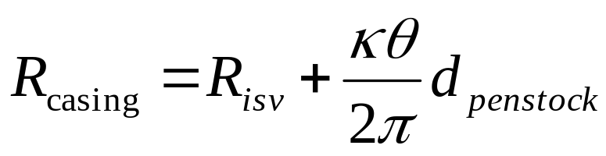
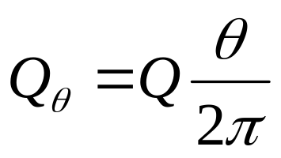
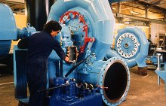
Segmental Design of Spiral Casing
At any angle θ, the radius of casing is:
A full spiral is generally recommended for high head 300m, semi-spiral is recommended for low head < 50m.
In general κ =1.0, however corrected using CFD.

Slide 25
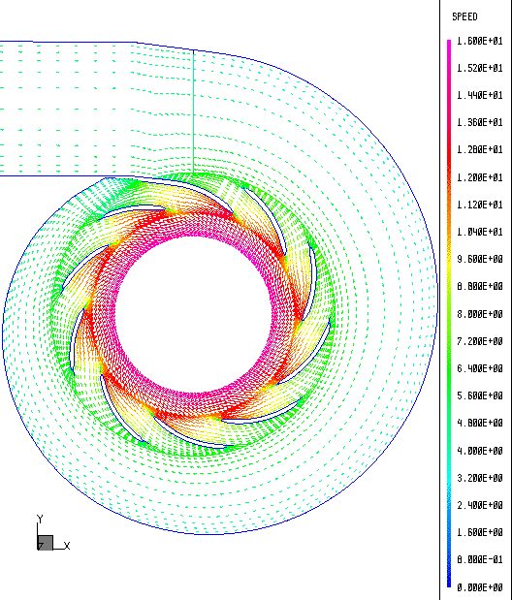

Flow Distribution Analysis of Casing
Stay vanes or Guide vanes

Slide 26
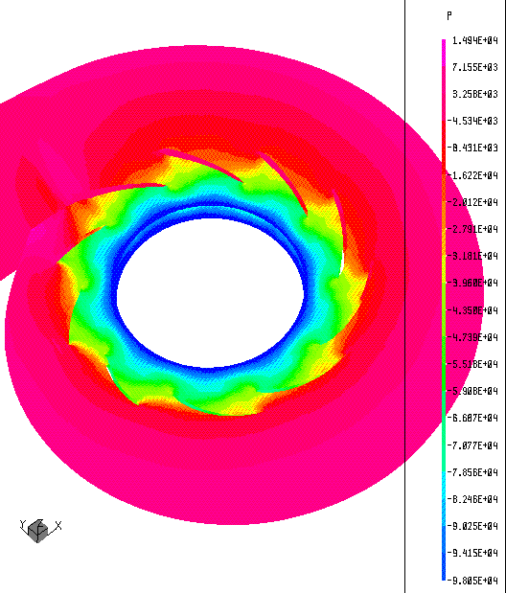
Static Pressure Distribution in Casing.

Slide 27
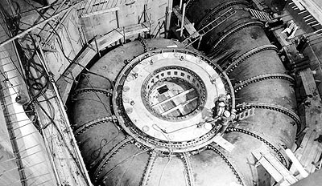

Mega Civil Works for Mechanical Power Generation

Slide 28

Complete Francis Model

Slide 29


Meshing of Fluid Domain

Slide 30

Problem Definition in CFD

Slide 31


Blade Loading & Torque

Slide 32

Relative Performances of Components

Slide 33

Cause for Runner Losses

Slide 34

Cause for Runner Losses

Slide 35

Modification of Hydrofoil Shape

Slide 36

Improvement of the Runner Design using CFD
Classical Theory

