Slide 1
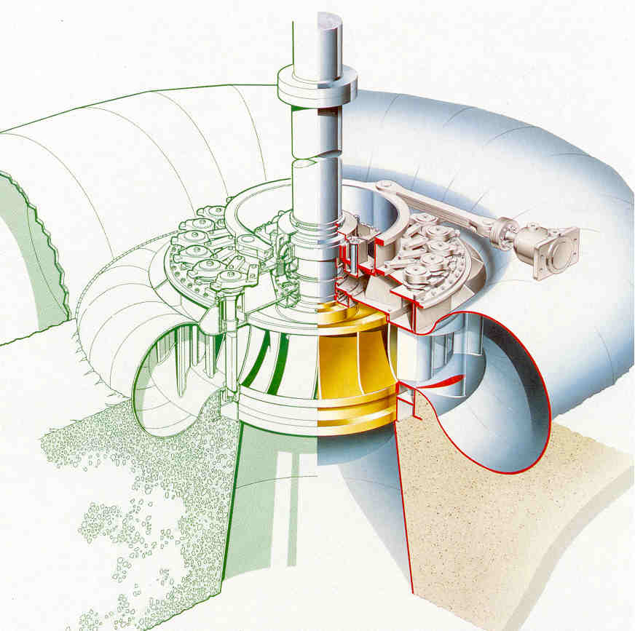

Design Analysis of Francis Turbine Runner
P M V Subbarao
Professor
Mechanical Engineering Department
Selection of Correct Geometrical Features to Infuse DoR & Mixed Flow …..

Slide 2
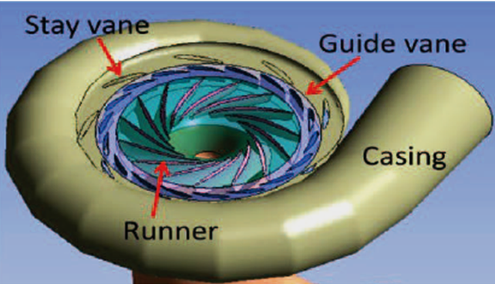


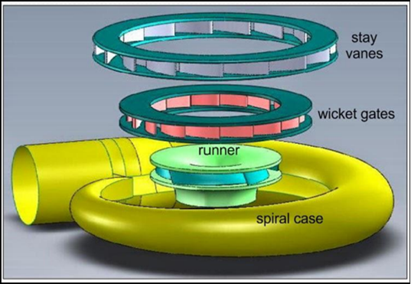
3D Geometric Model of A Francis Turbine

Slide 3
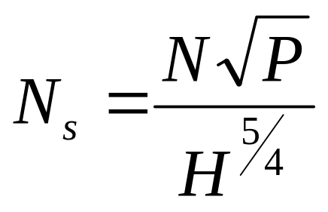
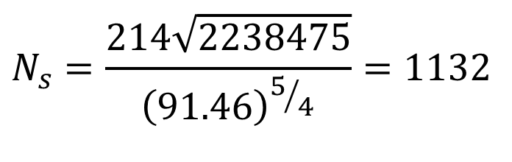
Indian Francis Turbine Plant
Srisailam Reservoir and Nagarjuna Sagar Reservoir are the two major water storage reservoirs built across the Krishna River in Andhra Pradesh.
Srisailam Hydroelectric Power Station is installed near the tow of the Srisailam dam with an installed power capacity of 1670 MW, which is one of the biggest HPS in India.
Head available: 91.46 m
Specific speed in rpm
P in hp & H in meters
$$N_{s}=\frac{214\sqrt{2238475}}{{\left(91.46\right)}^{5/4}}=1132$$
2,238,475 hp

Slide 4
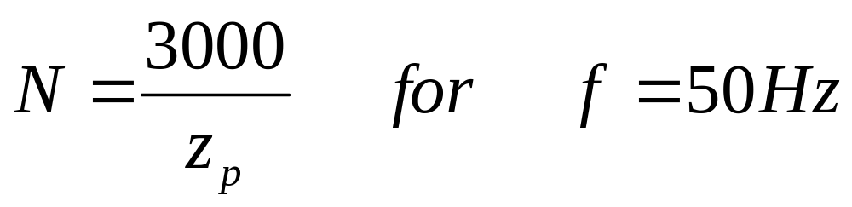
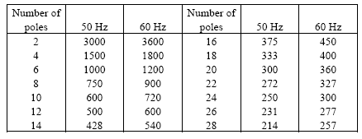
Selection of Speed of A Turbo Machine
Z_{p} : Number of pairs of poles of the generator

Slide 5
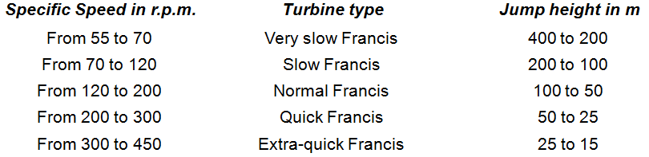
Sizing of Hydropower Plant
Specific speed in rpm
P in hp & H in meters

Slide 6
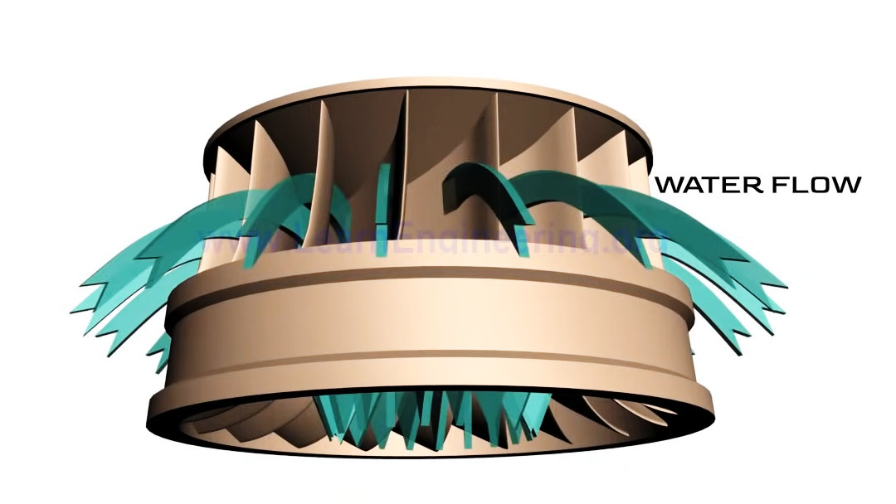
Hydrodynamic Theory of Runner

Slide 7
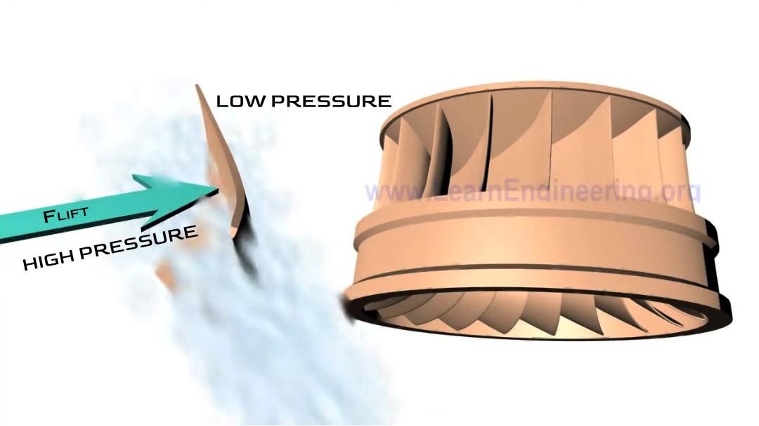
Hydrodynamic Theory of Runner

Slide 8
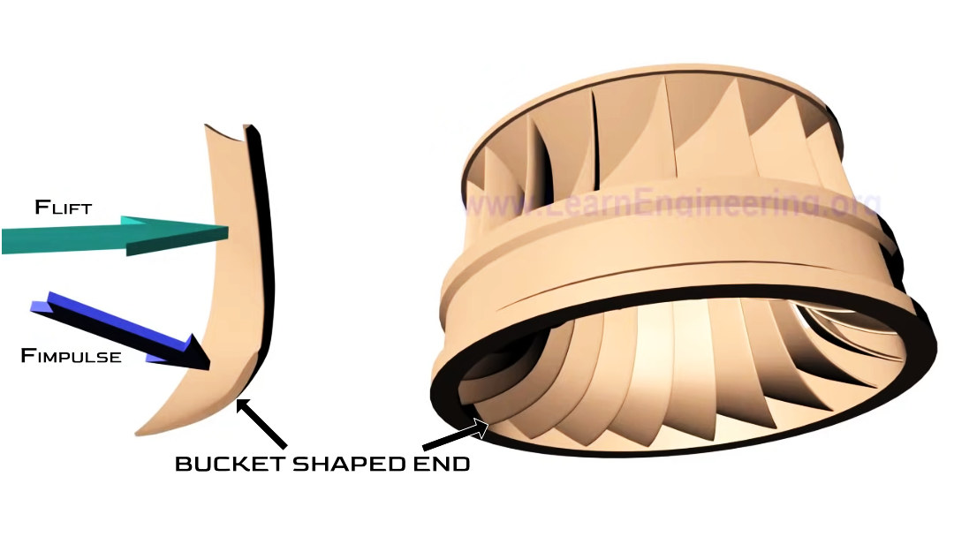
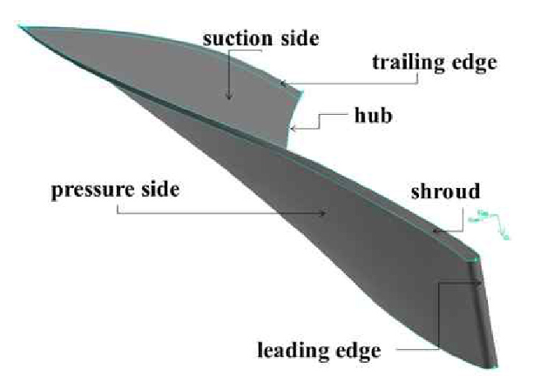
Hydrodynamic Theory of Runner

Slide 9
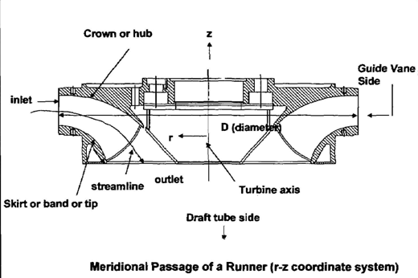
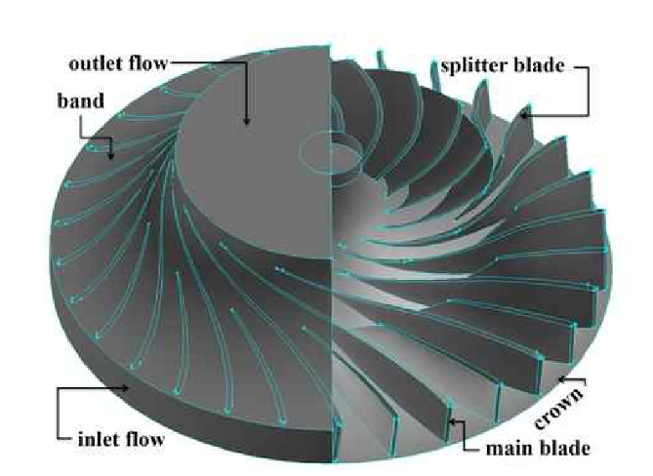
Sectional View of The Runner

Slide 10
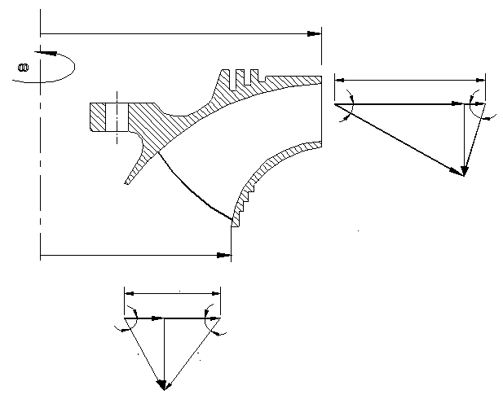
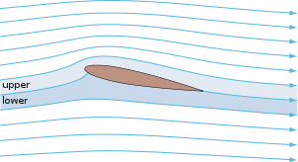
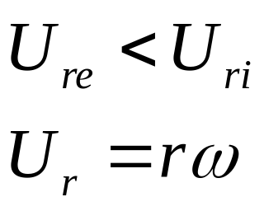
Representative Inlet Velocity triangles
r_{ri}
U_{ri}
V_{wi}
β_{i}
α_{i}
V_{fi}
V_{ri}
V_{ai}
r_{re}
U_{re}
V_{we}
α_{e}
β_{e}
V_{fe}
V_{ae}
V_{re}

Slide 11
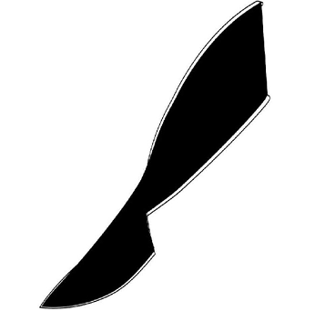
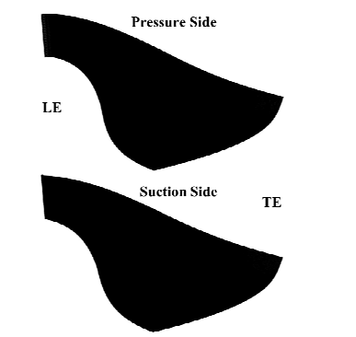
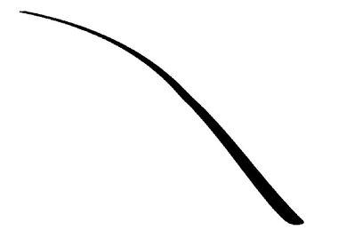
Camber Surface + Hydrofoil= 3D Blade

Slide 12
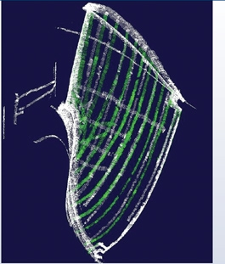
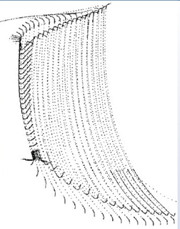
CAD Model of Runner Blade

Slide 13
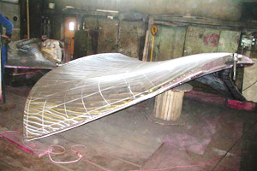
Francis Runner Blade

Slide 14
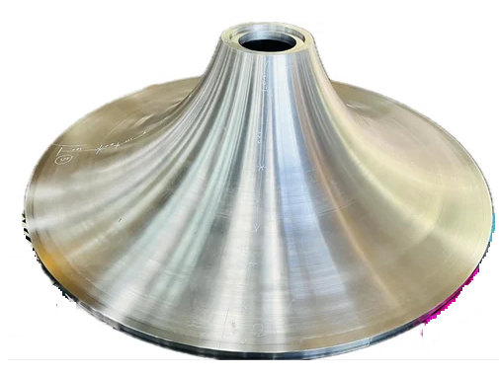
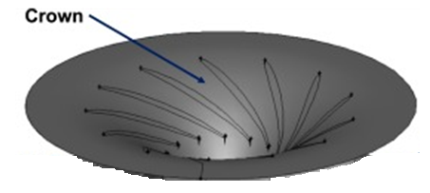
Dissection of A Francis Turbine Runner

Slide 15
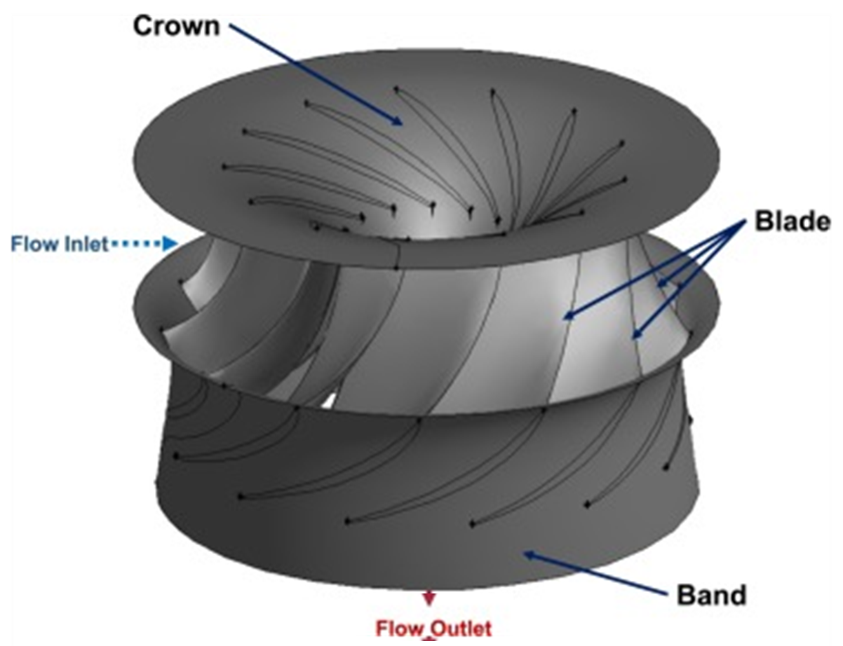
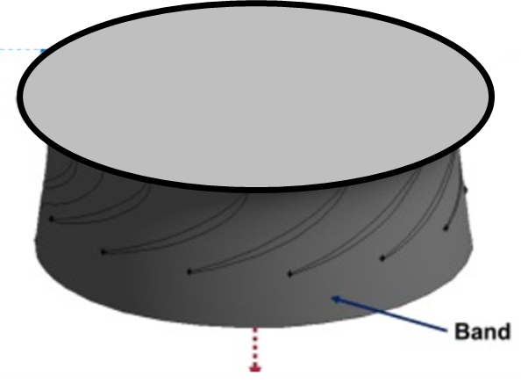
Wooden Model Reference Model Practice

Slide 16
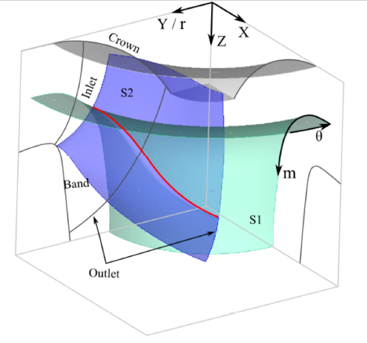
CAD Model of Periodic Section of A Runner

Slide 17
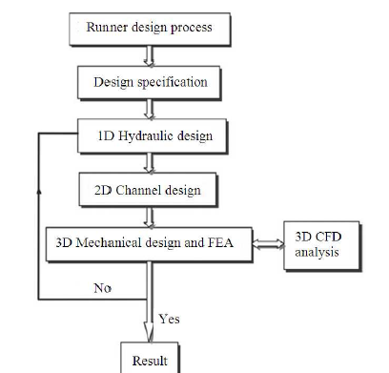
Flow Chart for Runner Design

Slide 18
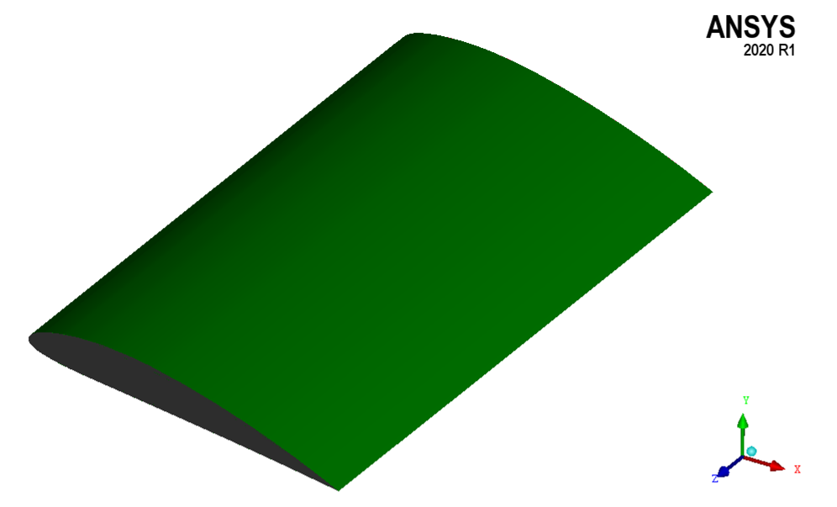
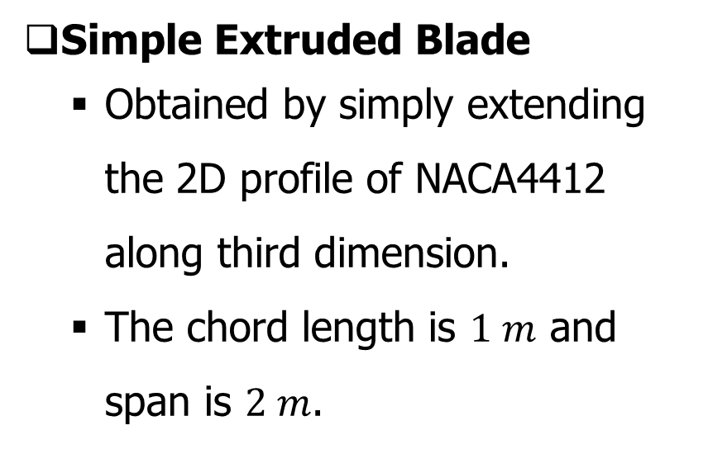
Design and Description of Blades
Simple Extruded Blade
  Obtained by simply extending the 2D profile of NACA4412 along third dimension.
  The chord length is $1 m$ and span is $2 m$.
Simple extruded blade

Slide 19
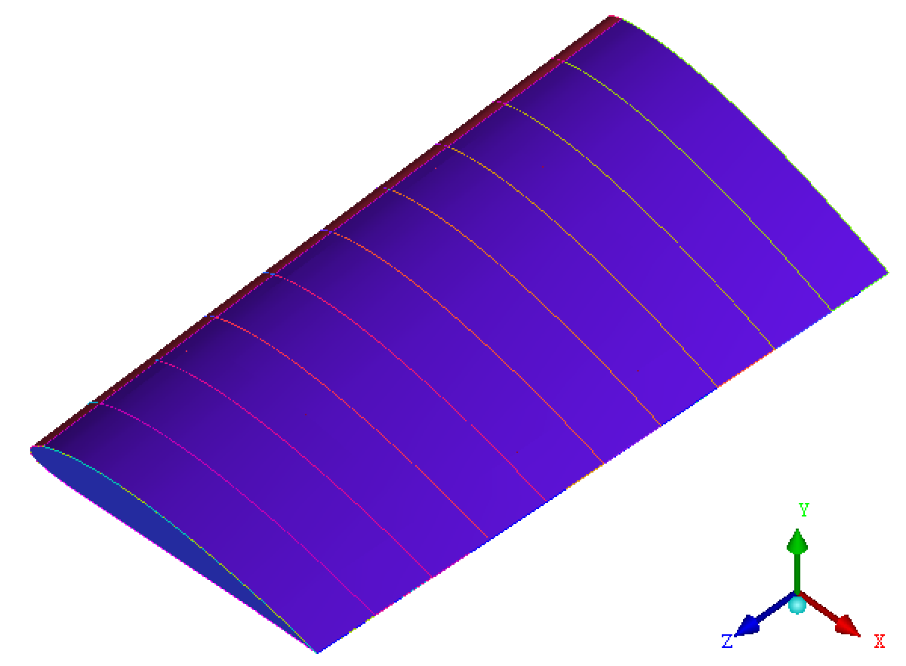
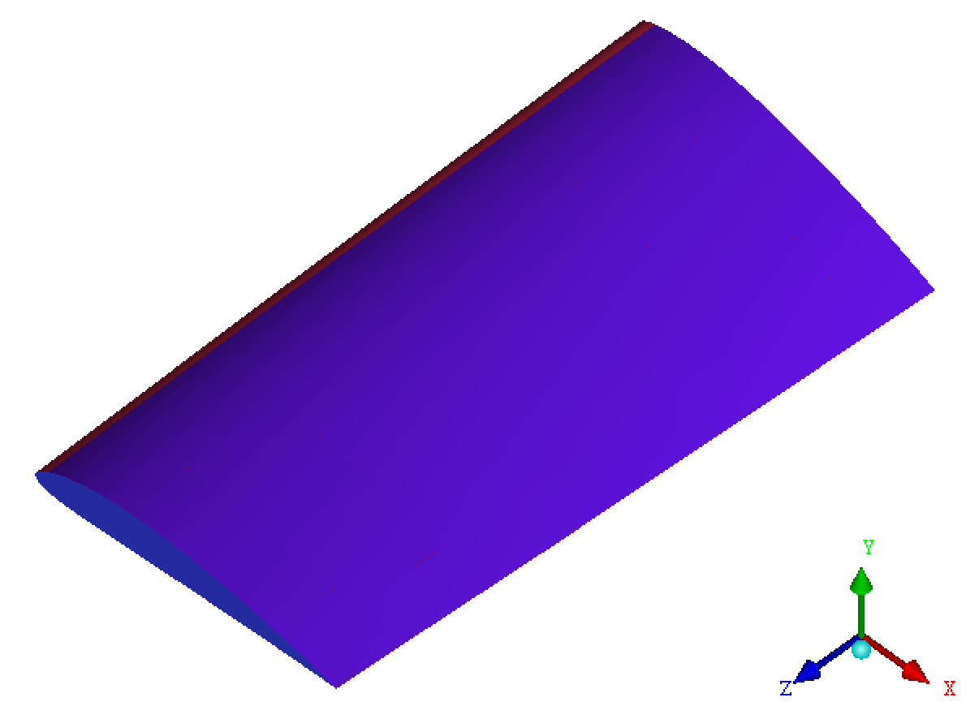
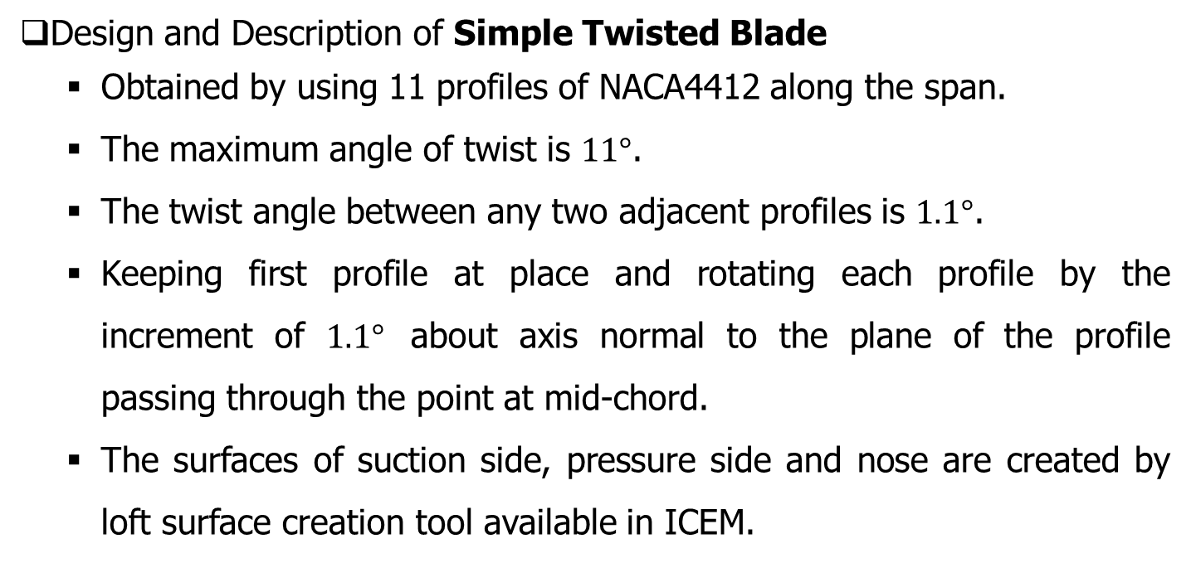
Design and Description of Blades
Design and Description of Simple Twisted Blade
  Obtained by using 11 profiles of NACA4412 along the span.
  The maximum angle of twist is $11°$.
  The twist angle between any two adjacent profiles is $1.1°$.
  Keeping first profile at place and rotating each profile by the increment of $1.1°$ about axis normal to the plane of the profile passing through the point at mid-chord.
  The surfaces of suction side, pressure side and nose are created by loft surface creation tool available in ICEM.
Designed simple twisted blade
Figure showing 11 profiles along the span of simple twisted blade

Slide 20
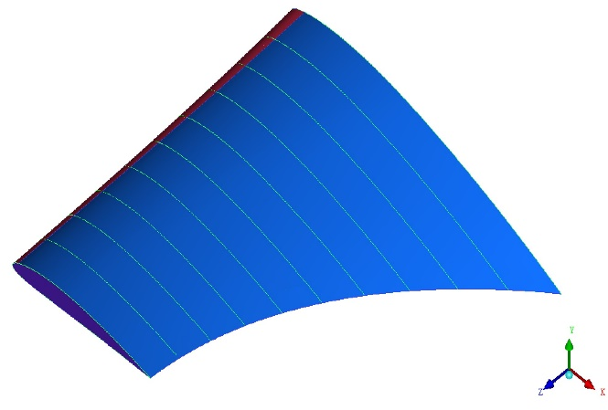
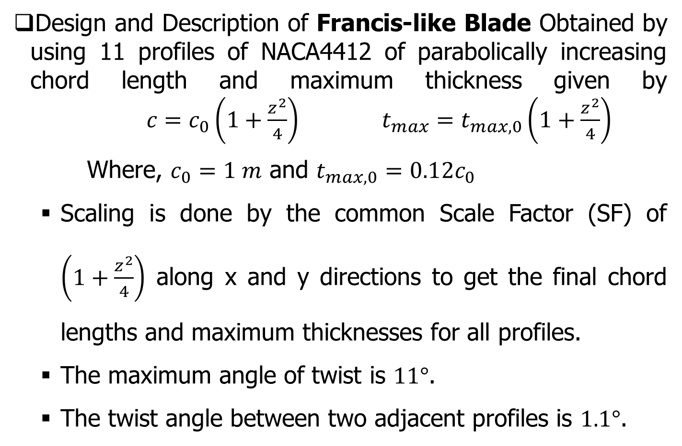
Design and Description of Blades
Design and Description of Francis-like Blade Obtained by using 11 profiles of NACA4412 of parabolically increasing chord length and maximum thickness given by $c=c_{0}\left(1+\frac{z^{2}}{4}\right)$ $t_{max}=t_{max,0}\left(1+\frac{z^{2}}{4}\right)$
  Where, $c_{0}=1 m$ and $t_{max,0}=0.12c_{0}$
  Scaling is done by the common Scale Factor (SF) of $\left(1+\frac{z^{2}}{4}\right)$ along x and y directions to get the final chord lengths and maximum thicknesses for all profiles.
  The maximum angle of twist is $11°$.
  The twist angle between two adjacent profiles is $1.1°$.
Figure showing 11 profiles along the span of Francis-like blade

Slide 21
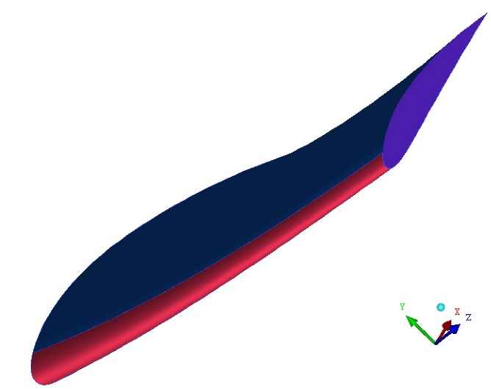
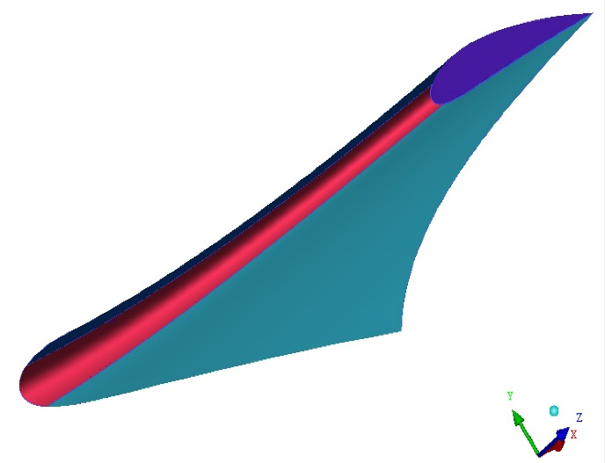
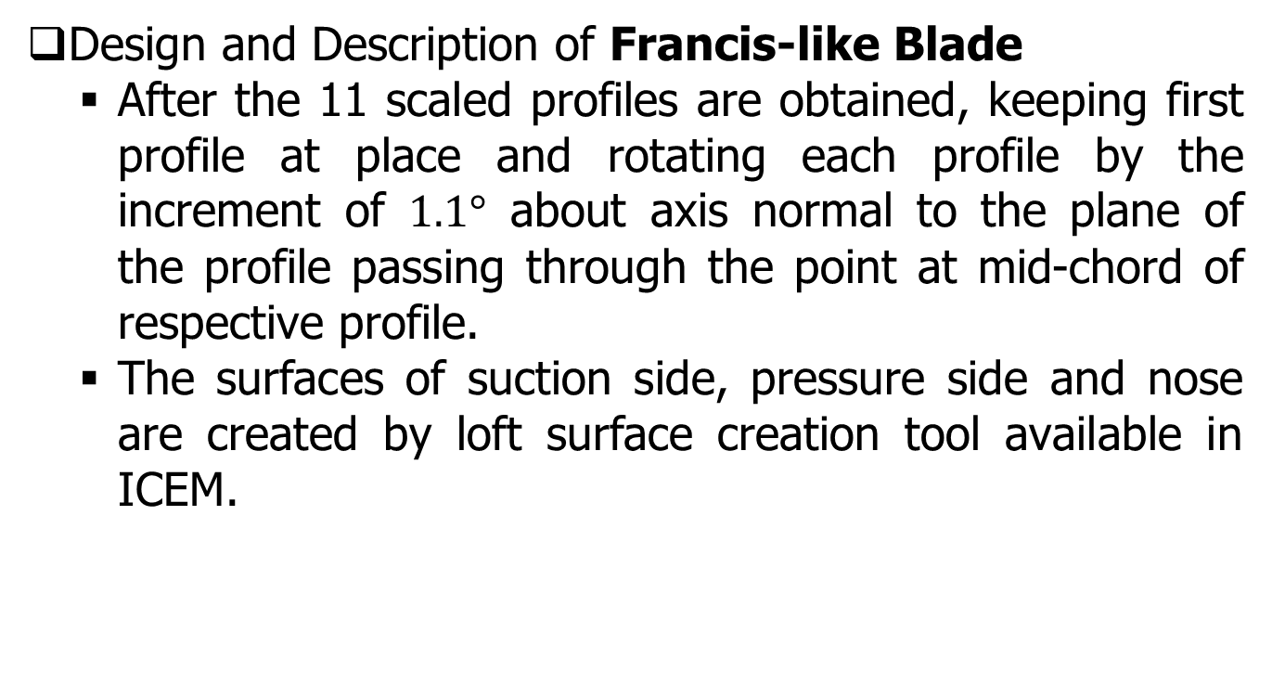
Design and Description of Blades
Design and Description of Francis-like Blade
  After the 11 scaled profiles are obtained, keeping first profile at place and rotating each profile by the increment of $1.1°$ about axis normal to the plane of the profile passing through the point at mid-chord of respective profile.
  The surfaces of suction side, pressure side and nose are created by loft surface creation tool available in ICEM.
Figure showing increasing thickness along crown side cross section of the blade
Figure showing the provided twist of 11° from band side to crown side

Slide 22
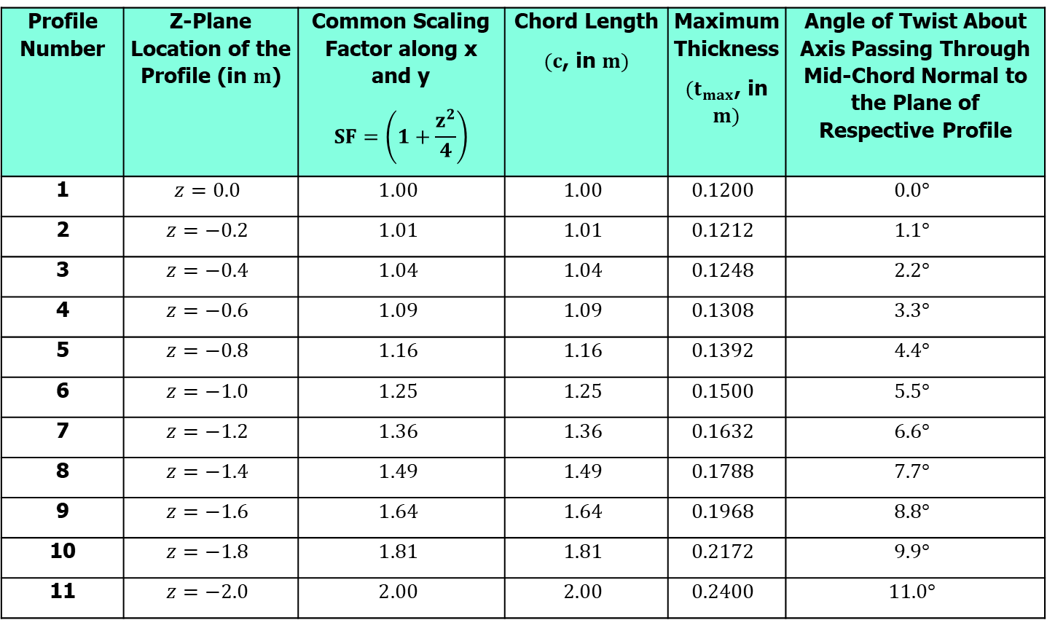
Design and Description of Blades
Data used to design the Francis-like blade
Profile Number | Z-Plane Location of the Profile (in $m$) | Common Scaling Factor along x and y $$SF=\left(1+\frac{z^{2}}{4}\right)$$ | Chord Length $(c$, in $m)$ | Maximum Thickness $(t_{max}$, in $m)$ | Angle of Twist About Axis Passing Through Mid-Chord Normal to the Plane of Respective Profile
1 | $$z=0.0$$ | $$1.00$$ | $$1.00$$ | $$0.1200$$ | $$0.0°$$
2 | $$z=−0.2$$ | $$1.01$$ | $$1.01$$ | $$0.1212$$ | $$1.1°$$
3 | $$z=−0.4$$ | $$1.04$$ | $$1.04$$ | $$0.1248$$ | $$2.2°$$
4 | $$z=−0.6$$ | $$1.09$$ | $$1.09$$ | $$0.1308$$ | $$3.3°$$
5 | $$z=−0.8$$ | $$1.16$$ | $$1.16$$ | $$0.1392$$ | $$4.4°$$
6 | $$z=−1.0$$ | $$1.25$$ | $$1.25$$ | $$0.1500$$ | $$5.5°$$
7 | $$z=−1.2$$ | $$1.36$$ | $$1.36$$ | $$0.1632$$ | $$6.6°$$
8 | $$z=−1.4$$ | $$1.49$$ | $$1.49$$ | $$0.1788$$ | $$7.7°$$
9 | $$z=−1.6$$ | $$1.64$$ | $$1.64$$ | $$0.1968$$ | $$8.8°$$
10 | $$z=−1.8$$ | $$1.81$$ | $$1.81$$ | $$0.2172$$ | $$9.9°$$
11 | $$z=−2.0$$ | $$2.00$$ | $$2.00$$ | $$0.2400$$ | $$11.0°$$

Slide 23
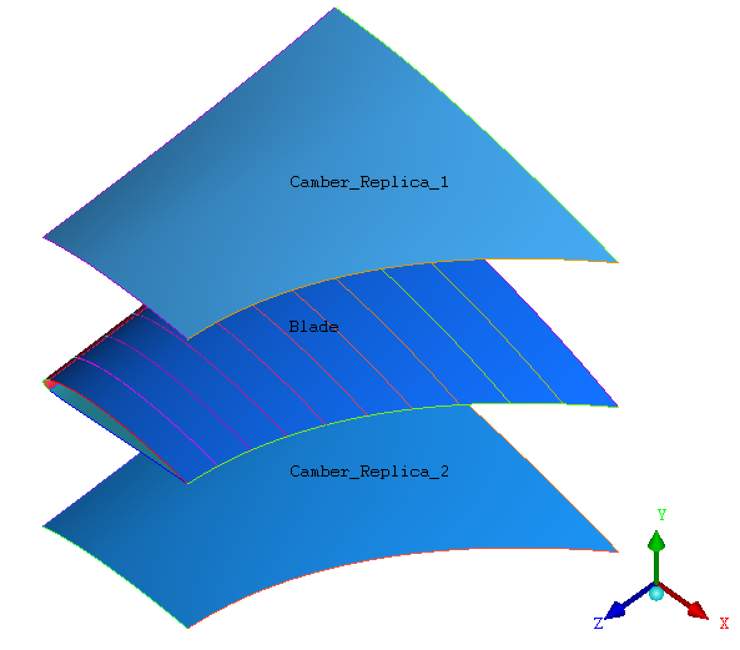
Arrangement of Flow Channel

Slide 24
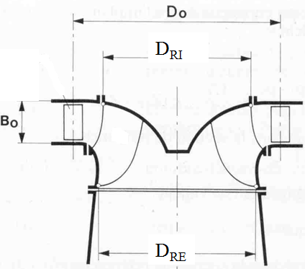
Internal Anatomy of Runner

Slide 25
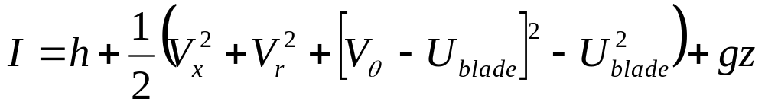
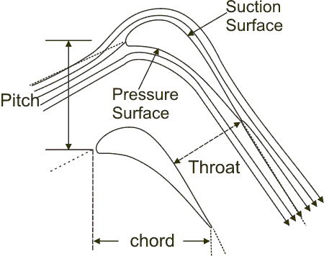
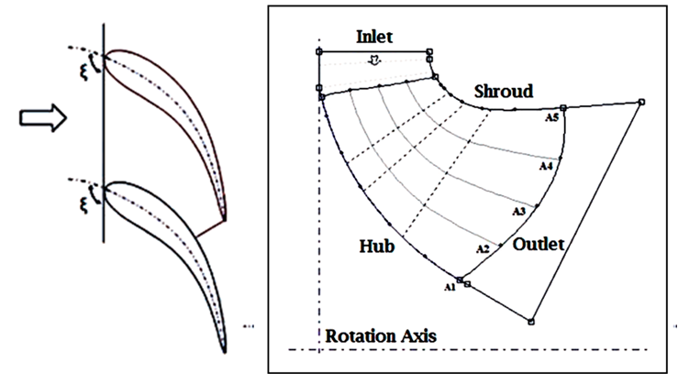
Blade Velocity Vs Tangential Component of Fluid Velocity
U_{b}
In maridional plane at mean radius of rotor
V_{w}
U_{b}
V_{r}
V_{f}
V_{a}

Slide 26
Shape of Francis Channel : Meridional Plan
R_{r1i}
R_{r1e}
R_{r2i}
L/D_{ri}
^{R}_{r2e}

Slide 27
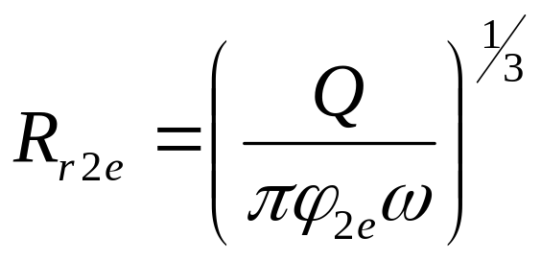
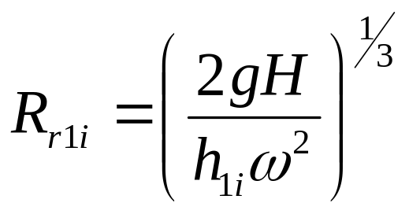
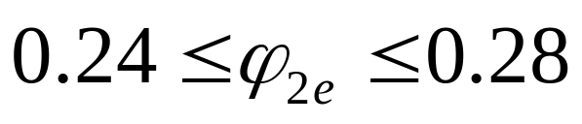
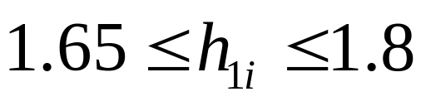
Models for values of Radii
The real value of the outlet tip radius
The real value of the intlet root radius
R_{r2e} and R_{r1i} are only fix two points of the leading and trailing edges and the rest of these curves should be drawn to lead to better efficiency of runner.

Slide 28
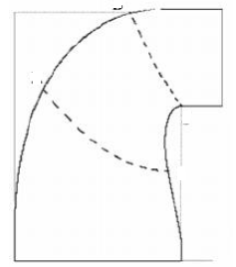


Determination of Inlet & exit edges of Runner
The form of these edges is two parabolic curves.
1i
Define the non-dimensional specific speed
1e
2i
For
2e
the leading edge form is a parabolic arc
with the peak in the point by radius of 2.R_{r1i}-R_{r2i}which passes through the points 1i and 2i,

Slide 29

Determination of Inlet & exit edges of Runner
1i
and for specific speeds between
1e
its form is also a parabolic arc but with the minimum point in the 1i
and the axis is parallel to runner axis.
2i
2e
In the exit area, trailing edge is a parabolic curve which has a minimum point in 1e and also passes through a point such as 2i with a radius of R_{r1i}/3.

Slide 30

Determination of Inlet & exit edges runner
The form of these edges is two parabolic curves.
1i
Define the non-dimensional specific speed
1e
2i
For
2e
the leading edge form is a parabolic arc
with the peak in the point by radius of 2.R_{r1i}-R_{r2i}which passes through the points 1i and 2i,

Slide 31

Dimensions of Runner Channel : Meridional Plan
R_{r1i}
The BOVET well known relations give the geometry of hub and shroud curves in the runner blade zone.
The form of limit curves is defined by equation:
R_{r1e}
R_{r2i}
L/D_{ri}
^{R}_{r2e}

Slide 32



Location of Runner Vane in Runner Channel

Slide 33

Variation of Flow Velocity
V_{f}
s

Slide 34


Perpendicular Plan : Conservation of Rothalpy

Slide 35

Modern Functions for Blade Angle Variations

Slide 36
Creation of Runner Channel

Slide 37

Kinematics and angles of the flow at blade inlet

Slide 38

Kinematics and angles of the flow at blade outlet

Slide 39

Typical Geometrical Details in Meridional Plane: Sample Design

Slide 40

Centerline of Blade at Mean Dimeter

Slide 41

Mean Surface of Runner Blade
Camber Surface of an Aerofoil

Slide 42
Construction of the Real Blades
Using NACA Profiles
Once the camber surface is determined and verified in space.
Embark this surface with profiles of adequate thickness, which will confer the necessary mechanical strength,
the maximum energy transfer and
the minimum drag by the liquid flow.
Chose appropriate NACA profiles.
The thickness relative function is given by the formula:

Slide 43


NACA 65 Series for Francis Runner Blade

Slide 44

The transposition of the profiles for all the 11 streamlines

Slide 45

A Linear Array of Blades

Slide 46


Circumferential Arrangement of Hydrofoil Blades

Slide 47

3D Reconstruction of Runner with Blades

Slide 48

Study of Velocity distribution on runner for Improvement

Slide 49

Blade to Blade Flow Variation

Slide 50

Three-Dimensional Flow Visualization

Slide 51

Runner and Sourrings

