Slide 1
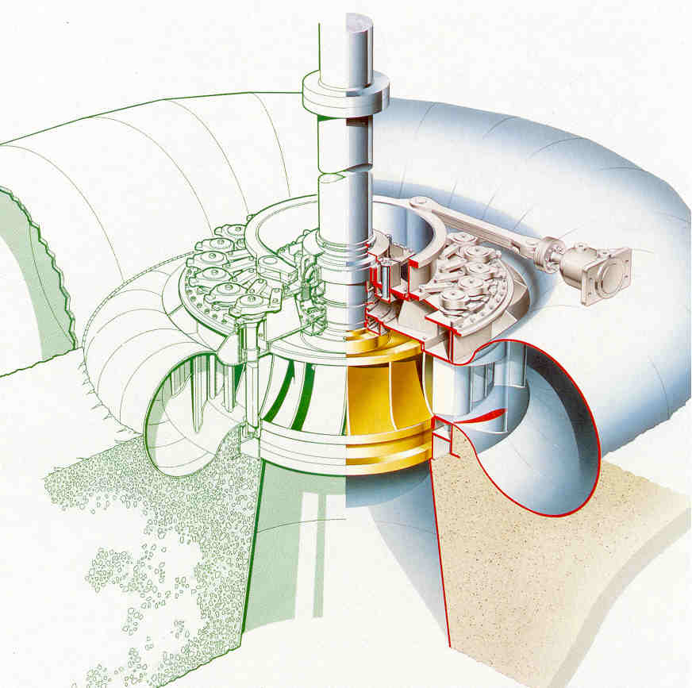

Francis Turbine
P M V Subbarao
Professor
Mechanical Engineering Department
Blend some Reaction into Impulse…
Works well for Resources with Medium Head and Large Flowrate …..

Slide 2


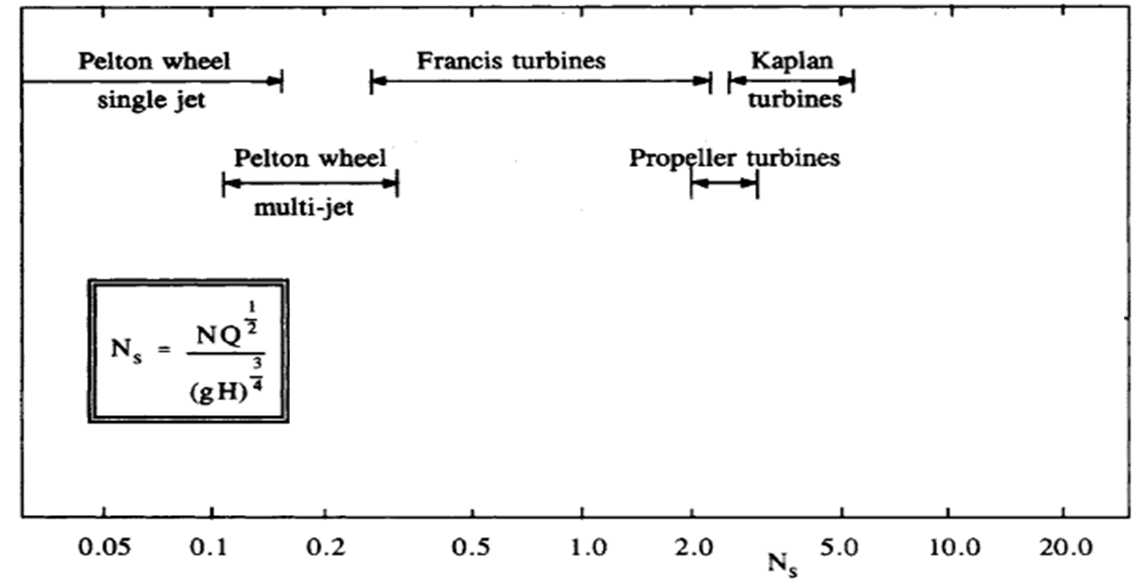
Speed Vs Type of Hydraulic Turbine

Slide 3
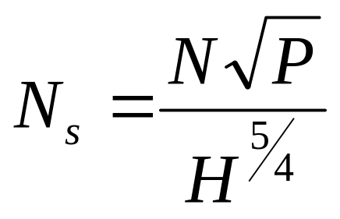
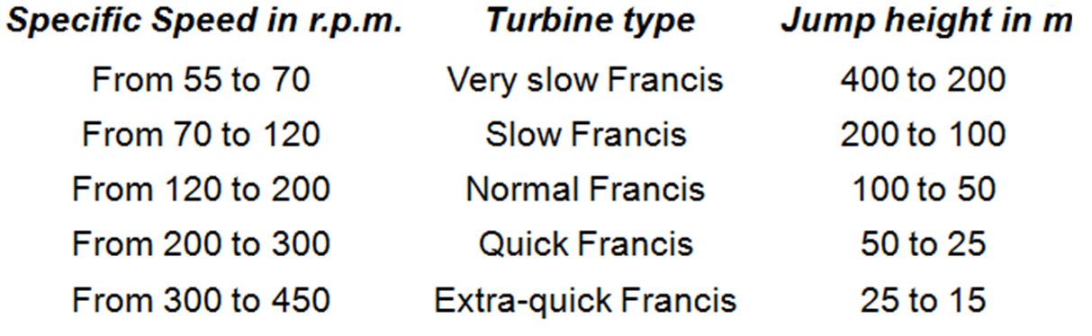
Specific Speed Range of Francis Turbine
Specific speed in rpm
P in hp & H in meters

Slide 4
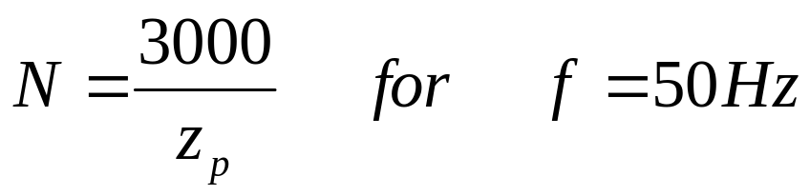
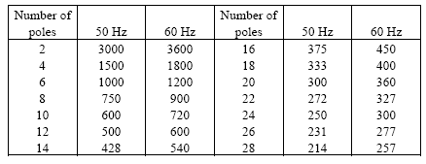
Selection of Speed of A Francis Turbine
Z_{p} : Number of pairs of poles of the generator

Slide 5
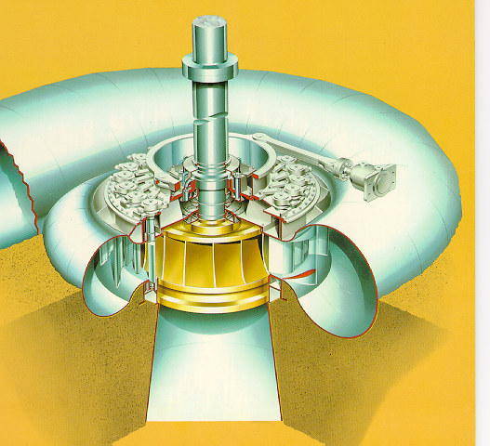
The Francis Turbine
A Francis turbine is suitable for medium heads (45 to 400 m) and requires a relatively large quantity of water.

Slide 6
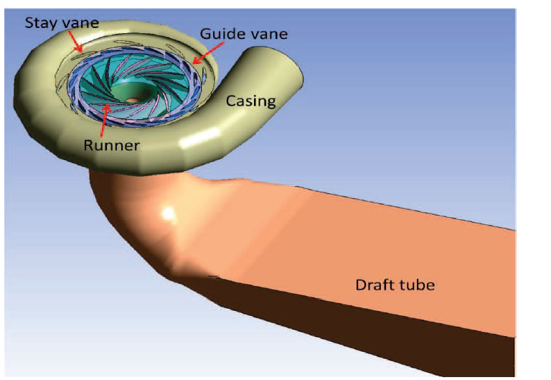
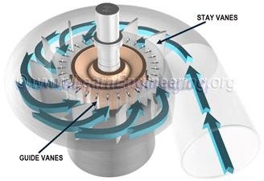
3D Geometric Model of A Francis Turbine

Slide 7
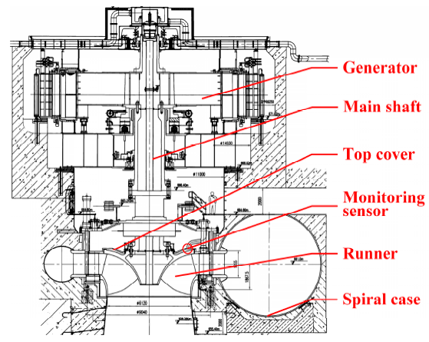
The Francis Turbine
It is a reaction turbine developed by an English born American Engineer, Sir J.B. Francis.

Slide 8
The Francis Turbine
The water enters the turbine through the outer periphery of the runner in the radial direction and leaves the runner in the axial direction, and hence it is called ‘mixed flow turbine’.

Slide 9
The Francis Turbine
It is a reaction turbine and therefore only a part of the available head is converted into the velocity head before water enters the runner.

Slide 10
The Francis Turbine
The pressure head goes on decreasing as the water flows over the runner blades.

Slide 11
The Francis Turbine
The static pressure at the runner exit may be less than the atmospheric pressure and and water simultaneously fills all the passages of the runner blades.

Slide 12
The Francis Turbine
The change in pressure while water is gliding over the blades is called ‘reaction pressure’ and is partly responsible for the rotation of the runner.

Slide 13
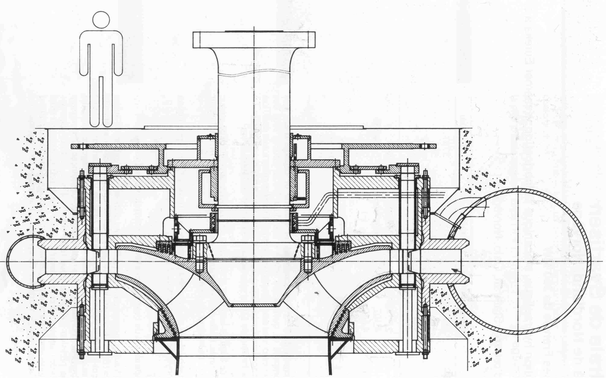
Variations of Francis : SVARTISEN
P = 350 MW
H = 543 m
Q = 71.5 m³/s
n = 333 rpm

Slide 14
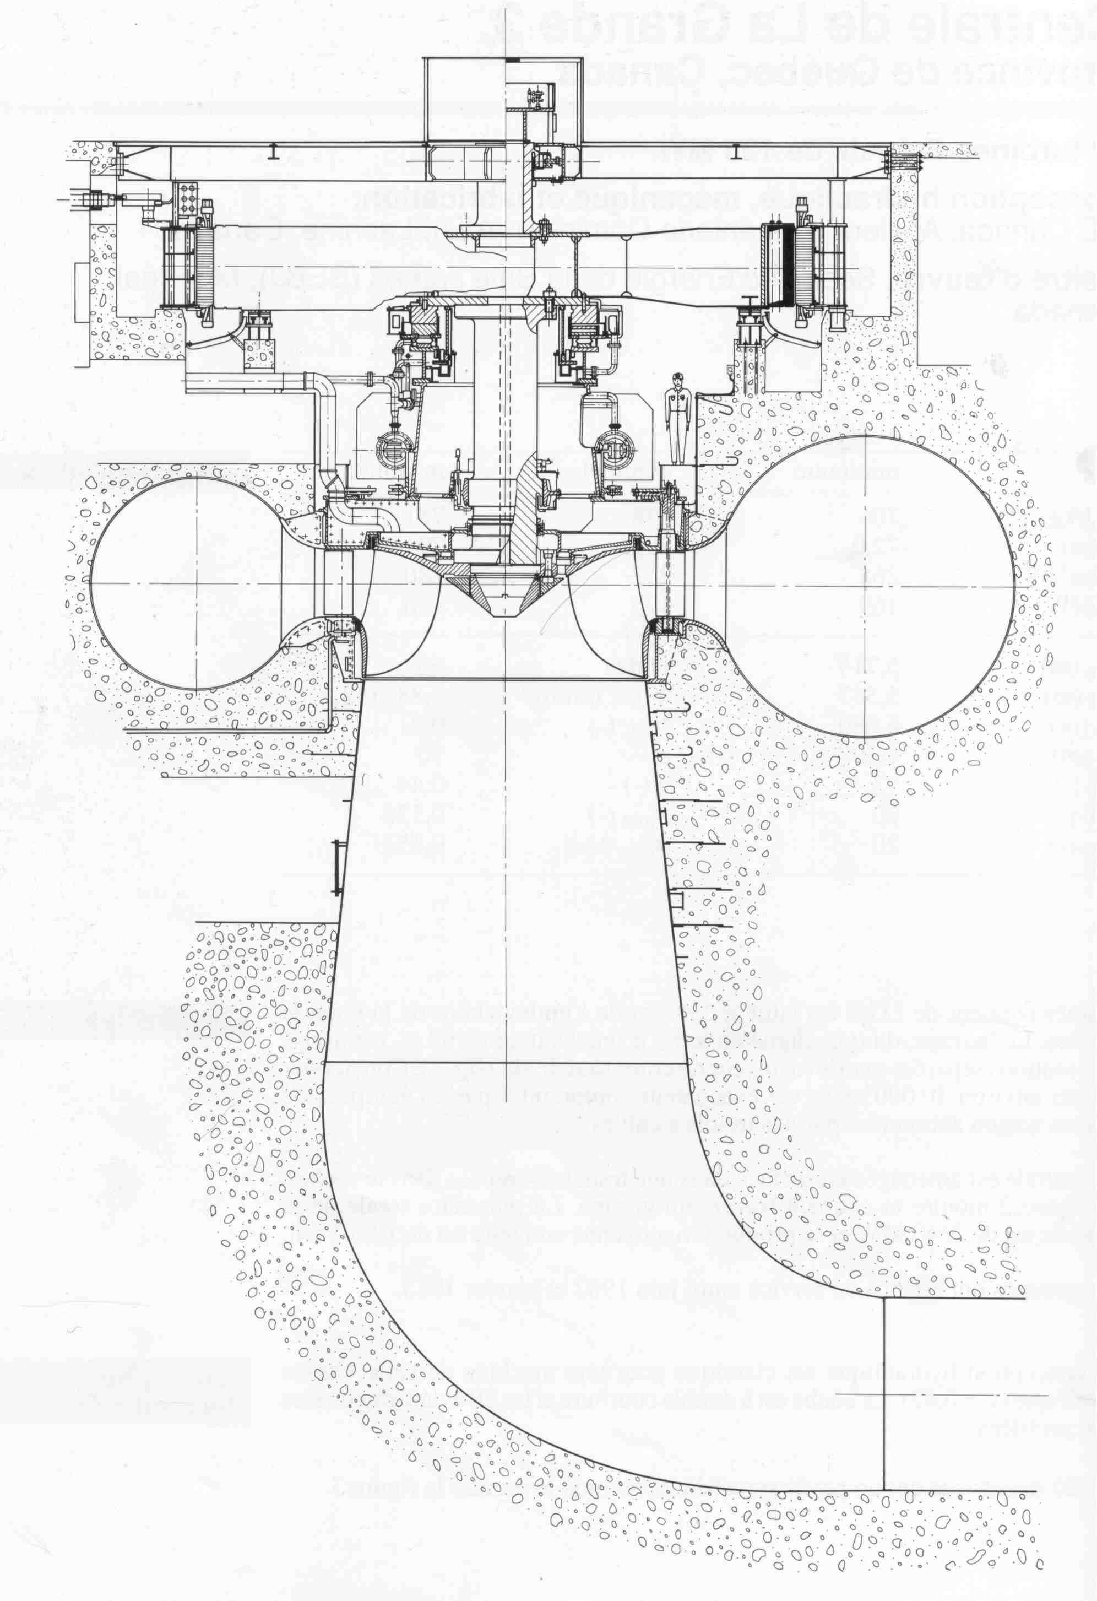
Variations of Francis : La Grande, Canada
P = 169 MW
H = 72 m
Q = 265 m³/s
n = 112,5 rpm

Slide 15
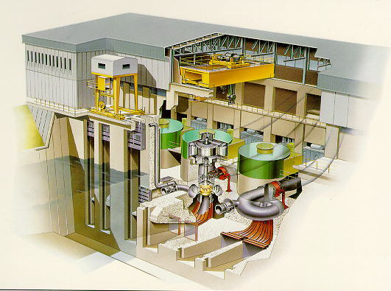
The Francis Installation

Slide 16
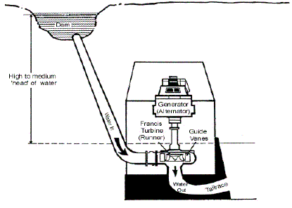
Francis Turbine Power Plant : An Invariant Power Hydraulic Turbine

Slide 17
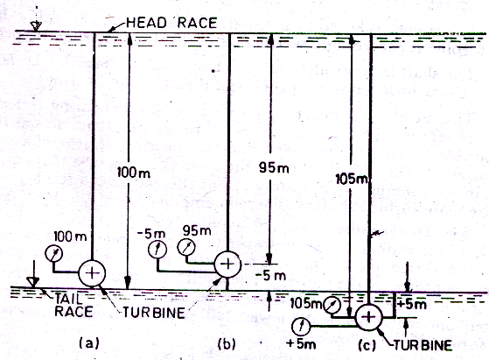
Location of Francis Turbine

Slide 18
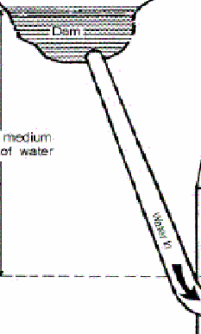
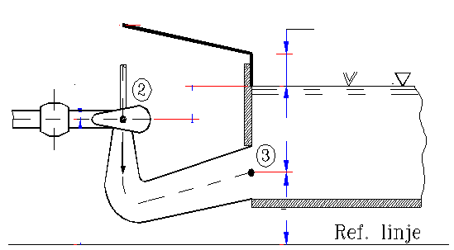
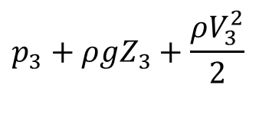
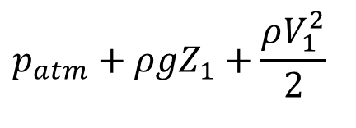
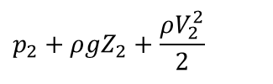
An Active Pascal Law : A Hydraulic Model for Francis Units
$${p_{atm}+ρgZ}_{1}+\frac{ρV_{1}^{2}}{2}$$
$${p_{2}+ρgZ}_{2}+\frac{{ρV}_{2}^{2}}{2}$$
1
$${p_{3}+ρgZ}_{3}+\frac{{ρV}_{3}^{2}}{2}$$

Slide 19
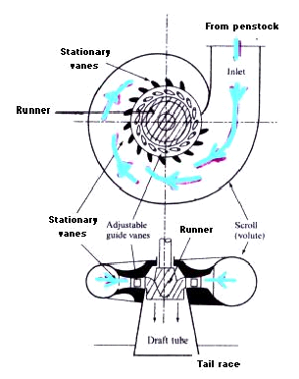
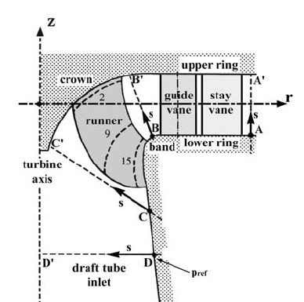
Sectional Views of A Francis Turbine

Slide 20
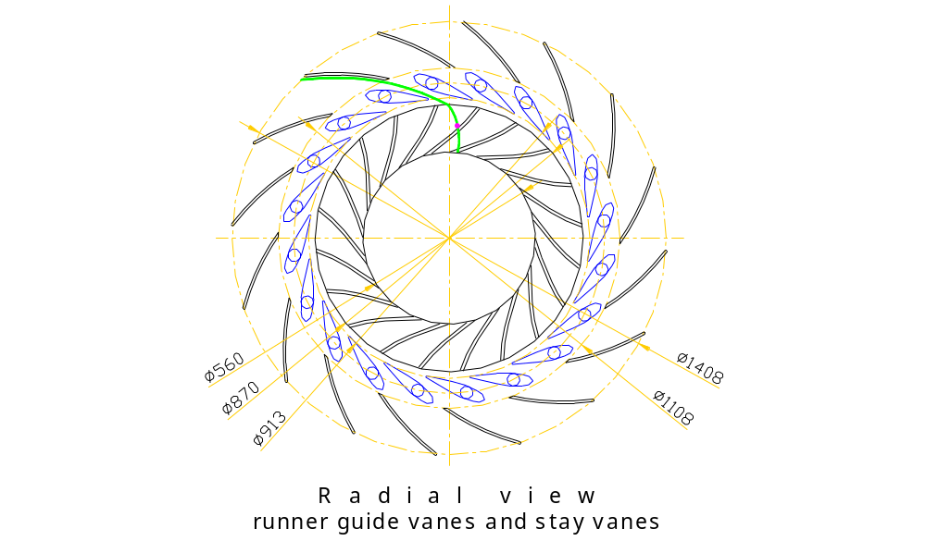











Absolute Path of the Water Parcel
Water parcle
Water from spiral casing

Slide 21
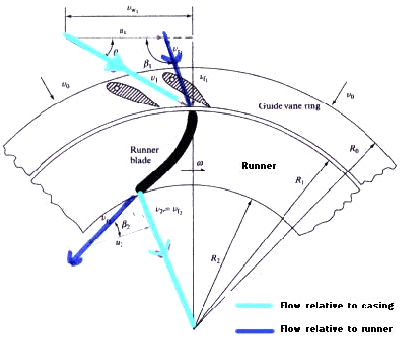
Inlet and Exit Velocity Triangles

Slide 22
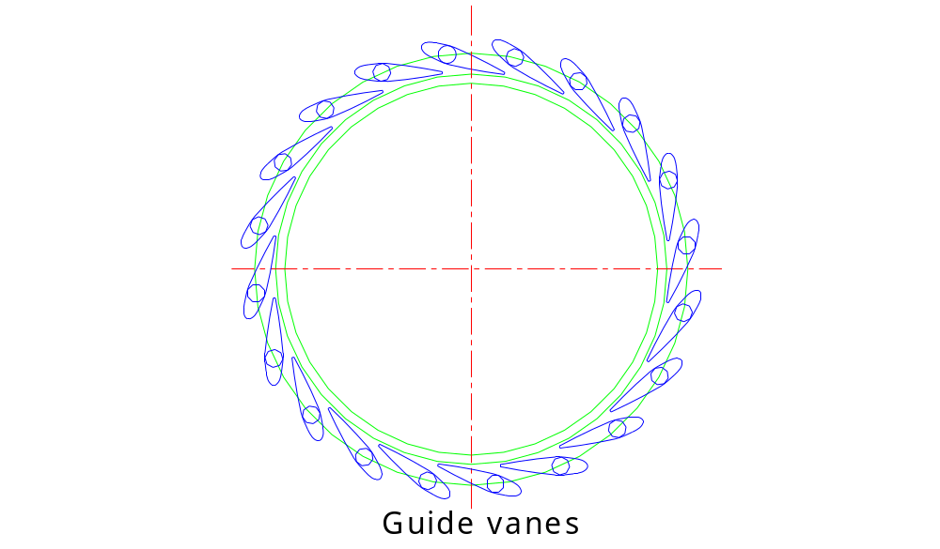
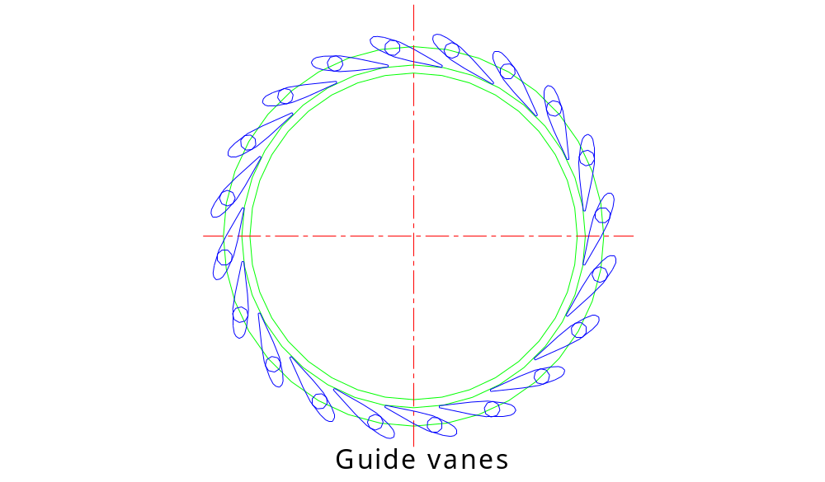
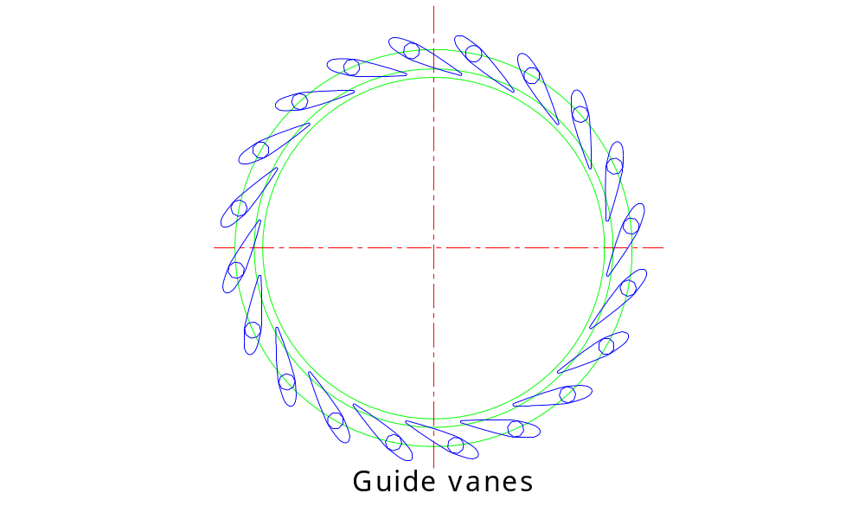
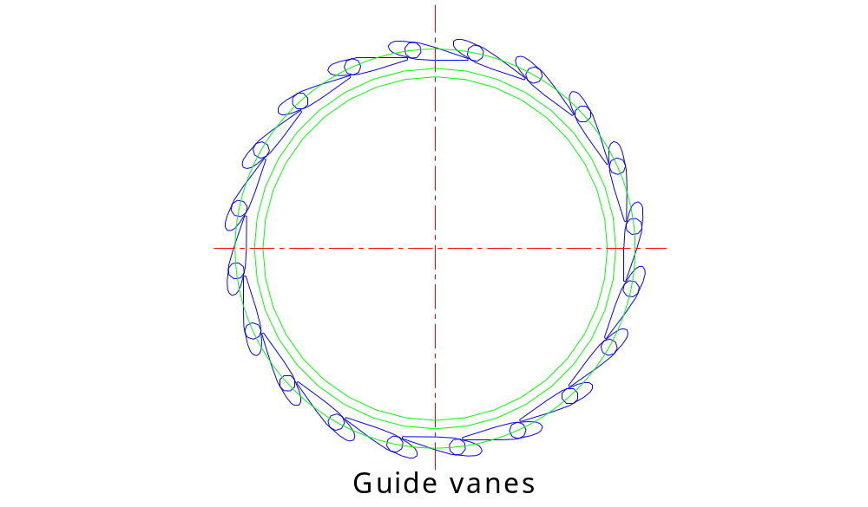
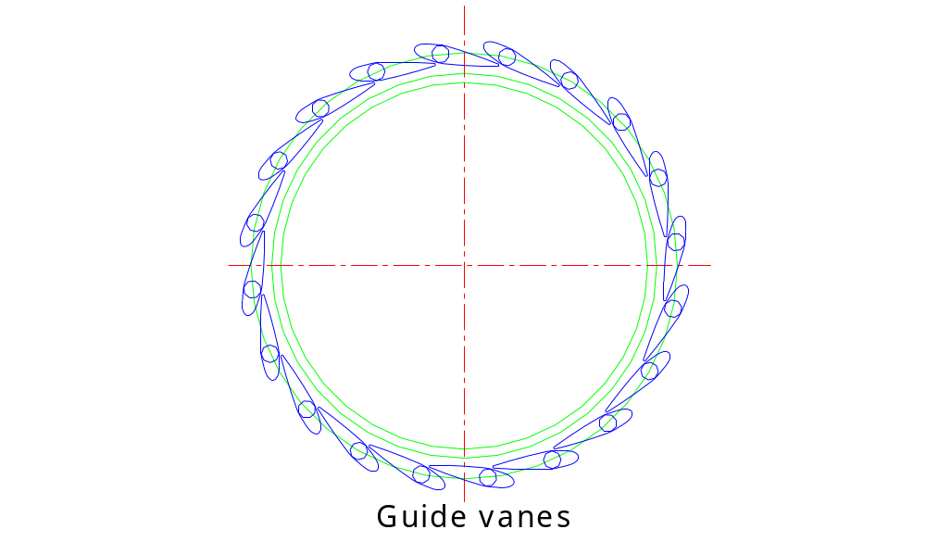
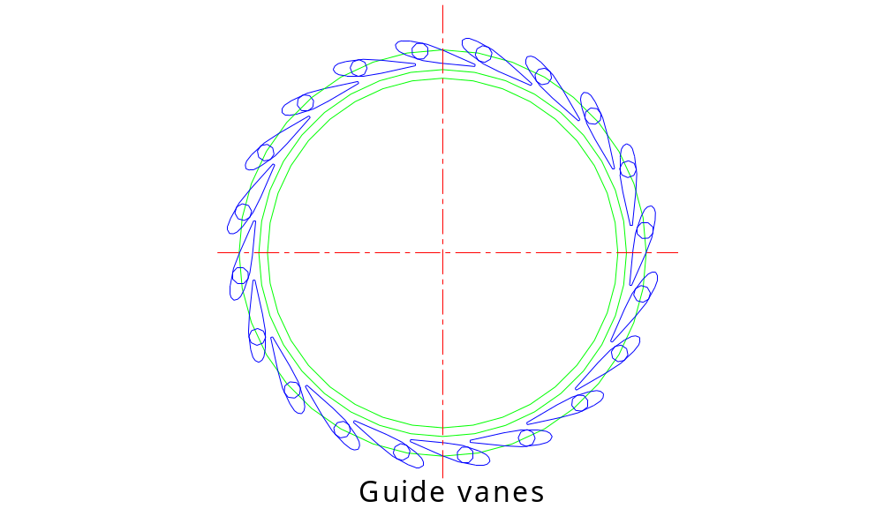



Variable Inlet Flow Angle & Guide Vanes
Runner inlet (Φ 0.870m)
Guide vane outlet for designα) (Φ 0.913m)
Closed
Position
Max. Opening Position

Slide 23
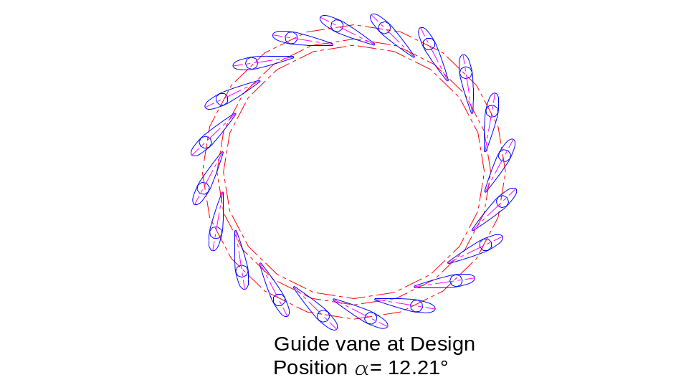
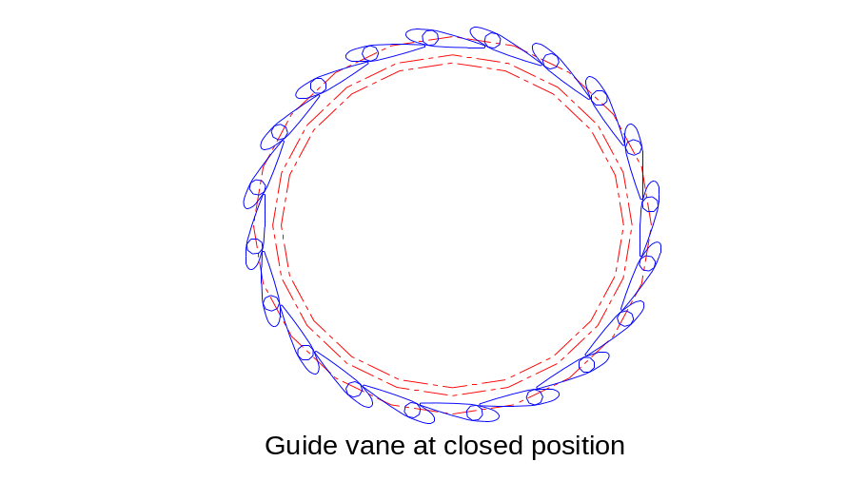
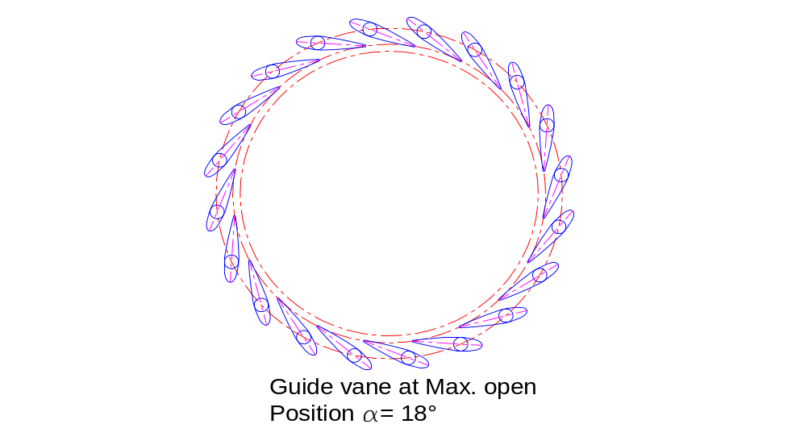
Operation of Guide Vanes for Best Performance
.

Slide 24










Ideal Hydraulic Energy Diagram
Outlet
draft tube
Outlet
runner
Inlet
runner
Outlet
stator vane
Inlet
stator vane
$$Z_{total}$$
$$Z_{static,guide}$$
$$Z_{static,runner}$$
$$Z_{abs}=0$$
Z_{atm}

Slide 25
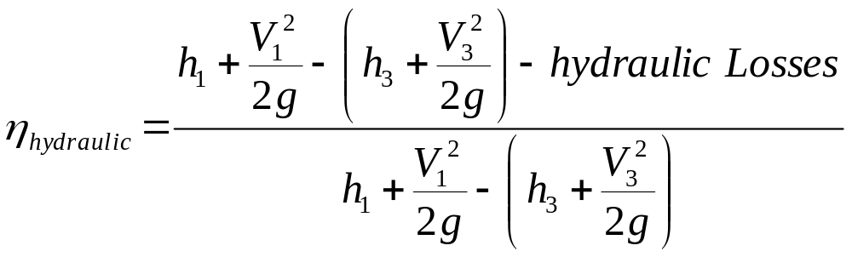
Hydraulic efficiency of Francis Hydraulic System

Slide 26
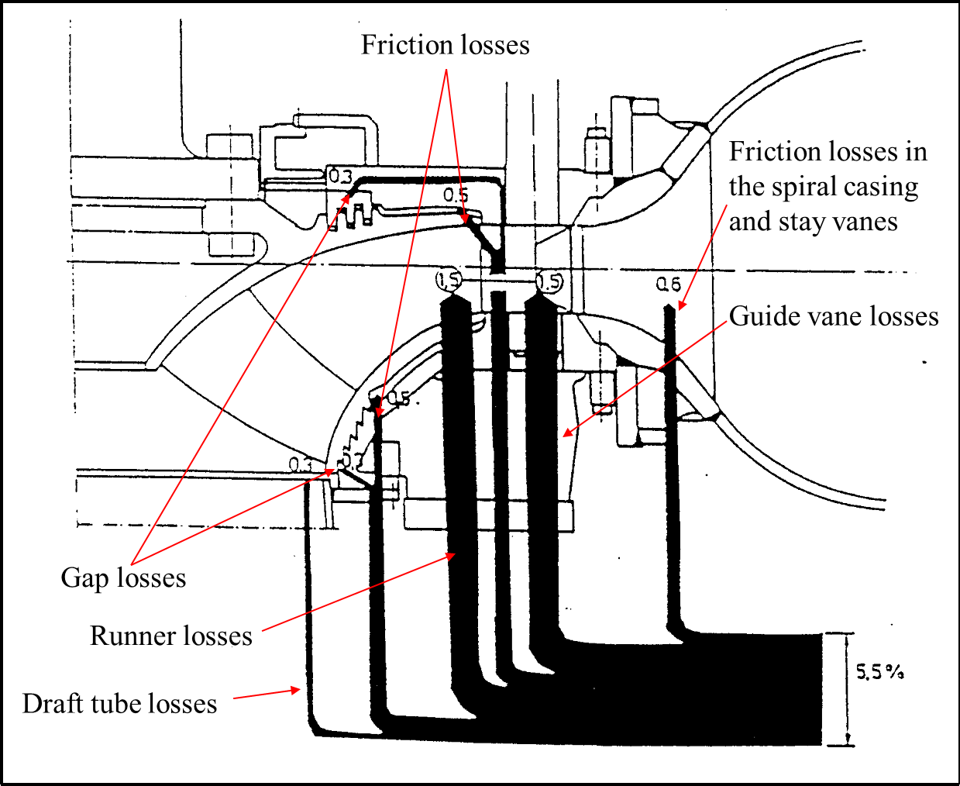
Sankey Diagram

Slide 27
Losses in Francis Turbines: Learning from the Machine
Draft tube
Hydraulic Efficiency [%]
Output Energy
Head [m]

Slide 28
Need for Overdesign of Francis Turbines : Learning from the Machine
Hydraulic Efficiency [%]
Output Energy
Output [%]

Slide 29
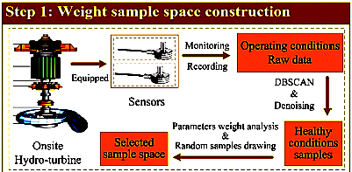
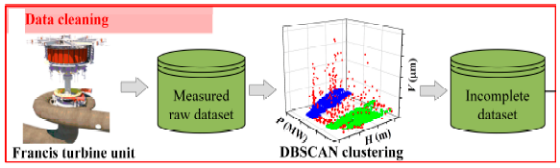
Methodology to Infuse Machine Learning into Francis Turbine Desgin & Operation

Slide 30
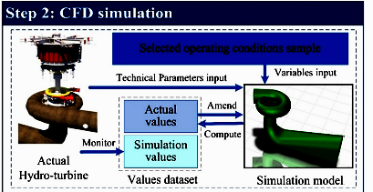
Methodology to Infuse Machine Learning into Francis Turbine Desgin & Operation

Slide 31
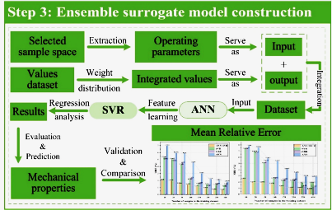
Methodology to Infuse Machine Learning into Francis Turbine Desgin & Operation

Slide 32
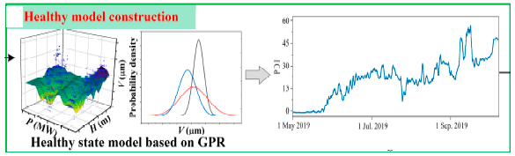
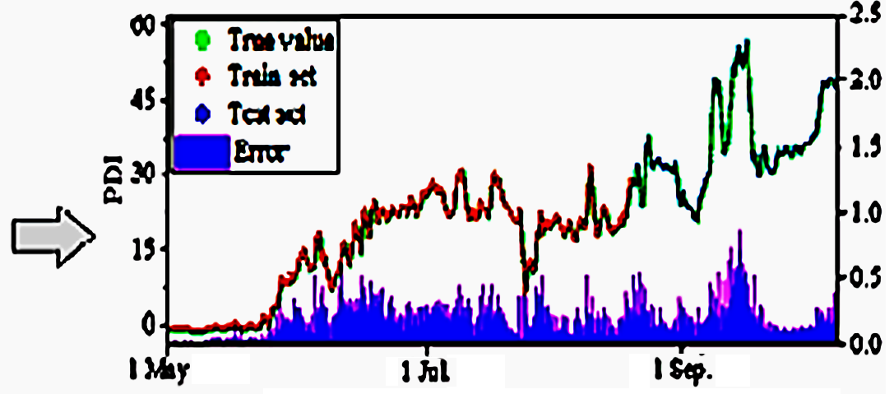
Performance Predicted by ML Package

