Slide 1

Design Rules for Development of Pelton Wheel - 2
P M V Subbarao
Head & Professor
Mechanical Engineering Department
Facilitation of Sufficient time through Learnings form Machine…….

Slide 2


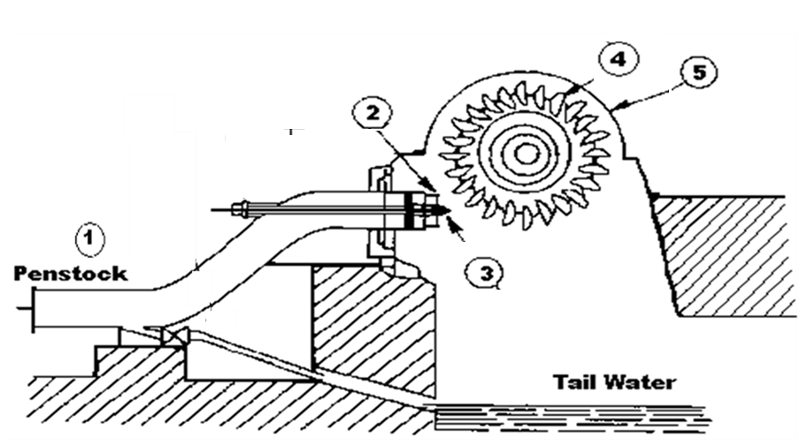


The Powerhouse of A Pelton Wheel
The Pelton turbine is the most popular machine type for the exploitation of high head and low discharge power plants.
Wheel with Buckets
Housing

Slide 3
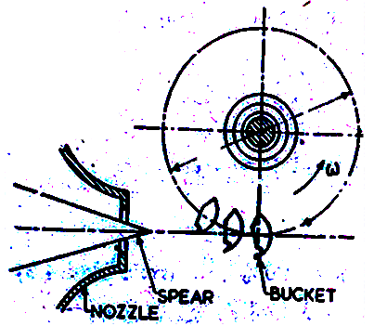
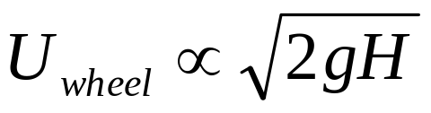
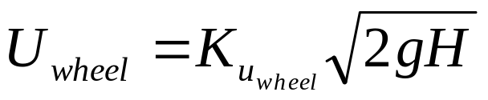
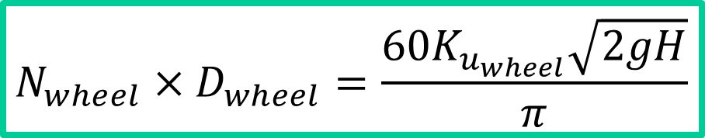
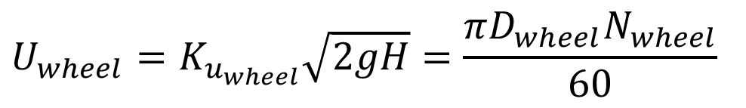
Jet Vs Mean Diameter of Pelton Runner
Mean diameter or Pitch circle diameter: D_{wheel}
Circumferential velocity of the wheel, U_{wheel}
Basic Law of Impulse as action:
Blade Speed Ratio
$$U_{wheel}=K_{u_{wheel}}\sqrt{2gH}=\frac{πD_{wheel}N_{wheel}}{60}$$
$$N_{wheel}×D_{wheel}=\frac{60K_{u_{wheel}}\sqrt{2gH}}{π}$$

Slide 4
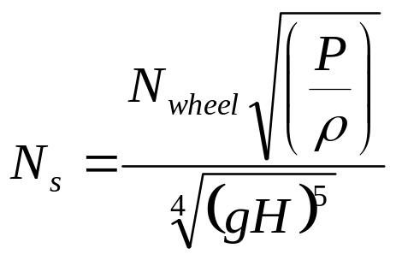
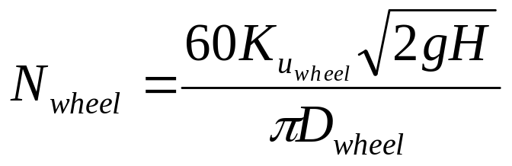

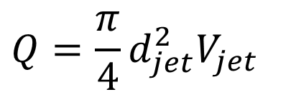
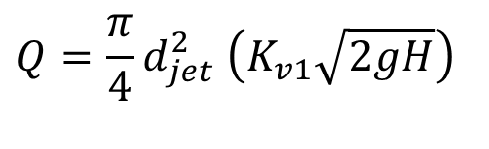
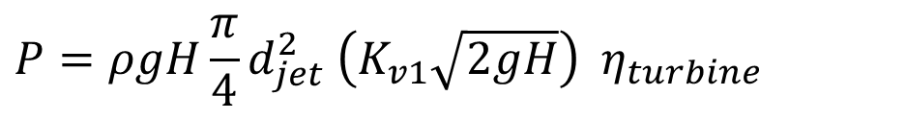
Specific Speed to Achieve Best Performance of A Wheel
Specific speed ensures perfect matching of resource time with machine time and hence best performance of wheel.
$$Q=\frac{π}{4}d_{jet}^{2}V_{jet}$$
$$Q=\frac{π}{4}d_{jet}^{2} \left(K_{v1}\sqrt{2gH}\right)$$
$$P=ρgH\frac{π}{4}d_{jet}^{2} \left(K_{v1}\sqrt{2gH}\right) η_{turbine}$$

Slide 5
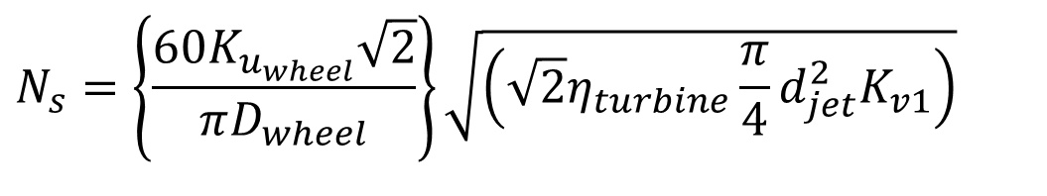
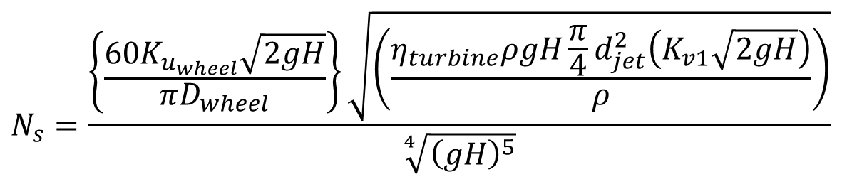
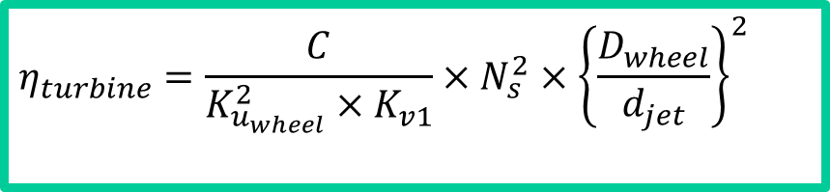
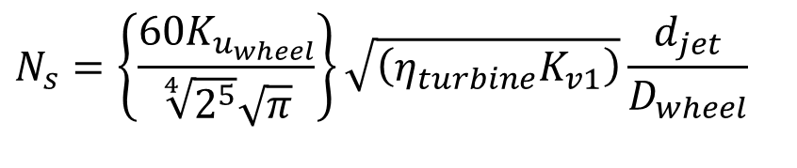
Role of Specific Speed in Wheel Design
$$N_{s}=\frac{\left\{\frac{60K_{u_{wheel}}\sqrt{2gH}}{πD_{wheel}}\right\}\sqrt{\left(\frac{η_{turbine}ρgH\frac{π}{4}d_{jet}^{2}\left(K_{v1}\sqrt{2gH}\right)}{ρ}\right)}}{\sqrt[4]{{\left(gH\right)}^{5}}}$$
$$N_{s}=\left\{\frac{60K_{u_{wheel}}\sqrt{2}}{πD_{wheel}}\right\}\sqrt{\left(\sqrt{2}η_{turbine}\frac{π}{4}d_{jet}^{2}K_{v1}\right)}$$
$$N_{s}=\left\{\frac{60K_{u_{wheel}}}{\sqrt[4]{2^{5}}\sqrt{π}}\right\}\sqrt{\left(η_{turbine}K_{v1}\right)}\frac{d_{jet}}{D_{wheel}}$$
$$η_{turbine}=\frac{C}{K_{u_{wheel}}^{2}×K_{v1}}×N_{s}^{2}×{\left\{\frac{D_{wheel}}{d_{jet}}\right\}}^{2}$$

Slide 6
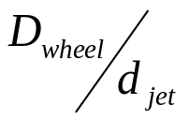
Optimal values of Wheel diameter to jet diameter
N_{s}

Slide 7
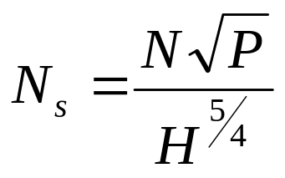
Experimental Best values of Wheel diameter to jet diameter
D_{wheel} /d_{jet} | 6.5 | 7.5 | 10 | 20
N_{s} (rpm) | 35 | 32 | 24 | 10
η_{turbine} | 0.82 | 0.86 | 0.89 | 0.90
P in hp, H in meters and N in rpm

Slide 8
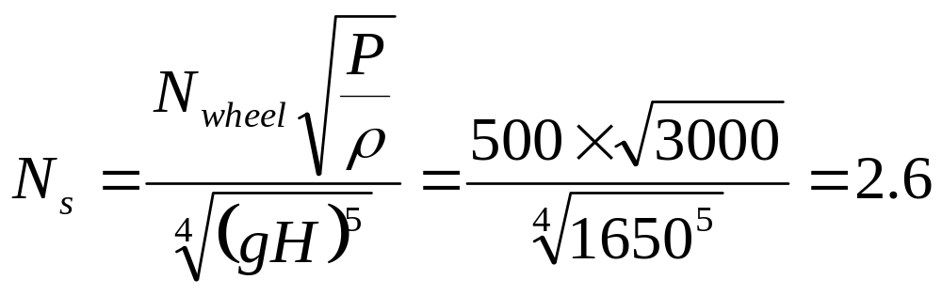
Extreme Natural Resources
The highest wheel to jet ratio used in the world is 110 (Kt. Glauraus Power House in Switzerland).
Specifications of this Pelton wheel are:
Power 3000HP (2.24MW) Speed: 500 rpm
D_{wheel}= 5.36m d_{jet}= 48.77mm
Head =1,650 m

Slide 9

Geometry of Wheel, Bucket & Jet Interactions
δ
R_{wheel}
ω
R_{pelton}
A
A’
d_{j,O}, V_{j,O}
B
B’

Slide 10
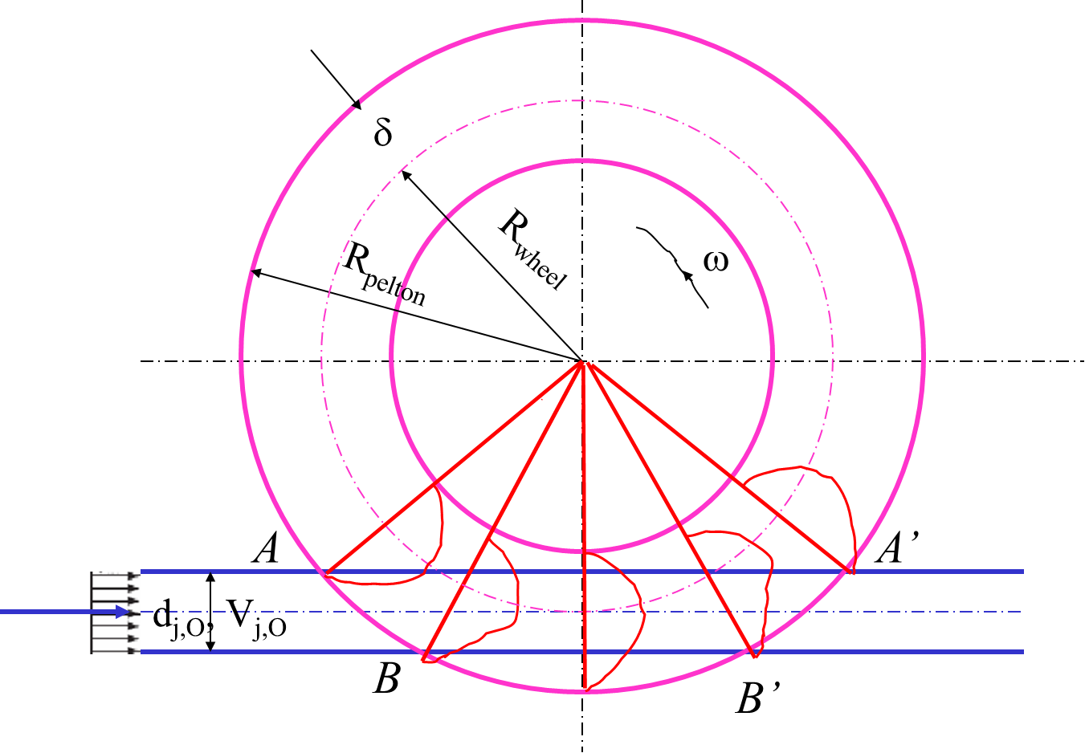
Number of buckets
The number of buckets for a given runner must be determined so that no water particle is lost.
Minimize the risks of detrimental interactions between the out flowing water particles and the adjacent buckets.

Slide 11
Number of buckets
The runner pitch is determined by the paths of;
  the bucket tip (diameter D_{pelton}),
  the Wheel-base diameter (D_{Base}).
and the relative paths of the water particles stemming from the upper A-A’and lower generators B-B’of the jet.
The bucket pitch must be selected so that no particle stemming from the lower generator of the jet can escape the runner without encountering any bucket!

Slide 12
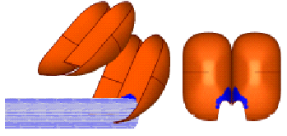
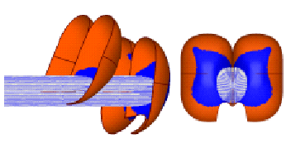
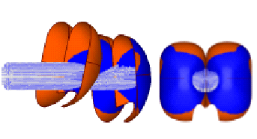
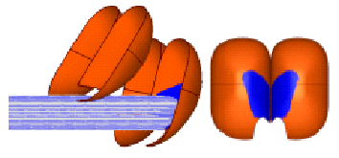
Artistic Drawing : Cycle of Jet Bucket Interactions
Δθ=5⁰
Δθ=25⁰
V_{jet}
V_{jet}
U_{blade}
U_{blade}
Δθ=35⁰
Δθ=15⁰
V_{jet}
U_{blade}

Slide 13
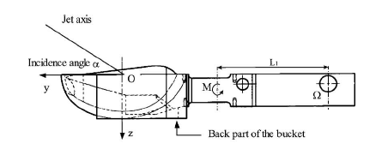
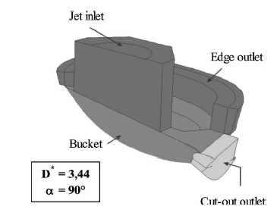
Bucket & Jet Interaction Cycle

Slide 14
Minimum Number of Buckets
δ
R_{wheel}
ω
R_{Pelton}
2ϕ = θ+ψ
θ
ψ
d_{j,O}, V_{j,O}
1C
1B
1E

Slide 15
Minimum Number of Buckets
t_{j} : Time taken bye the jet to travel l_{j}
t_{b}: Time taken by main bucket to travel ψ
δ
R_{Wheel}
ω
R_{Pelton}
θ
ψ
d_{O}, V_{j,O}
l_{j}

Slide 16
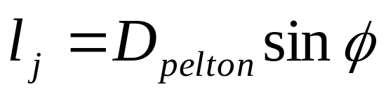
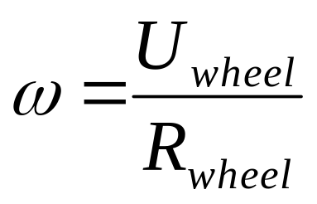
Minimum Number of Buckets
t_{j} = l_{j}/V_{jet,O}
For guaranteed interaction working t_{j} < t_{b}
δ
R_{W}
ω
t_{b} = ψ/ω
R_{P}
θ
ψ
d_{O}, V_{j,O}
l_{j}

Slide 17
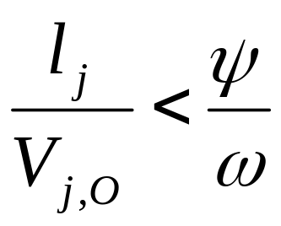
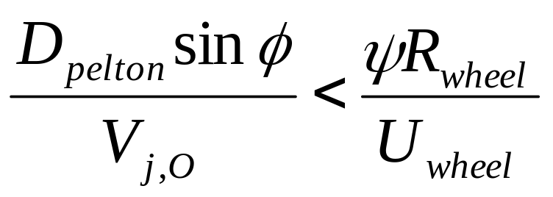
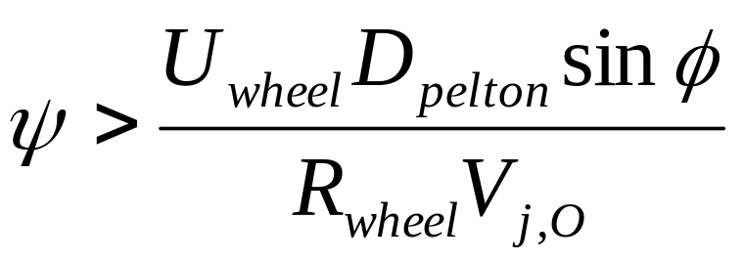
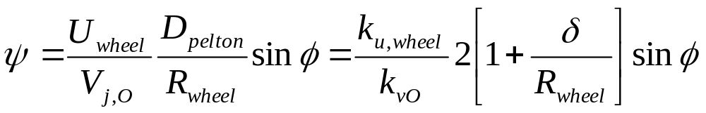
Minimum Number of Buckets
For better working t_{j} < t_{b}
The minimum allowable value of ψ

Slide 18
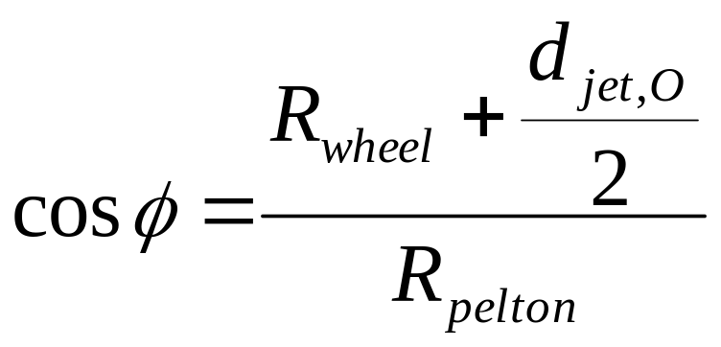
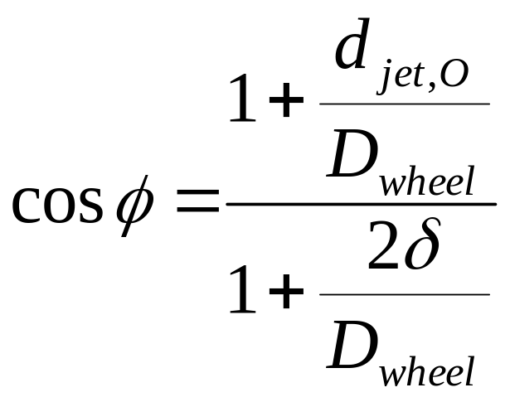
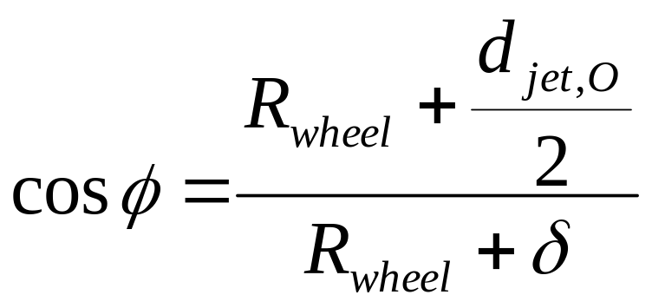
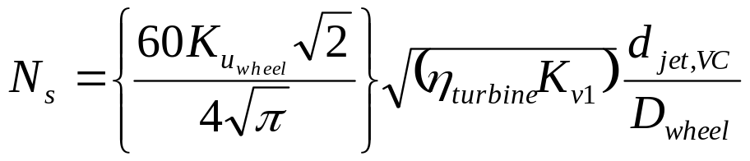
Half Angular Spacing
δ
R_{W}
ω
R_{P}
θ
ψ
d_{O}, V_{j,O}
l_{j}

Slide 19
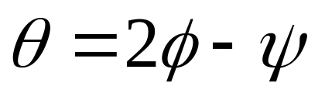
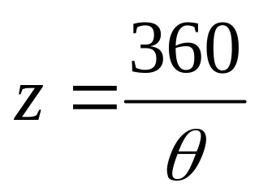
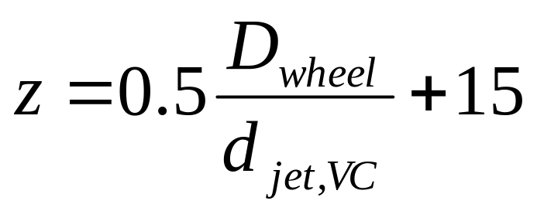
Maximum Allowable Angular Spacing of Buckets
Maximum allowable angle between two successive buckets
Minimum number of buckets
Dr Taygun has suggested an empirical relation for z

Slide 20
Geometry of Wheel, Bucket & Jet Interactions
δ
R_{wheel}
ω
R_{pelton}
A
d_{j,O}, V_{j,O}
A’
B
B’

Slide 21
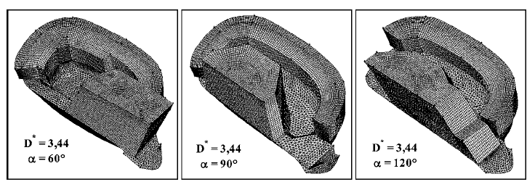
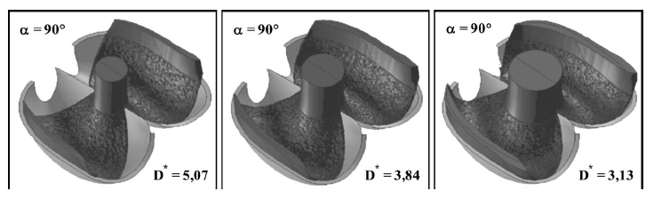
Bucket & Jet Interaction Cycle

Slide 22
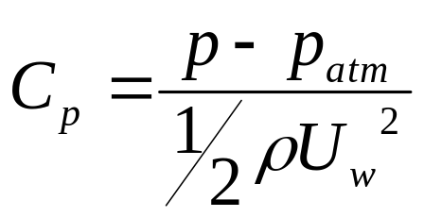
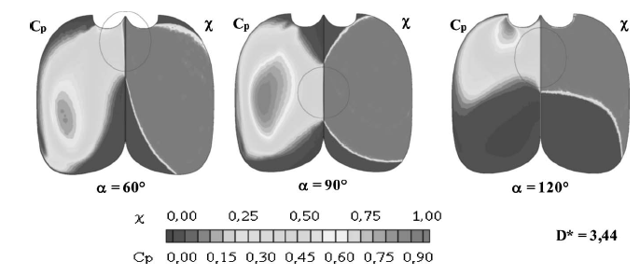
Distribution of Reaction to Impulse Action
Measure of Reaction: Local Pressure Coefficient

Slide 23
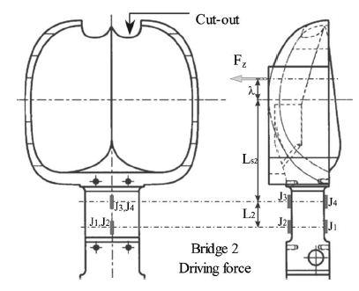
Driving Force on The Wheel

Slide 24
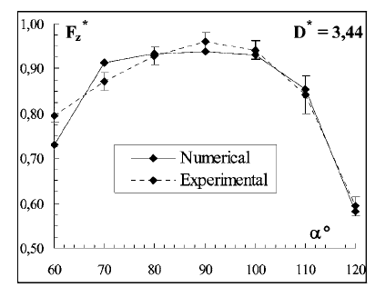
Instantaneous Driving Force during Bucket Duty Cycle

Slide 25
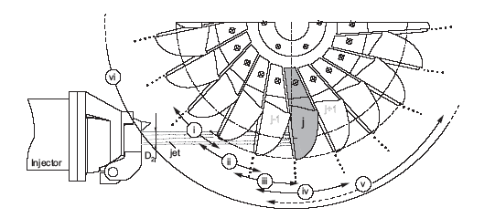
Bucket Duty Cycle
Reference Position

Slide 26
Zones of Bucket Duty Cycle
i) Approach of the tip to the jet (θj < −40◦).
ii) Initial feeding process : (θj = −40◦...−10◦).
iii) Entire separation of the jet (θj = −10◦...0◦)
iv) Last stage of inflow (θj = 0◦...15◦)
v) Last stage of outflow (θj = 15◦...50◦).
vi) Series of droplets (θj = −50◦...∞).

Slide 27

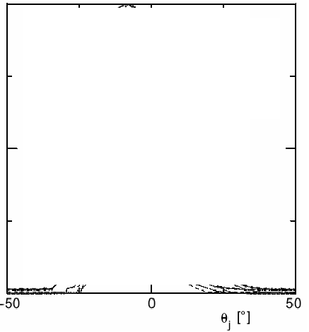
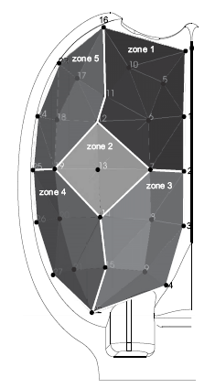
Bucket Power Distribution
P(θj)
Total
2
1
3
5
4

Slide 28
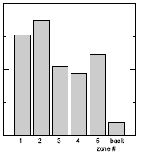
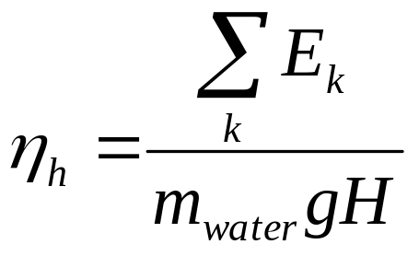
Bucket Energy Distribution
E_{j,k}

Slide 29
Closing Remarks on Pelton Wheel
The first scientifically developed concept and also patented product.
The only one option for high heads (> 600 m)
Best suited for low flow rates with moderate heads (240m -- 600m).
A better choice for moderate heads with medium flow rates.
Easy to construct and develop, as it works at constant (atmospheric) pressure.
Low rpm at moderate or marginal heads is a major disadvantage.

