Slide 1

Design Rules for Development of Pelton Wheel - 1
P M V Subbarao
Head & Professor
Mechanical Engineering Department
Facilitation of Sufficient time through Learnings form Machine…….

Slide 2


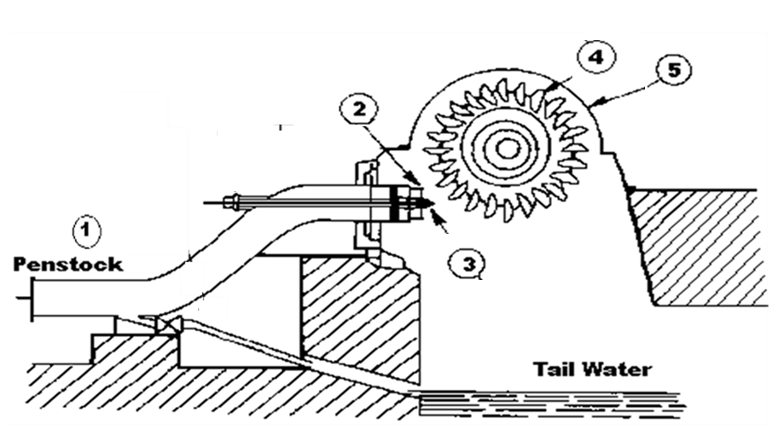


The Powerhouse of A Pelton Wheel
The Pelton turbine is the most popular machine type for the exploitation of high head and low discharge power plants.
Wheel with Buckets
Housing

Slide 3
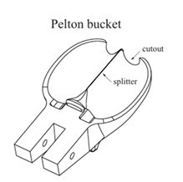
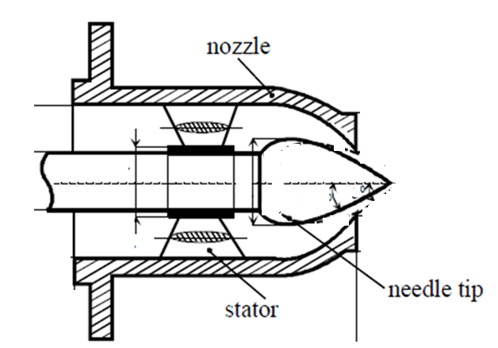
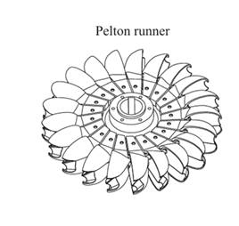

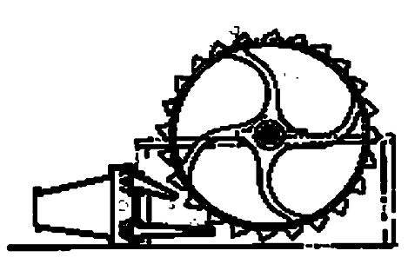
Design Optimization of Pelton Wheel
Most of the progress made take their roots in practical experience, know-how and extensive experimental tests.

Slide 4
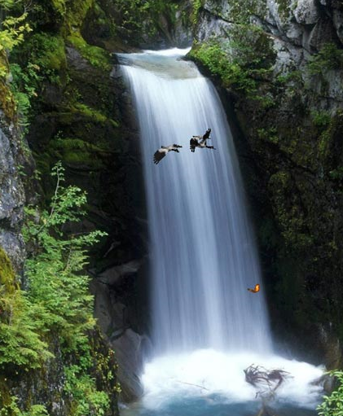
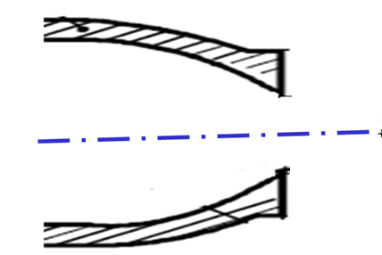
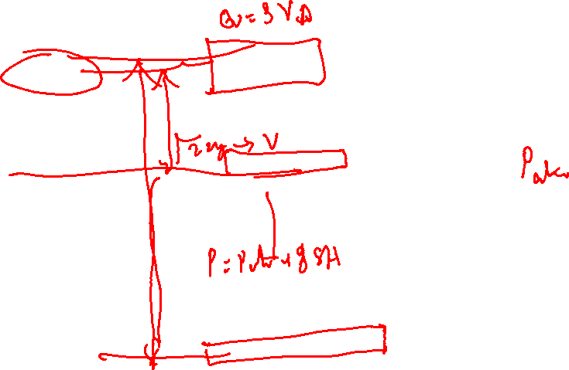
A Complex Engineering Micro Alternate To Simple Gigantic Natural System

Slide 5
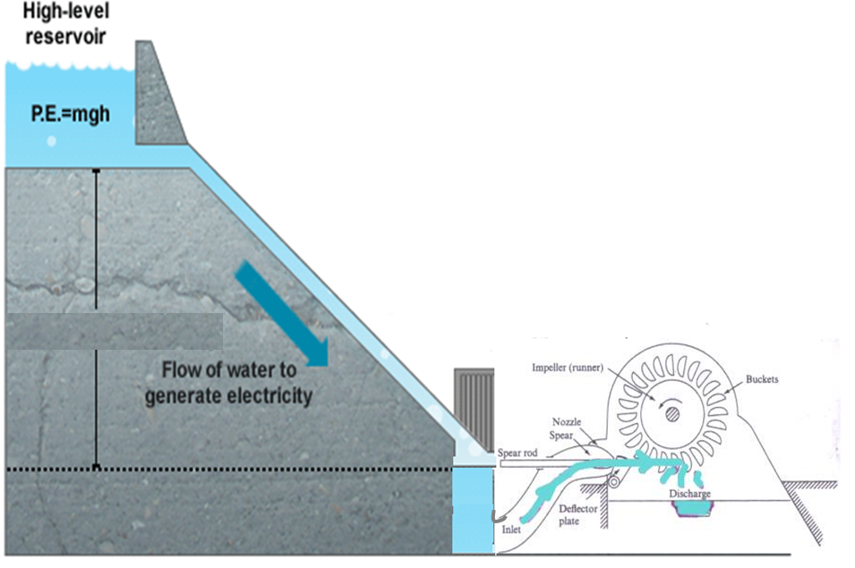
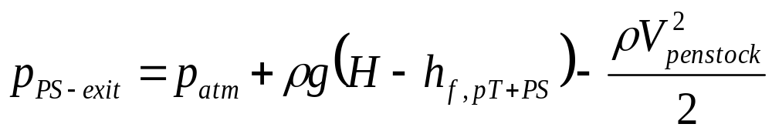
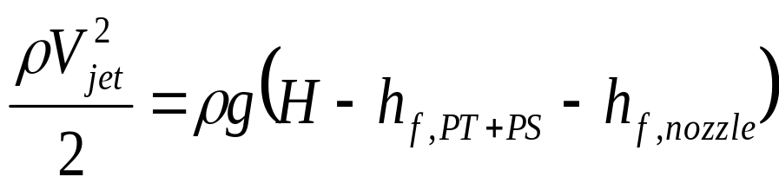
Design Of Intake for High Release of Power
p_{atm}
H

Slide 6
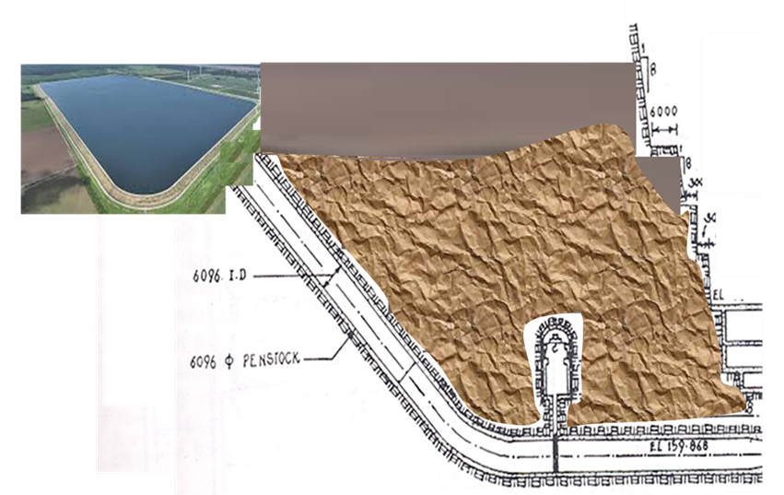
Head Fall with Lowest Irreversibility

Slide 7
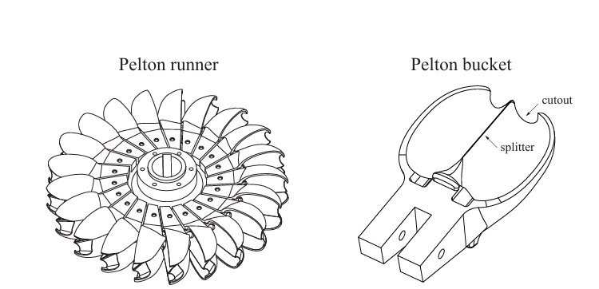
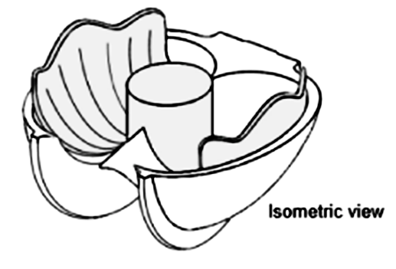
The Pelton Wheel & Bucket

Slide 8
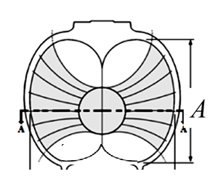
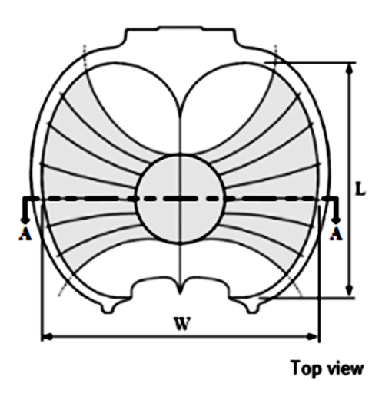
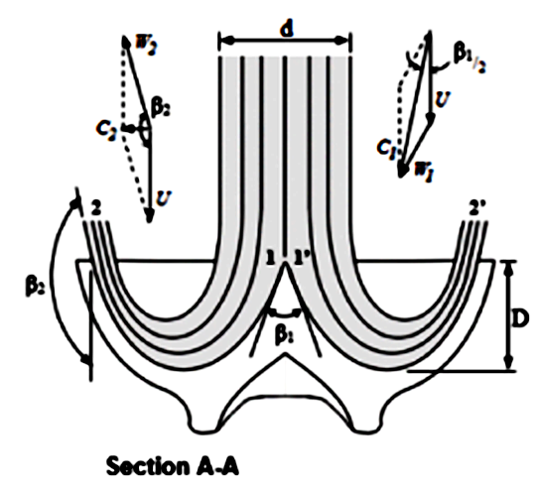
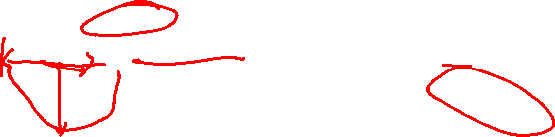
Projections of action by an Orthogonal Jet on a Pelton Bucket
A
B
C

Slide 9
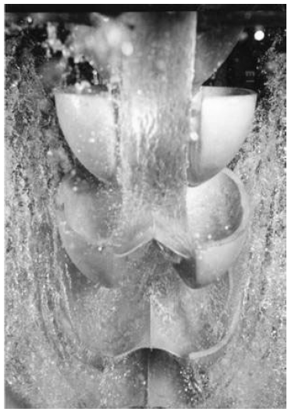
External stroboscopic flow visualization: Learning from Machine
Bucket succeeding the Main Bucket
Main Bucket Interacting with Jet
Bucket Preceding the Main Bucket

Slide 10
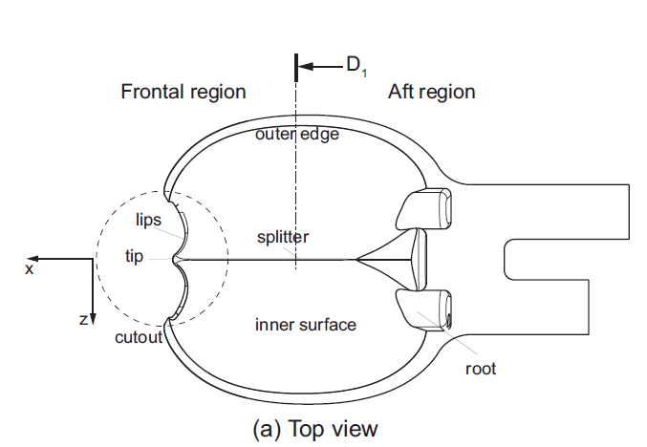
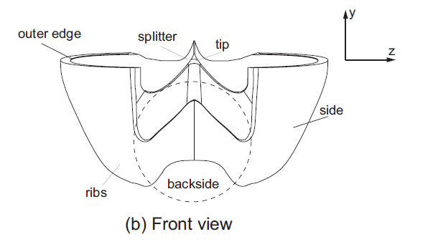
Bucket Geometric Definitions: Leant from Machine

Slide 11
Bucket Geometric Definitions: Leant from Machine

Slide 12
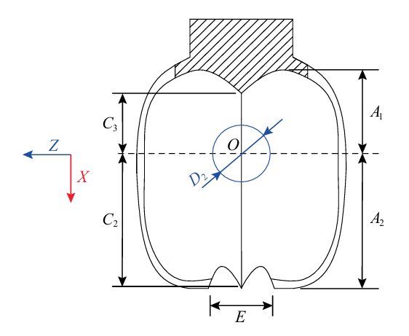
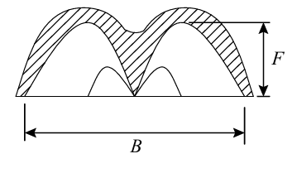
Macro Geometric Details of Bucket

Slide 13
A Set of Relations among Major Geometrical Features
A jet of finite velocity needs to have a relation with peripheral velocity of wheel.
A jet of finite area need to have a relation with dimensions of bucket.
A bucket of finite dimensions and shape should have a relation with wheel.

Slide 14
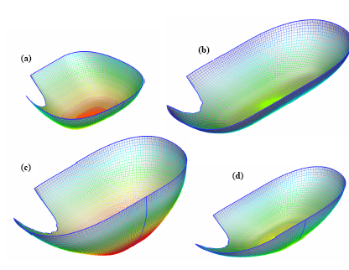
Shape variations of Buckets

Slide 15
Optimum Bucket Design
At first, various combinations of the free design variables are tested with the optimization method.
This helps in assessing the relative importance of each one, as well as to determine their variation ranges.
Efficiency depends more on the main bucket dimensions (length, width and depth), than on the shape of the outer part of its rim or on the lateral surface curvature.
The optimization has to be carried out for all the free design variables simultaneously.
This practice enhances the time of design optimization, but at the same time ensures that the resulting optimum design is acceptable.
The creation of evaluations using Artificial Intelligence Tool is an option of the method to achieve faster convergence.

Slide 16
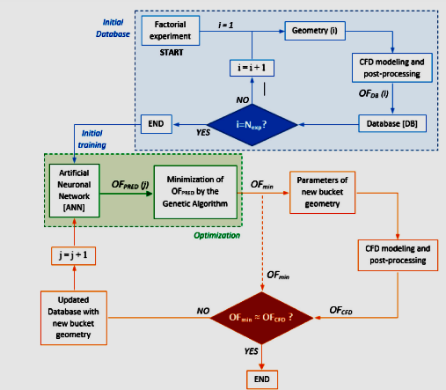
AI for Evaluation of Geometrical Features Bucket
General dimensions A₁,A₂,B,C₂,C₃,E,F

Slide 17
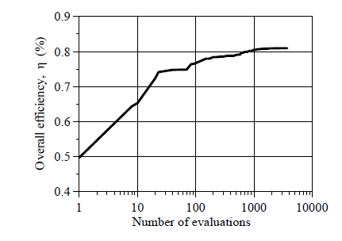
AI for Evaluation of Geometrical Features Bucket
Each evaluation is a combination of length, width and depth.

Slide 18
Further Parametric studies using AI Models
The developed methodology also facilitates the investigation of the effect of any design parameter on the runner efficiency.
Also, helps in the prediction of the turbine behaviour at various operation conditions (e.g. different head or rotation speed).
Two important parametric studies are:
In the first study the bucket size is varied by increasing or reducing its main dimensions (length, width, depth) at the same degree, so as the modified shapes remain similar to the initial one.

Slide 19
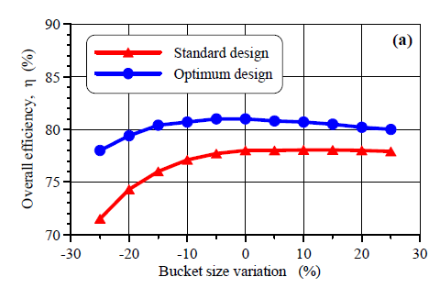
Optimization of Bucket Geometry

Slide 20
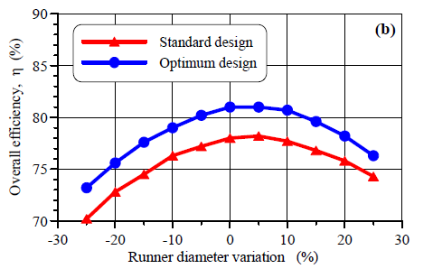
Sensitivity Analysis

Slide 21
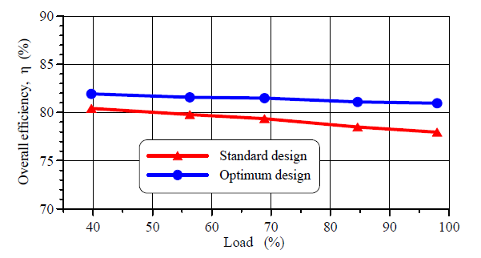
Optimization of Bucket Geometry

Slide 22
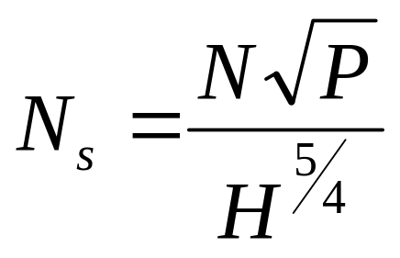
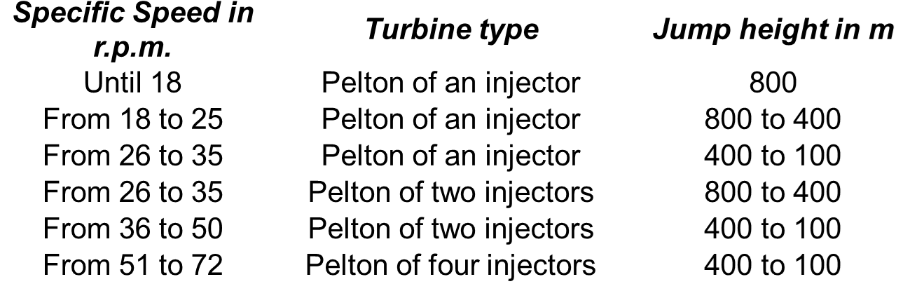
More Adapted Value of N_{s} for A given Type of Turbine
Specific speed in rpm

Slide 23
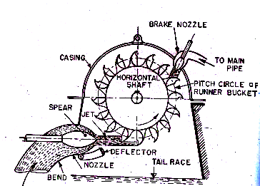
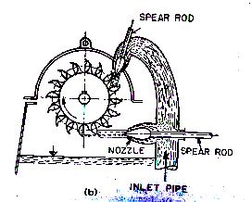
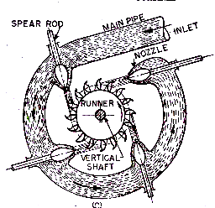
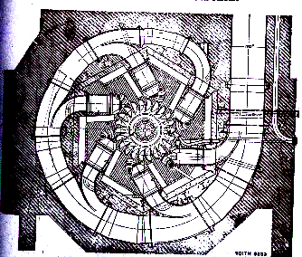
Multiple jet to Handle Larger Flow Rates with High Head

Slide 24
More Adapted Value of N_{s} for A given Type of Turbine
Specific speed in rpm

