Slide 1

Identification & Classification of Turbomachinery
P M V Subbarao
Professor
Mechanical Engineering Department
Fundamental Concepts Used to Create Turbomachinery !!!

Slide 2



Extrasomatic View of Natural Resources
Capital
Resource
ONE TIME RESOURCE
SOLAR ENERGY
INCOMING
RESOURCE
CO₂ + H₂O
PHTOSYNTHESIS
WINDS
VEGETATION
OCEAN
THERMAL
ENERGY
SOLAR
RADIATION
CLOUDS
CHEMICAL ENERGY
RAINS& Rrivers
THERMAL
WAVE
WIND ENERGY
FOSSILIZATION
HYDRO ENERGY
COAL
FOSSIL FUEL
PETROLEUM
NATURAL GAS

Slide 3
Sources for Extra-somatic Needs
Source of Energy
--Cycle Design
-- Resource Management System Design
--Turbomachine Design.
Fourth Law for Creation of Mechanical Beasts
Land, Water & Air (Sinks)

Slide 4
Extrasomatic View of Natural Resources
Capital
Resource
SOLAR ENERGY
INCOMING
RESOURCE
ONE TIME RESOURCE
CO₂ + H₂O
PHTOSYNTHESIS
WINDS
VEGETATION
OCEAN
THERMAL
ENERGY
SOLAR
RADIATION
CLOUDS
CHEMICAL ENERGY
RAINS& Rrivers
THERMAL
WAVE
WIND ENERGY
FOSSILIZATION
COAL
FOSSIL FUEL
PETROLEUM
NATURAL GAS
Windmills
HYDRO ENERGY
Steam & Gas Turbines
Water Wheels

Slide 5
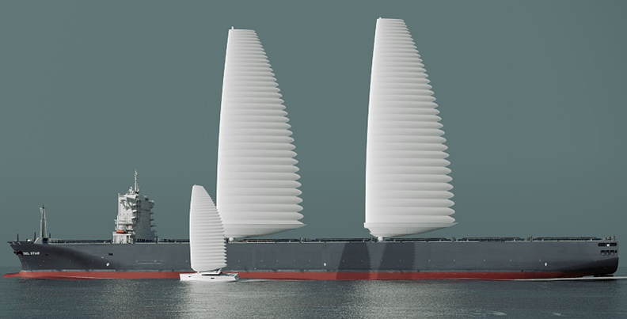

Travel on Water:
Fractional DoF to Second DOF

Slide 6
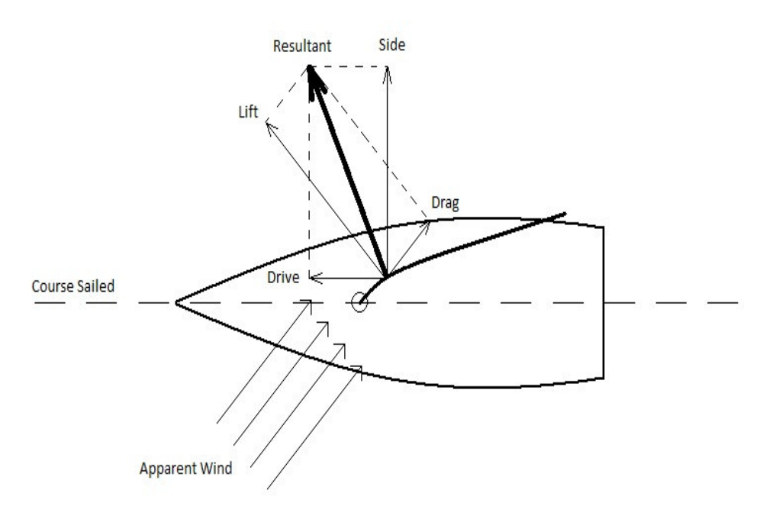
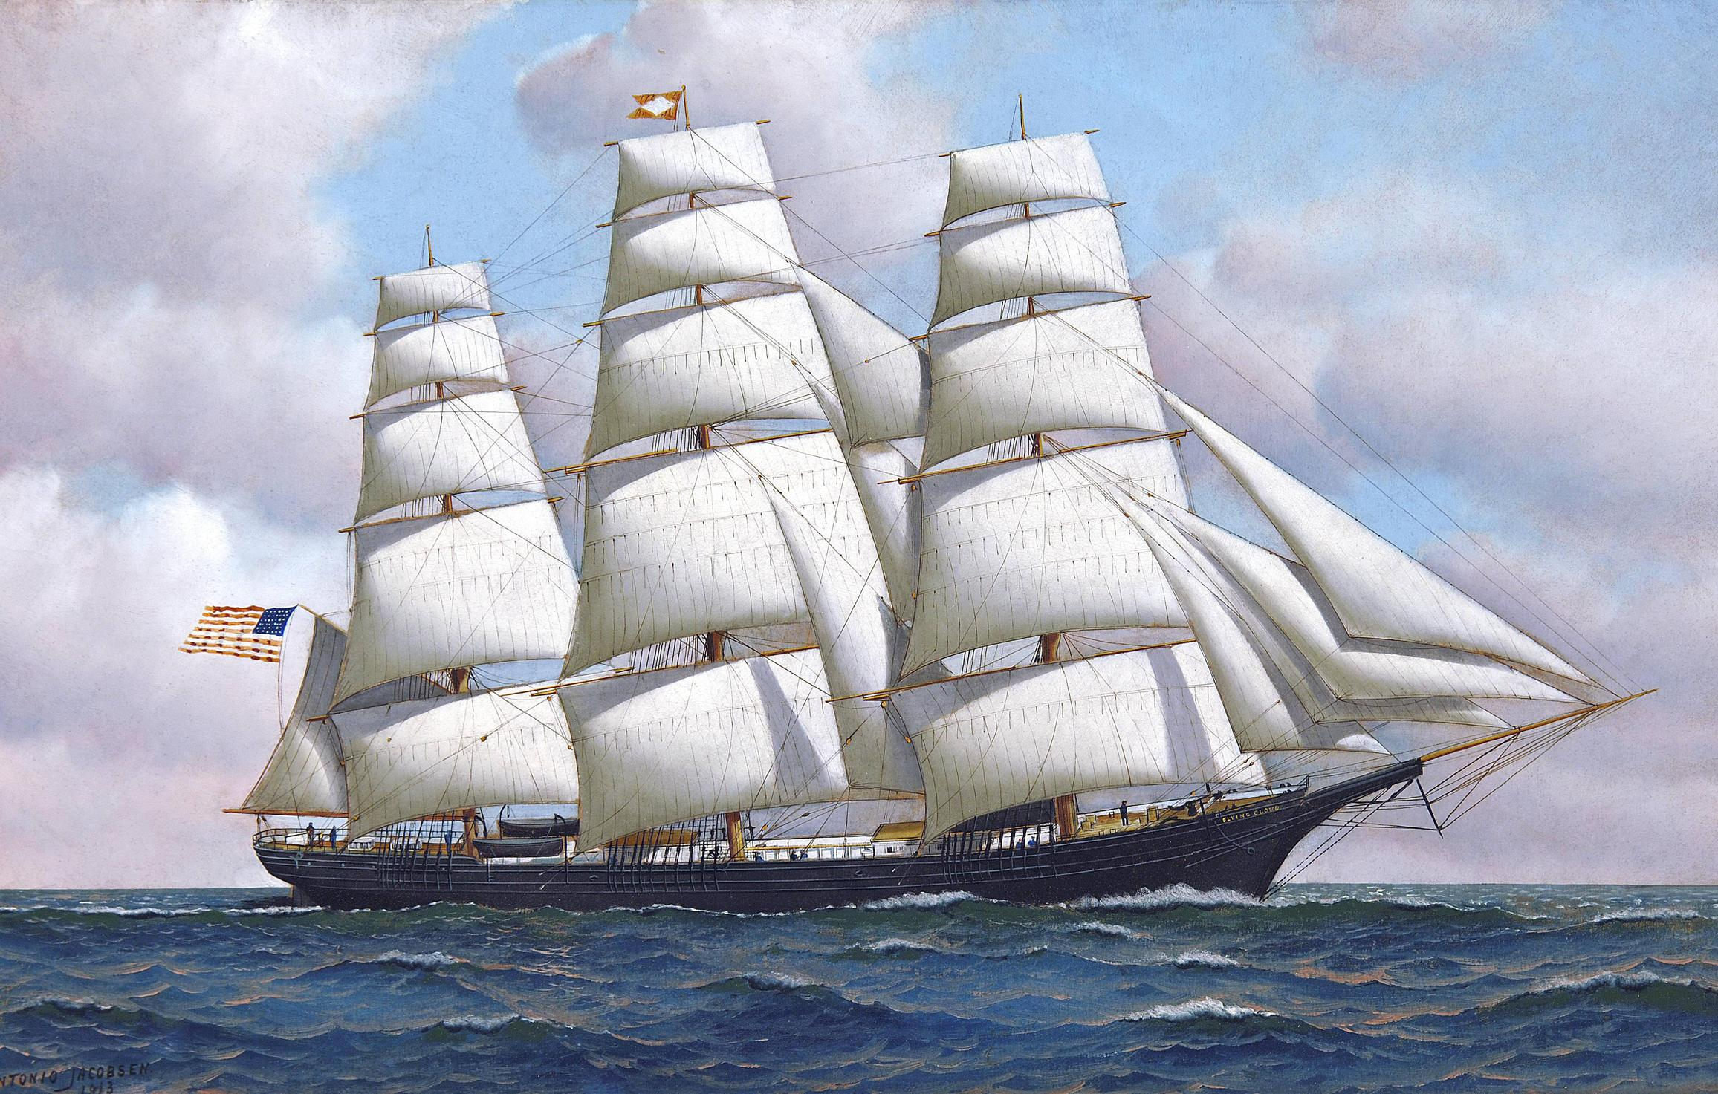

Utilization of Wind Power for Immediate Displacement
Instantaneous work done by wind on sail:
$$δW=\vec{F}.d\vec{x}$$
Scalar product leads to Immediate Consumption!

Slide 7
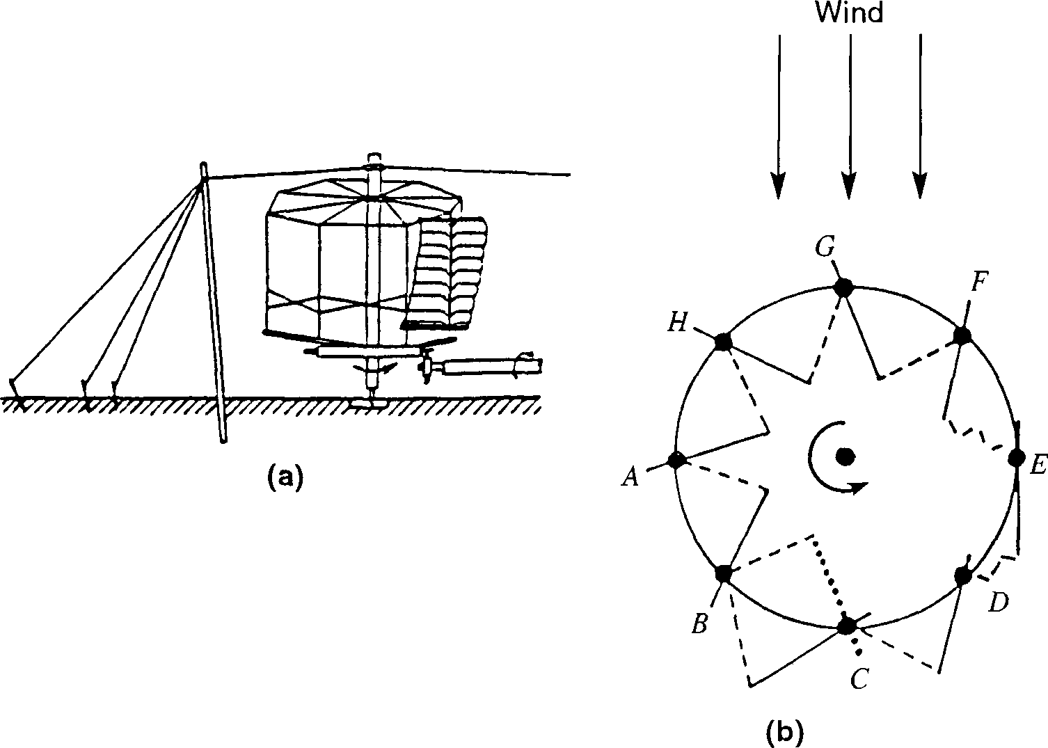


Utilization of Wind Power for Creation of Artificial Horse
Instantaneous Torque generated by wind :
$$\vec{τ}=\vec{F}× \vec{r}$$
Instantaneous shaft work done by wind :
Vector product preceding the Scalar product enhances the benifits!
$$δW=\vec{τ}.d\vec{θ}$$

Slide 8
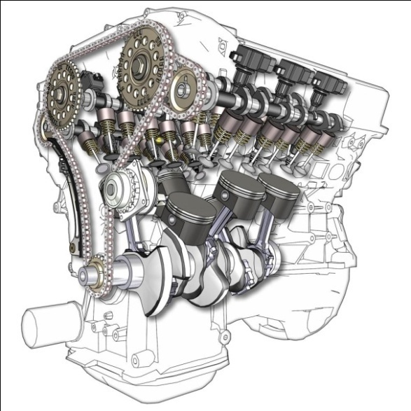
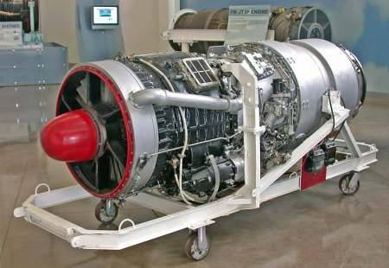
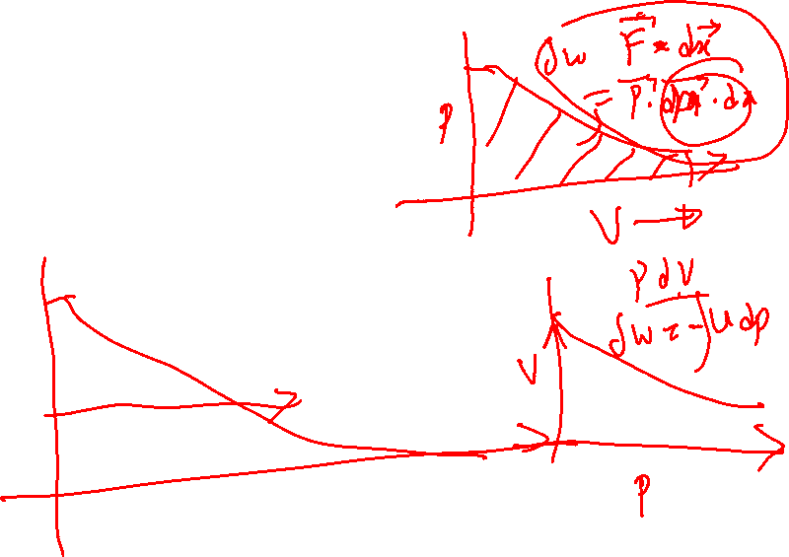
Thermodynamics (20th Century view) of Fluid-machines
The Devices for High Level Extrasomatic Needs.
Control Mass
Control Volume

Slide 9
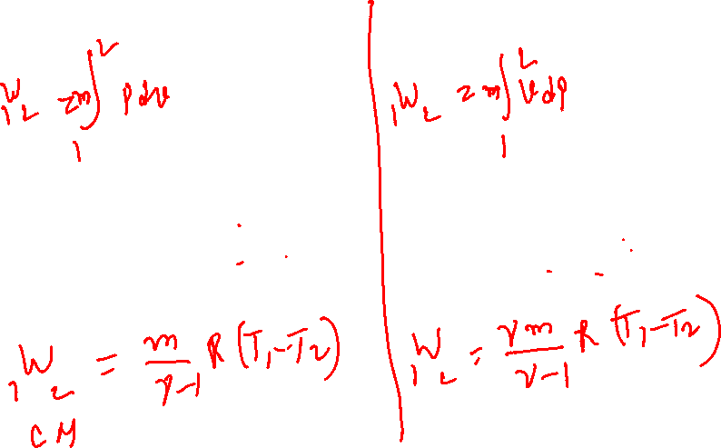
Thermodynamic Superiority of A Turbomachine
Any device working from state 1 to state 2:
Control Mass machine
Control Volume machine
Consider Isentropic Machines with same initial and final states and a perfect gas as working fluid:

Slide 10
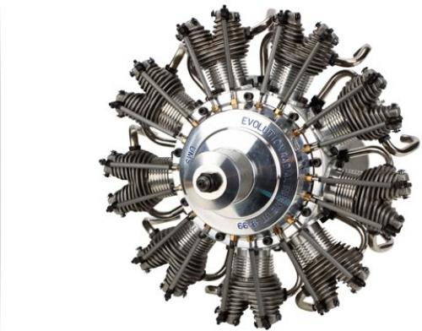
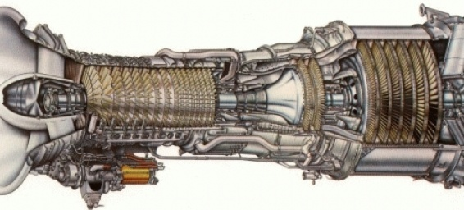
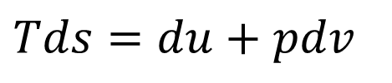
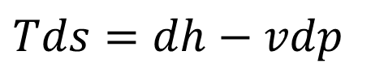
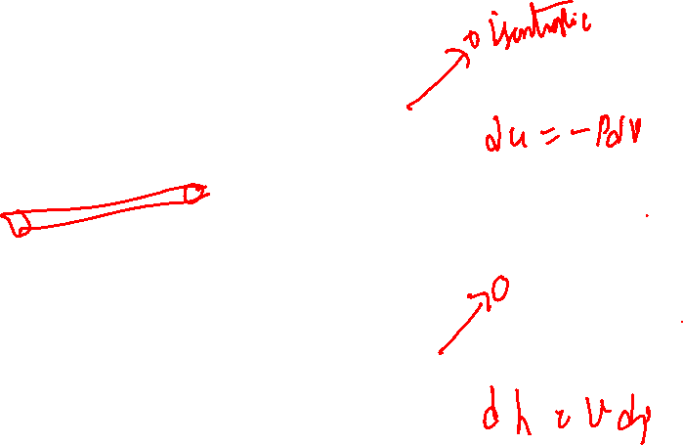
Ideal Utilization of Fluid Energy
Using Gibb’s Equation:
For control mass:
$$Tds=du+pdv$$
For control volume:
$$Tds=dh−vdp$$

Slide 11
The Thermodynamic Classification of Fluid-Machines
Two main categories of turbo-machine are identified:
Firstly, those which absorb power to increase the fluid pressure or head (fans, compressors and pumps);
Secondly, those that produce power by expanding fluid to a lower pressure or head (hydraulic, steam and gas turbines).
 | Incompressible Fluid | Compressible Fluid
Power Generating Machines | Hydraulic Turbines/ Wind Turbines | Steam/Gas Turbines
Power Consuming Machines | Pumps | Fan/blowers/ Compressors

Slide 12
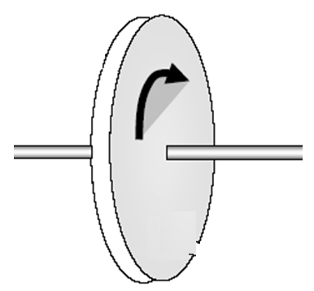
Fluid Dynamics of A Turbomachine
A Turbo-machine:
(An Active Hardware)
Fluid in
Fluid out
How to design hardware???

Slide 13
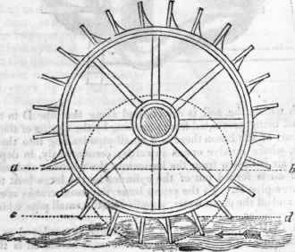
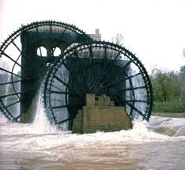
The Ancient Design : Undershot Water Wheel : 4000BC

Slide 14
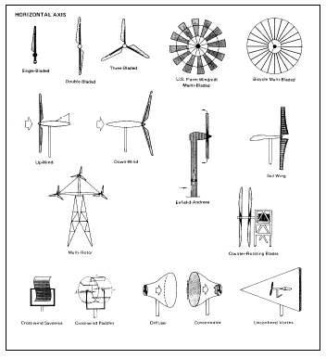
SOME TYPES OF WIND TURBINES: HAWT

Slide 15
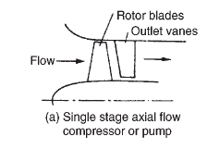
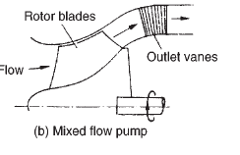
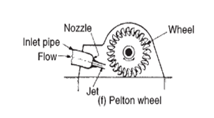
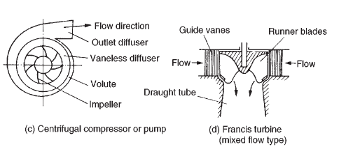
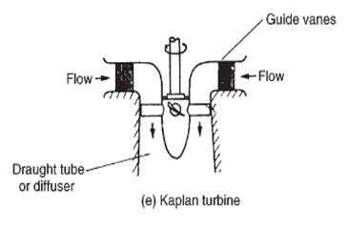
Various Types of Modern Hydraulic Turbomachines

Slide 16
Why So Many?
Why so many different types of either pumps (compressors) or turbines are in use ?
Is it due to (almost) infinite range of service requirements?
As a fact, for a given set of operating/resource requirements ,
there should be only one type of pump or turbine which is best suited to provide best/optimum performance.

Slide 17
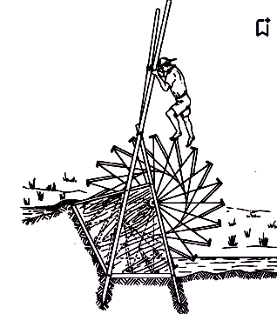
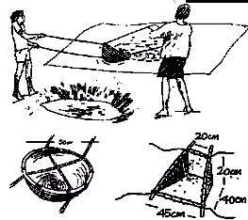
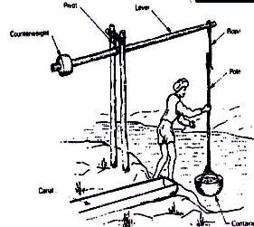
Classification of Turbo-machines
Two main categories of turbo-machine are identified:
Firstly, those which absorb power to increase the fluid power (Pumps, fans and compressors).
Human Muscle power to Fluid Power:
Fractional DoF
Second DoF

Slide 18
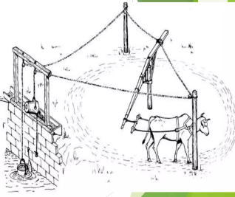
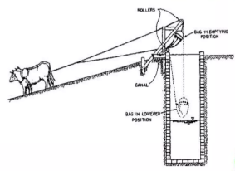
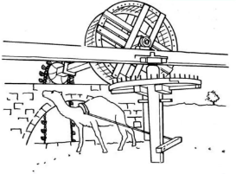
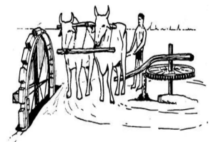
Classification of Turbo-machines
Animal Muscle power to Fluid Power:
Evolution of
Second DoF

Slide 19
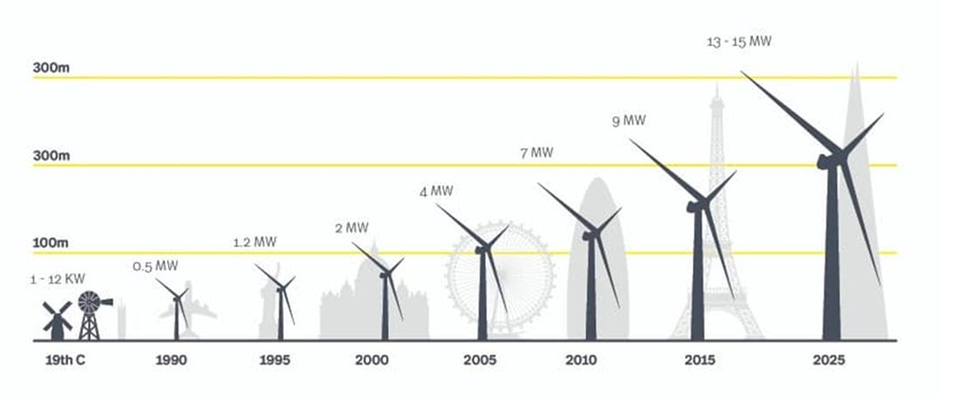
Classification of Turbo-machines
Two main categories of turbo-machine are identified:
Secondly, those that produce power by expanding fluid to a lower pressure or head (hydraulic, steam and gas turbines).
Fluid Power to Shaft Power:

Slide 20
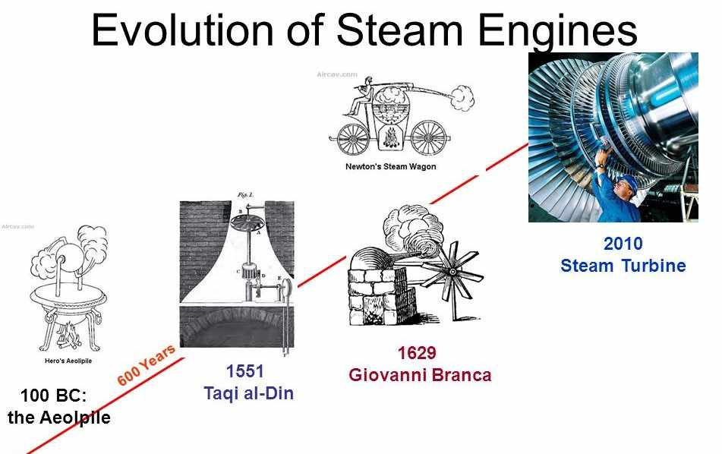
The Family of Steam Pumps : Artificial Horse/animal
Fire Power to Mechanical Power
Evolution of
Second DoF

Slide 21
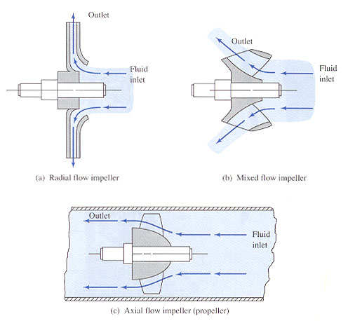
Advanced Classification : Flow Path

Slide 22
Classification : Flow Path
Turbo-machines are further categorised according to the nature of the flow path through the passages of the rotor.
When the path of the through-flow is wholly or mainly parallel to the axis of rotation, the device is termed an axial flow turbo-machine.
When the path of the through-flow is wholly or mainly in a plane perpendicular to the rotation axis, the device is termed a radial flow turbo-machine.
Mixed flow turbo-machines are widely used.
The term mixed flow refers to the direction of the through-flow at rotor outlet when both radial and axial velocity components are present in significant amounts.

Slide 23
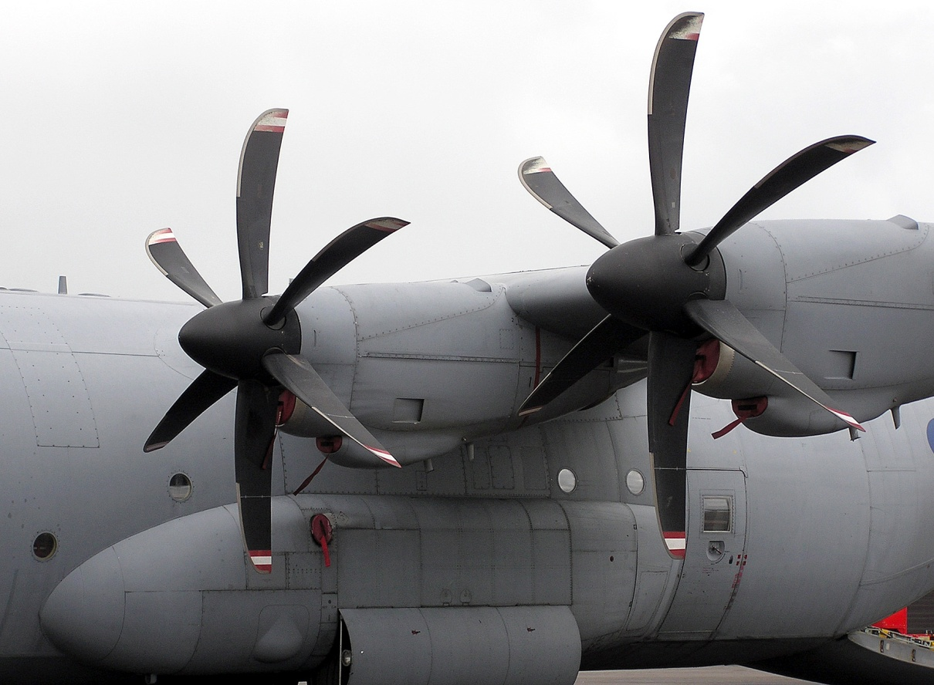
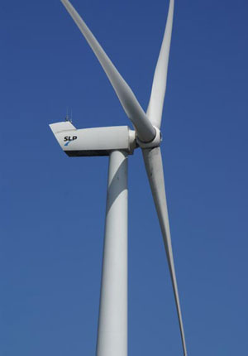
Solid – Fluid Interaction Level
Open flow
  No casing or enclosure for the rotating device
  Propeller is an open flow power consuming device.
  Windmill is an open flow power generating device.
Enclosed or encased flow devices

Slide 24
Any Unified Theory for Invention of Hardware?
Developed by the Father of Turbomachines…
The Fundamental Model for Turbomachinery

