Slide 1

Hydraulic Fluid Machines
P M V Subbarao
Head & Professor
Mechanical Engineering Department
Machines working with Truly Incompressible Flows…….

Slide 2


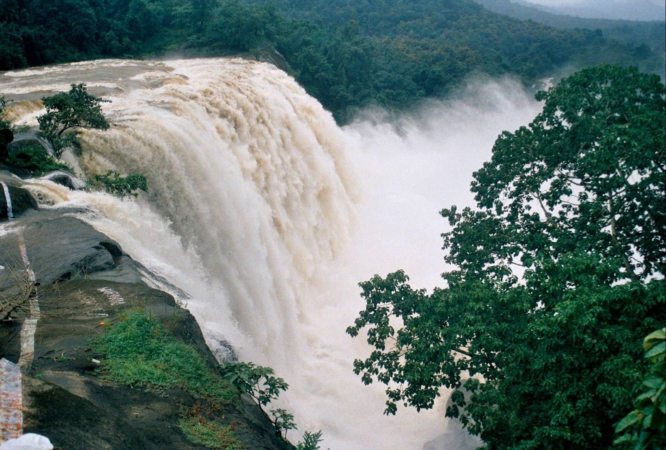
A Two-Way Welfare for the Globe

Slide 3
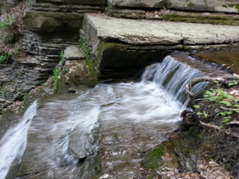
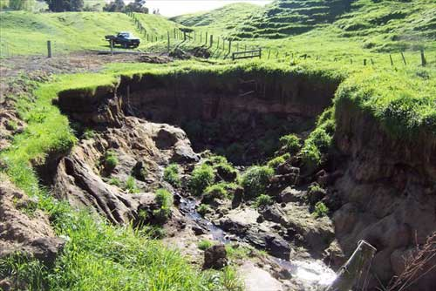
A Two-Way Welfare for the Globe

Slide 4
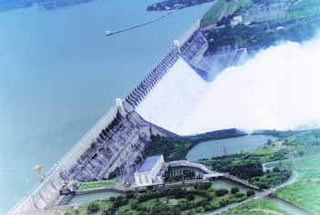
Reservoir Created using A DAM

Slide 5
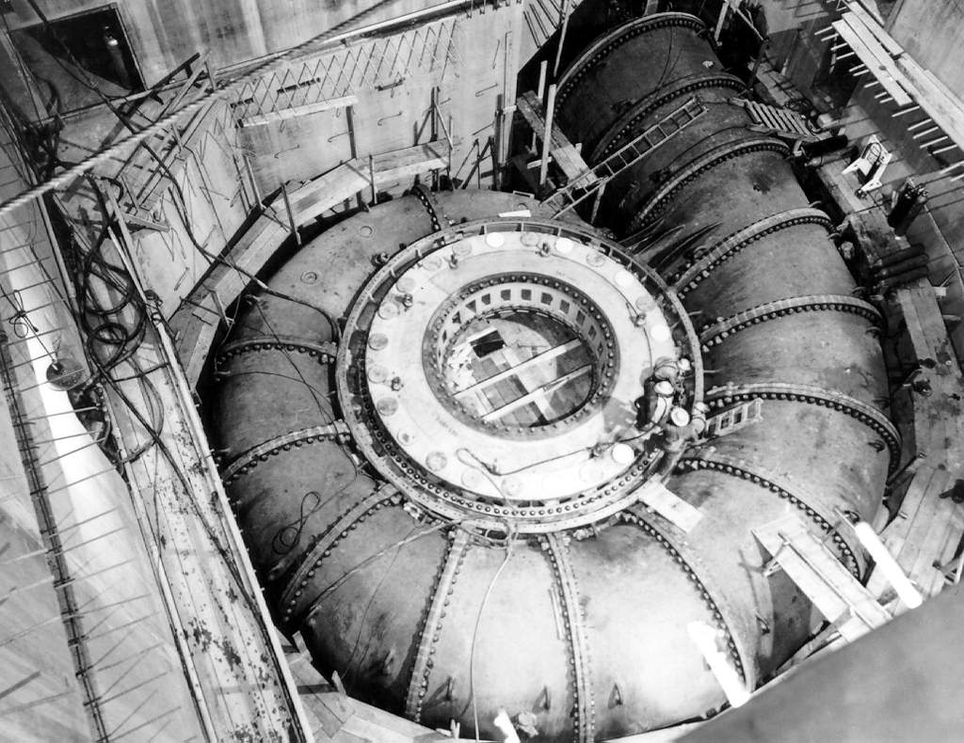
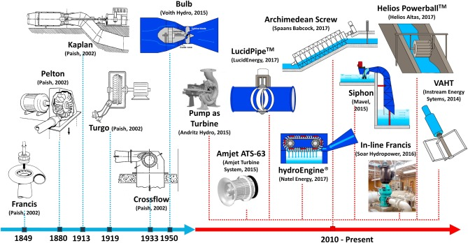
A Two-Way Welfare for the Globe

Slide 6
Identification of Resources
Primary characteristics of a Hydo-source and need.
The strength of a source: Head, H (m) or Δp
The Capacity: Discharge Q (m³/s) or Power, P (kg.m²/s³ ).

Slide 7
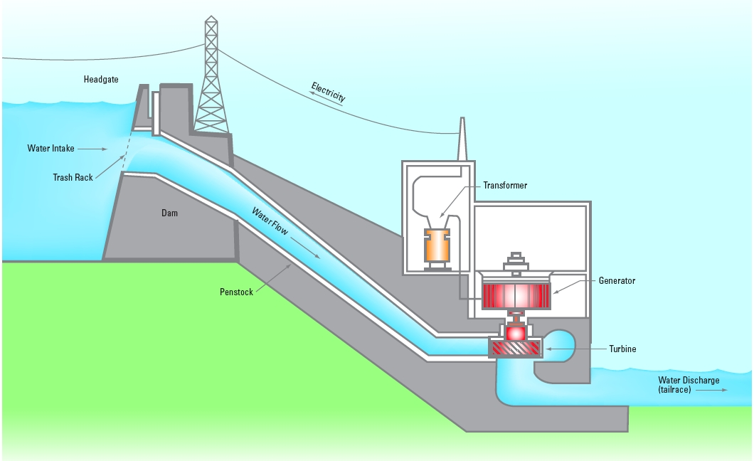
The Powerhouse
How to select Right Principle of Operation for the Turbine in a HEPP??

Slide 8
The Challenge: Development of Customized Mega Scale Dams and Mega Capacity Hydro Turbines !!!
A Novel Philosophy of Creation: Principle of Similitude
Every Maga Scale System can be Modelled as a Tiny System, with same Natrual Characteristics.

Slide 9


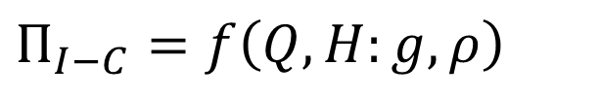

A Matching Parameter for a Euler’s Machine with The Resource
There exist a Matching Parameter with Reduced/no dimensions:
For hydraulic power Resources
$$Π_{I−G}=f\left(P,H:g,ρ\right)$$
For hydraulic power Needs
$$Π_{I−C}=f\left(Q,H:g,ρ\right)$$
For compressible power Generating fluid resources
$$Π_{C−G}=f\left(P,Δp:ρ\right)$$
For compressible power Consuming fluid needs
$$Π_{C−C}=f\left(Q,Δp:ρ\right)$$

Slide 10
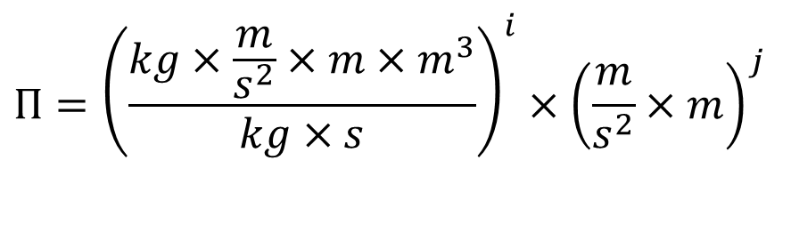
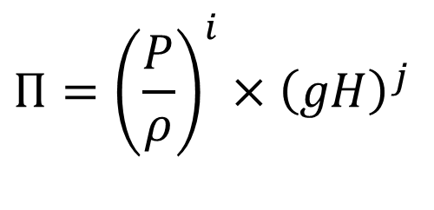
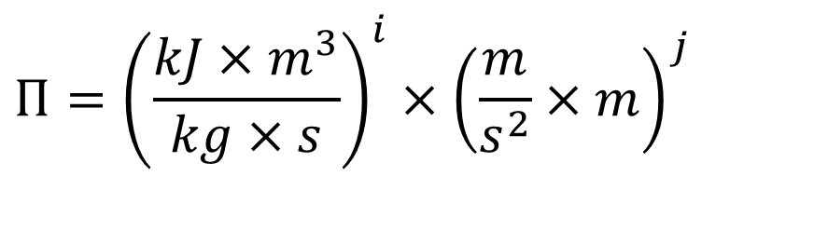
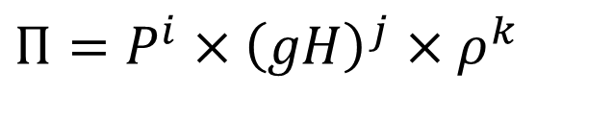

Machine-Resource Matching Parameter:
For a Hydraulic Power Resource:
$$Π_{I−G}=f\left(P,H:g,ρ\right)$$
$$Π={\left(\frac{P}{ρ}\right)}^{i}×{\left(gH\right)}^{j}$$
$$Π=P^{i}×{\left(gH\right)}^{j}×ρ^{k}$$
$$Π={\left(\frac{{kJ×m}^{3}}{kg×s}\right)}^{i}×{\left(\frac{m}{s^{2}}×m\right)}^{j}$$
$$Π={\left(\frac{{kg×\frac{m}{s^{2}}×m×m}^{3}}{kg×s}\right)}^{i}×{\left(\frac{m}{s^{2}}×m\right)}^{j}$$

Slide 11
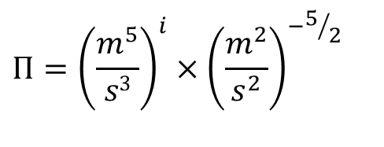
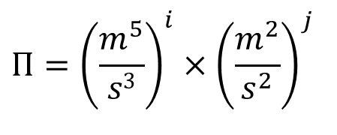
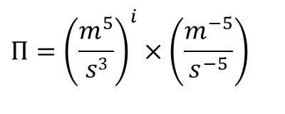
Step by Step Elimination of Fundamental Dimensions
$$Π={\left(\frac{m^{5}}{s3}\right)}^{i}×{\left(\frac{m^{2}}{s^{2}}\right)}^{j}$$
Take j = -5/2
$$Π={\left(\frac{m^{5}}{s3}\right)}^{i}×{\left(\frac{m^{2}}{s^{2}}\right)}^{−5/2}$$
$$Π={\left(\frac{m^{5}}{s3}\right)}^{i}×\left(\frac{m^{−5}}{s^{−5}}\right)$$

Slide 12
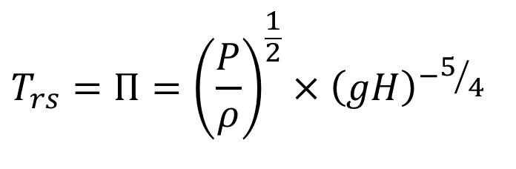
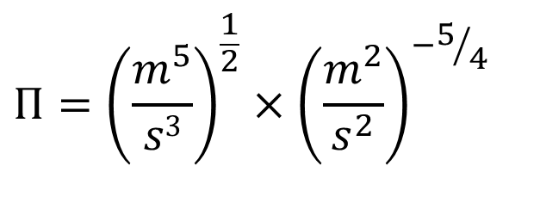
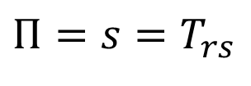
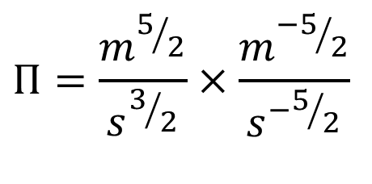
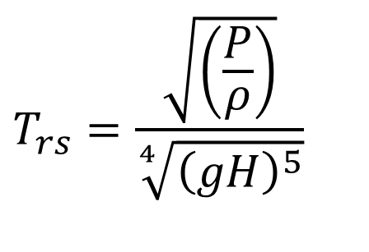
Step by Step Elimination of Fundamental Dimensions
Take i = 1/2 & j = -5/4
$$Π={\left(\frac{m^{5}}{s3}\right)}^{\frac{1}{2}}×{\left(\frac{m^{2}}{s^{2}}\right)}^{−5/4}$$
$$Π=\frac{m^{5/2}}{s^{3/2}}×\frac{m^{{−5}/2}}{s^{−5/2}}$$
Time demanded by resource
$$Π=s=T_{rs}$$
$$T_{rs}=Π={\left(\frac{P}{ρ}\right)}^{\frac{1}{2}}×{\left(gH\right)}^{−5/4}$$
$$T_{rs}=\frac{\sqrt{\left(\frac{P}{ρ}\right)}}{\sqrt[4]{{\left(gH\right)}^{5}}}$$

Slide 13
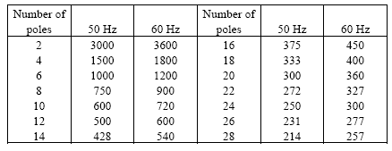
Selection of Speed of A Turbo Machine
The impact of Nationalism…….

Slide 14
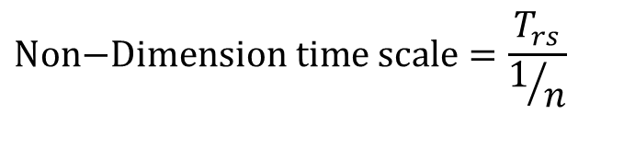
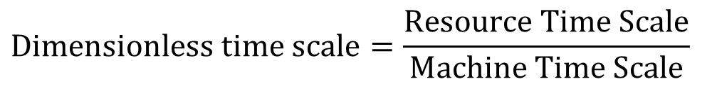

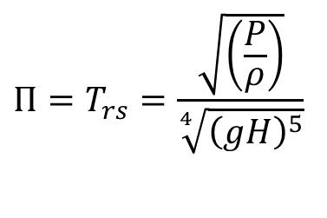
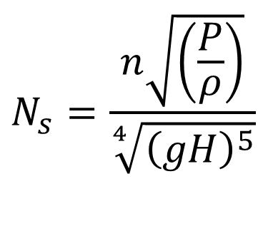
Matching of a Hydraulic Turbine to a Hydraulic Resource
$$Π_{I−G}=f\left(P,H:g,ρ\right)$$
Speed: N (rpm) or n (rps)
$$\text{Dimensionless} \text{time} \text{scale}=\frac{\text{Resource} \text{Time} \text{Scale}}{\text{Machine} \text{Time} \text{Scale}}$$
$$Π=T_{rs}=\frac{\sqrt{\left(\frac{P}{ρ}\right)}}{\sqrt[4]{{\left(gH\right)}^{5}}}$$
$$\text{Non}\text{−}\text{Dimension} \text{time} \text{scale}=\frac{T_{rs}}{1/n}$$
$$N_{s}=\frac{n\sqrt{\left(\frac{P}{ρ}\right)}}{\sqrt[4]{{\left(gH\right)}^{5}}}$$
This is named as Specific Speed, N_{s}

Slide 15
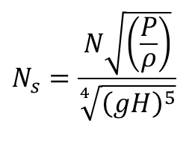
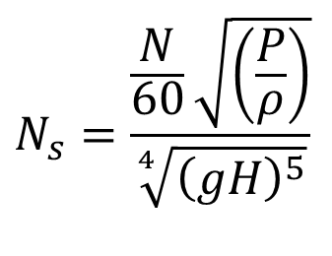
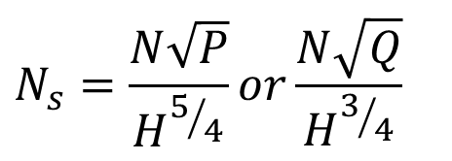
Popular Definitions for Hydraulic Machines
$$N_{s}=\frac{\frac{N}{60}\sqrt{\left(\frac{P}{ρ}\right)}}{\sqrt[4]{{\left(gH\right)}^{5}}}$$
$$N_{s}=\frac{N\sqrt{\left(\frac{P}{ρ}\right)}}{\sqrt[4]{{\left(gH\right)}^{5}}}$$
$$N_{s}=\frac{N\sqrt{P}}{H^{5/4}}or\frac{N\sqrt{Q}}{H^{3/4}}$$
The specific speed, usually represented by N_{s}, also denominated as absolute specific speed or specific angular speed.

Slide 16
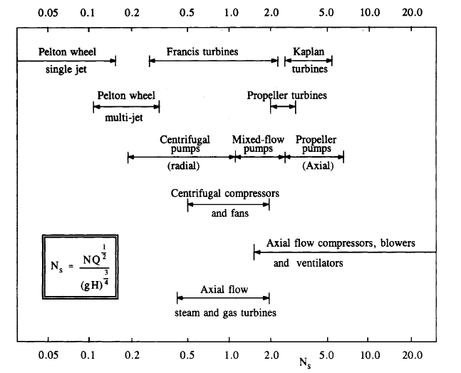
Speed Vs Type of Best Suitable Hydraulic Turbine

Slide 17
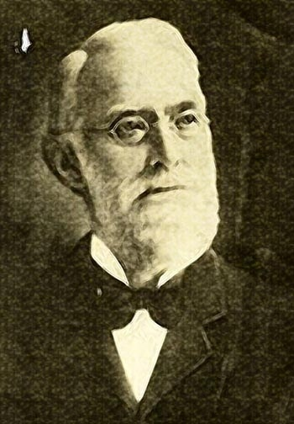
Pelton Turbine: The First Titled Impulse Turbine
Lester Allan Pelton, considered to be the father of modern-day hydroelectric power, was born in Vermilion Township, Erie County, in Ohio, on September 5, 1829.
Pelton embarked on an adventure in search of gold.
Shifted to California from Ohio in 1850, he was 21 years old.
After a failed quest for gold, he joined in the gold mines as a millwright, and carpenter at Camptonville, Yuba County, California in 1864 .

Slide 18
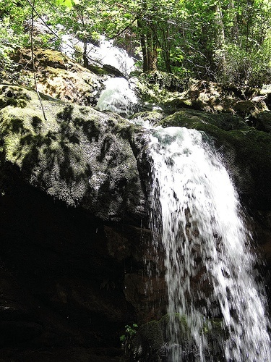
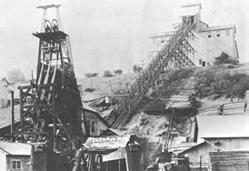
Captonville

Slide 19
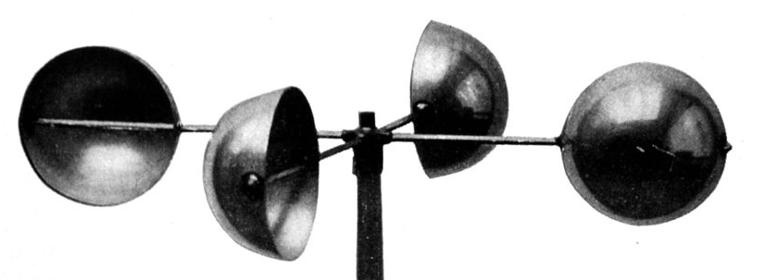
Campton Ville Gold Mine :
Use of Hydro Power Unit
Water wheels were being used to provide mechanical power for all things mining, air compressors, pumps, stamp mills and operating other machines.
The energy to drive these wheels was supplied by powerful jets of water which struck the base of the wheel with flat-faced vanes.
These vanes eventually evolved into hemispherical cups, with the jet striking at the center of the cup on the wheel.
Pelton observed that one of the water wheels appeared to be rotating faster than other similar machines.
It turned out initially that this was due to the wheel had come loose and moved a little on its axle.

Slide 20
Damaged Wheel is A Better Design
He noticed the jet was striking the inside edge of the cups and exiting the other side of the cup.
His quest for improvement resulted in an innovation.
Pelton reconstructed the wheel, with the cups off center only to find again that it rotated more rapidly.
Pelton also found that using split cups enhanced the effect. By 1879 he had tested a prototype at the University of California, which was successful.
He was granted his first patent in 1880.
By 1890, Pelton turbines were in operation, developing thousands of horsepower, powering all kinds of equipment.

Slide 21
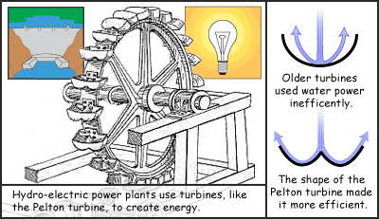
Hydro Power Plant using Pelton Wheel
The Pelton wheel was first used at the Mayflower Mine in Nevada City, California in 1878

Slide 22
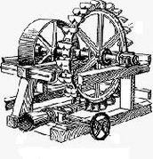
A Patent on Water Wheel
In 1880 Pelton was granted a patent with the following text.
"Pelton water turbine or wheel is a rotor driven by the impulse of a jet of water upon curved buckets fixed to its periphery;
each bucket is divided in half by a splitter edge that divides the water into two streams.
The buckets have a two-curved section which completely reverses the direction of the water jet striking them."

Slide 23
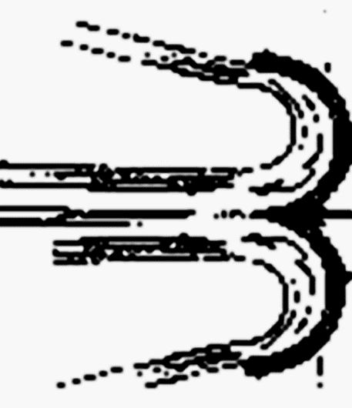
Kinematics of Flow for Actual Bucket in flow plane
$$V_{w,i}=V_{jet}×\cos{α_{i}}$$
$$V_{a,i}=V_{jet}$$
$$V_{r,e}$$
$$V_{w,e}=U_{b}−V_{r,e}×\cos\left(180−β_{e}\right)$$
Euler torque equation:
$$τ=\dot{m}×r×\left(V_{w,i}−V_{w,o}\right)$$

Slide 24
Frictional Flow Past A Bucket
For a real flow past a bucket:
$$V_{r,e}<V_{r,i}⇒V_{r,e}=k_{b}×V_{r,i}$$
$$V_{w,e}=U_{b}−k_{b}×V_{r,i}×\cos\left(180−β_{e}\right)$$
$$V_{r,i}=\frac{V_{jet}×\cos{α_{i}}−U_{b}}{\cos{β_{i}}}$$
$$τ=\dot{m}×r×\left(V_{jet}×\cos{α_{i}}−\left(U_{b}−k_{b}\left\{\frac{V_{jet}×\cos{α_{i}}−U_{b}}{\cos{β_{i}}}\right\}\cos\left(180−β_{e}\right)\right)\right)$$
$$P=\dot{m}×U_{b}×\left(V_{jet}×\cos{α_{i}}−\left(U_{b}−k_{b}\left\{\frac{V_{jet}×\cos{α_{i}}−U_{b}}{\cos{β_{i}}}\right\}\cos\left(180−β_{e}\right)\right)\right)$$

