Slide 1

Design Analysis of Modern Wind Turbines
P M V Subbarao
Professor
Mechanical Engineering Department
I I T Delhi
Natural Wind have no Fixed Direction or Magnitude…..
“The pessimist complains about the wind;
the optimist expects it to change;
the realist adjusts the sails.”
-- William Arthur Ward

Slide 2


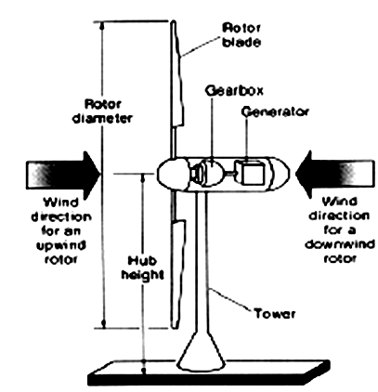

Organs of Modern Wind Turbines
The principal subsystems which make up the total wind energy conversion system are
the rotor,
the power train,
(3) the nacelle structure,
(4) the tower,
(5) the foundation, and
(6) the ground equipment station.

Slide 3
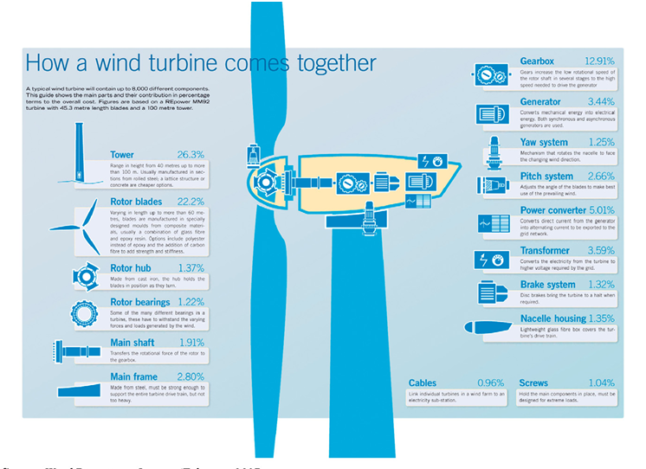
Component-wise Cost Share of a 5 MW Wind Turbine

Slide 4
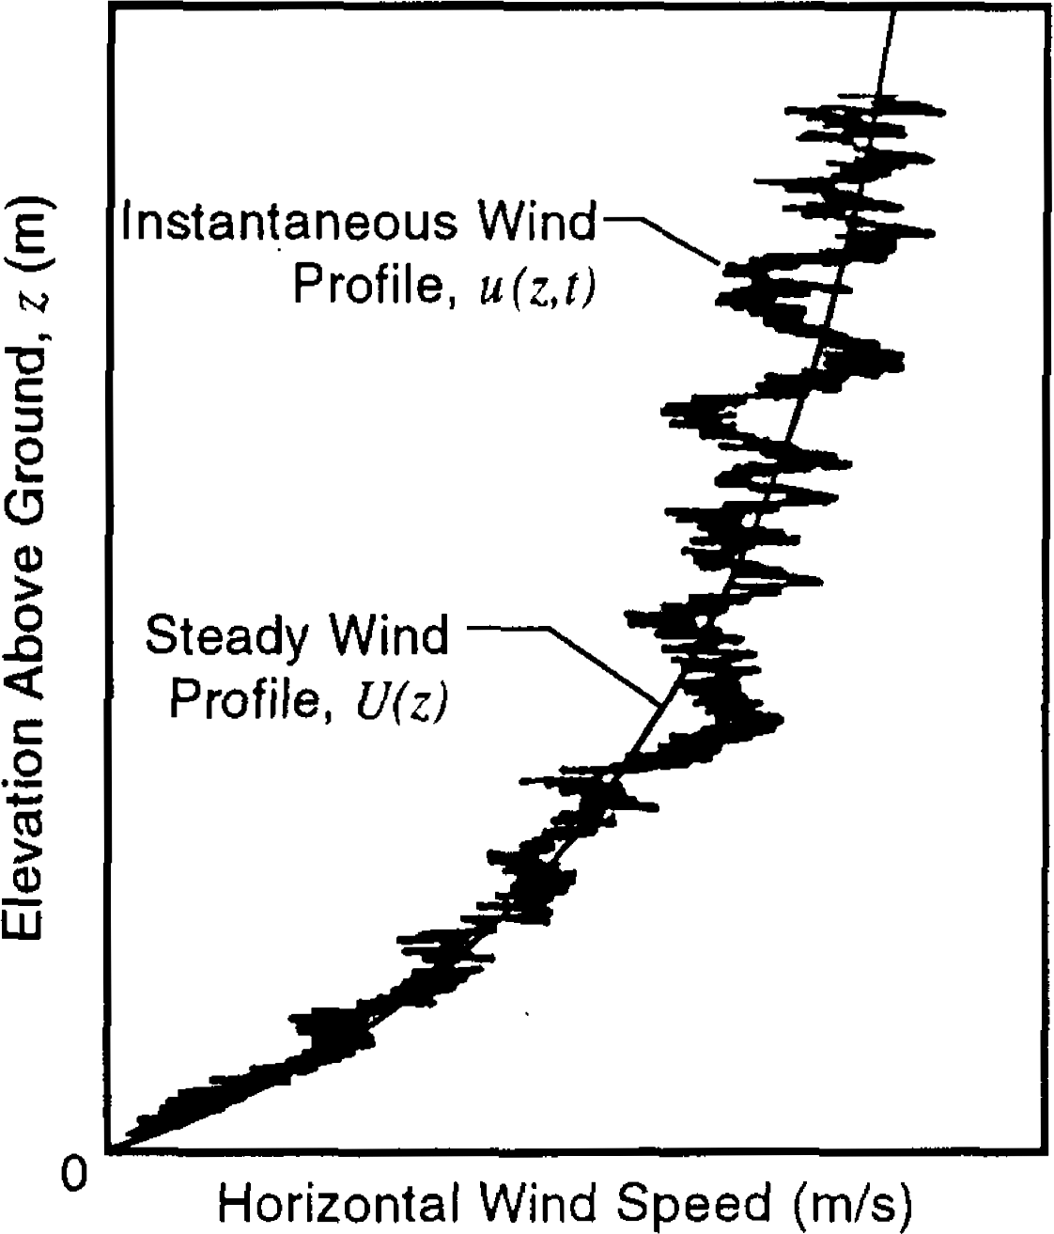
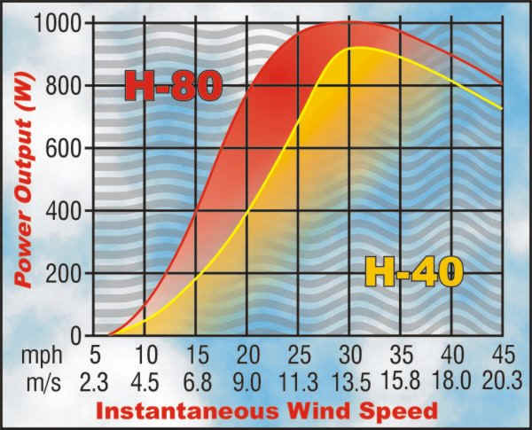
Aerodynamics for Selection of Tower Height

Slide 5
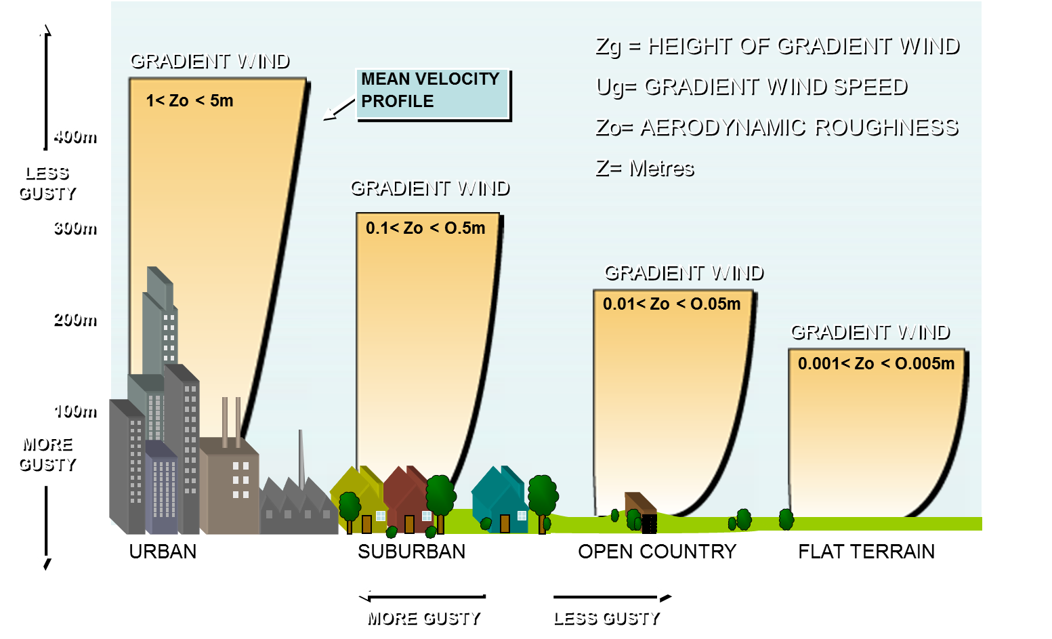
Wind profile Characterization (Shear)

Slide 6
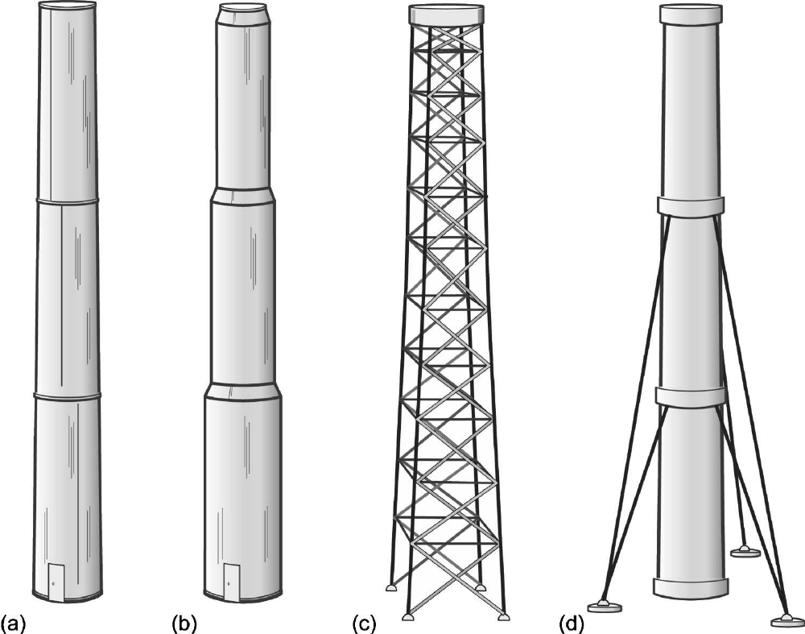
Tower and Foundation
(a)Tubular shell (b) Stepped shell (c)Truss (or lattice) (d) Guyed shell

Slide 7
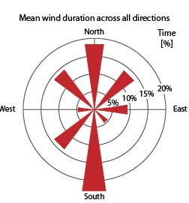
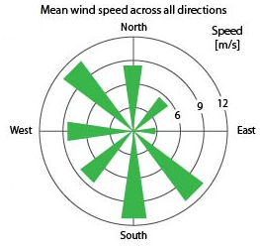

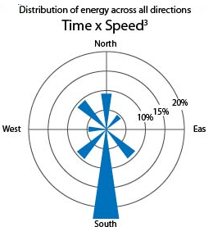
Random Nature of Turbulent Wind

Slide 8
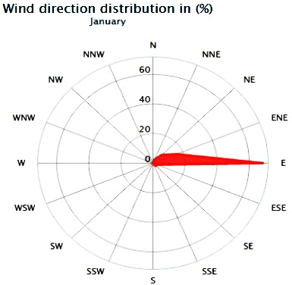
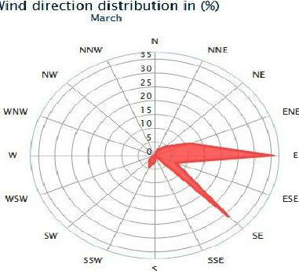
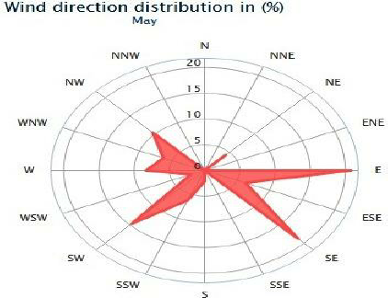
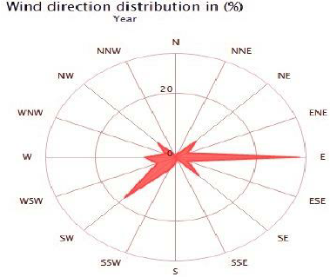
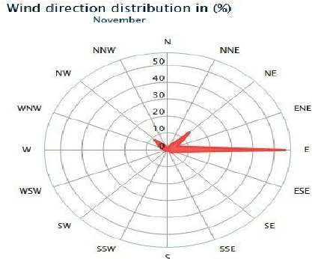
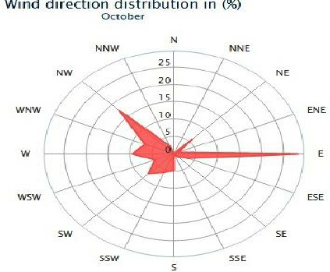
Random Nature of Wind Magnitude & Direction

Slide 9
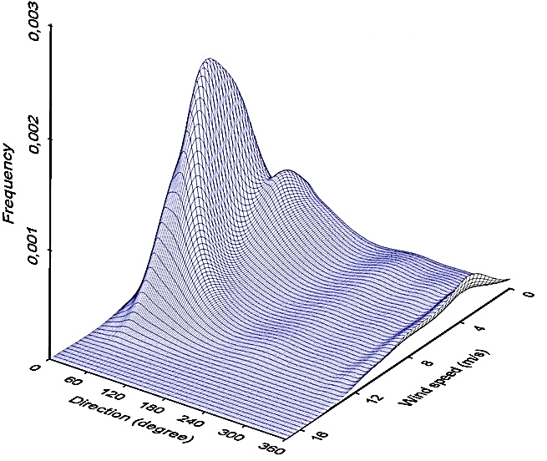
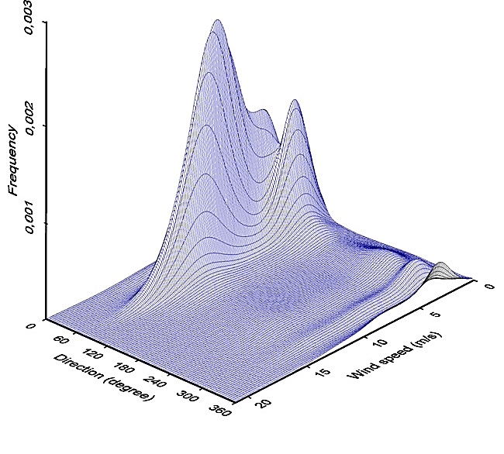
Two Variable (speed-direction) PDF for Wind

Slide 10
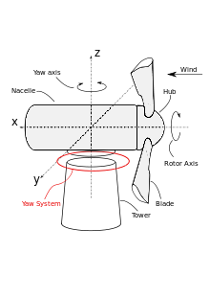
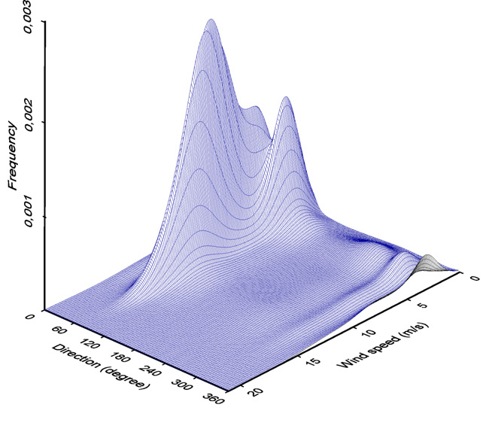
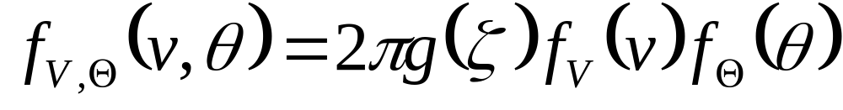
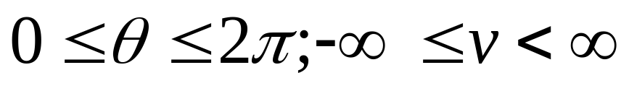
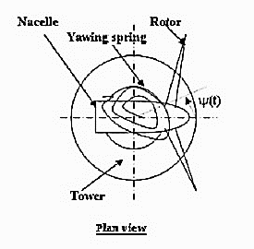
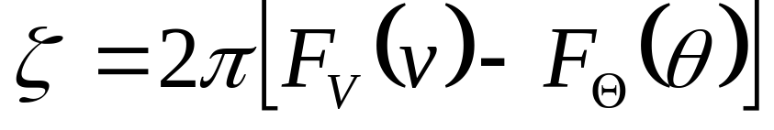
Probability Density for Direction –Velocity Distribution
The probability density for an angular–linear distribution
the circular variable ζ, is defined as

Slide 11
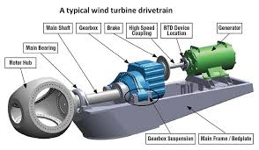
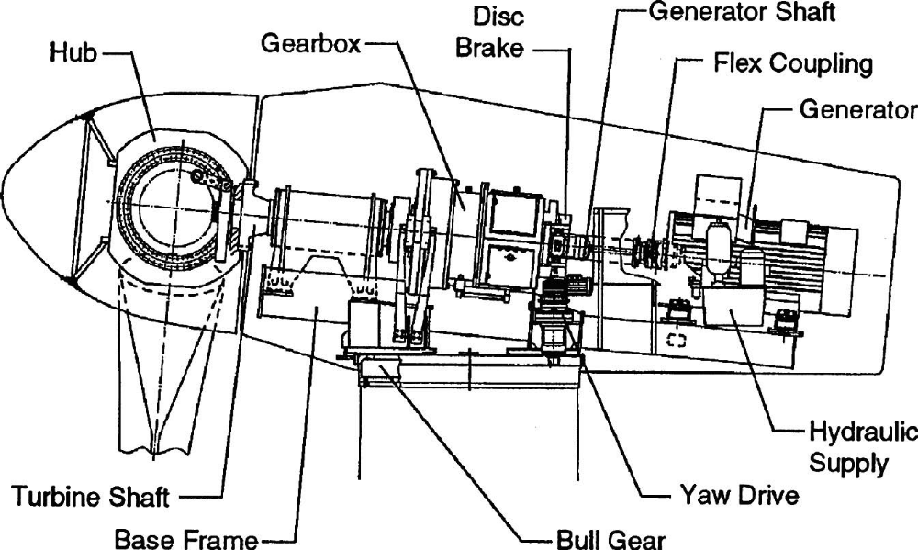
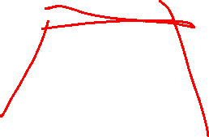
Drive Train, Nacelle, and Yaw Drive Assembly

Slide 12
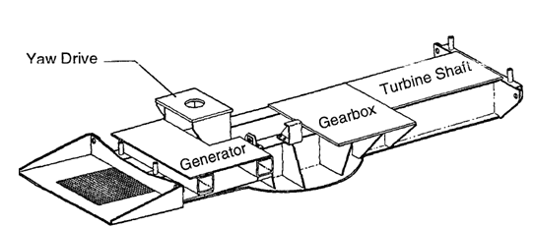
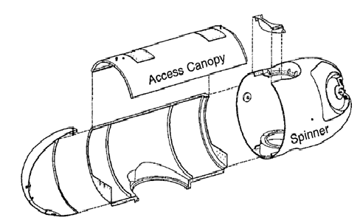
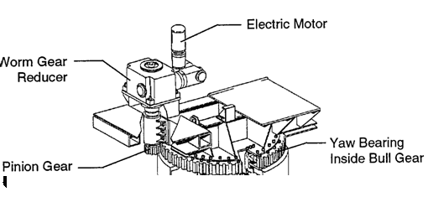
The Nacelle Structure Subsystem
HAWT nacelle structure is the primary load path from the turbine shaft to the tower.
Bed plate assembly
Enclosure
yaw drive mechanism

Slide 13
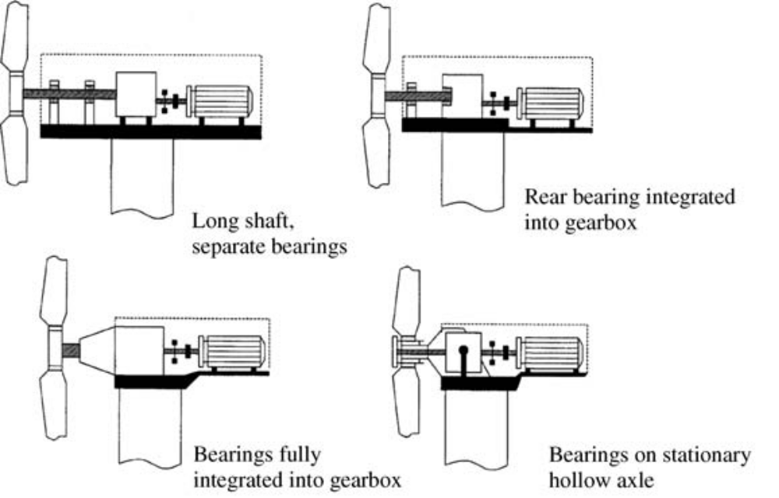
Main Shaft

Slide 14
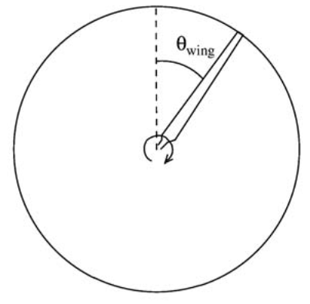
Instantaneous Direction of Wind & Rotor Axis
Rotor Plane
α(t)
V₀

Slide 15
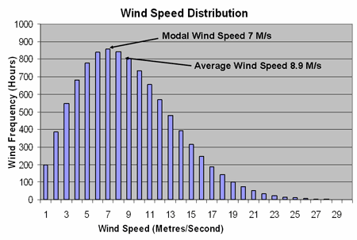
Directional Independence of Two Variable PDF
A single variable PDF can be generated using wind speed as a primary variable.
This function shows probability of occurrence of wind of a given speed in all possible directions.

Slide 16
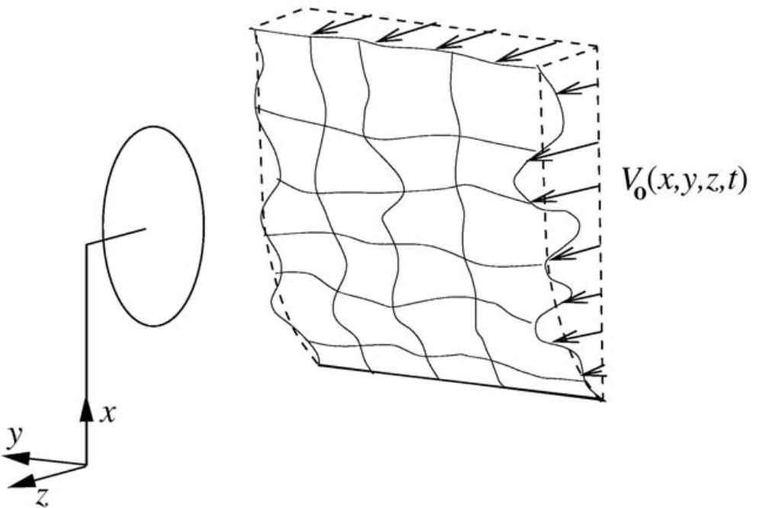
Performing Under Highly Uncertain Conditions

Slide 17
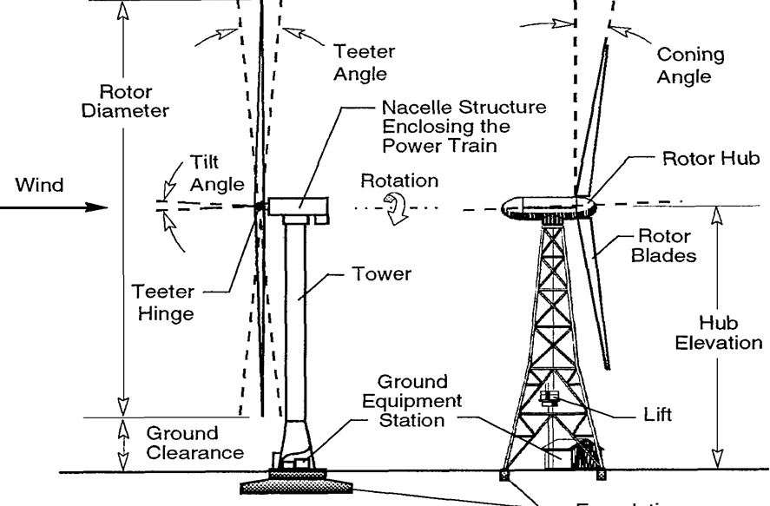
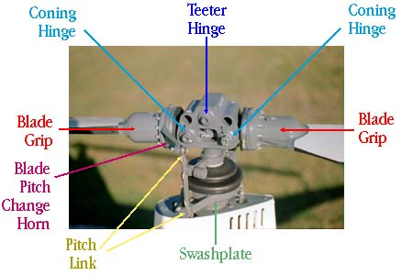
Safety Features of Horizontal-Axis Wind Turbines
(Teetered-hub) upwind rotor
(Rigid-hub )downwind rotor

Slide 18
Wind Distribution Data
Hours per Year
Wind Speed, (m/s)

Slide 19
Wind Power Curve
Power Density, W/m²
Wind Speed, (m/s)

Slide 20
Annual Energy Density Distribution
Annual Energy Density, GJ/m²
Wind Speed, (m/s)

Slide 21
Normalized Annual Energy Density Distribution
Wind Speed, (m/s)

Slide 22
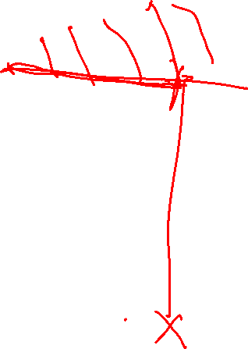
Cummulative Energy Per Yeat
Cummulative Annual Energy Density, GJ/m²
Wind Speed, (m/s)

Slide 23
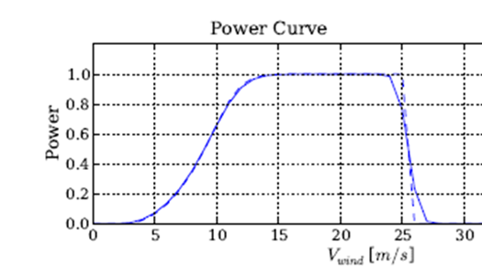
Power curve of Wind Turbine

Slide 24
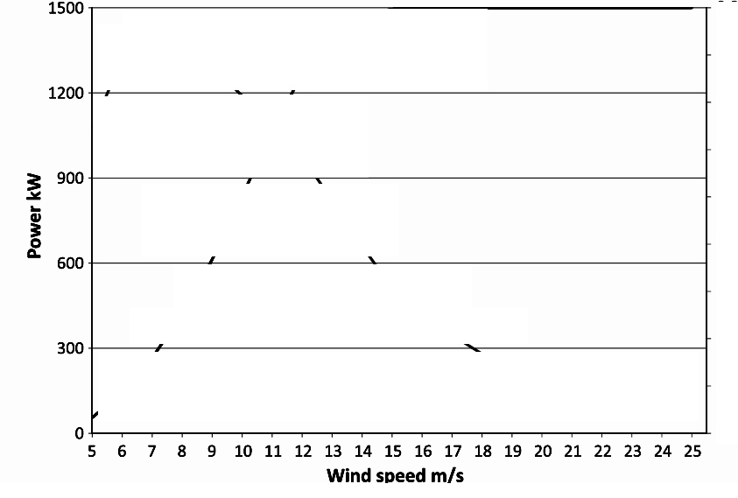
Power Curve Supplied by Manufacturer
Vestas turbine V63
Cut-in speed = 5 m/s,
Cut-out speed = 25 m/s
Nominal power = 1.5 MW
Nominal speed = 16 m/s.

Slide 25
Geometric Features Beyond Aerodynamics Level 1
The terms downwind rotor and upwind rotor denote the location of the rotor with respect to the tower.
An unconed rotor is one in which the spanwise axes of all of the blades lie in the same plane.
Blade axes in a coned rotor are tilted downwind from a plane normal to the rotor axis, at a small coning angle.
Coning helps to balance the downwind bending of the blade caused by aerodynamic loading.

Slide 26
Geometric Features Beyond Aerodynamics Level 2
The minimum distance between a blade tip and the tower is defined as Tower Clearance (TC).
TC is influenced by blade coning, rotor teetering, and elastic deformation of the blades under load.
Elastic deformation can be significant for blades fabricated from composite materials, such as fiber glass.
Often an axis-tilt angle is required to obtain sufficient clearance.
Axis tilt is kept to a minimum because of potential negative side effects, such as reduced swept area and a vertical component to the rotor torque that can cause a yaw moment on the nacelle.

Slide 27
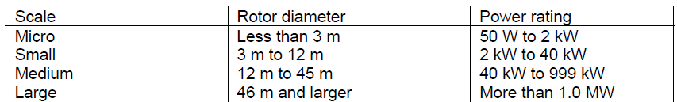
Size of Rotor vs Capacity

Slide 28
Blades : The Muscles
There are many things to consider in designing blades, but most of them fall into one of two categories:
(1) aerodynamic performance and
(2) structural strength.
Other important design considerations;
  Blade materials & recyclability;
  Blade manufacturing & worker health and safety;
  Noise reduction & condition/health monitoring;
  Blade roots and hub attachment;
  Passive control or smart blade options;
  Costs.

Slide 29
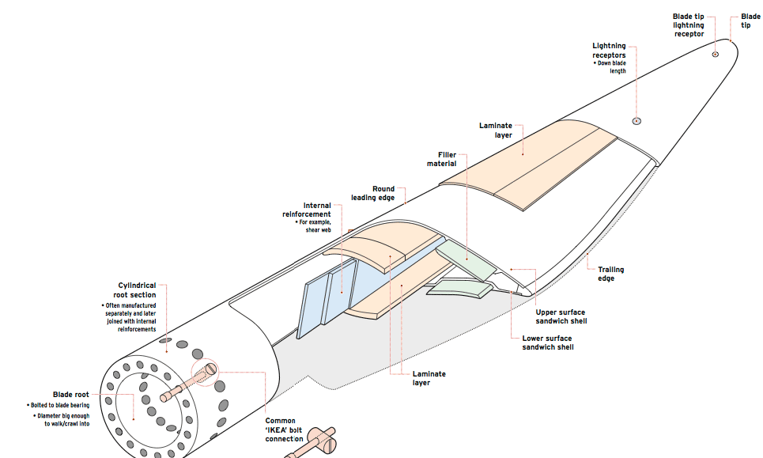
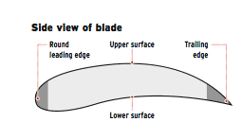
Horizontal-Axis Wind Turbines : Blades

Slide 30
Aerodynamic Performance
The primary aerodynamic factors affecting blade design are:
Design rated power and rated wind speed;
Design tip speed ratio;
Solidity;
Airfoil;
Number of blades;
Rotor power control (stall or variable pitch);
Rotor orientation (upwind or downwind of the tower).

Slide 31

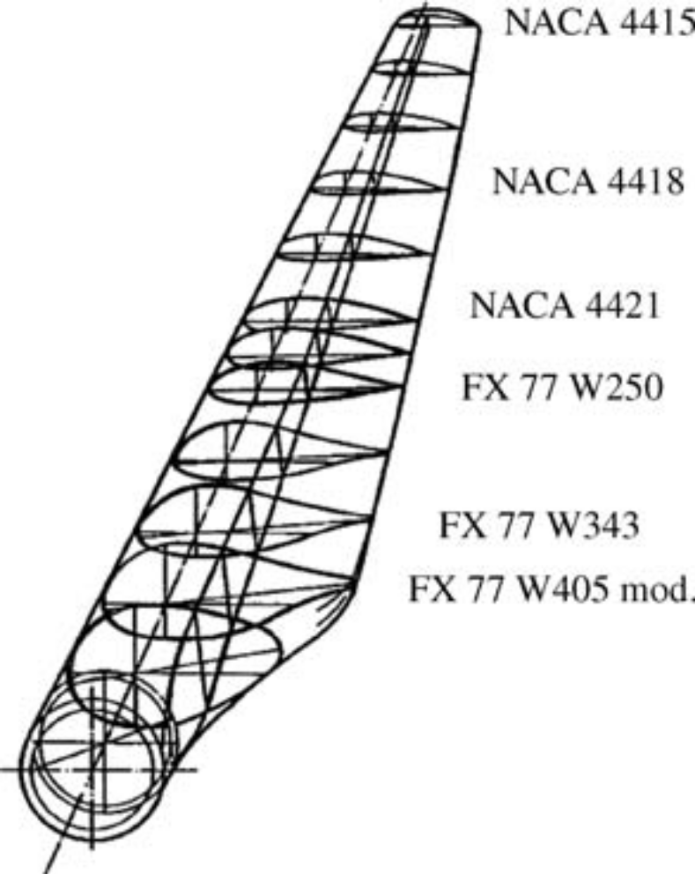
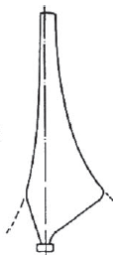
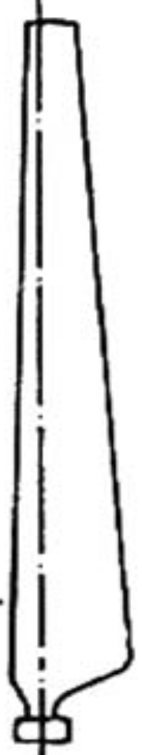
Three Dimensional Geometry of Blades

Slide 32
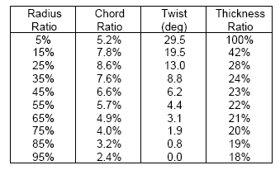
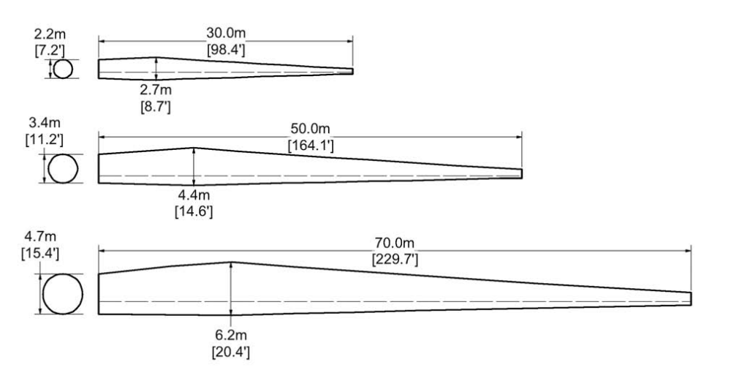
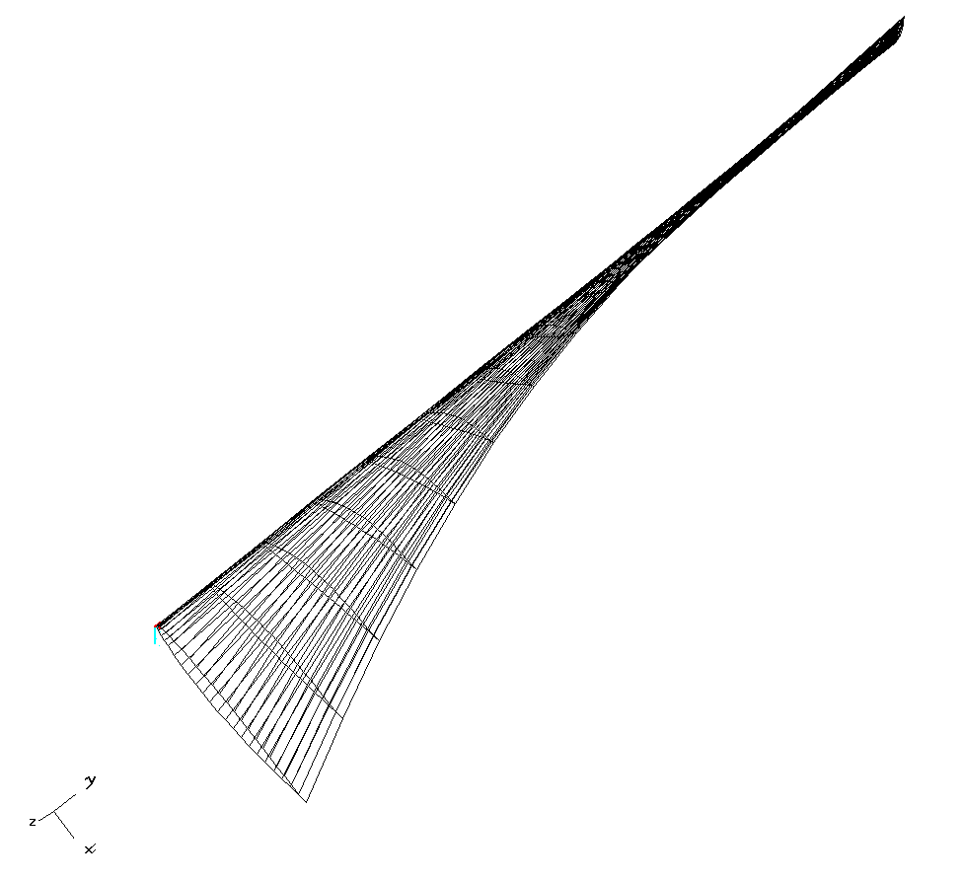
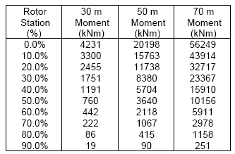
Large HAWT Blades

Slide 33
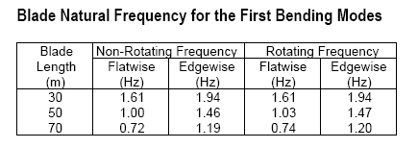
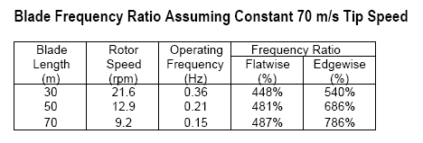
Design for Fatigue: Dynamic & Cycling Loads

Slide 34


Heterogeneous Material Properties
Materials Cost Breakdown

Slide 35
Rotor Blades on A Hub
The rotor blades and the hub of a wind turbine are the most critical elements.
They determine;
the amount and efficiency of energy capture,
well as the magnitude of static and dynamic loads transferred to the turbine.
They also represent the highest cost subsystem and decide the sizes of other systems.
The control of turbine power output is often through rugged and precise mechanisms in the hub for changing blade pitch angle or adjustable aerodynamic devices on the rotor blades.

Slide 36

Blade Aerodynamic Control
One of the most popular means for limiting rotor power is changing the pitch angle of the blades.
  Pitch Control Actuators:
  Hydraulic pitch actuator.
  Electromechanical gear motors.
  Centrifugal Governor.
Furling : The rotor is turned partially out of the wind by yawing to one side (called horizontal furling) or pitching upward (vertical furling).

Slide 37

The Rotor Hub
The rotor hubs rigidly connect the blades to one another and to the drive train.
This rigid design affects the structural dynamic loads both within the hub as well as the loads transferred to the drive train.
During alignment of the wind turbine to changes in wind direction (yawing), each blade experiences a cyclic load at its root end that varies with blade position.
This is true of one, two, three blades, or more.
A three-bladed rotor, develops very low value of resultant cyclic loads at the hub thus transfers reduced cyclic loading into the drive train and the rest of the system during yawing.

Slide 38


Hub Options

Slide 39


Overspeed control
Tip brakes
Pitchable tips

Slide 40
Drive Train, Nacelle, and Yaw Drive Assembly

Slide 41
The Nacelle Structure Subsystem
HAWT nacelle structure is the primary load path from the turbine shaft to the tower.
Bed plate assembly
Enclosure
yaw drive mechanism

Slide 42
Main Shaft

Slide 43

Generator, Electrical System, and Controls
The generator type is chosen on the basis of the turbine’s rated power and the use of the electrical energy.
The generator choice is also highly dependent on the method of controlling rotor aerodynamic power and speed, as well as on the choice of the drive train.
Both synchronous and asynchronous generators are used in all sizes of wind turbines at present.
The majority of generators are asynchronous.
Large- and medium-scale turbines: Induction generators are three-phase with 690 VAC output.
Small-scale turbines, single-phase 20/240 or 400 VAC outputs.

Slide 44
Tower and Foundation
(a)Tubular shell (b) Stepped shell (c)Truss (or lattice) (d) Guyed shell

Slide 45

Variable Speed Control System

Slide 46

The Power Extraction Analysis

Slide 47


Power curve of Wind Farm with 50 Nos of 3.6 MW Turbines

Slide 48


Torque Produced in a Linear Wind shear
Decreasing Turbine Torque with increasing wind gradient

Slide 49




Description of Flow Past A Working Wind Turbine

Slide 50





Simplified (Linear) Kinematics of Near WT Wakefield

Slide 51

Layout of A Wind Farm

Slide 52



Structure of Wind Farm: HVAC
Macro Structure of A Wind Turbine
Macro Structure of A Wind Farm (HVAC)

Slide 53


Windfarm Efficiency
The total freestream power is defined as the power output from the wind farm assuming all turbines produced power output without wake effects.
Wind farm efficiency, η, is defined as the sum of measured power at each turbine, P_{actual} divided by the total freestream power, P_{freestream}
The freestream power is adjusted to account for the number of operating turbines.
If all wind turbines are producing the freestream power the efficiency is 100%

Slide 54


Available Wind Velocity for a WT in A Windfarm
V∞

