Slide 1

Betz Analysis of Wind Turbines
P M V Subbarao
Professor
Mechanical Engineering Department
I I T Delhi
Scientific Modelling for Guaranteed Power…

Slide 2

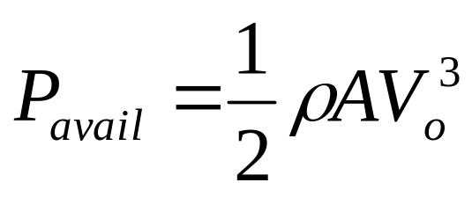
The Power in the Wind
The power in the wind is proportional to:
  the area of windmill being swept by the wind
  the cube of the wind speed
  the air density - which varies with altitude
The formula used for calculating the power in the wind is shown below:
where, P is power in watts (W)
ρ is the air density in kilograms per cubic metre (kg/m³)
A is the swept rotor area in square metres (m²)

Slide 3

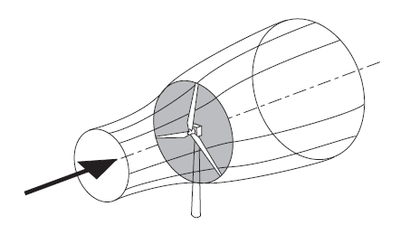
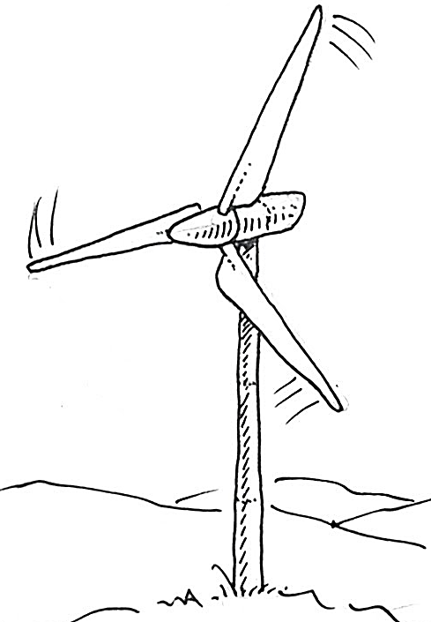
Who are Contiguous to A Wind Turbine?

Slide 4
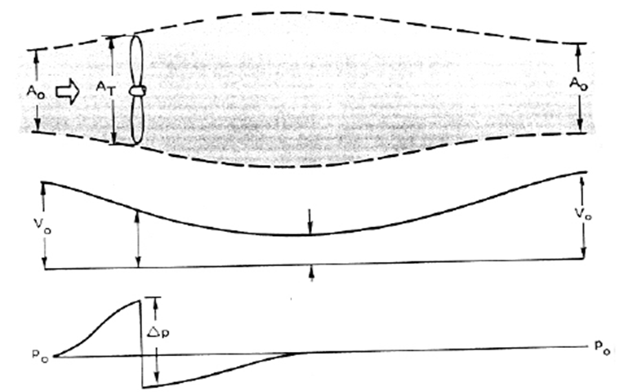
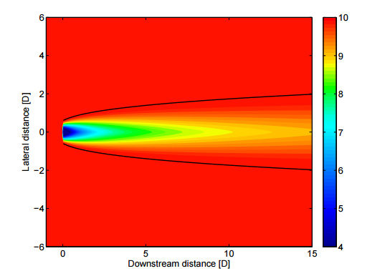
Support from Surroundings of A Donating Stream Tube
A_{rotor}
The Mach number is small and the air density is thus constant and the axial velocity must decrease continuously from V_{o} to u₁.

Slide 5
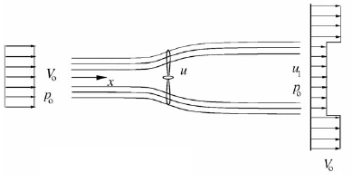

Thermodynamic Description of Flow Past A Working Wind Turbine
Front view of Stream Tube for HAWT
The rotor disc acts as an energy extractor slowing the wind speed from V₀ far upstream of the rotor to u at the rotor plane and to u₁ in the wake.

Slide 6
Basic Assumptions to Identify the Important Design Parameter: Betz
This analysis uses the following assumptions:
Homogenous, incompressible, steady state fluid flow;
No frictional drag;
An infinite number of blades;
Uniform thrust over the disc or rotor area;
A non–rotating wake;
The static pressure far upstream and far downstream of the rotor is equal to the undisturbed ambient static pressure

Slide 7
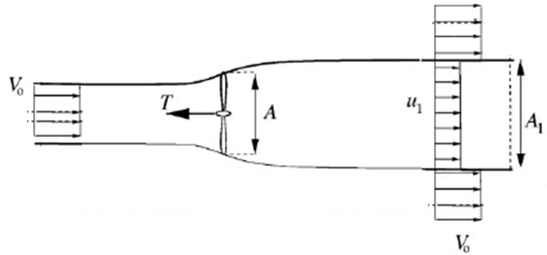

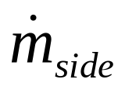
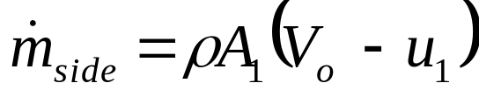
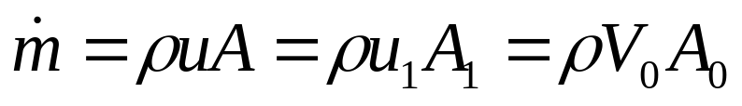
Conservation Mass Across Double Boundaries
The conservation of mass for entire participating wind (outer CV):
The conservation of mass for the donor CV gives a relationship between A and A₁ as:

Slide 8
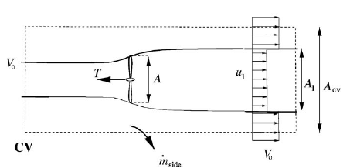

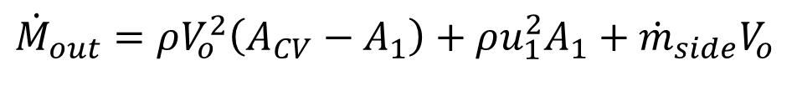
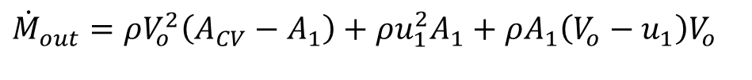

Axial Momentum Balance for an Ideal Wind Turbine
The axial momentum equation using the simplified assumptions of an ideal rotor in a control volume
$${\dot{m}}_{side}=ρA_{1}\left(V_{o}−u_{1}\right)$$
Rate of momentum entering the Outer boundary:
$${\dot{M}}_{in}=ρV_{o}^{2}A_{CV}$$
Rate of momentum Leaving the Outer boundary:
$${\dot{M}}_{out}=ρV_{o}^{2}\left(A_{CV}−A_{1}\right)+ρu_{1}^{2}A_{1}+{\dot{m}}_{side}V_{o}$$
$${\dot{M}}_{out}=ρV_{o}^{2}\left(A_{CV}−A_{1}\right)+ρu_{1}^{2}A_{1}+ρA_{1}\left(V_{o}−u_{1}\right)V_{o}$$

Slide 9

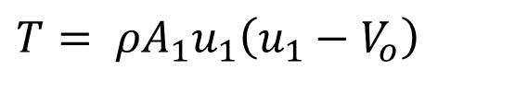
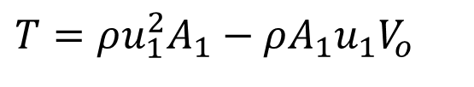

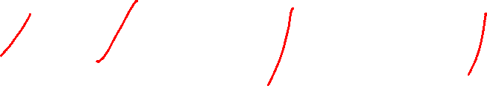
Axial Momentum Balance for an Ideal Wind Turbine
Thrust (T) generated by the wind turbine on wind = Change in Rate of Momentum
$$T={\dot{M}}_{out}−{\dot{M}}_{in}$$
$$T=ρV_{o}^{2}\left(A_{CV}−A_{1}\right)+ρu_{1}^{2}A_{1}+ρA_{1}\left(V_{o}−u_{1}\right)V_{o}−ρV_{o}^{2}A_{CV}$$
$$T=ρV_{o}^{2}A_{CV}−ρV_{o}^{2}A_{1}+ρu_{1}^{2}A_{1}+ρA_{1}V_{o}^{2}−ρA_{1}{u_{1}V}_{o}−ρV_{o}^{2}A_{CV}$$
$$T=ρu_{1}^{2}A_{1}−ρA_{1}{u_{1}V}_{o}$$
$$T= ρA_{1}u_{1}\left(u_{1}−V_{o}\right)$$
Donor Wind stream needs to satisfy:
$$T=\dot{m}\left(u_{1}−V_{o}\right)=ρuA\left(u_{1}−V_{o}\right)$$

Slide 10
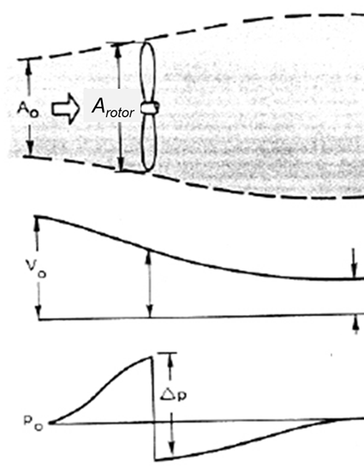
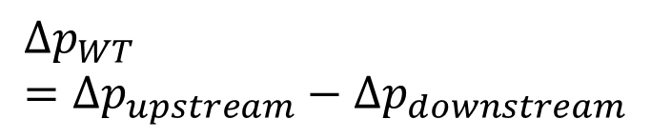
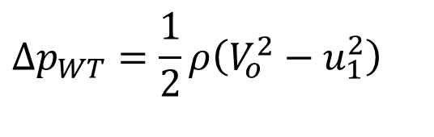

Velocity & Pressure Field Generated in the Donor Stream
Axial Force Generated by Pressure filed on the Wind Turbine
$$F_{axial}=Δp_{WT}A$$
$$Δp_{WT}=Δp_{upstream}−Δp_{downstream}$$
$$Δp_{WT}=\frac{1}{2}ρ\left(V_{o}^{2}−u_{1}^{2}\right)$$

Slide 11
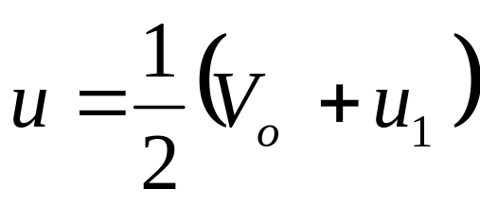
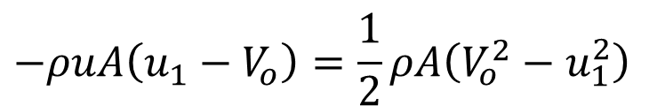

Stable Operation of Wind Turbine
For Stable operation of wind turbine structure the Axial Force must equal and opposite to Thrust
$$F_{axial}=−T$$
$$−ρuA\left(u_{1}−V_{o}\right)=\frac{1}{2}ρA\left(V_{o}^{2}−u_{1}^{2}\right)$$

Slide 12
Axial Momentum Balance for an Ideal Wind Turbine
It is seen that the velocity in the rotor plane is the mean of the wind speed V_{o} and the unused wind speed in the wake u₁.

Slide 13
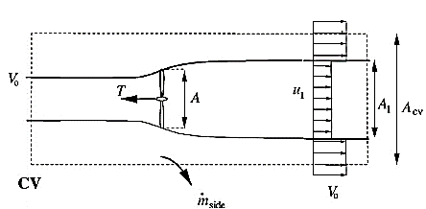
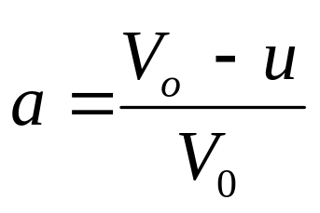
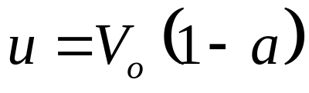
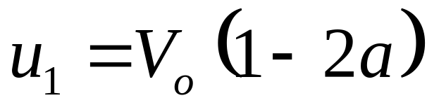
Characteristic Design Parameter of A Wind Turbine Rotor
Define a design parameter as axial induction factor:

Slide 14
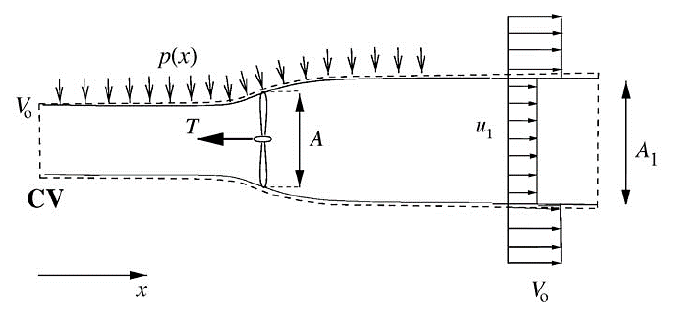
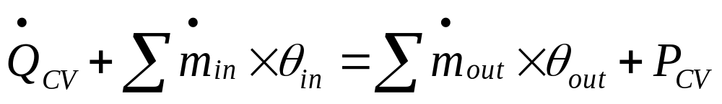
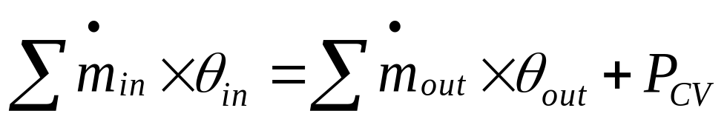
First Law Analysis of SSSF past a Wind turbine
First Law :
There is no heat transfer across the boundary of CV.

Slide 15

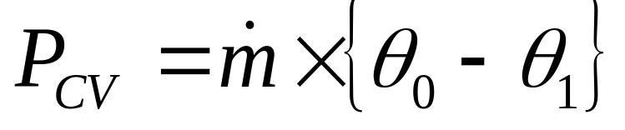
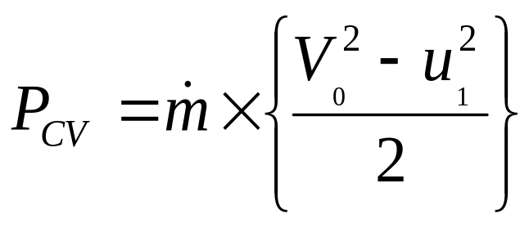
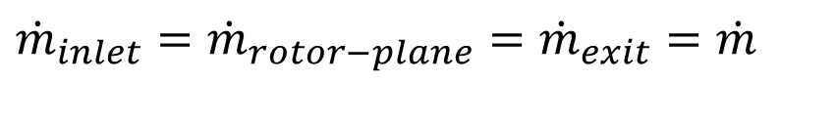
Frictionless Low Mach Number Flow Past a WT
SSSF: Conservation of mass
$${\dot{m}}_{inlet}={\dot{m}}_{rotor−plane}={\dot{m}}_{exit}=\dot{m}$$
SSSF: First Law:
The flow is assumed to be isothermal, frictionless, no change in potential energy.

Slide 16
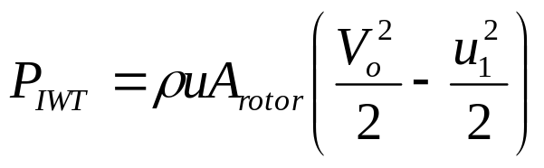
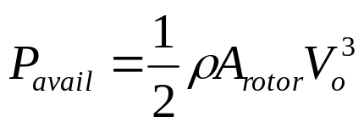
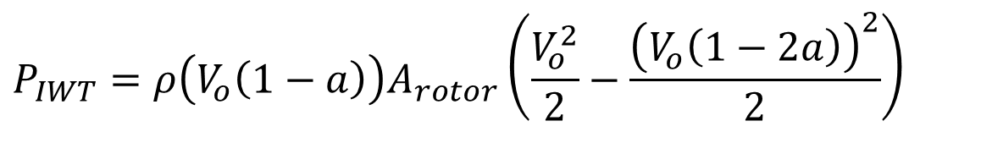


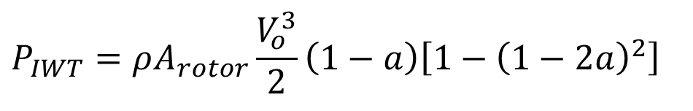
Power Generated by an Ideal Wind Turbine
$$u_{1}=V_{o}\left(1−2a\right)$$
$$P_{IWT}=ρ\left(V_{o}\left(1−a\right)\right)A_{rotor}\left(\frac{V_{o}^{2}}{2}−\frac{{\left(V_{o}\left(1−2a\right)\right)}^{2}}{2}\right)$$
$$P_{IWT}=ρA_{rotor}\frac{V_{o}^{3}}{2}\left(1−a\right)\left[1−{\left(1−2a\right)}^{2}\right]$$
$$P_{IWT}=2ρA_{rotor}V_{o}^{3}a {\left(1−a\right)}^{2}$$
The available power in a cross-section equal to the swept area A by the rotor is:

Slide 17
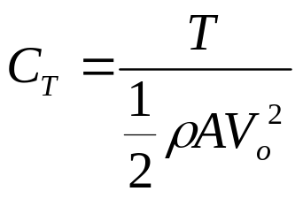
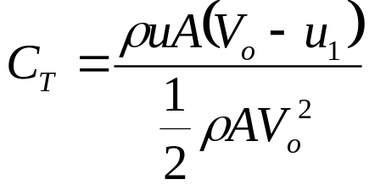
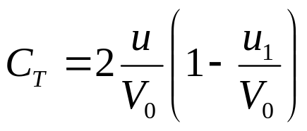
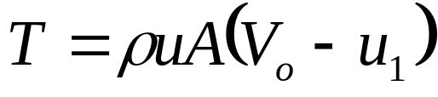
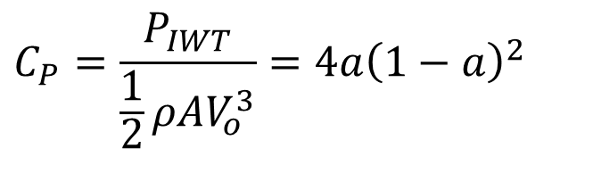
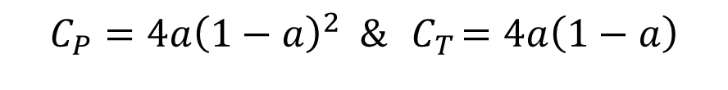
Non-dimensional Capacity Factor
The absorbed power is often non-dimensionalized with respect to P_{avail} as a power coefficient C_{P}:
$$C_{P}=\frac{P_{IWT}}{\frac{1}{2}ρAV_{o}^{3}}=4a{\left(1−a\right)}^{2}$$
Similarly, a thrust coefficient C_{T} is defined as:
the power and thrust coefficients for the ideal wind turbine using 1-D analysis may be written as:
$$C_{P}=4a{\left(1−a\right)}^{2} \&{ C}_{T}=4a\left(1−a\right)$$

Slide 18
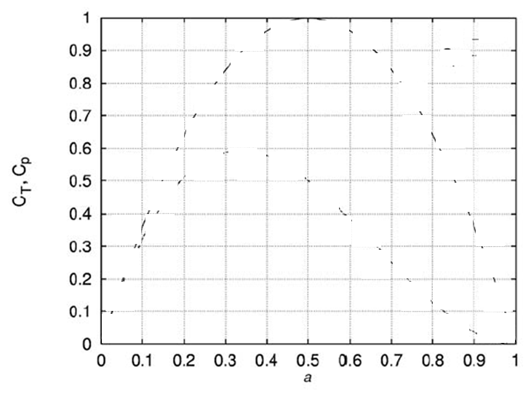
The Compact Ideal Wind Turbine
C_{T}
C_{p}
a

Slide 19
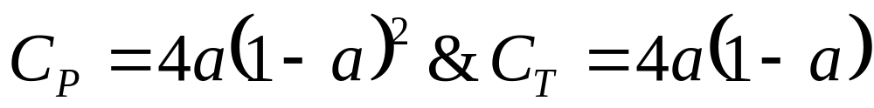
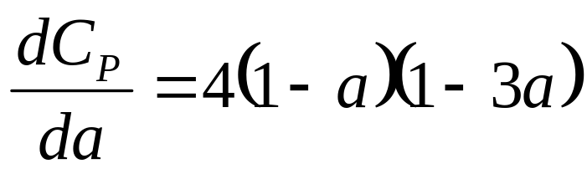
Maximum Feasible Axial Induction
Differentiating C_{P} with respect to a yields:
It is easily seen that C_{P}, max = 16/27 for a = 1/3.
This theoretical maximum for an ideal wind
turbine is known as the Betz limit (59.3%).

Slide 20
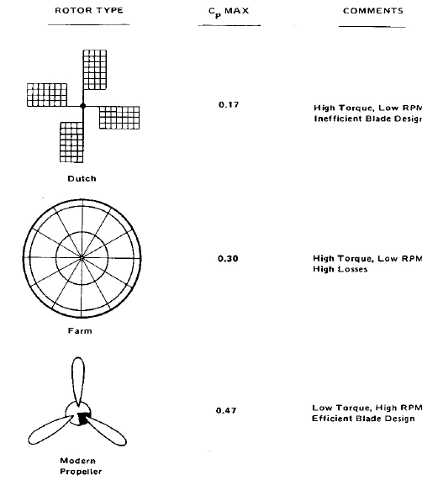
Actual Performance of WTs

Slide 21
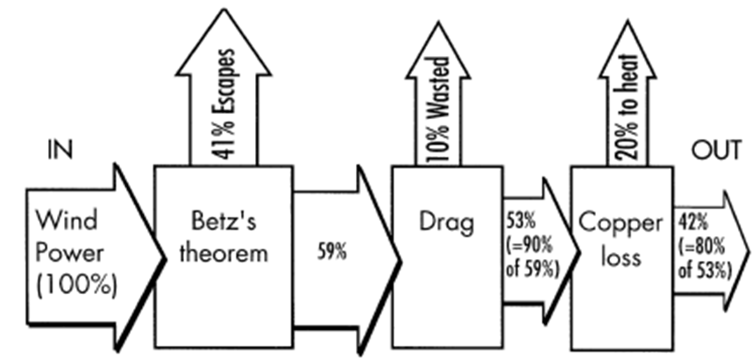
Wind Turbine : Actual Power Extraction Analysis

Slide 22
Discussion of Betz Anlaysis
Experiments have shown that the assumptions of an ideal wind turbine (in agreements with Betz thrust equation are only valid for an axial induction factor, a of less than approximately 0.4.
If the momentum theory were valid for higher values of a, the velocity in the wake would become negative as can readily be seen by equation

Slide 23
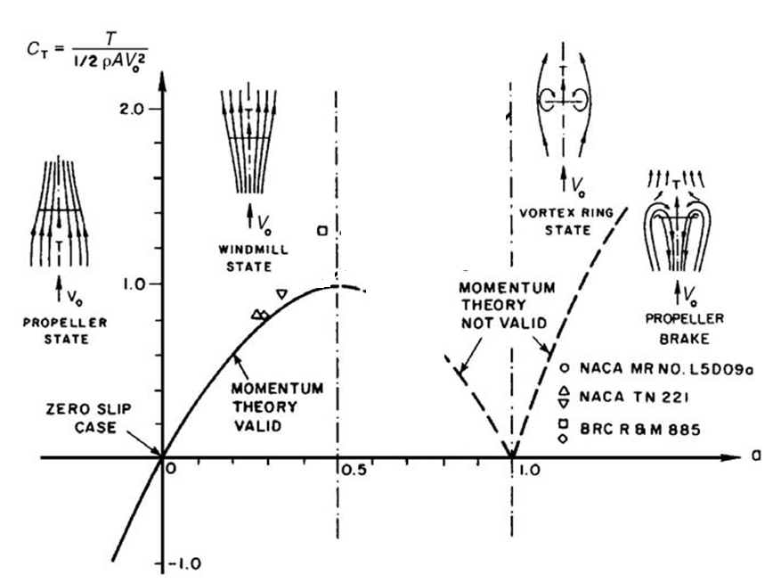
The Measured C_{T} as a function of the a

Slide 24
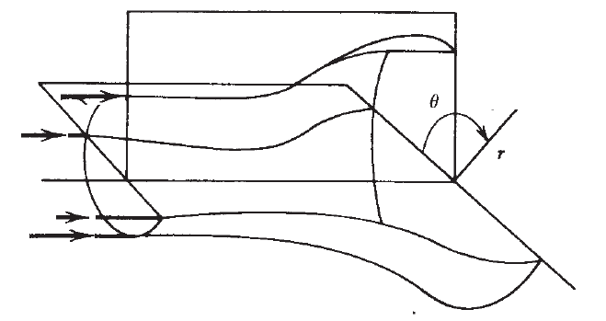

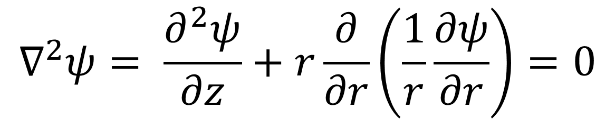
Construction of Stream Tube
For Ideal Flow:
$$∇^{2}ψ= \frac{∂^{2}ψ}{∂z}+r\frac{∂}{∂r}\left(\frac{1}{r}\frac{∂ψ}{∂r}\right)=0$$

Slide 25
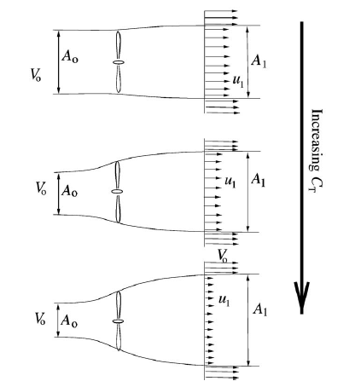

Structure of Wake Vs Capacity of A Wind Turbine

Slide 26

Turbulent-wake state
Induced by the unstable shear flow at the edge of the wake

Slide 27
Domain of Invalidity of Betz Theory
For a wind turbine, a high thrust coefficient C_{T}, and thus a high axial induction factor a, is present at low wind speeds.
The simple momentum theory is not valid for values of a greater than approximately 0.4.
The reason is that the free shear layer at the edge of the wake becomes unstable when the velocity jump V₀ – u₁ becomes too high.
This instability leads to formation of eddies, which transport momentum from the outer flow into the wake.
This situation is called the state of Turbulent-Wake.

Slide 28


State of Turbulent wake

Slide 29

Optimum Available Power due to Non-ideal Wake
Fraction of Betz Limit

Slide 30

Creative Designs

