Slide 1

Analysis of Wind Turbines
P M V Subbarao
Professor
Mechanical Engineering Department
I I T Delhi
Incompressible Turbo-machine using Compressible Fluid…..
Resource is Local & Green…

Slide 2


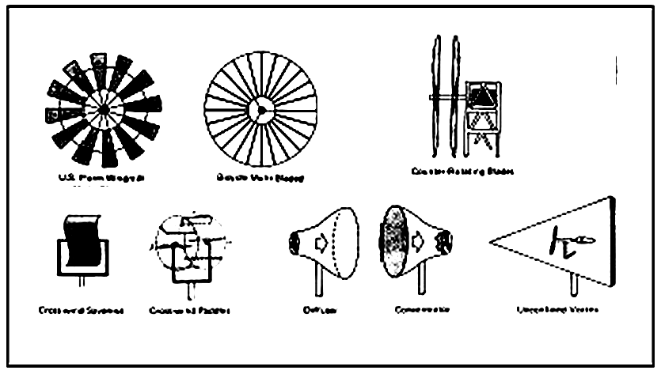
Primitive WINDMILLS
Working fluid is Air….
Flow is nearly incompressible and Isothermal….
Nearly 1000 years of struggle by Local Inventors….

Slide 3
History of Wind Power
Wind is a clean, safe, renewable form of energy.
The use of wind power in sailing vessels appeared in antiquity.
The earliest mentions of the use of wind power come from the East: India, Tibet, Afghanistan, Persia.
The widespread use of wind power for grinding grain and pumping water was delayed until
  the 7th century in Persia,
  the 12th century in England, and
  the 15th century in Holland.
17th century, Leibniz proposed using windmills and waterwheels together to pump water from mines in the Harz Mountains.
Dutch settlers brought Dutch mills to America in the 18th century.
This led to the development of a multiblade wind turbine that was used to pump water for livestock.

Slide 4
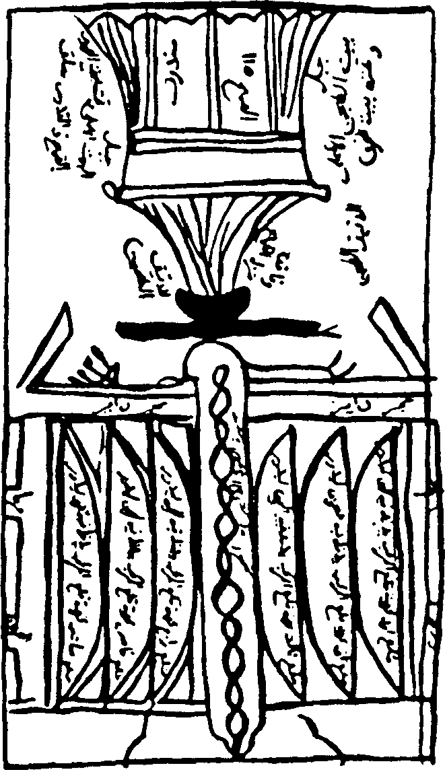
A Persian vertical-axis windmill in Sıstan
The two storied,walled structure had millstones at the top and a rotor at the bottom.
The latter consisting of a spoked reel with 6 to 12 upright ribs, each covered with cloth to form separate sails.
The sketch shows the bellying of the cloth coverings as they catch the wind and push the reel around.
Each wall had an offset opening the height of the rotor, with its perimeter beveled to decrease the free area through the thickness of the wall and hence accelerate the wind from any direction.

Slide 5
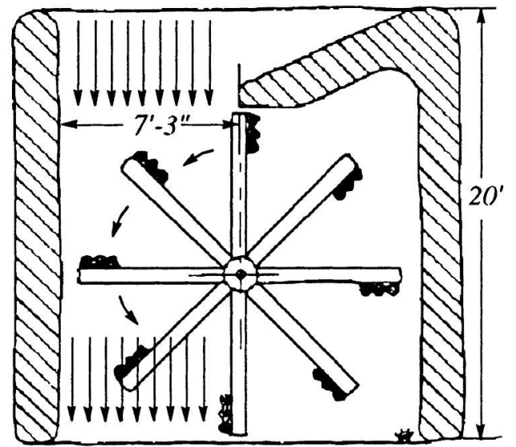
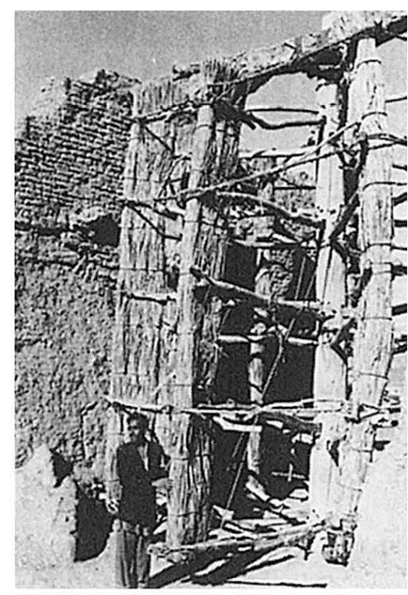
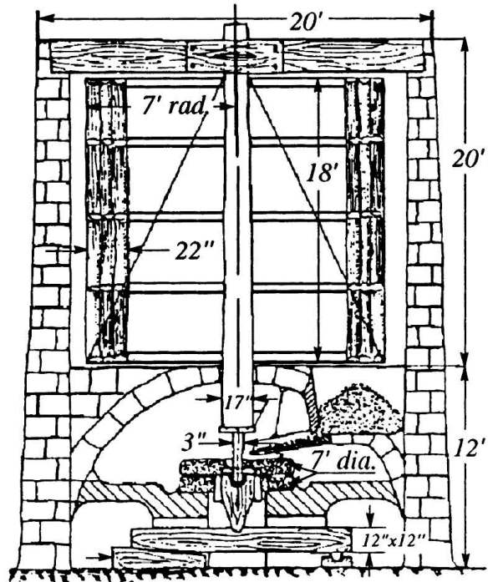
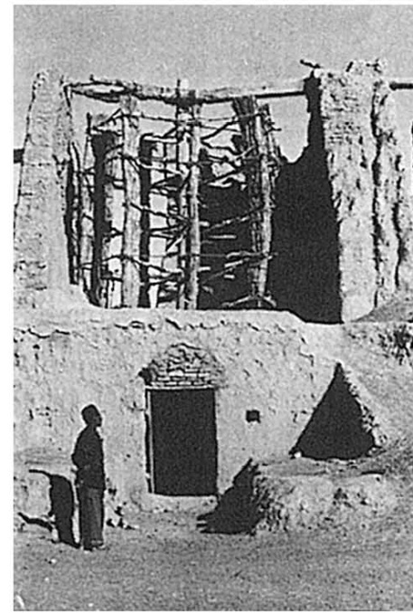
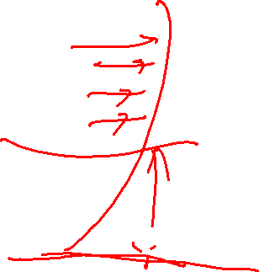
The Windmills of Neh

Slide 6
Performance of Persian Mills : 1963
In 1963, 50 mills were still operating.
Each milled an average of a ton of grain in 24 hours, so in a 120day windy season, they were said to produce a total output of 6,000 tons.
Based on a wind speed of about 30 m/s, an effective exposure at any time of 1.5 blades
The mill efficiency was of 50 percent, with a power output of about 75 hp per mill.
It is difficult to accept this high figure!!!
The basic design of these primitive vertical axis mills has lasted at least 1,000 years

Slide 7
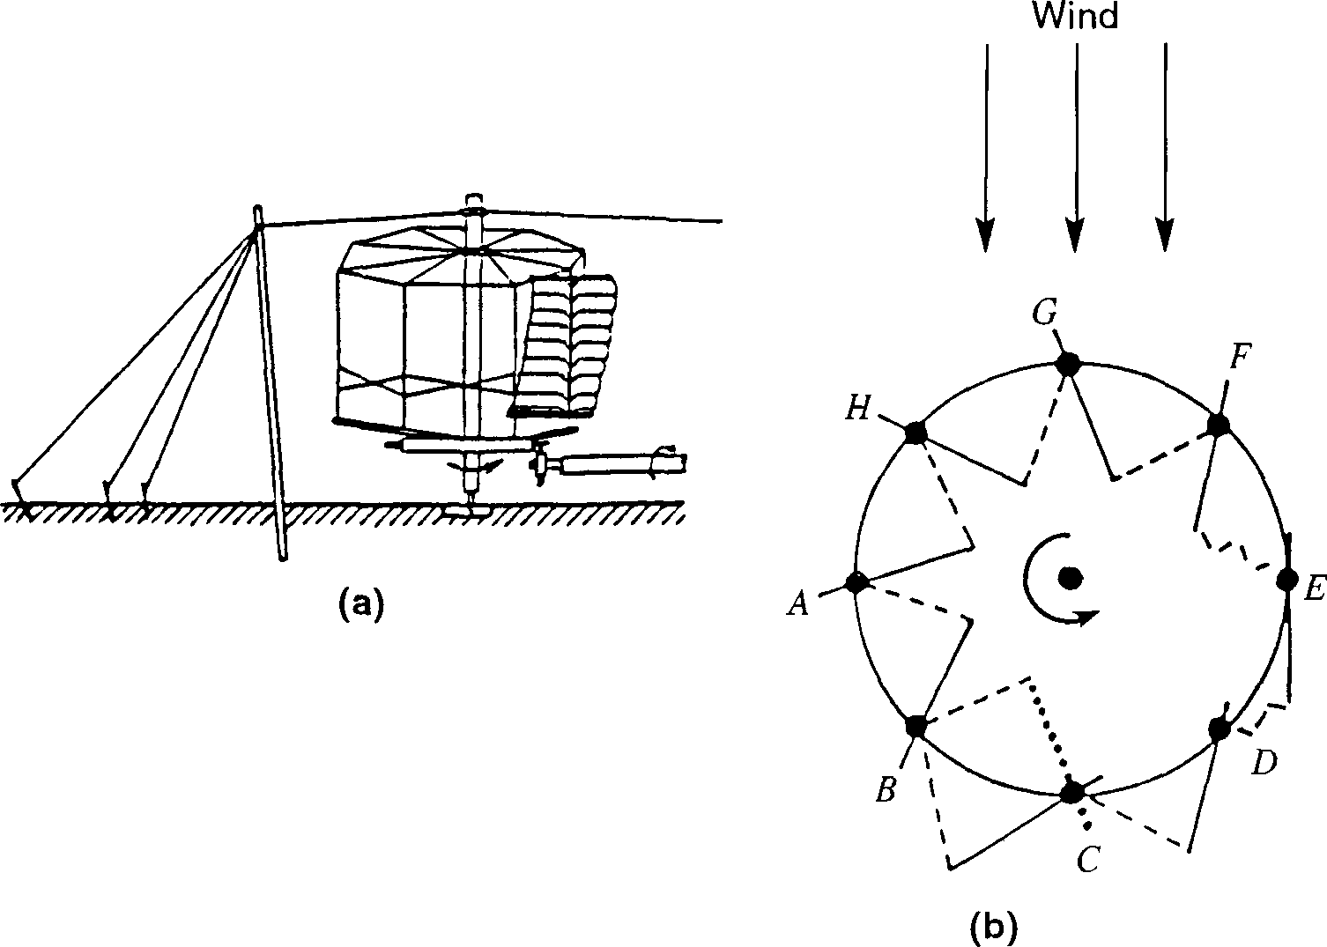
The vertical-axis Chinese windmill

Slide 8
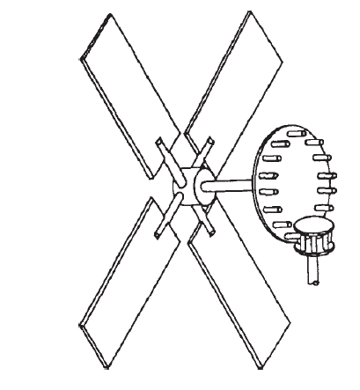
The Horizontal-Axis European Windmill
Conversion of the Roman watermill with its horizontal wheel shaft to the ordinary windmill with a horizontal shaft.
All the essentials of a windmill were ready to hand except the sails which replace the blades and rim on the water wheel.
The mechanism is is like that of an early watermill turned upside down,
The watermill drive being from below upwards and the windmill drive from above downwards.

Slide 9
A Story of A Native Power System
For many countries, fossil energy is transported/imported.
The history of wind power in Denmark, provides a salutary lesson on the importance of “Nativity of a Technology”.
From 1900 to 1910, many Danish wind driven electricity plants were in use.
Diesel engines were beginning to give them some stiff competition by 1910 to 1914 because of their convenience and economy.
During World War I, oil supplies to the country were virtually shut off and wind power was resurrected.
Many 20 to 35kW capacity new wind turbine plants were built at that time.

Slide 10
The Ups & Downs
After the war, electrification took place throughout the country, and once more the windmill languished.
In 1939, World War II caused another cutoff in fuel supplies, and wind power was once more called upon to the fullest extent possible.
After the hostilities ended, further rapid, extensive electrification took place, but this time the utility of wind power was not discounted.
A research program was begun to consider it as a supplement to the large, central plants.
In the period after 1945, there were developments not only in Denmark, but in France, Germany, and Britain as well.

Slide 11

Wind Turbine
7th century in Persia.
44% Wind — Denmark Set New Wind Energy Record In 2017 : News on 6th Jan 2018
An Ancient Technology….
Why So much Delay…..

Slide 12

Ingenuity vs Empathy
Outcome of Euler Theory:
The Arabelle steam turbine: The largest steam turbine ever 1,770 MW.
Who will care the Ecology & Remote Poor Community?
Not only mass production, but also production by masses.

Slide 13

Gram Swaraj : A pivotal concept in Mahatama Gandhi's thinking
The fundamental concept of Gram swaraj is that every village should be its own republic,
"independent of its neighbours for its own vital wants and yet interdependent for many others in which dependence is necessary," according to Gandhi, writing in 1942.
Each village should be basically self-reliant, making provision for all necessities of life - food, clothing, clean water, sanitation, housing, education and so on ….
Wind Energy Systems are the Requirement of Gram Swaraj……
“HamAri Urja Hamare SAth aur
HamAre HAth JagannAdh"

Slide 14
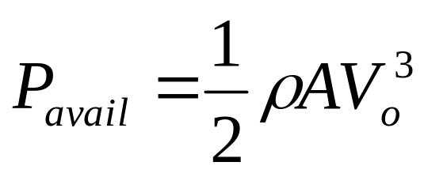
The power in the wind
The power in the wind is proportional to:
  the area of windmill being swept by the wind
  the cube of the wind speed
  the air density - which varies with altitude
The formula used for calculating the power in the wind is shown below:
where, P is power in watts (W)
ρ is the air density in kilograms per cubic metre (kg/m³)
A is the swept rotor area in square metres (m²)

Slide 15
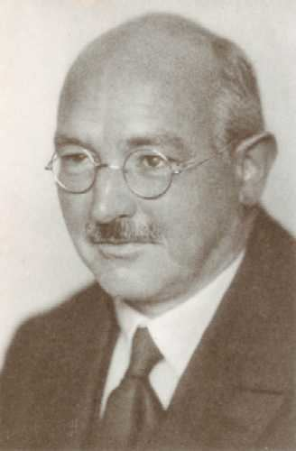
Wind Mills Beyond Business
Development of wind turbines, in a plan to establish German rural population in the east, replacing the Slavic population.
In 1936, Prof. Betz succeeded Ludwig Prandtl as director of the Aerodynamische Versuchsanstalt (AVA, aerodynamics laboratory).
He received the Ludwig-Prandtl-Ring from the German Society for Aeronautics and Astronautics for "outstanding contribution in the field of aerospace engineering" in 1958.
Prof. Albert Betz.
1920 paper "Theoretical Limit for Best Utilization of Wind by Wind Motors".

Slide 16
Denmark is Heading Towards 60% Wind Energy
More green energy in the electricity grid.
44% Wind — Denmark Set New Wind Energy Record In 2017 : News on 6th Jan 2018.
Denmark to construct three new offshore wind farms by 2030 : 29th June 2018.
The deal also includes a target for 55 per cent of the country's energy to be supplied from renewable sources by 2030, up from a previous goal of 50 percent set by the current government.

Slide 17

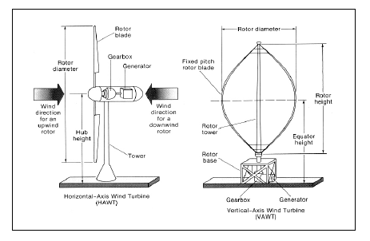
Schematics of Modern Wind Turbines
Rotation = r * Ω
α
Wind = V₀
Relative Wind = V_{r}

Slide 18
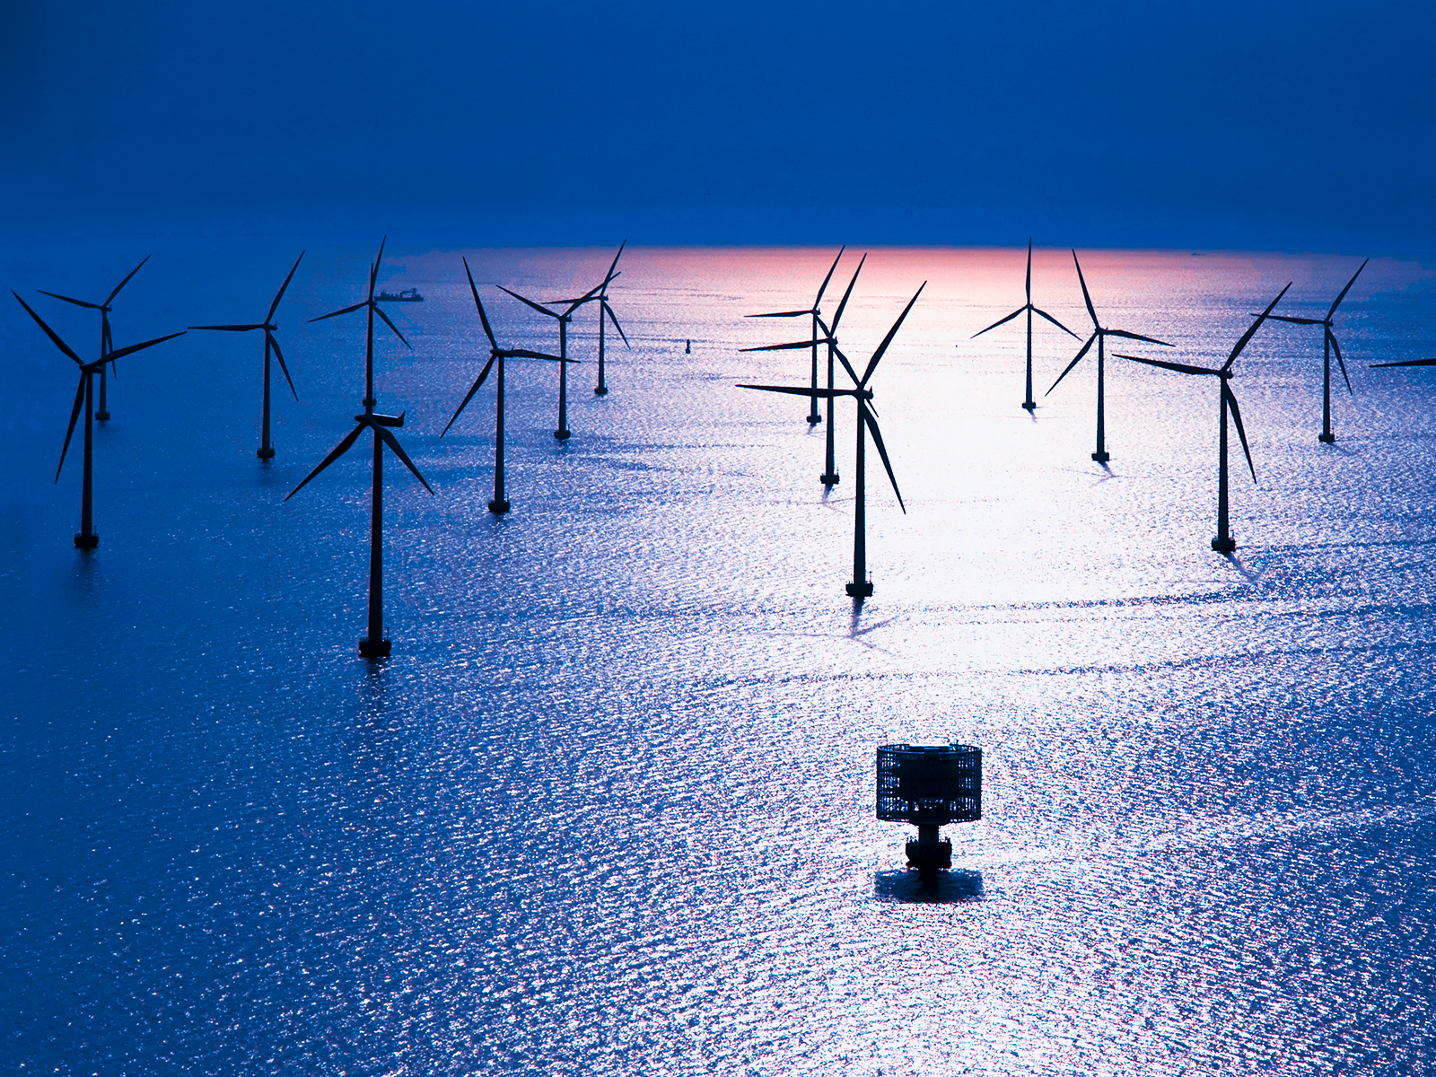
Layout of An Offshore Wind Farm
I am Gandhian !!!

Slide 19
Structure of Offshore Wind Farms
Name of Wind Farm | Horns Rev. 1 | Nysted | Scorby Sands | Egmond aan Zee
Available site at harbour (km) | 15 | 64 | 30 | 30
Project Capacity | 160 MW | 165.6 MW | 60 MW | 108 MW
Turbine Capacity | 2 MW | 2.3 MW | 2 MW | 3 MW
Number of Turbines | 80 | 72 | 30 | 36
Total Turbine Height | 110 m | 110m | 100 m | 115 m
Hub Height | 70 m | 69 m | m | 70 m
Rotor Diameter | 80 m | 82 m | 80 m | 90 m
CO₂ reduced per year (tons) | 187135 | 180806 | 67802 | 122044

Slide 20
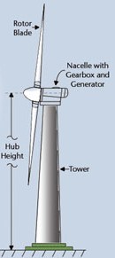
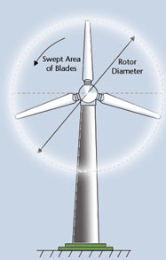
Wind Flow Past A Locked Wind Turbine
What if this Wind is Empathic???

Slide 21

Identification of Thermodynamic Control Volume: A Big Challenge

Slide 22
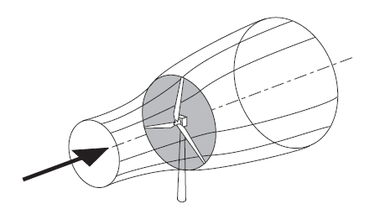
The Donor Stream Tube to A Wind Turbine

Slide 23
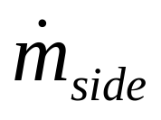
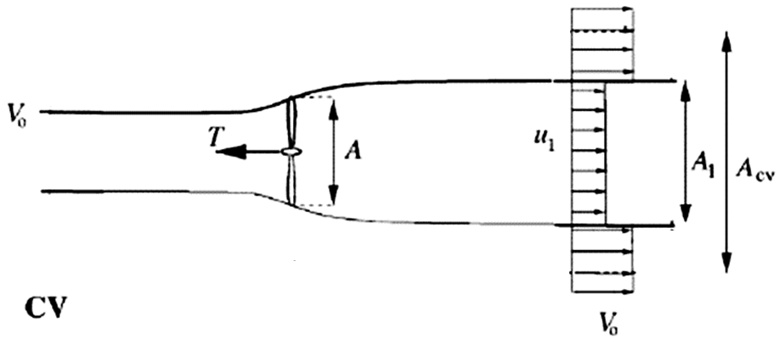
Cooperation from Surroundings of A Donor Stream Tube

