Slide 1

Design Rules for Real Centrifugal Compressors
P M V Subbarao
Professor
Mechanical Engineering Department
Reversible or Irreversible : Design to get Required Pressure Ratio….

Slide 2


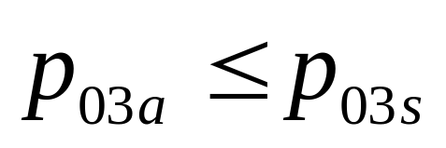

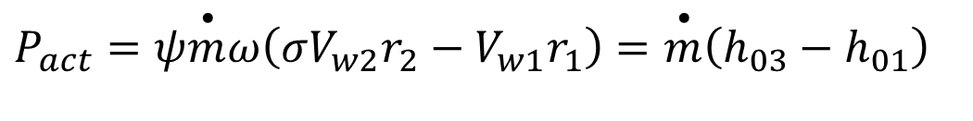
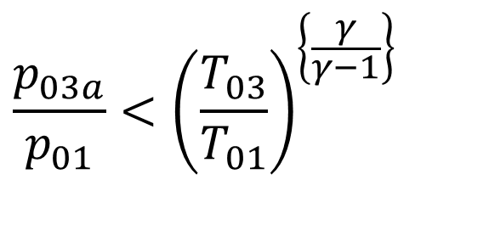
Confluence of Euler Theory and Thermodynamics
Actual Work consumed by A compressor = Increase in Stagnation Enthalpy of gas
$$P_{act}=ψ\overset{•}{m}ω\left(σV_{w2}r_{2}−V_{w1}r_{1}\right)=\overset{•}{m}\left(h_{03}−h_{01}\right)$$
$$=\dot{m}c_{p}\left(T_{03}−T_{01}\right)$$
For an irreversible compression, the actual pressure rise is less than isentropic pressure rise due to (T₀₃-T₀₁).
$$\frac{p_{03a}}{p_{01}}<{\left(\frac{T_{03}}{T_{01}}\right)}^{\left\{\frac{γ}{γ−1}\right\}}$$

Slide 3
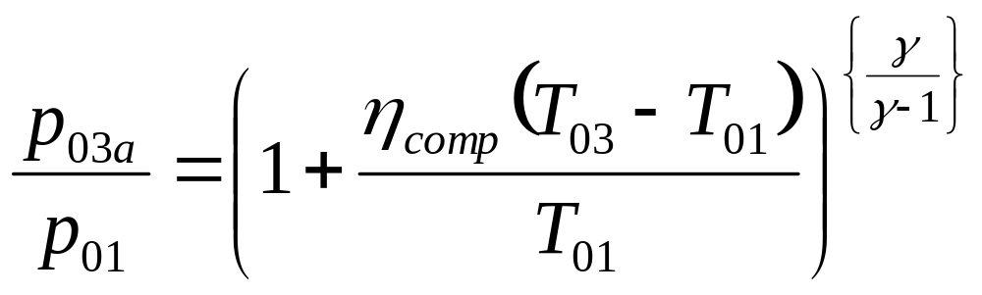
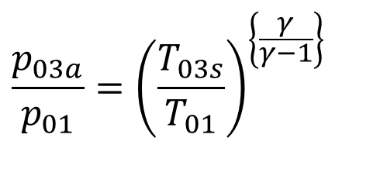
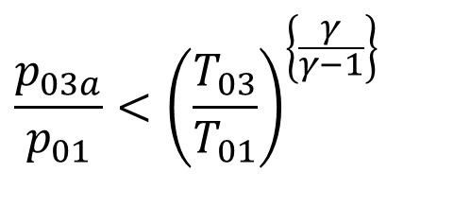
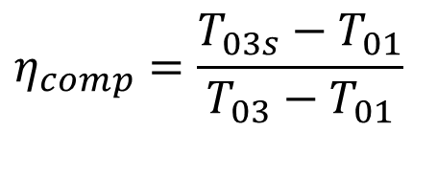

Confluence of Gas Dynamics and Thermodynamics
$$\frac{p_{03a}}{p_{01}}<{\left(\frac{T_{03}}{T_{01}}\right)}^{\left\{\frac{γ}{γ−1}\right\}}$$
$$\frac{p_{03a}}{p_{01}}={\left(\frac{T_{03s}}{T_{01}}\right)}^{\left\{\frac{γ}{γ−1}\right\}}$$
$$∃ T_{03s} for p_{03a}$$
Define, Global Adiabatic Efficiency of A Compressor:
$$η_{comp}=\frac{T_{03s}−T_{01}}{T_{03}−T_{01}}$$

Slide 4
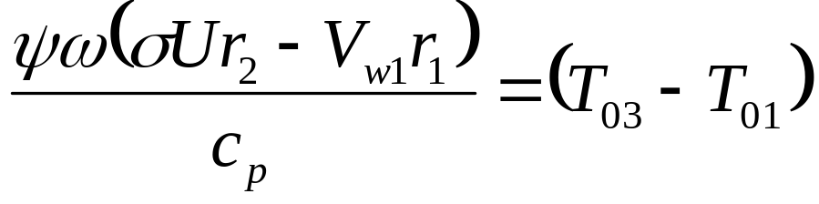
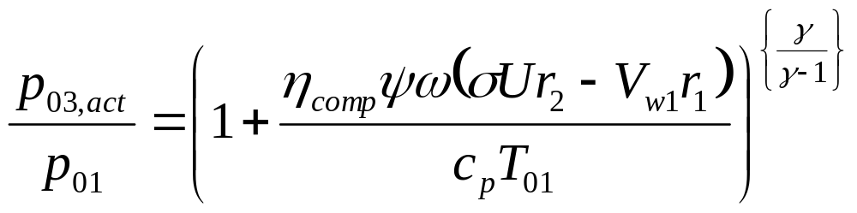
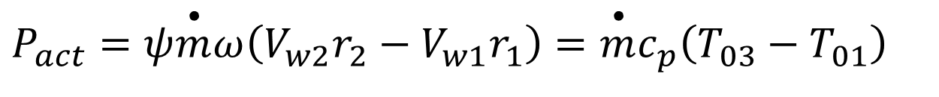
Confluence of Gas Dynamics and Thermodynamics
$$P_{act}=ψ\overset{•}{m}ω\left(V_{w2}r_{2}−V_{w1}r_{1}\right)=\overset{•}{m}c_{p}\left(T_{03}−T_{01}\right)$$

Slide 5

Main Challenges to Design A Compact CC
The slip factor limits the capacity of the compressor, and this should be as high as possible.
A high value of slip factor requires higher number of vanes.
Higher number vanes will increase frictional losses and hence increase the value of power input factor and decrease the value of efficiency.
A suitable compromise must be found, and present-day practice is :
19 – 21 vanes to get a slip factor value of 0.9.
Future focus is on Compact design of a centrifugal.

Slide 6
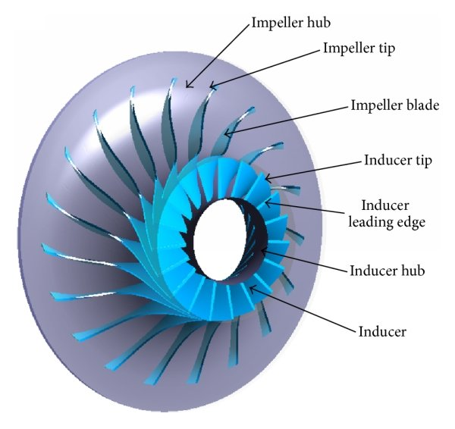
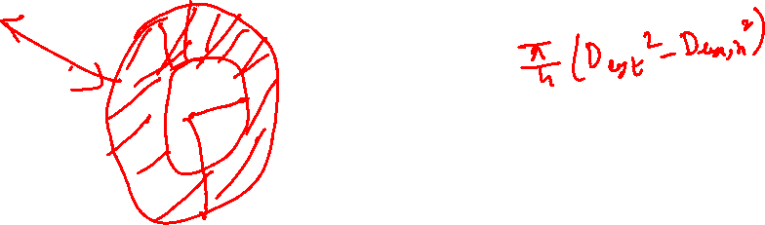
Clues for Compact design of a centrifugal compressor inlet

Slide 7
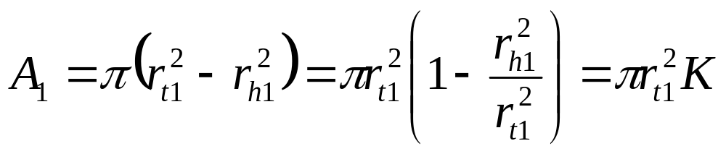
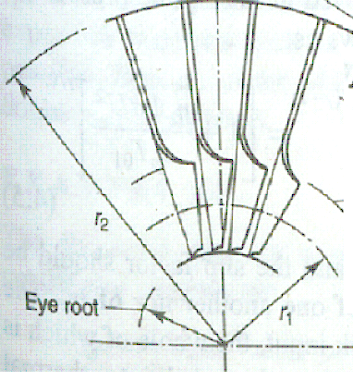
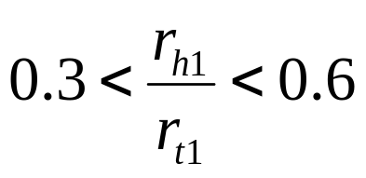
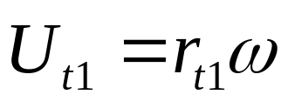
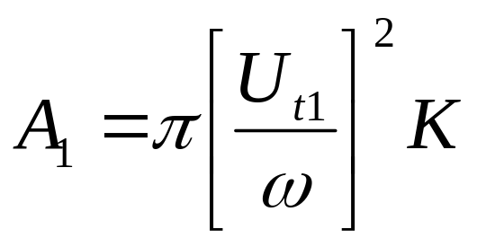
Compact design of a centrifugal compressor inlet
To obtain high efficiencies from high pressure ratio compressors it is necessary to limit the relative Mach number at the eye.
The flow area at the eye can be written as
Optimum ratio:
Tip velocity of eye:
Eye tip
Eye hub

Slide 8
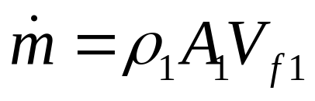
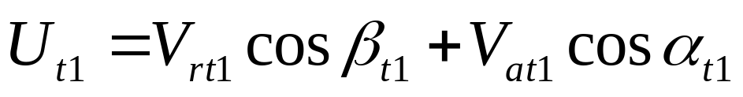
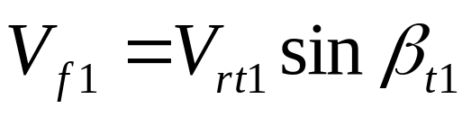

Compact design of a centrifugal compressor inlet
With uniform flow velocity the continuity equation is
U_{t1}
V_{wt1}
β_{t1}
α_{t1}
V_{rt1}
V_{at1}
V_{ft1}

Slide 9
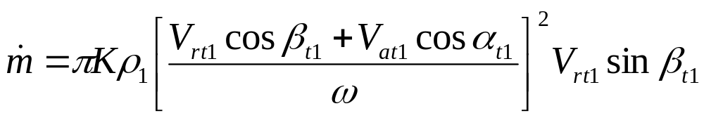
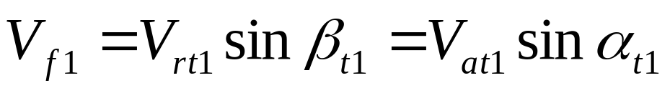
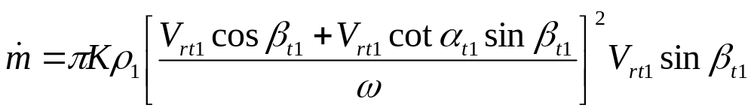
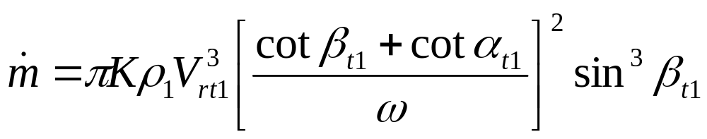
Compact design of a centrifugal compressor inlet

Slide 10
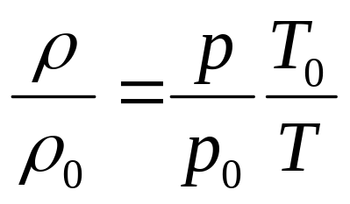
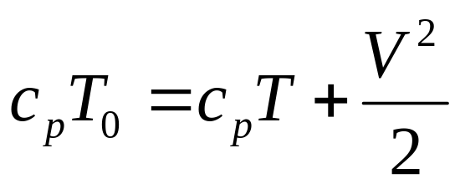
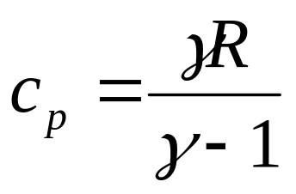
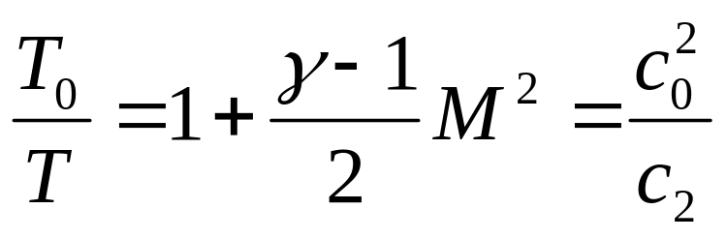
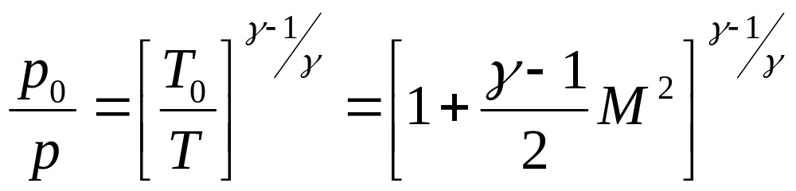
Compact design of a centrifugal compressor inlet
For a perfect gas it is most convenient to express the static density ρ₁ in terms of the stagnation temperature T₀₁ and stagnation pressure p₀₁ because these parameters are usually constant at entry to the compressor.
Now,

Slide 11
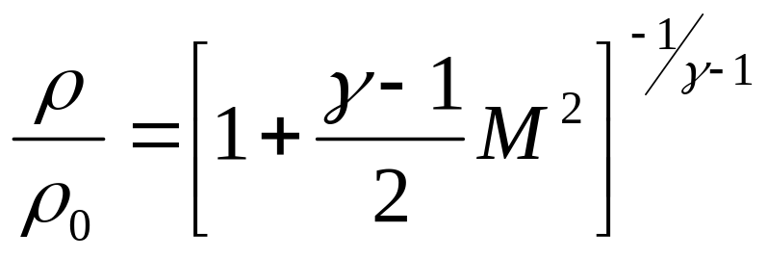
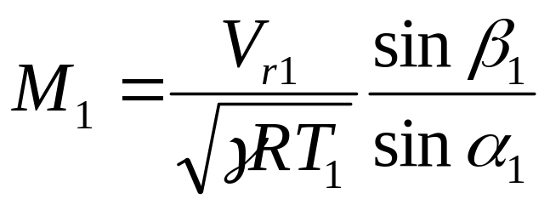
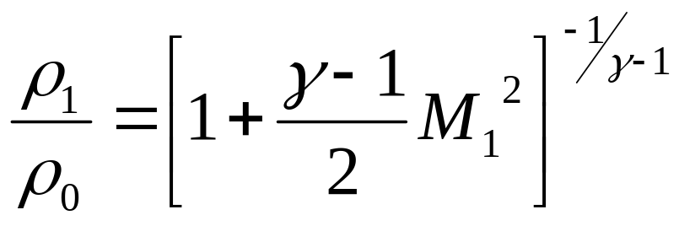
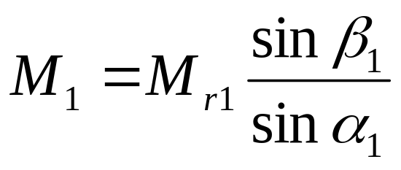
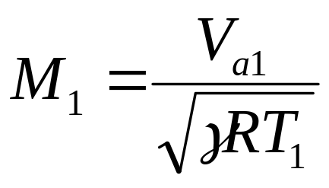
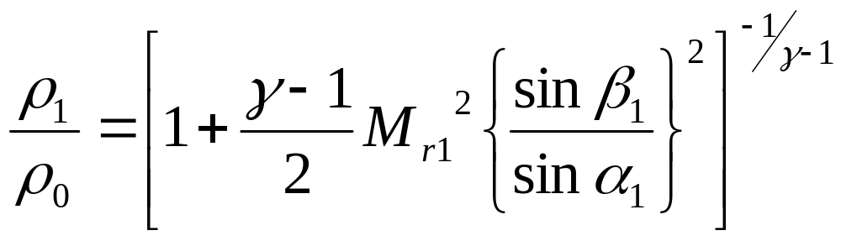
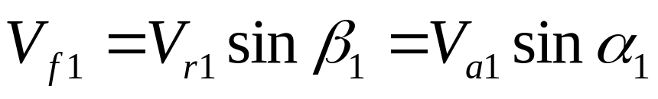
Compact design of a centrifugal compressor inlet

Slide 12
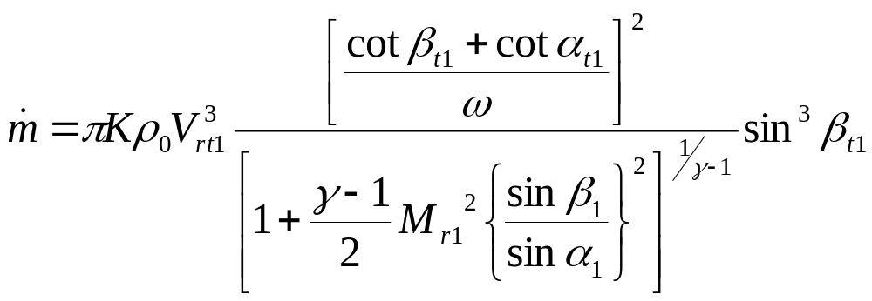
Compact design of a centrifugal compressor inlet

Slide 13
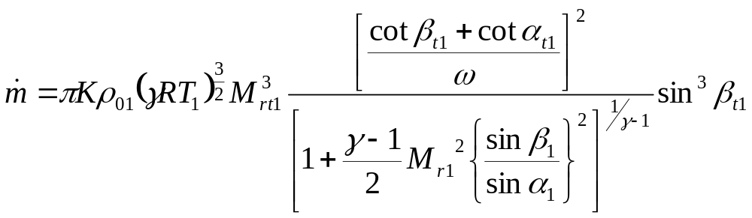
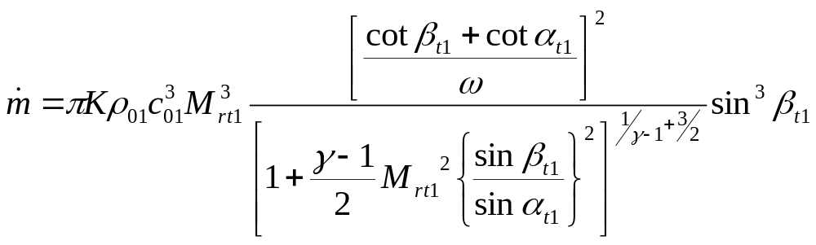
Compact design of a centrifugal compressor inlet

Slide 14
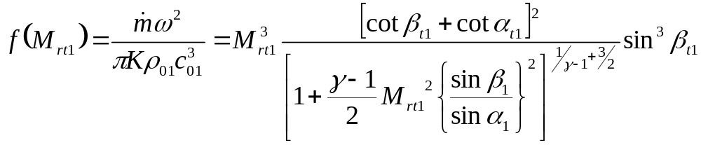
Compact design of a centrifugal compressor inlet
This equation is extremely useful and can be used in a number of different ways.
For a particular gas and known inlet conditions one can specify values of γ, R, p₀₁ and T₀₁ and obtain f(M_{rt1}) as a function of M_{rt1} and β_{t1}.
By specifying a particular value of M_{rt1} as a limit, the optimum value of β_{t1} for maximum mass flow can be found.
A graphical procedure is the simplest method of optimising as illustrated below.

Slide 15
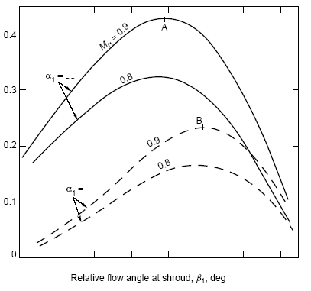
Compact design of a centrifugal compressor inlet
60
f(M_{rt1})
90
80
50
30
10

Slide 16
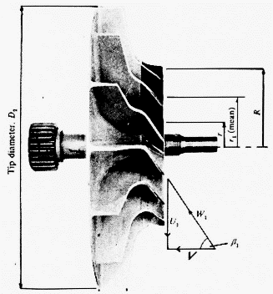
Prewhirl at Entry to an Impeller
Introducing positive prewhirl (i.e. in the direction of impeller rotation) can give a significant reduction of the inlet Mach number M_{r1} but, reduces the specific work done on the gas.
Prewhirl is obtained by fitting guide vanes upstream of the impeller.
Guide vanes are designed to produce either a free-vortex or a forced-vortex velocity distribution.

Slide 17
Prewhirl at Entry to an Impeller
For a free-vortex flow the flow velocity V_{f} is constant with the tangential velocity V_{w} varying inversely with the radius.
The use of some forced-vortex velocity distribution does alleviate this problem.

Slide 18
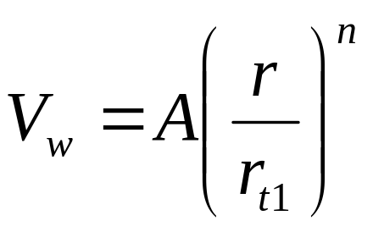
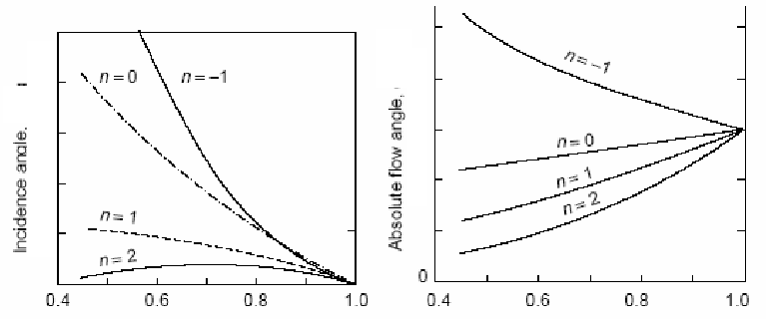
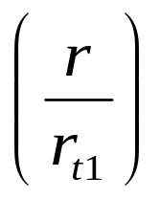
Radial Equilibrium Theory for Prewhirl
Forced Power Law Guide Vanes:
High β
α₁
α₁
50
70
Low β
80
70

Slide 19
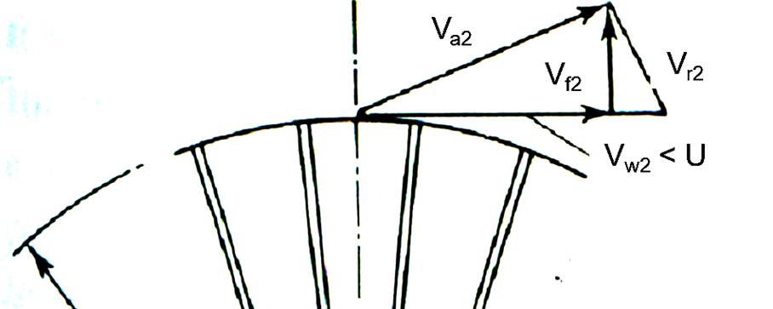

Realistic Velocity Triangles for An Impeller

Slide 20
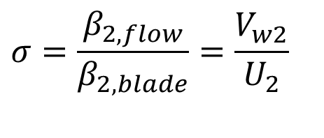
Slip factor
Even under ideal (frictionless) conditions the relative flow leaving the impeller of a compressor or pump will receive less than perfect guidance from the vanes and the flow is said to slip.
If the impeller could be imagined as being made with an infinite number of infinitesimally thin vanes, then an ideal flow would be perfectly guided by the vanes and would leave the impeller at the vane angle.
A slip factor may be defined as
$$σ=\frac{β_{2,flow}}{β_{2,blade}}=\frac{V_{w2}}{U_{2}}$$
The slip factor is a vital piece of information needed by compressor designers, as its accurate estimation enables the correct value of the energy transfer between impeller and fluid to be made.

Slide 21
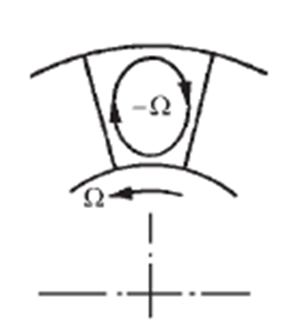
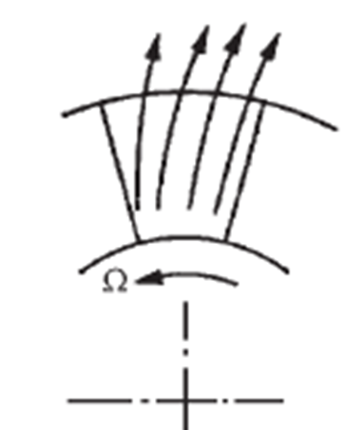
Relative Eddy Concept
Without flow
With flow

Slide 22
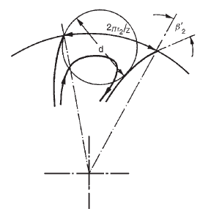
Slip Factor
$$σ=1−\frac{0.8π\sqrt{cosβ_{2}}}{Z}$$
Z number of vanes.
For Z= 19 to 21, σ = 0.9

Slide 23

Performance of centrifugal compressors
Pressure Ratio
The overall or total-to-total efficiency

Slide 24

Performance of Radial Vane Compressor

Slide 25


Performance of Backward Vane Compressor
β₂ =90
β₂ =75
β₂ =60

Slide 26

Load Capacity of A Compressor
$$\frac{∆h}{U_{2}^{2}}$$
$$\frac{V_{f2}^{}}{U_{2}^{}}$$

Slide 27

Load Capacity of A Compressor
$$\frac{V_{f2}^{}}{U_{2}^{}}$$

Slide 28


Dimensional Analysis
Experimental performance curves or maps provide a versatile data for compressor engineers.
The data is translated into most general form.
Data in general form is minimally affected by air speed, altitude etc.
The total pressure ratio of a compressor is:
Using dimensional analysis & Buckingham Pi Theorem:

Slide 29


Overall Efficiency of CC

Slide 30


Test Rig For Centrifugal Compressor

Slide 31

Compressor Characteristics
Zero Efficiency Points
Maximum Efficiency point
Supply pipe
Compressor exit

Slide 32

Pressure Cycling During Surging

Slide 33

Surge Control System
The function of the surge control system is to detect the approach to surge and provide more flow to the compressor through opening the recycle valve to avoid the potentially damaging flow reversal period and surge cycling.

Slide 34




Compressor Hill Chart (Map)

Slide 35

Compressor Hill Chart (Map)

Slide 36

Variable Speed Operation

Slide 37

Remarks on Centrifugal Compressors
High pressure ratio per stage (r_{0p}= 3 to 4).
Less flow area per unit mass flow rate.
A multistage centrifugal compressors have shorter lengths.
They are best suited for low mass flow rates.
As the flow is turned by 90⁰, the efficiency of centrifugal compressor is relatively low.
The impeller is an integral unit of blades and a disk.
Even if one blade is damaged the entire unit is to be replaced.

