Slide 1

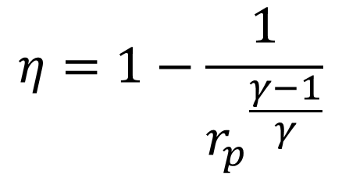
Analysis of Centrifugal Compressors
$$η=1−\frac{1}{{r_{p}}^{\frac{γ−1}{γ}}}$$
P M V Subbarao
Professor
Mechanical Engineering Department
Best Suited for Low Volume Flow Rates and High Compression Ratio….

Slide 2


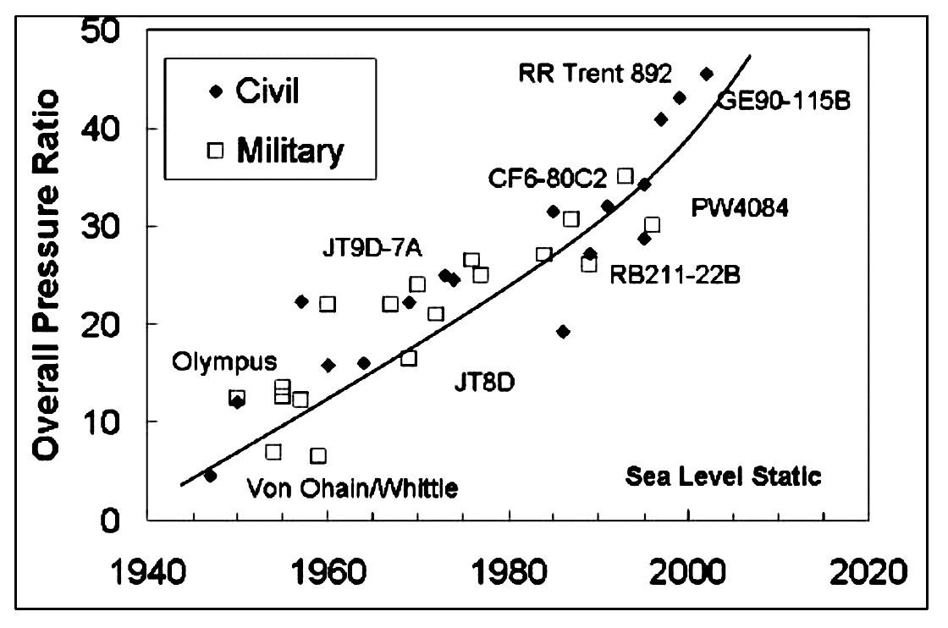
Advances in High Performance Jet Engines

Slide 3
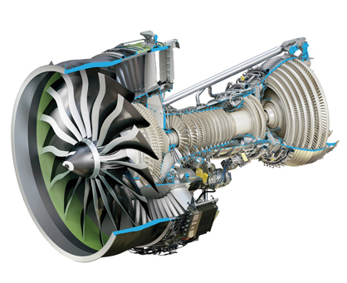
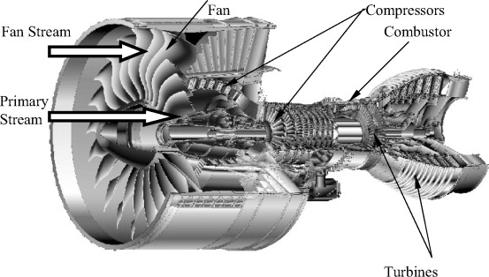
World’s Most Powerful Engine : GE9X
Overall pressure ratio: 60
Thrust-to-weight ratio: 6.3
The GE9X engine for the Boeing 777X has been recognized by the Guinness Book of World Records as the most powerful commercial aircraft jet engine (test performance) after reaching 584 kN of thrust.

Slide 4
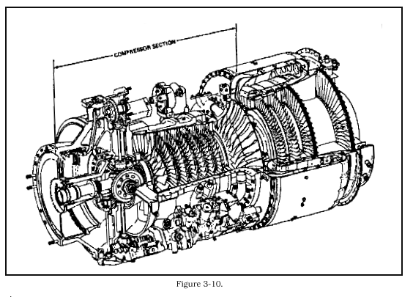
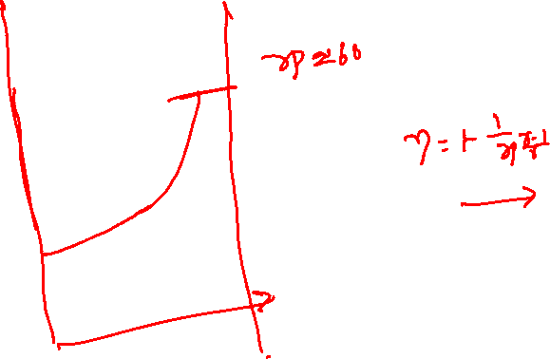
Multistage Hybrid Compressor

Slide 5
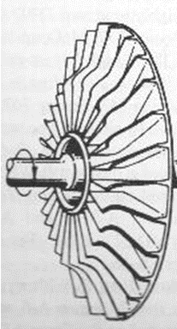
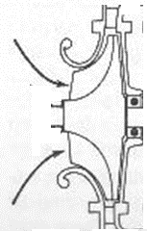
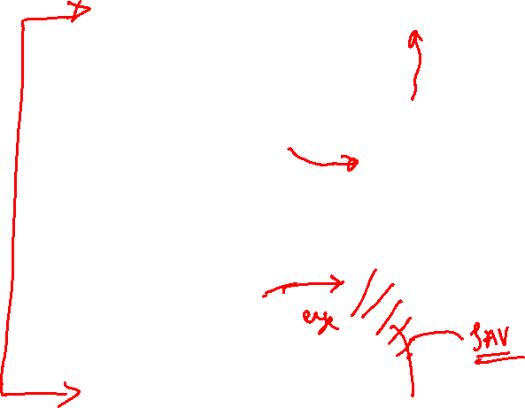
Centrifugal Compressor
Sectional View of A Centrifugal Compressor
Impellers/Rotor

Slide 6
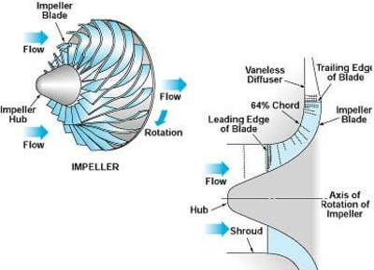
Anatomy of A Centrifugal Compressor

Slide 7
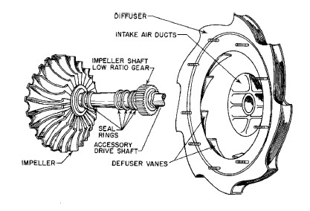
Impeller & Diffuser Pair

Slide 8
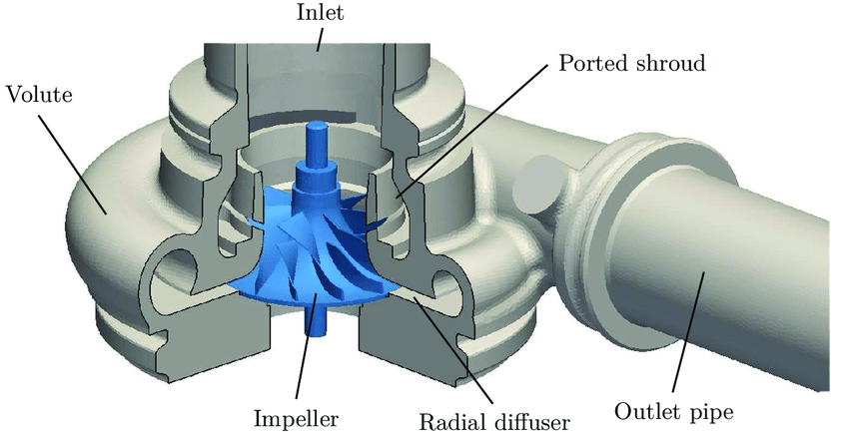
Simple Centrifugal Compressor
The centrifugal compressor consists essentially of a stationary casing containing a rotating impeller.

Slide 9
Simple Centrifugal Compressor
Air/gas is sucked into the impeller eye and whirled round at high speed by the vanes on the impeller disc.

Slide 10
Simple Centrifugal Compressor
Impeller imparts a high velocity to the air/gas.
Centripetal acceleration leads to increase in rise of some amount of static pressure.

Slide 11
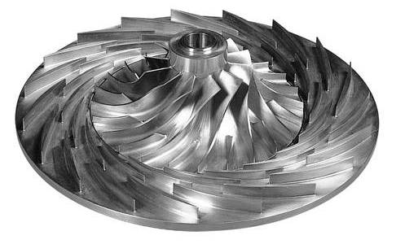
Simple Centrifugal Compressor
The remaining increase in rise of pressure occurs in stationary rig called diffuser.
Diffuser is an annular rign with a number of diverging passages in which the air is decelerated with a consequent rise in static pressure.

Slide 12
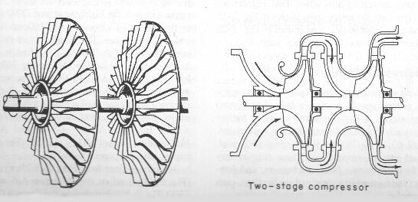
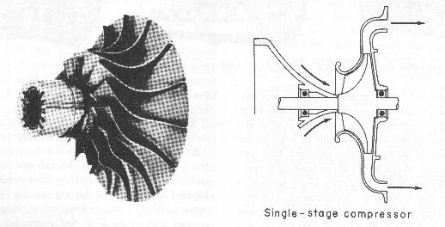
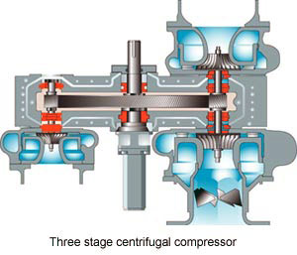
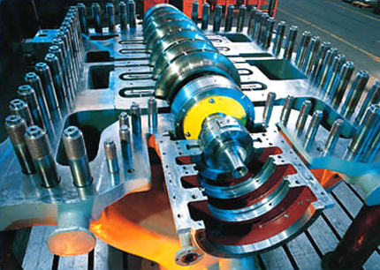
Multistage Centrifugal Compressors

Slide 13
Impeller & Diffuser Pair

Slide 14
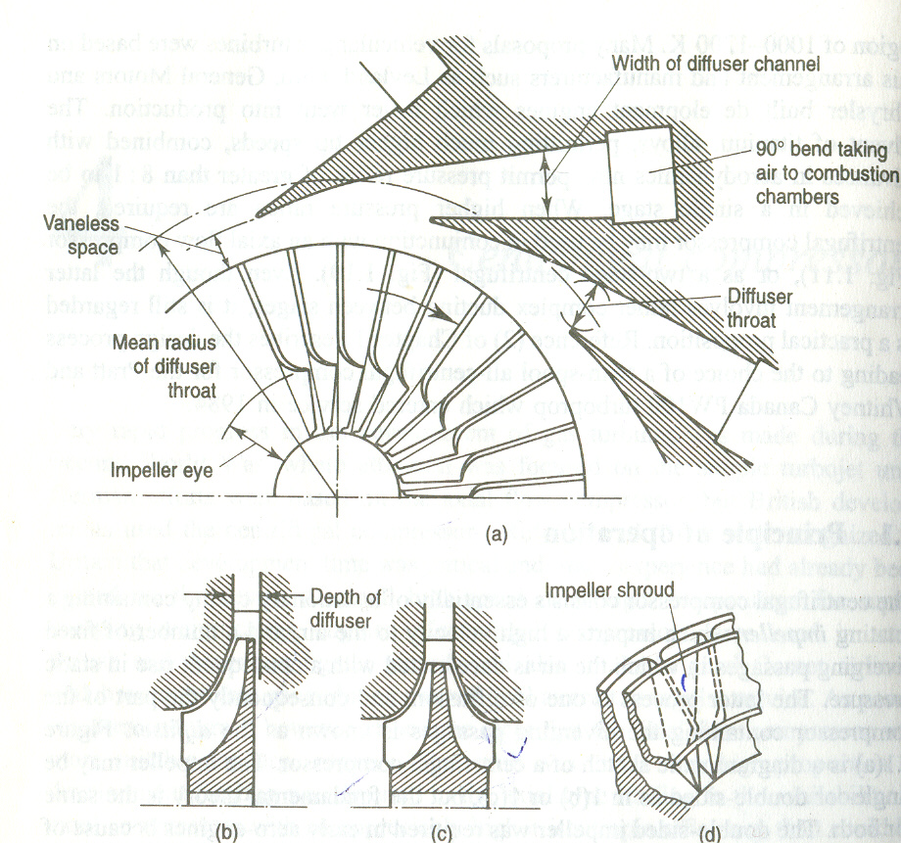
Anatomy of Impellers in A Centrifugal Compressor

Slide 15
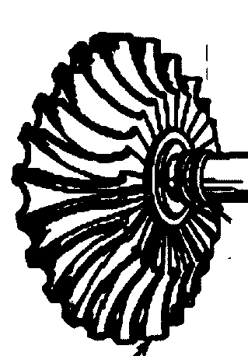
Gas Dynamics of An Impeller

Slide 16
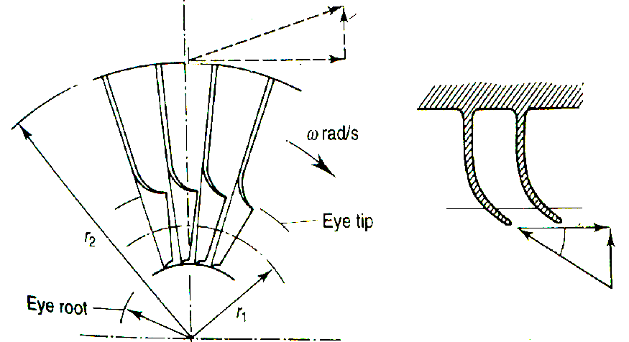
Ideal Velocity Triangles for An Impeller
V_{a2}
V_{f2} =V_{r2}
V_{w2}= U_{tip}
U_{eye}
β₁
V_{w1}=0
V_{f1}=V_{a1}
V_{r1}

Slide 17
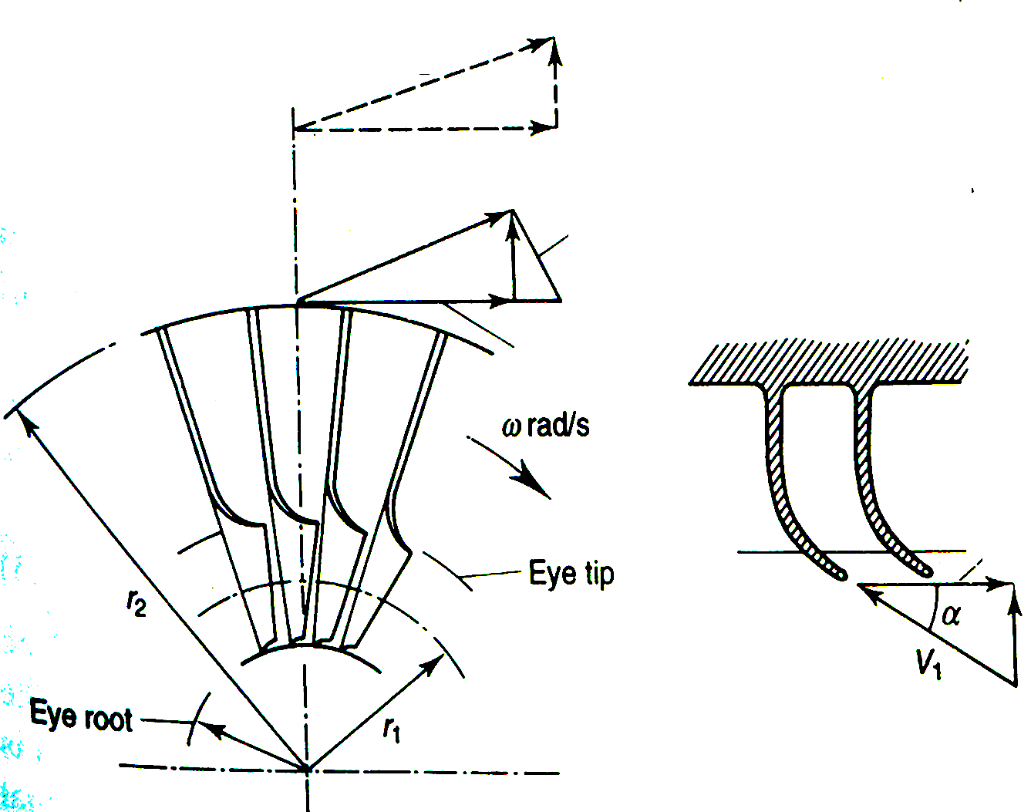
Reality of Exit Velocity Triangle for An Impeller
V_{a2}
V_{r2}
β₂
V_{w2}
V_{a2}
V_{r2}
V_{f2}
V_{w2}
β₁
V_{f1}=V_{a1}
V_{r1}

Slide 18
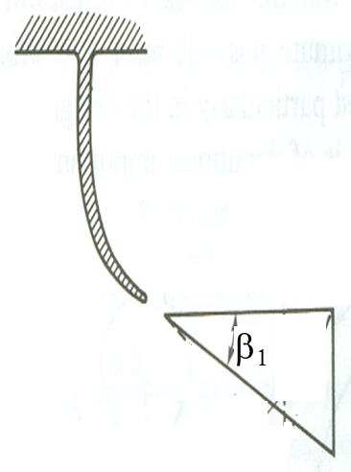
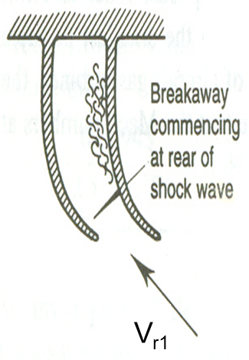
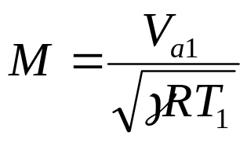
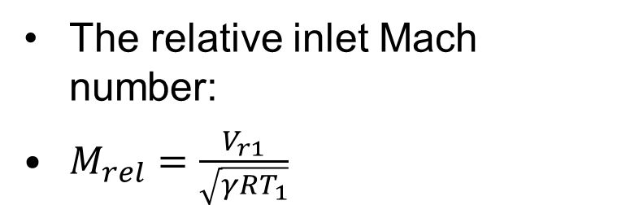
Inlet Mach Number for Impeller
The inlet Mach number:
The relative inlet Mach number:
$M_{rel}=\frac{V_{r1}}{\sqrt{γRT_{1}}}$
At inlet, the air must be deflected a certain angle before it passes into the radial channels on the impeller.
The inlet Mach number is controlled by Using the angle of prewhirl.

Slide 19
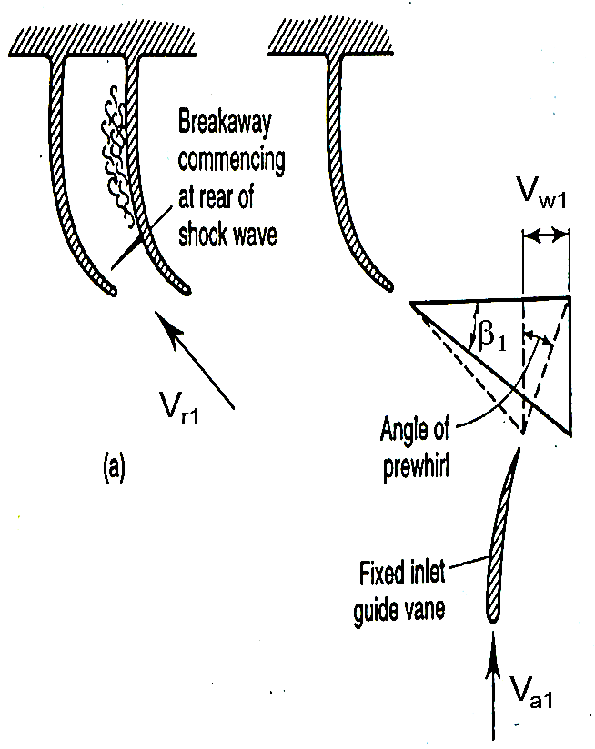
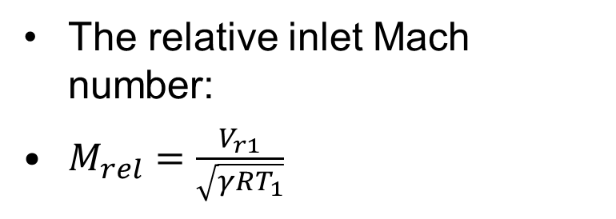
Control of Inlet Mach Number for Impeller
The relative inlet Mach number:
$M_{rel}=\frac{V_{r1}}{\sqrt{γRT_{1}}}$
The inlet Mach number is controlled by Using the angle of prewhirl.

Slide 20
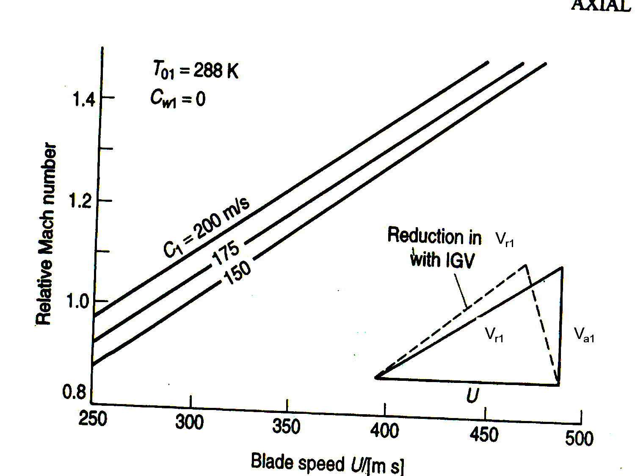
Control of INLET Mach Number
V_{a1}

Slide 21
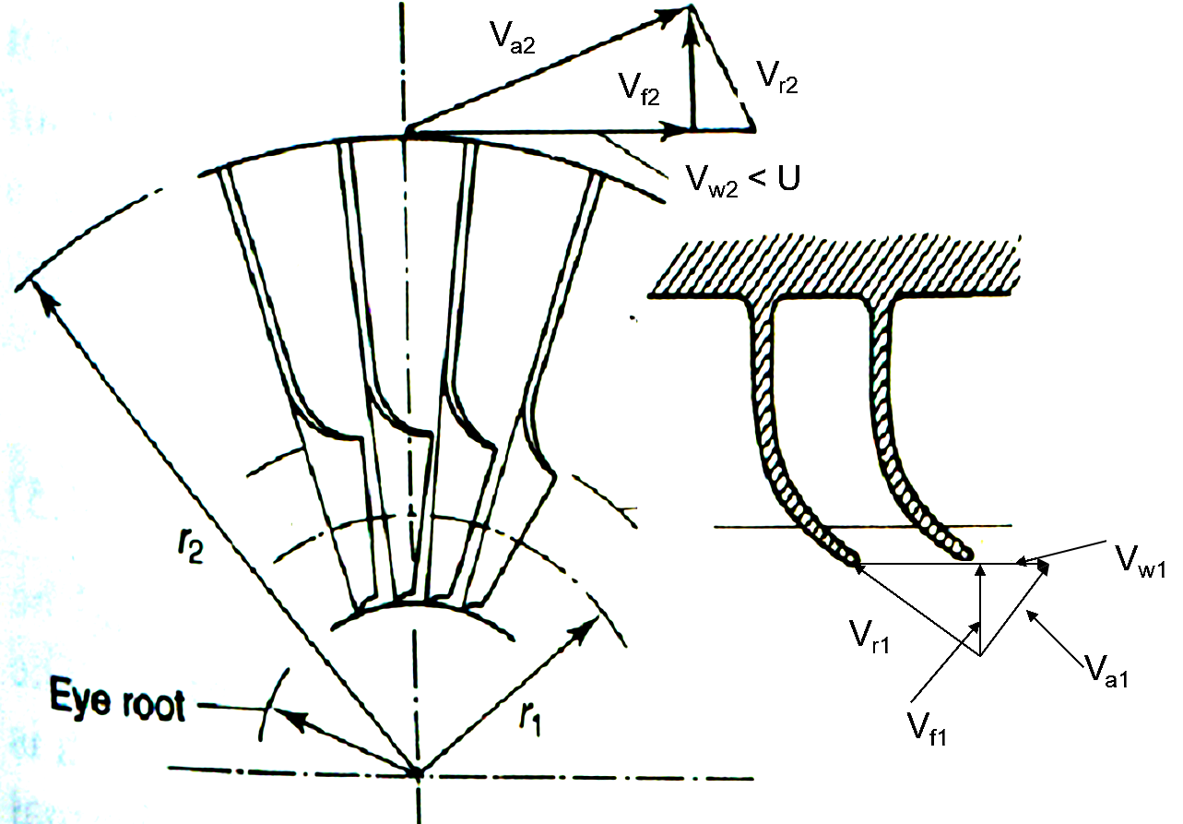
Realistic Velocity Triangles for An Impeller

Slide 22





Euler Equation for A Centrifugal Compressor
Rate of Angular momentum of air at impeller eye
Rate of Angular momentum of air at impeller exit
Change in Rate of Angular momentum of air across an impeller
Resisting Torque on Impeller
Power Consumed by the Impeller:
Only Impeller can consume Power !!!

Slide 23
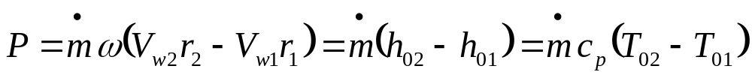
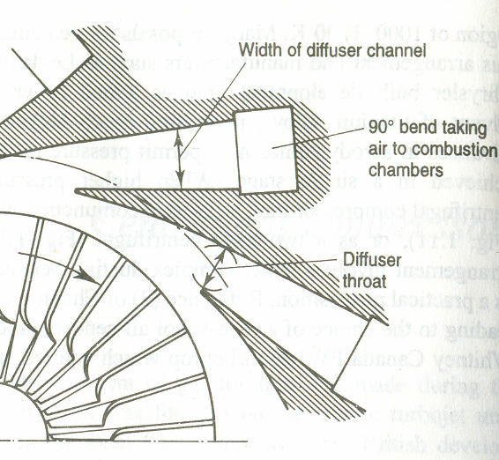
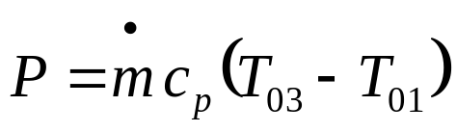

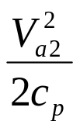
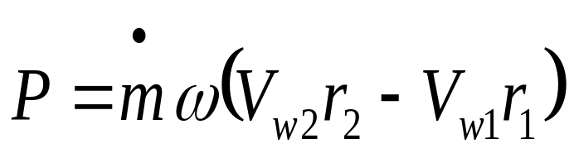

Thermodynamic View of an isentropic Compressor
p₀₃=p₀₂
3
p₃
2
1
Only Impeller can consume Power !!!
T₀₃=T₀₂
p₂
T
p₀₁
p₁
T₀₁
s

Slide 24
Irreversible Impeller
p_{03s}=p_{02s}
p_{02a}
T₀₃=T₀₂
Impeller Losses
T
p₀₁
T₀₁
s

Slide 25
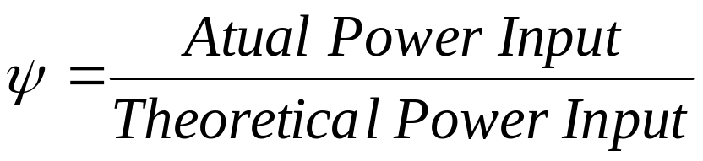
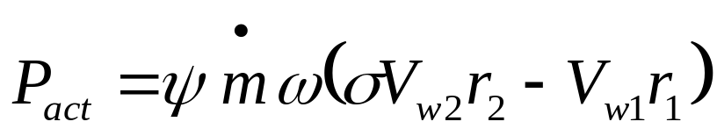
Power Input to An Irreversible Impeller
Power input factor, ψ
Typical values for the power input factor, ψ : 1.035 – 1.04.

Slide 26
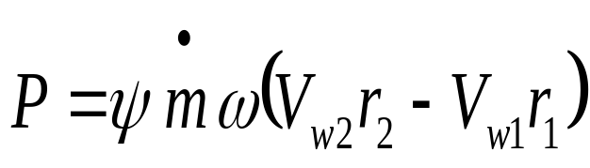
Irreversible Impeller
p_{02s}
p_{02a}
Impeller Losses
T_{02as}
T
p₀₁
T₀₁
s

Slide 27
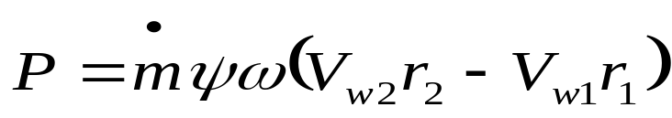
Irreversible Diffuser
p_{03s}=p_{02s}
p_{02a}
p_{03a}
T₀₃=T₀₂
Impeller Losses
Overal Losses
T
p₀₁
T₀₁
s

Slide 28
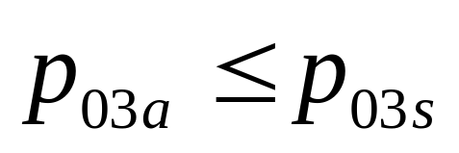
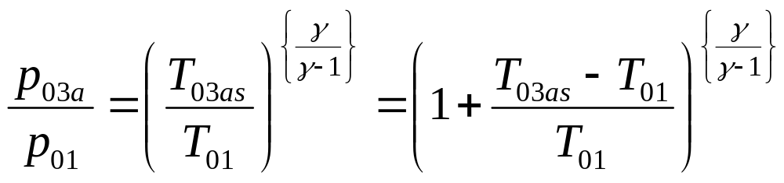
Confluence of Gas Dynamics and Thermodynamics
Work consumed by A compressor = Increase in Stagnation Enthalpy of gas
For an irreversible compression, the actual pressure rise is less than isentropic pressure rise due to (T₀₃-T₀₁).

Slide 29
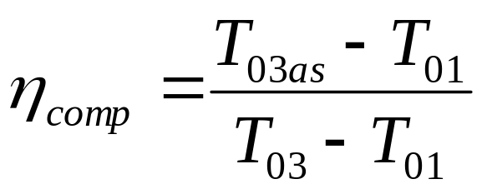
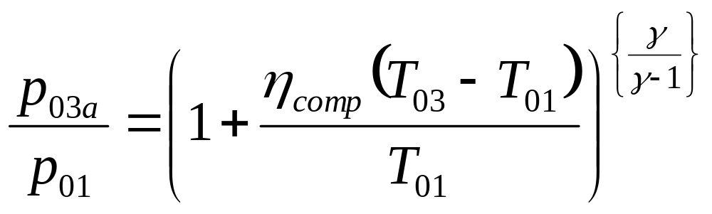
Confluence of Gas Dynamics and Thermodynamics
Define, Global Adiabatic Efficiency of A Compressor:

