Slide 1

Design Rules for Axial Flow Compressors & Gas Turbines
P M V Subbarao
Head & Professor
Mechanical Engineering Department
Ideal Gas Machines …..

Slide 2


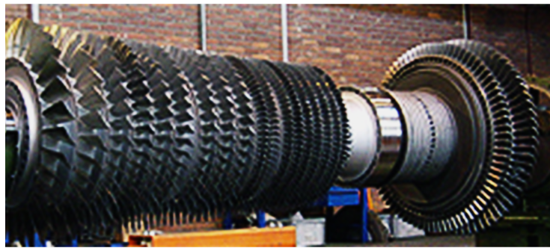
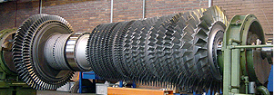
Compressor – Turbine Monoblock Rotor

Slide 3
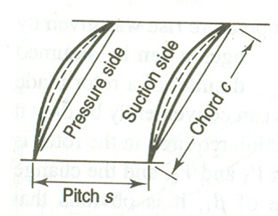
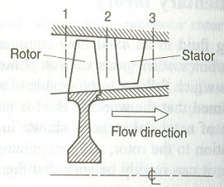
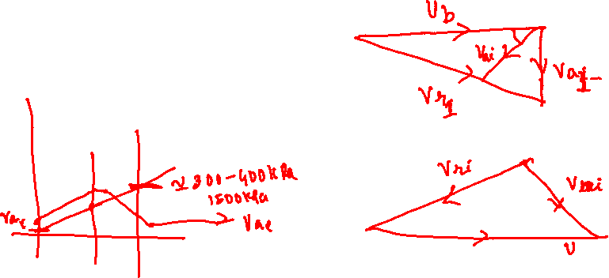
Blade Speed vs Flow Velocity
U_{b}

Slide 4
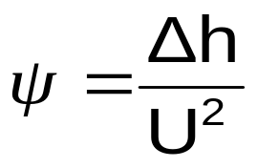
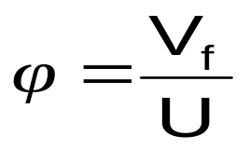
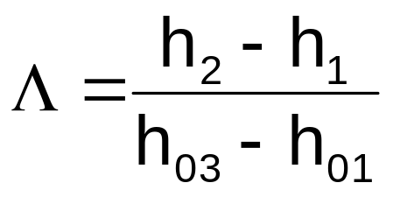
Selection of Global Stage Variables
Stage load coefficient
Stage flow coefficient
Stage reaction

Slide 5
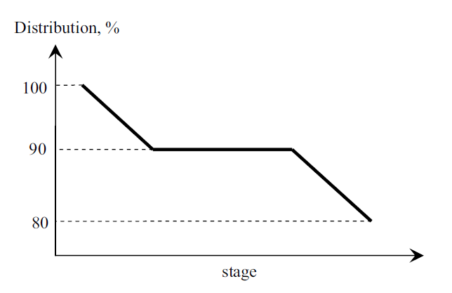
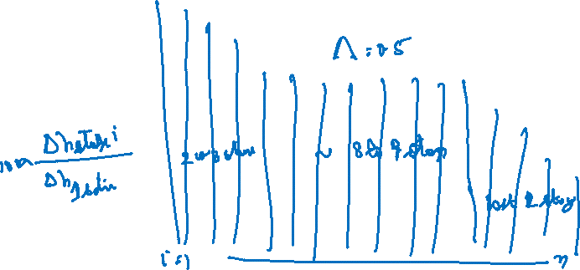
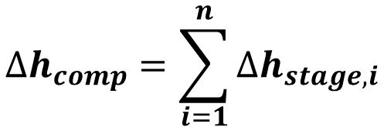
The stage load distribution throughout the compressor
$$∆h_{comp}=\sum_{i=1}^{n}{∆h_{stage,i}}$$

Slide 6
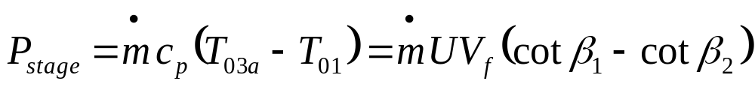
Selection of Design Parameters
A high pressure rise per stage will decrease the number of stages for a given overall pressure rise.
A high pressure rise per stage is obtained using:
High blade speed.
High inlet flow velocity.
High fluid deflection in rotor blades.

Slide 7
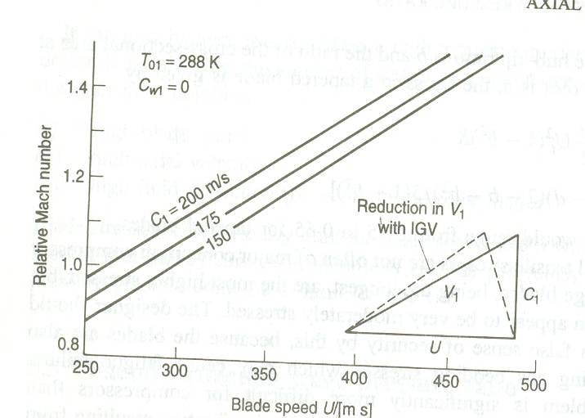
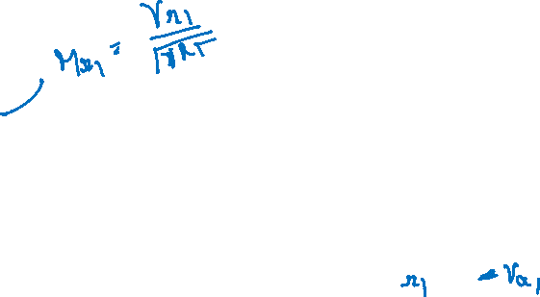
Selection of Inlet Angle
V_{a1}

Slide 8
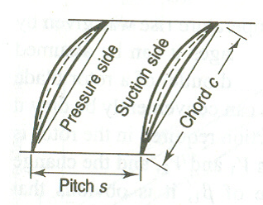
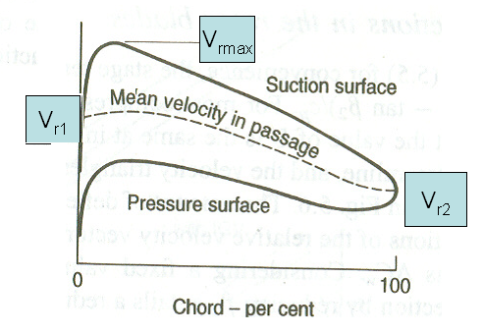
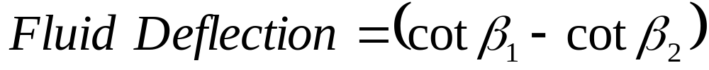
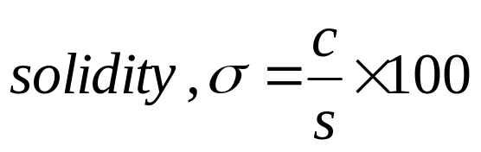
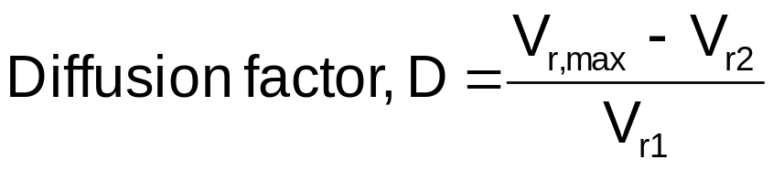
Fluid Deflection

Slide 9
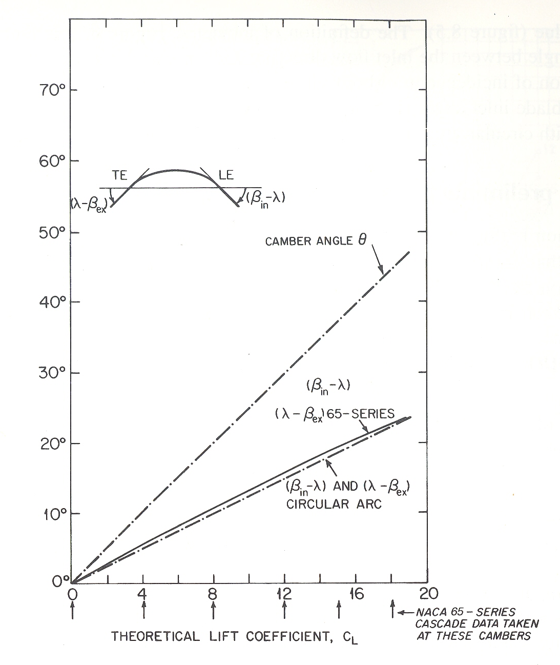
Performance of Aerofoil
Camber angle, θ
Naca 65 : β_{in}−λ
Circula rarc : β_{in}−λ

Slide 10
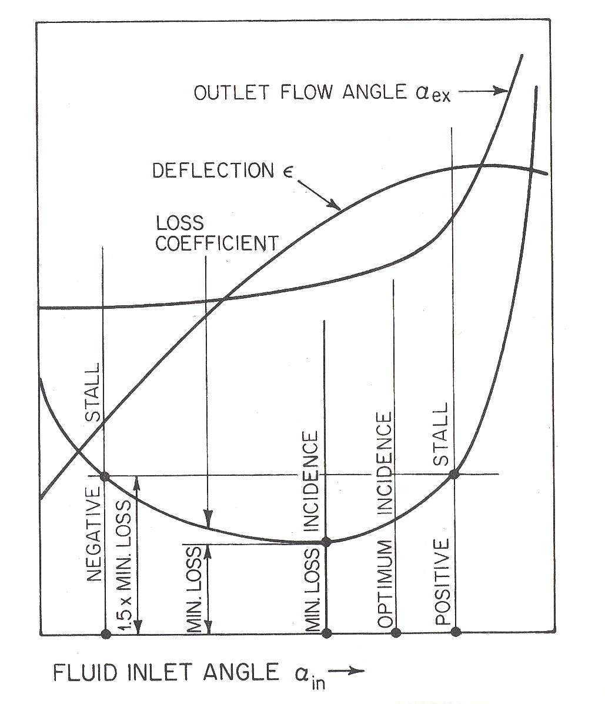
Clues to Invent an Aerofoil
Outlet flow Angle
Deflection
Loss coefficient

Slide 11
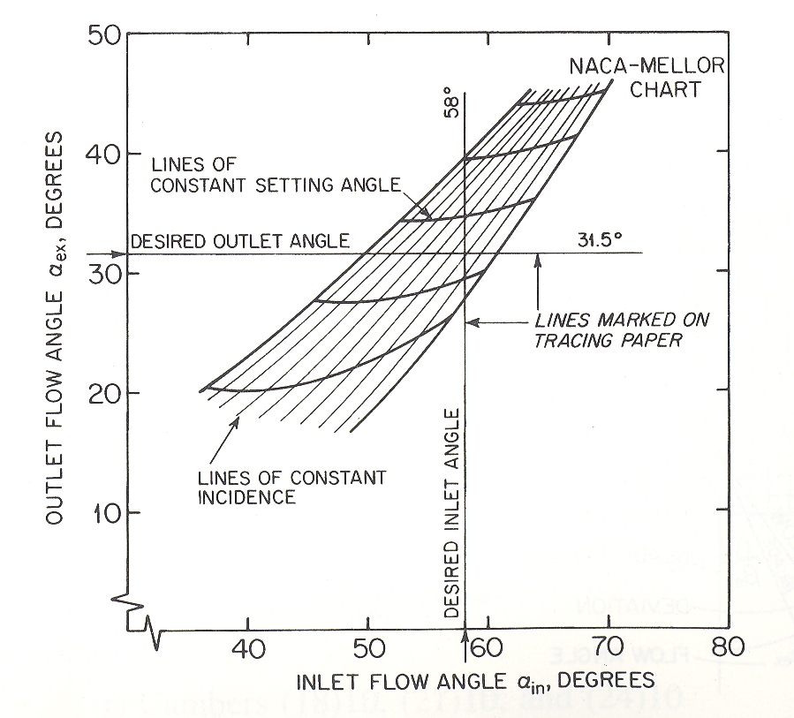
Flow Angle Charts

Slide 12
Current Design Practice
Fan or low-pressure Compressor
Parameter | Range
Pressure ratio for single stage | 1.5 – 2.0
Pressure ratio for two stages | 2.0 – 3.5
Pressure ratio for three stages | 3.5 – 4.5
Inlet mass flow rates | 195 – 205 kg/m².s
Tip speed | 427 – 457 m/s
Diffusion factor | 0.5 – 0.55

Slide 13
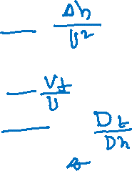
Current Design Practice
High pressure Compressor
Parameter | Range
Stage loading coefficient | 0.3 – 0.35
Flow coefficient | 0.45 – 0.55
Hub/tip ratio | 0.6 – 0.75
Inlet mass flow rates | 175 – 185 kg/m².s
Tip speed | 386 – 457 m/s
Diffusion factor | 0.5 – 0.55

Slide 14
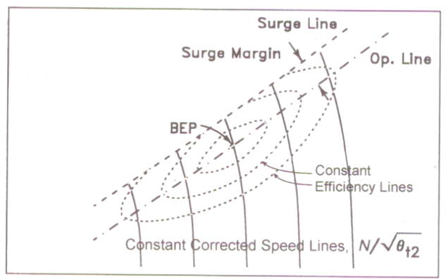
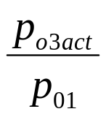
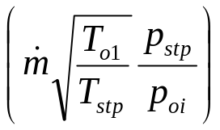
Compressor Maps

Slide 15
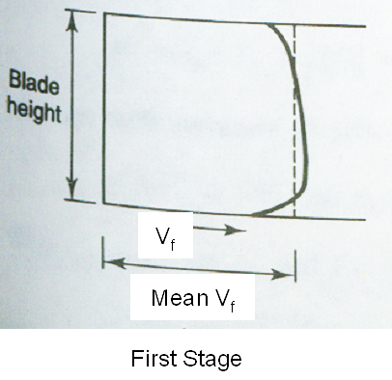
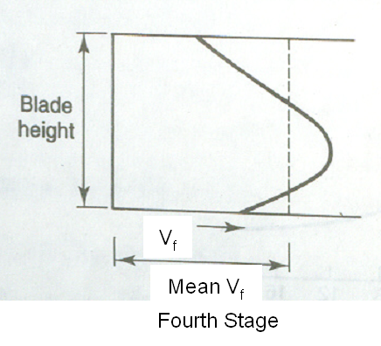
Multistage Compression
Loss in capacity due to variation of velocity is defined as work done factor.
Work done factor, λ, decrease with number of stages.

Slide 16
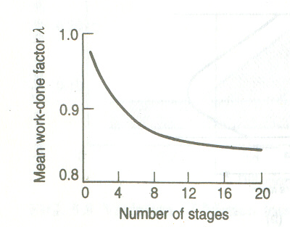

Slide 17
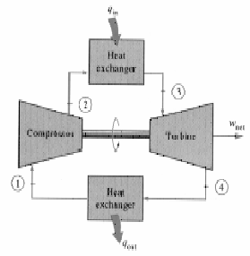
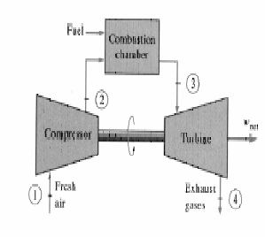
Brayton Cycle
1-2 Isentropic compression (in a compressor)
2-3 Constant pressure heat addition
3-4 Isentropic expansion (in a turbine)
4-1 Constant pressure heat rejection

Slide 18
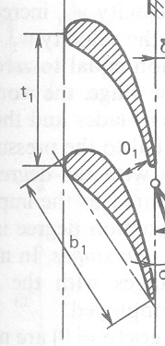
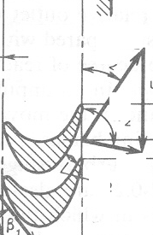
Sequence of Energy Losses in A Gas Turbine Stage
Gas
Thermal
Power
Blade
kinetic
Power
Gas
kinetic
Power
Nozzle Losses
Stage Losses
Moving Blade
Losses
Isentropic efficiency of
Nozzle
Blade Friction Factor

Slide 19
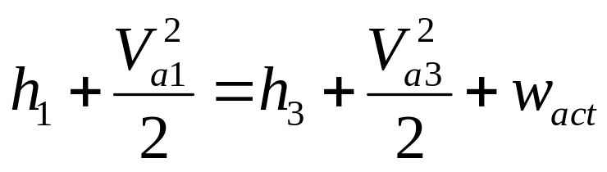
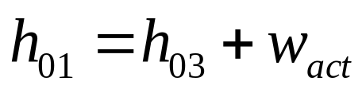
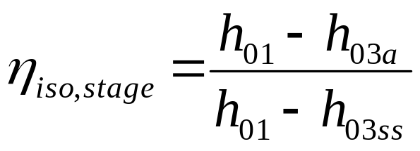
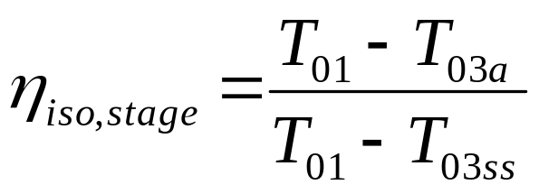
Irreversible Adiabatic Flow Through A Turbine Stage : SSSF
Ideal work w_{iso} = h₀₁ –h_{03ss}
Actual work w_{act} = h₀₁ – h_{03a}
Isetropic Efficiency of a stage
1
2s
h
2a
3a
3ss
3s
s

Slide 20
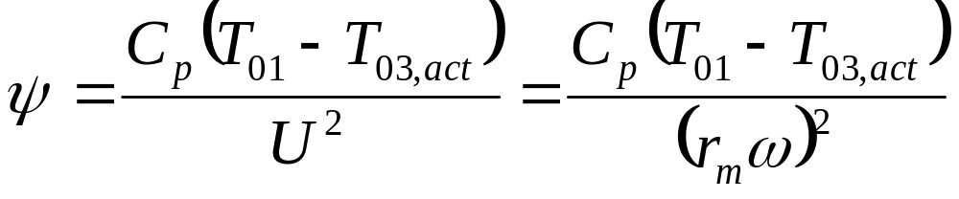
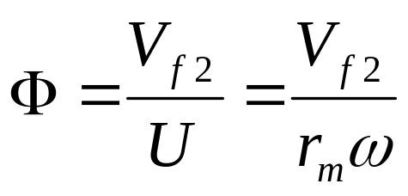
Stage Loading and Flow Coefficient
Stage Loading Coefficient: Ratio of specific stage work output and square of mean rotor speed.
Flow Coefficient: Ratio of the axial velocity entering to the mean rotor speed.

Slide 21
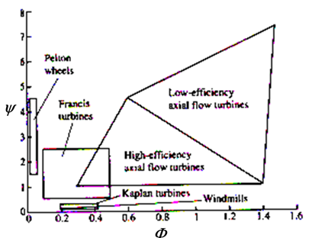
Sizing of A Turbine Stage

Slide 22
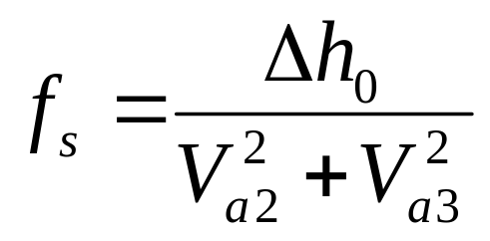
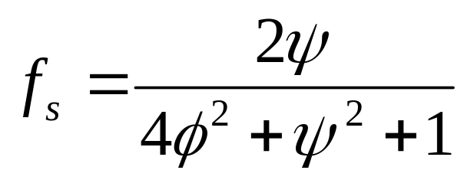
Theoretical Model for Loss Estimation
The losses in any blade row will be proportional to the dynamic head or kinetic energy in the row.
Define the coefficient f_{s} as the ratio of the shaft work output to the sum of the mean kinetic energies within stator + rotor.
For a 50% reaction turbine:

Slide 23
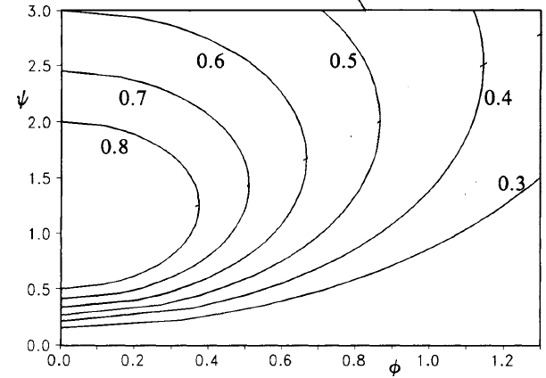
Performance Vs Size of A Turbine
ψ
f_{s} =
Φ

Slide 24
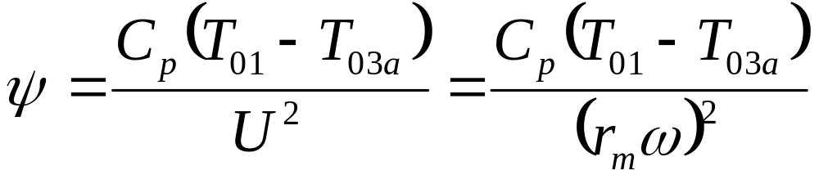
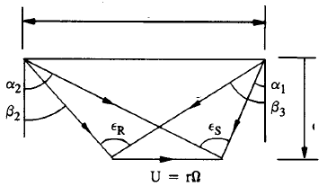
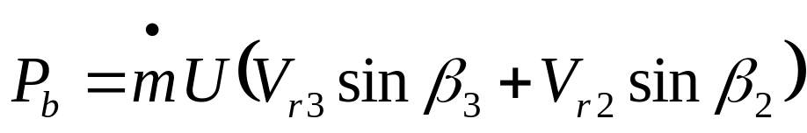
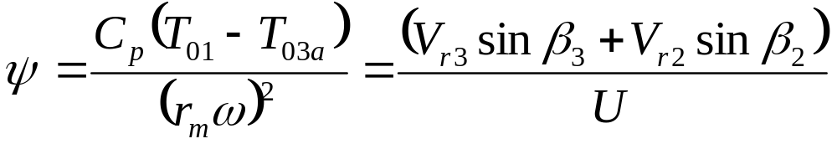
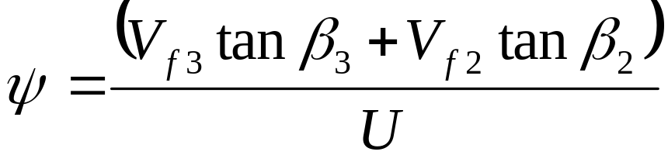
General Practice of Gas Turbine Velocity Triangle Analysis
ΔV_{w}
V_{a2}
V_{r3}
V_{f}
V_{r2}
V_{a3}

Slide 25
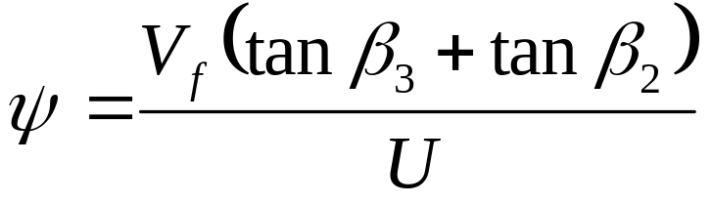
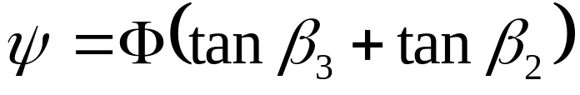

Sizing of A Gas Turbine Stage
ΔV_{w}
V_{a2}
V_{r3}
V_{f}
V_{r2}
V_{a3}

Slide 26

Selection of Geometrical Parameters
α₃
β₂
90-α₂

Slide 27

Selection of Geometrical Parameters
Λ/Φ=2
Λ/Φ=1
(β₂+β₃)
Λ/Φ=0
Λ/Φ=0.5
β₂

Slide 28

Design Algorithm

Slide 29

Design Algorithm

Slide 30

Model turbine instrumentation

Slide 31

Design validation

