Slide 1

Analysis & Control of Irreversible Flow in Gas Turbines Systems
P M V Subbarao
Head & Professor
Mechanical Engineering Department
Ideal Gas Machines …..

Slide 2


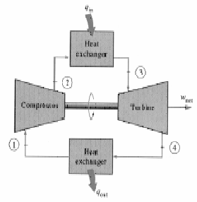
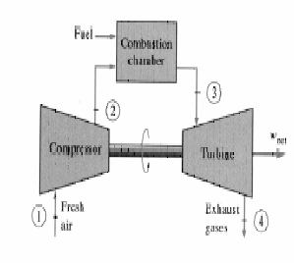
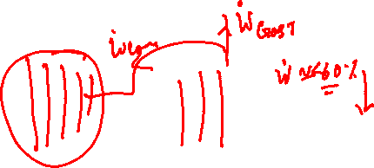
Brayton Cycle
1-2 Isentropic compression (in a compressor)
2-3 Constant pressure heat addition
3-4 Isentropic expansion (in a turbine)
4-1 Constant pressure heat rejection

Slide 3
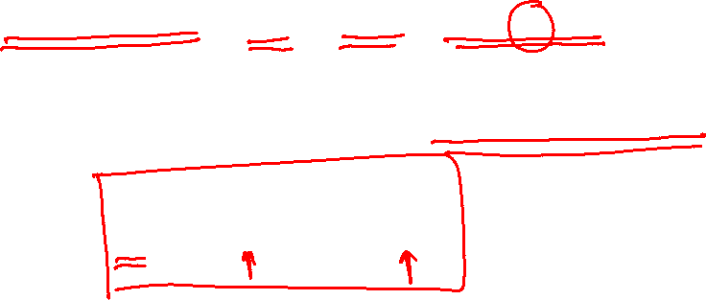
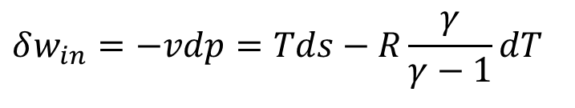
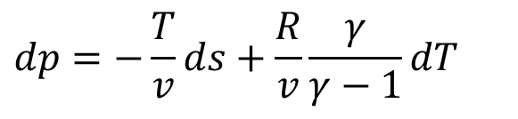
Expenditures in A Gas Power Generation System
Creation of Life and induction of Energy into Working Fluid.
Compression : Creation of life , w_{in}
$$Tds=dh−vdp⇒δw_{in}=−vdp=Tds−c_{p}dT$$
$$δw_{in}=−vdp=Tds−R\frac{γ}{γ−1}dT$$
The measure of Life:
$$dp=−\frac{T}{v}ds+\frac{R}{v}\frac{γ}{γ−1}dT$$
Two extreme roots for generation of life: ds > 0 or dT=0

Slide 4
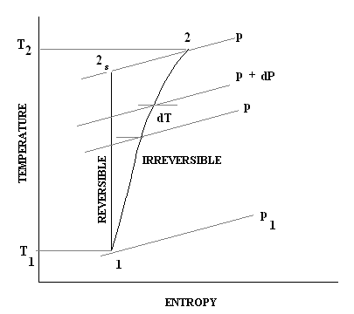
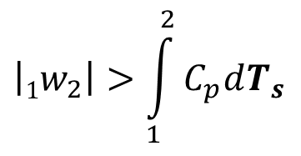
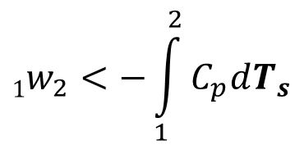
Actual Global Compression is Irreversible
$$1w_{2}<−\int_{1}^{2}{C_{p}dT_{s}}$$
$$\left|1w_{2}\right|>\int_{1}^{2}{C_{p}dT_{s}}$$

Slide 5
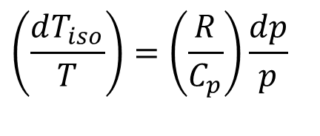
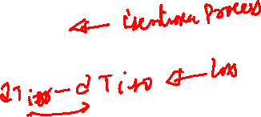
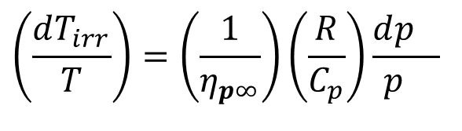
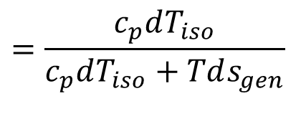
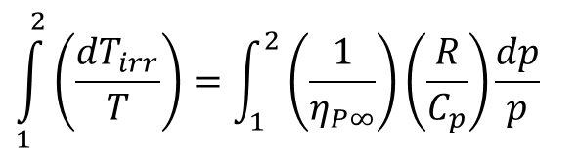
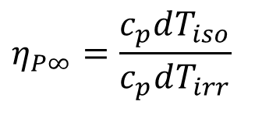
True Irreversible Adiabatic Compression
$$\left(\frac{dT_{iso}}{T}\right)=\left(\frac{R}{C_{p}}\right)\frac{dp}{p}$$
Define Polytropic Efficiency as:
$$η_{P∞}=\frac{c_{p}dT_{iso}}{c_{p}dT_{irr}}$$
$$=\frac{c_{p}dT_{iso}}{c_{p}dT_{iso}+Tds_{gen}}$$
$$\left(\frac{dT_{irr}}{T}\right)=\left(\frac{1}{η_{p∞}}\right)\left(\frac{R}{C_{p}}\right)\frac{dp_{}}{p_{}}$$
For an irreversible compressor:
$$\int_{1}^{2}{\left(\frac{dT_{irr}}{T}\right)}=\int_{1}^{2}{\left(\frac{1}{η_{P∞}}\right)\left(\frac{R}{C_{p}}\right)\frac{dp}{p}}$$

Slide 6
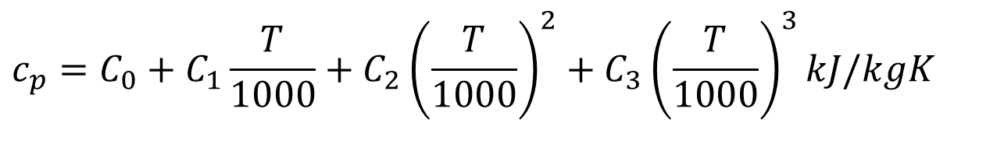
Variation of Specific Heat of Ideal Gases
$$c_{p}=C_{0}+C_{1}\frac{T}{1000}+C_{2}{\left(\frac{T}{1000}\right)}^{2}+C_{3}{\left(\frac{T}{1000}\right)}^{3}kJ/kgK$$
Gas | C₀ | C₁ | C₂ | C₃
Air | 1.05 | -0.365 | 0.85 | -0.39
Methane | 1.2 | 3.25 | 0.75 | -0.71
CO₂ | 0.45 | 1.67 | -1.27 | 0.39
Steam | 1.79 | 0.107 | 0.586 | -0.20
O₂ | 0.88 | -0.0001 | 0.54 | -0.33
N₂ | 1.11 | -0.48 | 0.96 | -0.42

Slide 7
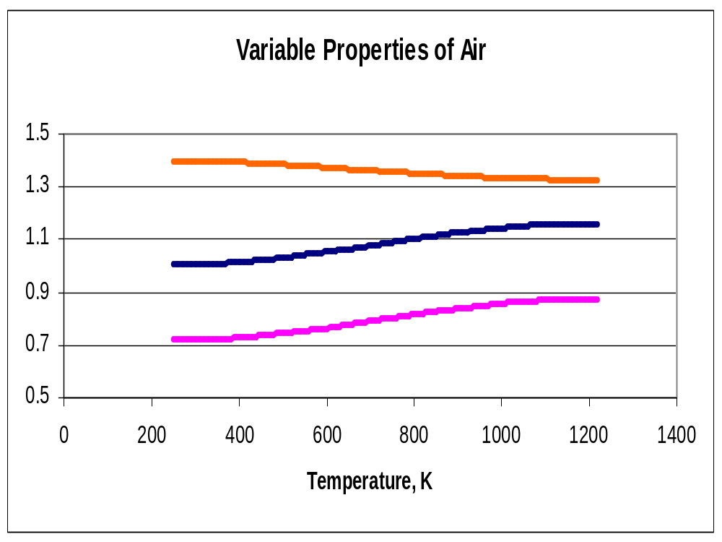
γ
c_{p}
c_{v}

Slide 8
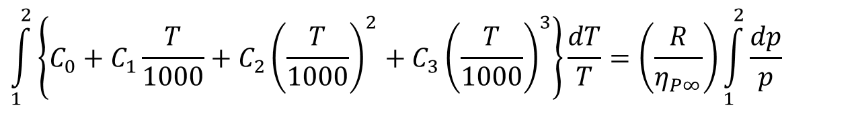
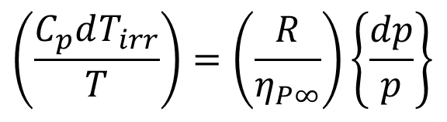
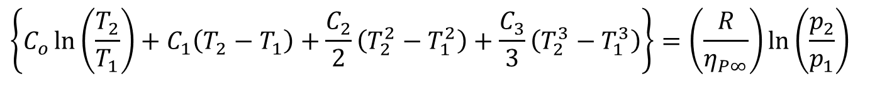
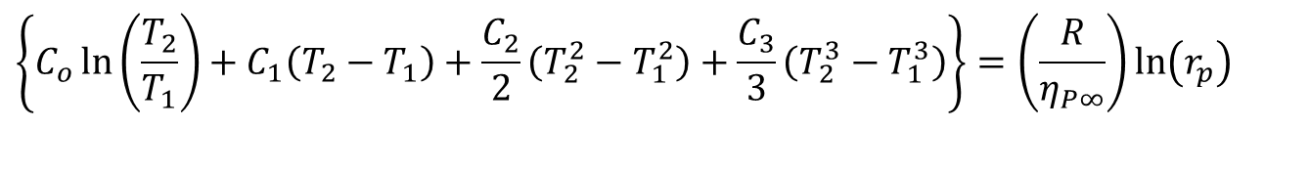
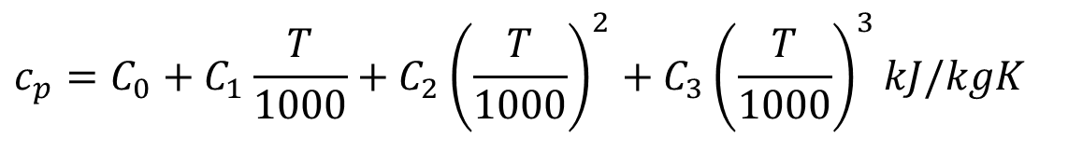
Phenomenological Model for Irreversible Compression
$$\left(\frac{C_{p}dT_{irr}}{T}\right)=\left(\frac{R}{η_{P∞}}\right)\left\{\frac{dp}{p}\right\}$$
Let the air is modeled as:
$$c_{p}=C_{0}+C_{1}\frac{T}{1000}+C_{2}{\left(\frac{T}{1000}\right)}^{2}+C_{3}{\left(\frac{T}{1000}\right)}^{3}kJ/kgK$$
$$\int_{1}^{2}{\left\{C_{0}+C_{1}\frac{T}{1000}+C_{2}{\left(\frac{T}{1000}\right)}^{2}+C_{3}{\left(\frac{T}{1000}\right)}^{3}\right\}\frac{dT}{T}}=\left(\frac{R}{η_{P∞}}\right)\int_{1}^{2}{\frac{dp}{p}}$$
$$\left\{C_{o}\ln\left(\frac{T_{2}}{T_{1}}\right)+C_{1}\left(T_{2}−T_{1}\right)+\frac{C_{2}}{2}\left(T_{2}^{2}−T_{1}^{2}\right)+\frac{C_{3}}{3}\left(T_{2}^{3}−T_{1}^{3}\right)\right\}=\left(\frac{R}{η_{P∞}}\right)\ln\left(\frac{p_{2}}{p_{1}}\right)$$
$$\left\{C_{o}\ln\left(\frac{T_{2}}{T_{1}}\right)+C_{1}\left(T_{2}−T_{1}\right)+\frac{C_{2}}{2}\left(T_{2}^{2}−T_{1}^{2}\right)+\frac{C_{3}}{3}\left(T_{2}^{3}−T_{1}^{3}\right)\right\}=\left(\frac{R}{η_{P∞}}\right)\ln\left(r_{p}\right)$$

Slide 9
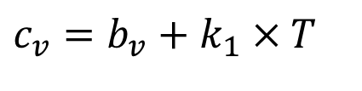
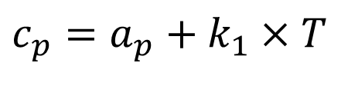
Generalized First Order Models for Variable Specific Heats
$$c_{p}=a_{p}+k_{1}×T$$
$$c_{v}=b_{v}+k_{1}×T$$
For design analysis of Gas Turbines:
a_{p} = 28.182 – 32.182 kJ/kmol.K
b_{v} = 19.868 – 23.868 kJ/kmol.K
k₁ = 0.003844–0.009844 kJ/kmol.K²

Slide 10
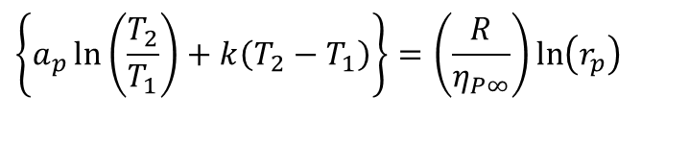
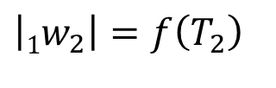
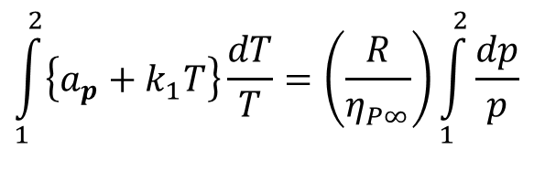
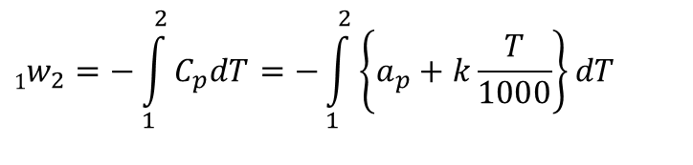
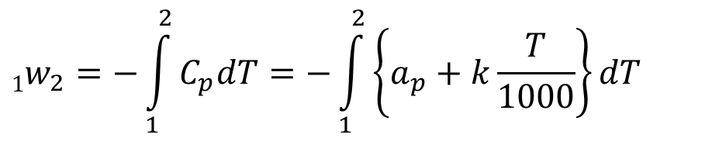
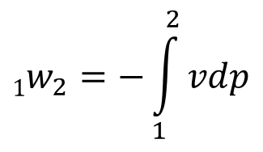
Irreversible Compression model with Linear variable properties
$$\int_{1}^{2}{\left\{a_{p}+k_{1}T\right\}\frac{dT}{T}}=\left(\frac{R}{η_{P∞}}\right)\int_{1}^{2}{\frac{dp}{p}}$$
$$\left\{a_{p}\ln\left(\frac{T_{2}}{T_{1}}\right)+k\left(T_{2}−T_{1}\right)\right\}=\left(\frac{R}{η_{P∞}}\right)\ln\left(r_{p}\right)$$
For compression from 1 to 2:
$$1w_{2}=−\int_{1}^{2}{vdp}$$
The expenditure due to compression:
$$1w_{2}=−\int_{1}^{2}{C_{p}dT}=−\int_{1}^{2}{\left\{a_{p}+k\frac{T}{1000}\right\}dT}$$
$$1w_{2}=−\int_{1}^{2}{C_{p}dT}=−\int_{1}^{2}{\left\{a_{p}+k\frac{T}{1000}\right\}dT}$$
$$\left|1w_{2}\right|=f\left(T_{2}\right)$$

Slide 11
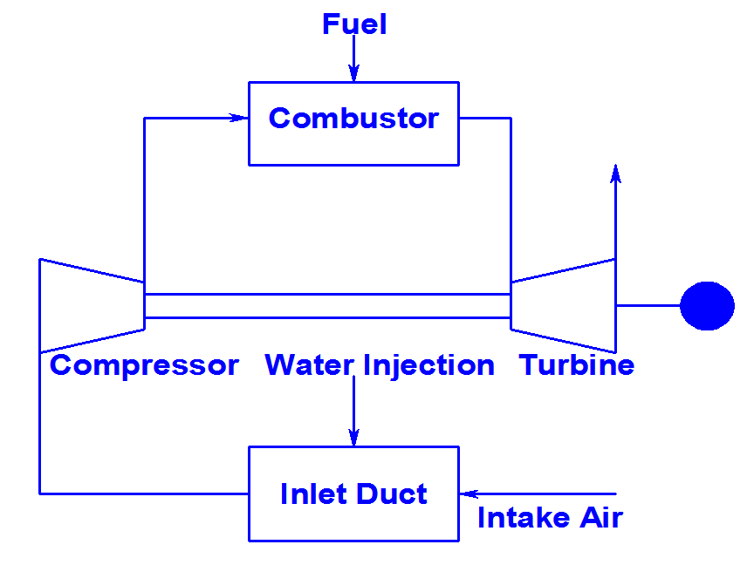
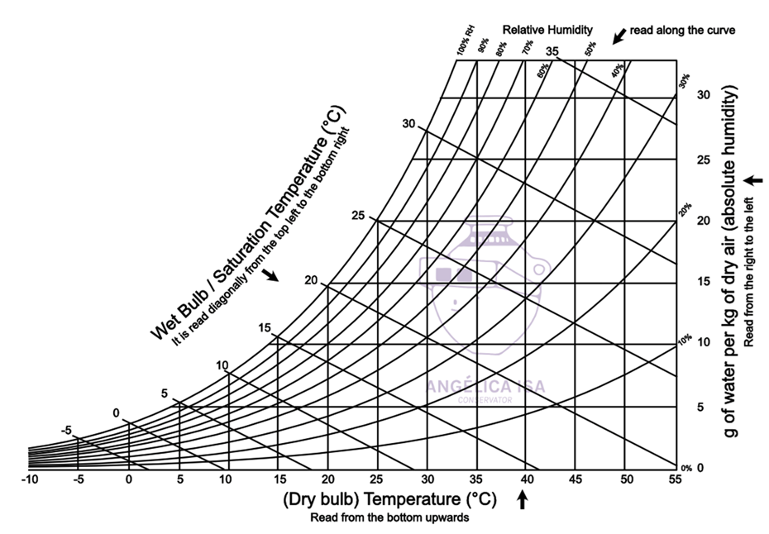
The Wet Compression (WC) Gas Turbine PGS

Slide 12
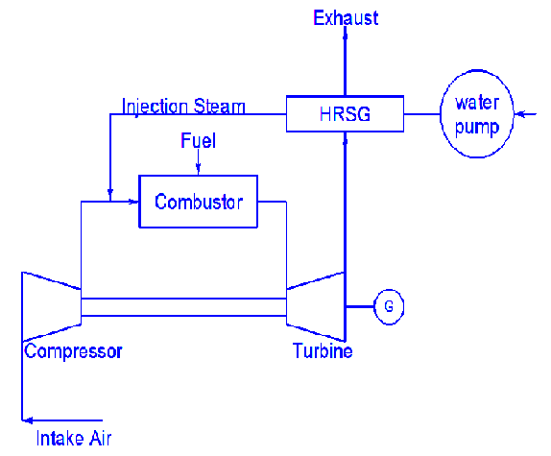
The Steam Injected Gas Turbine PGS

Slide 13
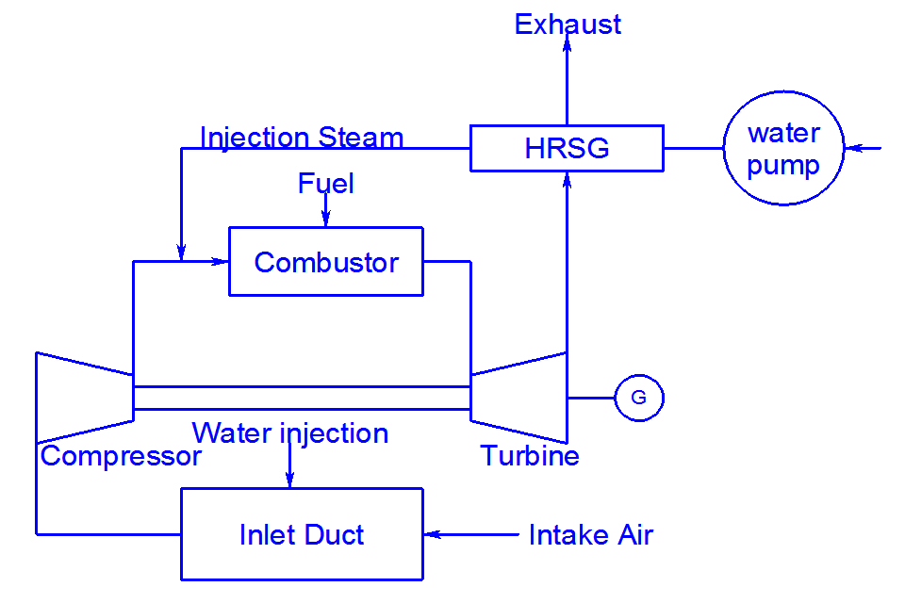
The Integrated (SWC) Gas Turbine PGS

Slide 14
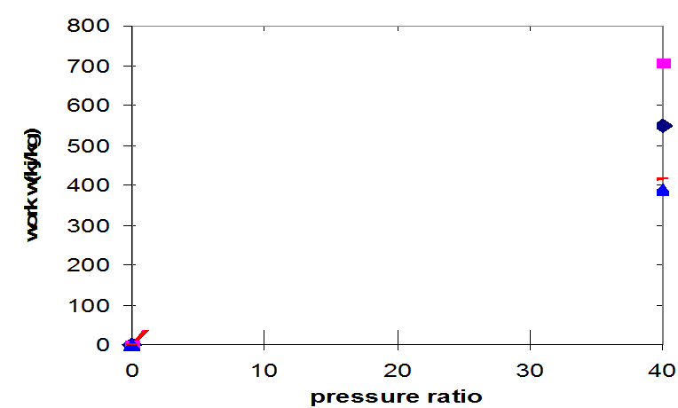
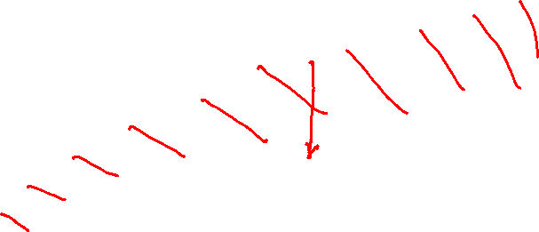
Variation of compression work with pressure ratio
w_{irr}
w_{iso}

Slide 15
The Wet Compression (WC) Cycle
One of the most effective ways to increase the gas turbine power output is to reduce the amount of work required for its compressor.
A gas turbine compressor consumes about 30 to 50% of work produced by the turbine.
The wet compression cycle has the following benefits over the simple cycle.
Lower compressor work
Higher turbine work
Higher cycle efficiency

Slide 16

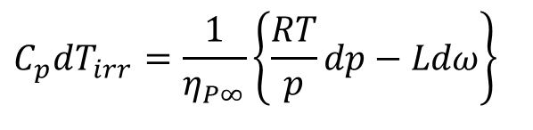
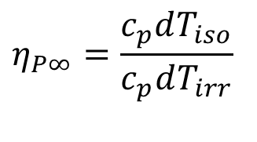
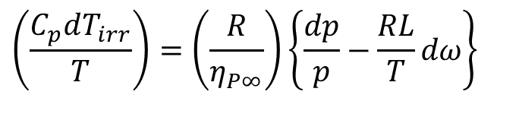
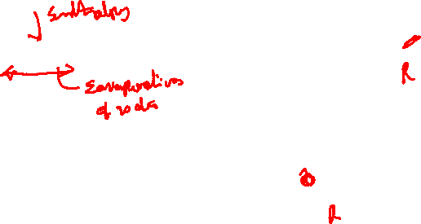
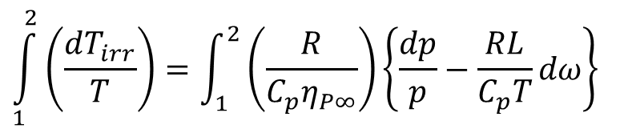
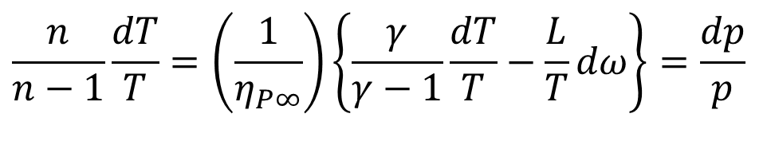
Irreversible Adiabatic wet Compression
$$η_{P∞}=\frac{c_{p}dT_{iso}}{c_{p}dT_{irr}}$$
Define Polytropic Efficiency as:
$$C_{p}dT_{irr}=\frac{1}{η_{P∞}}\left\{\frac{RT}{p}dp−Ldω\right\}$$
$$\left(\frac{C_{p}dT_{irr}}{T}\right)=\left(\frac{R}{η_{P∞}}\right)\left\{\frac{dp}{p}−\frac{RL}{T}dω\right\}$$
For an irreversible wet compression:
$$\int_{1}^{2}{\left(\frac{dT_{irr}}{T}\right)}=\int_{1}^{2}{\left(\frac{R}{C_{p}η_{P∞}}\right)\left\{\frac{dp}{p}−\frac{RL}{C_{p}T}dω\right\}}$$
Define wet index of irreversible compression as:
$$\frac{n}{n−1}\frac{dT}{T}=\left(\frac{1}{η_{P∞}}\right)\left\{\frac{γ}{γ−1}\frac{dT}{T}−\frac{L}{T}dω\right\}=\frac{dp}{p}$$

Slide 17
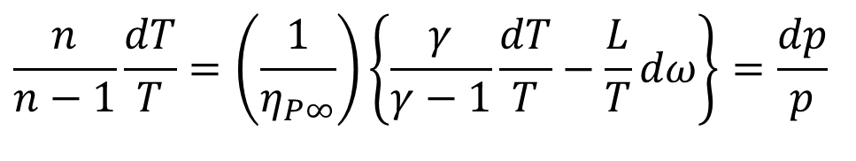
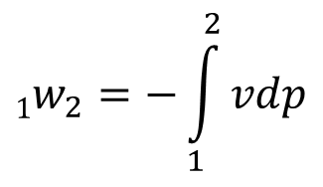
Work savings due to wet compression
$$1w_{2}=−\int_{1}^{2}{vdp}$$
The expenditure due to wet compression:
An irreversible wet compression is modelled as:
$$\frac{n}{n−1}\frac{dT}{T}=\left(\frac{1}{η_{P∞}}\right)\left\{\frac{γ}{γ−1}\frac{dT}{T}−\frac{L}{T}dω\right\}=\frac{dp}{p}$$

Slide 18
Compressor work with wet compression
Compressor work with wet compression is a function of
Pressure ratio ,
Evaporative rate dω/dT and
Geometry of the compressor.
Wet compression work is much lower than that of dry air compression work.
The higher is the pressure ratio, more the saving in compressor work.

Slide 19
Variation of wet compression work with pressure ratio
w_{irr,dry}
w_{rev,dry}
w_{irr,wet}
w_{rev,wet}
(Evaporative rate dw/dT=7.5e-4 kg/kg of air.K)

Slide 20
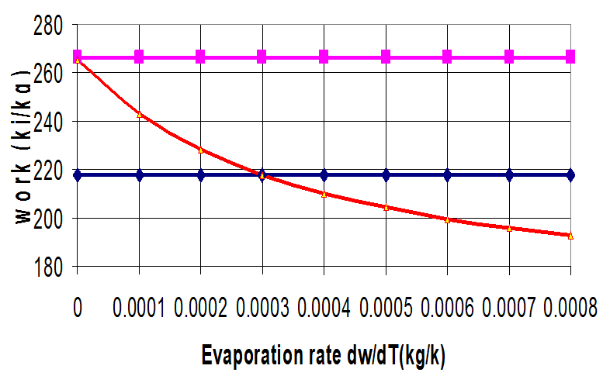
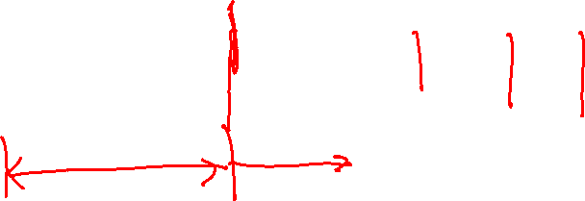
Variation Of Wet Compression Work With The Evaporative Rate
Pressure ratio = 7
w_{irr,dry}
w_{rev,dry}
w_{irr,wet}

Slide 21
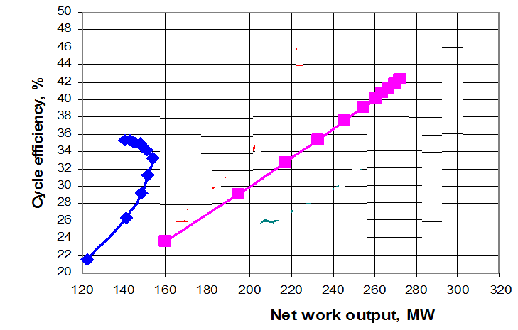
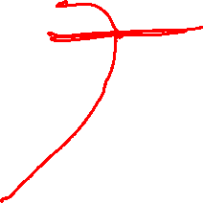
Extension of Optimal Design Range using Wet Compression

Slide 22

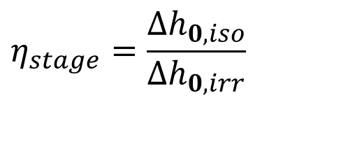
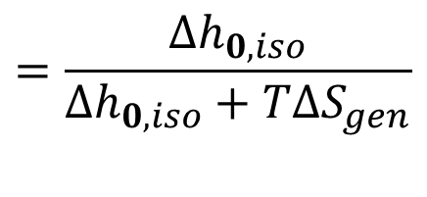

Global Compressor Stage Efficiency
$$η_{stage}=\frac{Δh_{0,iso}}{Δh_{0,irr}}$$
$$=\frac{Δh_{0,iso}}{Δh_{0,iso}+T{∆S}_{gen}}$$
Measure of Losses
$$Δh_{0,irr}−Δh_{0,iso}$$
Extra power consumption due to Irreversible flow:
$$\dot{m}\left(Δh_{0,irr}−Δh_{0,iso}\right)$$

Slide 23


Stage of An Axial Flow Compressor

Slide 24



Irreversible Adiabatic Stage of an Axial Flow Compressor
p_{03s}=p_{02s}
p₀₂
p₀₃
T₀₃=T₀₂
T_{02s}
Rotor Losses
Total Losses
T_{03s}
T
p₀₁
T₀₁
s

Slide 25

Gas dynamics of Irreversible Compressor

Slide 26

Blade Speed
For a given rotor speed the velocity of the blade at the tip will be maximum.
The centrifugal stress in the rotor blades depends on the rotational speed, the blade material and length of the blade.
The maximum centrifugal stress is given by,
b, hub-tip diameter ratio.
K varies in the range 0.55 – 0.65.

Slide 27


Blade Speed vs Flow Velocity
U_{b}

Slide 28


Inlet Velocity Triangle & Flow Velocity
α₁
β₁

Slide 29




Stage Efficiency
The stage efficiency of an adiabatic compressor stage is:
For calorically perfect gas
Actual temperature rise of a fluid when compressed in an irreversible stage for a pressure ratio of p₀₃/p₀₁ is:

Slide 30




System of Equations for Stage Design

