Slide 1

Analysis of Gas Turbines Systems for Power Generation
P M V Subbarao
Head & Professor
Mechanical Engineering Department
A Pair of Axial Compressible Flow Turbomachines for Essential and Exotic Needs…..

Slide 2


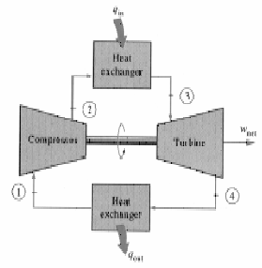
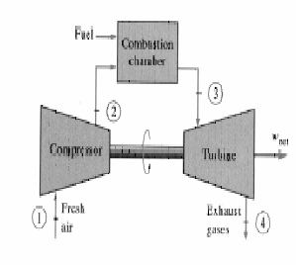
Brayton Cycle
1-2 Isentropic compression (in a compressor)
2-3 Constant pressure heat addition
3-4 Isentropic expansion (in a turbine)
4-1 Constant pressure heat rejection

Slide 3
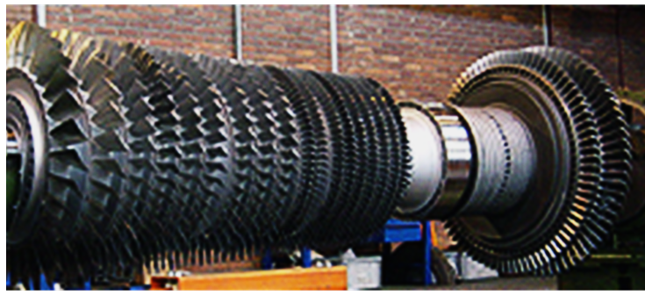
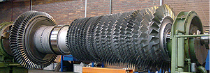
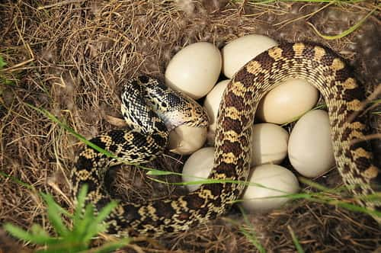
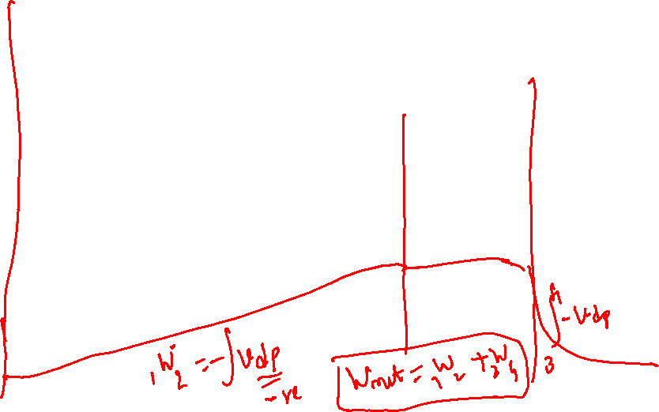
Compressor – Turbine Monoblock Rotor

Slide 4
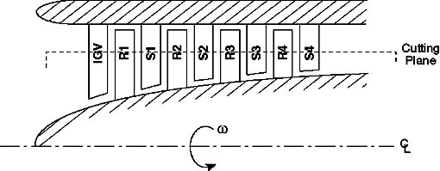
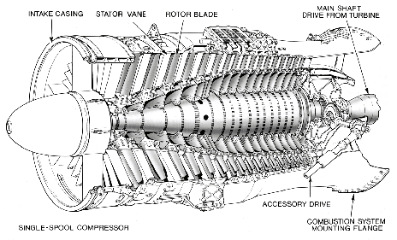
Schematic diagram of a multistage Axial Flow Compressor

Slide 5
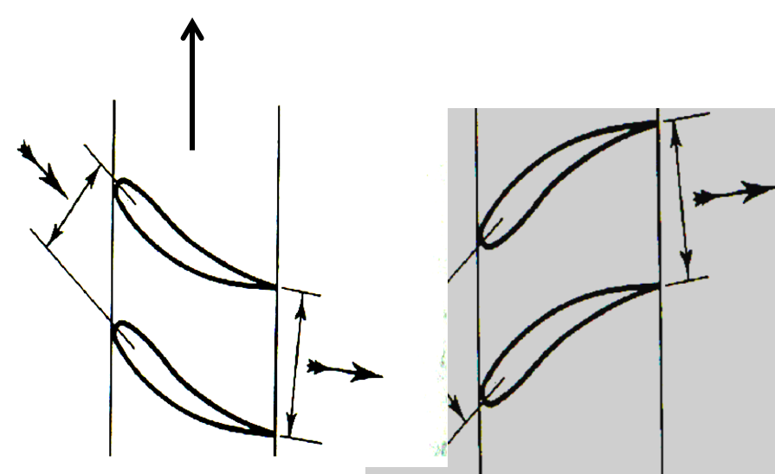
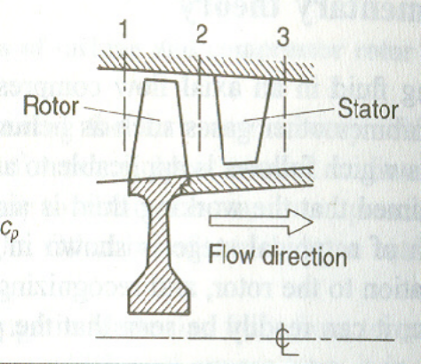

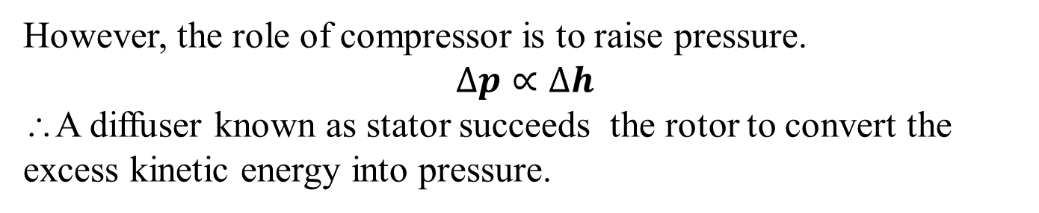

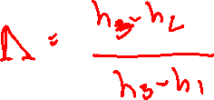
Need for a Stator in multistage compressor
Compressor
Rotor Blades
Compressor
Stator Blades
In general, a rotor also adds kinetic energy along with pressure raise to the fluid.
$$P_{compressor−rotor}∝∆h_{o}$$
However, the role of compressor is to raise pressure.
$$∆p∝∆h$$
∴A diffuser known as stator succeeds the rotor to convert the excess kinetic energy into pressure.

Slide 6
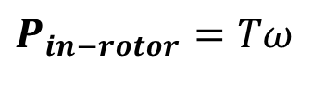
Stagnation Thermodynamics of An Ideal Axial flow Compressor Stage
p₀₂ = p₀₃
T₀₂ = T₀₃
p₃
T₃
V₃²/c_{p}
V₂²/c_{p}
p₂
T₂
T
$$P_{in−rotor}=Tω$$
p₀₁
T₀₁
V₁²/c_{p}
p₁
T₁
s

Slide 7
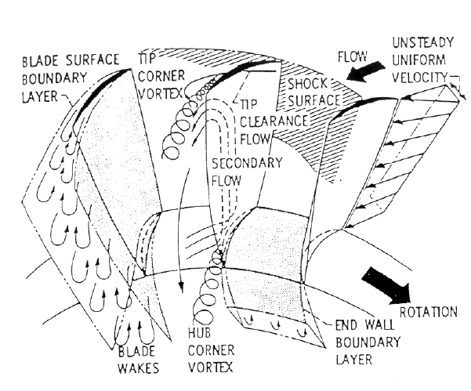
Irreversible Flow Past Compressor Blades

Slide 8
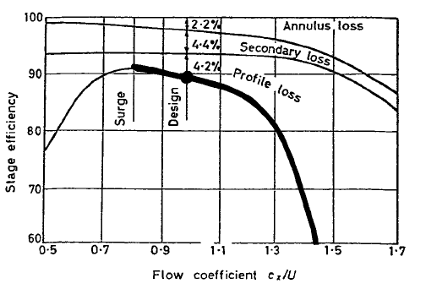

Losses in Compressor due to Change in Flow Component
Annulus Loss
Secondary Loss
Profile Loss Loss
V_{f}/U

Slide 9
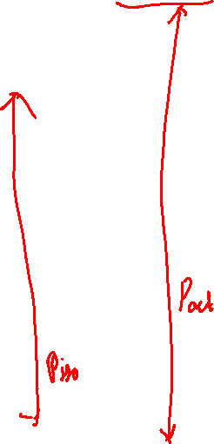
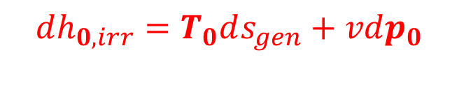
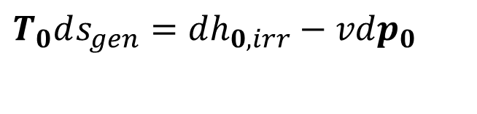
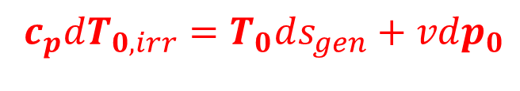
Irreversible Adiabatic Stage of an Axial Flow Compressor
T_{03a}
p₀₃
T_{03s}
p₀+dp₀
p₀
Consider an infinitesimal irreversible compression
$$T_{0}ds_{gen}=dh_{0,irr}−vdp_{0}$$
T₀
$$dh_{0,irr}=T_{0}ds_{gen}+vdp_{0}$$
p₀₁
T₀₁
$$c_{p}dT_{0,irr}=T_{0}ds_{gen}+vdp_{0}$$
s

Slide 10
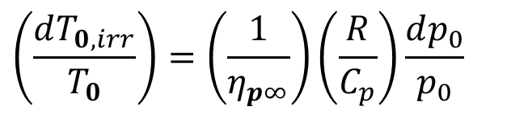
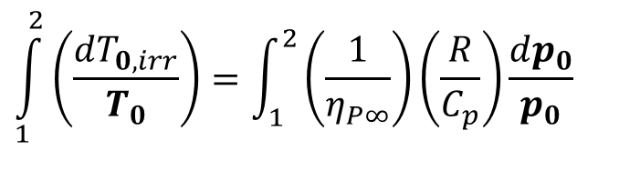
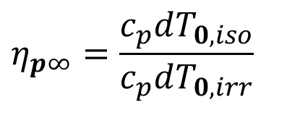
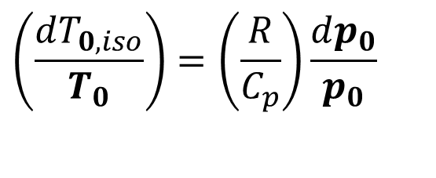
Model for an Irreversible Adiabatic Compression
$$\left(\frac{dT_{0,iso}}{T_{0}}\right)=\left(\frac{R}{C_{p}}\right)\frac{dp_{0}}{p_{0}}$$
For an isentropic compression:
Define Polytropic Efficiency as a measure of local irreversibility:
$$η_{p∞}=\frac{c_{p}dT_{0,iso}}{c_{p}dT_{0,irr}}$$
$$\left(\frac{dT_{0,irr}}{T_{0}}\right)=\left(\frac{1}{η_{p∞}}\right)\left(\frac{R}{C_{p}}\right)\frac{dp_{0}}{p_{0}}$$
For an irreversible compressor:
$$\int_{1}^{2}{\left(\frac{dT_{0,irr}}{T_{0}}\right)}=\int_{1}^{2}{\left(\frac{1}{η_{P∞}}\right)\left(\frac{R}{C_{p}}\right)\frac{dp_{0}}{p_{0}}}$$

Slide 11
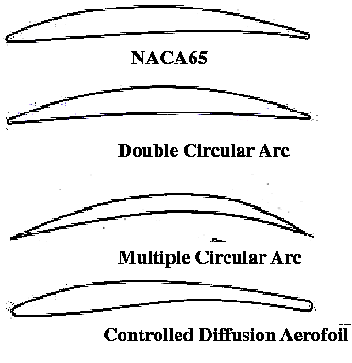
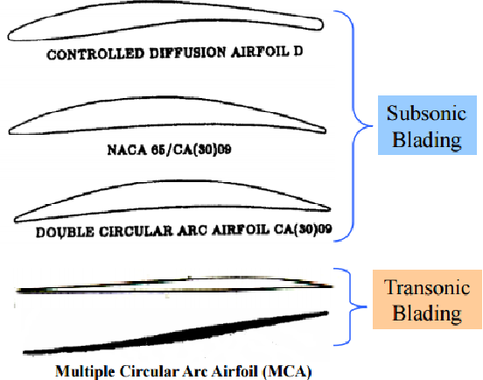
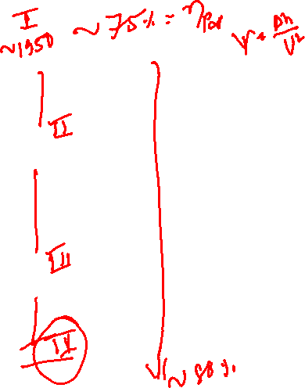
Evolution of Compressor Blades

Slide 12
Variants of Global Compression Processes
1
v
2n
2s
2k
w_{isothermal} = Least compression work
2T
p₁
p₂
p
0

Slide 13
Major Concerns about Gas Turbine PGS
Irreversible Adiabatic Compression of gas.
More (~40% of turbine power) internal power consumption.
High exhaust gas temperatures and high-quality waste heat.
Look for potential concepts and technologies for improvement.

Slide 14
New Initiatives
The U.S. Department of Energy (DOE) has initiated a development program called the advanced turbine system (ATS).
The aim of ATS is to achieve over 60% efficiency, with low No_{x} and suitable operating costs.
The different manufactures participated and initiated the collaborative advanced gas turbine development.
The outcome of their effort include a variety of advanced configurations, including compression with cooling, humid air turbine, steam injection, reheat combustor and chemical recuperation.

Slide 15
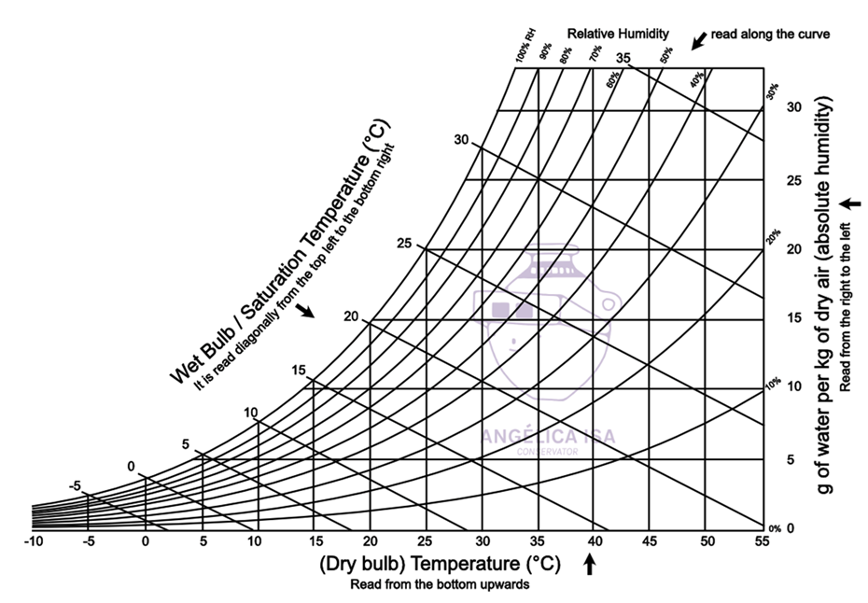
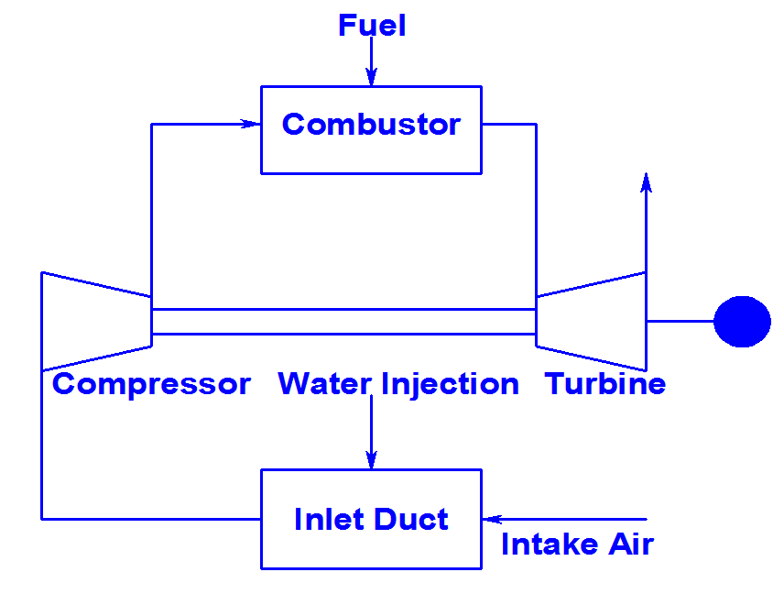
The Wet Compression (WC) Gas Turbine PGS

Slide 16
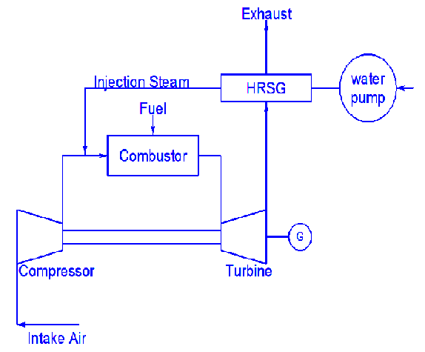
The Steam Injected Gas Turbine PGS

Slide 17
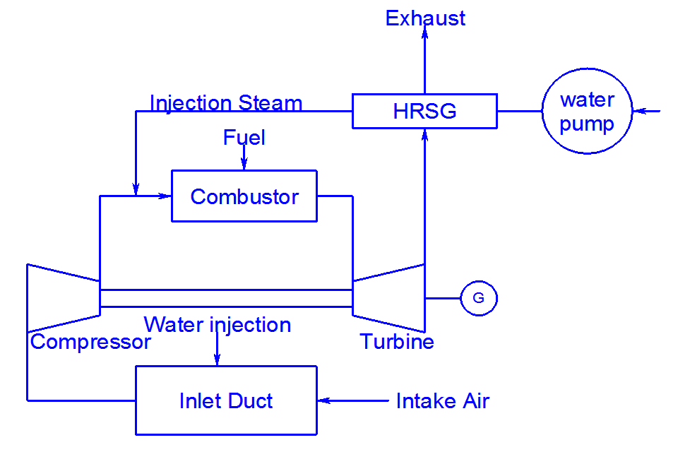
The Integrated (SWC) Gas Turbine PGS

Slide 18

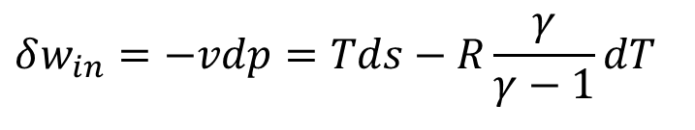
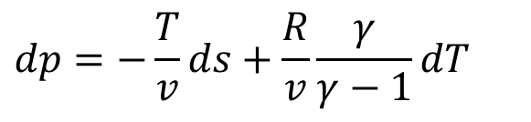
Expenditures in A Gas Power Generation System
Creation of Life and induction of Energy into Working Fluid.
Compression : Creation of life , w_{in}
$$Tds=dh−vdp⇒δw_{in}=−vdp=Tds−c_{p}dT$$
$$δw_{in}=−vdp=Tds−R\frac{γ}{γ−1}dT$$
The measure of Life:
$$dp=−\frac{T}{v}ds+\frac{R}{v}\frac{γ}{γ−1}dT$$
Two extreme roots for generation of life: ds > 0 or dT=0

Slide 19
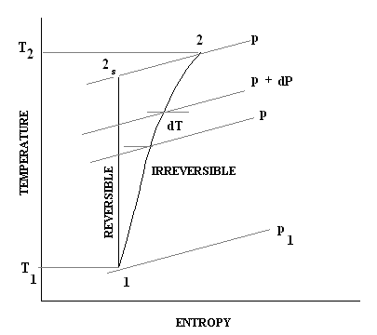
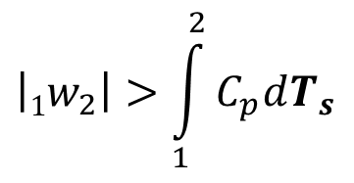
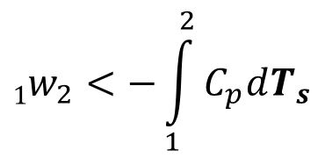
Actual Global Compression is Irreversible
$$1w_{2}<−\int_{1}^{2}{C_{p}dT_{s}}$$
$$\left|1w_{2}\right|>\int_{1}^{2}{C_{p}dT_{s}}$$

Slide 20
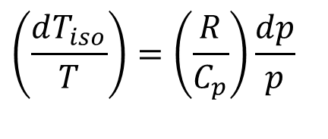
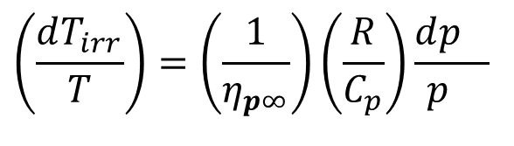
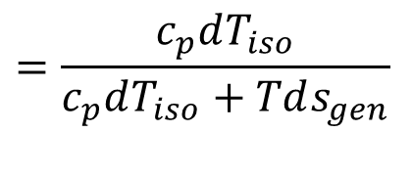
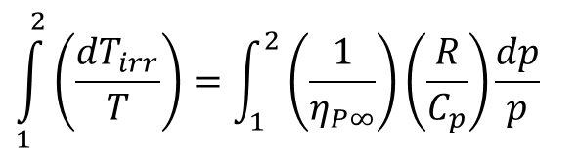
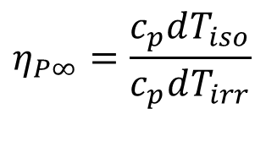
True Irreversible Adiabatic Compression
$$\left(\frac{dT_{iso}}{T}\right)=\left(\frac{R}{C_{p}}\right)\frac{dp}{p}$$
Define Polytropic Efficiency as:
$$η_{P∞}=\frac{c_{p}dT_{iso}}{c_{p}dT_{irr}}$$
$$=\frac{c_{p}dT_{iso}}{c_{p}dT_{iso}+Tds_{gen}}$$
$$\left(\frac{dT_{irr}}{T}\right)=\left(\frac{1}{η_{p∞}}\right)\left(\frac{R}{C_{p}}\right)\frac{dp_{}}{p_{}}$$
For an irreversible compressor:
$$\int_{1}^{2}{\left(\frac{dT_{irr}}{T}\right)}=\int_{1}^{2}{\left(\frac{1}{η_{P∞}}\right)\left(\frac{R}{C_{p}}\right)\frac{dp}{p}}$$

