Slide 1

Gas Turbines Systems for Land and Aerospace Applications
P M V Subbarao
Head & Professor
Mechanical Engineering Department
A Pair of Axial Compressible Flow Turbomachines for Essential and Exotic Needs…..

Slide 2


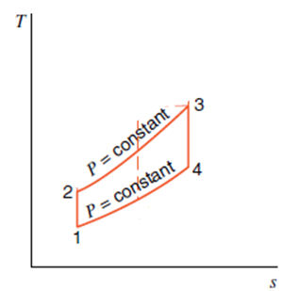
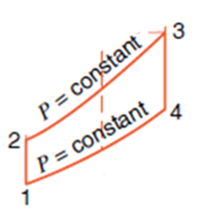
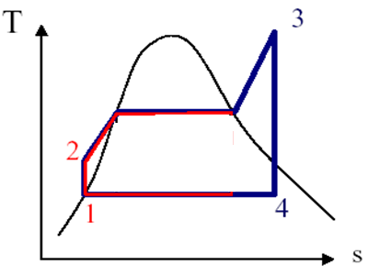
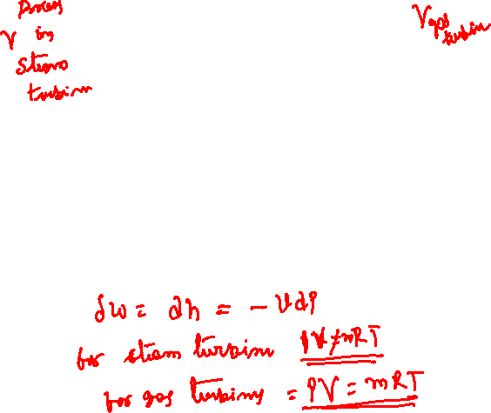
Thermodynamics of Steam & Gas Turbines
p=constant
p=constant
Process 3 → 4 Isentropic expansion

Slide 3
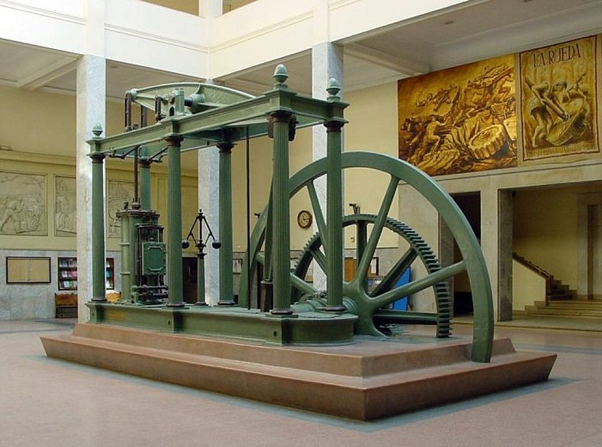
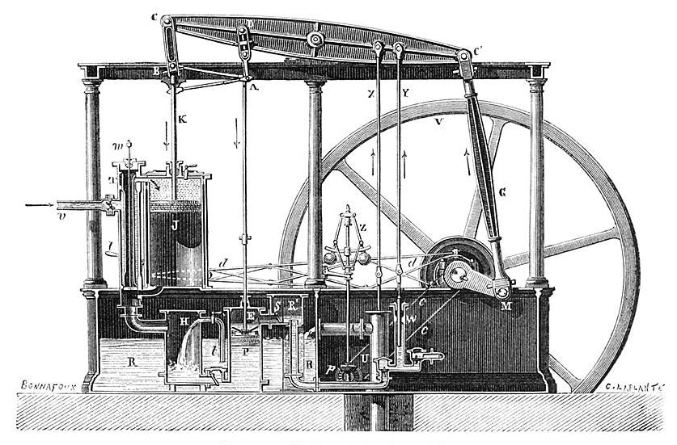
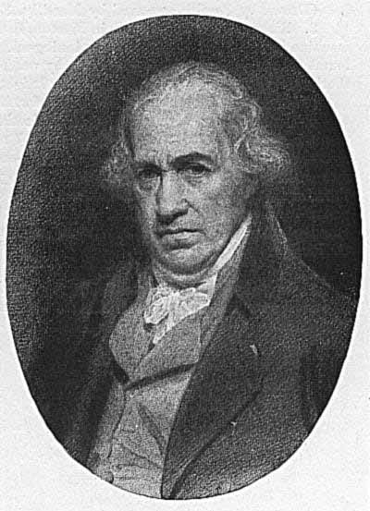
James Watt’s Engine : Most Important Innovation for Conservation
James Watt radically improved Newcomen's engine (1769) by condensing the steam outside the cylinder .

Slide 4
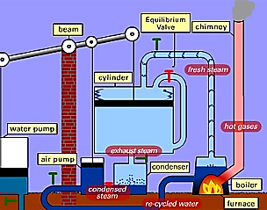
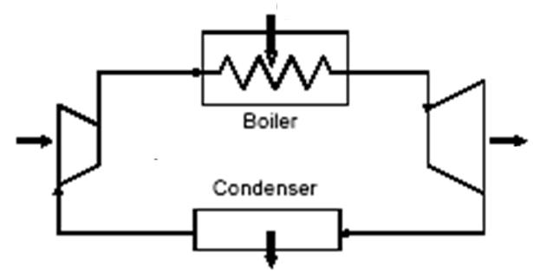
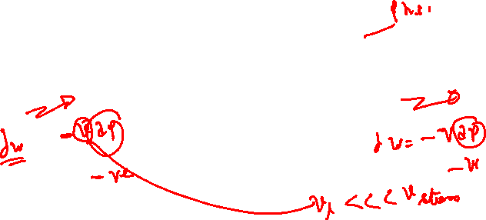
Cycle Executed by James Watt’s Engine
Work generation
Cylinder
Pump

Slide 5
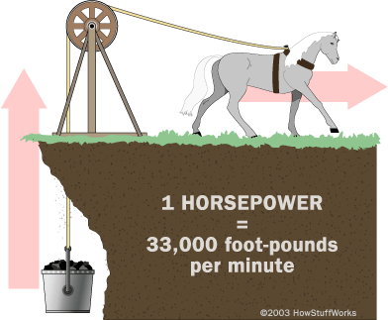
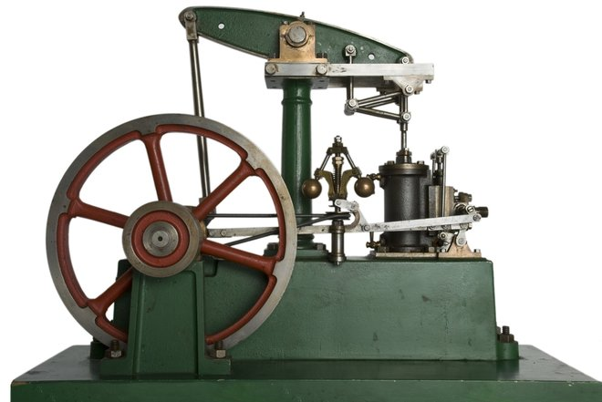
James Watts Creation of An Artificial Horse

Slide 6
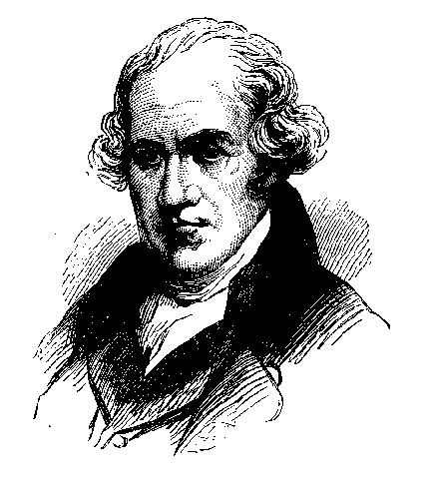

James Watt Engine
Watt's Double-Acting Engine, 1784.
The Watt Hammer, 1784.
Trevithick's Locomotive, 1804
The " Atlantlc," 1832.
Steam Engine Reached its pinnacle in size when it was called to drive 5 MW electric generator.
Steam Engine As an Alternate to Horse or Cattle…..

Slide 7
Progress on Development of James Watt Engine
The British had progressed through the genius of a few engineers who lacked formal scientific education.
British engineers had also accumulated and published reliable data about the efficiency of many types of engines under actual running conditions.
They vigorously argued the merits of low- and high-pressure engines and of single-cylinder and multi-cylinder engines.

Slide 8
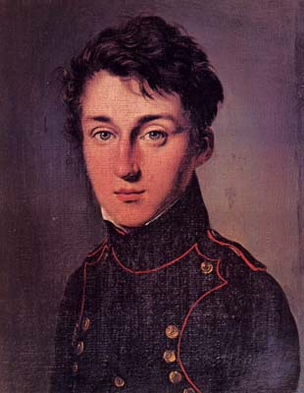
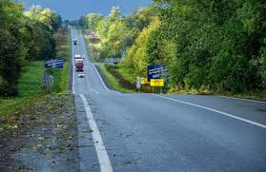

Theoretical Design Vs Practical System

Slide 9
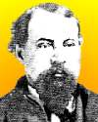

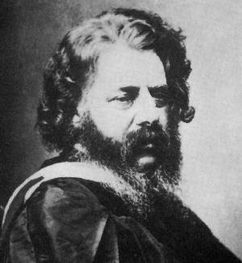
A Major Crossroad Confusion: How to go from <6% to 75% Efficiency ???????

Slide 10
Rankine, William John Macquorn
(1820-1872)
In 1849 he delivered two papers on the subject of heat, and in 1849 he showed the further modifications required to French physicist Sadi Carnot's theory of thermodynamics.
“A Manual of the Steam Engine and other Prime Movers 1859”

Slide 11
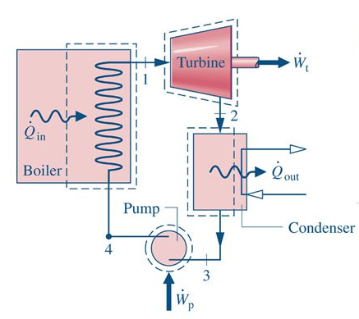
Layout of an Ideal Rankine Cycle
Rankine raised the technology of the steam engine to science, the word, " energy " is something due to him.

Slide 12
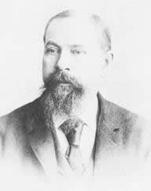
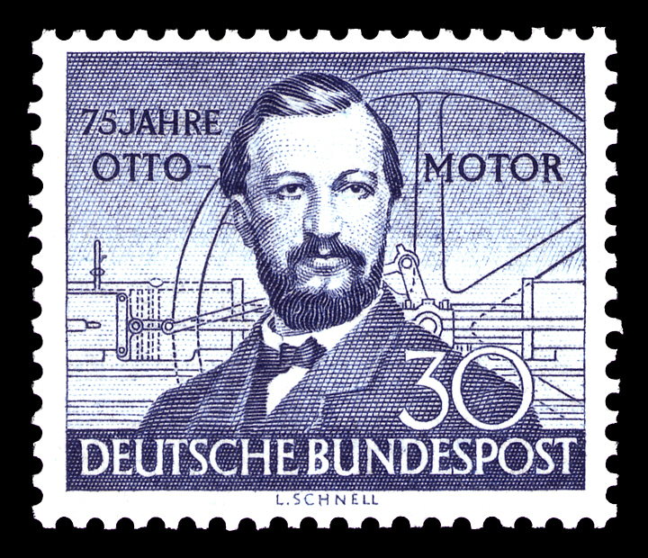
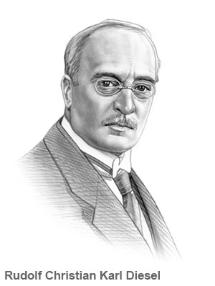
Inventors of Cyclic Gas Engines
CARNOT Gas Engine THEORY
1824
Brayton Cycle
1872
Diesel Cycle
1893
Otto Cycle
1876

Slide 13

The Rankine Cycle vs Brayton Cycle
p=constant
p=constant
Rankine Cycle
Brayton Cycle
Process 1→ 2 Isentropic compression
Process 2 → 3 Constant pressure heat addition
Process 3 → 4 Isentropic expansion
Process 4 → 1 Constant Pressure heat rejection

Slide 14
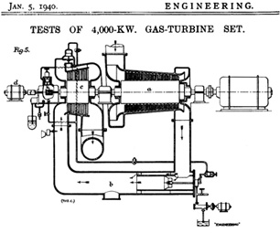
The World‘s First Industrial Gas Turbine Set

Slide 15
The Ideal Gas Engine
1824: Sadi Carnot, who founded the science of thermodynamics, identified several fundamental ideas that would be incorporated in later internal combustion engines:
  He noted that air compressed by a ratio of 15 to 1 would be hot enough (200°C) to ignite dry wood.
  He recommended compressing the air before combustion. Fuel could then be added by "an easily invented injector".
  Carnot realized that the cylinder walls would require cooling to permit continuous operation.
  Later, Diesel thought he could avoid this, but found out the hard way.
  He noted that usable heat would be available in the exhaust, and recommended passing it under a water boiler.

Slide 16
Pre & Post Carnot Research on Gas Engines
1791: A patent was given to John Barber, an Englishman, for the first true gas turbine.
His invention had most of the elements present in the modern day gas turbines.
The turbine was designed to power a horseless carriage.
No working model was ever built, but Barber’s sketches and the low efficiency of the components available at the time make it clear that the device could not have worked even though it incorporated the essential components of today’s gas-turbine engine.
The basic gas turbine cycle is named for the Boston engineer, George Brayton, who first proposed the Brayton cycle around 1870.
1872: The first true gas turbine engine was designed by Dr Franz Stikze, but the engine never ran under its own power.

Slide 17
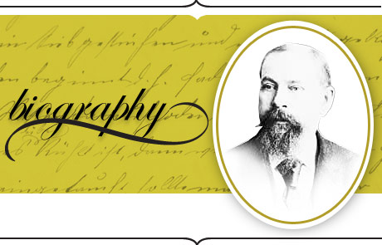
George Brayton
The internal-combustion engine, by which Brayton's name is best remembered, was first developed by him at Bricksburg, N. J., about 1870.
It began to attract attention by 1873, after tests and a report by Professor Thurston, and by exhibition before the Franklin Institute, and is remarkable in that it employed a cycle of controlled combustion.

Slide 18
George Brayton : The “Ready Motor”
The “Ready Motor,” as it was called, used oil fuel directly in the cylinder without a carburetter, and had a separate compression pump for the air supply, and worked steadily and more efficiently than any combustion engine produced to that time.

Slide 19
Net Positive Power by A gas Engine
1903: A Norwegian, Ægidius Elling, was able to build the first gas turbine that was able to produce more power than needed to run its own components, which was considered an achievement in a time when knowledge about aerodynamics was limited.
Using rotary compressors and turbines it produced 11 hp (massive for those days).
He further developed the concept, and by 1912 he had developed a gas turbine system with separate turbine unit and compressor in series, a combination that is now common.
1914: Application for a gas turbine engine filed by Charles Curtis.
1918: One of the leading gas turbine manufacturers of today, General Electric, started their gas turbine division.
1930: Sir Frank Whittle patented the design for a gas turbine for jet propulsion.

Slide 20
The World‘s First Industrial Gas Turbine Set

Slide 21
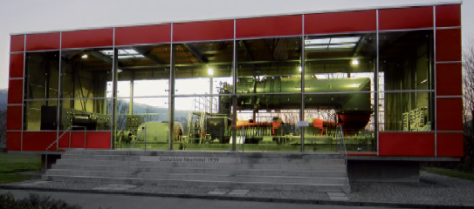
4 MW GT for Power Generation

Slide 22
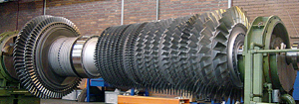
Monoblock Design of Gas Turbos

Slide 23
Initial Success of Gas Turbine Power Generation Systems
A temperature of 538°C was considered absolutely safe for uncooled heat resisting steel turbine blades.
This would result in obtainable outputs of 2000-8000 KW with compressor turbine efficiencies of 73-75%, and an overall cycle efficiency of 17-18%.
First Gas turbine electro locomotive 2500 HP ordered from BBC by Swiss Federal Railways.

Slide 24
Steam Turbine Vs Gas Turbine : Power Generation
The advent of high pressure and temperature steam turbine with regenerative heating of the condensate and air pre-heating, resulted in coupling efficiencies of approx. 25%.
The gas turbine having been considered competitive with steam turbine plant of 18% which was considered not quite satisfactory.
The Gas turbine was unable to compete with “modern” base load steam turbines of 25% efficiency.
There was a continuous development in steam power plant which led to increase of Power Generation Efficiencies of 35%⁺
This hard reality required consideration of a different application for the gas turbine.

Slide 25
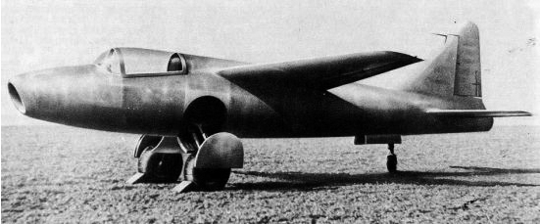
First turbojet-powered aircraft – Ohain’s engine on He 178
The world’s first aircraft to fly purely on turbojet power, the Heinkel He 178.
Its first true flight was on 27 August, 1939.

Slide 26
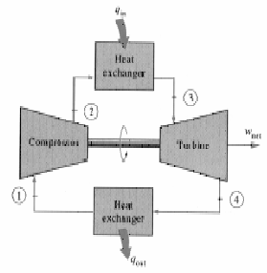
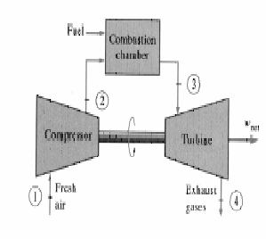
Brayton Cycle
1-2 Isentropic compression (in a compressor)
2-3 Constant pressure heat addition
3-4 Isentropic expansion (in a turbine)
4-1 Constant pressure heat rejection

