Slide 1

Human – Energy Needs – Turbomachinery
P M V Subbarao
Professor
Mechanical Engineering Department
Turbomachine Is An Evergreen Solution to an Essential Human Need!!!

Slide 2

Why were/are Turbomachines embedding with Human Evolution???

Slide 3
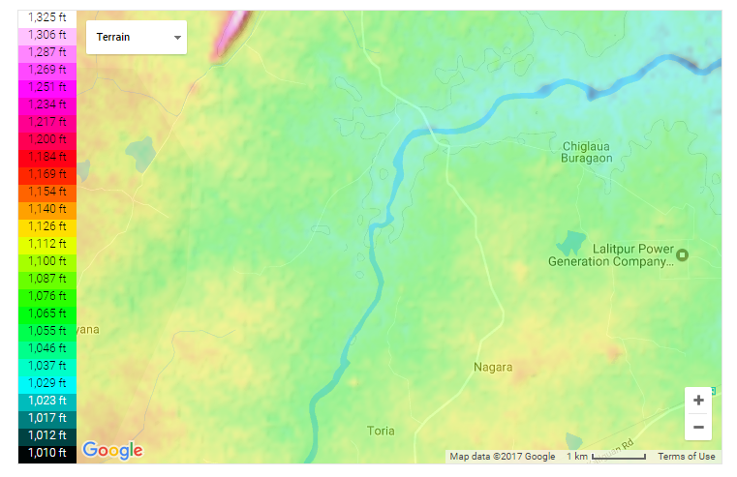
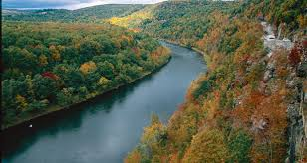
My First Exposure to Rural Needs: A Native Energy System
Shri Mangal Singh
Water Wheel on River Sajnam, Bhailoni Lod Village
Lalitpur Dist.

Slide 4
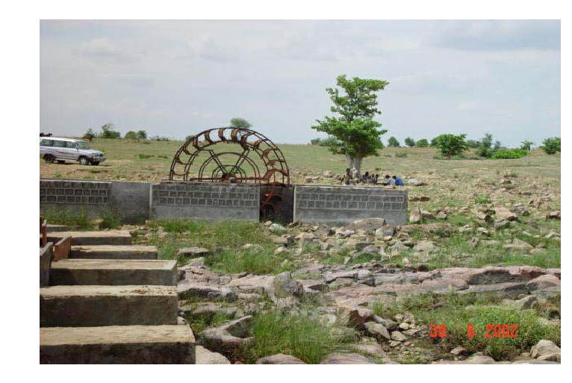
Photograph of Mangal Turbine

Slide 5
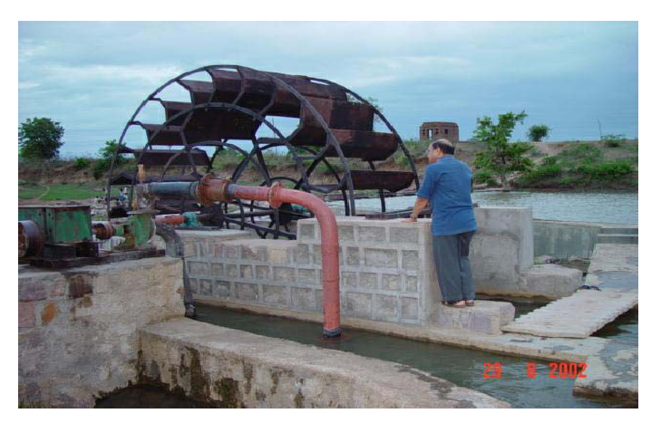
Photograph of Mangal Turbine

Slide 6
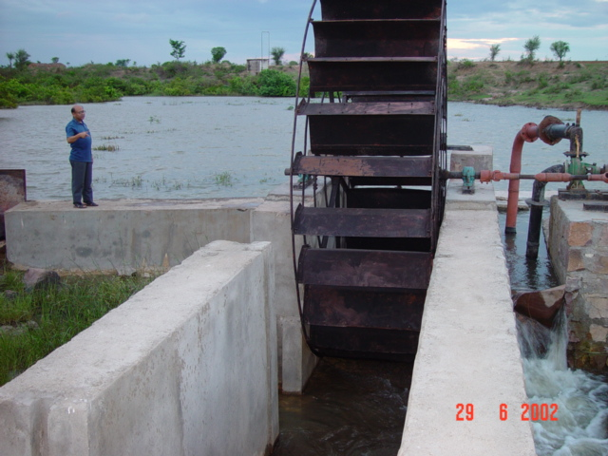
Photograph of Mangal Turbine

Slide 7
Analysis of the Local Design
Diameter of the wheel : 4m.
Speed of the wheel: 13 RPM.
24 blades !
Huge Diameter !
Very Low Speed!
Weighing more than a ton!
Huge material cost!
The speed of A common pump or Generator is 1500 RPM.
A gear box is required to Increase the speed 120 times!
Very costly gear box.
Basic Limitation is Poor Blade Design

Slide 8


Samantara akSha-rekhA Jhal Chakra

Slide 9
Explanation by Shri Mangal Singh
We tried small wheels: They could not develop enough torque at all.
Large diameter produced enough torque to drive the pump.
Large diameter : Large Perimeter: More number of blades.
Result :Heavy and costly wheel !!!
Large diameter : Low RPM for same flow velocity.
Heavy and costly gear box.

Slide 10
My Harsh Reaction
It is very non-scientific work.
Unreasonable design and cost.
One can decrease cost to one fourth, with little science and engineering.
!!!!!!!!
A Sponsored Project : 3.6 lakhs & One and Half years.
IIT Delhi design should be fabricated by same person and should be installed at same site.

Slide 11
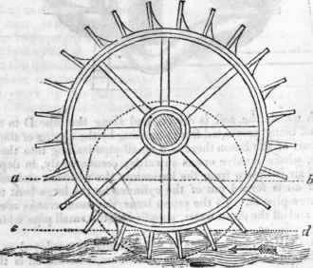

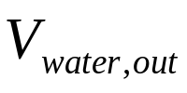

Kinematics of the Ancient Design : Undershot Water Wheel

Slide 12
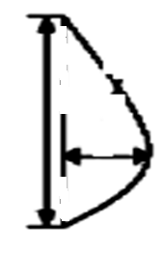

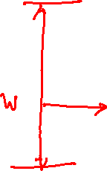
Design of Blade Geometry
Blade Cross Section
Kinematics of Blade & Jet
Outlet Jet
Inlet jet

Slide 13
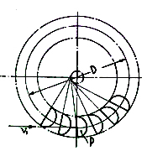
Transient Kinetics of the Blade-Jet Interactions
V_{jet}

Slide 14
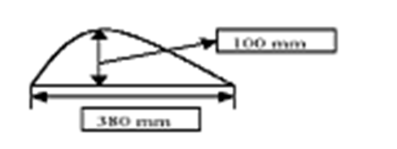
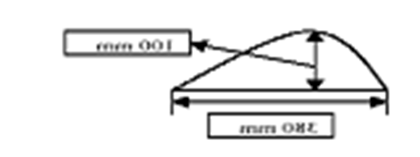

Construction of Wheel
Blade Cross Section

Slide 15
Profile of Blade

Slide 16

Design of Blade Profile : Computational Fluid Dynamics Simulations
W : width of blade
d : depth of blade
h : Height of Channel

Slide 17
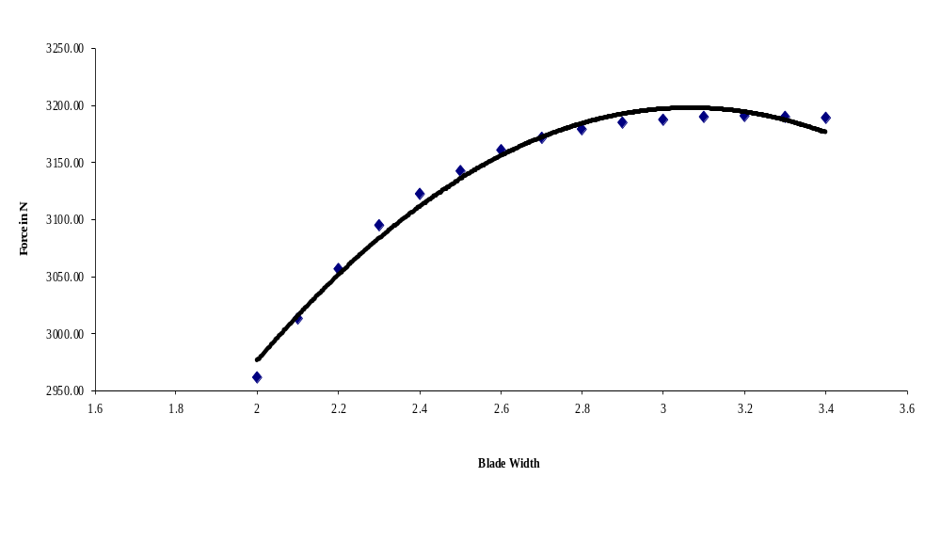
Selection of Blade Width

Slide 18
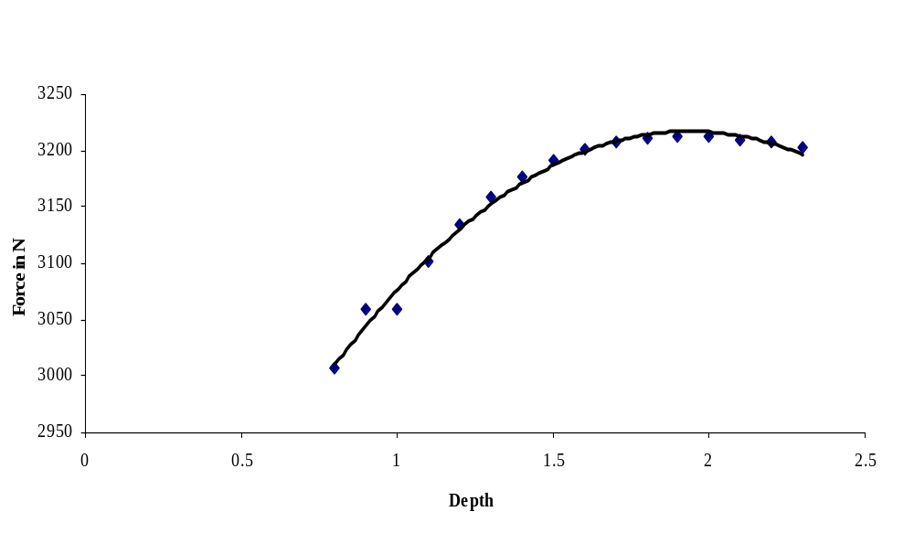
Selection of Blade Width

Slide 19
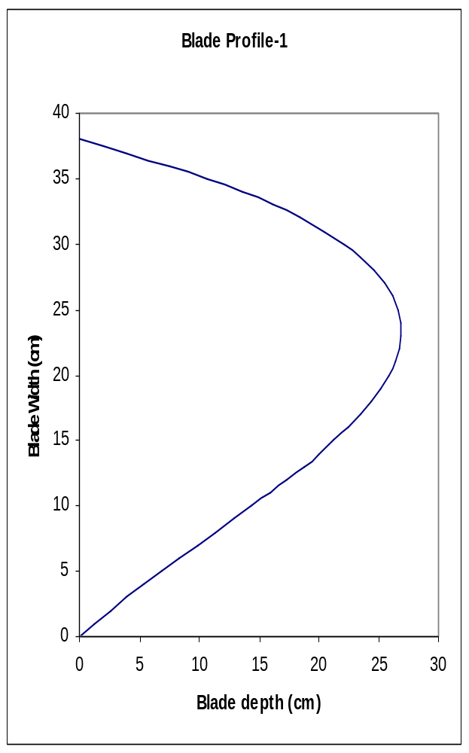
Optimal Blade Shape Created by Computational Flow Analysis

Slide 20

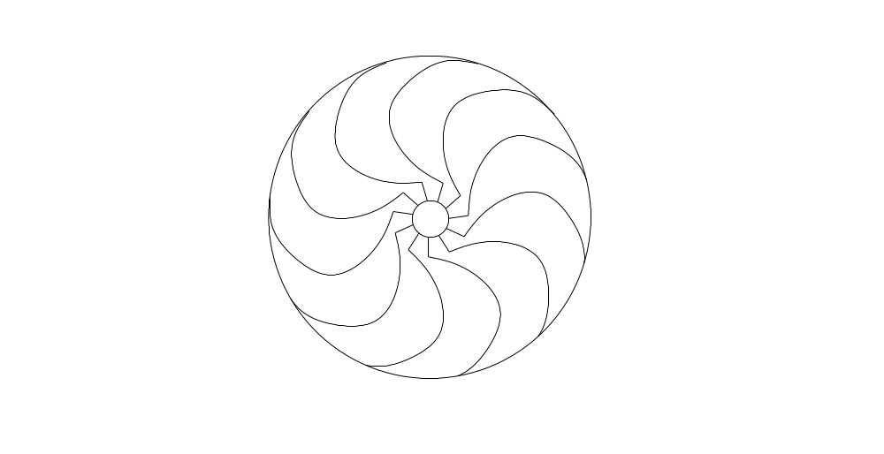

Geometrical Detailing of Undershot Horizontal axis turbine
B
D_{o}
β₂
T

Slide 21
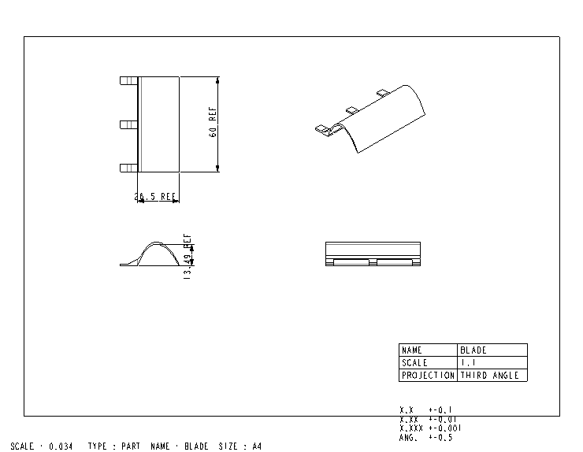
CAD Model of 3D Blade

Slide 22
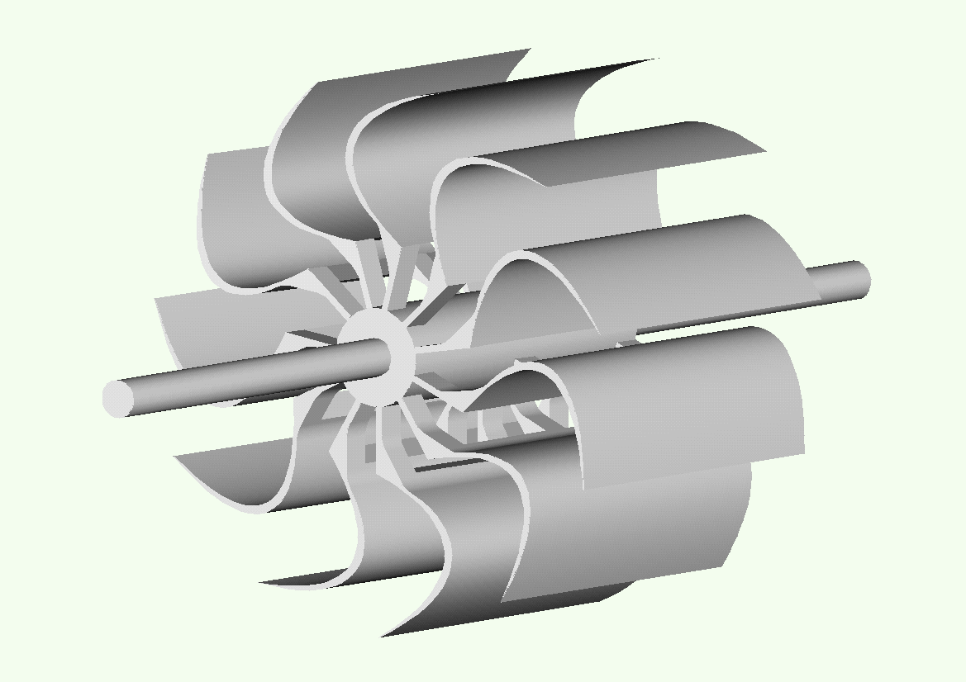
Assembled Wheel

Slide 23
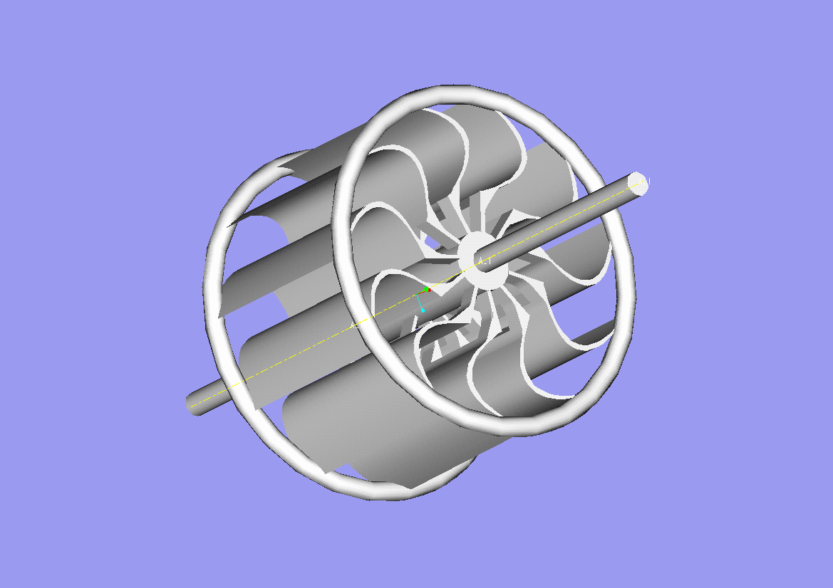
Assembled Wheel

Slide 24
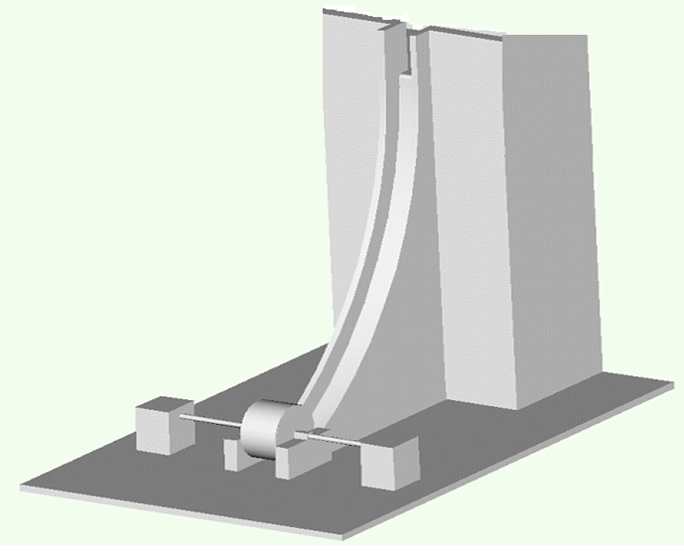
Turbine System Layout & Civil Construction Layout

Slide 25
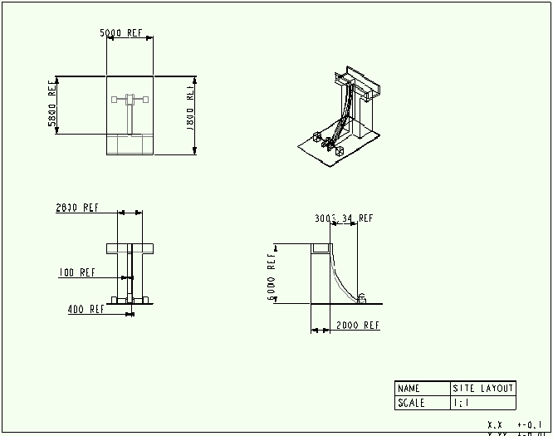
Design of Check Dam and Spillway

Slide 26
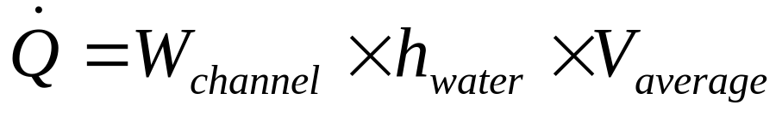
Channel for flow of water
h_{channel}
h_{water}
W_{channel}
Flow rate of water:

Slide 27
Final Design of Wheel

Slide 28
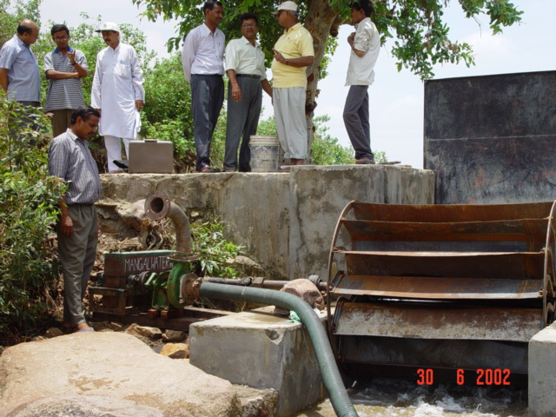
Fabricated IIT Delhi Design

Slide 29
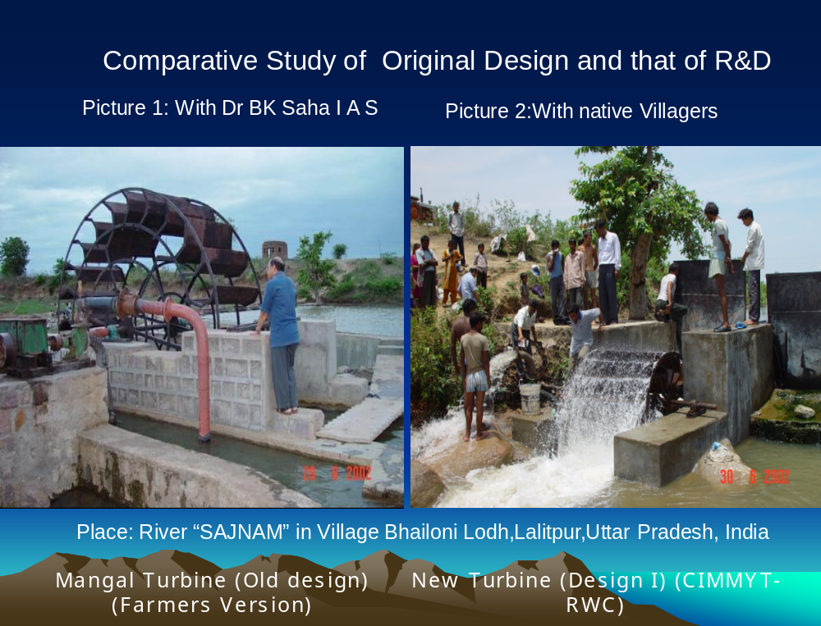

Slide 30
Comparative study on development of Micro hydro water wheel
Specification
Farmer
’
s version
New Design
Bhailoni Village
(Semera Village)
Lalitpur,UP
Lalitpur,UP
Diameter in m
4
1.26
Head at site in m
1.5
1.5
Power developed
6kw
6kw
Water utilized to
1800l/s
400l/s
run
Pump discharge
22 l/s
22l/s
efficiency
40%[t] 20%[p]
72%[t] 68%[p]
No. of blades
24
14
Principle
impulse
impulse
Cost of wheel
$1800
$160
Cost of gear box
$2700
$320

Slide 31
IIT Delhi Contributions
Design, Fabrication and Erection of 5 kW Horizontal Axis Hydro-Turbo Pump on a small river near Jhansi.
Design , Fabrication and Testing of 3.5 kW Horizontal Axis Hydro-Turbo Pump cum Generator on a Drainage Canal at Sonipat.
Design and Development of 5 KW Horizontal Axis Hydro-Turbo Pump cum Generator at Pokhri, Uttaranchal.
Design and Development of 5 KW Horizontal Axis Hydro Generator at Halflong, Assam.

Slide 32
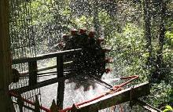
Halflong, Assam, India: Micro Hydro Power Project to Benefit 38 Families

Slide 33
Peace thru Technology
Inhabitants of a remote village in the rugged, mountainous terrain of North Cachar Hills are getting uninterrupted power supply even though it is not connected by conventional power grid.
This has been made possible by the State’s first micro hydro-electricity.
The project generates 6.8 KVA power from a hilly stream called Boro Robi nullah near the hamlet.
It has a 12-foot-high water reservoir and a turbine.
“This was started as a pilot project with support from the Army, and following its successful implementation, we plan to set up more such micro hydel projects in similar terrain in the district,” HP Rajkumar, Project Director, District Rural Development Agency (DRDA), NC Hills, said, adding that a couple of sites had already been identified for the purpose.
Rajkumar said that the Army engineers designed the turbine, which cost Rs 1.25 lakh. “The Army has been very enthusiastic about the project and extended every possible cooperation to us.
We got technical expertise from the IIT-Delhi as well,” he said.
At the moment the project is illuminating 38 households of the village besides a school, a church, a temple and an auditorium. “The households have two bulbs each.

Slide 34
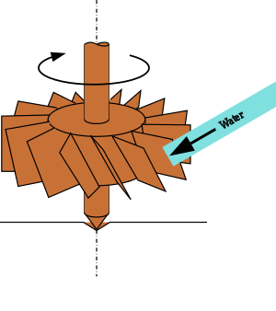
Vertical Axis Water Wheels
A
Source of power in Rural Uttaranchal

Slide 35
Site visited | Head available (in M) | Flow Rate (l/sec) | Wheel Speed In RPM | Output Speed In RPM | Diameter of wheel In CM | No. of Blades | Power Output In KW | Applications
Sangtiyawala | 1.40 | 480 | 90 | 1500 | 106 | 16 | 1 | Chakki, Alternator
Bhogpur Gharat (1) | 2.30 | 889 | 95 | 1500 | 106 | 16 | 2 | Dhan Cutter, Alternator
Bhogpur Gharat (2) | 2.30 | 645 | 104 | 104 | 84 | 29 | - | Chakki
Donkwala (1) | 1.50 | - | 70 | 1500 | 100 | 30 | 1 | Chakki, Alternator
Donkwala (2) | 1.50 | - | 90 | 1500 | 97 | 30 | 1 | Chakki, Alternator
Donkwala (3) | 1.25 | - | 95 | 1500 | 90 | 29 | 1 | Chakki, Alternator
Naya Gharat Lacchiwala | 1.85 | 634 | 50 | 1500 | 107 | 11 | 5 | Chakki, Dhan cutter, Alternator
New Design | 1.8 + 1.0 | 342 | 100 | 1500 | 73 | 11 | 3 | Chakki, Alternator

Slide 36
layouts for Uttaranchal Units
Gear Box
Generator
Main Shaft
Canal
Forbay
Grinding Wheel
Bush Bearing
12” Pulley
10” Pulley
Grinder adjusting lever
Penstock
Water Wheel
New Design
Wooden Base

Slide 37
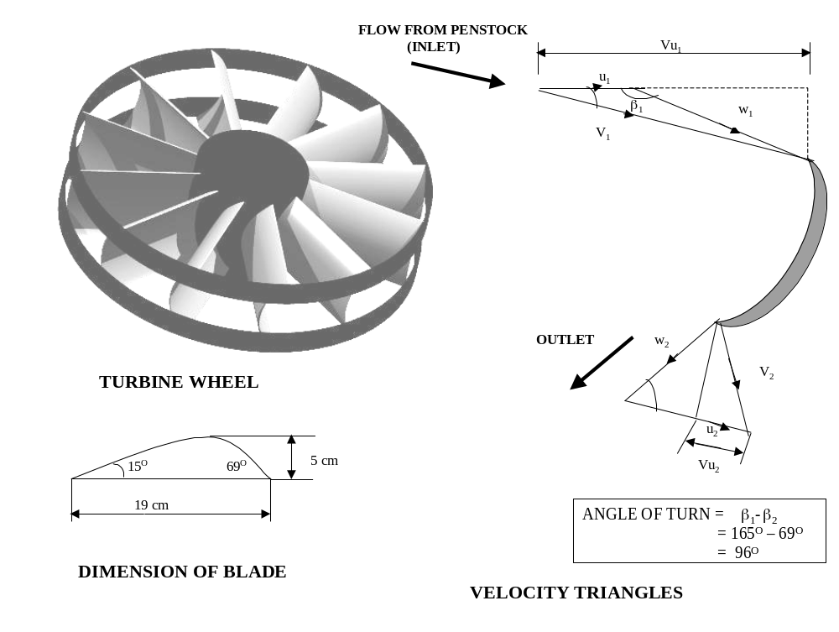
Specification of upgraded wheel for Garhwhal area

Slide 38
National Workshop on
Development of Man-Power in
Ultra Micro Hydel Turbines for
Rural Energy Systems
20th March to 28th March 2004.
Created ~35000 self employed youth

Slide 39
Study of Human Evolution ……
May be Misunderstood by Biologists!!!

Slide 40


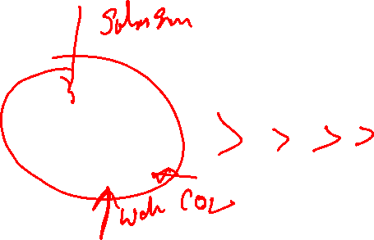
Thermodynamic Classification of Humans
Life on Earth
Carbon Energy Reservoirs
Autotrophs
Heterotrophs
Somatic Heterotrophs
Extra-Somatic Heterotrophs

Slide 41
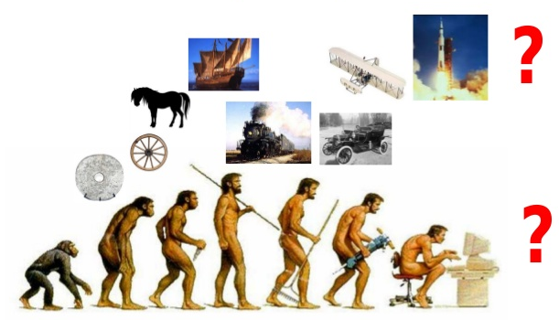
Outreach thru Energetic Evolution

