Slide 1

Analysis of Irreversible Flow through Turbines
P M V Subbarao
Professor
Mechanical Engineering Department
Control & Minimization of Entropy Generation in Turbine Stages.……

Slide 2


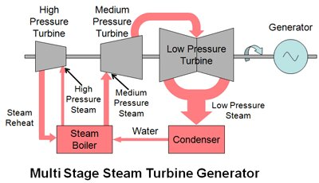
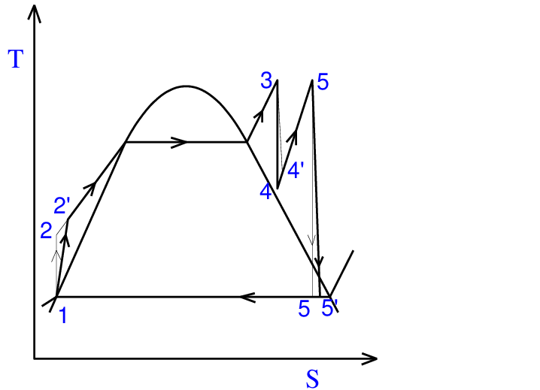
Structure of Large High-Pressure Turbine
4a
2a
5a

Slide 3
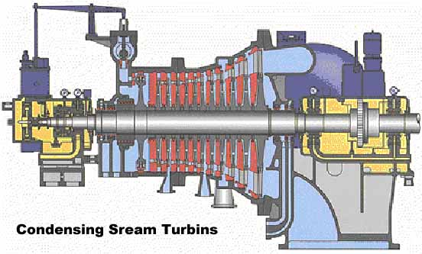
Structure of Large High-Pressure Turbine

Slide 4

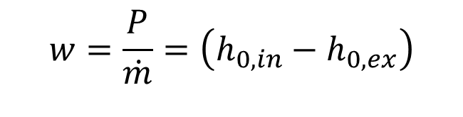
Isentropic vs Irreversible Adiabatic Flow Through Turbine : SSSF
$$w=\frac{P}{\dot{m}}=\left(h_{0,in}−h_{0,ex}\right)$$
3 (in)
Ideal work w_{iso} = h_{0,in} – h_{0,exit,iso}
Actual work w_{act} = h_{0,in} – h_{0,exit,act}
The Lost Work due to irreversible flow
h₀
$$∆w_{loss}=w_{iso}−w_{act}$$
4a,Exit,actual
4s (Exit, iso)
s
s

Slide 5
Stagewise Distribution of Entropy Generation
3
Control Stage
4^{I}_{a}
Stage 1
4^{I}_{s}
4^{II}_{a}
Stage 2
4^{II}_{s}
4^{III}_{a}
Stage 3
4^{III}_{s}
h₀
4^{IV}_{s}
4^{IV}_{a}
Stage 4
4^{V}_{a}
Stage 5
4^{V}_{s}
4^{VI}_{a}
4^{VI}_{s}
4s
s

Slide 6
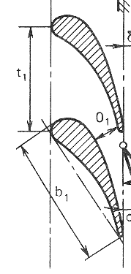
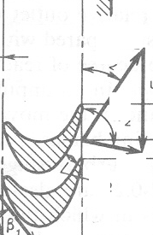
Sequence of Energy Losses in a Turbine Stage
Steam
Thermal
Power
Blade
kinetic
Power
Steam
kinetic
Power
Gap Losses
Nozzle Losses
Stage Losses
Moving Blade
Losses
Isentropic efficiency of
Nozzle
Blade Friction Factor

Slide 7
BREAKDOWN OF STAGE LOSSES - 1
The work done on the rotor blades is indicated by the change in tangential momentum.
The overall integrated value can be calculated from the velocity conditions for the mass passing through the rotor blades.
The energy given up by the gas is more than this!
The difference is due to
the friction on the blade profiles, and loss in blade wakes (profile loss);
the friction on the walls at root and tip, and other end effects (secondary loss);
the sudden enlargements in the fluid path, or wall cavities (annulus loss).

Slide 8
BREAKDOWN OF STAGE LOSSES - 2
Not all the fluid passes through the rotor blades, because of leakage through
  diaphragm glands,
  balance holes, and
  over the rotor blade tips;
The actual work per unit total mass flow is less than the work done on the blades per unit blade mass flow as evaluated in the last slide.
Windage and bearing losses reduce the coupling power below that produced at the blades.
Losses resulting from partial admission lacing wire and wetness losses are also similar to windage loss.

Slide 9
Classification of Losses based on Mutual Interaction
Group I
Guide profile loss.
Runner profile loss.
Guide secondary loss.
Runner secondary loss.
Guide annulus loss
Runner annulus loss
Group 2
Guide gland leakage loss.
Balance hole loss.
Rotor tip leakage loss.
Lacing wire loss.
Wetness loss
Disc windage loss.
Losses due to partial admission.

Slide 10
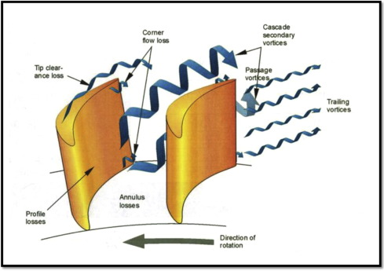
Classification of Losses based on Mutual Interaction
Group I
Guide profile loss.
Runner profile loss.
Guide secondary loss.
Runner secondary loss.
Guide annulus loss
Runner annulus loss

Slide 11
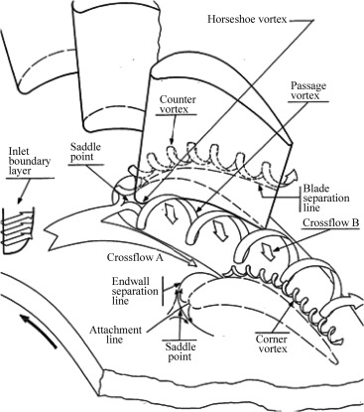
Classification of Losses based on Mutual Interaction
Group I
Guide profile loss.
Runner profile loss.
Guide secondary loss.
Runner secondary loss.
Guide annulus loss
Runner annulus loss

Slide 12
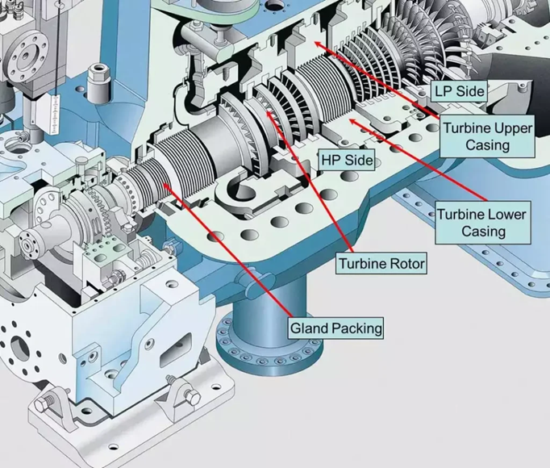
Classification of Losses based on Mutual Interaction
Group I
Guide profile loss.
Runner profile loss.
Guide secondary loss.
Runner secondary loss.
Guide annulus loss
Runner annulus loss

Slide 13
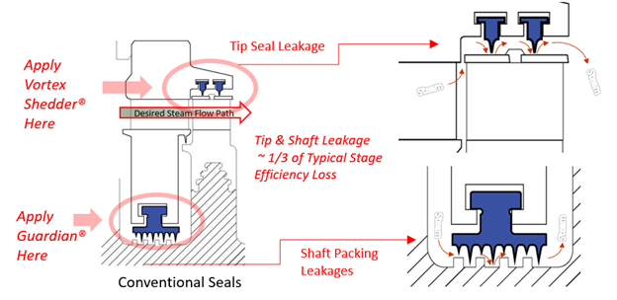
Classification of Losses based on Mutual Interaction
Group 2
Guide gland leakage loss.
Balance hole loss.
Rotor tip leakage loss.
Lacing wire loss.
Wetness loss
Disc windage loss.
Losses due to partial admission.

Slide 14
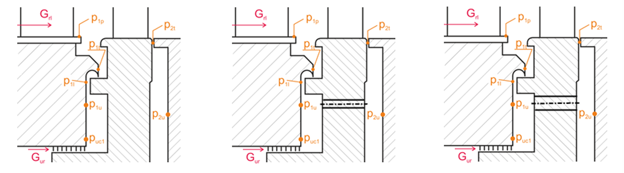
Classification of Losses based on Mutual Interaction
Group 2
Guide gland leakage loss.
Balance hole loss.
Rotor tip leakage loss.
Lacing wire loss.

Slide 15
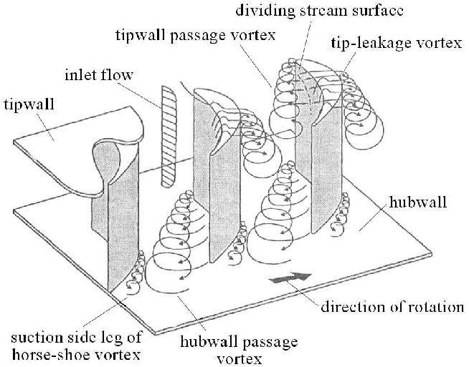
Classification of Losses based on Mutual Interaction
Group 2
Guide gland leakage loss.
Balance hole loss.
Rotor tip leakage loss.
Lacing wire loss.
Wetness loss
Disc windage loss.
Losses due to partial admission.

Slide 16
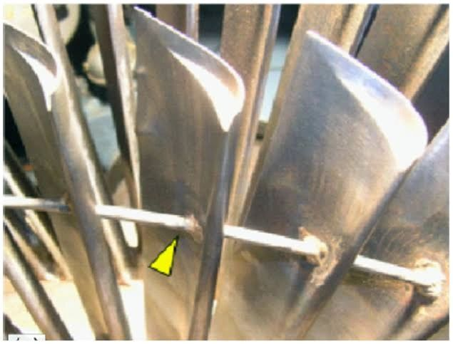
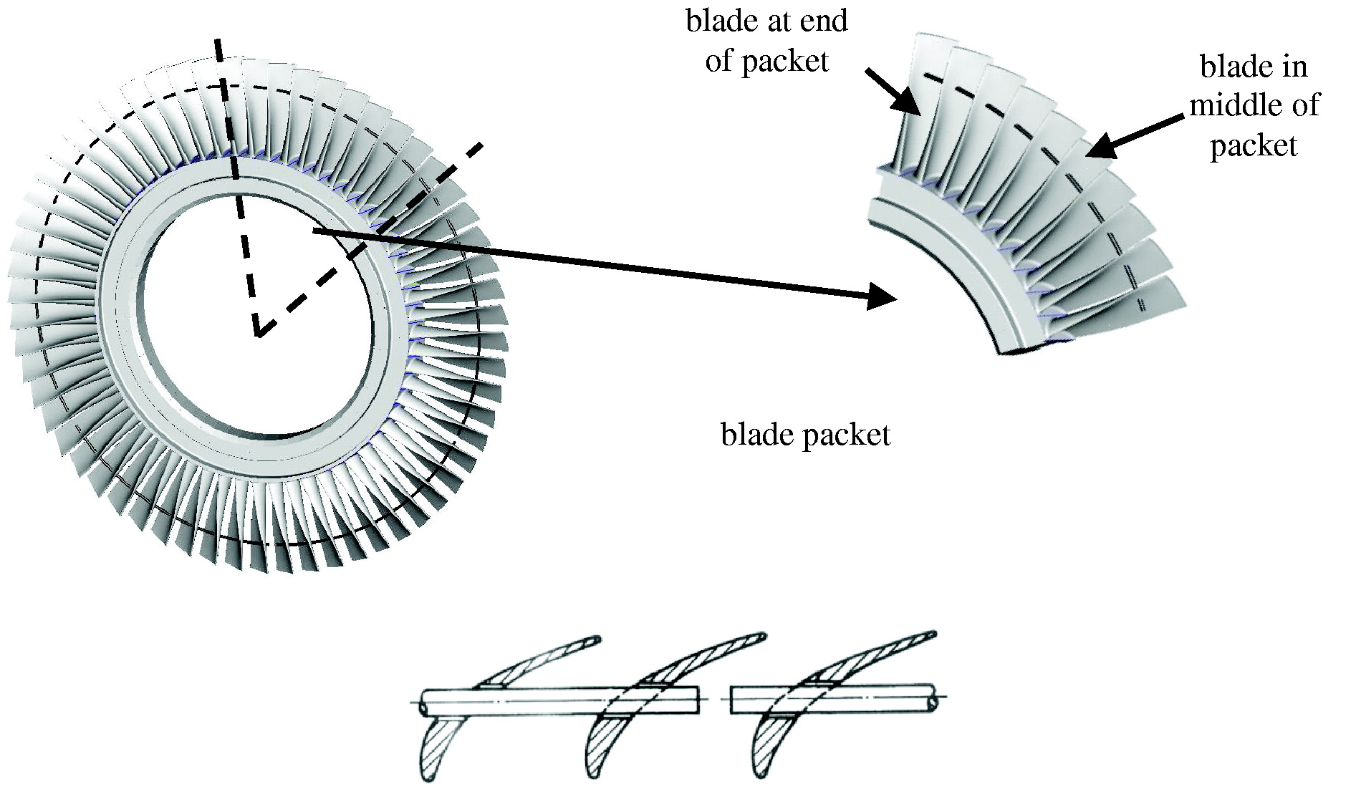
Classification of Losses based on Mutual Interaction
Group 2
Guide gland leakage loss.
Balance hole loss.
Rotor tip leakage loss.
Lacing wire loss.
Wetness loss
Disc windage loss.
Losses due to partial admission.

Slide 17
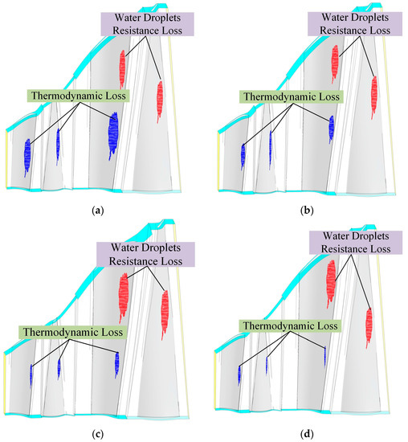
Classification of Losses based on Mutual Interaction
Group 2
Guide gland leakage loss.
Balance hole loss.
Rotor tip leakage loss.
Lacing wire loss.
Wetness loss
Disc windage loss.
Losses due to partial admission.

Slide 18
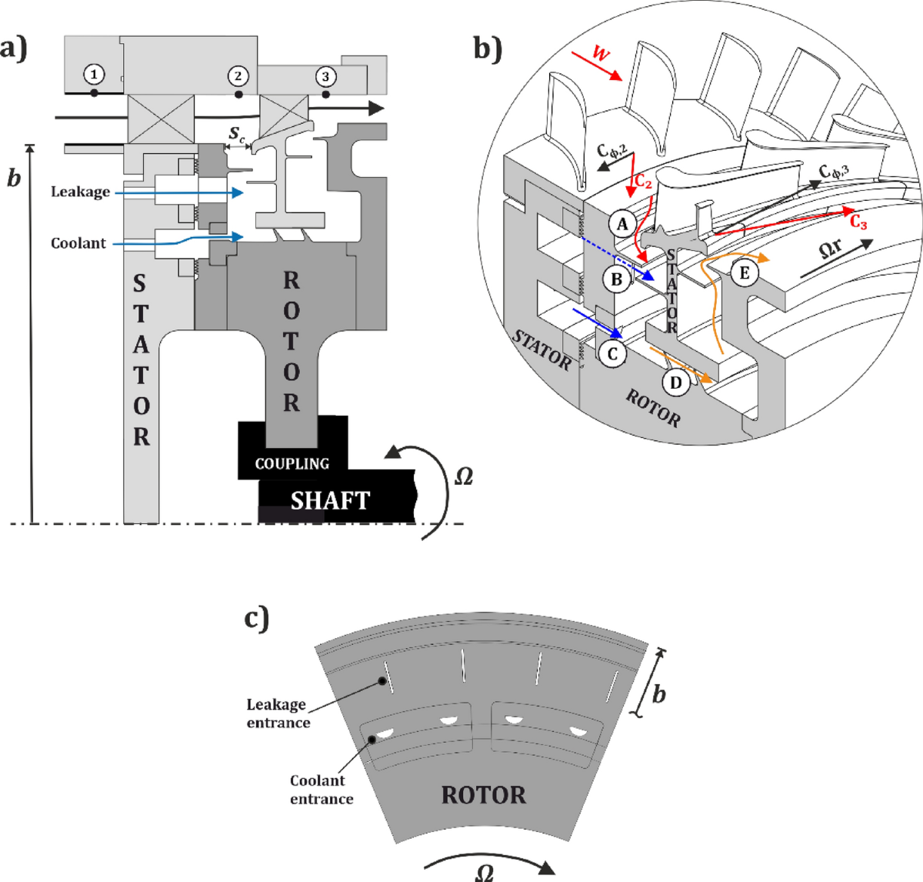
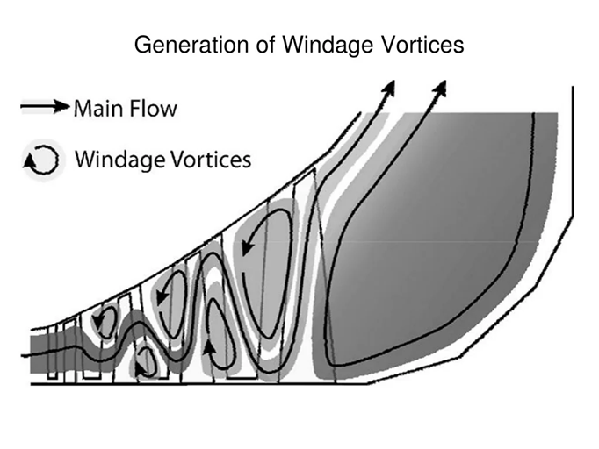
Classification of Losses based on Mutual Interaction
Group 2
Guide gland leakage loss.
Balance hole loss.
Rotor tip leakage loss.
Lacing wire loss.
Wetness loss
Disc windage loss.
Losses due to partial admission.

Slide 19
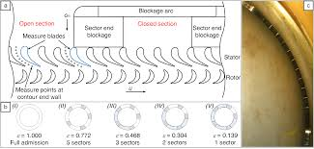
Classification of Losses based on Mutual Interaction
Group 2
Guide gland leakage loss.
Balance hole loss.
Rotor tip leakage loss.
Lacing wire loss.
Wetness loss
Disc windage loss.
Losses due to partial admission.

Slide 20

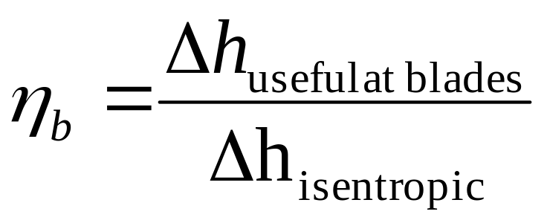
Blading Efficiency
A blading efficiency can be defined as
Referring to the mass flow passing through the rotor blade.

Slide 21

The Overall Stage Efficiency
The overall stage efficiency is then defined in a similar form as
Referring to the mass flow passing through the stage.

Slide 22
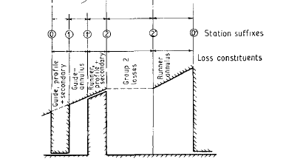

Physical Locations for Occurrence of Losses

Slide 23
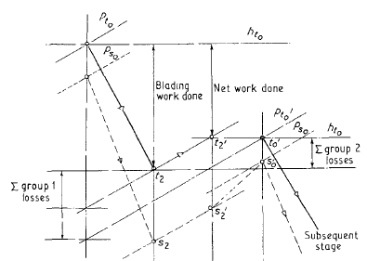
Physical Locations for Occurrence of Losses

Slide 24
INFLUENCE PARAMETERS
The loss generation in a turbine stage are a function of many parameters:
Reynolds number Re and Mach number M
Aspect ratio, h/s.
Pitch–chord ratio, t/s.
Relative flow turning,
Ratio of relative velocities
Blade loading parameter
Inlet boundary layer
Boundary layer at the trailing edge
Leakage flow interaction.

Slide 25
PROFILE LOSSES
Historically, one essential feature sought during 2D profile section design for a given velocity triangle has been to reach minimum loss.
This includes skin friction on the profile surface and trailing edge loss.
Owing to higher velocity levels and the occurrence of adverse pressure gradients, the skin friction loss on a typical subsonic profile is mainly determined by the flow behaviour on the suction side.
Typically more than 80 per cent of the skin friction loss occurs on the suction side.

Slide 26
Distribution of Entropy Generation in a Stage
Stage inlet, i
Stator flow path
^{eI}_{a}
Stator-rotor gap
^{eI}_{s}
^{eII}_{a}
Rotor flow Path
^{eII}_{s}
^{eIII}_{a}
Inter-stage gap
^{eIII}_{s}
h₀
^{eIV}_{s}
^{eIV}_{a}
…..
^{eV}_{a}
^{eV}_{s}
^{eVI}_{a}
^{eVI}_{s}
Stage Exit, es
s

Slide 27
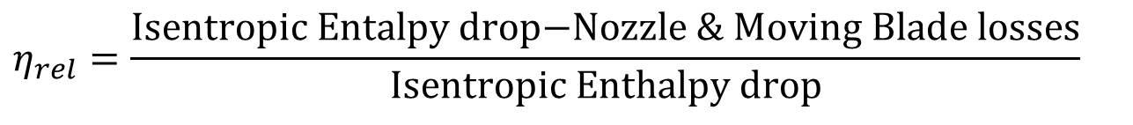
Definition of Isentropic/adiabatic Efficiency
Relative blade efficiency is calculated as:
$$η_{rel}=\frac{\text{Isentropic} \text{Entalpy} \text{drop}\text{−}\text{Nozzle}\text{ \& }\text{Moving} \text{Blade} \text{losses}}{\text{Isentropic} \text{Enthalpy} \text{drop}}$$
Internal Relative Efficiency is calculated as:
$$η_{int,{r}el}=\frac{\text{Isentropic} \text{Entalpy} \text{drop}\text{−}\text{Nozzle}\text{ \& }\text{Moving} \text{Blade} \text{loss}\text{−}\text{stage} \text{losses}}{\text{Isentropic} \text{Enthalpy} \text{drop}}$$

Slide 28
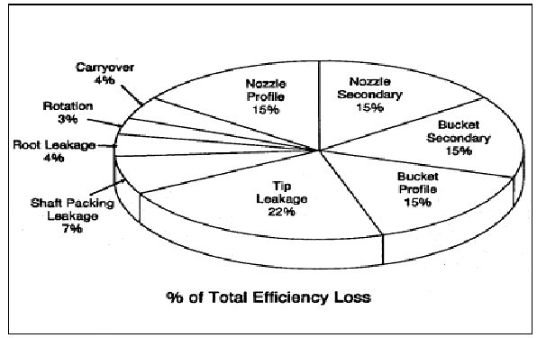
Typical Distribution of Major Losses A Stages

Slide 29
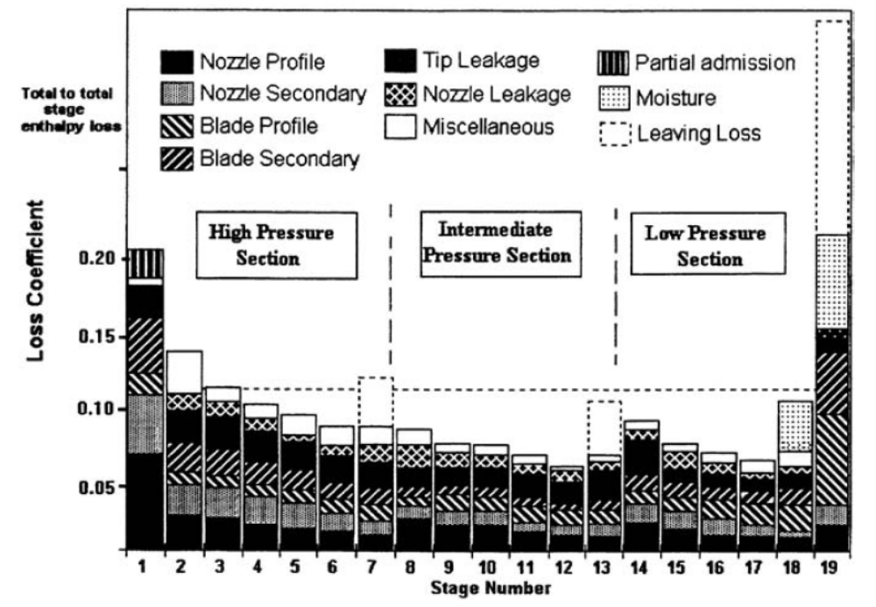
General Distribution of Stagewise Losses

Slide 30
Parson’s concept of multi-stage had produced an additional but marginal thermodynamic advantage.

Slide 31
Diverging Nature of Isobars on h-s Diagram
High Pressure
h
Low Pressure
s

Slide 32
Behavior of Superheated Steam at Constant Pressure
h
T

Slide 33
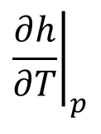
Well Behavior of Superheated Steam
$${\left.\frac{∂h}{∂T}\right|}_{p}$$
T

Slide 34
Internal Reheating due to Irreversibilities
3
4^{I}_{a}
4^{I}_{s}
4^{II}_{a}
4^{II}_{s}
4^{III}_{a}
4^{III}_{s}
h₀
4^{IV}_{s}
4^{IV}_{a}
4^{V}_{a}
4^{V}_{s}
4^{VI}_{a}
4^{VI}_{s}
4s
s

Slide 35
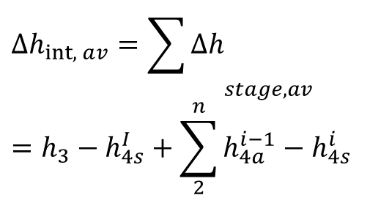
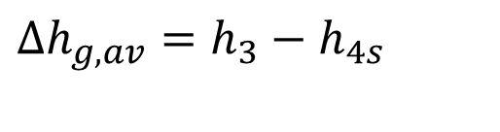
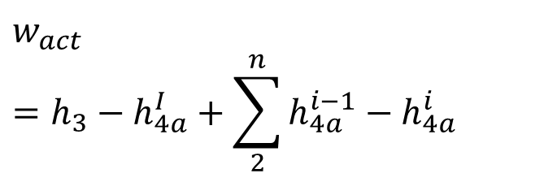
Steam Flow Path in a Multi-Stage Impulse Turbine
3
Global available enthalpy for Power:
$$Δh_{g,av}=h_{3}−h_{4s}$$
4^{I}_{a}
4^{I}_{s}
Internally available enthalpy for Power:
4^{II}_{a}
4^{II}_{s}
$$Δh_{int,{a}v}={\sum{Δh}}_{stage,av} \\ =h_{3}−h_{4s}^{I}+\sum_{2}^{n}{h_{4a}^{i−1}−h_{4s}^{i}}$$
4^{II}_{ss}
4^{III}_{a}
4^{III}_{s}
4^{III}_{ss}
4^{IV}_{s}
4^{IV}_{a}
4^{IV}_{ss}
4^{V}_{a}
4^{V}_{s}
Total actual stage work output per unit mass:
4^{V}_{ss}
4^{VI}_{a}
$$w_{act}=h_{3}−h_{4a}^{I}+\sum_{2}^{n}{h_{4a}^{i−1}−h_{4a}^{i}}$$
4^{VI}_{s}
4s

Slide 36
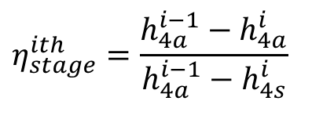
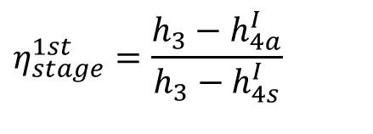
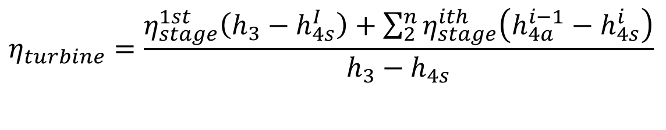
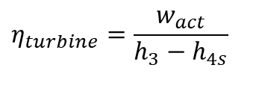
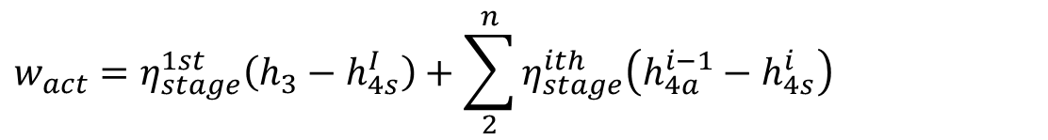
Improved Behavior of A Sequential Group of Stages
Define Stage Efficiency:
$$η_{stage}^{1st}=\frac{h_{3}−h_{4a}^{I}}{h_{3}−h_{4s}^{I}}$$
$$η_{stage}^{ith}=\frac{h_{4a}^{i−1}−h_{4a}^{i}}{h_{4a}^{i−1}−h_{4s}^{i}}$$
$$w_{act}=η_{stage}^{1st}\left(h_{3}−h_{4s}^{I}\right)+\sum_{2}^{n}{η_{stage}^{ith}\left(h_{4a}^{i−1}−h_{4s}^{i}\right)}$$
$$η_{turbine}=\frac{w_{act}}{h_{3}−h_{4s}}$$
Global internal efficiency of turbine:
$$η_{turbine}=\frac{η_{stage}^{1st}\left(h_{3}−h_{4s}^{I}\right)+\sum_{2}^{n}{η_{stage}^{ith}\left(h_{4a}^{i−1}−h_{4s}^{i}\right)}}{h_{3}−h_{4s}}$$

Slide 37

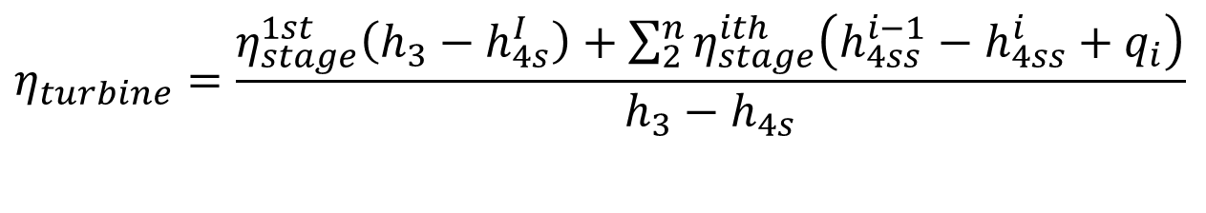
Reheat Factor
$$η_{turbine}=\frac{η_{stage}^{1st}\left(h_{3}−h_{4s}^{I}\right)+\sum_{2}^{n}{η_{stage}^{ith}\left(h_{4ss}^{i−1}−h_{4ss}^{i}+q_{i}\right)}}{h_{3}−h_{4s}}$$
q_{i} is always positive.
Therefore,
$$η_{turbine}>η_{stage}^{i}$$
Multistage turbines will increase the possibility of recovering lost work!
The larger the number of stages, the greater is the heat recovery.
The difference is called heat recovery factor, α.
General value of α is 0.04 to 0.06.

Slide 38
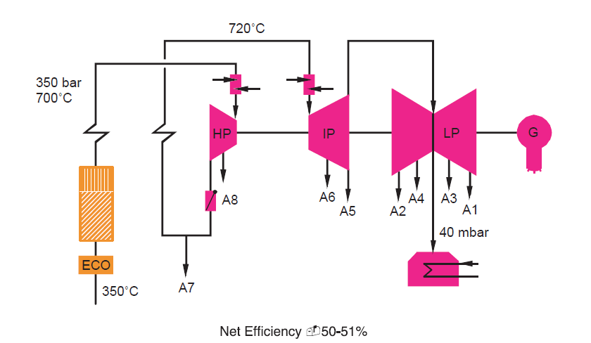
Advanced 700 8C Pulverised Coal-fired Power Plant Project

