Slide 1

Aerofoil Theory for Design of Turbine Blade Profile-2
P M V Subbarao
Professor
Mechanical Engineering Department
Duplication of Ideas from Natural Virtuoso…

Slide 2


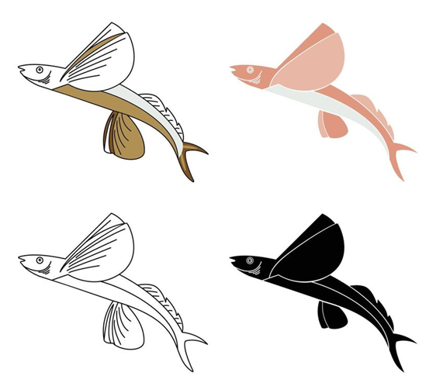

Development of an Engineering Science from A Virtuoso Natural Skill

Slide 3
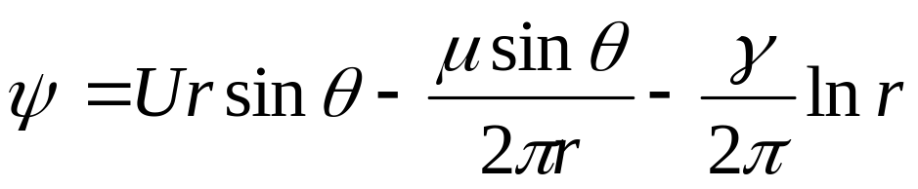
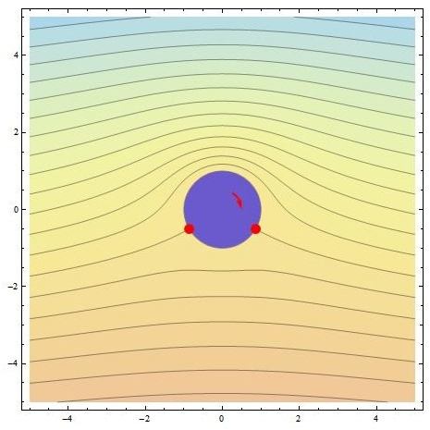
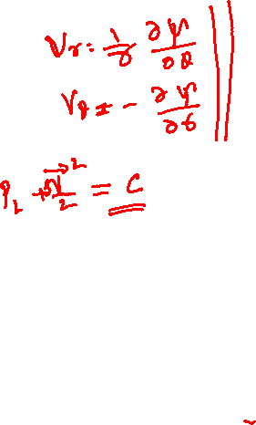
Visualization of Multilevel Interaction Function

Slide 4
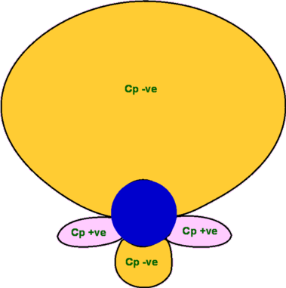
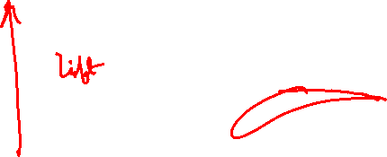
Creation of Zero Weight Balloon

Slide 5
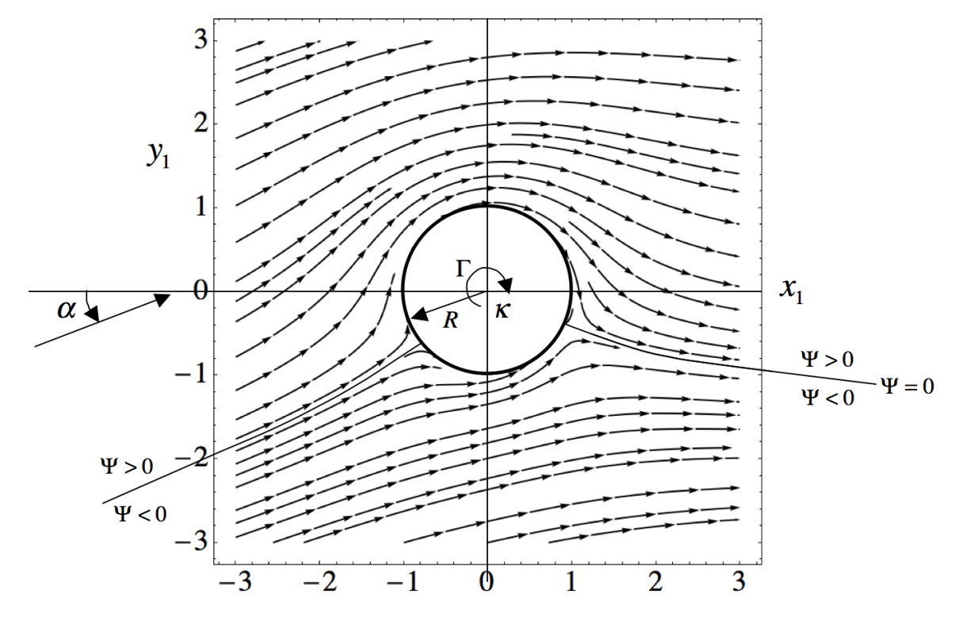
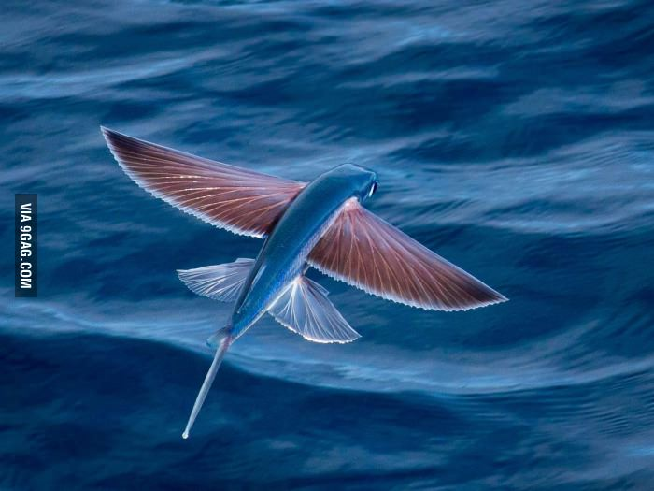
Angle of Attack
Unbelievable Flying Objects

Slide 6
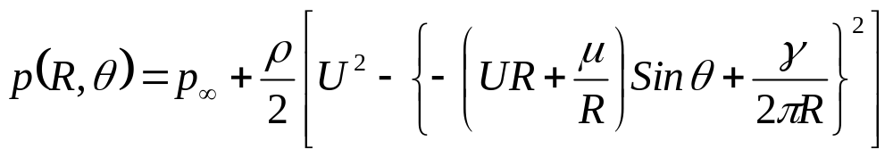
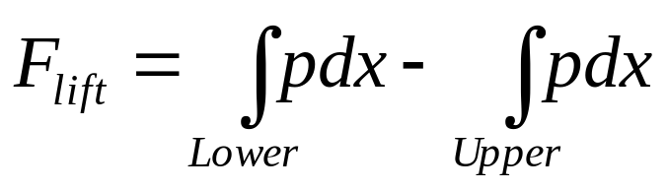
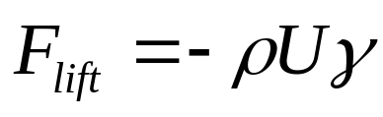
Computation of Lift
Lift per unit span, (i.e. per unit distance normal to the plane of the paper) is given by:
On the surface of the cylinder, x = R Cosθ.
Thus, dx = -Rsinθdθ.
The above integrals may be thought of as integrals with respect to θ.
For the lower surface, θ varies between π and 2π.
For the upper surface, θ varies between π and 0.

Slide 7
The Kutta – Joukowski Lift Theorem
This is an important result.
It says that clockwise vortices will produce positive lift that is proportional to γ and the free stream speed with direction 90 degrees from the stream direction rotating opposite to the circulation.
Kutta and Joukowski generalized this result to lifting flow over any general body.
This Equation is known as the Kutta-Joukowski theorem.

Slide 8
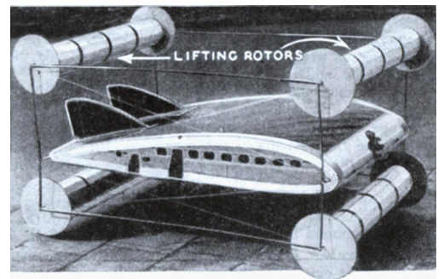
Magnus Effect in Aeronautics
Rotor airplane concept by Ernst Zeuzem

Slide 9
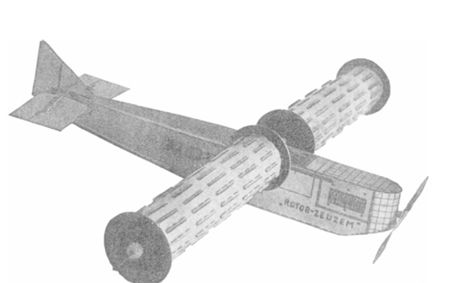
Magnus Effect in Aeronautics
1925
Span: 13m
Length: 8.6 m
Height: 2.7 m
Rotor diameter: 1.2 m
Rotating speed: 550–1600 rpm
Engine power: 550hp
OWE: 1050kg Payload: 550
Model Rotor-Zeuzem

Slide 10
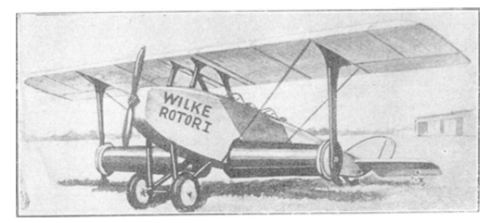
Magnus Effect in Aeronautics
Rotor airplane concept by Gerhard Wilke

Slide 11
Is it A Good Idea???
Unbelievable Flying Objects

Slide 12
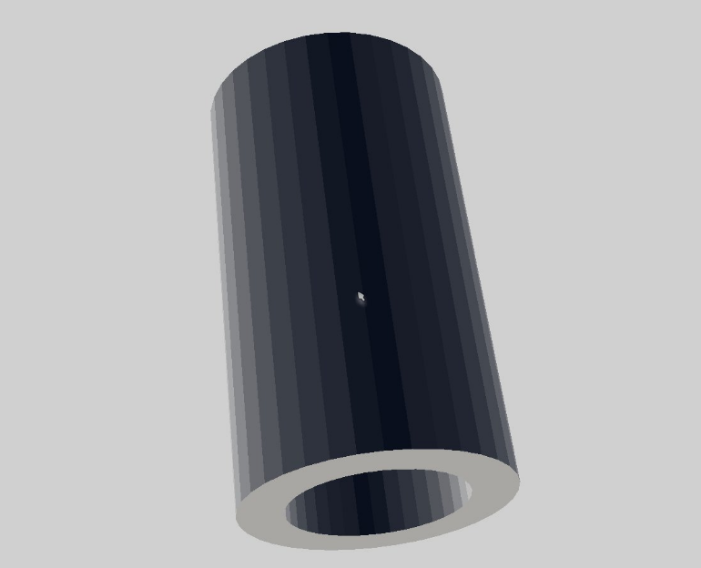
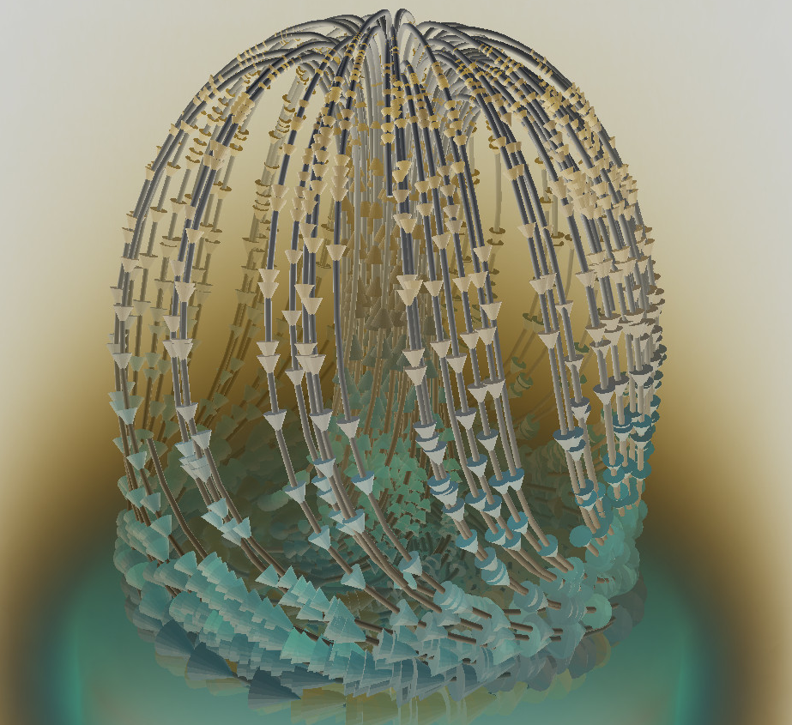
Change In Perspective on Imagination
Consider hallow Cylinder in Polar Coordinates
Polar to Cartesian Mapping
New Object in Cartesian
Coordinates

Slide 13
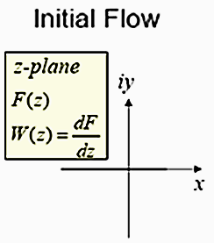
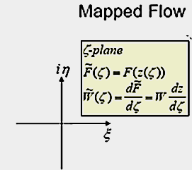
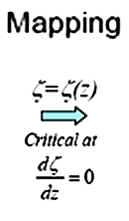

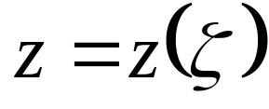
The Art of Transformation/Mapping

Slide 14
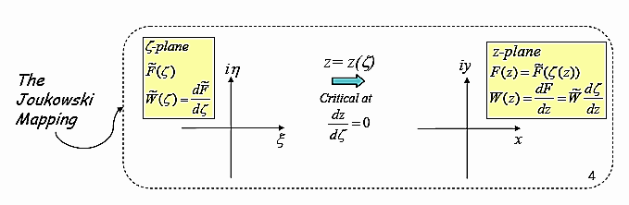
Transformation for Inventing a True Flyer
A large amount of airfoil theory has been developed by distorting flow around a cylinder to get flow around an airfoil.
The essential feature of the distortion is that the potential flow being distorted ends up also as potential flow.

Slide 15
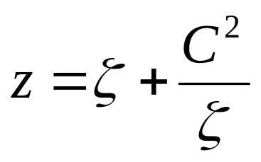
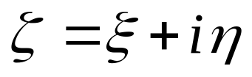
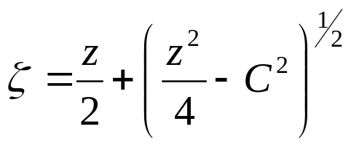
Jowkowski Transformation
The most common Conformal transformation is the Jowkowski transformation which is given by
C is real and >0
The inverse of transformations is:

Slide 16
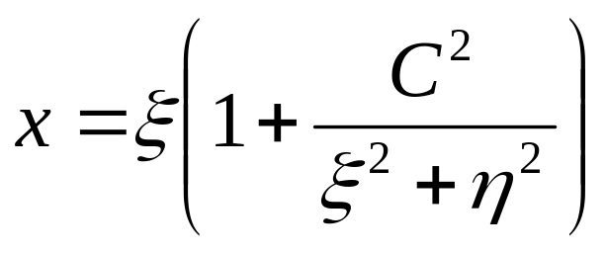
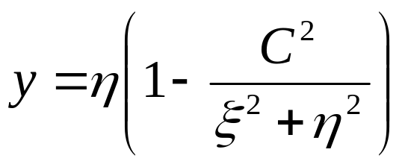
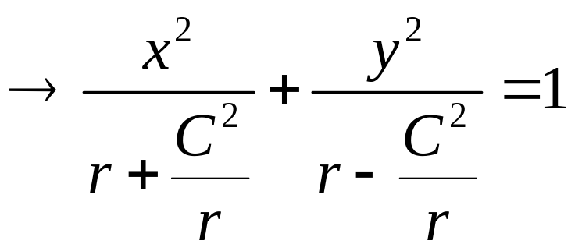
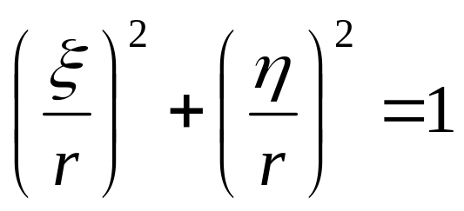
Study of Jowkowski transformation
This gives
For a circle of radius r in ζ plane is transformed in to an ellipse in z - plane:

Slide 17
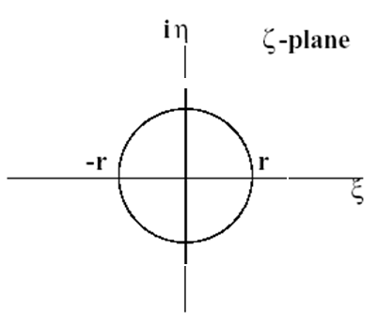
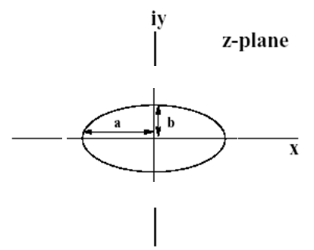
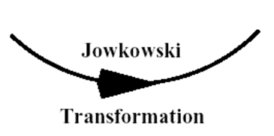
The Outcome

Slide 18
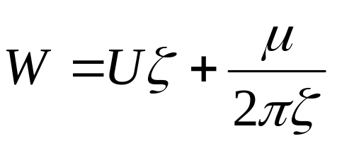
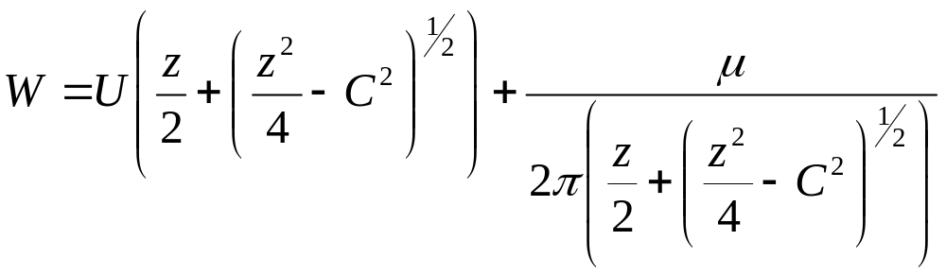
Flow Past Cylinder in Transformed Plane
Potential function in transformed Plane:
Structure of streamlines in real Plane:

Slide 19
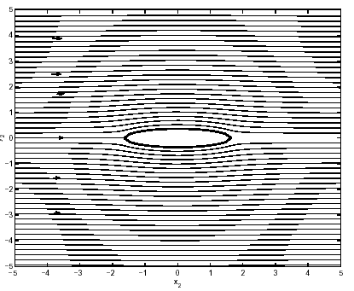
Flow Past an Ellipse in Real Plane
Flow past circular cylinder in ζ – plane is seen as flow past an elliptical cylinder of C = 0.8 in z – plane.

Slide 20
Translationary Transformations
If the circle is centered in (0, 0) and the circle maps into the segment shown and lying on the x axis;
If the circle is centered in (ξ_{c} ,0), the circle maps in an airfoil that is symmetric with respect to the ξ axis;
If the circle is centered in (0, η_{c} ), the circle maps into a curved segment;
If the circle is centered in and ( ξ_{c} , η_{c} ), the circle maps in an asymmetric airfoil.

Slide 21
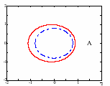
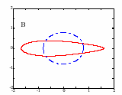

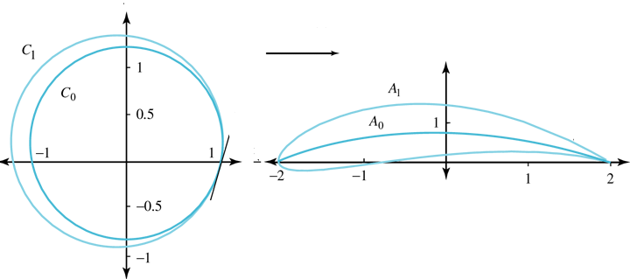
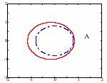
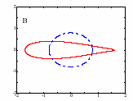
Flow Over An Airfoil

Slide 22
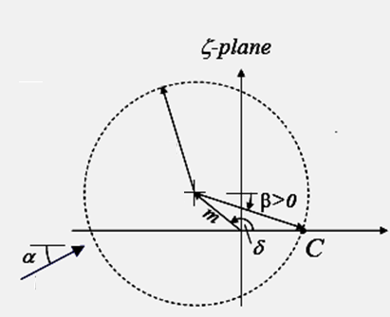

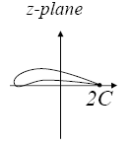


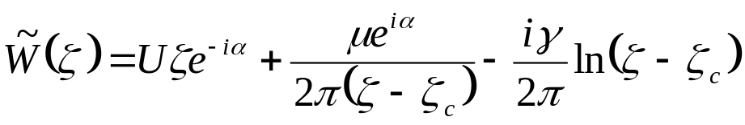
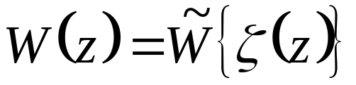
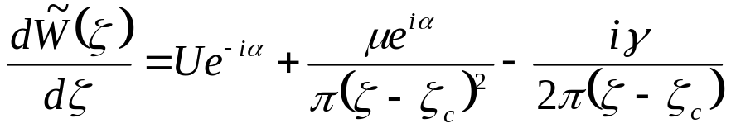
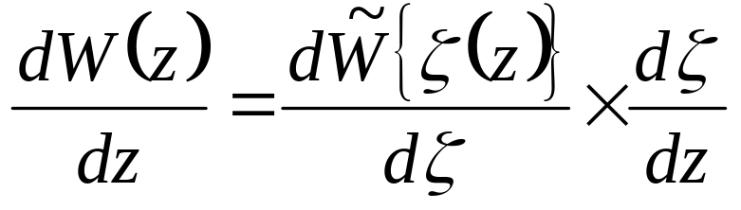
Mapping for flow Past An Airfoil
R
ζ_{c}
U

Slide 23
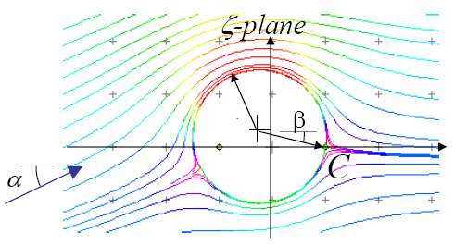
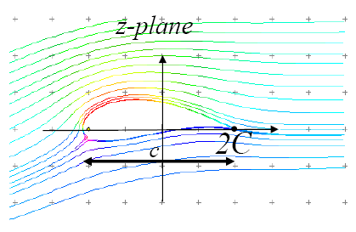
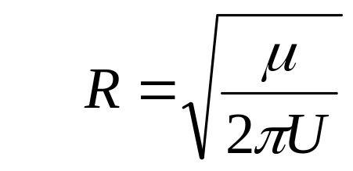
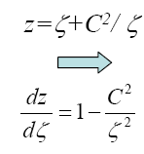
Non-rotating Bodies to Generate Lift
R
ζ_{c}
The lift on an airfoil varies as the sine of the angle of attack or, for small angles, linearly with angle of attack
The primary (and almost exclusive) influence of camber in controlling the zero lift angle of attack -β
The lift curve slope at zero angle of attack is 2π for a flat plate, and increases weakly with increasing thickness and camber

Slide 24
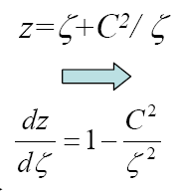

Obtaining the Pressure Distribution
R
ζ_{c}
Choose a set of points on the circle
For these points determine
Velocity on the circle

Slide 25
Closing Remarks on Jowkowski Method
One of the troubles with conformal mapping methods is that parameters such as ξ_{c} and η_{c} (ζ_{c}=ξ_{c}+i η _{c}) are not so easily related to the airfoil shape.
Thus, if we want to analyze a particular airfoil, we must iteratively find values that produce the desired section.
A technique for doing this was developed by Theodorsen.
Another technique involves superposition of fundamental solutions of the governing differential equations.
This method is called thin airfoil theory.

Slide 26


Generation of Zero Weight
Pressure Balloon on Airfoil Surface

Slide 27


Calculation of Lift (Tangential) Force
The lift force L is determined by integration of the measured pressure distribution over the airfoil’s surface.
where, p_{i} = surface pressure distribution ,
p∞ = pressure in the free-stream
U∞ = free-stream velocity,
ρ = air density (temperature),
c = airfoil chord

Slide 28




Definition of lift and drag Coefficients
Lift and drag coefficients C_{l} and C_{d} are defined as:

Slide 29
The Basic & Essential Cause for Generation of Lift
The experts advocate an approach to lift by Newton's laws.
Any solid body that can force the air downward clearly implies that there will be an upward force on the airfoil as a Newton's 3rd law reaction force.
From the conservation of momentum for control Volume
The exiting air is given a downward component of momentum by the solid body, and to conserve momentum,
something must be given an equal upward momentum to solid body.
Only those bodies which can give downward momentum to exiting fluid can experience lift !
Kutta-Joukowski theorem for lift.

Slide 30


Turbine Blade Cross Section
Airfoil Geometry
Airfoil geometry can be characterized by the coordinates of the upper and lower surface.
It is often summarized by a few parameters such as: maximum thickness, maximum camber, position of max thickness, position of max camber, and nose radius.
One can generate a reasonable airfoil section given these parameters.
This was done by Eastman Jacobs in the early 1930's to create a family of airfoils known as the NACA Sections.

Slide 31

AIRFOIL NOMENCLATURE
Mean Chamber Line: Set of points halfway between upper and lower surfaces
  Measured perpendicular to mean chamber line itself
Leading Edge: Most forward point of mean chamber line
Trailing Edge: Most reward point of mean chamber line
Chord Line: Straight line connecting the leading and trailing edges
Chord, c: Distance along the chord line from leading to trailing edge
Chamber: Maximum distance between mean chamber line and chord line
  Measured perpendicular to chord line

Slide 32

Other Geometric Specifications of An Aerofoil

Slide 33
NACA Airfoil Series
NACA (National Advisory Committee for Aeronautics) or
NASA (National Aeronautics and Space administration)
Identified different airfoil shapes with a logical numbering system.
Before NACA series, airfoil design was rather arbitrary with nothing to guide designer’s except experience with known shapes and experimentation with modified shapes
1- NACA 4-digit series
2- NACA 5-digit series
3- NACA 1-series or 16-series
4- NACA 6- series
5- NACA 7- series
6- NACA 8- series

Slide 34

NACA Airfoil Naming Convention
NACA (National Advisory Committee for Aeronautics) precursor to NASA
Early NACA series, 4-, 5-, modified 4-/5-digit generated with analytical equations
Later families, including 6-Series, are more complicated shapes derived using theoretical rather than geometrical methods

Slide 35

NACA Four-digit Series
First digit specifies maximum camber in percentage of chord
Second digit indicates position of maximum camber in tenths of chord
Last two digits provide maximum thickness of airfoil in percentage of chord
Example: NACA 2415
Airfoil has maximum thickness of 15%
of chord (0.15c)
Camber of 2% (0.02c) located 40%
back from airfoil leading edge (0.4c)
NACA 2415

Slide 36

Example: NACA 2412
NACA 2 4 12
Maximum thickness (t ) in percentage of chord (t/c)_{max} = 0.12
Camber in percentage of chord
y_{c} = 0.02 C
Position of camber in tenths of chord x_{c} = 0.4 C
x_{c}
y_{c}
c

Slide 37

NACA 5-Digit Series
After the 4-digit sections came the 5-digit sections such as the famous NACA 23012.

Slide 38

Camber line Equations for NACA Aerofoils
The NACA 4 digit and 5 digit airfoils were created by superimposing a simple meanline shape with a thickness distribution.
The camber line of 4-digit sections was defined as a parabola from the leading edge to the position of maximum camber, then another parabola back to the trailing edge.
NACA 5 digit airfoils use a camberline with more curvature near the nose.
A cubic was faired into a straight line for the 5-digit sections

Slide 39



Thickness Distribution of NACA Airfoils
The NACA 4 digit and 5 digit airfoils were created by superimposing a simple meanline shape with a thickness distribution that was obtained by fitting a couple of popular airfoils of the time:

Slide 40

NACA 6-Digit Series
The 6-series of NACA airfoils departed from this simply-defined family.
These sections were generated from a more or less prescribed pressure distribution and were meant to achieve some laminar flow.

