Slide 1

Aerofoil Theory for Design of Turbine Blade Profile-1
P M V Subbarao
Professor
Mechanical Engineering Department
Duplication of Ideas from Natural Virtuoso…

Slide 2


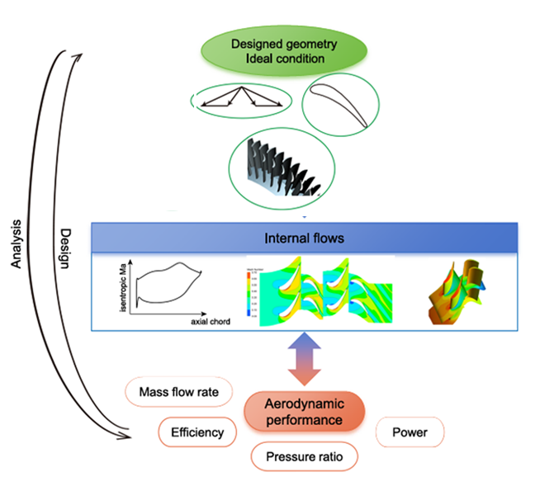
The core for turbomachinery aerodynamics

Slide 3
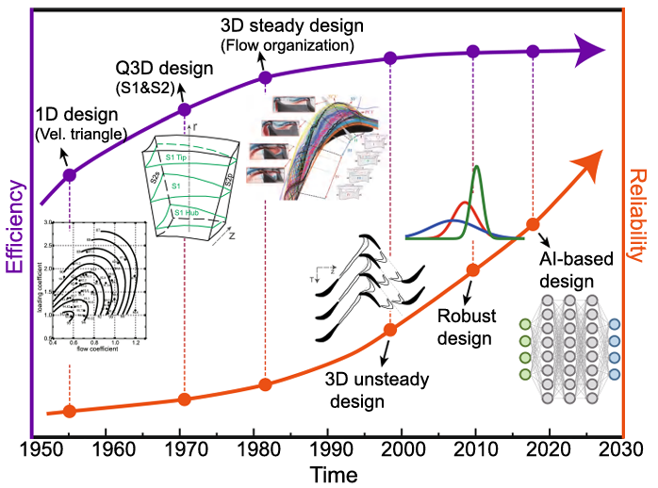
The core for turbomachinery aerodynamics

Slide 4
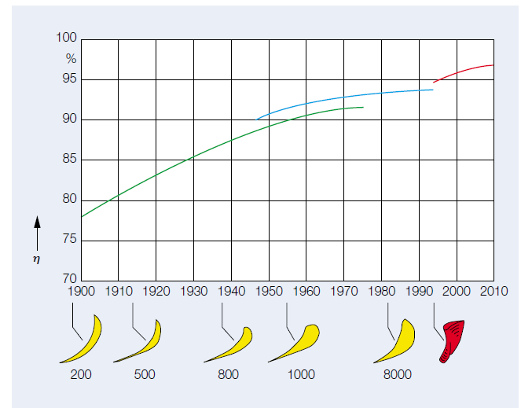
High-performance blade CS : Advanced Aero Design

Slide 5
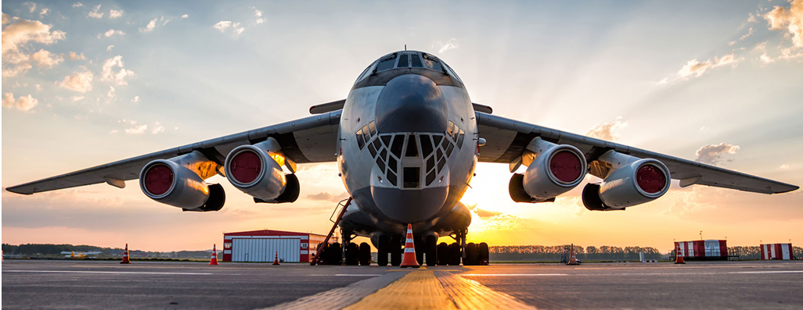
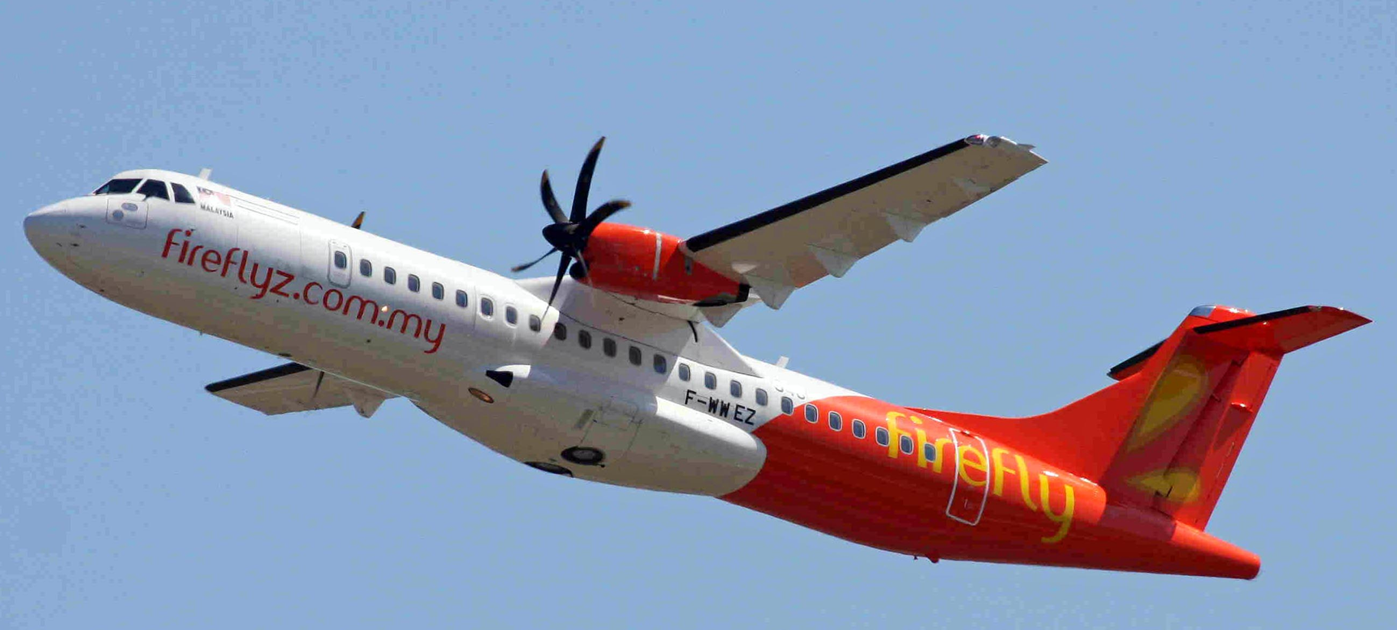
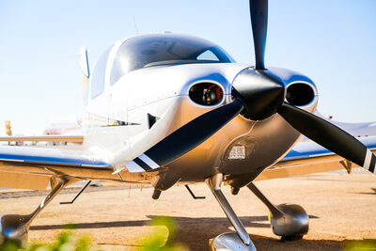
Super Powering all the Competetors…

Slide 6
The Shocking News in The New York Times: 9 December 1903
1 million to 10 million years they might be able to make a plane that would fly ?!?!?!
People had dreamed of flying for many years.
The United States Army was trying to develop an airplane in 1903, but the plane wouldn't fly.
The New York Times wrote that maybe in
1 million to 10 million years they might be able to make a plane that would fly.
Only eight days later two men were successful in flying the first manned plane.
Controlled, powered flight had seemed impossible until Orville Wright took off on the 17th December 1903.
They were Wilbur Wright and his younger brother, Orville.

Slide 7

Development of an Ultimate Fluid machine

Slide 8
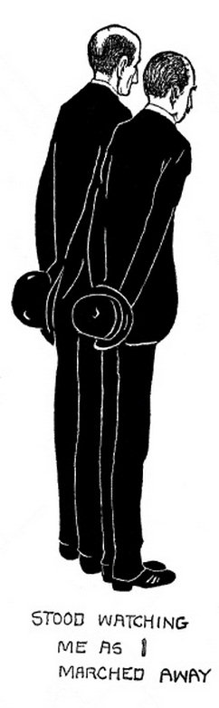
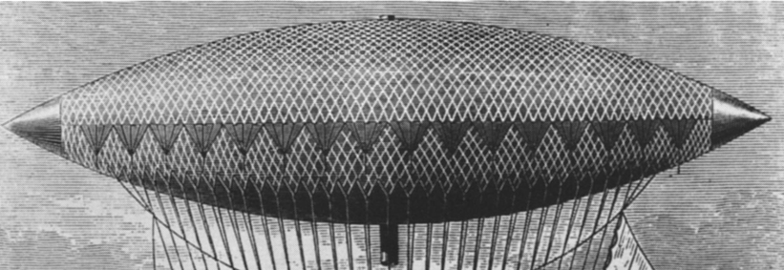
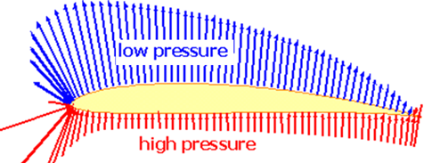
A Ship Can’t Fly
“An airship, is a big, clumsy balloon filled with gas.”
“A flying machine,” by Wilbur.
“The name we prefer is ‘flyer,’” said Orville.
Right Action to generate Lift
Airship
Flyer

Slide 9
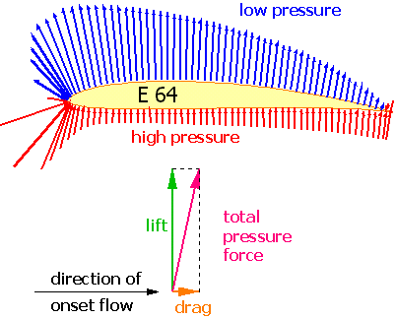
Superiority of Zero Weight Balloon

Slide 10
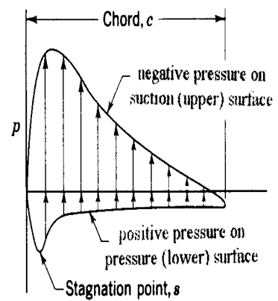
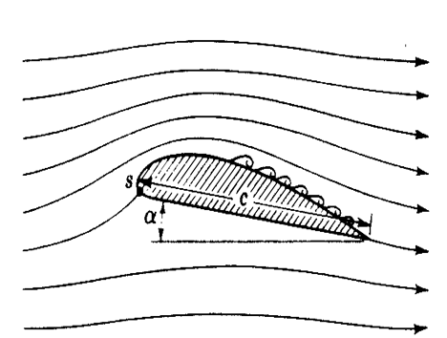
The Cause and Effect

Slide 11
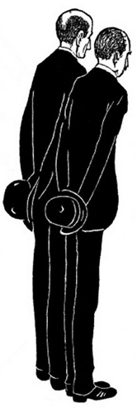
The Strange Natural Geniuses : The Wright Brothers
Wilbur Wright on Their Flying
"It is possible to fly without motors, but not without knowledge and skill.“
"The desire to fly is an idea handed down to us by our ancestors who...looked enviously on the birds soaring freely through space...on the infinite highway of the air.“

Slide 12
The Natural Genius
&
The Art of Generating Lift

Slide 13
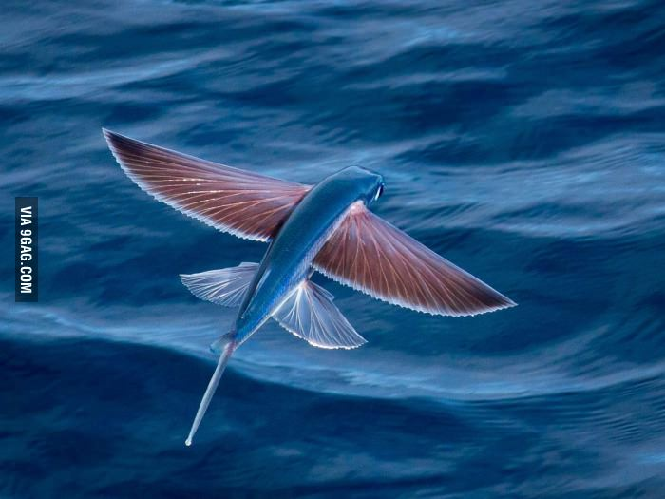
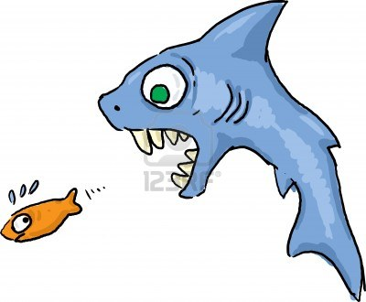
Hydrodynamics of Prey & Predators
Flying fish can be seen jumping out of warm ocean waters worldwide.
Their streamlined torpedo shape helps them gather enough underwater speed to break the surface, and their large, wing-like pectoral fins get them airborne.
Flying fish are thought to have evolved this remarkable gliding ability to escape predators, of which they have many.

Slide 14
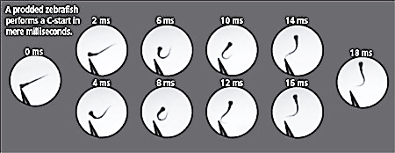
The Potential of C-Start

Slide 15
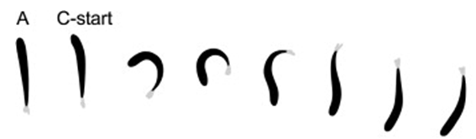
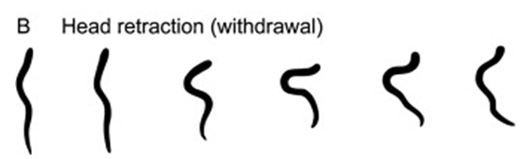
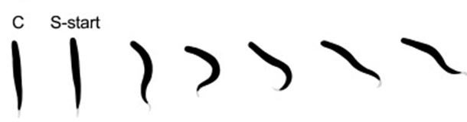
Motor control strategies : Multiple Skills of Natural Genius
Larva of Chinook Salman
Larval Lamprey
Northern Pike

Slide 16

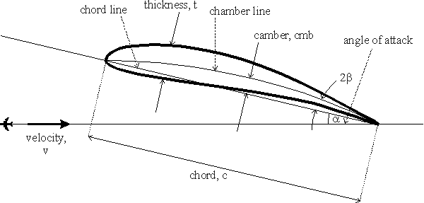
Development of an Ultimate Fluid machine : The Frozen C Device

Slide 17
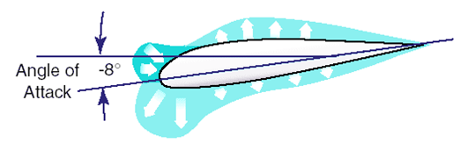
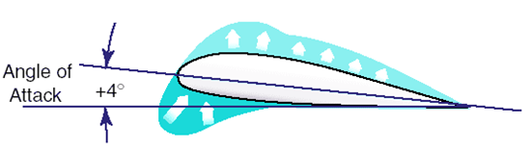
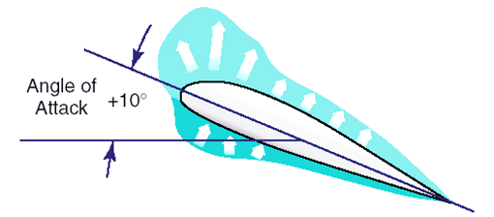
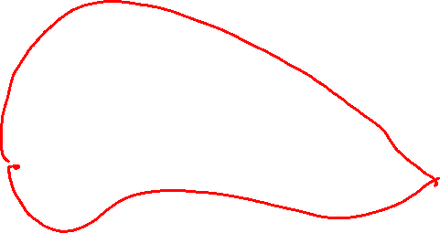
Effect Based Description

Slide 18
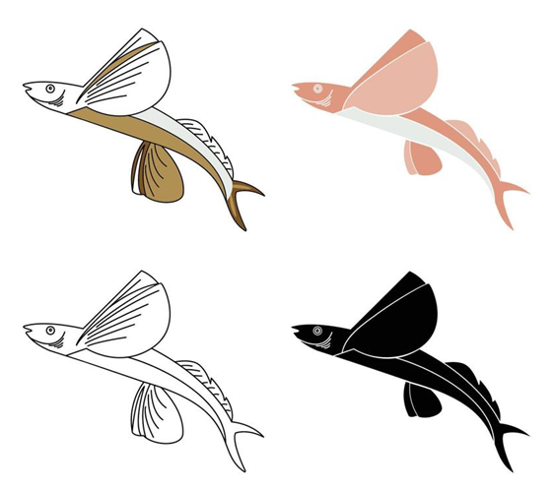
Development of an Engineering Science from A Virtuoso Natural Skill

Slide 19
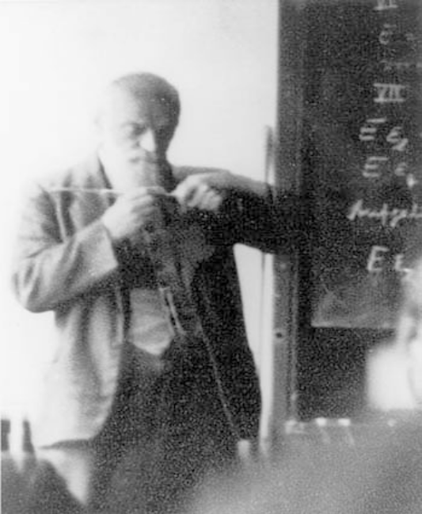
Paul Richard Heinrich Blasius, 1911
Paul Richard Heinrich Blasius was born on 9 August 1883 in Berlin.
He studied at the universities of Marburg and Gottingen from 1902 to 1906.
He joined as a scientific collaborator and research assistant with Ludwig Prandtl from 1908 at the hydraulics laboratory of Berlin technical University.
He was one of the first students of Prandtl who provided a mathematical basis for boundary-layer drag.
He also showed as early as 1911 that the resistance to flow through smooth pipes could be expressed in terms of the Reynolds number for both laminar and turbulent flow.
He developed another Powerful theorem in 1911.

Slide 20
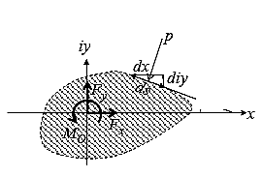
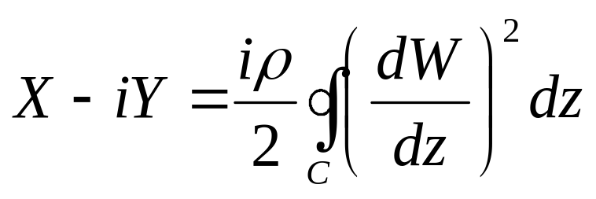

The Theorem of Blasius
Let a steady uniform flow past a fixed two-dimensional body with bounding contour C be a harmonic flow with velocity potential W(z).
Then, if no external body forces are present, the force (X, Y ) exerted by the fluid on the body is given by

Slide 21
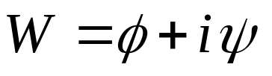
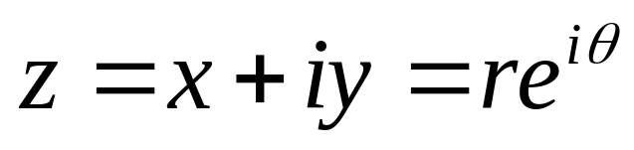
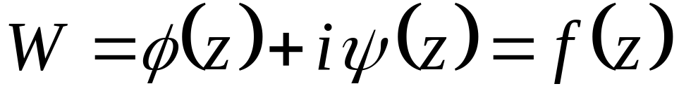
The Complex Potential : Model for A Machine
Inviscid Flow field and force generating solid(s) can be invented as a complex potential.
In particular, the complex potential is defined as
In the complex plane every point is associated with a complex variable
In general, we can write

Slide 22
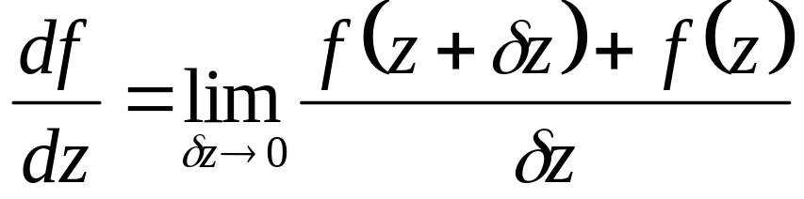
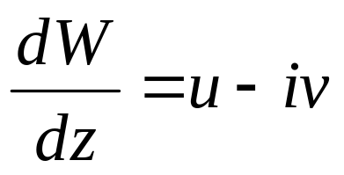
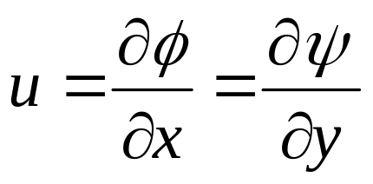
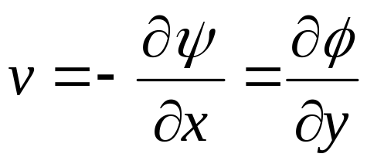
Derivatives of Complex Functions
Now, if the function f is analytic, this implies that it is also differentiable, meaning that the limit
so that the derivative of the complex potential W in the complex z plane gives the complex conjugate of the velocity.
Thus, knowledge of the complex potential as a complex function of z leads to the velocity field through a simple derivative.

Slide 23
Functions for Elementary Fascination
To Create IRROTATIONAL PLANE FLOW
  The uniform flow
The perturbation objects
  The source and the sink
  The vortex
  The Doublet

Slide 24
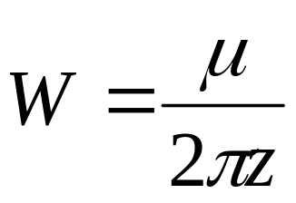
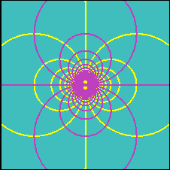
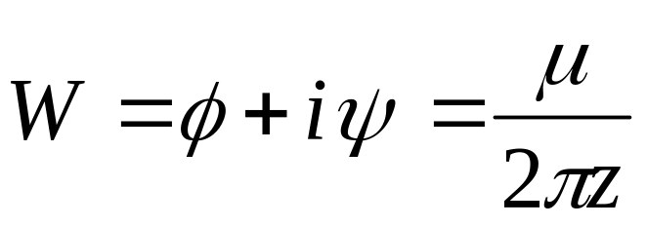
THE DOUBLET

Slide 25
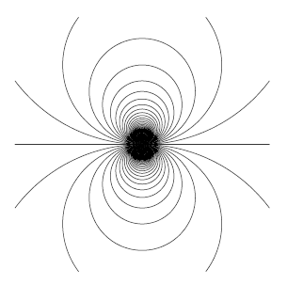

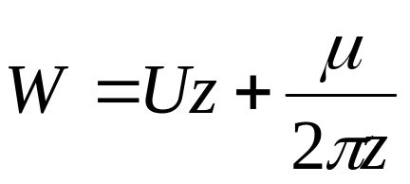
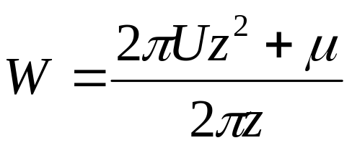
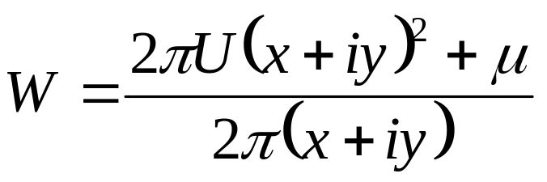
Uniform Flow Past A Doublet : Perturbation of Uniform Flow
The superposition of a doublet and a uniform flow gives the complex potential
+
ψ- Streamines – Uniform Flow
ψ- Streamlines-Doublet

Slide 26
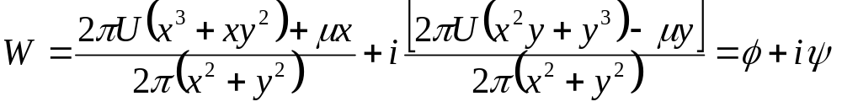
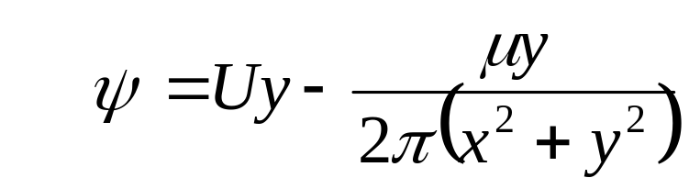
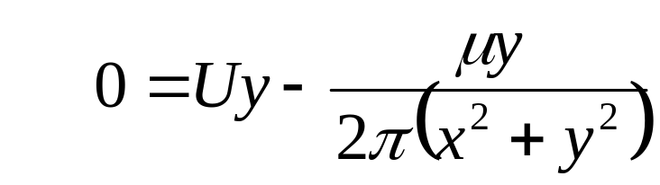
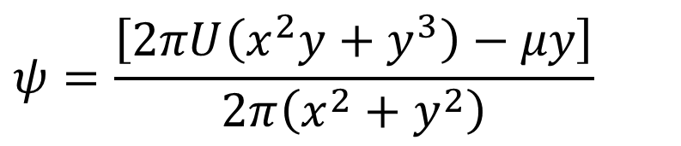
Diagnosis of the Interaction function
$$ψ=\frac{\left[2πU\left(x^{2}y+y^{3}\right)−μy\right]}{2π\left(x^{2}+y^{2}\right)}$$
Find out a streamline corresponding to a value of steam function is zero.

Slide 27
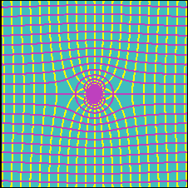

Visualization of Interaction Function
Note that one of the streamlines is closed and surrounds the origin at a constant distance equal to

Slide 28
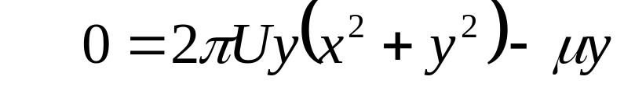
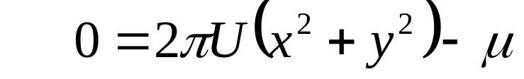
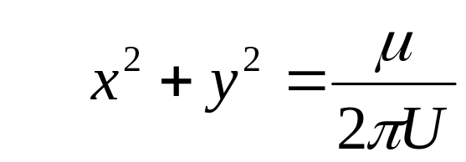

The Shape of Zero Value Stream Line
There exist a circular streamline of radius R, on which value of stream function is zero.
Important Hypothesis: Any stream function of zero value is an impermeable solid wall.
Plot shapes of iso-streamlines of all values.

Slide 29
Invention of Two Important Locations in Interaction Function
Compute the velocity at (two) intersections of the x-axis with the ψ=0 streamline.
These velocities will be found to be zero !?!?
These two points are thus called stagnation points.
There this zero valued streamline is the shape of a solid.
The entire flow field outside this circle is a mathematical representation of an ideal uniform flow past a Cylinder!

Slide 30

The velocity Field due to Flow Past A Cylinder

Slide 31



Stagnation Points on Cylinder Surface
Stagnation points, S:
u & v @x=±R &y=0.

Slide 32

Maximum velocity Points on Cylindrical Surface
Identify the locations of Maximum Stream-wise Velocity Profiles

Slide 33




Cartesian and Cylindrical Coordinate Systems

Slide 34




V² Distribution on the surface of Cylinder (ψ=0)
The velocity of the fluid is zero at = 0º and = 180º. Maximum velocity occur on the sides of the cylinder at = 90º and = -90º.

Slide 35




Creation of Pressure Distribution by the Interaction Function
The pressure field is obtained from the Bernoulli equation
Non-productive zero weight Balloons !?!?!
Define coefficient of Pressure:

Slide 36

Experimental Validation

Slide 37



THE VORTEX FUNCTION
In the case of a vortex, the flow field is purely tangential.
The picture is similar to that of a source but streamlines and equipotential lines are reversed.
The complex potential is
There is again a singularity at the origin, this time associated to the fact that the circulation along any closed curve including the origin is nonzero and equal to γ.
If the closed curve does not include the origin, the circulation will be zero.

Slide 38



Uniform Flow Past A Doublet with Vortex
The superposition of a doublet and a uniform flow gives the complex potential

Slide 39

Visualization of Multilevel Interaction Function

Slide 40








The Non-living Genius : Lifting Machine

Slide 41






Computation of Velocity Field
The radial and tangential velocities are given by:
On the surface of the cylinder (r=R):

Slide 42



Computation of Surface Pressure Field
Find the pressure field over the surface of the cylinder from Bernoulli’s equation:

Slide 43

Creation of Zero Weight Balloon

