Slide 1
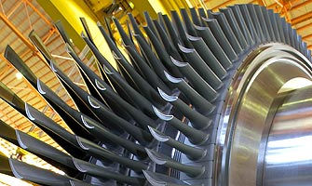

Large Turbines : A Focus on Radial Direction
P M V Subbarao
Professor
Mechanical Engineering Department
An Essential Condition for Stable Operation of A Multi-Stage Machine

Slide 2


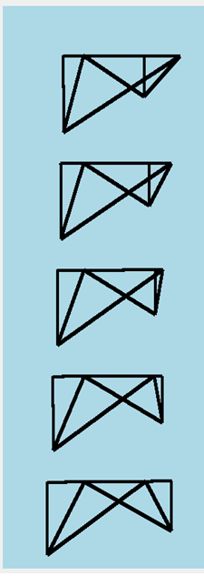
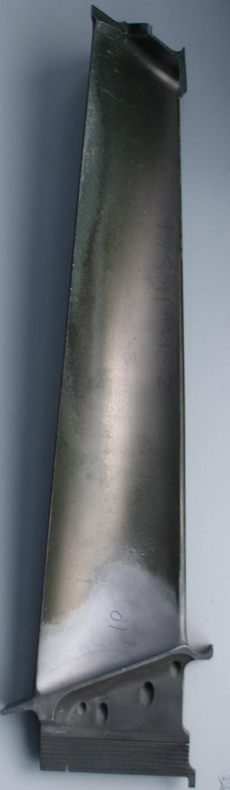
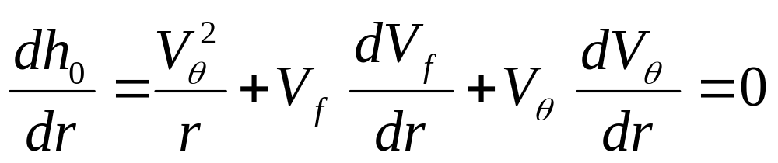
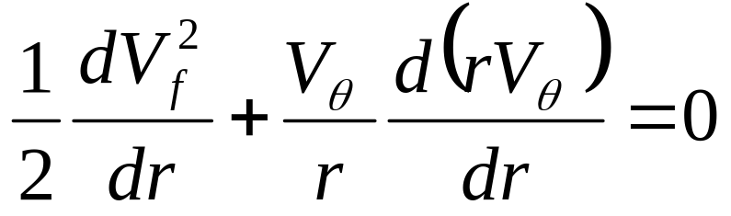
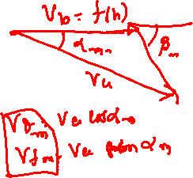
Condition for Radial Equilibrium of Fluid Parcels

Slide 3
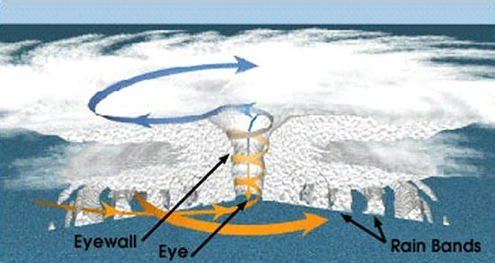
Lessons from Nature

Slide 4
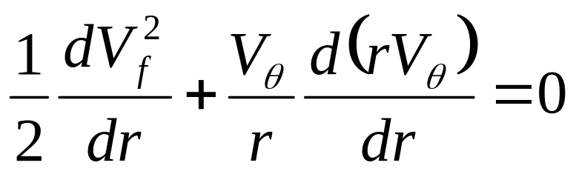
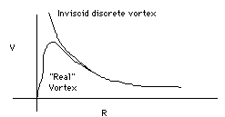
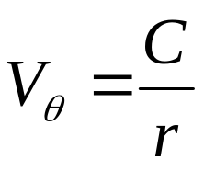
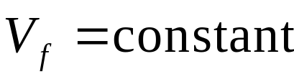
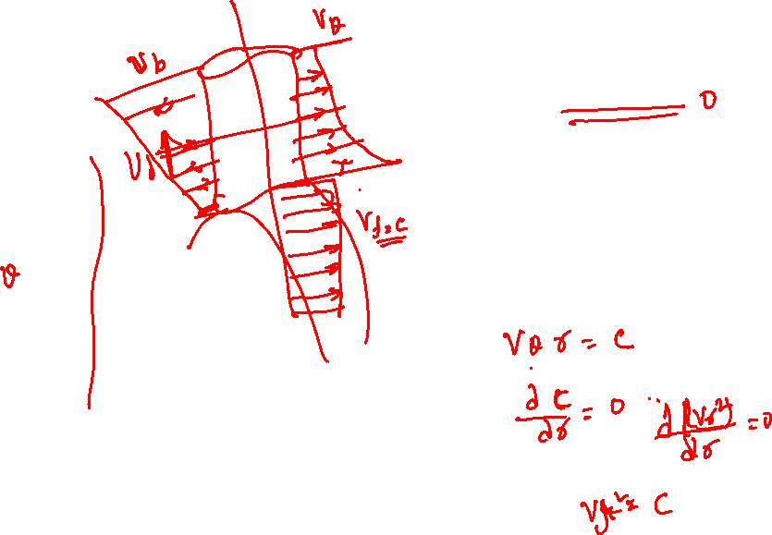
General Rules for Radial Variation of Whirl Component : 1
1960 Designers used Free vortex model for radial variation of whirl component.
Free Vortex Whirl:

Slide 5
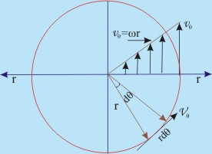
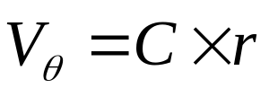
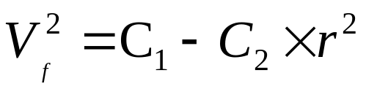
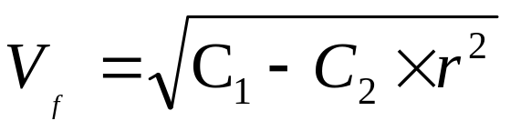
General Rules for Selection of Whirl Component : 2
Forced Vortex Whirl :

Slide 6
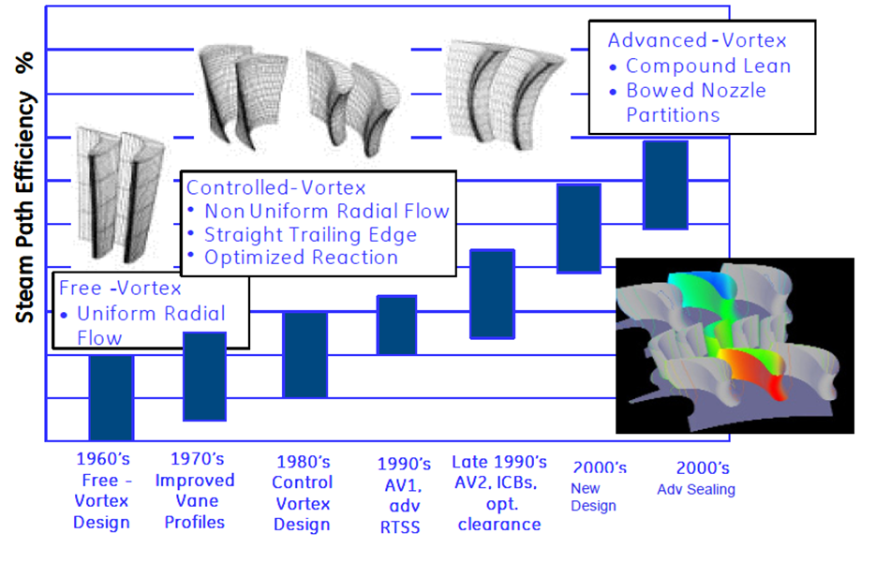
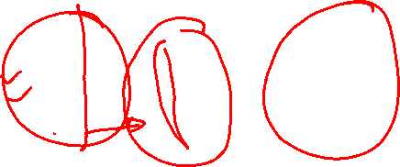
Evolution of Blade Design along Radial Direction

Slide 7
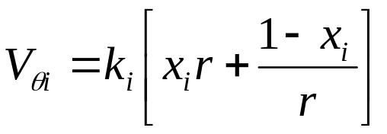
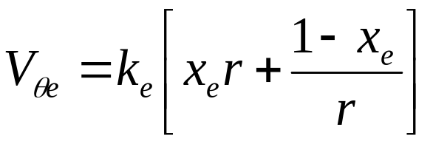

Hybrid Models for Whirl Velocity
Weighted mean of free and forced vortices
Inlet
Exit

Slide 8
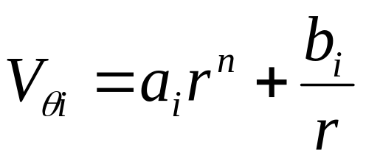
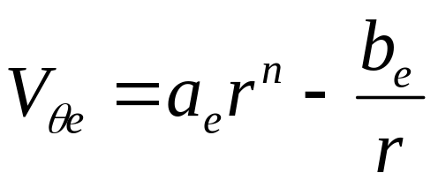
Biased Models for Whirl Velocity
General Whirl Distribution

Slide 9
Radial Variation of Whirl Velocity
Intake
Discharge

Slide 10
Radial Variation of Flow Velocity
Discharge
Intake

Slide 11

Radial Variation of Mass flow rate
Intake
Exit
$$d{\dot{m}}_{fluid}$$

Slide 12
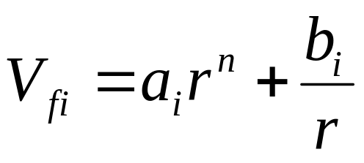
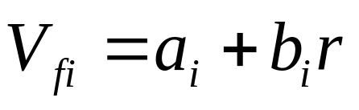
Pressure Controlled Vortex Model

Slide 13
Other Physics Based Models
Uniform distribution of mass flow rate.
Uniform distribution of forces.
Uniform distribution of torque.

Slide 14
Evolution of Turbine Blading

Slide 15
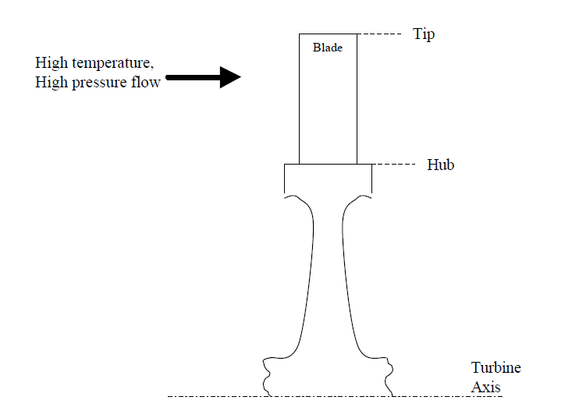
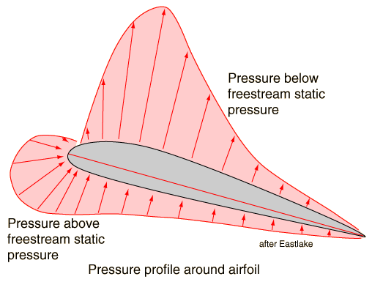
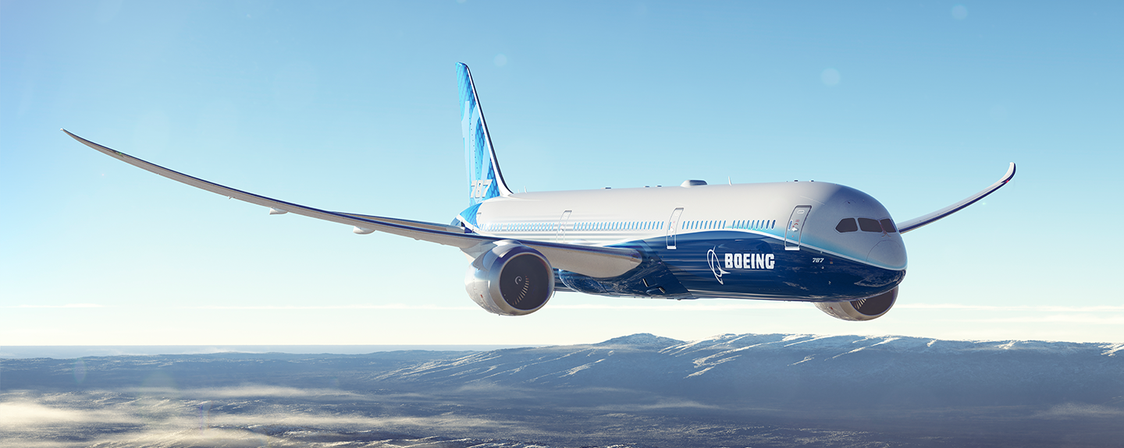
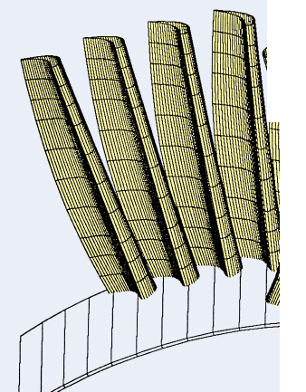
Single Blade Turbine is Useless

Slide 16
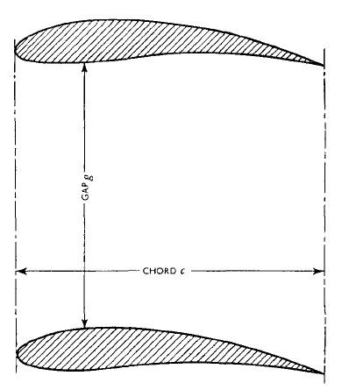
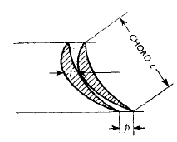
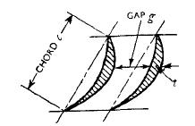
The Gap between Blades
CHORD, C

Slide 17
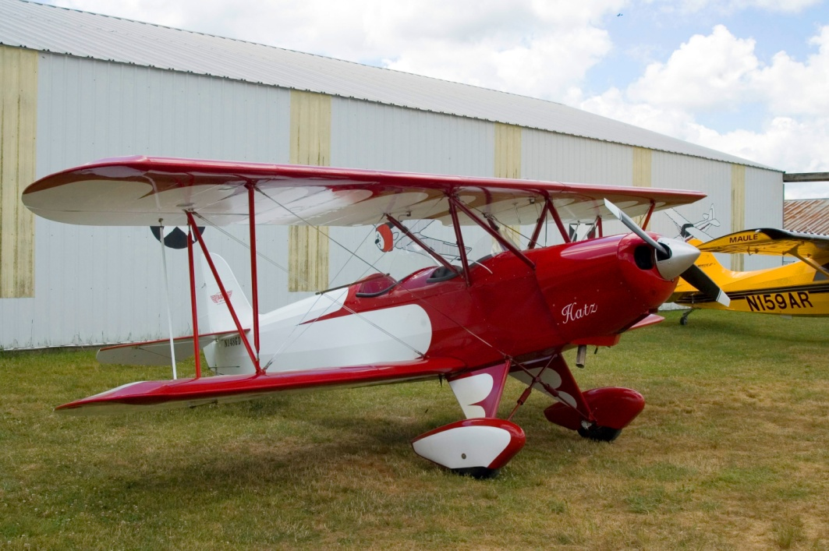
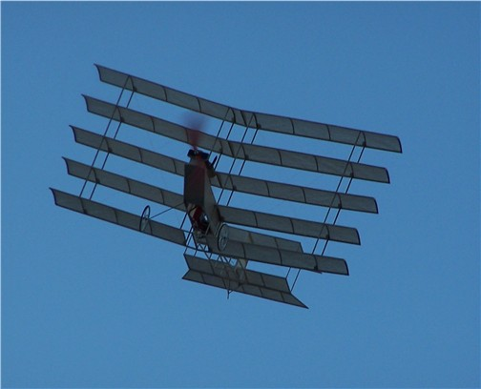
The group of Aerofois
An important point to be examined is whether the crowding together of steam/gas turbine blades has effects similar to those noticed in aeroplane practice.
A biplane is stated to have less lifting effect than a monoplane of the same wing surface.

Slide 18
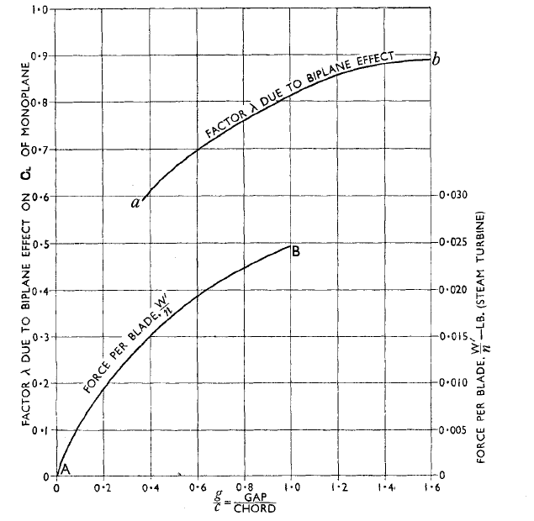
“Biplane Effect” on Lift of Aerofoils

Slide 19
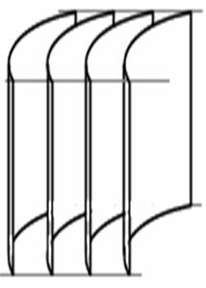
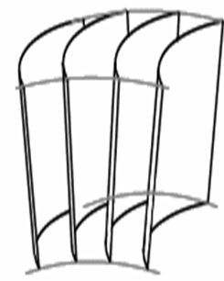
Cascades : A Group of Turbine Blades
The biplane arrangement is analogous to the circumferential pitching of steam/gas turbine blades.
Additional wing surfaces in series (one behind the other), analogous to avoiding of pressure compounding in a turbine.
The reasons for grouping may have some bearing on turbine blading efficiency.
Parallel Cascades
Turbine Cascades

Slide 20
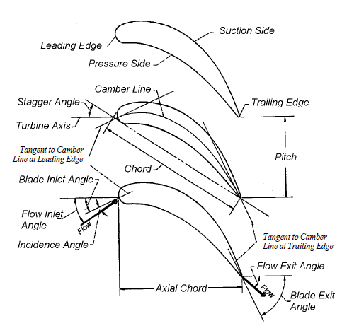
Nomenclature of Turbine Cascades

Slide 21
Solidity: the first Step in Cascade Design
One of the important aspects of cascade design is the selection of the blade solidity.
Defined as the ratio of chord or axial chord to blade spacing.
A minimum allowable value is usually desired from the standpoint of reducing weight, cooling flow, and cost.
An increase in the blade spacing eventually results in decreased blade efficiency due to separated flow.
An optimum solidity cascade should be a fully attached flow with maximum blade spacing.
The gas dynamic factors affecting solidity are
The requirements of velocity diagram
The blade loading

Slide 22
Pressure Distribution on A Single Aerofoil

Slide 23
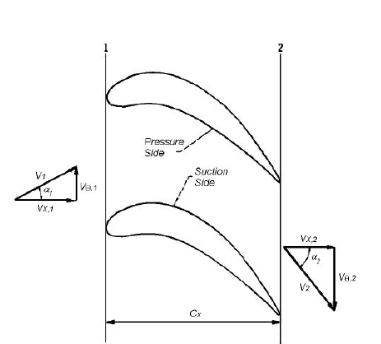
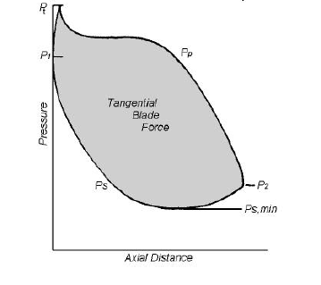
Cascade Velocity Diagrams & Surface Static Pressure Distribution

Slide 24
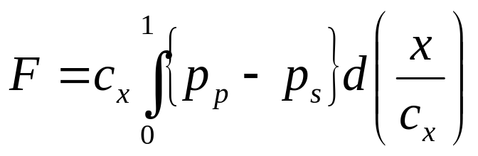
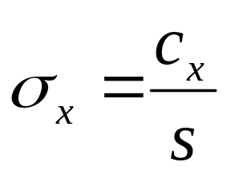
The Cause to be Created
The area between the two curves represents the total blade force acting on the flow in the tangential direction.
Thus,
where c_{x} is axial chord, p_{p} is pressure side static pressure, p_{s} is suction side static pressure.
Define axial solidity σ_{x} as

Slide 25
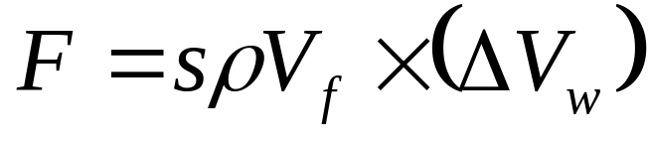
The effect to be Achieved
Considering two-dimensional flow through the cascade of unit height between two blades, then the tangential force F exerted by the fluid as it flows from blade inlet to exit is given as:

Slide 26
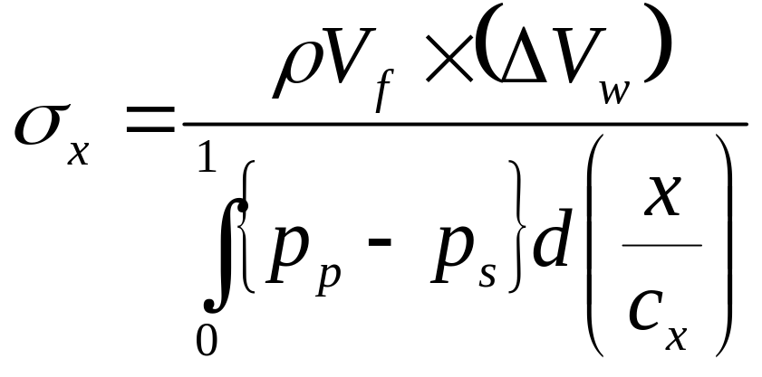
Combined Cause & Effect
Substituting cause equations into effect equation yields

Slide 27
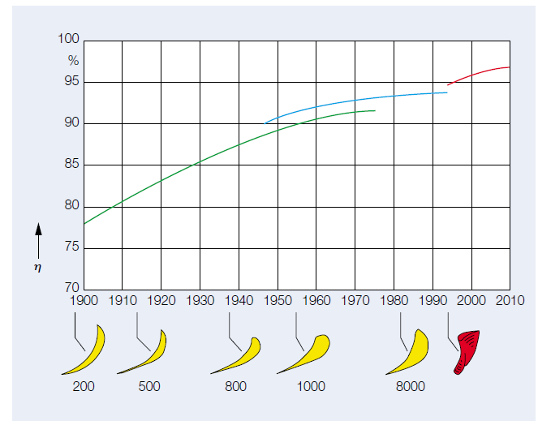
High-performance blade CS : Advanced Aero Design

Slide 28
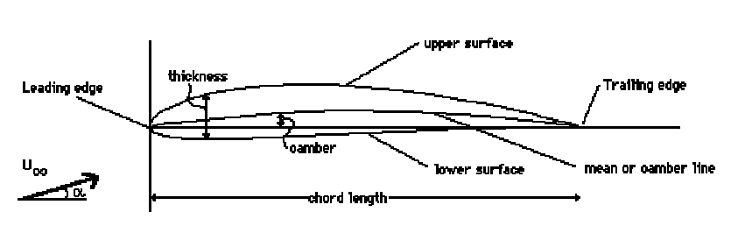
Turbine Blade Cross Section
Airfoil Geometry
Airfoil geometry can be characterized by the coordinates of the upper and lower surface.
It is often summarized by a few parameters such as: maximum thickness, maximum camber, position of max thickness, position of max camber, and nose radius.
One can generate a reasonable airfoil section given these parameters.
This was done by Eastman Jacobs in the early 1930's to create a family of airfoils known as the NACA Sections.

Slide 29
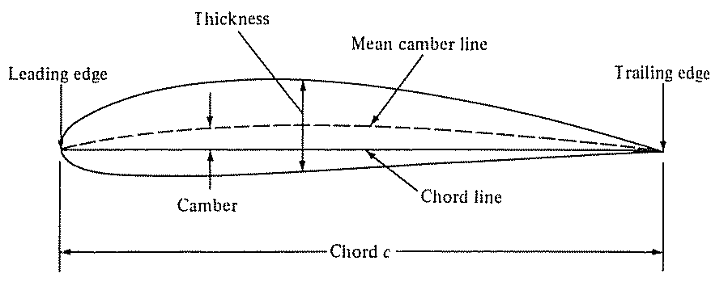
AIRFOIL NOMENCLATURE
Mean Chamber Line: Set of points halfway between upper and lower surfaces
  Measured perpendicular to mean chamber line itself
Leading Edge: Most forward point of mean chamber line
Trailing Edge: Most reward point of mean chamber line
Chord Line: Straight line connecting the leading and trailing edges
Chord, c: Distance along the chord line from leading to trailing edge
Chamber: Maximum distance between mean chamber line and chord line
  Measured perpendicular to chord line

Slide 30
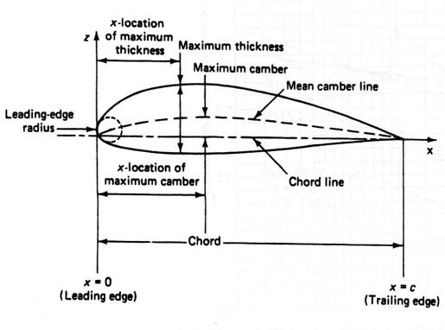
Other Geometric Specifications of An Aerofoil

Slide 31
NACA Airfoil Series
NACA (National Advisory Committee for Aeronautics) or
NASA (National Aeronautics and Space administration)
Identified different airfoil shapes with a logical numbering system.
Before NACA series, airfoil design was rather arbitrary with nothing to guide designer’s except experience with known shapes and experimentation with modified shapes
1- NACA 4-digit series
2- NACA 5-digit series
3- NACA 1-series or 16-series
4- NACA 6- series
5- NACA 7- series
6- NACA 8- series

Slide 32
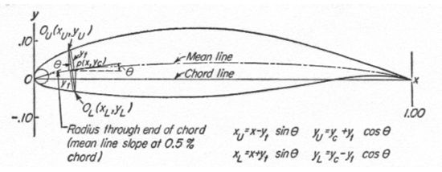
NACA Airfoil Naming Convention
NACA (National Advisory Committee for Aeronautics) precursor to NASA
Early NACA series, 4-, 5-, modified 4-/5-digit generated with analytical equations
Later families, including 6-Series, are more complicated shapes derived using theoretical rather than geometrical methods

Slide 33
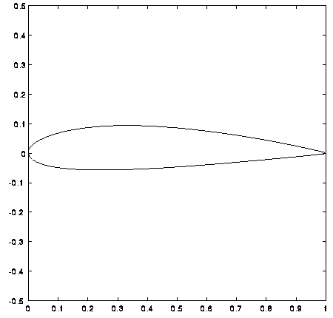
NACA Four-digit Series
First digit specifies maximum camber in percentage of chord
Second digit indicates position of maximum camber in tenths of chord
Last two digits provide maximum thickness of airfoil in percentage of chord
Example: NACA 2415
Airfoil has maximum thickness of 15%
of chord (0.15c)
Camber of 2% (0.02c) located 40%
back from airfoil leading edge (0.4c)
NACA 2415

Slide 34
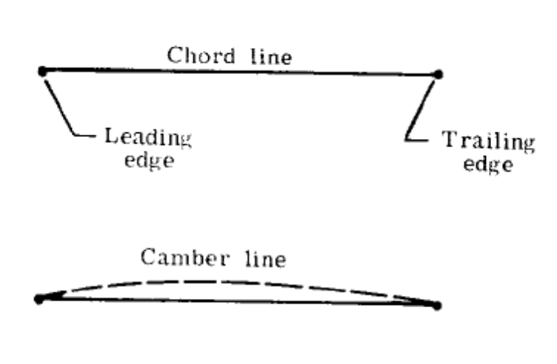
Example: NACA 2412
NACA 2 4 12
Maximum thickness (t ) in percentage of chord (t/c)_{max} = 0.12
Camber in percentage of chord
y_{c} = 0.02 C
Position of camber in tenths of chord x_{c} = 0.4 C
x_{c}
y_{c}
c

Slide 35

NACA 5-Digit Series
After the 4-digit sections came the 5-digit sections such as the famous NACA 23012.

Slide 36

Camber line Equations for NACA Aerofoils
The NACA 4 digit and 5 digit airfoils were created by superimposing a simple meanline shape with a thickness distribution.
The camber line of 4-digit sections was defined as a parabola from the leading edge to the position of maximum camber, then another parabola back to the trailing edge.
NACA 5 digit airfoils use a camberline with more curvature near the nose.
A cubic was faired into a straight line for the 5-digit sections

Slide 37



Thickness Distribution of NACA Airfoils
The NACA 4 digit and 5 digit airfoils were created by superimposing a simple meanline shape with a thickness distribution that was obtained by fitting a couple of popular airfoils of the time:

Slide 38

NACA 6-Digit Series
The 6-series of NACA airfoils departed from this simply-defined family.
These sections were generated from a more or less prescribed pressure distribution and were meant to achieve some laminar flow.

