Slide 1

Structure of Large Steam Turbines
P M V Subbarao
Professor
Mechanical Engineering Department
More Rules for Development of Power Plant Turbines!!

Slide 2


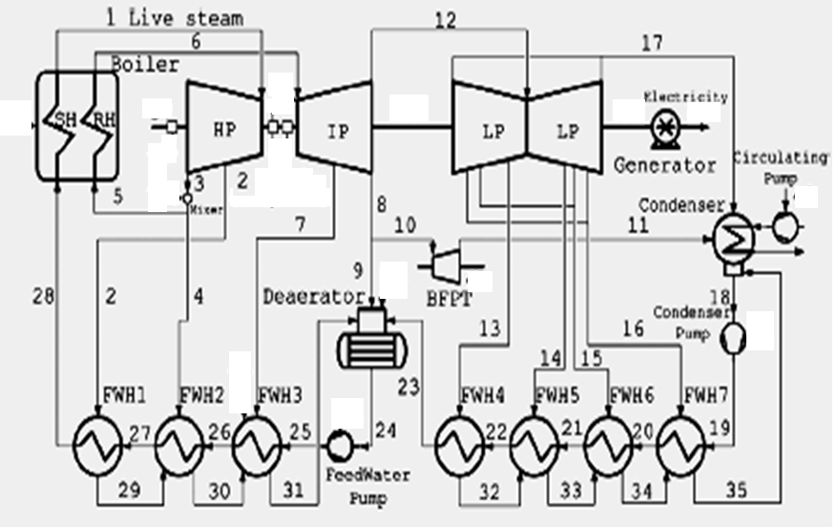
Structure of Modern Rankine Cycle Power Plant

Slide 3
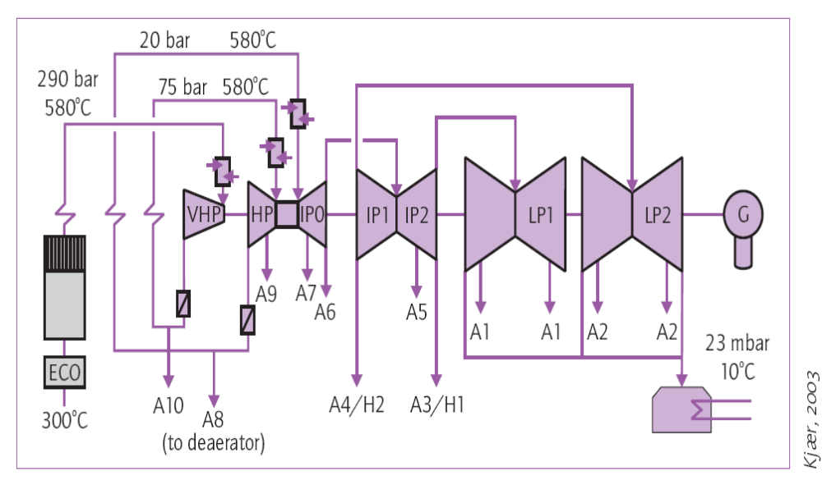
Super Critical Cycle of Nordjyl land NO.3 Unit in Denmark
T₅=580°C
p₅=2.0MPa
h₅=3645kJ/kg
s₄=7.65 kJ/kg.K
T₁=580°C
p₁=29.0MPa
h₁=3389 kJ/kg
s₁=6.183 kJ/kg.K
T_{6”}=19.7°C
p_{6”}=2.3kPa
h_{6”}=1808kJ/kg
s_{6”}=6.183 kJ/kg.K
X_{6”}=70.3%
T₃=580°C
p₂=7.5MPa
h₂=3598kJ/kg
s₂=6.998 kJ/kg.K
T₂=350.8°C
p₂=7.5MPa
h₂=3005kJ/kg
s₂=6.183 kJ/kg.K
T₄=361.9°C
p₄=2.0MPa
h₄=3163kJ/kg
s₄=6.998 kJ/kg.K
T_{6’}=19.7°C
p_{6’}=2.3kPa
h_{6’}=2047kJ/kg
s_{6’}=6.998 kJ/kg.K
x_{6’}=80.01%
T₇=19.7°C
p₇=2.3kPa
h₇=82.8kJ/kg
s₇=0.2927 kJ/kg.K

Slide 4
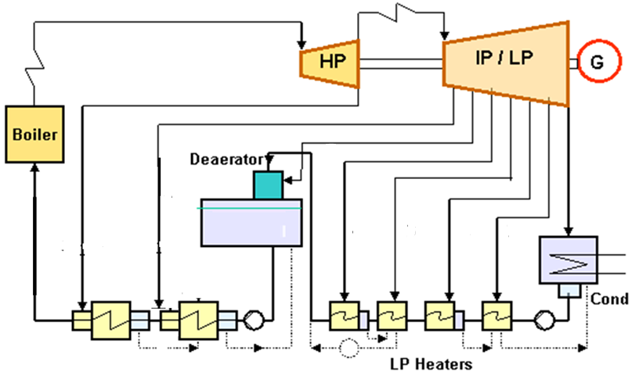
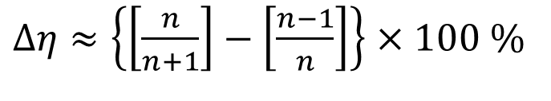
Basic Idea to Raise Final Feed Water Temperature
Approximate increase in cycle efficiency due to addition of n^{th} FWH
$Δη≈\left\{\left[\frac{n}{n+1}\right]−\left[\frac{n−1}{n}\right]\right\}$ $×100 \%$

Slide 5
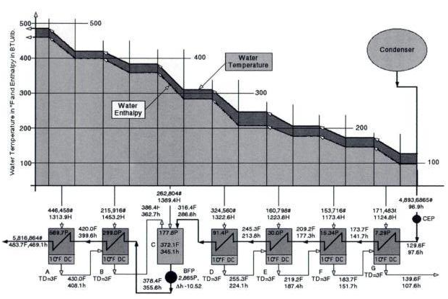
Train of Shell & Tube HXs.

Slide 6
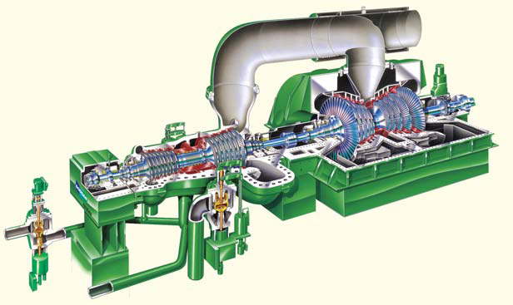
Typical ~ 500 MW Designs

Slide 7
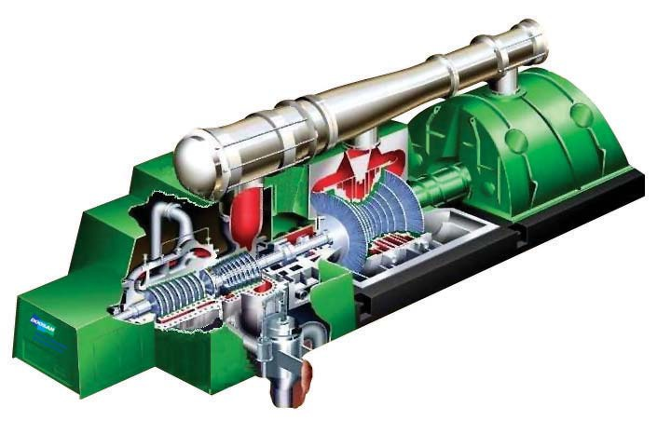
Typical ~ 800 MW Designs

Slide 8
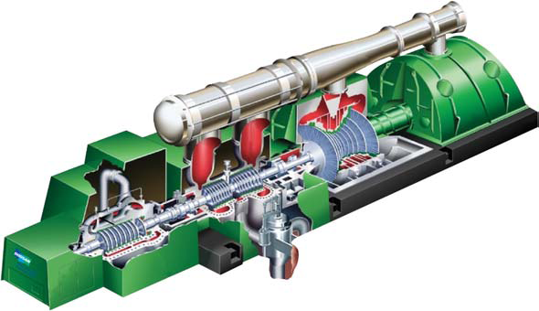
~ 1000 MW Designs

Slide 9
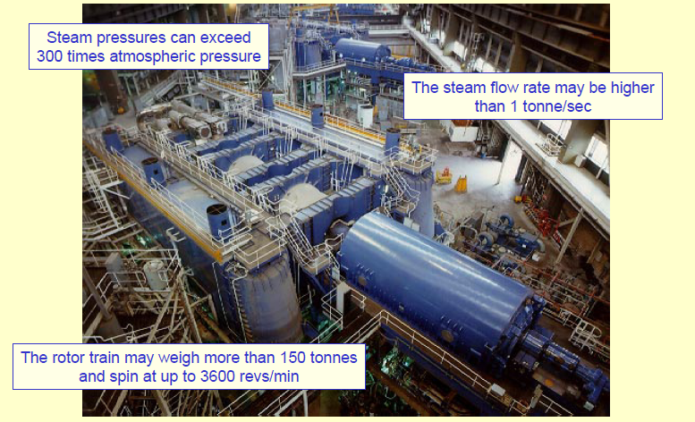
Some Facts about Advanced Steam Turbines

Slide 10
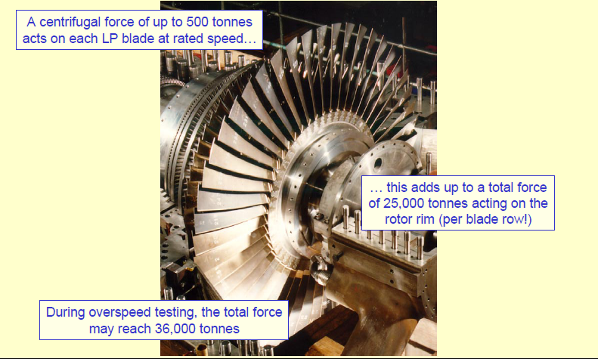
Increased Magnitudes of Forces

Slide 11
Steam Volume Variation HP Range
Specific volume, m³/kg
Steam Path, Mpa

Slide 12
Steam Volume Variation IP Range
Specific volume, m³/kg
Steam Path, Mpa

Slide 13

Steam Volume Variation LP Range
Specific volume, m³/kg
Steam Path, Mpa

Slide 14
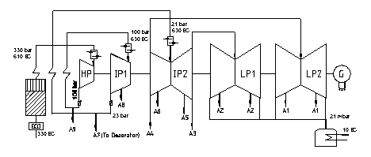
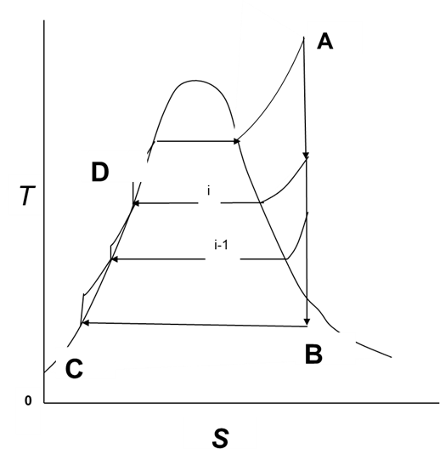
Bleeding for FWHs : A win-win Idea

Slide 15
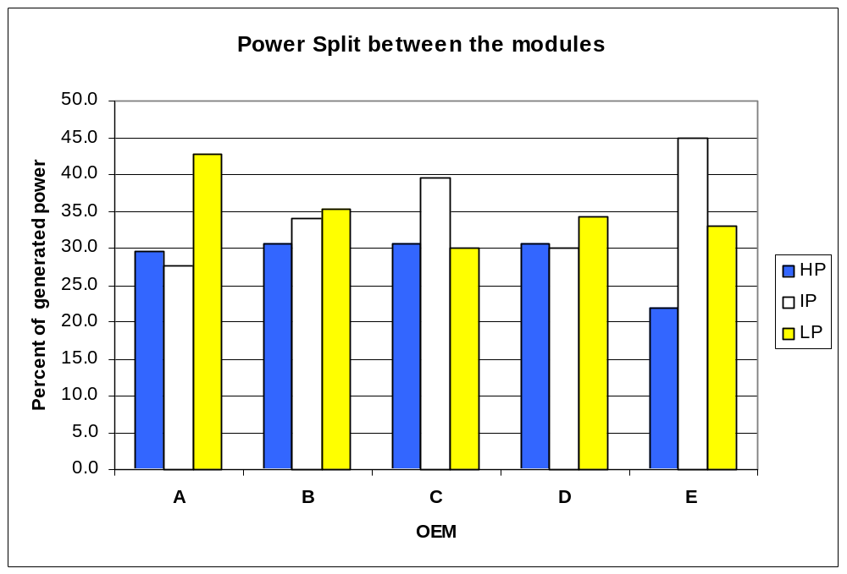

Slide 16
Mechanical Arrangements of Steam Turbines
More solutions to Turbo-machinery Issues.
Tandem Reheat Steam Turbine
Cross Compound Steam Turbine

Slide 17
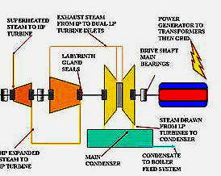
Tandem Reheat Steam Turbine

Slide 18
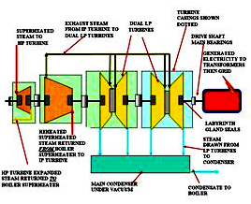
Tandem-compound four-flow steam turbine

Slide 19
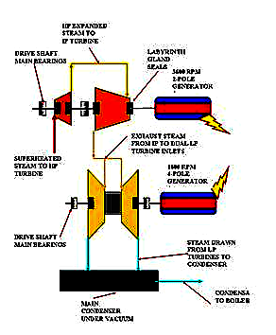
Cross Compound Reheat Steam Turbine

Slide 20
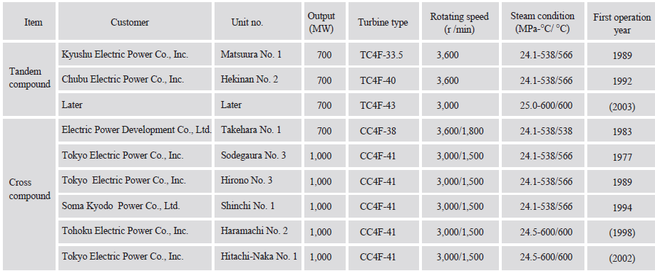
Large-Capacity Steam Turbines Thermal Power Plant

Slide 21
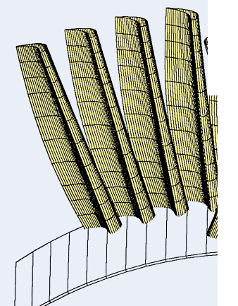
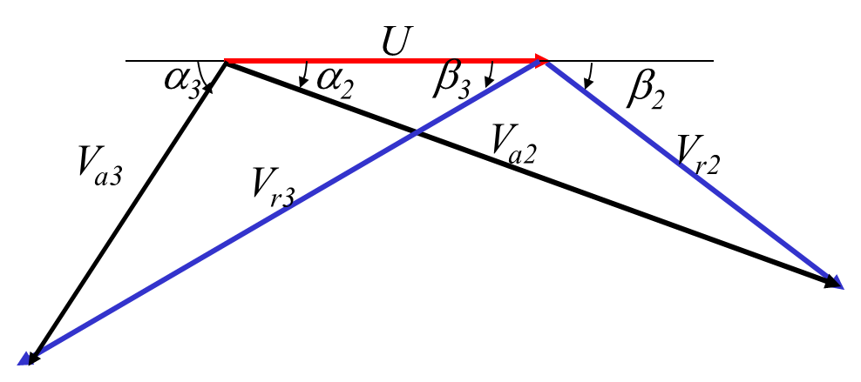
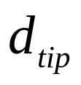
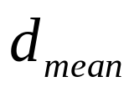
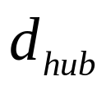
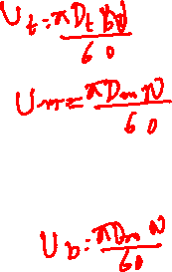
Variation of Flow along the Blade Height : from Hub to Tip
Validity/consequence of the Meridional Plane Analysis???
No Impact of Radial variation of Blade velocity???

Slide 22
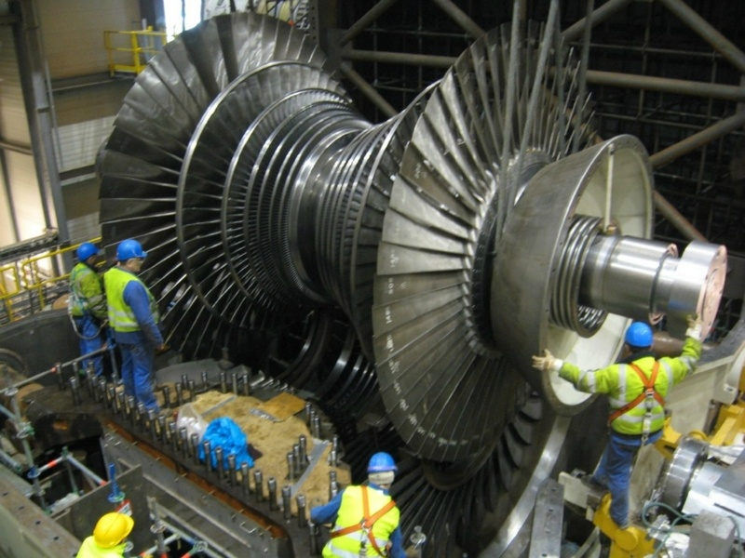
Radial Direction of an Axial Flow Turbo-Machines
The third direction in an axial flow machine is the radial direction.
The direction of Centrifugal forces!
Strong centrifugal forces are exerted on blades & fluid in radial direction.
The centrifugal force field distorts the flow velocity profiles considerably, if there is a possibility.
Fluid particles (if there is a possibility) will tend to get accelerated outwards blade tip rather than passing along cylindrical stream surfaces as classically assumed.

Slide 23
Radial Direction of an Axial Flow Turbo-Machines
Possibility is very high in the stages with tall blades.
An approach known as the radial equilibrium method, is widely used for three-dimensional design calculations in an axial flow machine.

Slide 24
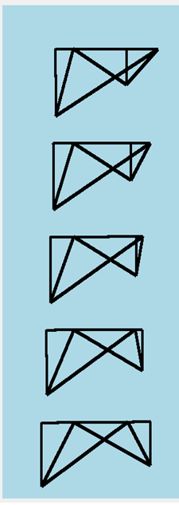
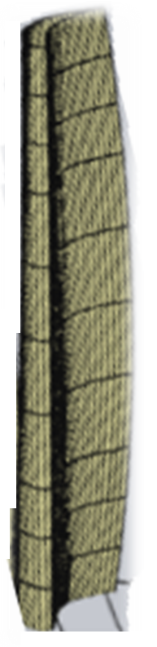
Radial Variation of Velocity Triangles

Slide 25
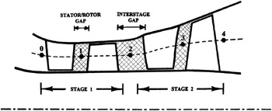

Flow Through Stator, Rotor and More

Slide 26
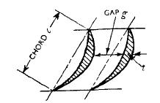
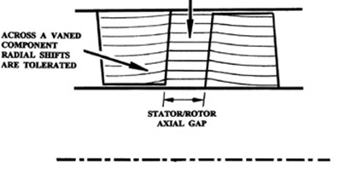
Flow in Stator-Rotor Inter stage Gaps

Slide 27
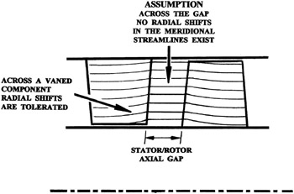
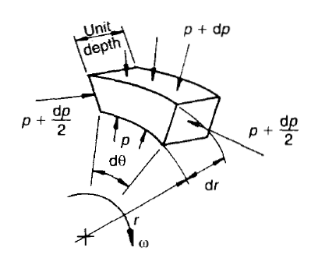

Radial Equilibrium Theory
This theory aims to achieve radial equilibrium od the working fluid before and after a rotor blade row.
Radial movement will disturb the loading on the moving blade passage.
More significant for large Axial Flow Machines.
The fluid parcels in the gaps before and after must remain in radial equilibrium.

Slide 28
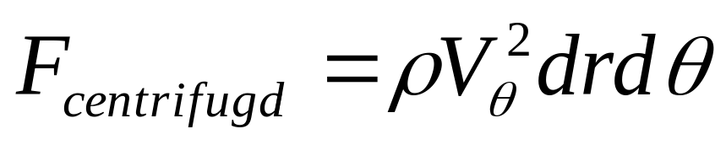
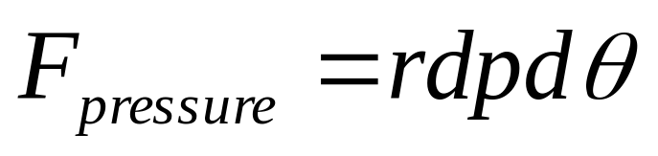
Radial Equilibrium Analysis of an infinitesimal Fluid Parcel Rotor-Stator Gap
The centrifugal force = (ρrdrdθ)ω²r
V_{θ}= rω
The centrifugal force is
The pressure force on the element

Slide 29
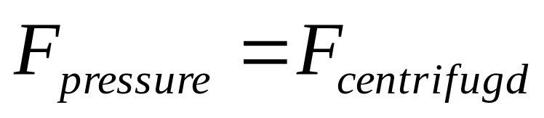
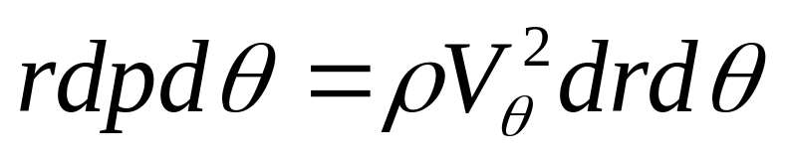
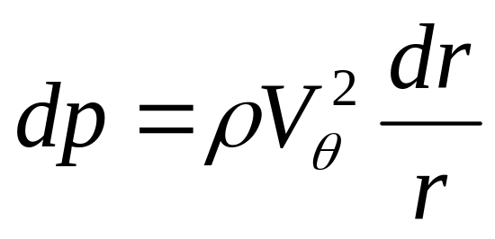
Radial Equilibrium Analysis
If the two forces are the only ones acting (viscous and other effects neglected), the particle will move at constant radius if:

Slide 30
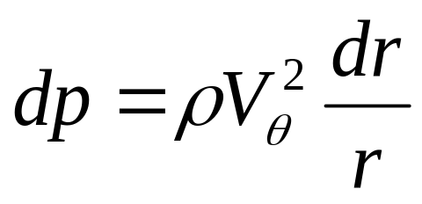
Equilibrium Pressure Field for A Rotating Fluid
Fluid particles entering or leaving a rotor blade must adjust their pressure field as per the law of radial equilibrium.
The fluid must be subjected to a thermodynamic process to achieve this equilibrium.
However, total enthalpy of the fluid will remain constant as there is no work transfer in this process.
This thermodynamic process is defined as :
Isentropic constant total enthalpy pressure adjustment process.

Slide 31
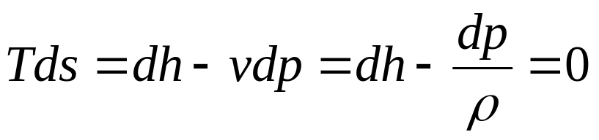
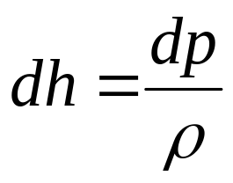
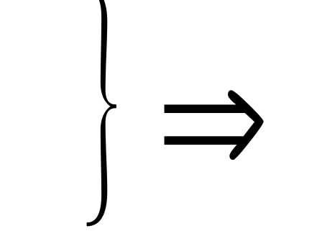
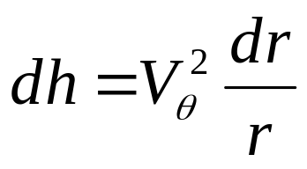
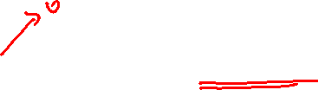
Isentropic Process to Reach Radial Equilibrium
The radial variation of whirl velocity should be according to above equation.
Total enthalpy is conserved during this process!!

Slide 32
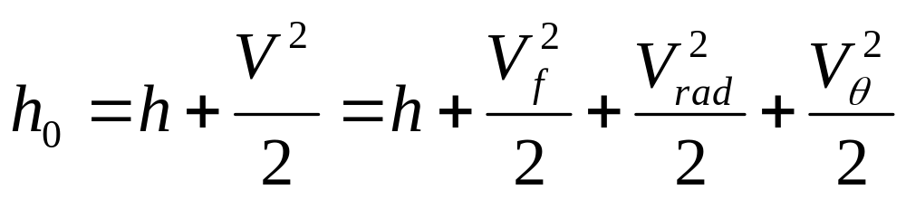
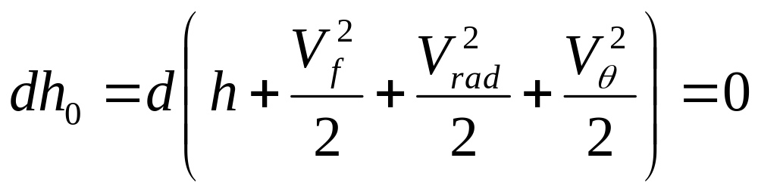
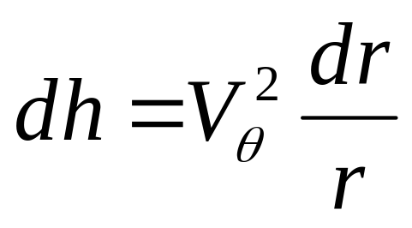
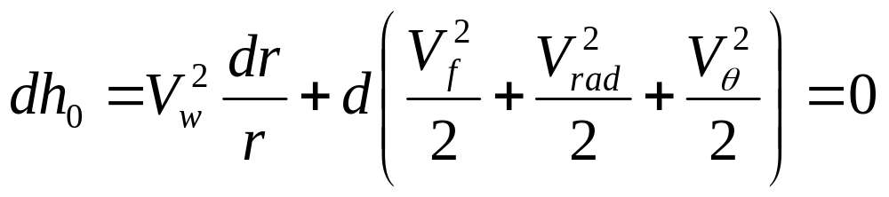
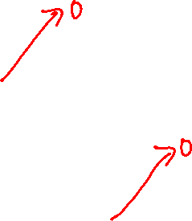
Conservation of Total Enthalpy Along Radial Direction
Stagnation enthalpy should conserve along radial direction, as there are not interactions with rotor at inlet or exit of rotor.

Slide 33

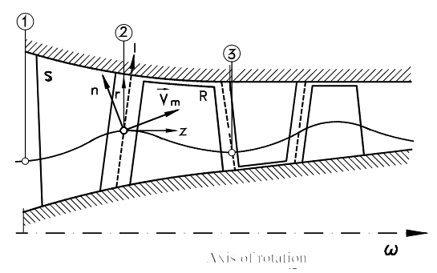

ODE for the Radial Equilibrium of Fluid Parcels

Slide 34
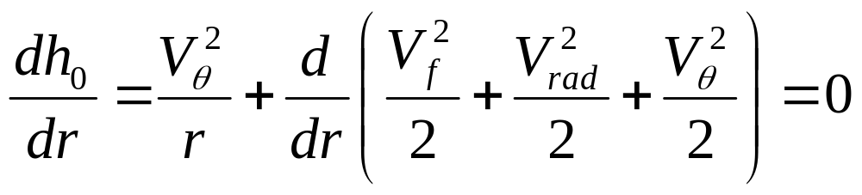
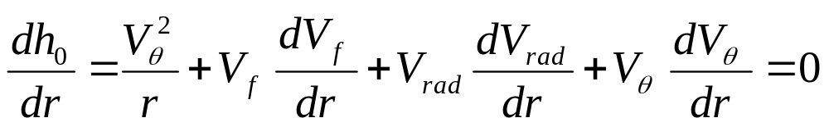


ODE Governing the Radial Equilibrium
Radial equilibrium demands that radial component of velocity must be zero.

Slide 35



Condition for Radial Equilibrium of Fluid Parcels

