Slide 1

Isentropic Analysis of Large Steam Turbines
P M V Subbarao
Professor
Mechanical Engineering Department
Rules for Development of Industrial Turbines!!

Slide 2


Progress in Steam Rankine Cycle
Year | 1907 | 1919 | 1938 | 1950 | 1958 | 1959 | 1966 | 1973 | 1975
MW | 5 | 20 | 30 | 60 | 120 | 200 | 500 | 660 | 1300
p,MPa | 1.3 | 1.4 | 4.1 | 6.2 | 10.3 | 16.2 | 15.9 | 15.9 | 24.1
T_{h} ºC | 260 | 316 | 454 | 482 | 538 | 566 | 566 | 565 | 538
T_{r} ºC | -- | -- | -- | -- | 538 | 538 | 566 | 565 | 538
FHW | -- | 2 | 3 | 4 | 6 | 6 | 7 | 8 | 8
Pc,kPa | 13.5 | 5.1 | 4.5 | 3.4 | 3.7 | 3.7 | 4.4 | 5.4 | 5.1
η,% | -- | ~17 | 27.6 | 30.5 | 35.6 | 37.5 | 39.8 | 39.5 | 40

Slide 3
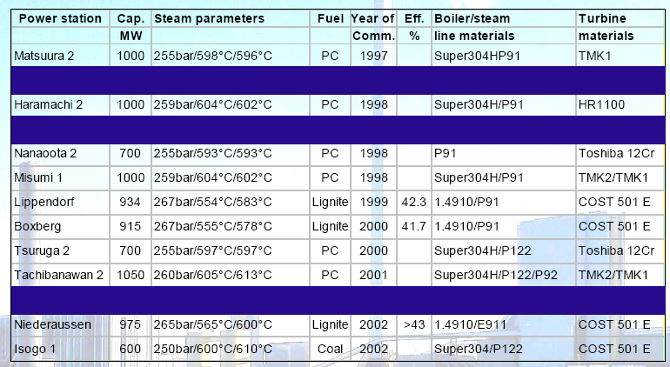
Ultra Supercritical Installations of The World

Slide 4
General Rules for Design of A Large Impulse-Reaction turbine
  The height of the blade must be viable.
  The height of blade must vary at a uniform rate, thus contributing to more economic designs.
  As a result of enthalpy drop occurring in the moving blades, there is a considerable amount of pressure is exerted on the rotor.
  This is transmitted to thrust bearing.
To avoid large axial thrust it is usual to allow:
Low degree of reaction in high pressure stages.
In large steam turbines (>300 MW), it is now usual to allow 60 – 70% of degree of reaction in low pressure stages.

Slide 5


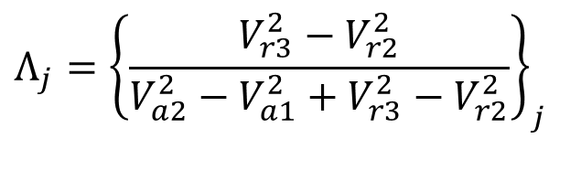

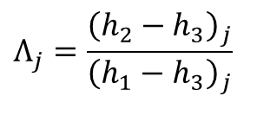

First Law Analysis of an i^{th} Isentropic Reaction Stage
$$Λ_{j}=\frac{{\left(h_{2}−h_{3}\right)}_{j}}{{\left(h_{1}−h_{3}\right)}_{j}}$$
$$Λ_{j}={\left\{\frac{V_{r3}^{2}−V_{r2}^{2}}{V_{a2}^{2}−V_{a1}^{2}+V_{r3}^{2}−V_{r2}^{2}}\right\}}_{j}$$
1
2
3
$$V_{a1,j}=V_{a3,j−1} For any Λ$$
$$V_{a3,j}≠V_{a3,j−1} For any Λ$$
$$V_{a3,j}≠V_{a1,j} For any Λ$$

Slide 6
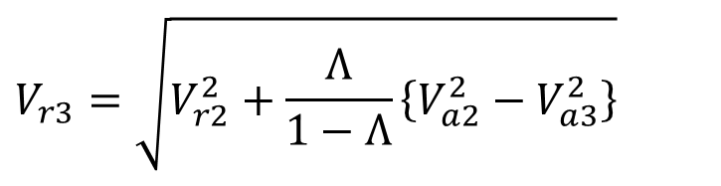
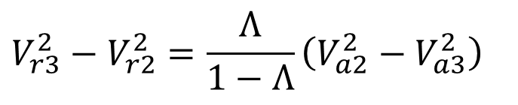
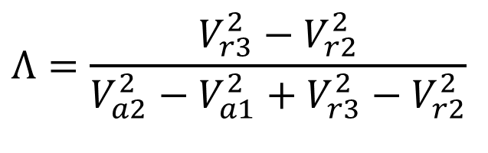
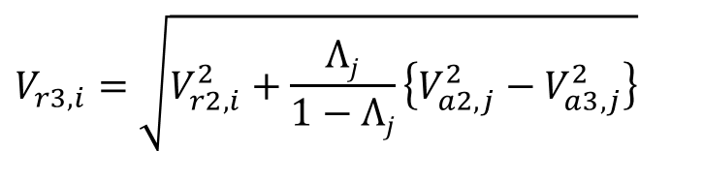
Exit Relative Velocity of Steam
$$Λ=\frac{V_{r3}^{2}−V_{r2}^{2}}{V_{a2}^{2}−V_{a1}^{2}+V_{r3}^{2}−V_{r2}^{2}}$$
$$V_{r3}^{2}−V_{r2}^{2}=Λ\left\{V_{a2}^{2}−V_{a1}^{2}+V_{r3}^{2}−V_{r2}^{2}\right\}$$
$$V_{r3}^{2}\left(1−Λ\right)=Λ\left(V_{a2}^{2}−V_{a1}^{2}\right)+V_{r2}^{2}\left(1−Λ\right)$$
$$V_{r3}^{2}−V_{r2}^{2}=\frac{Λ}{1−Λ}\left(V_{a2}^{2}−V_{a3}^{2}\right)$$
$$V_{r3}=\sqrt{V_{r2}^{2}+\frac{Λ}{1−Λ}\left\{V_{a2}^{2}−V_{a3}^{2}\right\}}$$
$$V_{r3,i}=\sqrt{V_{r2,i}^{2}+\frac{Λj}{1−Λj}\left\{V_{a2,j}^{2}−V_{a3,j}^{2}\right\}}$$
∴for any j^{th} Stage

Slide 7
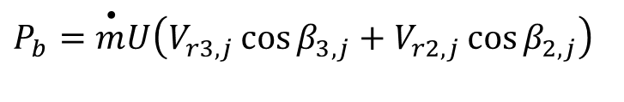
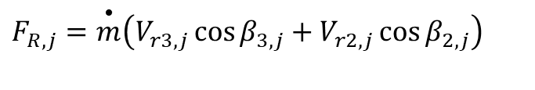

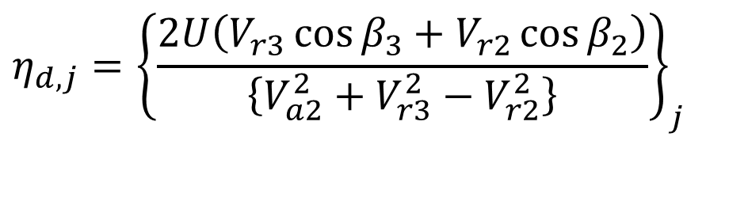
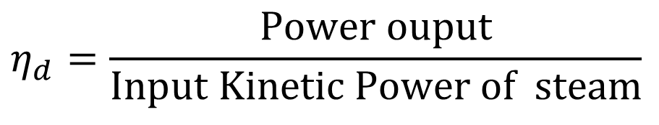
Performance of An i^{th} Isentropic Reaction Stage
The driving force on wheel
$$F_{R,j}=\overset{•}{m}\left(V_{r3,j}\cos{β_{3,j}}+V_{r2,j}\cos{β_{2,j}}\right)$$
$$P_{b}=\overset{•}{m}U\left(V_{r3,j}\cos{β_{3,j}}+V_{r2,j}\cos{β_{2,j}}\right)$$
Power Output of the blade :
Diagram Efficiency or Blade efficiency:
$$η_{d}=\frac{\text{Power} \text{ouput}}{\text{Input} \text{Kinetic} \text{Power} \text{of} \text{steam}}$$
$$η_{d,j}={\left\{\frac{2U\left(V_{r3}\cos{β_{3}}+V_{r2}\cos{β_{2}}\right)}{\left\{V_{a2}^{2}+V_{r3}^{2}−V_{r2}^{2}\right\}}\right\}}_{j}$$

Slide 8
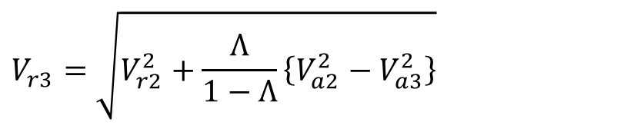
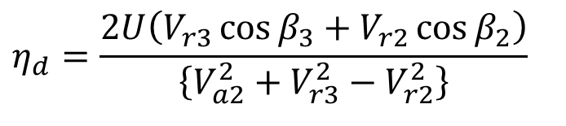
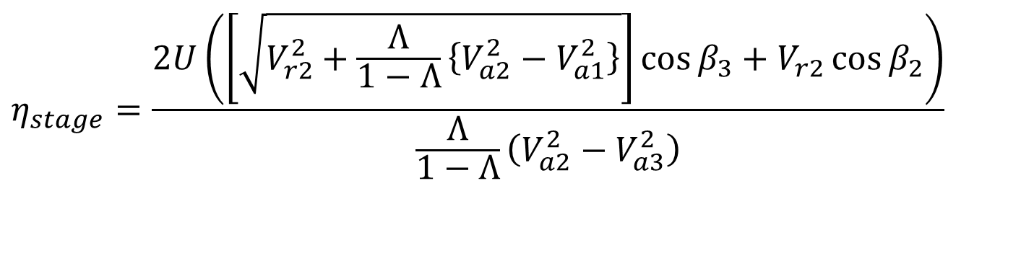
Performance of An i^{th} Isentropic Reaction Stage with DoR, Λ
$$η_{d}=\frac{2U\left(V_{r3}\cos{β_{3}}+V_{r2}\cos{β_{2}}\right)}{\left\{V_{a2}^{2}+V_{r3}^{2}−V_{r2}^{2}\right\}}$$
$$V_{r3}=\sqrt{V_{r2}^{2}+\frac{Λ}{1−Λ}\left\{V_{a2}^{2}−V_{a3}^{2}\right\}}$$
$$η_{stage}=\frac{2U\left(\left[\sqrt{V_{r2}^{2}+\frac{Λ}{1−Λ}\left\{V_{a2}^{2}−V_{a1}^{2}\right\}}\right]\cos{β_{3}}+V_{r2}\cos{β_{2}}\right)}{\frac{Λ}{1−Λ}\left(V_{a2}^{2}−V_{a3}^{2}\right)}$$

Slide 9
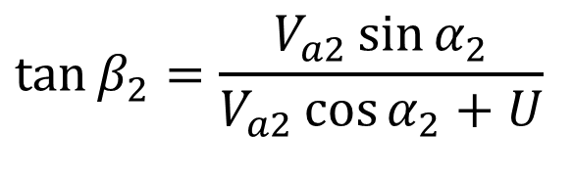
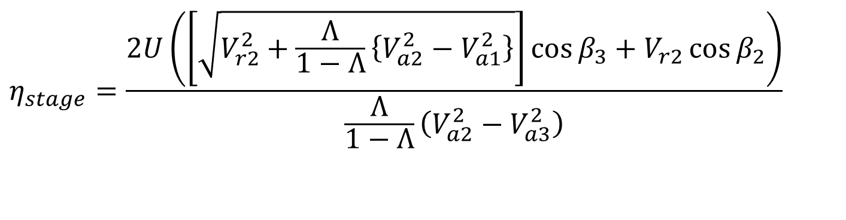
Development of A Non-dimensional Model
: An i^{th} Isentropic Reaction Stage with DoR, Λ
$$η_{stage}=\frac{2U\left(\left[\sqrt{V_{r2}^{2}+\frac{Λ}{1−Λ}\left\{V_{a2}^{2}−V_{a1}^{2}\right\}}\right]\cos{β_{3}}+V_{r2}\cos{β_{2}}\right)}{\frac{Λ}{1−Λ}\left(V_{a2}^{2}−V_{a3}^{2}\right)}$$
$$\tan{β_{2}}=\frac{V_{a2}\sin{α_{2}}}{V_{a2}\cos{α_{2}}+U}$$
U
α₃
α₂
β₃
β₂
V_{a2}
V_{r2}
V_{a3}
V_{r3}

Slide 10
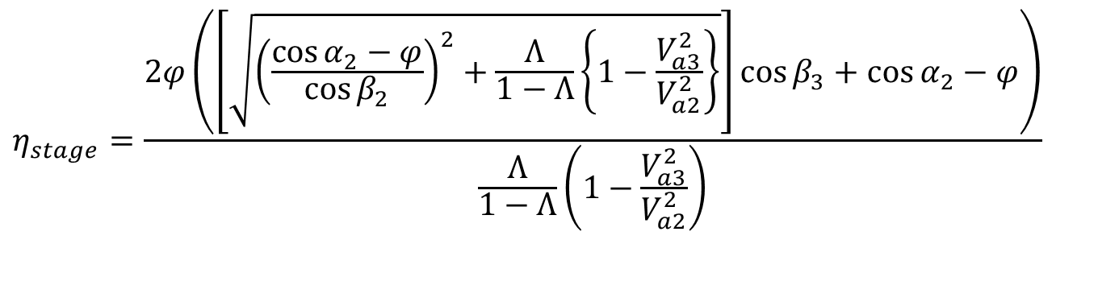
Optimal Design of An isentropic Stage with DoR, Λ
For a given shape of the blade, the efficiency is a strong function of φ =U/V_{a2}.
$$η_{stage}=\frac{2φ\left(\left[\sqrt{{\left(\frac{\cos{α_{2}}−φ}{\cos{β_{2}}}\right)}^{2}+\frac{Λ}{1−Λ}\left\{1−\frac{V_{a3}^{2}}{V_{a2}^{2}}\right\}}\right]\cos{β_{3}}+\cos{α_{2}}−φ\right)}{\frac{Λ}{1−Λ}\left(1−\frac{V_{a3}^{2}}{V_{a2}^{2}}\right)}$$

Slide 11
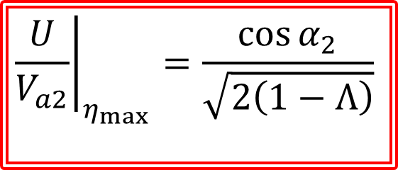
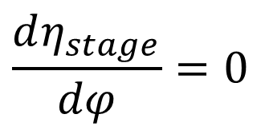
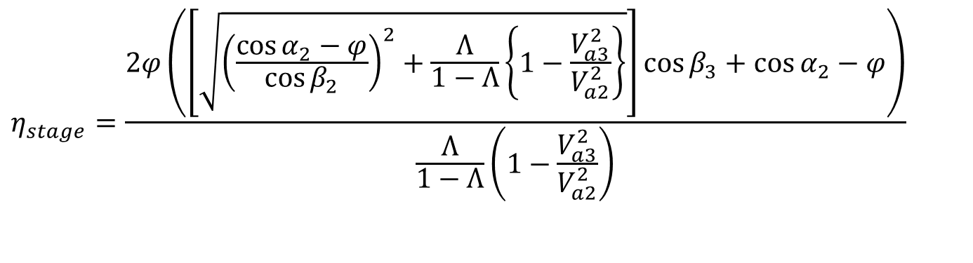
Optimal Design of An isentropic Stage with DoR, Λ
$$η_{stage}=\frac{2φ\left(\left[\sqrt{{\left(\frac{\cos{α_{2}}−φ}{\cos{β_{2}}}\right)}^{2}+\frac{Λ}{1−Λ}\left\{1−\frac{V_{a3}^{2}}{V_{a2}^{2}}\right\}}\right]\cos{β_{3}}+\cos{α_{2}}−φ\right)}{\frac{Λ}{1−Λ}\left(1−\frac{V_{a3}^{2}}{V_{a2}^{2}}\right)}$$
For a given shape of the blade, the efficiency is a strong function of φ =U/V_{a2}.
$$\frac{dη_{stage}}{dφ}=0$$
For maximum efficiency:
$${\left.\frac{U}{V_{a2}}\right|}_{η_{max}}=\frac{\cos{α_{2}}}{\sqrt{2\left(1−Λ\right)}}$$

Slide 12
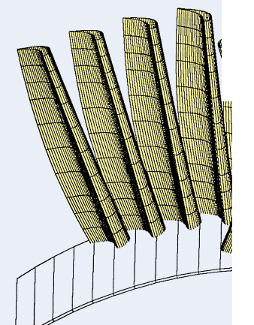
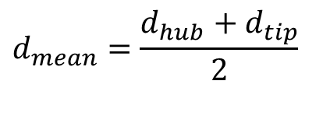


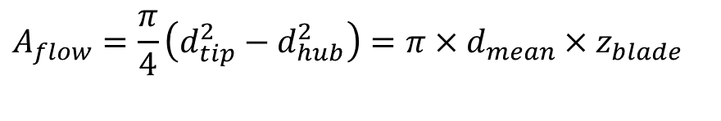


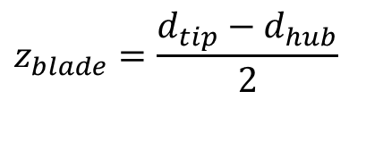
Geometrical Details of A Rotor
Mean Diameter of A Rotor:
$$d_{mean}=\frac{d_{hub}+d_{tip}}{2}$$
Blade Height
$$z_{blade}=\frac{d_{tip}−d_{hub}}{2}$$
$$∴d_{mean}=d_{hub}+z_{blade}=d_{tip}−z_{blade}$$
$$d_{tip}$$
Area Available for steam/gas flow
$$d_{mean}$$
$$A_{flow}=\frac{π}{4}\left(d_{tip}^{2}−d_{hub}^{2}\right)=π×d_{mean}×z_{blade}$$
$$d_{hub}$$

Slide 13
Multistage Expansion of Steam
Temp | Pressure | Specific Volume | Specific Enthalpy | Specific Entropy
C | MPa | m3/kg | kJ/kg | kJ/kg/K
575 | 25 | 0.01345 | 3415 | 6.271
554.9 | 22.5 | 0.01458 | 3380 | 6.271
532.9 | 20 | 0.01597 | 3342 | 6.271
508.5 | 17.5 | 0.0177 | 3300 | 6.271
481.1 | 15 | 0.01995 | 3253 | 6.271
449.9 | 12.5 | 0.02298 | 3200 | 6.271
413.4 | 10 | 0.02735 | 3137 | 6.271
369.2 | 7.5 | 0.03424 | 3061 | 6.271
311.8 | 5 | 0.04699 | 2961 | 6.271
226.2 | 2.5 | 0.08061 | 2810 | 6.271
179.9 | 1 | 0.1808 | 2635 | 6.271
151.9 | 0.5 | 0.3335 | 2515 | 6.271
143.6 | 0.4 | 0.4062 | 2478 | 6.271
133.5 | 0.3 | 0.5239 | 2432 | 6.271
120.2 | 0.2 | 0.7505 | 2370 | 6.271
99.62 | 0.1 | 1.39 | 2270 | 6.271
81.33 | 0.05 | 2.582 | 2177 | 6.271
75.87 | 0.04 | 3.153 | 2149 | 6.271
69.1 | 0.03 | 4.082 | 2113 | 6.271
60.06 | 0.02 | 5.88 | 2064 | 6.271
45.81 | 0.01 | 11 | 1985 | 6.271

Slide 14
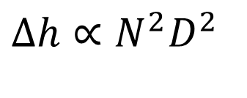

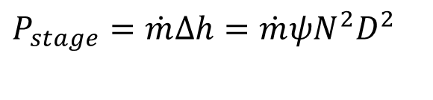



Large Power Plants : Selection of Speed
Swallowing Capacity :
$$\dot{Q}=\dot{m}v$$
$$\dot{Q}∝ND^{3}$$
$$∆h∝N^{2}D^{2}$$
Loading Capacity :
$$∆h=ψU^{2}$$
Power Capacity :
$$P∝ρN^{3}D^{5}$$
$$P_{stage}=\dot{m}∆h=\dot{m}ψN^{2}D^{2}$$

Slide 15

Variation of Diameter along a stages
Diameter
d
Stage 1
Stages
Stage Z

