Slide 1

Isentropic Analysis Multi-Stage Impulse Turbines
P M V Subbarao
Professor
Mechanical Engineering Department
Rules for Development of Industrial Turbines!!

Slide 2


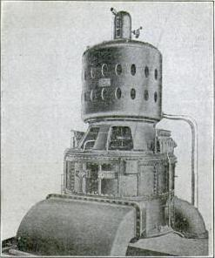
The most powerful steam turbine-generator in the world at the time of its construction:1903
Built in 1903, the 5,000-kilowatt Curtis steam turbine-generator was the most powerful in the world.
It stood just 25 feet high, much shorter than the 60 feet reciprocating engine-generator of a similar capacity

Slide 3
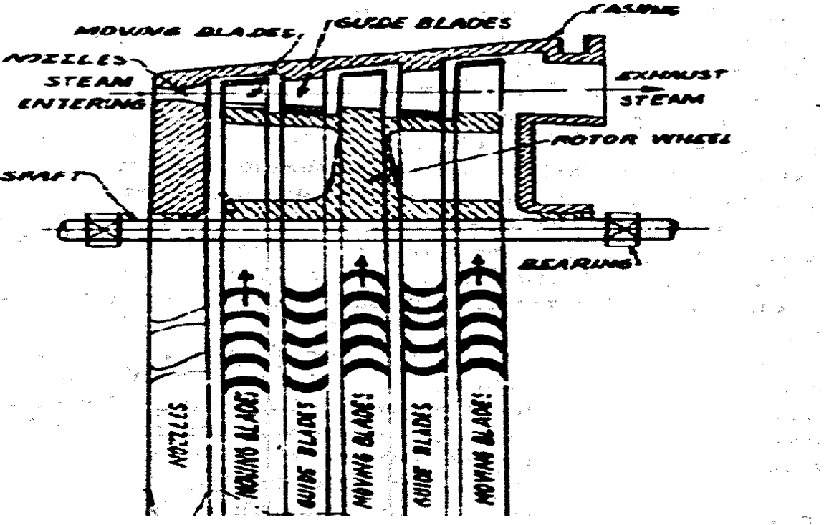
The Curtis Design
V_{a}
p,h.T &ρ

Slide 4
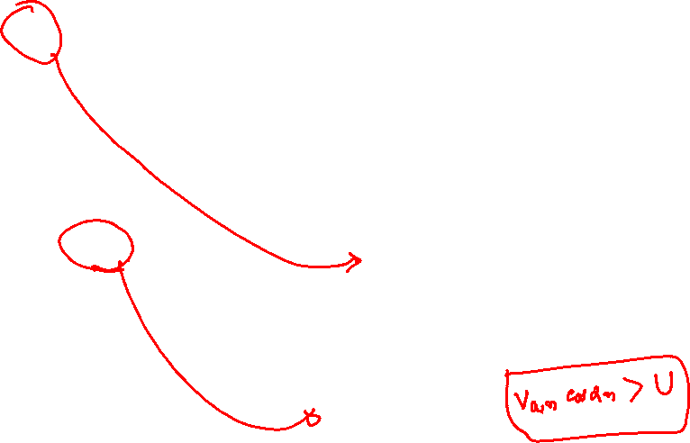
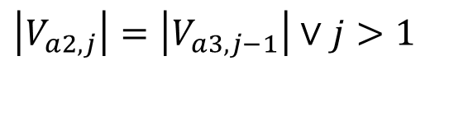
A System of Velocity Triangles for Curtis Turbine
U
α_{3,1}
α_{2,1}
β_{3,1}
β_{2,1}
V_{a3,1}
V_{a2,1}
V_{r2,1}
V_{r3,1}
U
α_{3,2}
α_{2,2}
β_{3,2}
β_{2,2}
V_{a3,2}
V_{a2,2}
V_{r2,2}
V_{r3,2}
$$\left|V_{a2,j}\right|=\left|V_{a3,j−1}\right|∨j>1$$
U
α_{3,3}
α_{2,3}
β_{3,3}
β_{2,3}
V_{a3,3}
V_{r3,3}
V_{a2,3}
V_{r2,3}

Slide 5

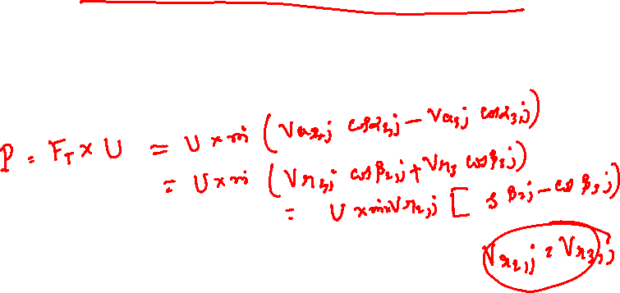
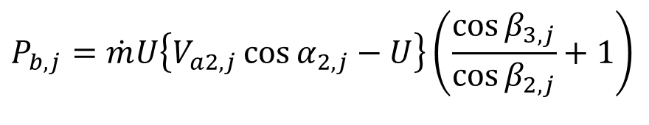
j^{th} Reversible Symmetric Curtis Stage
The power developed in any j^{th} impulse stage:
$$P_{b,j}=\dot{m}U\left\{V_{a2,j}\cos{α_{2,j}}−U\right\}\left(\frac{\cos{β_{3,j}}}{\cos{β_{2,j}}}+1\right)$$
For Symmetric Curtis blade
$$P_{b,j}=2\dot{m}U\left\{V_{a2,j}\cos{α_{2,j}}−U\right\}$$
U
α_{3,j}
α_{2,j}
β_{3,j}
β_{2,j}
V_{a2,j}
V_{a3,j}
V_{r2,j}
V_{r3,j}

Slide 6
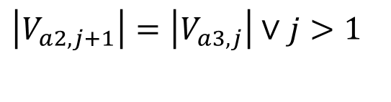
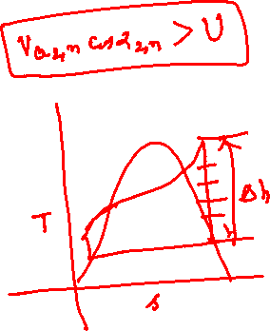
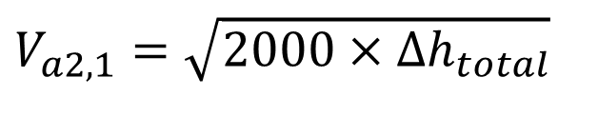
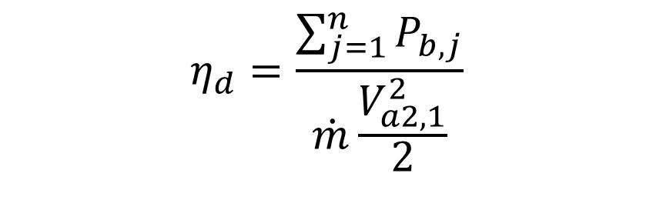
The Curtis Impulse Turbine
Total enthalpy drop available for mechanical power is converted into absolute velocity in one stator wheel (Nozzle).
$$\left|V_{a2,j+1}\right|=\left|V_{a3,j}\right|∨j>1$$
$$η_{d}=\frac{\sum_{j=1}^{n}{P_{b,j}}}{\dot{m}\frac{V_{a2,1}^{2}}{2}}$$
$$V_{a2,1}=\sqrt{2000×Δh_{total}}$$

Slide 7
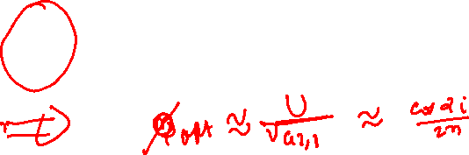
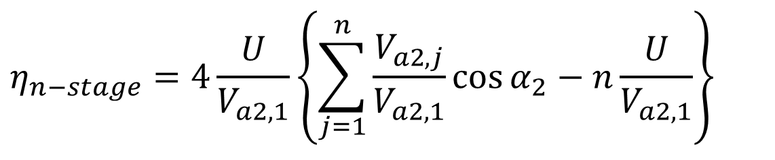
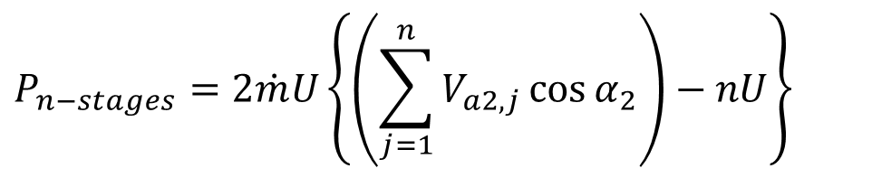
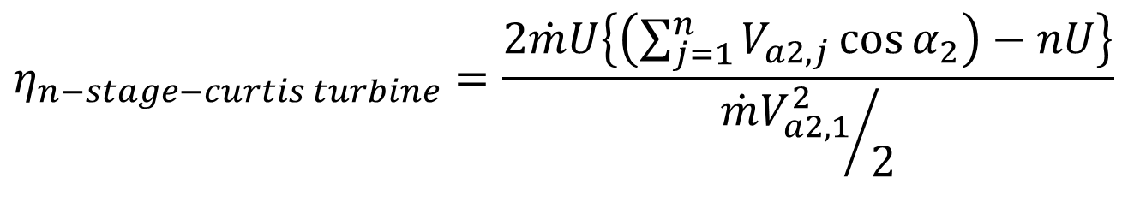
N Stage Curtis Turbine with Symmetric Blades
$$P_{n−stages}=2\dot{m}U\left\{\left(\sum_{j=1}^{n}{V_{a2,j}\cos{α_{2}}}\right)−nU\right\}$$
$$η_{n−stage−curtis turbine}=\frac{2\dot{m}U\left\{\left(\sum_{j=1}^{n}{V_{a2,j}\cos{α_{2}}}\right)−nU\right\}}{{{\dot{m}V}_{a2,1}^{2}}/2}$$
$$η_{n−stage}=4\frac{U}{V_{a2,1}}\left\{\sum_{j=1}^{n}{\frac{V_{a2,j}}{V_{a2,1}}\cos{α_{2}}−n\frac{U}{V_{a2,1}}}\right\}$$

Slide 8
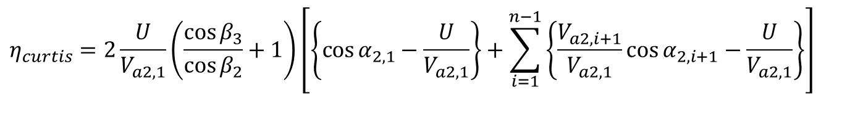
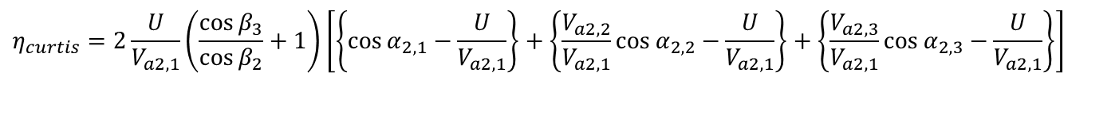
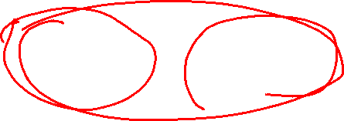
Efficiency of Multi Rotor Curtis Turbine
For a three rotor Curtis Turbine with same rotor blades:
$$η_{curtis}=2\frac{U}{V_{a2,1}}\left(\frac{\cos{β_{3}}}{\cos{β_{2}}}+1\right)\left[\left\{\cos{α_{2,1}}−\frac{U}{V_{a2,1}}\right\}+\left\{\frac{V_{a2,2}}{V_{a2,1}}\cos{α_{2,2}}−\frac{U}{V_{a2,1}}\right\}+\left\{\frac{V_{a2,3}}{V_{a2,1}}\cos{α_{2,3}}−\frac{U}{V_{a2,1}}\right\}\right]$$
For a n-rotor Curtis Turbine with same rotor blades:
$$η_{curtis}=2\frac{U}{V_{a2,1}}\left(\frac{\cos{β_{3}}}{\cos{β_{2}}}+1\right)\left[\left\{\cos{α_{2,1}}−\frac{U}{V_{a2,1}}\right\}+\sum_{i=1}^{n−1}{\left\{\frac{V_{a2,i+1}}{V_{a2,1}}\cos{α_{2,i+1}}−\frac{U}{V_{a2,1}}\right\}}\right]$$

Slide 9
Rateau Steam Turbine
Rateau is credited with the invention of the pressure stage impulse turbine. He restricted the expansion of steam to the nozzles but used multiple stages with larger pressure drops per stage than Parson. In his design the rotors were separated by diaphragms which contained the nozzles. This reduced the number of stages for a given power output and shortened the distance between bearings. The Rateau turbine has been dated at 1901; the U.S. patent was issued in 1903. His turbine found wide acceptance in both marine and central station applications.

Slide 10
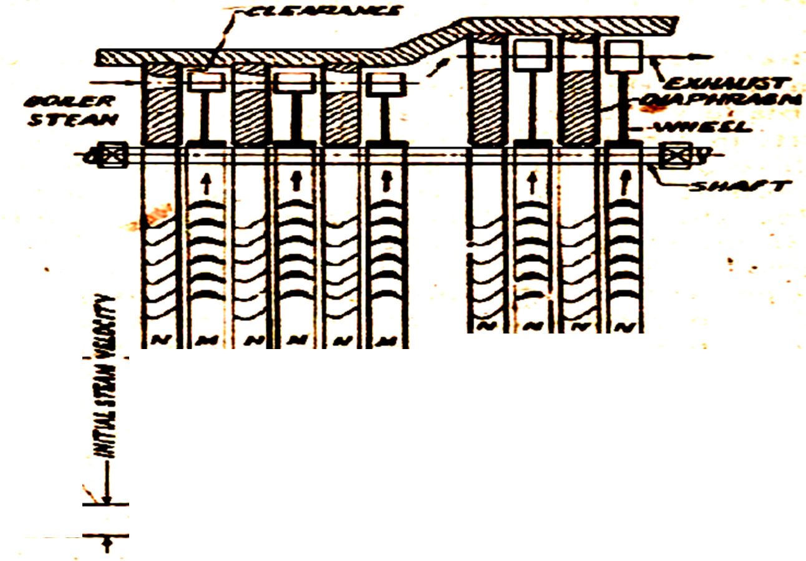
Pressure compounded impulse turbine : Rateau Design
V_{a}
p,h.T &ρ

Slide 11
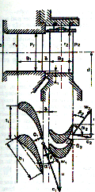
Impulse Turbines with pressure stages
Multistage turbines with pressure stages have found a wide field of usage in industry as prime movers (~ 10 MW).
The number pressure stages vary from 4 to 5.
The distribution of enthalpy drop in a large number of pressure stages enables the attainment of lower velocities for the steam flowing through the system of moving blades.
As a result more advantageous values of blade speed ratio and blade friction factor are obtained
.

Slide 12
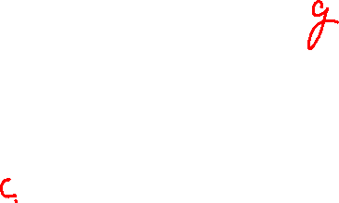
Compounding of Large Impulse Turbine
Compounding is done to reduce the rotational speed of the impulse turbine to practical limits.
Compounding is achieved by using more than one set of nozzle blades and rotors in a series.
All the rotors are keyed to a common shaft; so that the jet velocity is absorbed by the turbine in stages.
All the nozzle blades are overhanding from turbine casing.
Three main types of compounded impulse turbines are:
a) Pressure compounded Steam Turbine : The Rateau Design
b) Velocity compounded Steam Turbine : The Curtis Design
c) Pressure and velocity compounded Impulse turbines : The Rateau-urtis Design.

Slide 13
Curtis-Rateau Steam Turbine
The use of a single Curtis wheel, followed by several Rateau stages, characterized General Electric Company practice in the United States over the succeeding half-century. The combination is still widely used today.

Slide 14
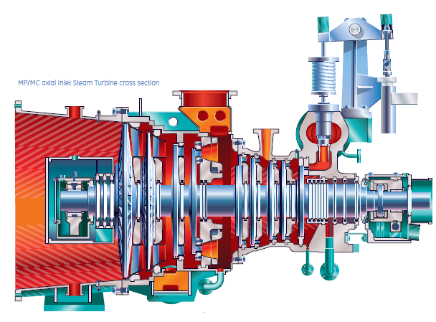
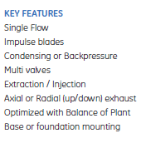
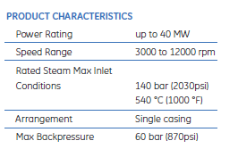
Multistage Impulse Turbine : GE Product

Slide 15
Multi-stage Impulse Turbines : Pressure stages
Multistage turbines with pressure stages have found a wide field of usage in industry as prime movers (~ 10 MW).
The number pressure stages vary from 4 to 5.
The distribution of enthalpy drop in a large number of pressure stages enables the attainment of lower velocities for the steam flowing through the system of moving blades.
As a result, more advantageous values of blade speed ratio and blade friction factor are obtained
.

Slide 16
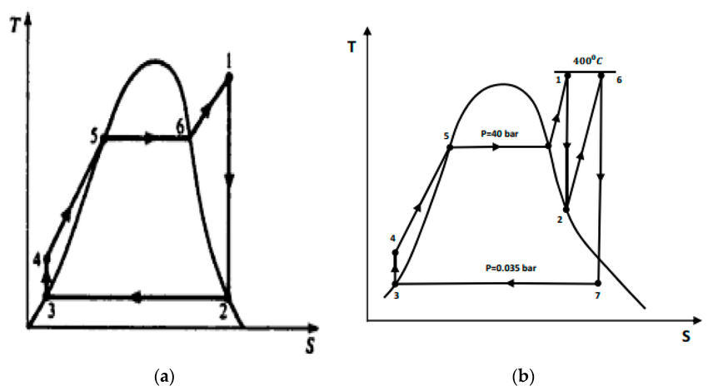
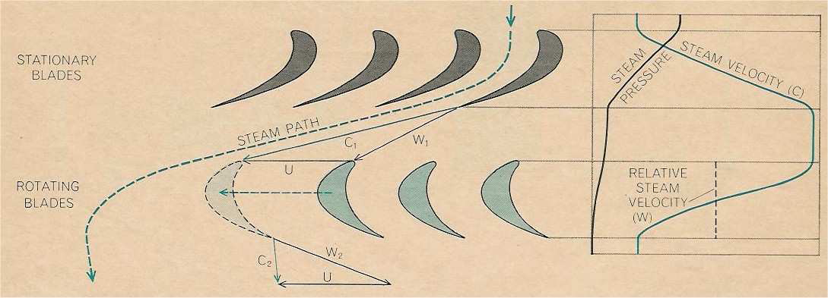
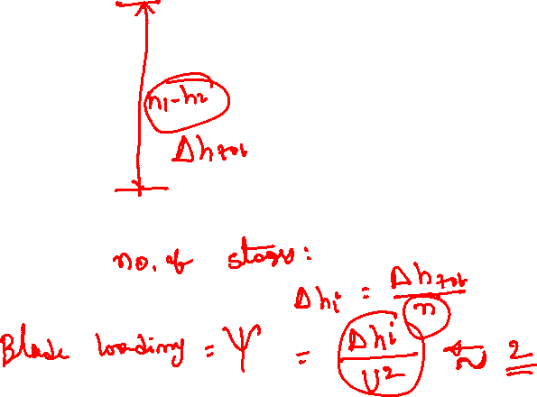

MSIT: Selection of Number of Stages

Slide 17
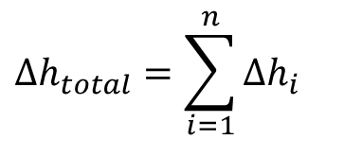
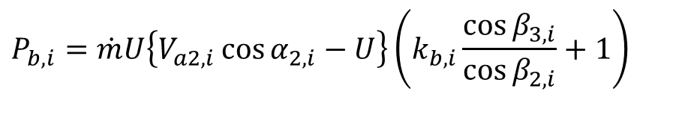
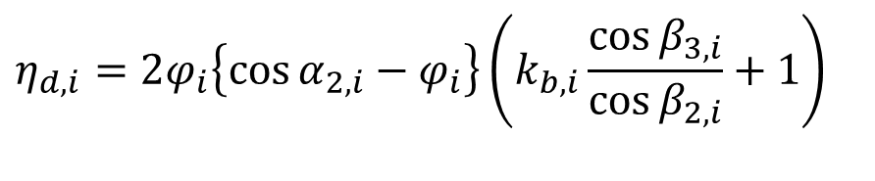
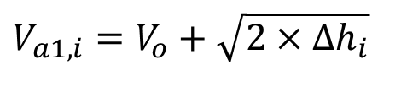
Impulse Turbines with pressure stages
Total enthalpy drop available for mechanical power
$$Δh_{total}=\sum_{i=1}^{n}{Δh_{i}}$$
$$V_{a1,i}=V_{o}+\sqrt{2×Δh_{i}}$$
$$P_{b,i}=\dot{m}U\left\{V_{a2,i}\cos{α_{2,i}}−U\right\}\left(k_{b,i}\frac{\cos{β_{3,i}}}{\cos{β_{2,i}}}+1\right)$$
$$η_{d,i}=2φ_{i}\left\{\cos{α_{2,i}}−φ_{i}\right\}\left(k_{b,i}\frac{\cos{β_{3,i}}}{\cos{β_{2,i}}}+1\right)$$

Slide 18
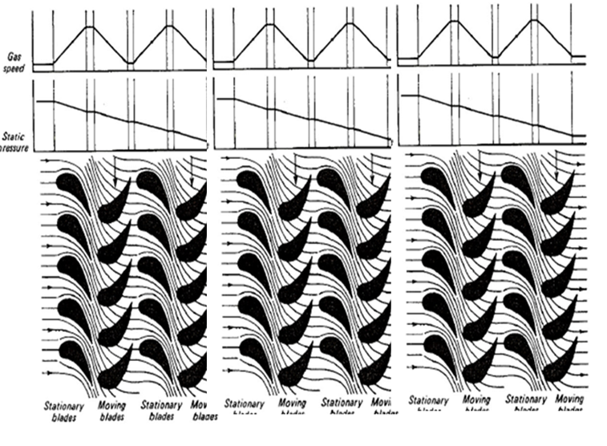
Parsons Steam/Gas Turbines : Multistage Reaction Turbines

Slide 19
Progress in Steam Rankine Cycle
Year | 1907 | 1919 | 1938 | 1950 | 1958 | 1959 | 1966 | 1973 | 1975
MW | 5 | 20 | 30 | 60 | 120 | 200 | 500 | 660 | 1300
p,MPa | 1.3 | 1.4 | 4.1 | 6.2 | 10.3 | 16.2 | 15.9 | 15.9 | 24.1
T_{h} ºC | 260 | 316 | 454 | 482 | 538 | 566 | 566 | 565 | 538
T_{r} ºC | -- | -- | -- | -- | 538 | 538 | 566 | 565 | 538
FHW | -- | 2 | 3 | 4 | 6 | 6 | 7 | 8 | 8
Pc,kPa | 13.5 | 5.1 | 4.5 | 3.4 | 3.7 | 3.7 | 4.4 | 5.4 | 5.1
η,% | -- | ~17 | 27.6 | 30.5 | 35.6 | 37.5 | 39.8 | 39.5 | 40

Slide 20
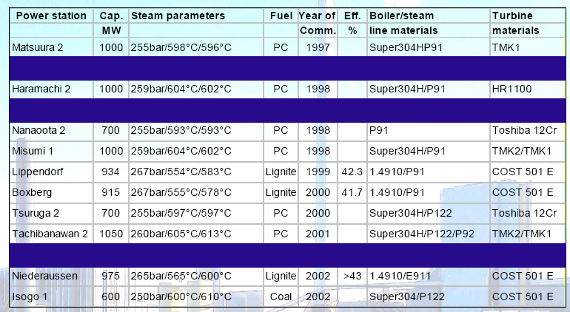
Ultra Supercritical Installations of The World

