Slide 1

Isentropic Analysis Multi-Stage Turbines
“The introduction of steam engines improved productivity and technology across various industries, allowing for the creation of smaller and more efficient engines.” – Industrial Revolution historian
P M V Subbarao
Professor
Mechanical Engineering Department
Rules for Development of Large Turbines!!

Slide 2


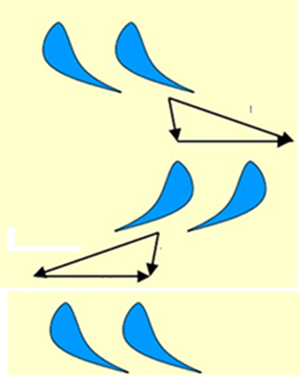






Parson’s Reaction Turbine
Stator/nozzle blade wheel
$$V_{a2}$$
$$V_{r2}$$
$$U_{b1}$$
Rotor/Moving Blade wheel
$$V_{r3}$$
$$V_{a3}$$
$$V_{a1}$$
Stator/nozzle blade wheel

Slide 3
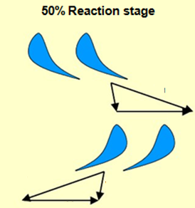

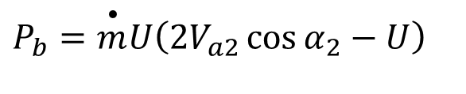
Parson (50% Reaction) Turbine
U
α₃
α₂
β₃
β₂
V_{a2}
V_{r2}
V_{a3}
V_{r3}
In a 50% reaction stage, the moving blades are a mirror image of the fixed blades.
Power Output of the blade :
$$P_{b}=\overset{•}{m}U\left(2V_{a2}\cos{α_{2}}−U\right)$$

Slide 4
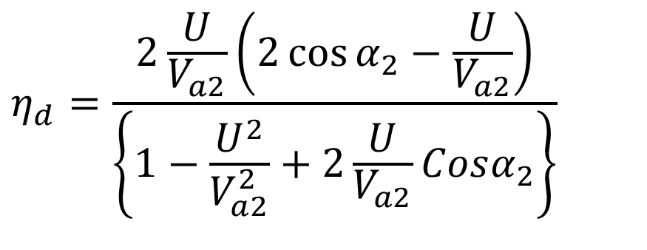
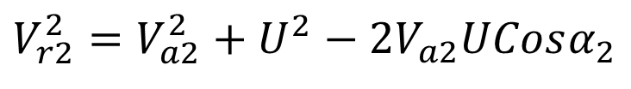
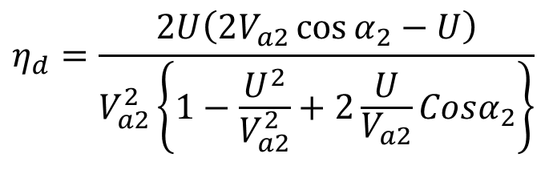
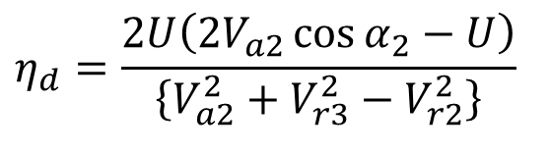
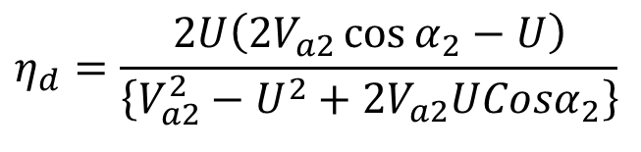
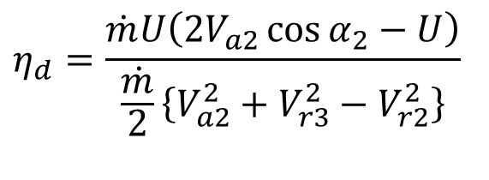
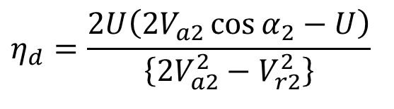
Efficiency of Parson Stage
$$η_{d}=\frac{\dot{m}U\left(2V_{a2}\cos{α_{2}}−U\right)}{\frac{\dot{m}}{2}\left\{V_{a2}^{2}+V_{r3}^{2}−V_{r2}^{2}\right\}}$$
$$η_{d}=\frac{2U\left(2V_{a2}\cos{α_{2}}−U\right)}{\left\{V_{a2}^{2}+V_{r3}^{2}−V_{r2}^{2}\right\}}$$
$$V_{r2}^{2}=V_{a2}^{2}+U^{2}−2V_{a2}UCosα_{2}$$
$$η_{d}=\frac{2U\left(2V_{a2}\cos{α_{2}}−U\right)}{\left\{2V_{a2}^{2}−V_{r2}^{2}\right\}}$$
$$η_{d}=\frac{2U\left(2V_{a2}\cos{α_{2}}−U\right)}{V_{a2}^{2}\left\{1−\frac{U^{2}}{V_{a2}^{2}}+2\frac{U}{V_{a2}}Cosα_{2}\right\}}$$
$$η_{d}=\frac{2U\left(2V_{a2}\cos{α_{2}}−U\right)}{\left\{V_{a2}^{2}−U^{2}+2V_{a2}UCosα_{2}\right\}}$$
$$η_{d}=\frac{2\frac{U}{V_{a2}}\left(2\cos{α_{2}}−\frac{U}{V_{a2}}\right)}{\left\{1−\frac{U^{2}}{V_{a2}^{2}}+2\frac{U}{V_{a2}}Cosα_{2}\right\}}$$

Slide 5
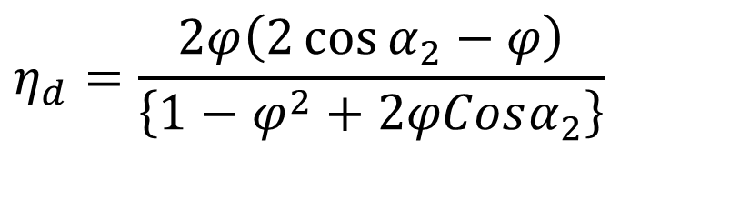
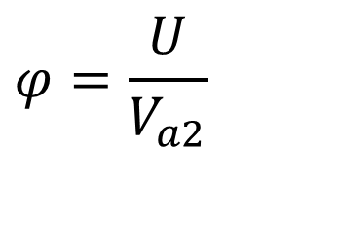
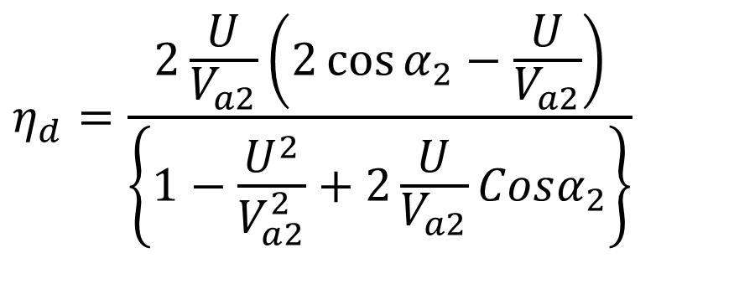
Efficiency of Parson Stage
$$η_{d}=\frac{2\frac{U}{V_{a2}}\left(2\cos{α_{2}}−\frac{U}{V_{a2}}\right)}{\left\{1−\frac{U^{2}}{V_{a2}^{2}}+2\frac{U}{V_{a2}}Cosα_{2}\right\}}$$
$$φ=\frac{U}{V_{a2}}$$
Define Blade Speed ratio
$$η_{d}=\frac{2φ\left(2\cos{α_{2}}−φ\right)}{\left\{1−φ^{2}+2φCosα_{2}\right\}}$$

Slide 6
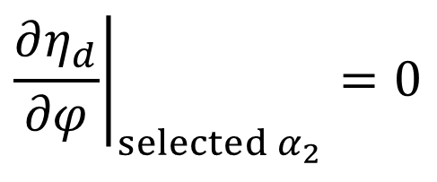
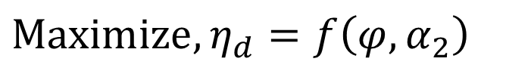
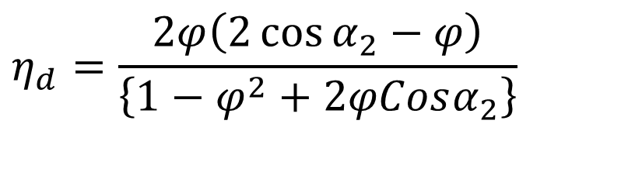
Maximum Efficiency of an Ideal Parson Blade
U
α₃
α₂
β₃
β₂
V_{a2}
V_{r2}
V_{a3}
V_{r3}
$$η_{d}=\frac{2φ\left(2\cos{α_{2}}−φ\right)}{\left\{1−φ^{2}+2φCosα_{2}\right\}}$$
$$\text{Maximize},η_{d}=f\left(φ,α_{2}\right)$$
Consider kinematic variable as optimization variable, for a symmetric blade.
$${\left.\frac{∂η_{d}}{∂φ}\right|}_{selected α_{2}}=0$$

Slide 7
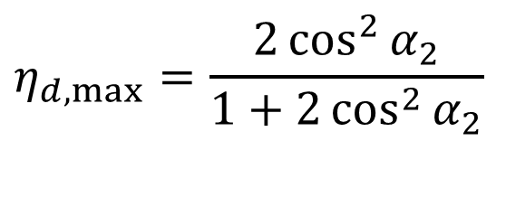
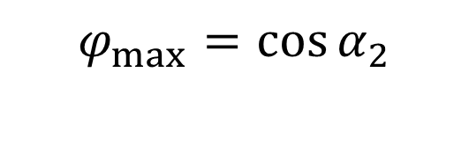
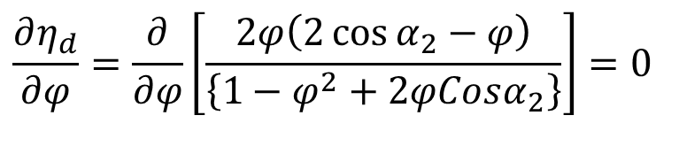
Optimal Kinematic Conditions for Parson Blade
$$\frac{∂η_{d}}{∂φ}=\frac{∂}{∂φ}\left[\frac{2φ\left(2\cos{α_{2}}−φ\right)}{\left\{1−φ^{2}+2φCosα_{2}\right\}}\right]=0$$
$$φ_{max}=\cos{α_{2}}$$
$$η_{d,max}=\frac{2\cos^{2}{α_{2}}}{1+2\cos^{2}{α_{2}}}$$

Slide 8
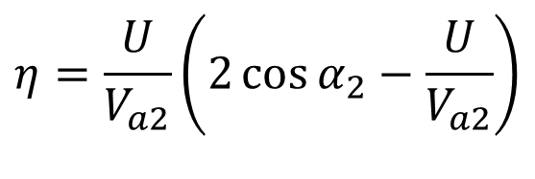
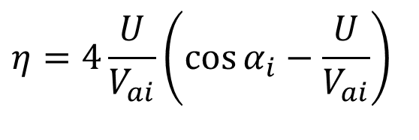
Optimal Stage Efficiency
$$η=4\frac{U}{V_{ai}}\left(\cos{α_{i}}−\frac{U}{V_{ai}}\right)$$
Impulse Stage :
$$η=\frac{U}{V_{a2}}\left(2\cos{α_{2}}−\frac{U}{V_{a2}}\right)$$
50% Reaction stage :

Slide 9
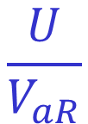

Maximum Efficiency of Impulse Blade
Impulse
Reaction
$$\frac{U}{V_{aI}}$$
$$\frac{U}{V_{aR}}$$

Slide 10
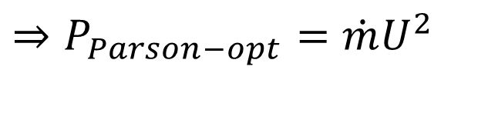
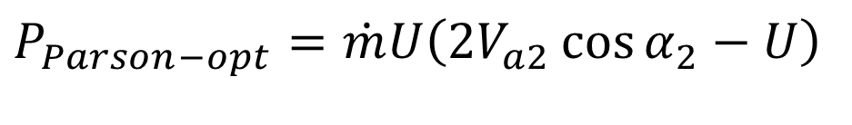
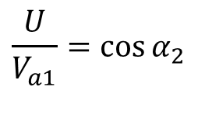
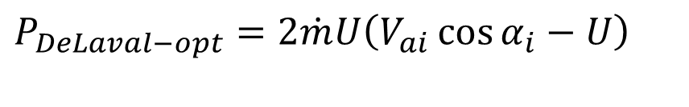
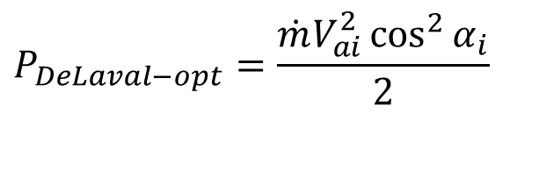
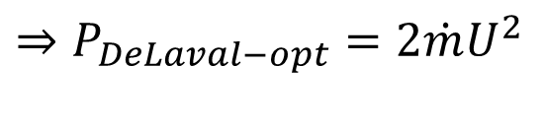
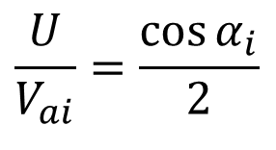
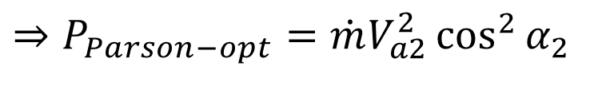
Power at Maximum Efficiency Conditions
$$P_{DeLaval−opt}=2\dot{m}U\left(V_{ai}\cos{α_{i}}−U\right)$$
Best DeLaval Stage :
$$\frac{U}{V_{ai}}=\frac{\cos{α_{i}}}{2}$$
$$⇒P_{DeLaval−opt}=2\dot{m}U^{2}$$
$$P_{DeLaval−opt}=\frac{\dot{m}V_{ai}^{2}\cos^{2}{α_{i}}}{2}$$
$$P_{Parson−opt}=\dot{m}U\left(2V_{a2}\cos{α_{2}}−U\right)$$
Ideal Parson Stage :
$$⇒P_{Parson−opt}=\dot{m}U^{2}$$
$$\frac{U}{V_{a1}}=\cos{α_{2}}$$
$$⇒P_{Parson−opt}=\dot{m}V_{a2}^{2}\cos^{2}{α_{2}}$$

Slide 11

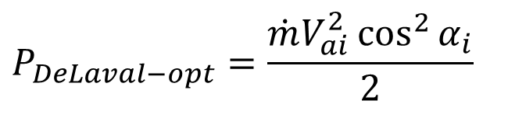
Capacity of Parson Blading for Same Inlet Steam Velocity
$$P_{DeLaval−opt}=\frac{\dot{m}V_{ai}^{2}\cos^{2}{α_{i}}}{2}$$
$$⇒P_{Parson−opt}=\dot{m}V_{a2}^{2}\cos^{2}{α_{2}}$$
At optimum U/V_{a2}, a 50% reaction stage produces TWICE the power of an impulse stage for same value of steam jet velocity.
This means that a 50% reaction turbine requires lower velocity of jet than that of an impulse turbine for a given capacity!
This fact has a major impact on achieving lower fluid dynamic losses with improved capital cost.
Reaction turbines are less expensive and highly preferred in large power plants.

Slide 12


Moderate Capacity of Parson Blading for Same Blade Velocity
$$⇒P_{impulse−Blade−opt}=2\dot{m}U^{2}$$
$$⇒P_{Parson−opt}=\dot{m}U^{2}$$
At optimum U/V_{ai}, an impulse stage produces TWICE the power of a 50% reaction stage for same blade speed!
This means that an impulse turbine requires only half the number of stages as a 50% reaction turbine for a given application!
This fact has a major impact on the construction of the turbine
It is also responsible for some of the greatest misunderstandings, since people assume that impulse blading is cheaper overall - this is NOT true!
Impulse turbines have fewer stages, but they must use a different form of construction which is expensive.

Slide 13




Newtons Second Law Analysis along Axial Direction
U
α₂
α₂
β₃
β₂
V_{a3}
V_{a2}
V_{r2}
V_{r3}
$$F_{A−A}=\dot{m}\left(V_{r3}Sinβ_{3}−V_{r2}Sinβ_{2}\right)$$
$$F_{A−R}=\dot{m}\left(V_{r2}Sinβ_{2}−V_{r3}Sinβ_{3}\right)$$
Condition for minimum axial thrust:
$$V_{r2}Sinβ_{2} ≈V_{r3}Sinβ_{3}$$

Slide 14
From Lectures of Sir Charles Parson
In 1884 or four years previously, I dealt with the turbine problem in a different way.
It seemed to me that moderate surface velocities and speeds of rotation were essential if the turbine motor was to receive general acceptance as a prime mover.
I therefore decided to split up the fall in pressure of the steam into small fractional expansions over a large number of turbines in series, so that the velocity of the steam nowhere should be great.
A moderate blade speed of turbine suffices for the highest economy.
The arrangement of small falls in pressure (Compounding) at each turbine also appeared to me to be surer to give a high efficiency.

Slide 15
From Books of Sir Charles Parson
This principle of compounding turbines in series is now universally used in all except very small engines, where economy in steam is of secondary importance.
The arrangement of small falls in pressure at each turbine also appeared to me to be surer to give a high efficiency.
The steam flowed practically in a non-expansive manner through each individual turbine, and consequently in an analogous way to water in hydraulic turbines whose high efficiency at that date had been proved by accurate tests.

Slide 16

An Invention that Made Electricity Very Cheap
The modern steam turbine was invented in 1884 by the Englishman Sir Charles Parsons.
The first model was connected to a dynamo that generated 7.5 kW (10 hp) of electricity.
The invention of Parson's steam turbine made cheap and plentiful electricity possible and revolutionized marine transport and naval warfare.
His patent was licensed and the turbine scaled-up shortly after by an American, George Westinghouse.
The Parson's turbine also turned out to be easy to scale up.

Slide 17
Scaling up Parsons’ Turbine for Power Generation
In 1912, a turbo-generator with 25,000 kilowatts was the world’s largest and most efficient.
Initially producing 7.5 kilowatts, its capacity escalated to 50,000 kilowatts during his era.
The unique design of his turbine permitted the construction of larger units than reciprocating engines.
By 1923, a single unit from Parsons’ company achieved 200,000 kilowatts, surpassing reciprocating steam engines.
Within Parson's lifetime the generating capacity of a unit was scaled up by about 10,000 times.
“The steam turbine can be constructed for much larger outputs than any reciprocating engine.” – Sir Charles Parsons.
Sir Charles Parsons died on February 11, 1931, while on a cruise.

Slide 18
The Fight or Agreement ?!?!

Slide 19
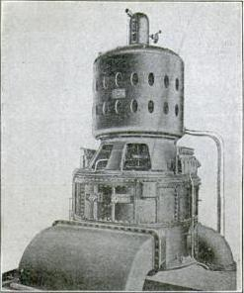
The most powerful steam turbine-generator in the world at the time of its construction:1903
Built in 1903, the 5,000-kilowatt Curtis steam turbine-generator was the most powerful in the world.
It stood just 25 feet high, much shorter than the 60 feet reciprocating engine-generator of a similar capacity

Slide 20
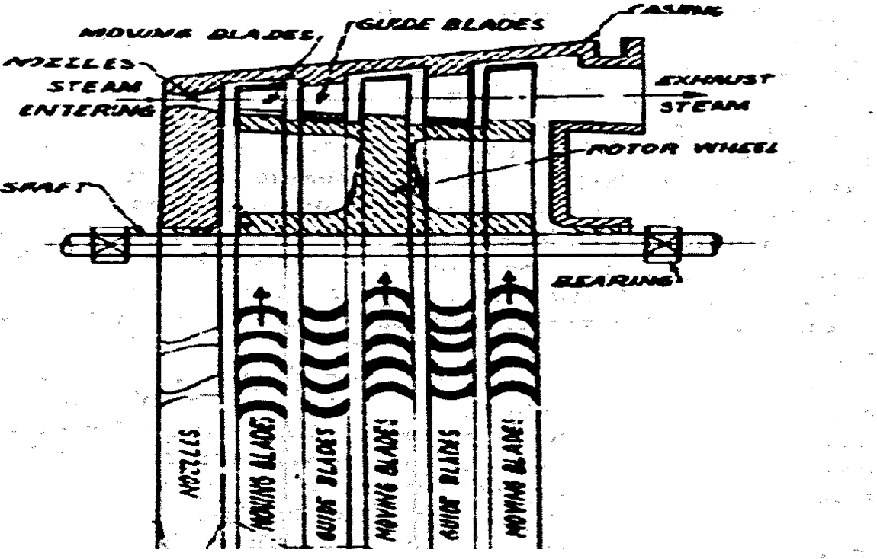

The Curtis Design
V_{a}
p,h.T &ρ

Slide 21
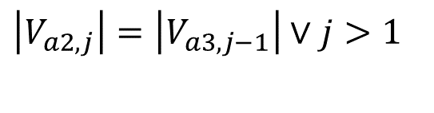
A System of Velocity Triangles for Curtis Turbine
U
α_{3,1}
α_{2,1}
β_{3,1}
β_{2,1}
V_{a3,1}
V_{a2,1}
V_{r2,1}
V_{r3,1}
$$\left|V_{a2,j}\right|=\left|V_{a3,j−1}\right|∨j>1$$
U
α_{3,2}
α_{2,2}
β_{3,2}
β_{2,2}
V_{a3,2}
V_{a2,2}
V_{r2,2}
V_{r3,2}
U
α_{3,3}
α_{2,3}
β_{3,3}
β_{2,3}
V_{a3,3}
V_{r3,3}
V_{a2,3}
V_{r2,3}

