Slide 1

Isentropic Analysis & Optimization of Flow Kinematics in Parson Turbines - 1
P M V Subbarao
Professor
Mechanical Engineering Department
Maximization of Energy Transfer with Safe Operational Conditions!!

Slide 2


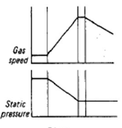
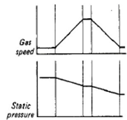
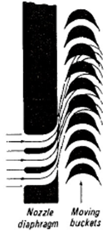
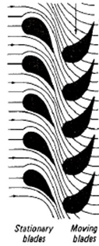
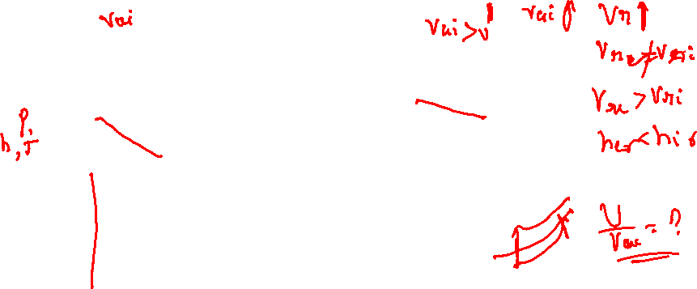
De Laval vs Parson Turbine : Level -1

Slide 3
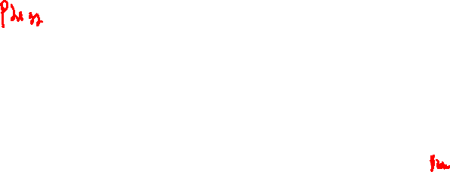
De Laval vs Parson Turbine : Level -2

Slide 4
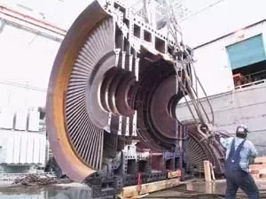
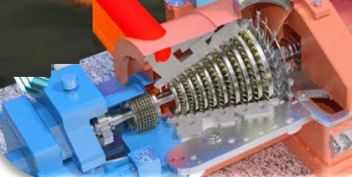
The Parsons Stage of A Turbine
Parson’s Stage utilizes the principle of impulse and reaction.
There are number of rows of moving blades attached to the rotor and equal number of fixed blades attached to the casing.

Slide 5
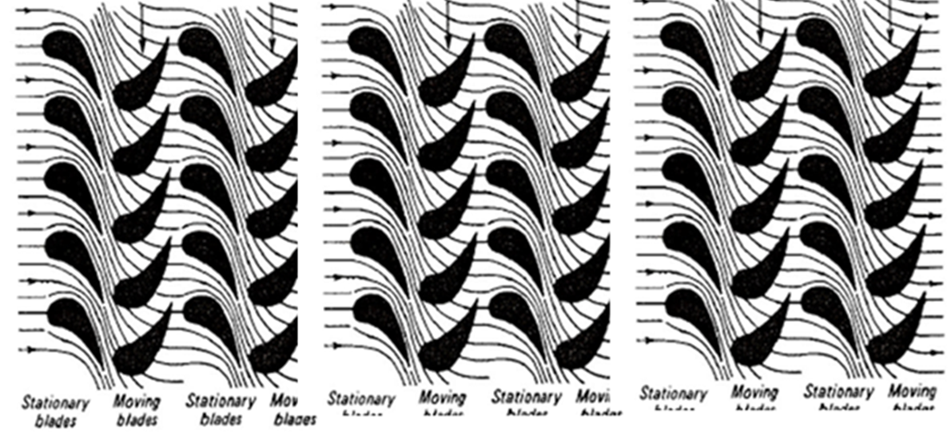
The Parsons Stage of A Turbine
The fixed blades are set in a reversed manner compared to the moving blades, and act as nozzles.

Slide 6
The Parsons Stage of A Turbine
The fixed blade channels are of nozzle shape and there is some drop in pressure accompanied by an increase in velocity.
The fluid then passes over the moving blades and, as in the pure impulse turbine, a force is exerted on the blades by the fluid.
There is further drop in pressure as the fluid passes through the moving blades, since moving blade channels are also of nozzle shape.
(Only) The relative velocity increases in the moving blades.

Slide 7
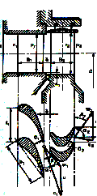

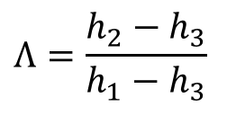
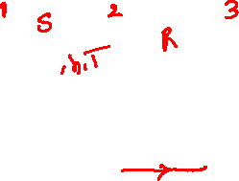
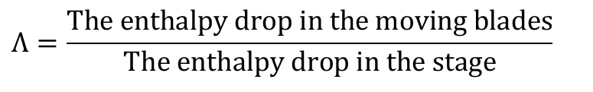
Basics of A Reaction Stage
U
α₃
α₂
β₃
β₂
V_{a2}
V_{r2}
V_{a3}
V_{r3}
The reaction effect is an addition to impulse effect.
The degree of reaction
p
$$Λ=\frac{\text{The} \text{enthalpy} \text{drop} \text{in} \text{the} \text{moving} \text{blades}}{\text{The} \text{enthalpy} \text{drop} \text{in} \text{the} \text{stage}}$$
V_{r}
V_{a}
$$Λ=\frac{h_{2}−h_{3}}{h_{1}−h_{3}}$$

Slide 8

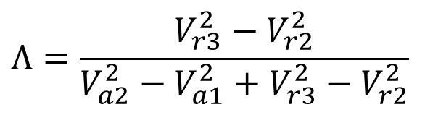
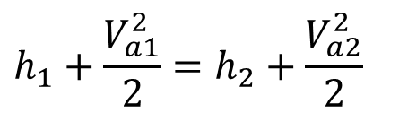
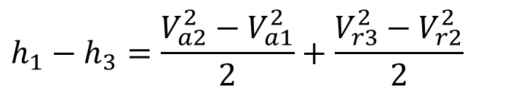
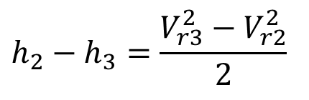
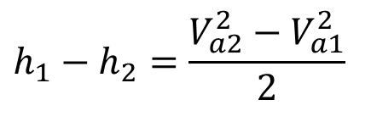
First Law Analysis of Reaction Stage
First law for an isentropic fixed (Nozzle) blades:
$$h_{1}+\frac{V_{a1}^{2}}{2}=h_{2}+\frac{V_{a2}^{2}}{2}$$
$$h_{1}−h_{2}=\frac{V_{a2}^{2}−V_{a1}^{2}}{2}$$
1
2
3
First law for moving (rotor) blades:
$$h_{2}−h_{3}=\frac{V_{r3}^{2}−V_{r2}^{2}}{2}$$
Gross enthalpy drop available to the stage:
$$h_{1}−h_{3}=\frac{V_{a2}^{2}−V_{a1}^{2}}{2}+\frac{V_{r3}^{2}−V_{r2}^{2}}{2}$$
$$Λ=\frac{V_{r3}^{2}−V_{r2}^{2}}{V_{a2}^{2}−V_{a1}^{2}+V_{r3}^{2}−V_{r2}^{2}}$$

Slide 9
Useful Velocities for A Reaction Stage
The flow velocities between two successive blade at inlet and exit are V_{f2} & V_{f3}.
V_{w2}
V_{w2}
U
α₃
α₂
β₃
β₂
V_{a2}
V_{r2}
V_{a3}
V_{f2}
V_{f3}
V_{r3}
The tangential (Working) components or whirl velocities at inlet and exit are V_{w2} & V_{w3}.

Slide 10

The Action in An Impulse-Reaction Stage
V_{rw3}
U
V_{rw2}
α₃
α₂
β₃
β₂
V_{a2}
V_{r2}
V_{a3}
V_{r3}
Newton’s Second Law for an Impulse-reaction Blade:
The tangential force acting of the jet is:
F = mass flow rate X Change of velocity in the tangential direction
Tangential relative (Whirl) velocity at blade Inlet : V_{r2} cos(β₂).
Tangential relative (Whirl) velocity at blade exit : -V_{r3} cos(β₃).
Change in velocity in tangential direction: -V_{r3} cos(β₃) – V_{r2} cos(β₂).
Tangential Force on steam jet,
$$F_{A}=−\dot{m}\left(V_{r3}\cos{β_{3}}+V_{r2}\cos{β_{2}}\right)$$

Slide 11
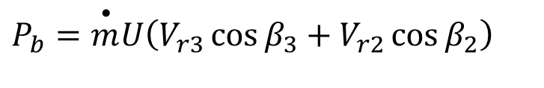
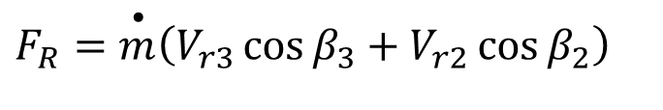
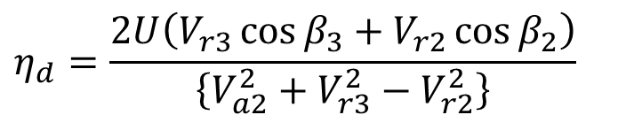
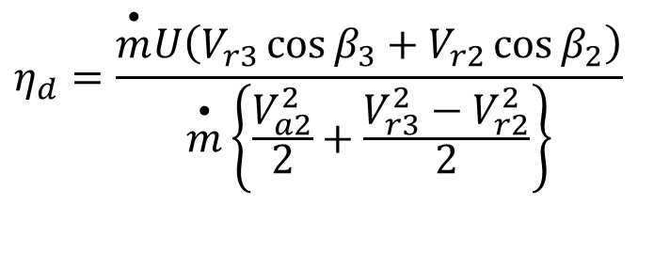
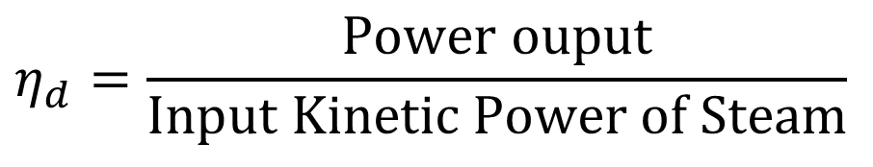
The Reaction in A Reaction Turbine
The reaction to this force provides the driving thrust on the wheel.
The driving force on wheel
$$F_{R}=\overset{•}{m}\left(V_{r3}\cos{β_{3}}+V_{r2}\cos{β_{2}}\right)$$
$$P_{b}=\overset{•}{m}U\left(V_{r3}\cos{β_{3}}+V_{r2}\cos{β_{2}}\right)$$
Power Output of the blade :
Diagram Efficiency of a Reaction Blade efficiency:
$$η_{d}=\frac{\text{Power} \text{ouput}}{\text{Input} \text{Kinetic} \text{Power} \text{of} \text{Steam}}$$
$$η_{d}=\frac{\overset{•}{m}U\left(V_{r3}\cos{β_{3}}+V_{r2}\cos{β_{2}}\right)}{\overset{•}{m}\left\{\frac{V_{a2}^{2}}{2}+\frac{V_{r3}^{2}−V_{r2}^{2}}{2}\right\}}$$
$$η_{d}=\frac{2U\left(V_{r3}\cos{β_{3}}+V_{r2}\cos{β_{2}}\right)}{\left\{V_{a2}^{2}+V_{r3}^{2}−V_{r2}^{2}\right\}}$$

Slide 12
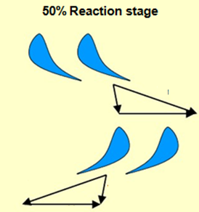
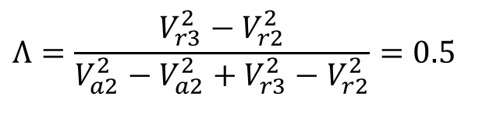
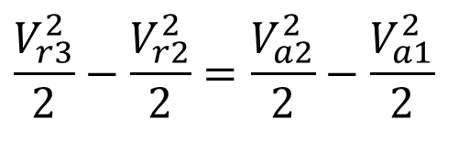
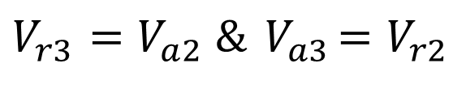
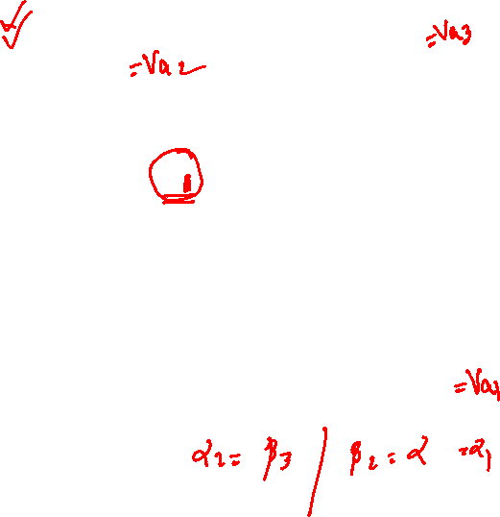
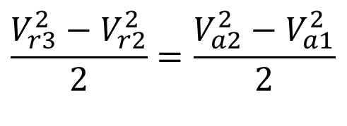

Parson (50% Impulse - 50% Reaction) Turbine
U
α₃
α₂
β₃
β₂
V_{a2}
V_{r2}
V_{a3}
V_{r3}
$$Λ=\frac{V_{r3}^{2}−V_{r2}^{2}}{V_{a2}^{2}−V_{a2}^{2}+V_{r3}^{2}−V_{r2}^{2}}=0.5$$
$$\frac{V_{r3}^{2}}{2}−\frac{V_{r2}^{2}}{2}=\frac{V_{a2}^{2}}{2}−\frac{V_{a1}^{2}}{2}$$
$$V_{r3}^{2}−V_{r2}^{2}=0.5\left(V_{a2}^{2}−V_{a1}^{2}+V_{r3}^{2}−V_{r2}^{2}\right)$$
An economic option:
$$\frac{V_{r3}^{2}−V_{r2}^{2}}{2}=\frac{V_{a2}^{2}−V_{a1}^{2}}{2}$$
$$V_{r3}=V_{a2} \&{ V}_{a3}=V_{r2}$$

