Slide 1

Isentropic Analysis & Optimization of Flow Kinematics in Impulse Turbines
P M V Subbarao
Professor
Mechanical Engineering Department
Maximization of Energy Transfer with Safe Operational Conditions!!

Slide 2


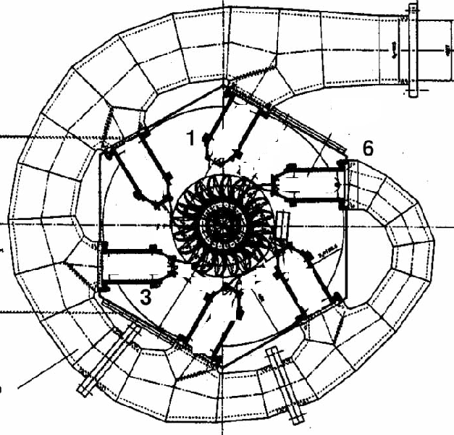
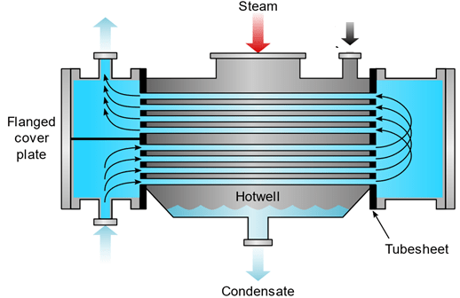

Steam Turbine Flow Path in De Laval Turbine for Maximum Benefits
How to minimize fuel consumption for a given rise in macroscopic kinetic energy of the jet at the exit of stator/nozzle?

Slide 3
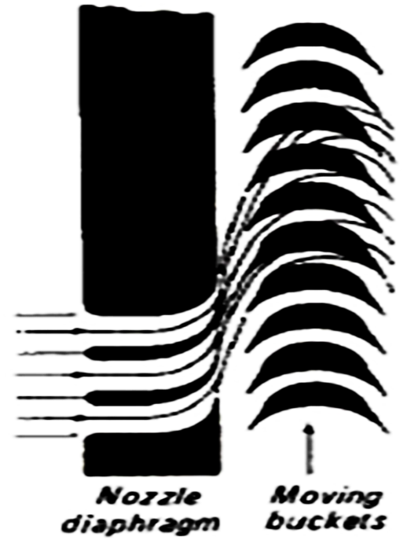

Isentropic Flow through an Impulse Blade Passage
U
α_{e}
α_{i}
β_{i}
β_{i}
V_{ae}
V_{ai}
V_{ri}
V_{re}
In an ideal impulse blade passage:
Pressure, temperature, enthalpy and magnitude of relative velocity remain constant.
The blade quasi-statically changes the direction of inlet relative velocity through an angle of 180-β_{i} -β_{e.}

Slide 4

Newtons Second Law Analysis of Isentropic Flow : Impulse Blade
U
α_{e}
α_{i}
β_{i}
β_{i}
V_{ae}
V_{ai}
V_{ri}
V_{re}
Newton’s Second Law for an Impulse Blade:
The tangential force acting on the jet is equal to Change in Rate of tangential momentum.
F_{tangential-action} = mass flow rate × Change in tangential velocity.
Change in tangential velocity : -V_{ae} cosα_{e} – V_{ai} cosα_{i}
-
$$F_{T−A}=−\dot{m}\left(V_{ae}\cos{α_{e}}+V_{ae}\cos{α_{e}}\right)$$

Slide 5
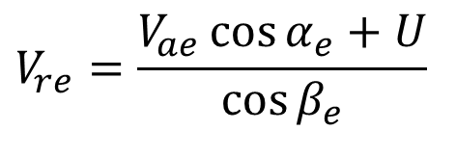

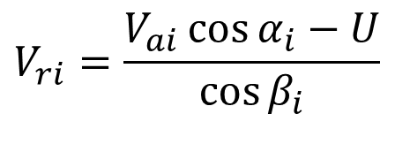
Newtons Second Law Analysis
U
α_{e}
α_{i}
β_{i}
β_{i}
V_{ae}
V_{ai}
V_{ri}
V_{re}
$$F_{T−A}=−\dot{m}\left(V_{ae}\cos{α_{e}}+V_{ai}\cos{α_{i}}\right)$$
Cosine Law for inlet and outlet Triangles
$$V_{ri}=\frac{V_{ai}\cos{α_{i}}−U}{\cos{β_{i}}}$$
$$V_{re}=\frac{V_{ae}\cos{α_{e}}+U}{\cos{β_{e}}}$$

Slide 6


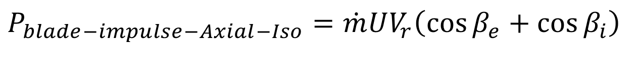
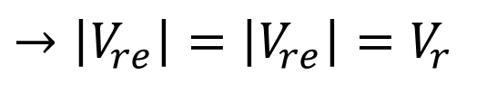
Force & Power Generated by an Ideal Axial-Impulse Turbine
Reaction forces is defined as tangential force applied by deflected steam jet on the Blade.
$$F_{T−R}=\dot{m}\left(V_{re}\cos{β_{e}}+V_{ri}\cos{β_{i}}\right)$$
Power Output of the blade :
$$P_{blade−impulse}=\dot{m}U\left(V_{re}\cos{β_{e}}+V_{ri}\cos{β_{i}}\right)$$
A Simplified model for DeLaval is Defines as Isentropic Axial Flow Impulse Turbine .
$$→\left|V_{re}\right|=\left|V_{re}\right|=V_{r}$$
$$P_{blade−impulse−Axial−Iso}=\dot{m}UV_{r}\left(\cos{β_{e}}+\cos{β_{i}}\right)$$

Slide 7
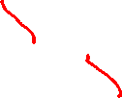
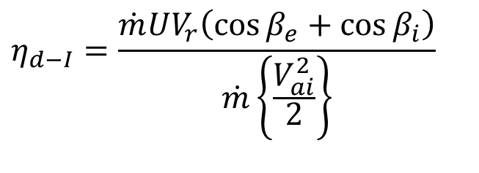
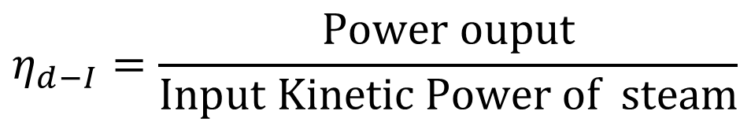
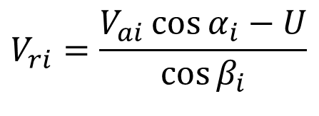
Performance of an Ideal Axial-Impulse Turbine
Efficiency of An isentropic DeLaval (Axial-Impulse) turbine, also defined as Diagram Efficiency or ideal Blade efficiency:
$$η_{d−I}=\frac{\text{Power} \text{ouput}}{\text{Input} \text{Kinetic} \text{Power} \text{of} \text{steam}}$$
$$η_{d−I}=\frac{\dot{m}UV_{r}\left(\cos{β_{e}}+\cos{β_{i}}\right)}{\dot{m}\left\{\frac{V_{ai}^{2}}{2}\right\}}$$
U
α_{e}
α_{i}
β_{i}
β_{i}
V_{ae}
V_{ai}
V_{ri}
$$V_{ri}=\frac{V_{ai}\cos{α_{i}}−U}{\cos{β_{i}}}$$
V_{re}

Slide 8
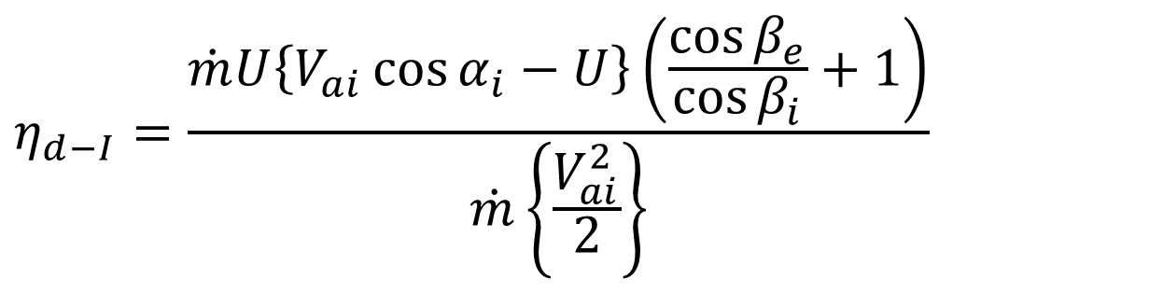
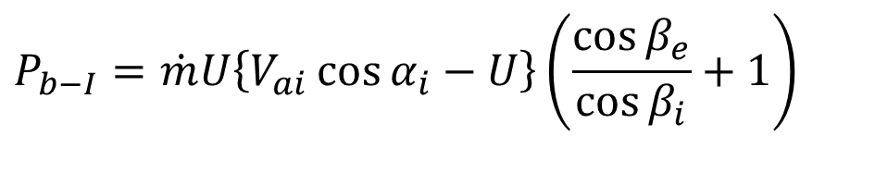

Performance of An Ideal Axial Flow Impulse Turbine
$$P_{b−I}=\dot{m}U\left\{V_{ai}\cos{α_{i}}−U\right\}\left(\frac{\cos{β_{e}}}{\cos{β_{i}}}+1\right)$$
U
α_{e}
α_{i}
β_{i}
β_{i}
V_{ae}
V_{ai}
V_{ri}
V_{re}
$$η_{d−I}=\frac{\dot{m}U\left\{V_{ai}\cos{α_{i}}−U\right\}\left(\frac{\cos{β_{e}}}{\cos{β_{i}}}+1\right)}{\dot{m}\left\{\frac{V_{ai}^{2}}{2}\right\}}$$

Slide 9
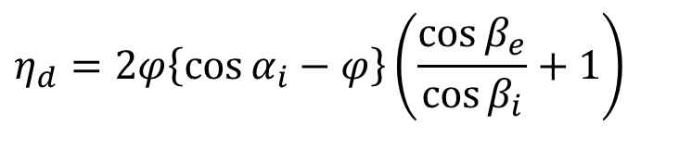
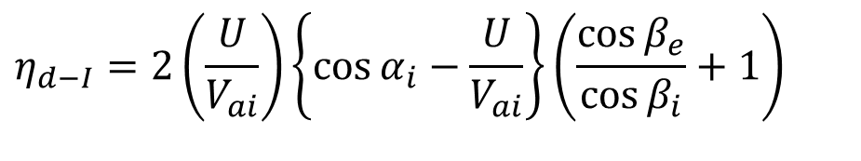
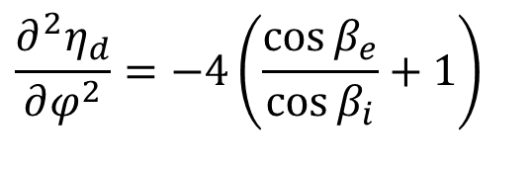
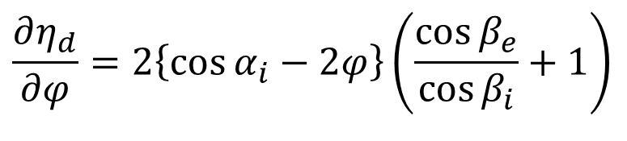
Optimal Performance of An Ideal Axial Flow Impulse Turbine
$$η_{d−I}=2\left(\frac{U}{V_{ai}}\right)\left\{\cos{α_{i}}−\frac{U}{V_{ai}}\right\}\left(\frac{\cos{β_{e}}}{\cos{β_{i}}}+1\right)$$
For a given shape of the blade, the efficiency is a strong function of U/V_{ai}, called blade speed ratio, φ
$$η_{d}=2φ\left\{\cos{α_{i}}−φ\right\}\left(\frac{\cos{β_{e}}}{\cos{β_{i}}}+1\right)$$
$$\frac{∂η_{d}}{∂φ}=2\left\{\cos{α_{i}}−2φ\right\}\left(\frac{\cos{β_{e}}}{\cos{β_{i}}}+1\right)$$
$$\frac{∂^{2}η_{d}}{∂φ^{2}}=−4\left(\frac{\cos{β_{e}}}{\cos{β_{i}}}+1\right)$$

Slide 10
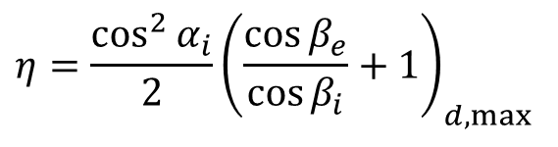
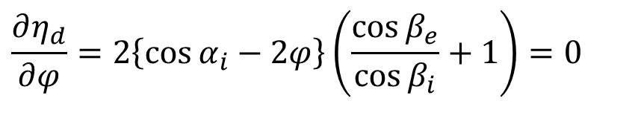
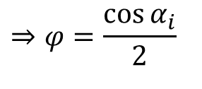
Optimal Performance of An Impulse Turbine
Condition for maximum efficiency:
$$\frac{∂η_{d}}{∂φ}=2\left\{\cos{α_{i}}−2φ\right\}\left(\frac{\cos{β_{e}}}{\cos{β_{i}}}+1\right)=0$$
$$⇒φ=\frac{\cos{α_{i}}}{2}$$
$${η=\frac{\cos^{2}{α_{i}}}{2}\left(\frac{\cos{β_{e}}}{\cos{β_{i}}}+1\right)}_{d,max}$$
Maximum efficiency:
U
α_{e}
α_{i}
β_{i}
β_{i}
V_{ae}
V_{ai}
V_{ri}
V_{re}

Slide 11
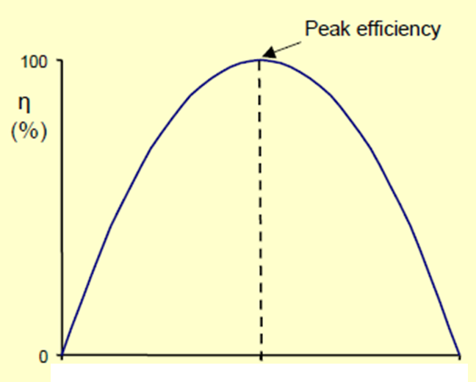
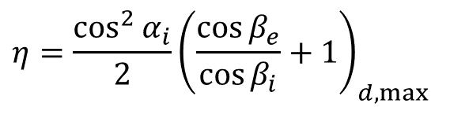
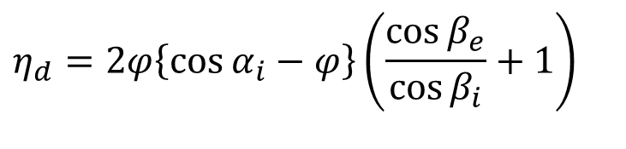
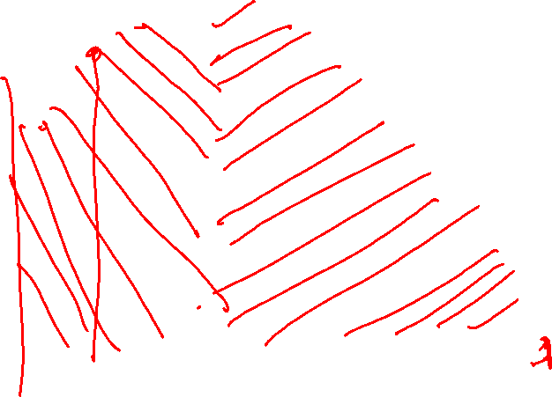
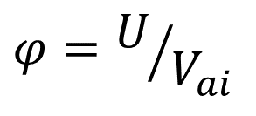
Maximum Efficiency of Impulse Blade
$${η=\frac{\cos^{2}{α_{i}}}{2}\left(\frac{\cos{β_{e}}}{\cos{β_{i}}}+1\right)}_{d,max}$$
$$η_{d}=2φ\left\{\cos{α_{i}}−φ\right\}\left(\frac{\cos{β_{e}}}{\cos{β_{i}}}+1\right)$$
$$φ=U/{V_{ai}}$$

Slide 12
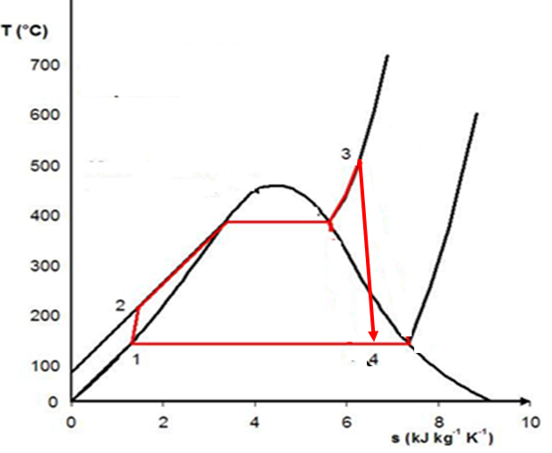
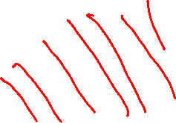
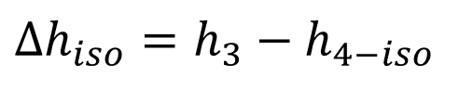
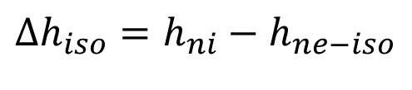
Challenges in Design of Optimal De Laval Turbine
For Improved Steam Conditions
Available Enthalpy drop for an Isentropic Turbine for Generation of Power
$$Δh_{iso}=h_{3}−h_{4−iso}$$
For an impulse turbine, this occurs across nozzle:
$$Δh_{iso}=h_{ni}−h_{ne−iso}$$
The value of h_{ne-iso} is decided by possible Condenser Temperature.
In reality, condenser temperature ≥ T_{amb}.
Case Study: Let h_{si}=3500 kJ/kg and T_{cond} = 45°

Slide 13
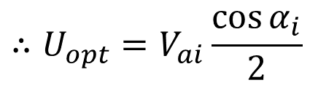
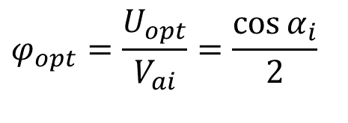
Selection of Better Live Steam Conditions
h₃ =3500kJ/kg |  |  | Specific Enthalpy, h₄ | Δh_{iso} | Jet Velocity
 | Pressure | Temp
 | MPa | °C | kJ/kg | kJ/kg | m/s
1 | 1 | 509.9 | 2464 | 1036 | 1439
2 | 5 | 528.4 | 2232 | 1268 | 1592
3 | 10 | 549.6 | 2135 | 1365 | 1652
4 | 15 | 569 | 2080 | 1420 | 1685
5 | 20 | 586.7 | 2041 | 1459 | 1708
6 | 25 | 602.9 | 2012 | 1488 | 1725
7 | 30 | 617.7 | 1989 | 1511 | 1738
8 | 35 | 631.3 | 1969 | 1531 | 1750
$$φ_{opt}=\frac{U_{opt}}{V_{ai}}=\frac{\cos{α_{i}}}{2}$$
$$∴U_{opt}=V_{ai}\frac{\cos{α_{i}}}{2}$$

Slide 14

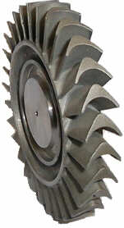
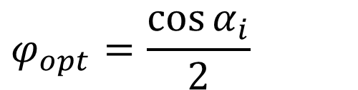

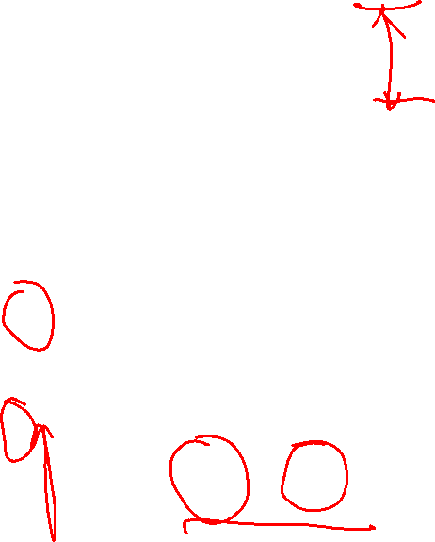
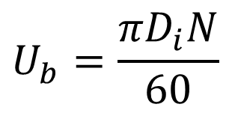

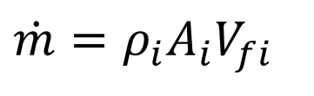
Optimal De Laval Turbine for Better Steam Conditions
U
α_{e}
α_{i}
β_{i}
β_{i}
V_{ae}
V_{ai}
V_{ri}
V_{fi}
V_{re}
$$\dot{m}=ρ_{i}A_{i}V_{fi}$$
$$φ_{opt}=\frac{\cos{α_{i}}}{2}$$
$$\dot{m}=ρ_{i}πD_{i}z_{bi}V_{ai}\sin\left(α_{i}\right)$$
$$U_{b}=\frac{πD_{i}N}{60}$$
$$D_{i}=D_{base}+z_{bi}$$

Slide 15
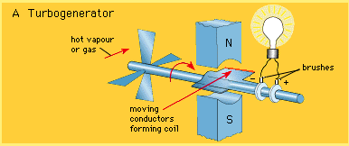
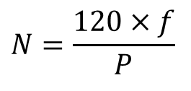
Turbine to Drive Faradays Electro-Magnetic Generator
Turbo Generator
$$N=\frac{120×f}{P}$$
Speed and frequency of synchronous generator
P = total number of field poles.
N = speed of the generator in r.p.m.
f = frequency of the generated voltage in Hz.

Slide 16
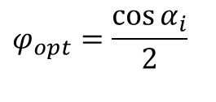
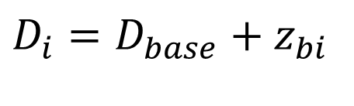
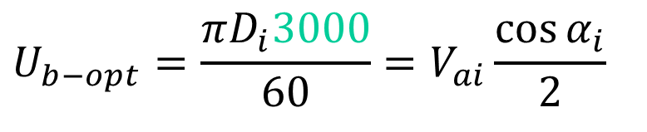

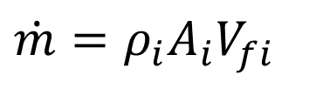
Ideal DeLaval Turbine for Better Steam Conditions
U
α_{e}
α_{i}
β_{i}
β_{i}
V_{ae}
V_{ai}
V_{ri}
V_{re}
$$φ_{opt}=\frac{\cos{α_{i}}}{2}$$
$$\dot{m}=ρ_{i}A_{i}V_{fi}$$
$$\dot{m}=ρ_{i}πD_{i}z_{bi}V_{ai}\sin\left(α_{i}\right)$$
$$U_{b−opt}=\frac{πD_{i}3000}{60}=V_{ai}\frac{\cos{α_{i}}}{2}$$
$$D_{i}=D_{base}+z_{bi}$$

Slide 17
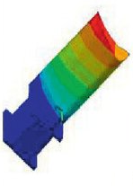
Impracticability of Best Turbine Concept
Better conditions of live steam enhances the value of inlet steam velocity and hence optimal blade velocity!
Huge Centrifugal Stresses in blades.
High jet & Relative Velocities!
More frictional losses….

Slide 18
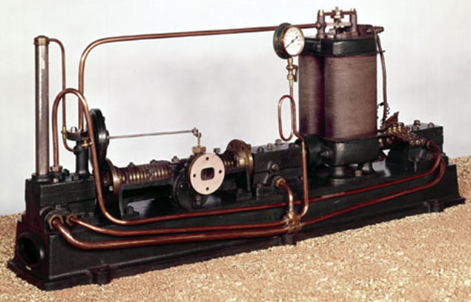
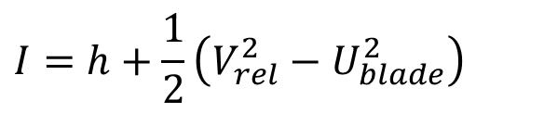
Parson Turbine working on Rankine Cycle
$$I=h+\frac{1}{2}\left(V_{rel}^{2}−U_{blade}^{2}\right)$$
Sir Parson’s Query:
It is necessary to conserve rothalpy for scientific design of an isentropic Turbine!
Why to conserve Relative Velocity ???

Slide 19
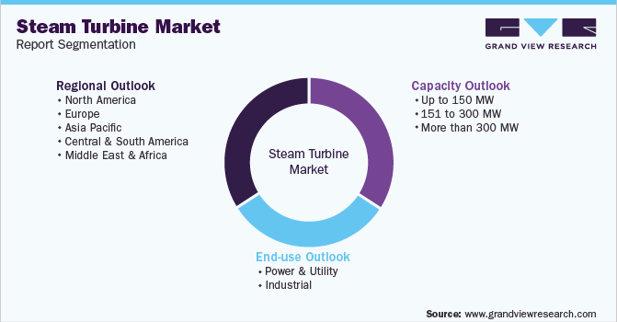
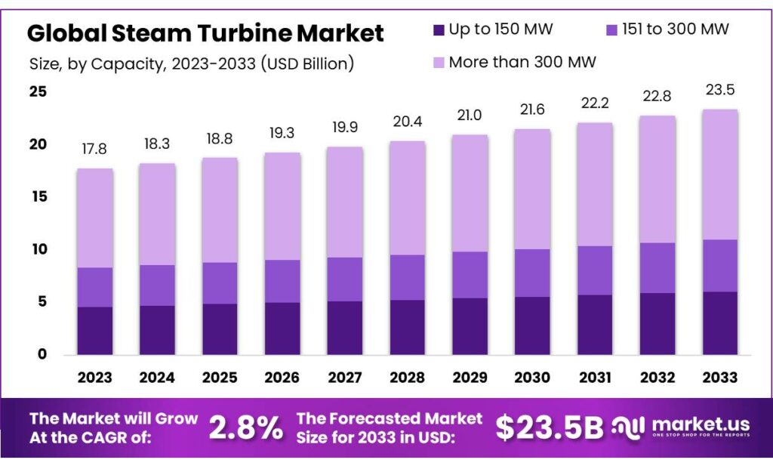
Emergence of Modern Steam Turbine
The modern manifestation of turbine, invented by Sir Charles Parsons (1884) has almost completely replaced the reciprocating piston steam engine primarily because of its greater thermal efficiency and higher power-to-weight ratio.
Because the turbine generates rotary motion, it is particularly suited to be used to drive an electrical generator – about 64% of all electricity generation in the world is by use of steam turbines in 2025!

