Slide 1

TURBOMACHINERY: Introduction
P M V Subbarao
Professor
Mechanical Engineering Department
Inventions due to Biological Need of Humans!!!

Slide 2

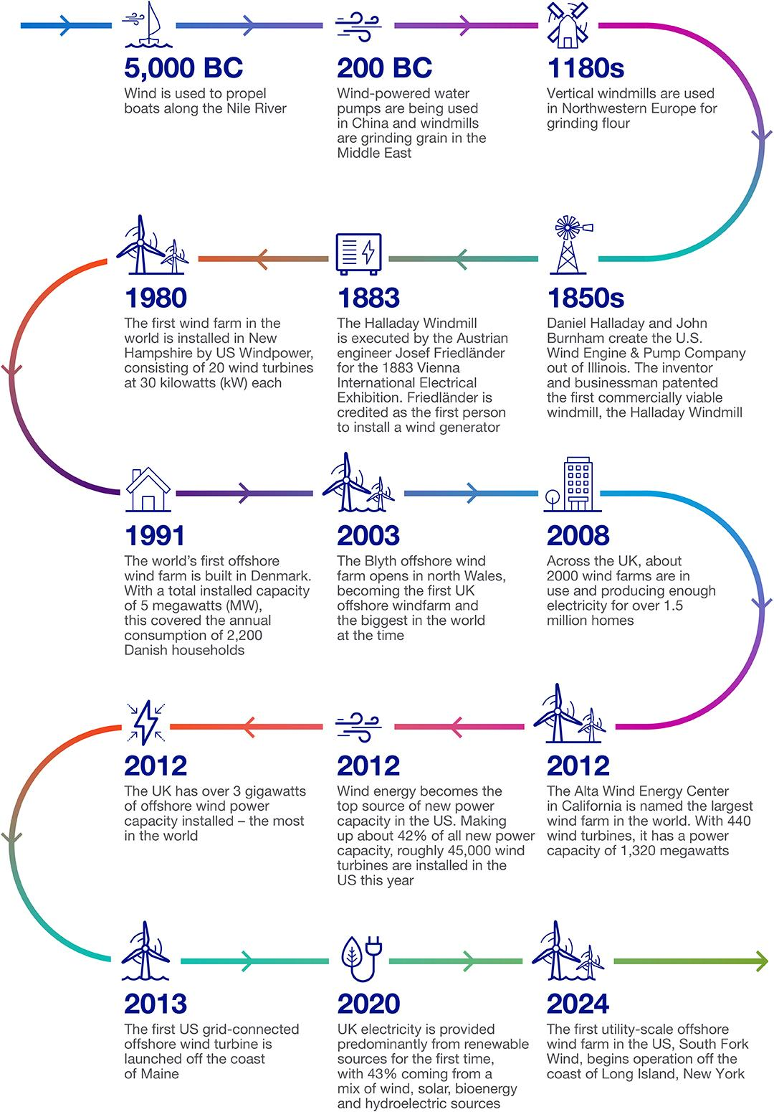
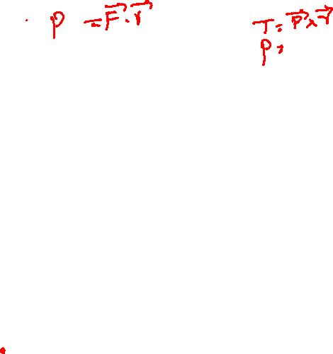
Embedded Energy System in Human Evolution

Slide 3
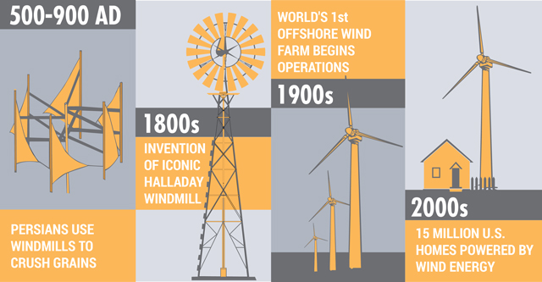
Embedded Energy System in Human Evolution

Slide 4
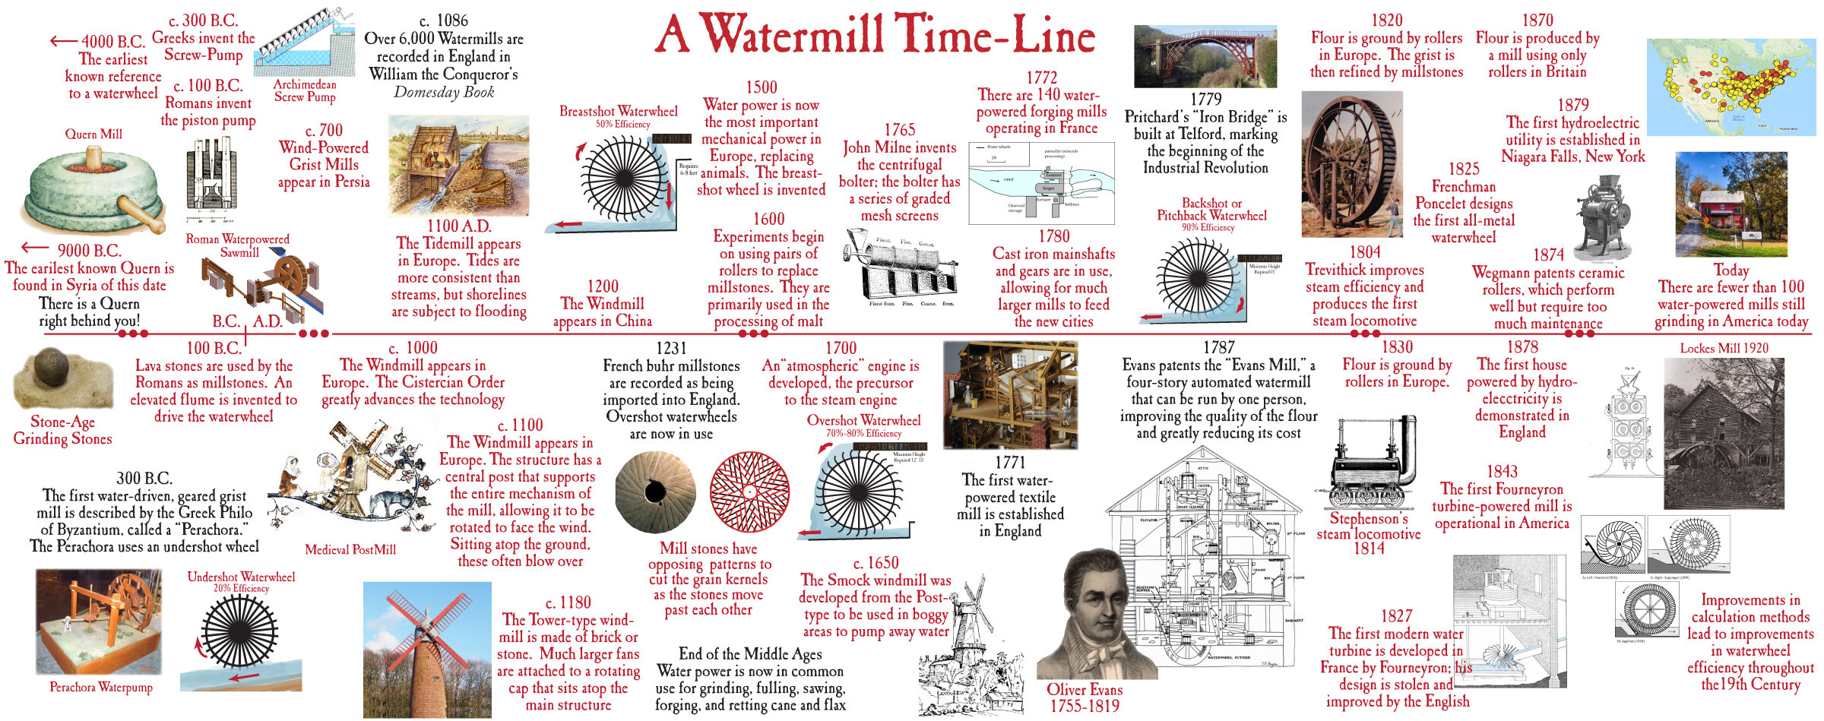
Embedded Energy System in Human Evolution

Slide 5
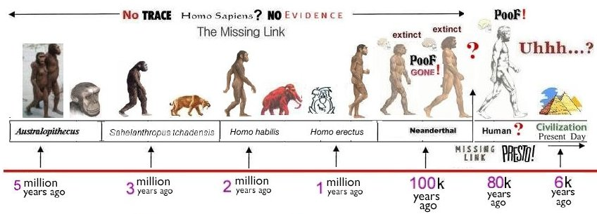
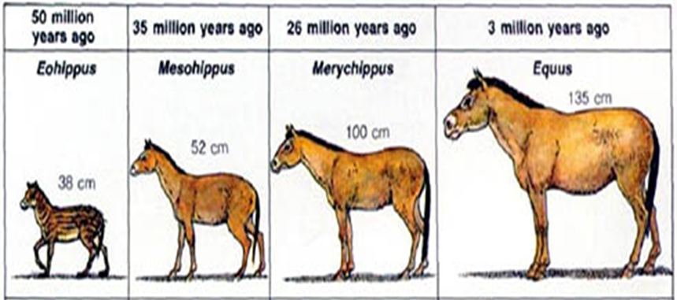
Evolution of Living Species

Slide 6
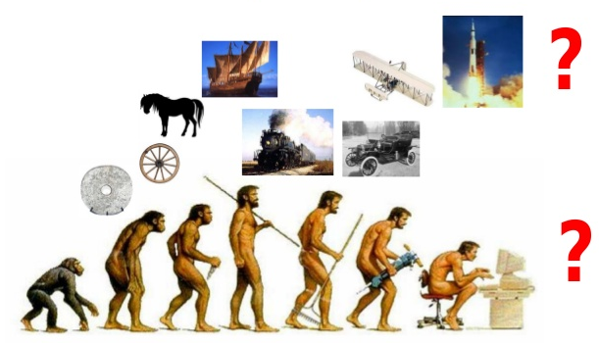
Ingenuity vs Human Evolution

Slide 7
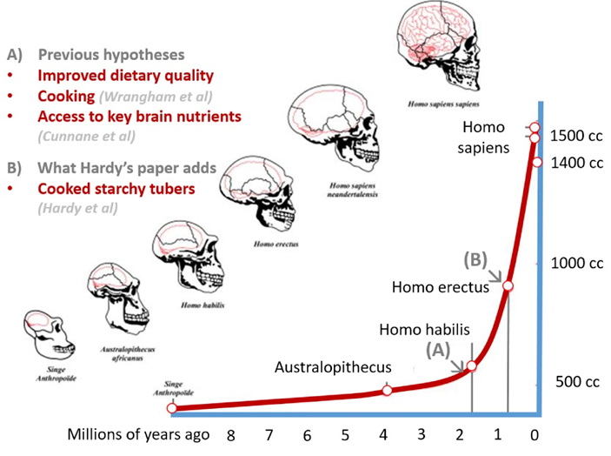
Extra Somatic Energy Usage Played/Plays A Vital Role in Human Evolution

Slide 8

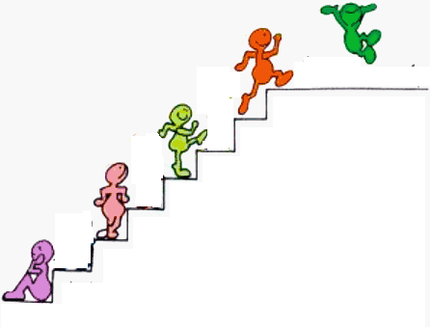
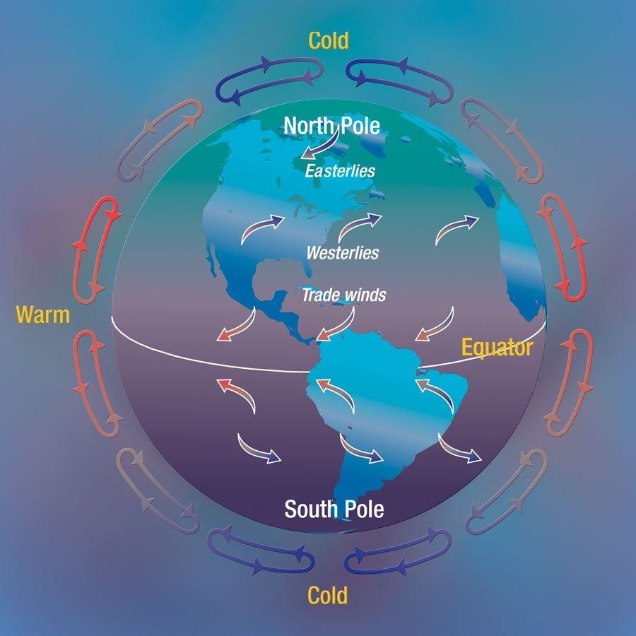

Energetic Evolution – Interaction Atmosphere
Machines Era
Windmills
Compound Tool Era
Single body Tool Era
Cattle as Energy Systems
Pre-historic Technology
Humans as Energy Systems
Pre-historic Energy Systems

Slide 9


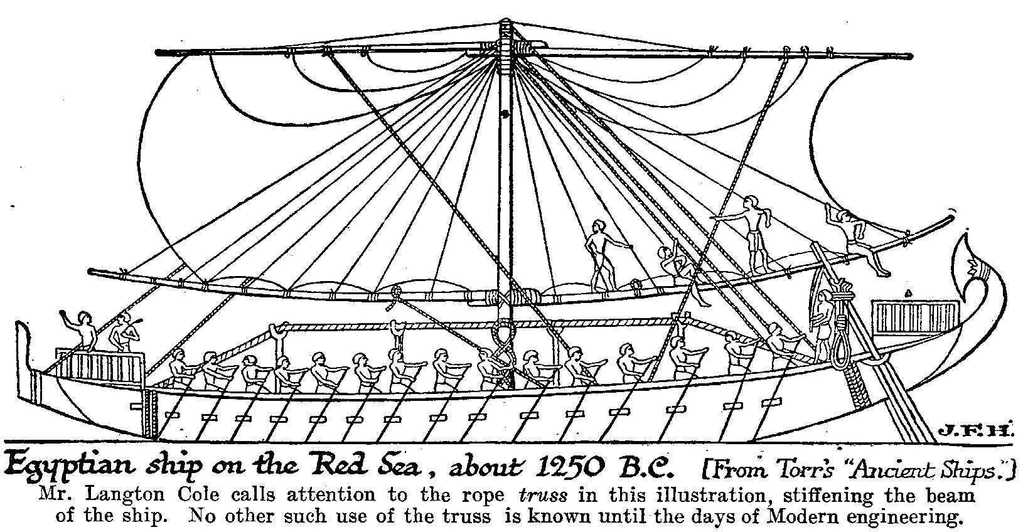
Energetic Evolution – Interaction Atmosphere

Slide 10
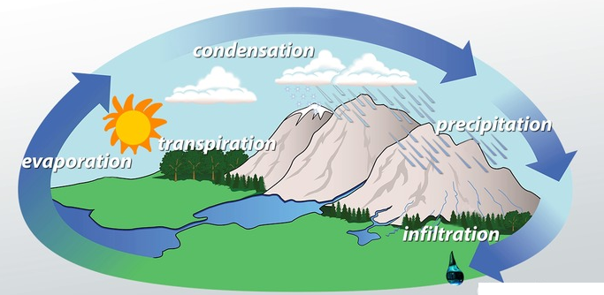
Energetic Evolution – Interaction Hydrosphere
Machines Era
Water Mills
Compound Tool Era
Single body Tool Era
Cattle as Energy Systems
Pre-historic Technology
Humans as Energy Systems
Pre-historic Energy Systems

Slide 11
Devices Evaluated by Kelvin-Plank’s Statement
“It is impossible to construct a heat engine which produces no effect other than the extraction of heat from a single source and the production of an equivalent amount of work”
“It is Impossible to Develop an Energy System that can perfectly utilize an Energy Resource.”

Slide 12
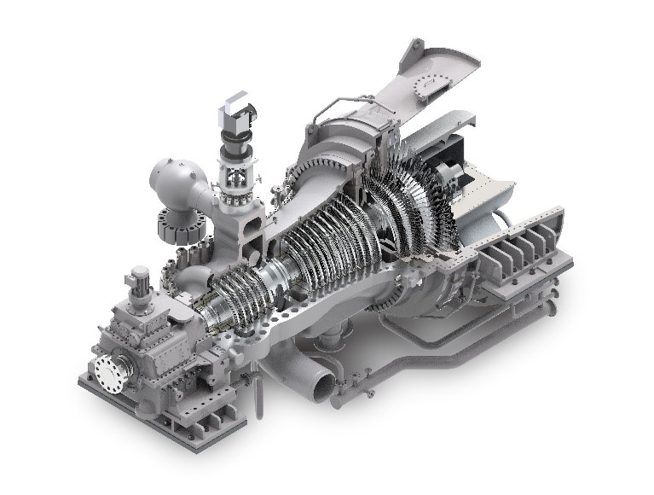
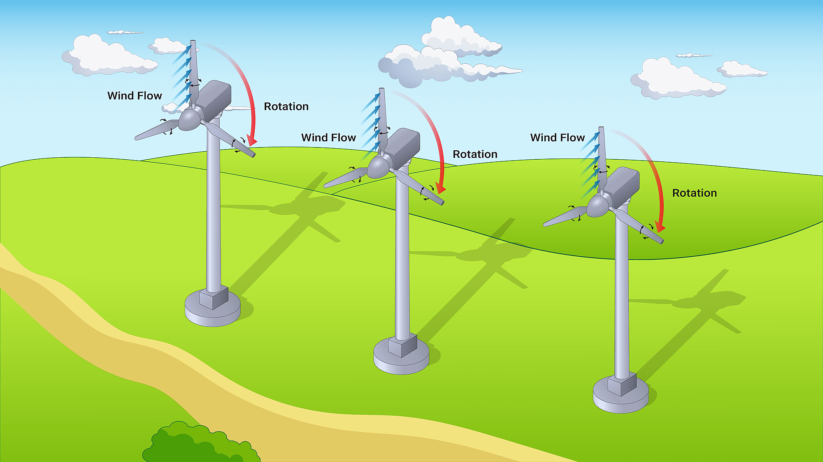

Thermodynamic Description of Turbomachine
A turbomachine is a control volume (Open System) with real or imaginary boundaries:

Slide 13
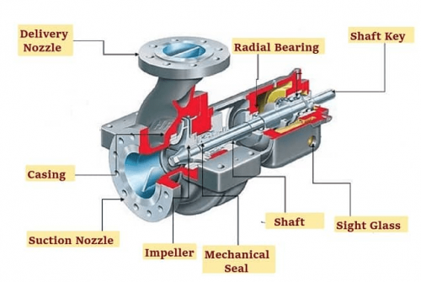
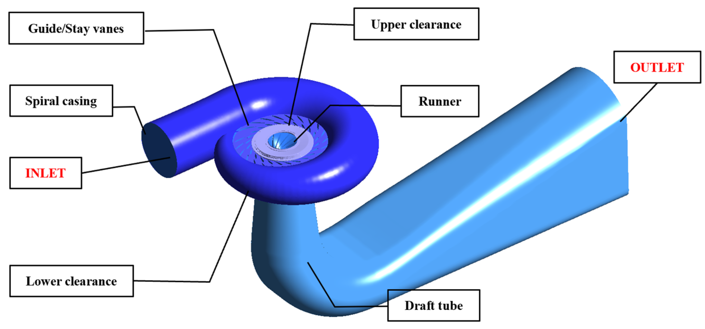
Thermodynamic Description of Turbomachine
A turbomachine may be power Generation or Comfort Generation Device.

Slide 14
Why were/are Turbomachines embedding with Human Evolution???

