Slide 1

Hybrid Automotive Prime Movers
P M V Subbarao
Professor
Mechanical Engineering Department
Creation of Scope for Strong, Clean and Efficient Motive Power .....

Slide 2
Concept of Hybrid Prime Movers
Basically, any vehicle power train is required to
(1) develop sufficient power to meet the demands of vehicle performance,
(2) carry sufficient energy onboard to support vehicle driving in the given range,
(3) demonstrate high efficiency, and
(4) emit very few environmental pollutants.
A vehicle with more than one energy source and energy converter only can satisfy all of the above demands.

Slide 3
Options of Converter Couples
A vehicle that has two or more energy sources and energy converters is called a hybrid vehicle.
A hybrid vehicle with an electrical power train (energy source energy converters) is called an HEV.
A limited speed range gasoline (or diesel) heat engine system –electric motor system.
Hydrogen fuel cell–electric motor system.
Chemical battery–electric motor system, etc.

Slide 4
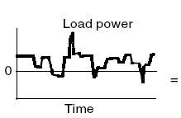
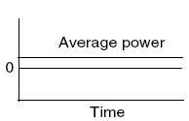
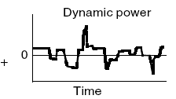
Decomposition of load power is into steady and dynamic components

Slide 5
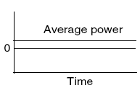
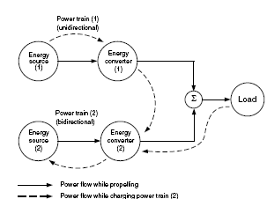
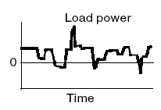
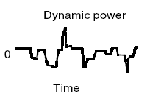
Conceptual Hybrid Scheme

Slide 6
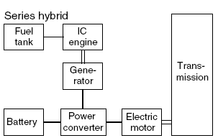
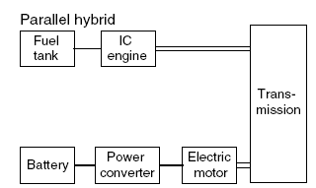
Basic Architectures of Hybrid Electric Drive Trains

Slide 7
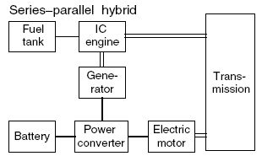
Advanced Architectures of Hybrid Electric Drive Trains

Slide 8
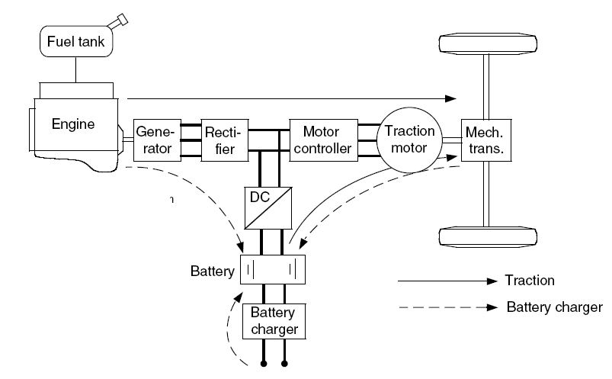
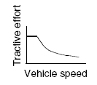

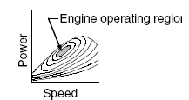
Analysis of Series Hybrid Electric Drive Trains
Unidirectional
Energy source
Bidirectional
Energy source

Slide 9
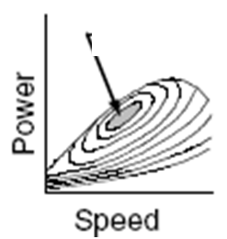
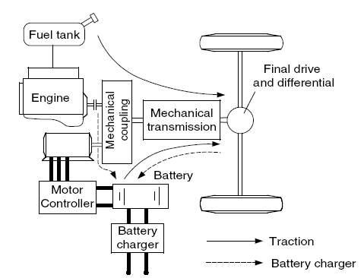
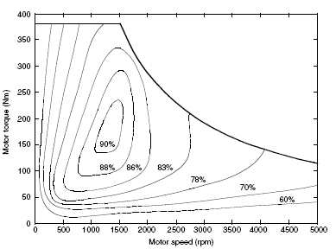
Analysis of Parallel Hybrid Electric Drive Trains
η_{max}

Slide 10




The mechanical coupling
The mechanical coupling in a PHEDT is classified as:
Torque coupling.
Speed coupling

Slide 11

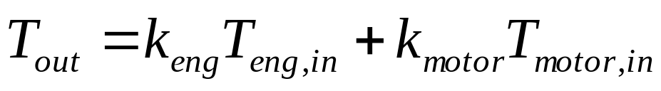
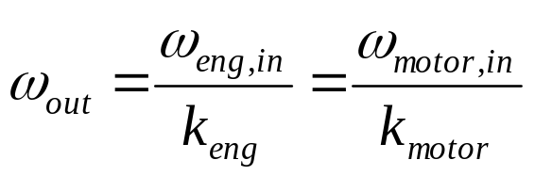
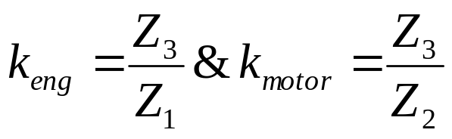
Torque-Coupling Parallel Hybrid Electric Drive Trains
The torque coupling adds the torques of the engine and the electric motor together or
Splits the engine torque into two parts: propelling and battery
charging.
If loss is ignored, the output torque and speed can be described by

Slide 12
Need for Better Hybrid Prime
Need for High power density is still an unsolved problem in HEVs.
Hybrid systems for heavy duty vehicles which are associated with high braking power.
More number of charging/discharging cycles.
Can withstand high rates of energy flow through the system during accelerations/decelerations.
Do not require batteries, many of the environmental concerns associated with battery manufacture and disposal are eliminated.
Have shorter payback time. The worst the conditions (frequent stops and go), the faster are the payback.
An electric hybrid can recover about 30 percent of the energy created during braking only.

Slide 13
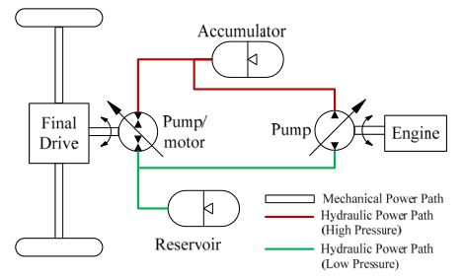
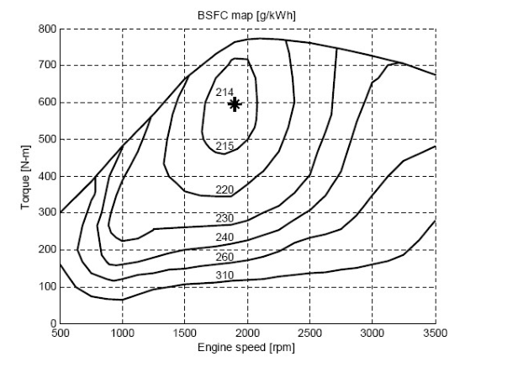
Hybrid Hydraulic Vehicle Configurations : Series
Series Hybrid Hydraulic Vehicle (SHHV:)

Slide 14
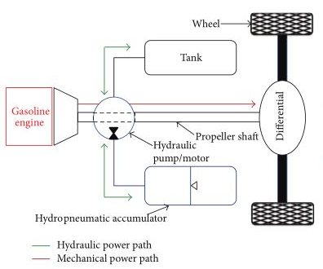
Hybrid Hydraulic Vehicle Configurations
Parallel Hybrid Hydraulic Vehicle (PHHV)

Slide 15
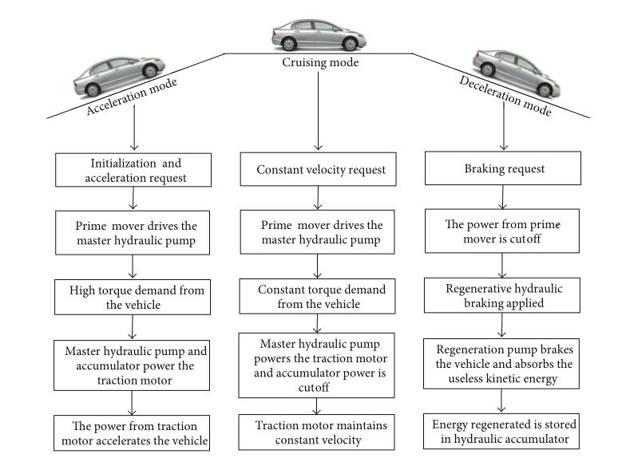
Working of series HHV

Slide 16
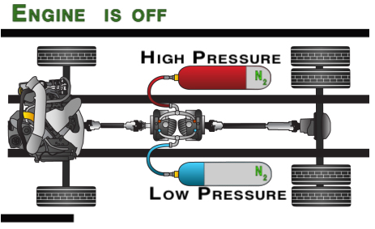
Light Acceleration/Short Cruising
When the accelerator pedal is pressed, the drive pump/motor uses high pressure fluid from the high-pressure accumulator to rotate the wheels. The fluid that has been used to rotate the wheels is then at a lower pressure and is transferred into the low-pressure reservoir.

Slide 17
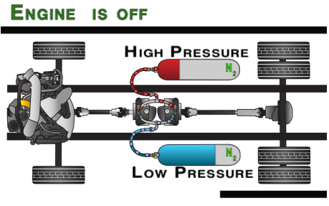
Regenerative Braking
In city stop-and-go traffic a key way fluid is pressurized is the braking process. When the vehicle starts braking, the pump/motor uses the momentum of the vehicle to pressurize fluid from the reservoir and stores it in the accumulator. Later when the vehicle accelerates only this newly pressurized fluid is used. This process captures and reuses over 70% of the energy normally lost during braking.

Slide 18
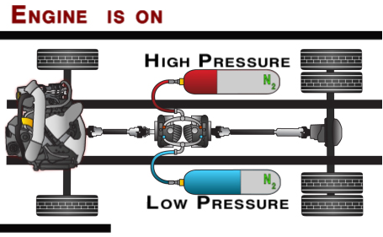
Extended Cruising/Heavy Acceleration
When the pressure level drops to a certain point the engine will turn on and begin to take fluid from the reservoir, pressurize it and transfer the fluid to the drive pump/motor. Any excess high-pressure fluid from the engine pump not needed by the drive pump/motor will be stored in the accumulator. Since it is not connected to the wheels, the engine will operate at its "sweet spot" where it runs most efficiently when it is on. The engine will shut off when it is no longer needed.

Slide 19
Hydraulic pump/motor
The pump/motor will store the braking energy into the accumulator and will also convert flow to Torque.
For HHV, the following pump/motor characteristics are needed:
1. Bidirectional: Conceptually, all hydraulic motor should be interchangeable with hydraulic pump. However, most hydraulic motors cannot be used as pump because they cannot be back driven. We need motor that can also act as pump for regenerative braking.
2. Variable Displacement
3. High Efficiency
4. Low Speed and High Torque
There are basically five types of motors available for the purpose, axial piston, gear Motor, gerotor, radial piston and vane type. Of all these axial piston type has highest efficiency and gear type having the lowest.
Axial piston pump/motor appear as best choice for HHV.

Slide 20
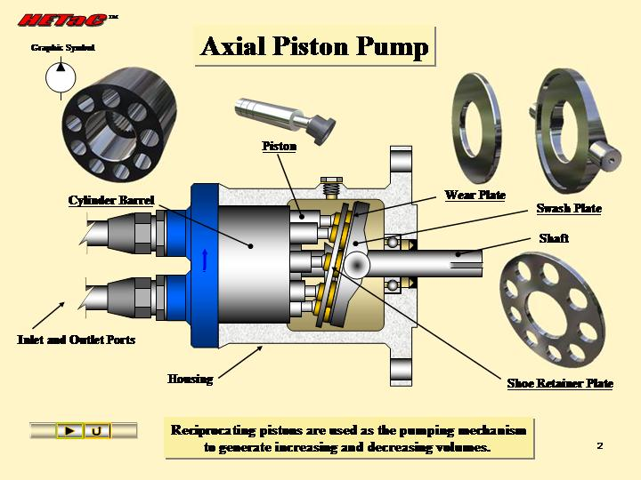

Slide 21
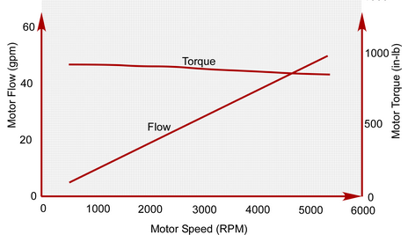
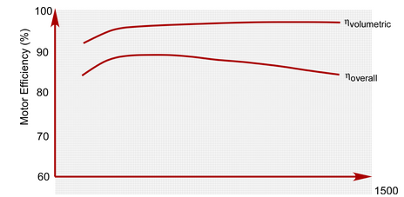

Performance Characteristics of Axial Piston Pumps

Slide 22
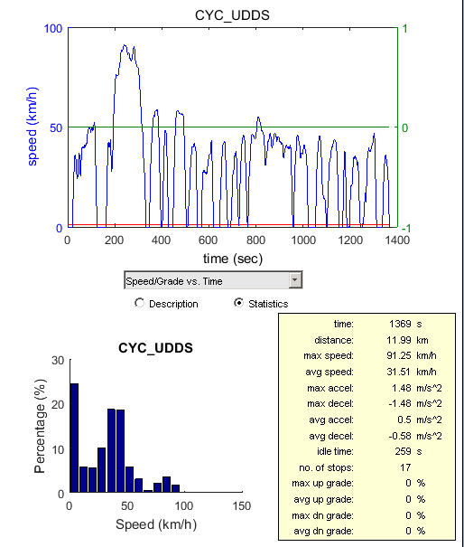
Only Vehicle Accelerates but Not the Engine

