Slide 1

Psychrometry & Air-conditioning
P M V Subbarao
Professor
Mechanical Engineering Department
I I T Delhi
Creation of Comfort /Conducive Ambience ..…

Slide 2


Psychrometric Chart & Processes
Psychrometrics is defined as the physics which deals with processes and properties of moist air (mixture of dry air and water vapor).
In 1903, Willis H. Carrier completed the world's first scientifically based air conditioning system for Sackett Wilhelm Lithographing Company situated in Brooklyn, New York., which was designed to control humidity.

Slide 3
The Birth of Air-conditioning System
From his rich experience, Willis Carrier coined the term- Air Conditioning System as:
“Air Conditioning is the control of the humidity of air by either increasing or decreasing its moisture content. Added to the control of humidity are the control of temperature by either heating or cooling the air, the purification of the air by washing or filtering the air, and the control of air motion and ventilation.”

Slide 4

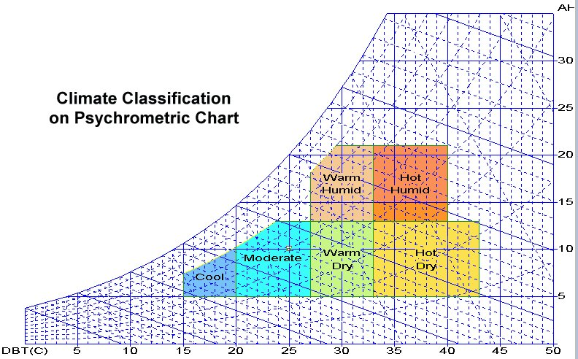
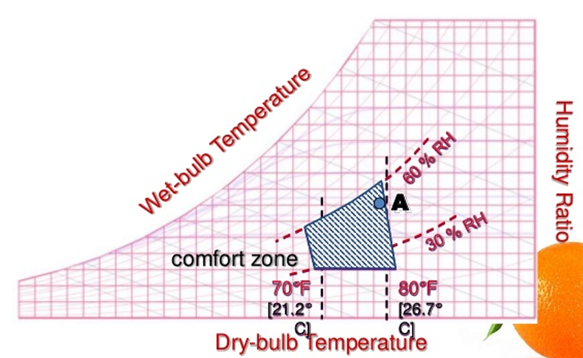
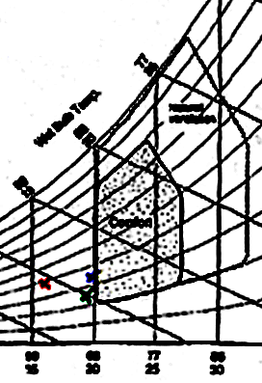

Conditioning of Ambient Atmosphere

Slide 5
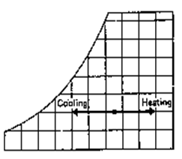
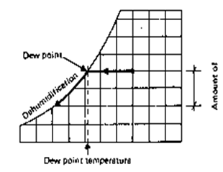
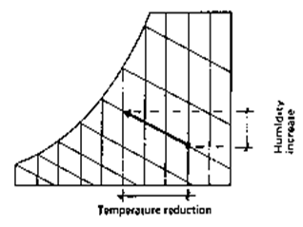
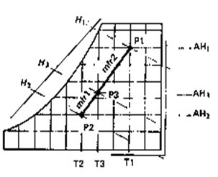
Energy Intensive Psychrometric Processes
Sensible Heating or Cooling
Dehumidification
Humidification & Cooling
Humidification & heating

Slide 11
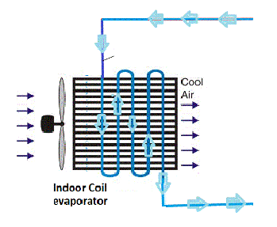
Analysis of Cooling Experiment
T_{ai}
T_{C}
T_{ae}

Slide 12
Cooling and Dehumidification
When ambient air is made to flow past a cooling coil, the air can undergo sensible cooling and dehumidification.
Let T_{c} be the temperature of cooler surface:
T_{ae} is usually larger than T_{c} as the most of the air leaving is at some state between C and ae.
The efficiency of cooling coil is defined as Coil By-pass Factor or Contact Factor.
T_{C}
T_{ai}
T_{ae}

Slide 14

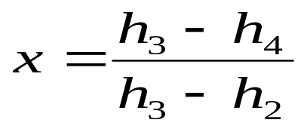
Flow Chart for Humid Summer Air-Conditioning System
Fan
1
Room
2
Recirculated air
6
5
4
Fresh air
3
Heater
Cooler
Mixer
Energy balance in mixing:

Slide 15
Analysis of Mixer
Return air
1
Room
2
Conditioned
Air
4
Fresh air
3
Mixer
Energy balance in mixing:

Slide 17
Cooling of Mixed Air
Fan
1
Room
2
Recirculated air
5
4
Fresh air
3
Cooler
Mixer

Slide 18
Winter Air-conditioning System
1
Room
2
Recirculated air
7
5
6
4
Fresh air
3
Pre Heater
Mixer
Heater
Washer

Slide 19
Sequence of Psychrometic Process in Winter A/C
2
6
x
7
1
4
5
1-x
3

Slide 20
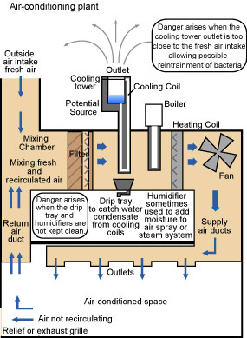
General Air Conditioning System
A typical all weather air conditioning system is shown diagrammatically above.
Some of the air is recirculated and mixed with a quantity of fresh air.

Slide 21
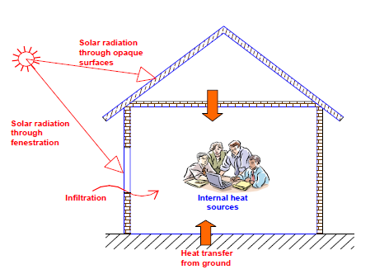
Components of Cooling Loads

Slide 22
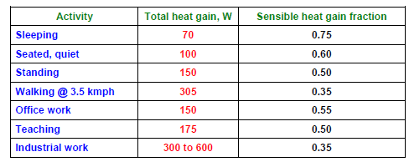
Total heat gain, sensible heat gain fraction from occupants

Slide 23
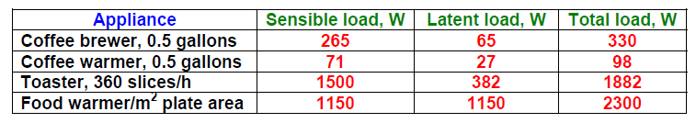
Typical appliance load

