Slide 1

Psychrometry & Air-conditioning
P M V Subbarao
Professor
Mechanical Engineering Department
I I T Delhi
Creation of Comfort /Conducive Ambience ..…

Slide 2

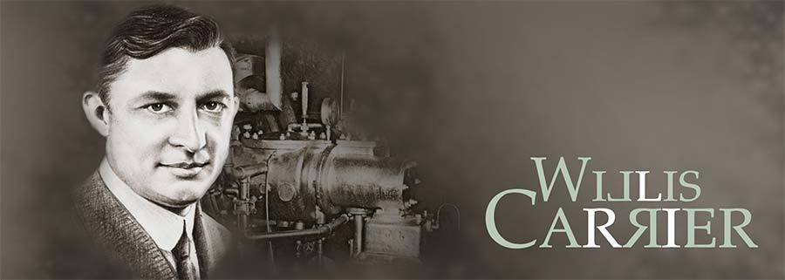
Psychrometric Chart & Processes
Psychrometrics is defined as the physics which deals with processes and properties of moist air (mixture of dry air and water vapor).
In 1903, Willis H. Carrier completed the world's first scientifically based air conditioning system for Sackett Wilhelm Lithographing Company situated in Brooklyn, New York., which was designed to control humidity.

Slide 3
The Birth of Air-conditioning System
From his rich experience, Willis Carrier coined the term- Air Conditioning System as:
“Air Conditioning is the control of the humidity of air by either increasing or decreasing its moisture content. Added to the control of humidity are the control of temperature by either heating or cooling the air, the purification of the air by washing or filtering the air, and the control of air motion and ventilation.”

Slide 4
Air Conditioning
Air conditioning is the means to control atmospheric environment in private and public buildings for the comfort of human beings or animals or for the proper performance of some scientific or industrial processes.
Full air conditioning systems control purity, movement, temperature and relative humidity of the air.

Slide 5
THERMAL COMFORT TEMPERATURE
The major aim of comfort study is to find comfort temperature for an individual or group.
However, 6 major variables determine how warm or cold a person feels.
Environmental factors
  air temperature
  air speed
  humidity
mean radiant temperature
Individual factors
  activity
  Clothing insulation (clo unit): 1 clo = 0.16oC .m²/w.
  The clo is a measure of thermal resistance and includes the insulation provided by any layer of trapped air between skin and clothing and insulation value of clothing itself.
  1 clo unit will maintain a sedentary man at 1 met indefinitely comfortable in an environment of 21ºC , 50% RH, and .01 m/s air movement. Possibly also individual differences, and recent thermal history.
Possibly also individual differences, and recent thermal history.

Slide 6
COMFORT STANDARDS
Activity - 1.2 met, mainly sedentary
Winter - 0.9 clo (sweater, long sleeve shirt, heavy slacks), air flow -0.15 m/s
Optimum operative temperature = 22.7ºC
Summer - 0.5 clo (light slacks, short sleeves or blouse), air flow -0.25 m/s
For each increased degree Kelvin up to maximum 28ºC at 0.8 m/s air, need to increase air motion by 0.275 m/s.
Optimum operative temperature = 24.4ºC With minimum clothes (0.05 clo)

Slide 7
Thermal Conditions
One of earliest reasons for building was to create shelter from elements.
The desire to keep dry and warm/or cool (depending on climate) has generated a variety of architectural forms which have evolved to increase the impermeability of the building envelope to natural conditions and through environmental engineering, allow us to create our own interior environmental conditions.
Basic model of thermal conditions
THE BODY
Our living bodies generate heat because we are homiothermic (warmblooded) creatures.
The rate at which heat is produced depends primarily on our metabolic rate.
Metabolic rate = our ability to generate heat is mostly a function of our level of muscular activity.
Some of the energy generated by muscular activity will be directly translated into work (force x distance) and the excess energy will be dissipated as heat.
Met units - Each of us in this classroom is producing about 1 met (1 unit of metabolic rate) of waste heat.
Because, as we shall see, heat exchange with our environment is primarily via the skin, the met unit is defined in terms of both heat energy and surface area.
1 met = 58.2 w/m² .

Slide 8
Metabolic Rates for Typical Tasks
Activity
Metabolic rate
(met units)
Reclining
0.8
Seated, quietly
1.0
Sedentary activity (office, dwelling, lab, school)
1.2
Standing, relaxed
1.2
Light activity, standing (shopping, lab, light industry)
1.6
Medium activity, standing (shop assistant, domestic work, machine work)
2.0
High activity (heavy machine work, garage work)
3.0

Slide 9
Air Conditioning
Air conditioning is the means to control atmospheric environment in private and public buildings for the comfort of human beings or animals or for the proper performance of some scientific or industrial processes.
Full air conditioning systems control purity, movement, temperature and relative humidity of the air.
Typical air conditioning systems for buildings are:
Perimeter induction
Fan coil
Chilled ceiling
Single duct
Dual duct
Variable air volume
Terminal heat recovery

Slide 10
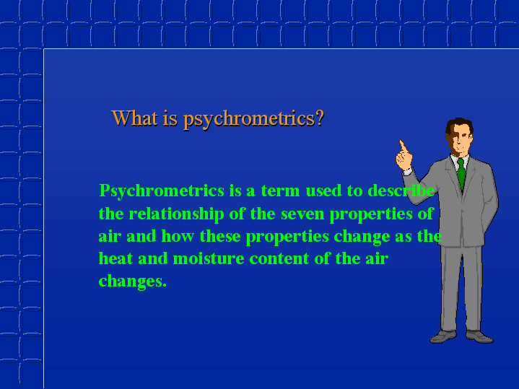

Slide 11
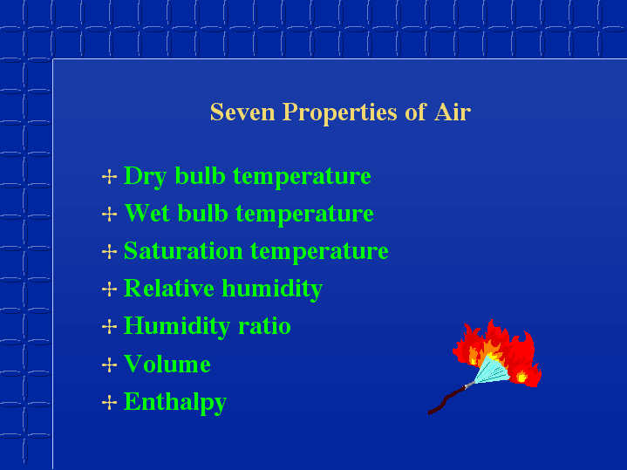

Slide 12
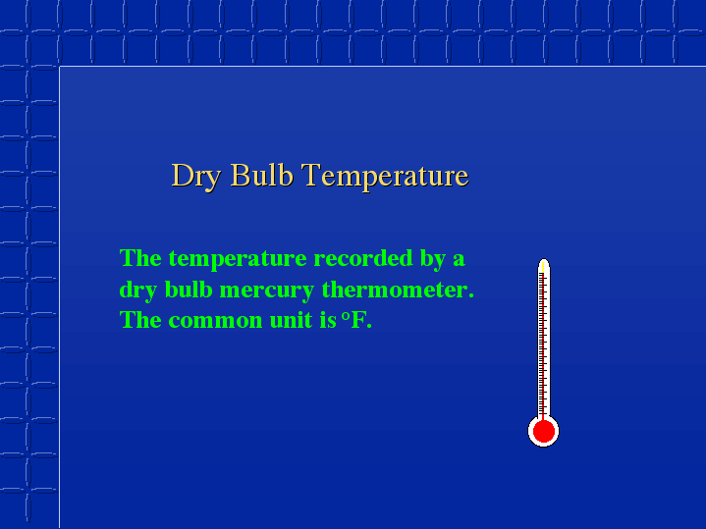

Slide 13
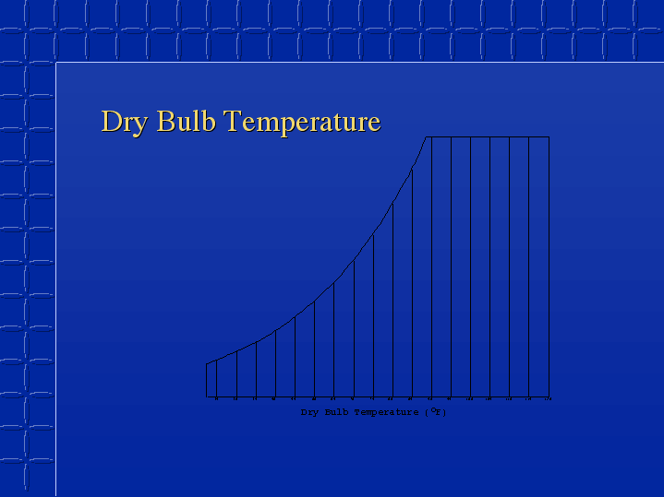

Slide 14
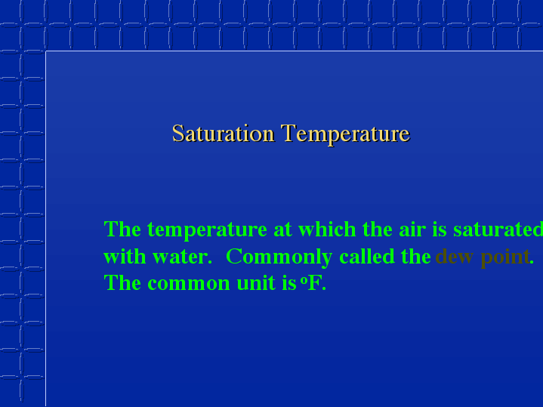
The partial pressure of water vapour is a function of saturation temperature
At dew point the air posses maxiumum water vapour it can

Slide 15
Saturated Air
Air contains maximum possible moisture at the temperature.
The partial pressure of moisture will be maxium, p_{vs}
Generally called as 100% saturated mixture.
In general a moist air may not contain 100% moisture, which air can posses.
The level of moisture is defined as Relative Humidity.

Slide 16
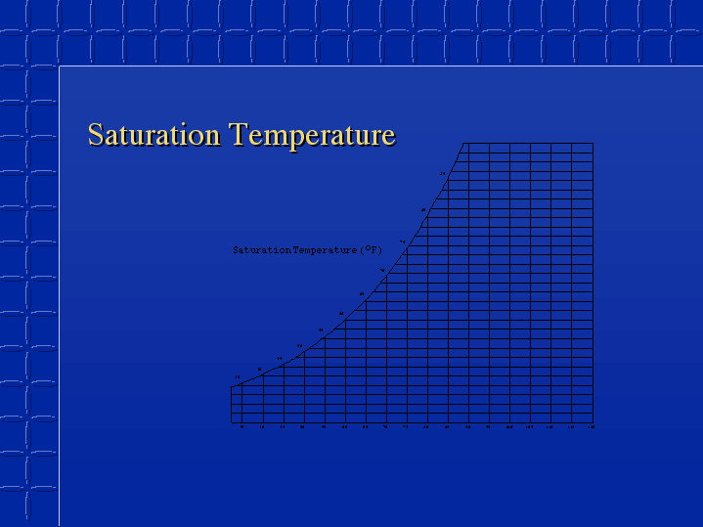

Slide 17
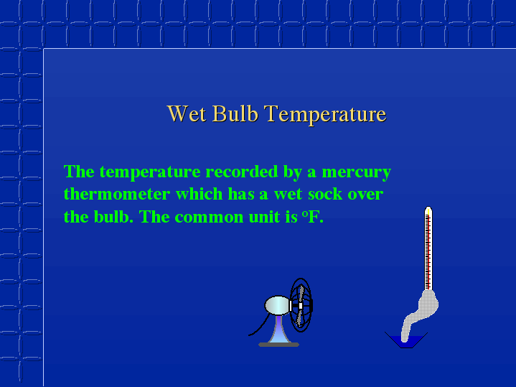
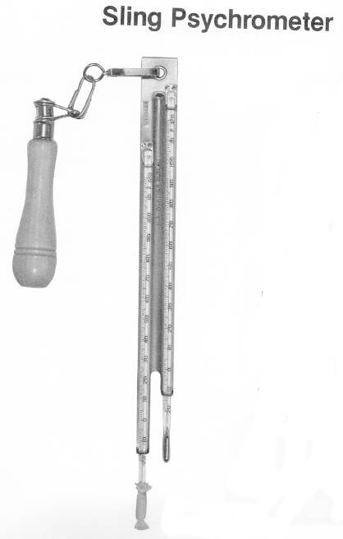

Slide 18
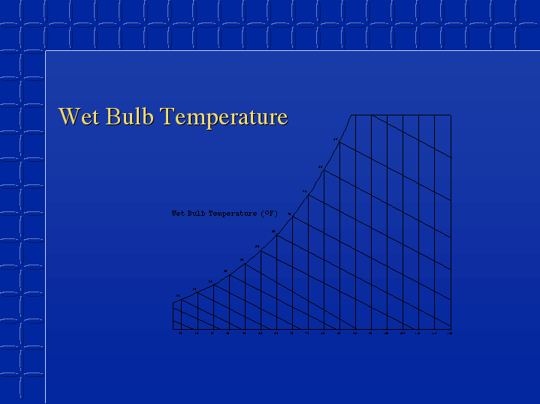

Slide 19
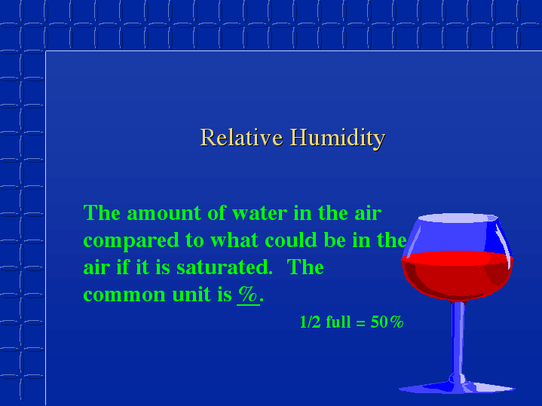
Φ = m_{v}/m_{vs}

Slide 20
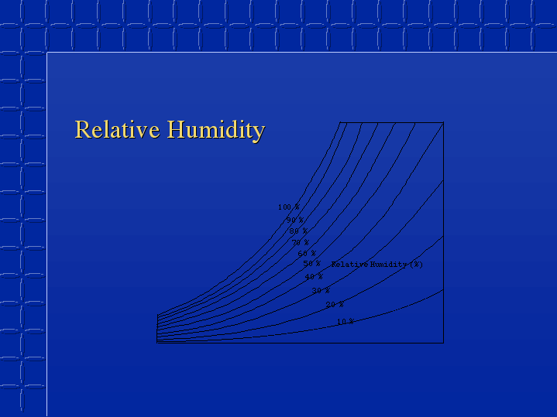

Slide 21
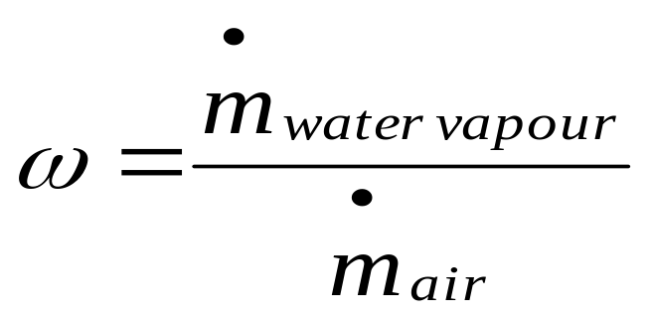
Specific Humidity or Humidity Ratio
Specific humidity or moisture content of air is the ratio of the mass of water to the mass of dry airin a given volume of moist air.

Slide 22
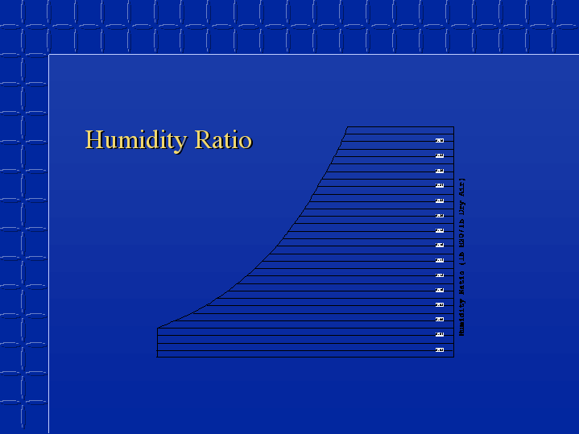

Slide 23
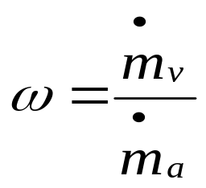
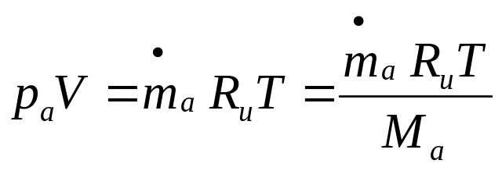
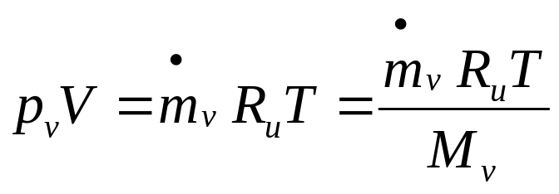
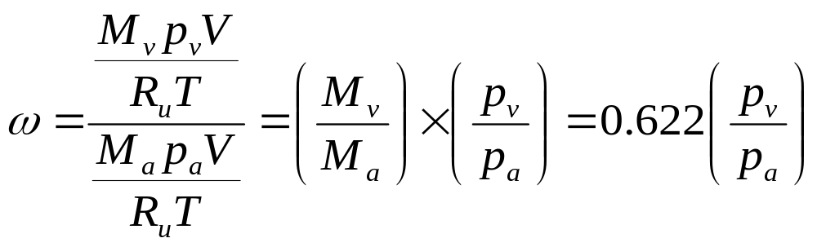

Slide 24
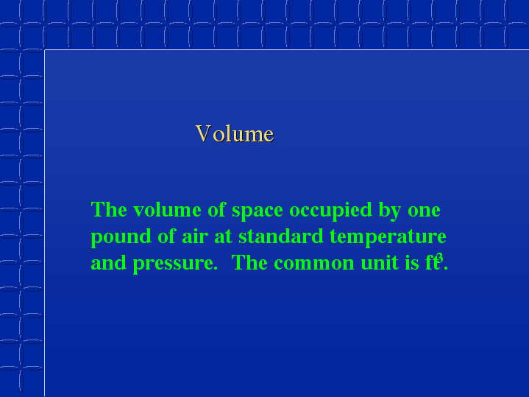
m³

Slide 25
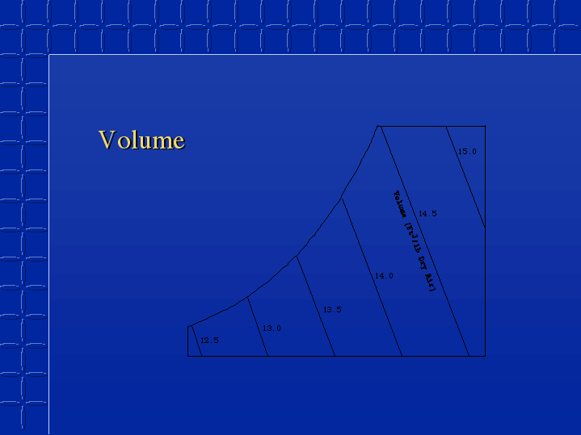

Slide 26
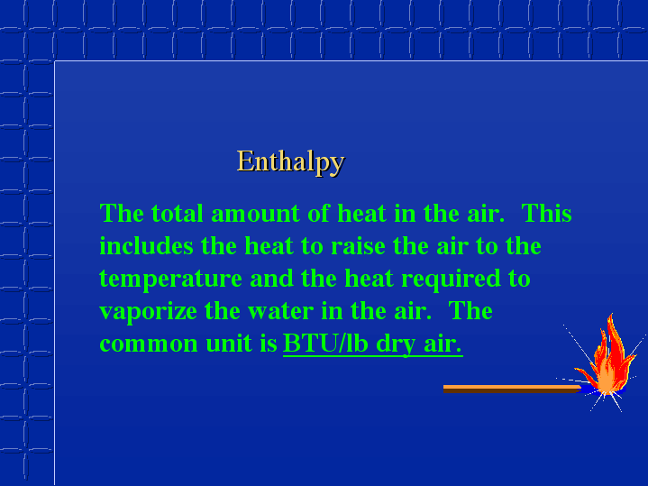
KJ/kg

Slide 27
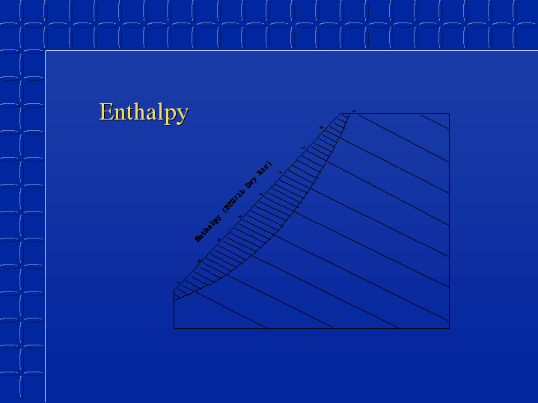

Slide 28
Psychrometric Chart & Processes

Slide 29
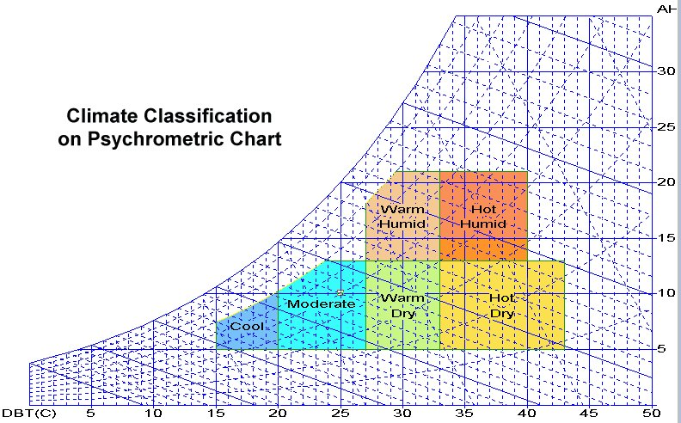

Slide 30
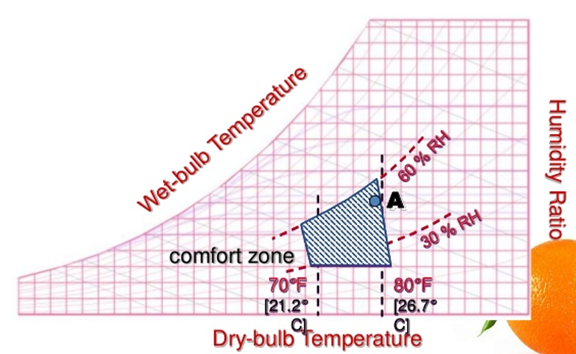
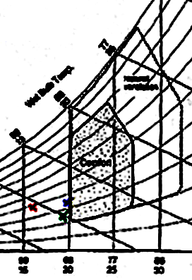

Conditioning of Ambient Atmosphere

Slide 31
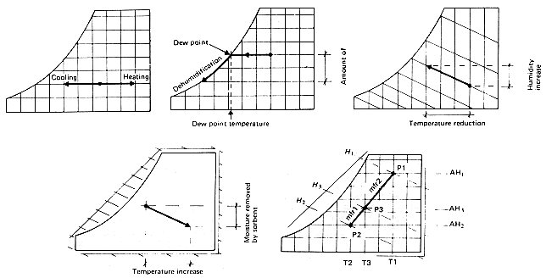
Psychrometric Processes

Slide 32
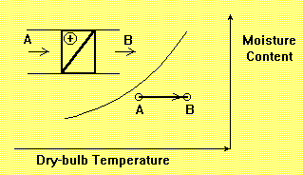

Sensible Heating Process
Sensible Heating Process is a process during which the dry-bulb temperature of air is increased.
The process occurs at constant moisture content.
The air passes over a hot and dry surface which might be pipe coil using steam or hot water, electrical resistance or an air-to-air heat recovery unit.
The load on the heater is:

Slide 33
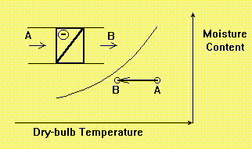

Sensible Cooling Process at Constant Moisture Content
Sensible cooling process at constant moisture content is a process during which the dry-bulb temperature of air is decreased.
The air passes over a cooling coil which uses chilled water or direct expansion of some refrigerant into the pipe coil.
The load on the cooling coil is:

Slide 34


Adiabatic Humidification Process
In this process, air enters a duct (which is assumed to be perfectly insulated in order to satisfy the condition for an adiabatic process) at dry-bulb temperature T1 and moisture content g1 and leaves the duct at dry-bulb temperature T2 and moisture content g2.
The latent heat gained by the air is equal to the sensible heat loss by the air. i.e.
here hfg is the latent heat of water.
If the water tank is infinitely long, the air at the outlet will be 100% saturated.
The temperature at this condition is known as adiabatic saturation temperature.

Slide 35
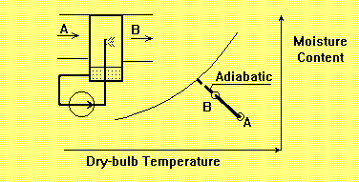
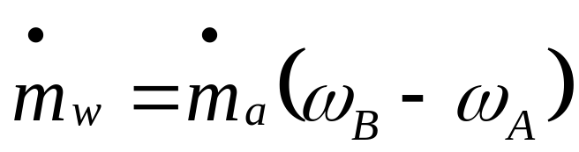
Adiabatic Humidifier with Recirculation of Spray Water
In this system, the water is recirculated through the pipes to nozzles.
That part of water which is not evaporated into the air stream, returns to the tank for recirculation.
This process can be assumed as an adiabatic process with good approximation.
The required make-up water supplied to the tank is:

Slide 36
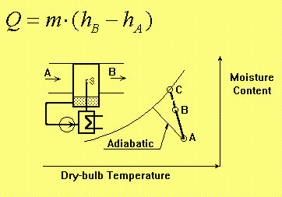
Spray Water with Recirculation and Heating
Spray-type humidifiers may use heating or cooling equipment to achieve the desired air condition.
The heat supplied to or gained from the system is:
When the heat is supplied to the system, the ADP (Apparatus Dew-Point Temperature) will be higher than the adiabatic process.

Slide 37
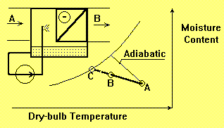
Spray Water with Recirculation and Cooling
In some cases the increase in moisture content is accompanied by sensible cooling
When the heat is gained from the system, the ADP (Apparatus Dew-Point Temperature) will be lower than the adiabatic process.

Slide 38
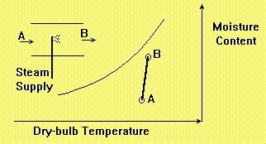
Steam Humidifiers: Direct Steam Injection
Steam can be directly injected to air stream for air conditioning purposes.
In this process, all the latent heat necessary for evaporation of water is added outside the air stream.
The supply of water vapor increases the enthalpy of the air.
The temperature increase in this process is negligible and it can be assumed as an isothermal process with good approximation

Slide 39
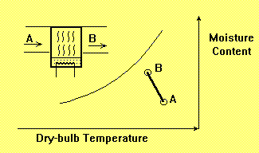
Pan Steam Humidifiers
A Pan Steam Humidifier uses a heating element inside a water tank. The tank is mounted at the bottom of the air duct.
The air flowing over the water surface will cause some evaporative cooling which results in drop of air dry-bulb temperature.

Slide 40
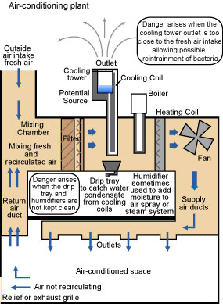
Summer Air Conditioning System

Slide 41
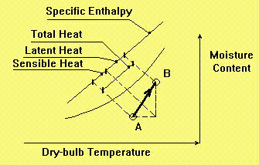
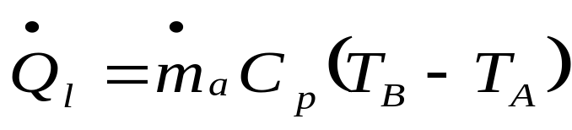
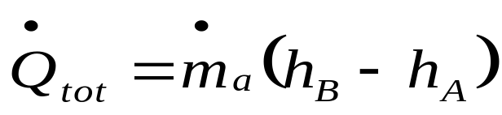
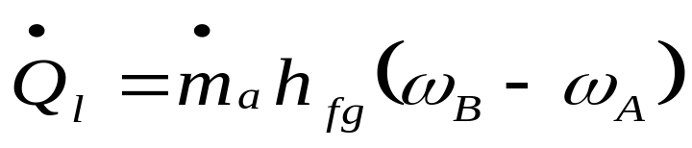
Process Line for Summer Air Conditioned Space
The room process line, known also as room ratio line (RRL) is defined by the condition of supplied air and the desired air condition in the space.
The RRL is dependent on both sensible and latent heat load.
The sensible heat load is defined as:
ma= mass flow rate of dry air
Cp= Humid Specific Heat
The latent heat load is defined as:
Total Heat Load = Sensible load+latent load

Slide 42
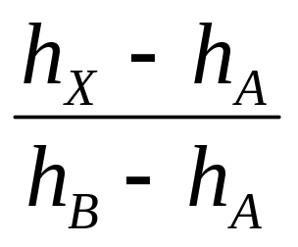
The Room Ratio Line: A—B :
X

Slide 43
Summer Air Conditioning System
A typical conventional air conditioning system is shown diagrammatically above.
Some of the air is recirculated and mixed with a quantity of fresh air.

Slide 44

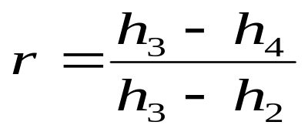
Fan
2
1
Room
Recirculated air
6
5
4
Fresh air
3
Heater
Cooler
Mixer
Energy balance in mixing:

Slide 45
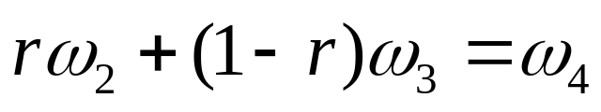
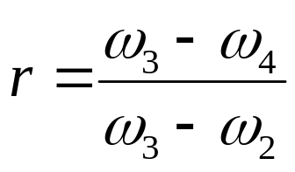
A mass balance in mixer:
In a cooling coil the air undergoes sensible cooling and dehumidification.
Let T_{c} be the temperature of cooler surface:
T₅ is usually larger than T_{c} as the most of the
air leaving is at some state between C and 5.
The efficiency of cooling coil is defined as
Coil By-pass Factor or Contact Factor.
5
4
Cooler

Slide 46
Winter Air-conditioning System
1
Room
2
Recirculated air
7
5
6
4
Fresh air
3
Pre Heater
Mixer
Heater
Washer

Slide 47
2
6
7
1
4
5
3

Slide 48
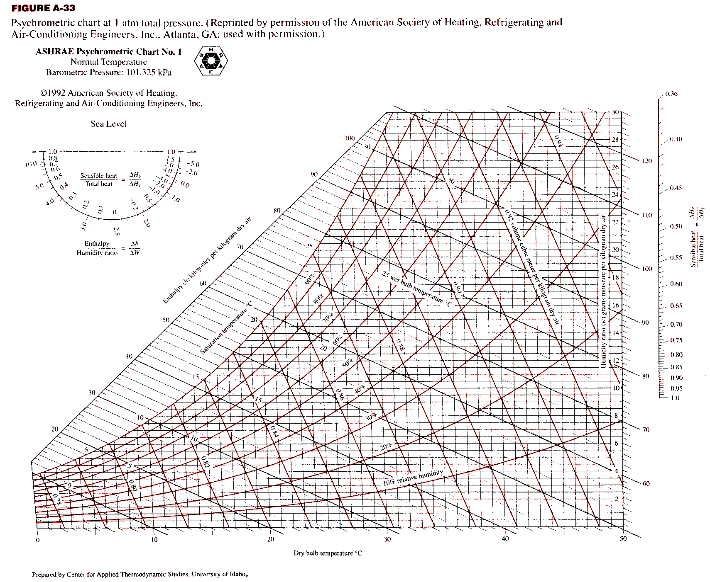

Slide 56

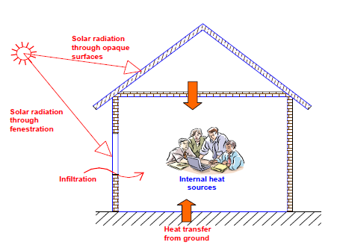
Components of Cooling Loads

Slide 57
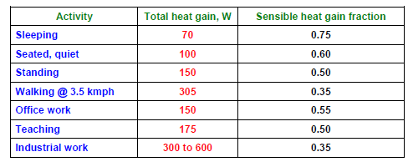
Total heat gain, sensible heat gain fraction from occupants

Slide 58
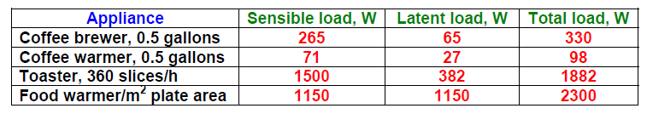
Typical appliance load

Slide 59

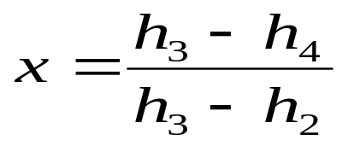
Flow Chart for Humid Summer Air-Conditioning System
Fan
1
Room
2
Recirculated air
6
5
4
Fresh air
3
Heater
Cooler
Mixer
Energy balance in mixing:

Slide 60
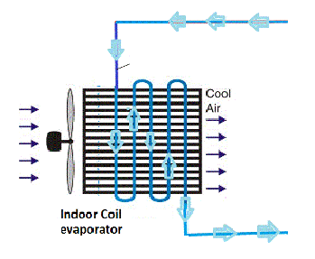
Cooling and Dehumidification
In a cooling coil the air can undergo sensible cooling and dehumidification.
Let T_{c} be the temperature of cooler surface:
T₅ is usually larger than T_{c} as the most of the air leaving is at some state between C and 5.
The efficiency of cooling coil is defined as Coil By-pass Factor or Contact Factor.
T_{C}
T₄
T₅

Slide 61
Winter Air-conditioning System
1
Room
2
Recirculated air
7
5
6
4
Fresh air
3
Pre Heater
Mixer
Heater
Washer

Slide 62
Sequence of Psychrometic Process in Winter A/C
2
6
x
7
1
4
5
1-x
3

