Slide 1

Variants of Turbo/Nonturbo based Propulsion Systems
P M V Subbarao
Professor
Mechanical Engineering Department
I I T Delhi
Superior Combination of Wrights Idea and Newton's Idea!!!

Slide 2

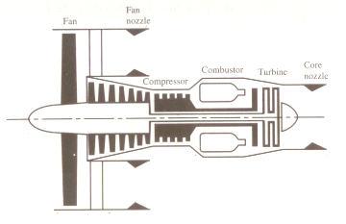

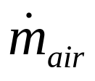
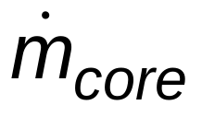



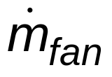
An Evolved design of Turbojet
Inlet
Total thrust may be Shared by both cold and hot jets..
4
7 or hj
5
6
1
2
cj
3
In 1939-1941 Soviet designer Arkhip Lyulka elaborated the design of turbojet and created an evolved turbojet.
Created the world's first turbofan engine, and acquired a patent for this new invention on April 22, 1941.

Slide 3
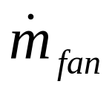
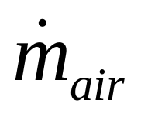
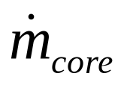
Special Design Variable for an Ideal Turbofan Engine
Inlet
Large amount of air is taken and all the air is first compressed by fan.
Downstream air is divided into fan flow and core flow.
Core flow performs turbojet events.
Fan flow is immediately expanded in a nozzle.
1
2

Slide 4
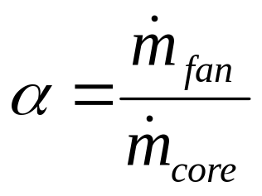
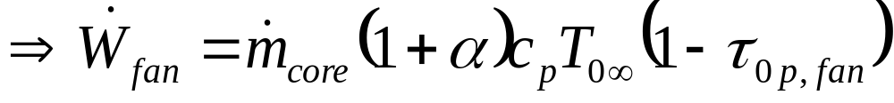
Sizing of Fan
Inlet
Design Parameter 1: Fan Total Pressure ratio
1
2
3

Slide 5
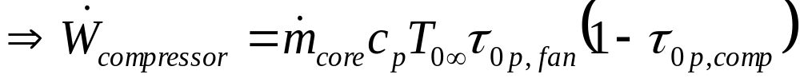
Sizing of Compressor
Inlet
Design Parameter 2: Compressor total pressure ratio
4
2
3
1

Slide 6
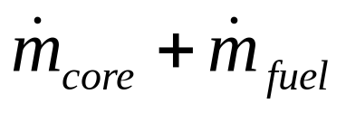
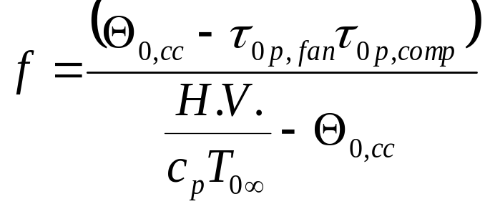
Sizing of Combustor
Inlet
5
4
1
2
3

Slide 7
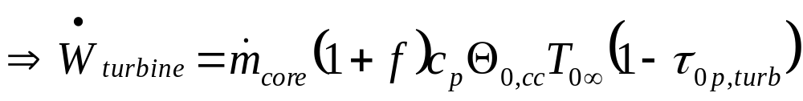
Combined Gas Dynamic & Thermodynamic SSSF model for Turbine
Inlet
6
5
4
1
2
3

Slide 8
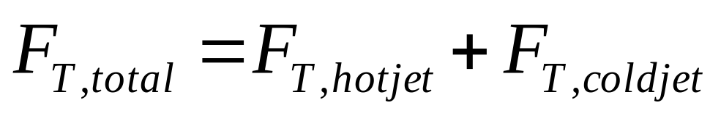
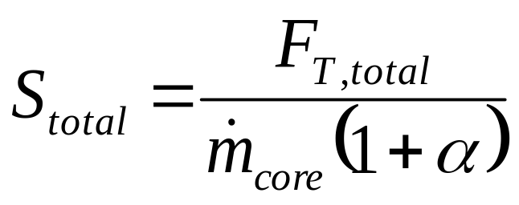
Generation of Thrust : The Capacity
Specific Thrust based on total flow

Slide 9
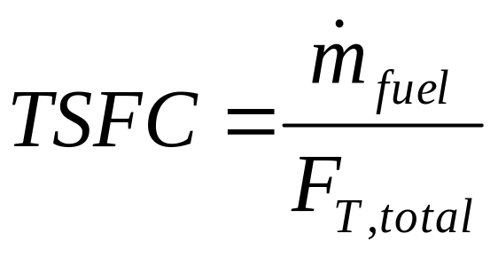
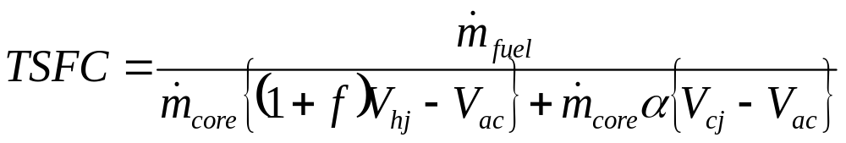
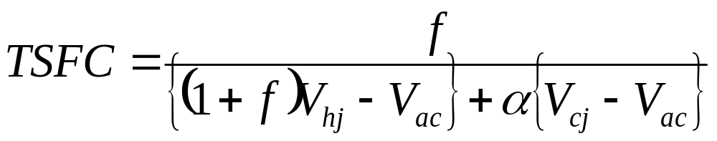
Thrust Specific Fuel Consumption TSFC

Slide 10
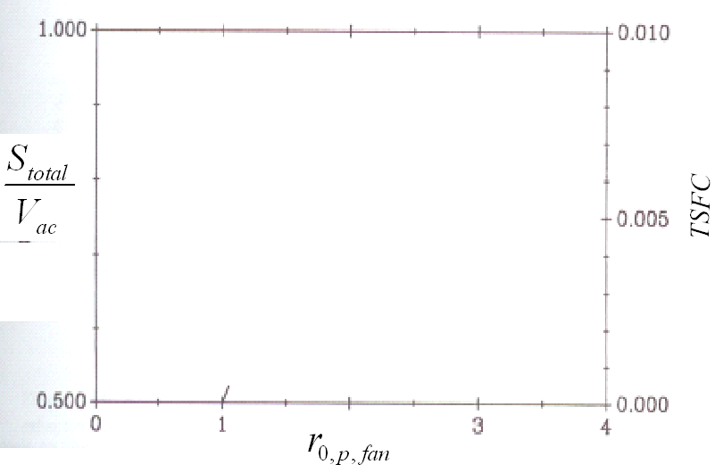
Influence of Fan: Pressure Ratio: M_{ac} = 0.75
r_{0,p,comp}=15.0
α=4.0
T_{0max}=1200K

Slide 11
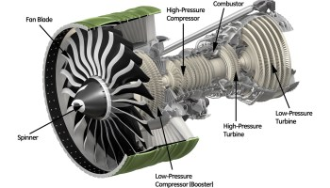
Best Selling Turbofans in World CFM series

Slide 12
Current Turbofan Engines
Model | Thrust | Bypass ratio | Pressure ratio | Applications
CFM56-7B18 | (86.7 kN) | 5.5 | 32.7 | Boeing 737-600
CFM56-7B20 | (91.6 kN) | 5.4 | 32.7 | Boeing 737-600, Boeing 737-700
CFM56-7B22 | (101 kN) | 5.3 | 32.7 | Boeing 737-600, Boeing 737-700
CFM56-7B24 | (108 kN) | 5.3 | 32.7 | Boeing 737-700, Boeing 737-800, Boeing 737-900

Slide 13
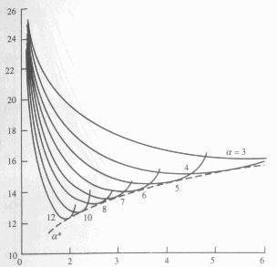
Optimum Fan Pressure Ratio for Fuel Economy
α
r_{0,p,comp}=24
T_{0max}=1800K
M_{ac} =0.9
TSFC
α=3
α=4
α=5
7
α=6
8
10
12
Fan Pressure Ratio

Slide 14
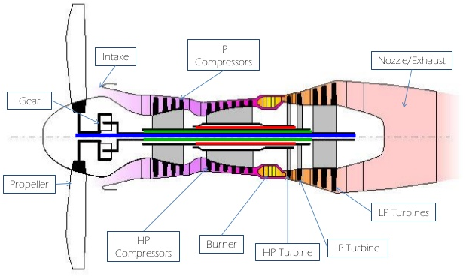
Infinite Bypass Ratio Engine
Turboprop Engine
V∞

Slide 15
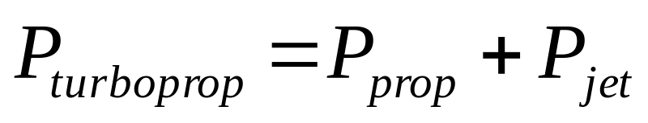
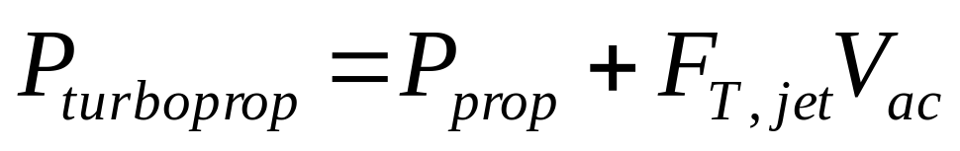
Power Generated by A Turboprop
The total propulsive power generated by an ideal turboprop is given by:

Slide 16
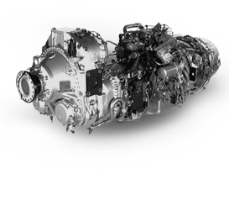
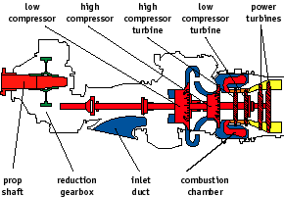
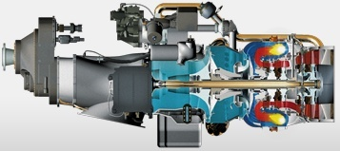
Pratt & Whitney PW127G Turboprop
The result is class-leading fuel consumption and low green house emissions.

Slide 17
Specifications
Type: Three spool, free shaft turboprop
Inlet: Scroll type
Compressor: Twin spool; 1 stage centrifugal LPC, 1 stage centrifugal HPC
Burner: Annular, reverse flow
Turbine: Three spool, single stage axial HPT, single stage axial LPC, 2 stage power turbine
Exhaust: Rear exit, axial flow jet-type outlet
Power Rating: 3,500 equivalent shaft horsepower at 1,200 rpm
Mechanical Horsepower Rating: 3,185 horsepower
Thrust Rating: 1750 lbt
Rated Torque Output: 13,939 lb-ft
Pressure Ratio: 14.5:1
Specific Fuel Consumption: .44 lb/shp/hr

Slide 18
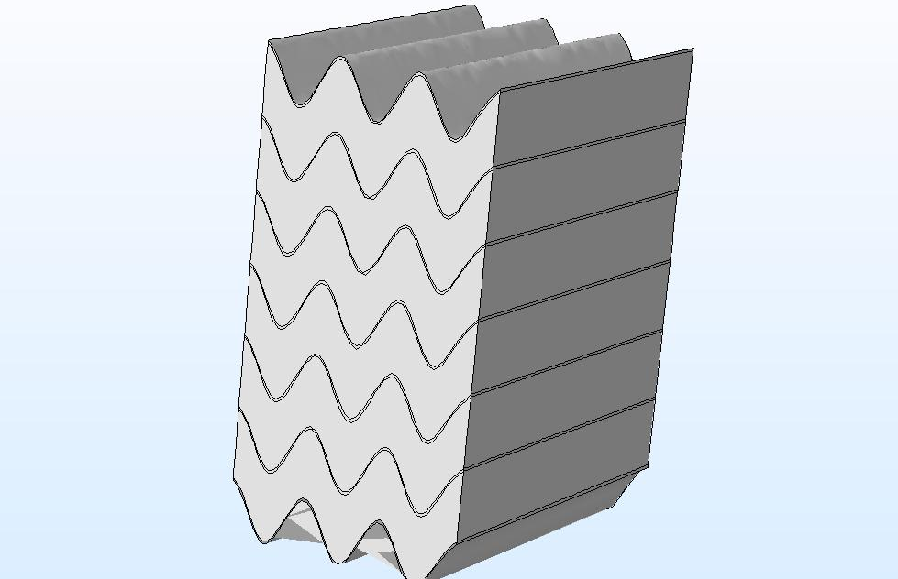
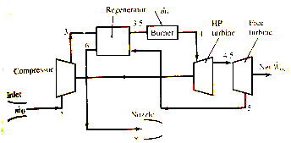
Our Research:Turboprop with Regeneration

Slide 19
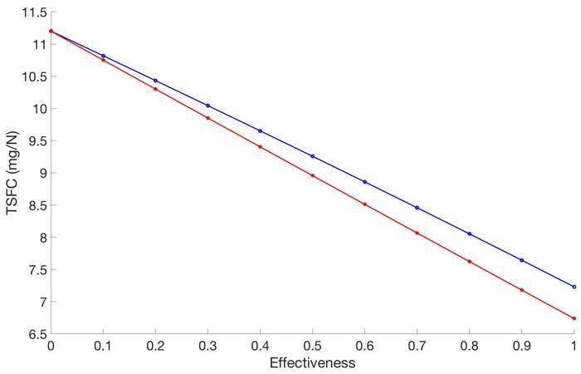

High Fuel Economy due to Regeneration
Deepanshu Singh, Rishabh Agrawal and P. M. V. Subbarao. ”Regenerative System for Turboprop Engines”,
Presented in EERE-02,
Energy-Efficient and Renewable Energy Technologies--Energy Generation,
AIAA Propulsion and Energy Forum (2708522),
July 11, 2017.

Slide 20
Fitness of Engines for Flying
Drag or Thrust
Speed of Aircraft

Slide 21
Learnings for Flying and National Needs
Turbo-engines can fly only in lower troposphere.
Density of air plays a role in feasibility of turboengines.
Turbo-engines can cruise very efficiently.
Inventions are required for:
Travel in outside troposphere.
Non-cruising carriers for weapons: Missiles.

Slide 22
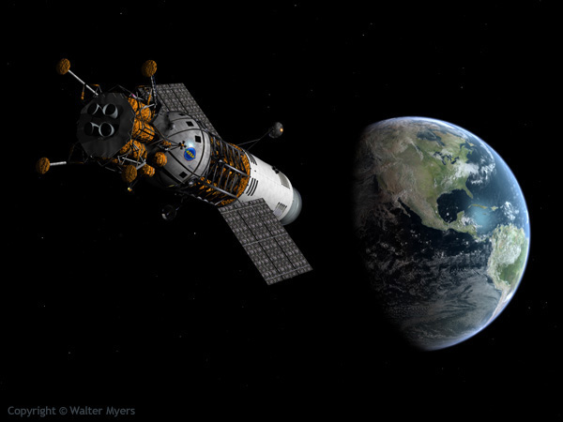
Propulsion in Space
Sky is the Limit

Slide 23
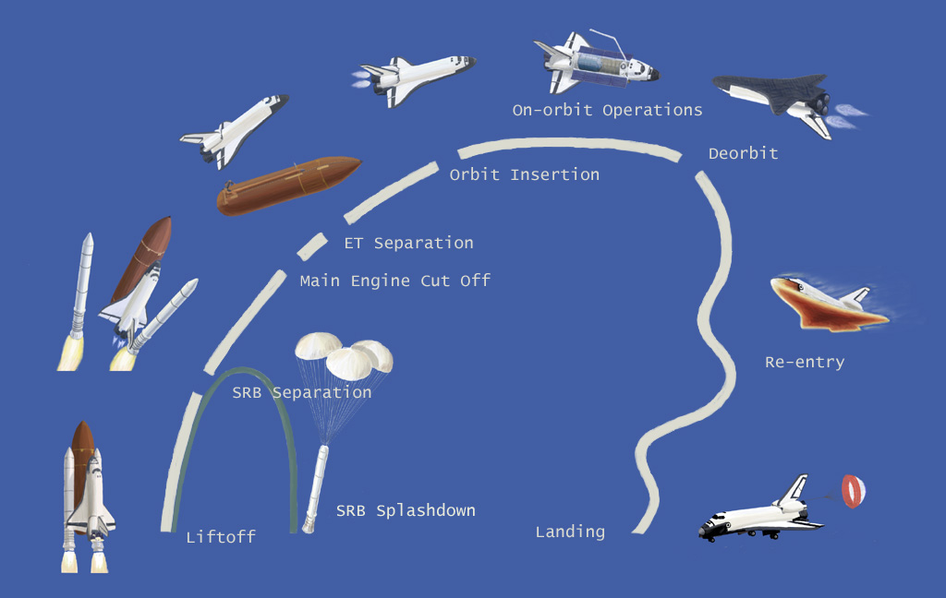
Travel Cycle of Modern Spacecrafts

Slide 24
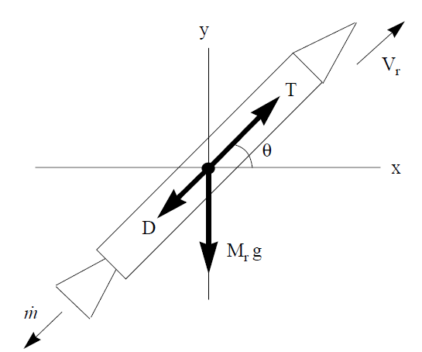
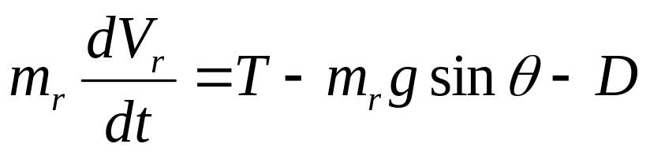
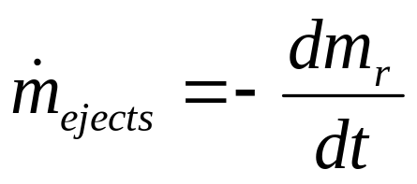
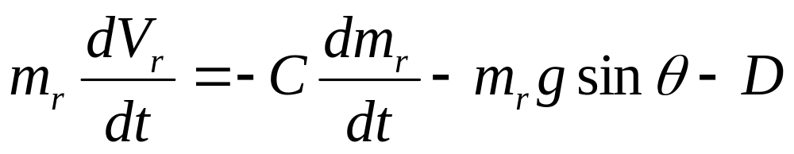
The Rocket : A Transient Control Volume
Conservation of mass:

Slide 25
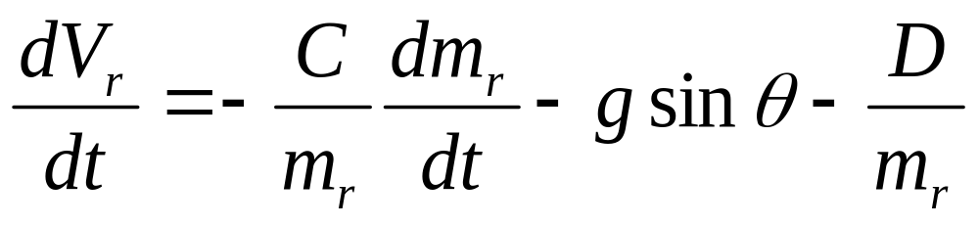
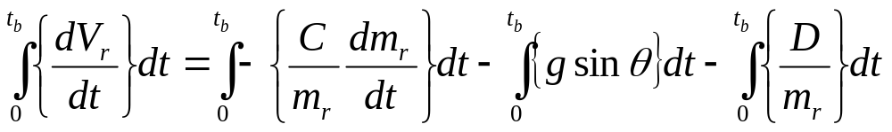
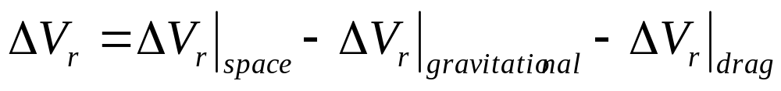
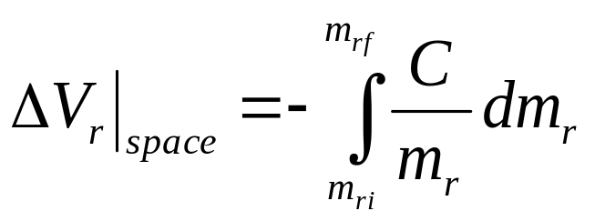
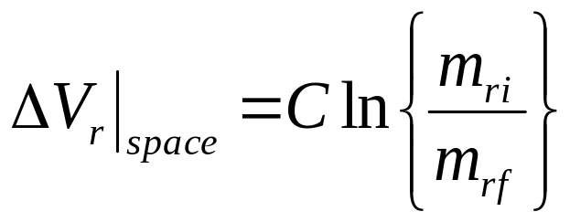
Finite Duration of Flying
A rocket is designed for a finite duration of flying, known as time of burnout, t_{b}.

Slide 26
UFO Logistics
Is It Really Possible That The Ancient Indians Had The Capacity To Deploy Devastating Nuclear Weapons Against Their Enemies?
Moreover, Is It Really Possible, As Many Ufologists Claim, That Awesomely Powerful Nuclear Weapons Were Actually Given To The Ancient Indian Warriors By Extra-tererstrials, Highly Advanced Spacemen From Other Planets?
Well, Passages From Ancient Indian National Epics Certainly Appear To Be Evidence Of Such Astonishing Claims….
Http://Www.Ufoevidence.Org/Documents/Doc1937.Htm

Slide 27
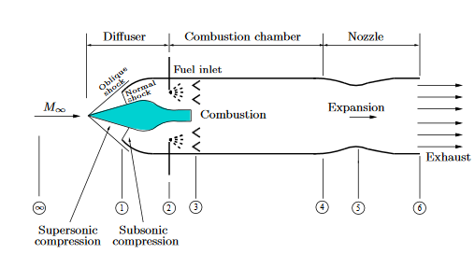
The Asthra : Ramjets

Slide 28
“The heavens cried out, the earth bellowed an answer, lightening flashed forth, fire flamed upwards, it rained down death. The brightness vanished, the fire was extinguished. Everyone who was struck by the lightening was turned to ashes”.
According To The Evidence
And again from the same source: “It was a ghastly sight to see. The corpses of the fallen were so mutilated they no longer looked like human beings. Never before have we seen such an awful weapon, and never before have we heard of such a weapon”.

Slide 29
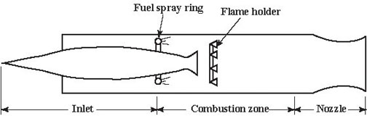
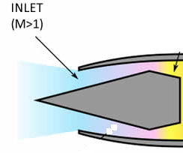
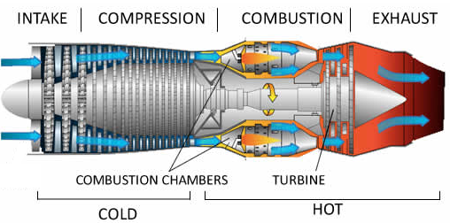
Jet Engine Vs Missile Engine (Ramjet)
V_{jet}

Slide 30
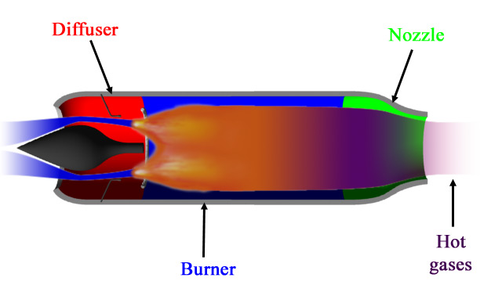
The Ancient Flyers : Ramjets (Asthras)
Only four operating components:
  A central Body
  intake (diffuser)
  burner (combustion chamber);
  nozzle

Slide 31
Ramjets - Basic Operating Features
External shock decelerate ambient air entering the flyer.
This Air is further decelerated in intake (diffuser).
The pressure rises due to ram effect.
Known as ram pressure and significant at supersonic speeds.
A ramjet therefore needs no machines or engine to increase the pressure.
Simplifies the design and reducing the cost.
Greatest disadvantage is that it has to be accelerated up to very high speed before it produces any useful thrust.
Also complicated supersonic intake required to avoid shock losses.

Slide 32
The Asthra : SRAM

Slide 33
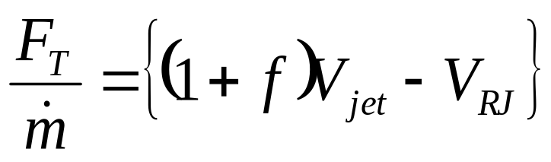
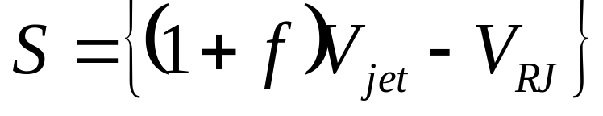
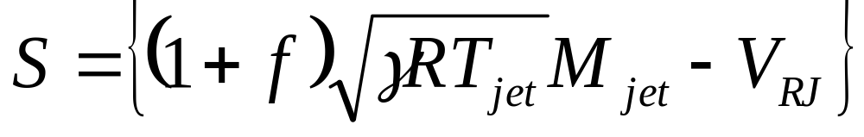
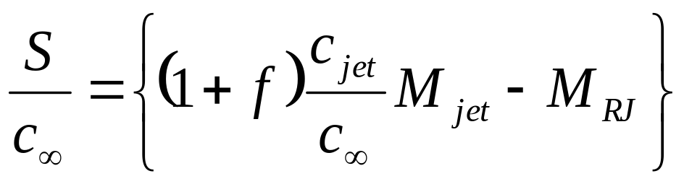
Performance Specification - 1
Specific Thrust S

Slide 34






Performance Specification - 2
Thrust Specific Fuel Consumption
Propulsive Power or Thrust Power:

Slide 35


Design of Compact Ramjet - 1
S

Slide 36

Design of Compact Ramjet - 2

Slide 37
Closing Remarks on Ramjets
Control of high speed Ramjet at off design conditions is very difficult due to occurrence of shocks in Nozzle.
Cannot be used for transport of humans and valuables.
Poor fuel economy due to low stagnation pressures.
An artificial method of enhancing/controlling stagnation pressures at the inlet to thrust generator is essential.

Slide 38


Reuse of Old Turboengines
Five basic components:
  intake: captures air and efficiently delivers it to compressor.
  compressor: increases air pressure and temperature.
  combustor: adds kerosene to the air and burns the mixture to increase the temperature and energy levels further.
  turbine: extracts energy from the gases to drive the compressor via a shaft.
  nozzle: accelerates the gases further.
High levels of engineering required for efficient operation, especially for compressor and turbine - therefore costly compared with ramjet.

