Slide 1

Turbo based Propulsion Systems
P M V Subbarao
Professor
Mechanical Engineering Department
I I T Delhi
Superior Combination of Wrights Idea and Newton's Idea!!!

Slide 2

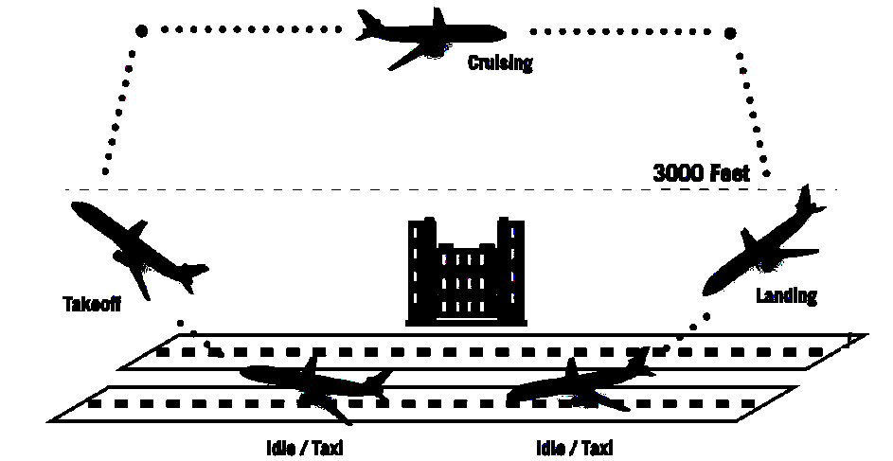
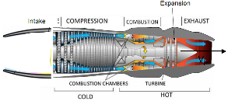
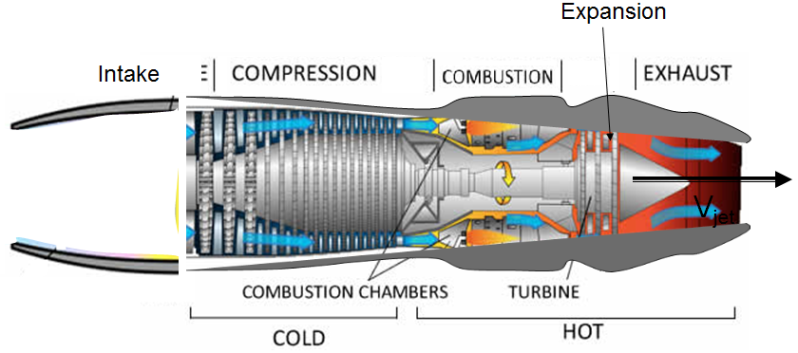
Aircraft Takeoff and Landing Cycles

Slide 3
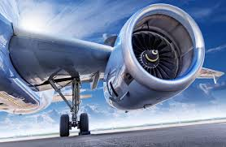
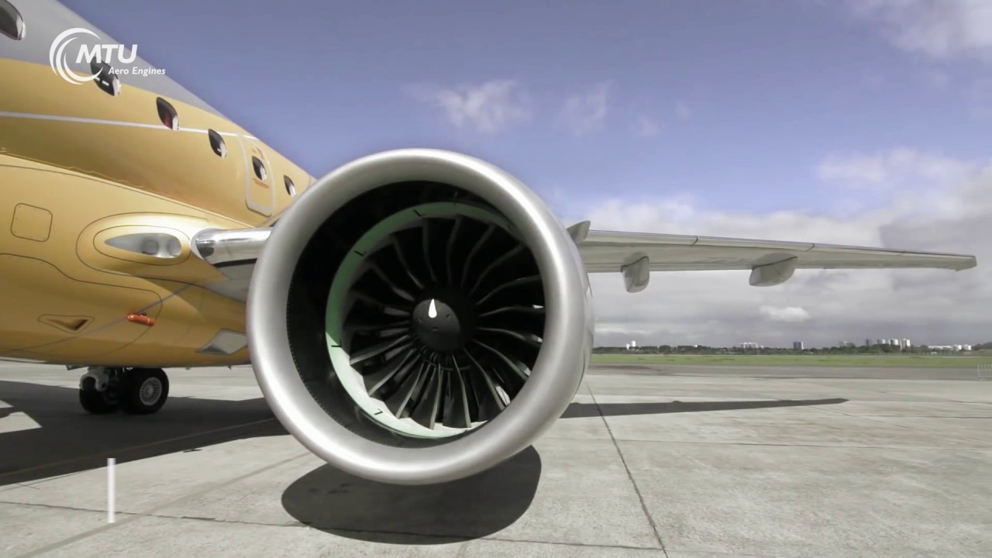
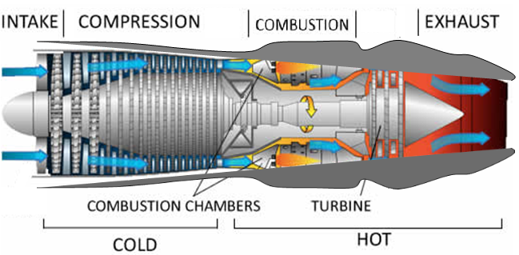
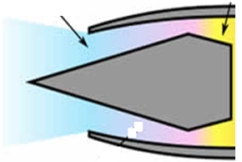
Anatomy of A Jet Engine
V_{ac}
Inlet M<1
Expansion
Inlet M>1
Intake
V_{jet}
4
5
6
2
3
1

Slide 4
Ideal Turbojet Cycle
Stagnation Properties vs Entropy
4
3
5,6
T₀
1,2
s
4
3
p₀
5,6
1,2
s

Slide 5
Ideal Turbojet Cycle – Static Properties vs Entropy
4
3
5
T
2
6 : Jet
1
s
4
3
5
p
2
1
6: Jet

Slide 6
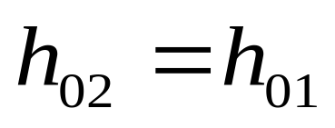
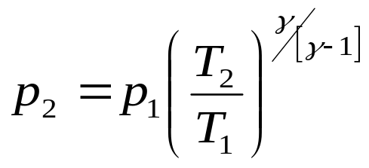
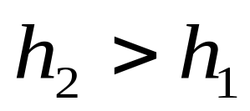
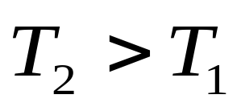
Intake of A Jet Engine
V_{ac}
Expansion
Inlet M<1
Intake
An inverse of Nozzle: Converts macro kinetic power of incoming air into Micro Kinetic Power
V_{jet}
2
1

Slide 7
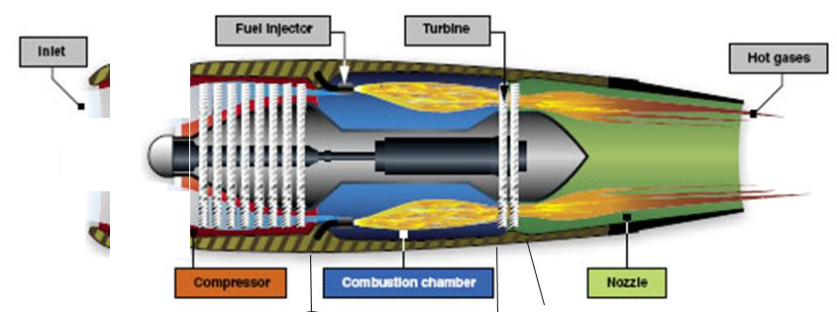
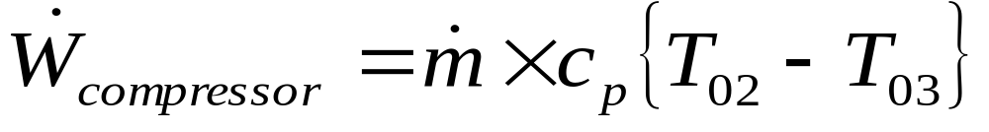
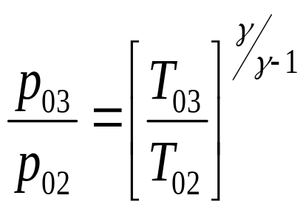
Measure of Extra Pressure Generation by Active Compressor
2
3
Isentropic active compression

Slide 8
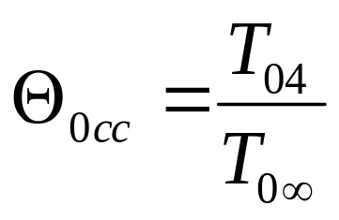
Combustion Chamber : Enhancement of Energy of would be Jet
V_{ac}
V_{jet}
3
4
Define total temperature ratio across combustion chamber as
3 -- 4
s : increasing
T: increasing
p : constant???

Slide 9
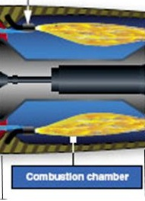
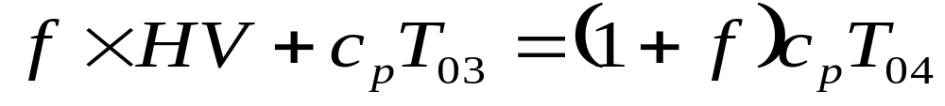
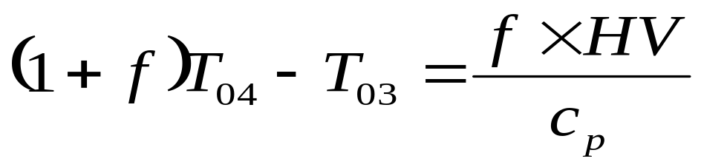
Energy Balance in Combustor : 3-- 4
For unit flow rate of air thru the Jet engine:
How much fuel should be added to get a compact jet engine ?
How to achieve better fuel economy?

Slide 10
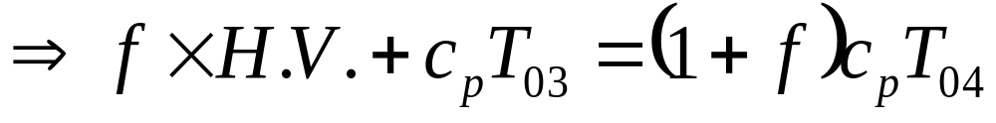
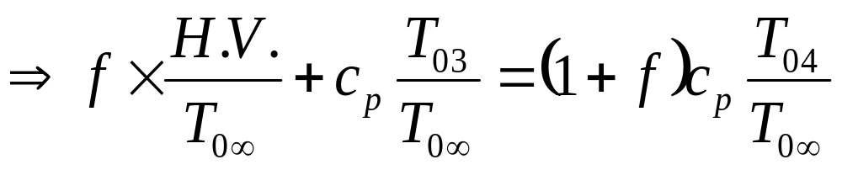
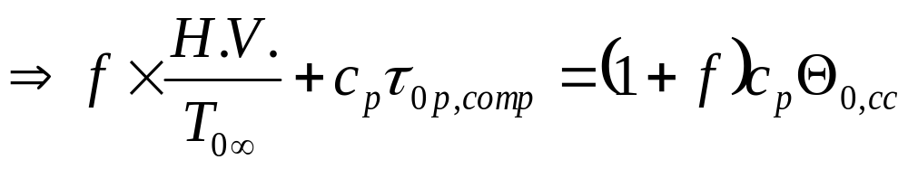
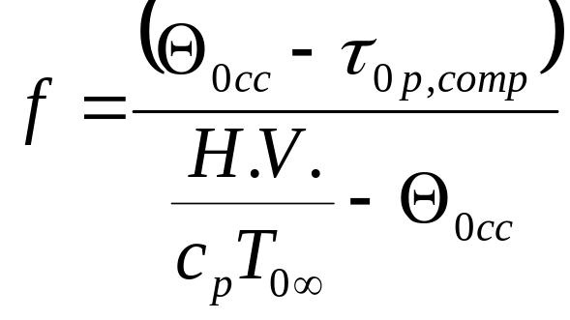
Model for Fuel-air ratio
Divide above equation by T_{0∞}

Slide 11
Turbine : A Slave to Drive Compressor
V_{ac}
V_{jet}
4
5
4 -- 5
s = constant
T : decreasing
p : decreasing

Slide 12
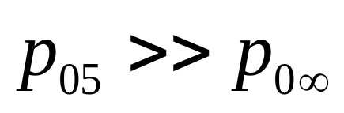
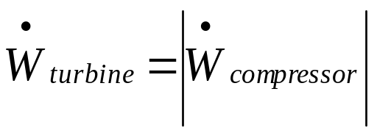
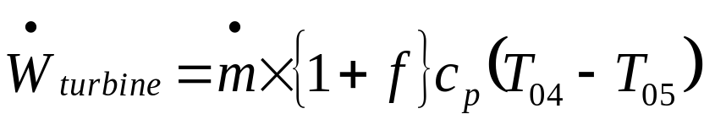
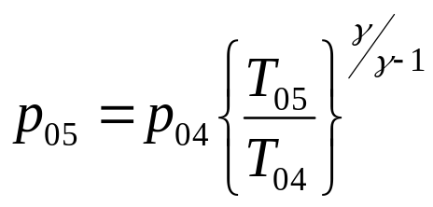
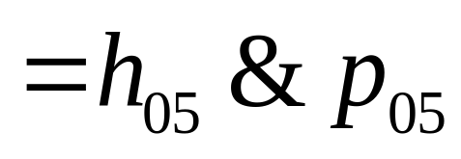
Sizing of Turbine : Just Enough Power
2
4
C
T
3
5
Duty of the Turbine is to drive the compressor : just enough power.
Remaining vigor of Gases:

Slide 13
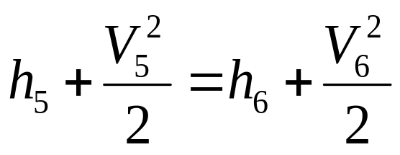
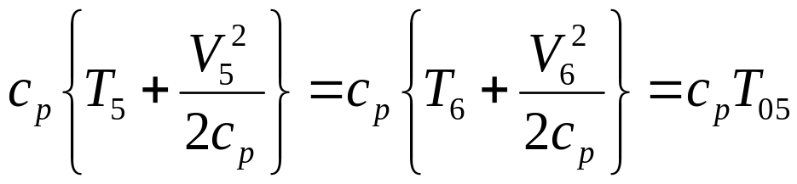
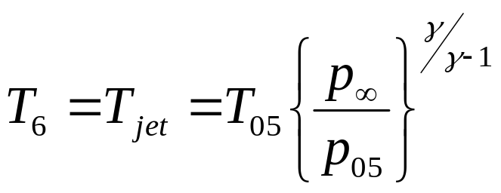
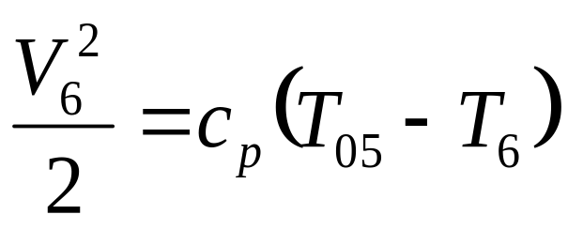
Nozzle : Steady State Stead Flow
5
6
First Law for unit mass flow rate of gas:
No heat transfer and no work transfer & No Change in potential energy.

Slide 14
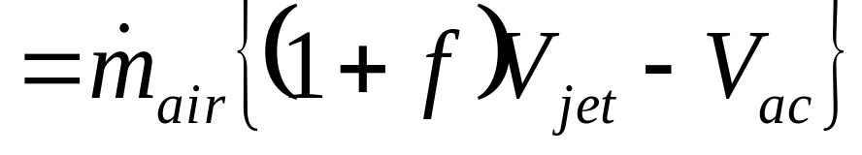
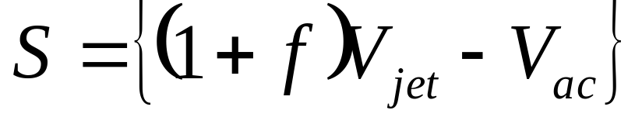
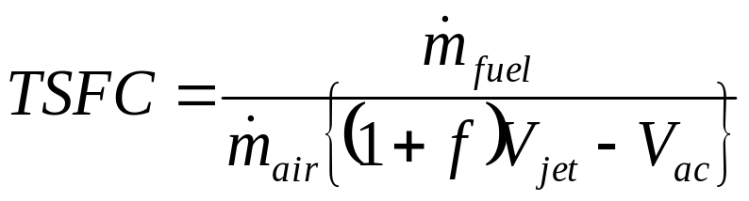
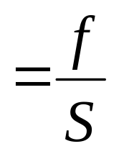
Performance of Turbojet Engine
Thrust F_{T}
Specific Thrust S
Thrust Specific Fuel Consumption TSFC

Slide 15
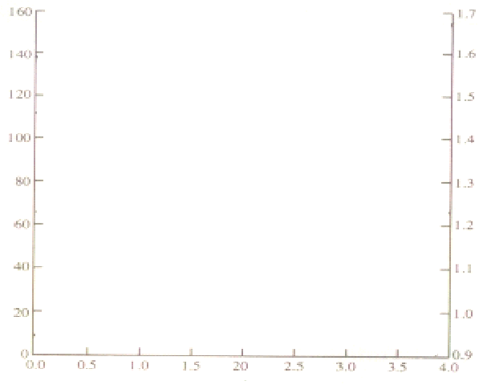
Performance of a Ideal Turbojet Engine : effect of Mach Number
r_{0p,comp} = 10
Θ_{0,cc}=4.5
S
Specific Thrust kN.s/kg
TSFC kg/ kN.hr
TSFC
M_{ac}

Slide 16
Parametric Cycle Analysis of
Ideal Turbo Jet Engine
Selection of Economic Design Conditions….

Slide 17
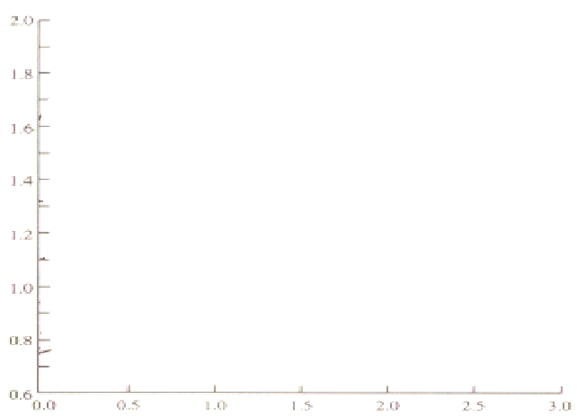
Effect of Flight Mach Number on Fuel Economy
Θ_{0,cc}=4.5
r_{0p}=2
r_{0p}=1
r_{0p}=3
TSFC kg/ kN.hr
r_{0p}=5
r_{0p}=10
r_{0p}=20
r_{0p}=30
M_{ac}

Slide 18
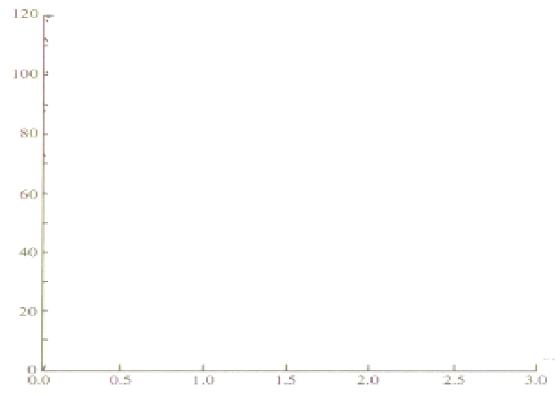
Effect of Flight Mach Number on Compactness
Θ_{0,cc}=4.5
r_{0p}=5
r_{0p}=3
Specific Thrust kN.s/kg
r_{0p}=2
r_{0p}=1
r_{0p}=10
r_{0p}=20
r_{0p}=30
M_{ac}

Slide 19
Summary of Turbojet Performance
A high compressor pressure ratio is desirable for subsonic flight for good specific thrust and low fuel consumption.
Rapid drop in specific thrust with pressure ratio at supersonic conditions.
A special care must be used in selecting the compressor pressure ratio for a supersonic flight.
Rapid fall in specific thrust under supersonic conditions is a serious concern for emergency/war use.

Slide 20
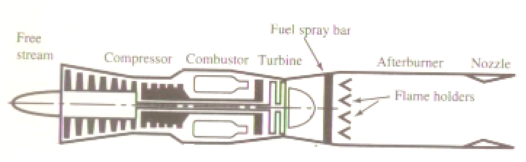
Turbo Jet with Afterburner
inlet
1
2
5
7
3
4
6

Slide 21
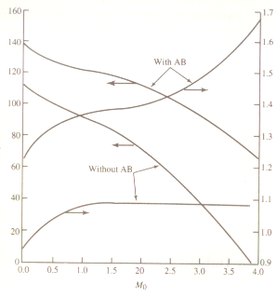
Comparative Study of Jet Performance with AB & w/o AB
r_{p} = 10 & Θ_{0,cAB}= Θ_{0,cc}
W AB
W AB
TSFC
Specific Thrust
W/O AB
W/O AB

Slide 22
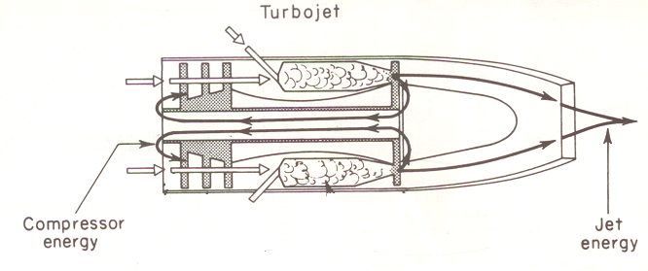
Energy Flow in Jet Engine
Energy input
Long distance travel demands high flight velocity.
A Single hot Jet was creating huge noise.
High flight velocity leads to drop in compactness and fuel economy.
A Single hot jet is blackmailing the jet engine !!!

Slide 23
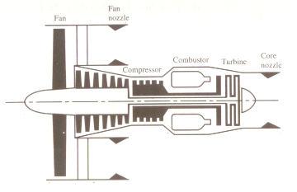

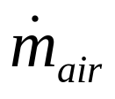
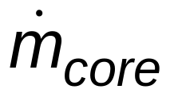



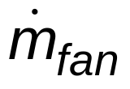
An Evolved design of Turbojet
Inlet
Total thrust may be Shared by both cold and hot jets..
4
7 or hj
5
6
1
2
cj
3
In 1939-1941 Soviet designer Arkhip Lyulka elaborated the design of turbojet and created an evolved turbojet.
Created the world's first turbofan engine, and acquired a patent for this new invention on April 22, 1941.

