Slide 1

Analysis & Evolution of Propulsion Systems
P M V Subbarao
Professor
Mechanical Engineering Department
I I T Delhi
Economic & Exotic Control Volumes for Flying Fast !!!

Slide 2


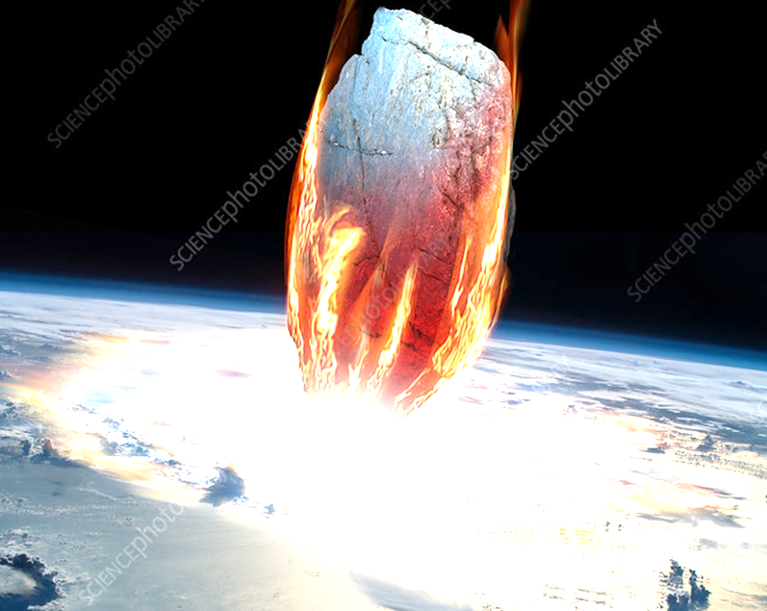
Two Extreme Flyers
Flying of point or zero degree conical object at high speeds : Leads to derivation Speed of Sound.
Flying of Large/180 degree conical object at high speeds : generation of A discontinuity.

Slide 3


Slide 4


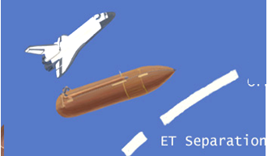
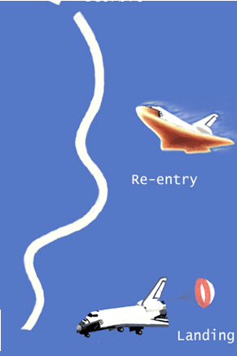
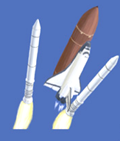

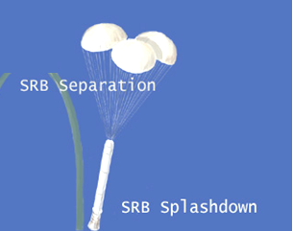

Travel Cycle for Modern Spacecraft

Slide 5
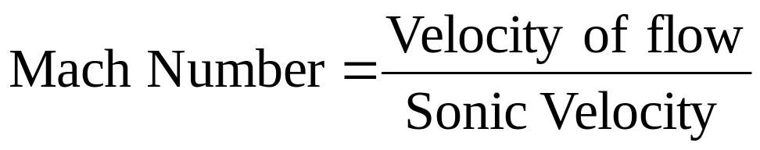
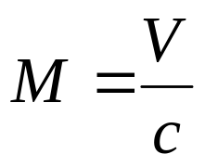
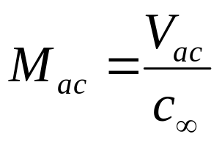
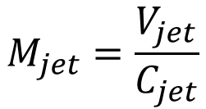
Mach Number : A True Measure of High Speed Systems
It is only an economical reason to think that the fastness of an object is described in terms of velocity (km/hr) !!!!
In mentally separating a body from the changeable environment in which it moves,
what we really do is to extricate a group of sensations on which our thoughts are fastened…….
Mach number of an aircraft
Mach number of a Jet

Slide 6
Role of Speed of Sound in High Speed Flows
Speed of sound in a fluid medium establishes an interaction between microscopic and macroscopic kinetic energies of the fluid molecules.
High speed flow is due to either relative or absolute condition.
In propulsion systems, it is due to the high speed motion of flying objects.
Every decelerating fluid molecule will gain microscopic energy and lose macroscopic kinetic energy.
These interactions are expressed through definition of Stagnation Properties.

Slide 7
Gas Particles Coming to Rest
Consider a case of a finite size object is flying at high speed in a stagnant fluid medium:
Relative to the object, the far field fluid particles are moving at equal and opposite to the speed of the object.
Due to no-slip condition the fluid particle reaches zero velocity condition at the wall of the object.
The fluid particles attain a state of stagnation.
Stagnation property is defined as property of a high speed fluid, when it is isentropically brought to rest.
Stagnation enthalpy, it is defined as the maximum available microscopic kinetic energy of a fluid.

Slide 8
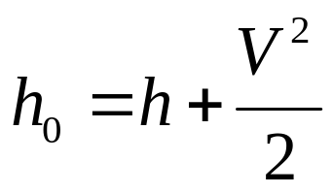
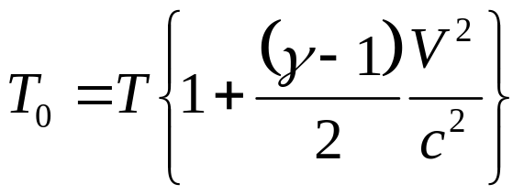
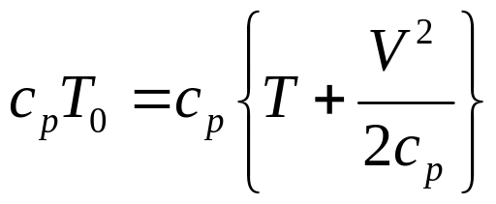
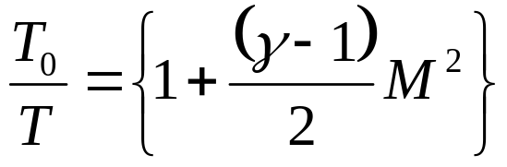
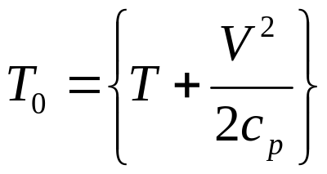
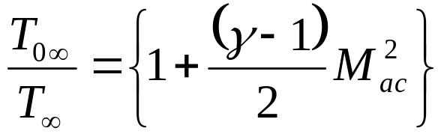
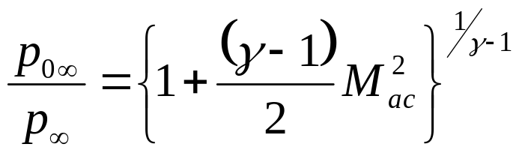
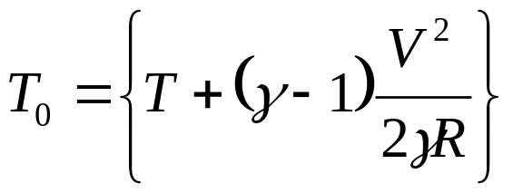
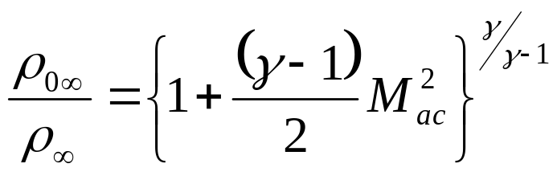
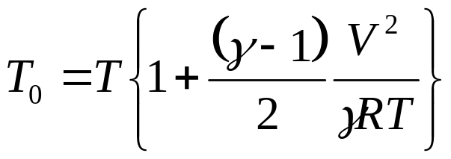
Stagnation Properties (Perfect Gas)

Slide 9
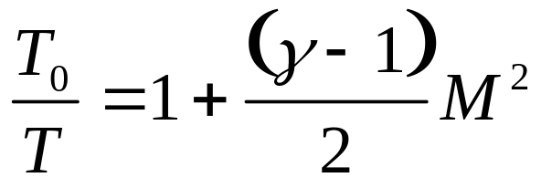
Stagnation Temperature of A Gas Flow
In general for an adiabatic Flow Field at M, the Stagnation Temperature is defined by the relationship
Stagnation Temperature is constant throughout an adiabatic flow field.
This is the maximum possible temperature.
T₀ is also sometimes referred to at Total Temperature
T is sometimes referred to as Static Temperature

Slide 10


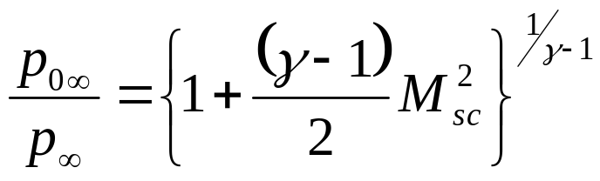

Engineering Importance of Stagnation Temperature
• Stagnation temperature is a measure of the total Kinetic Energy of the flow Field.
• Largely responsible for the high Level of heating that occurs on high speed aircraft or reentering space Vehicles …

Slide 11
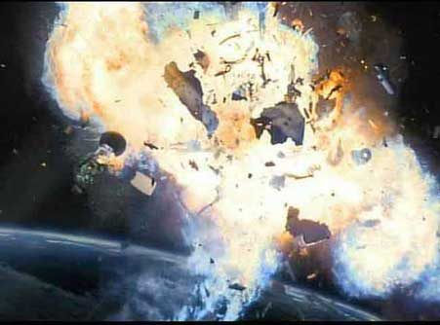
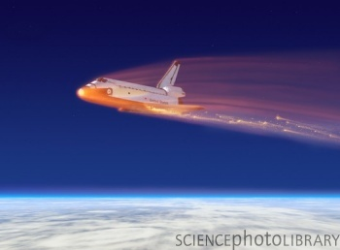
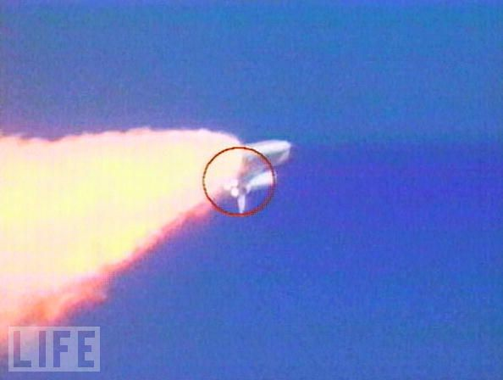
The Columbia Disaster !!!!
On Feb. 1, 2003, space shuttle Columbia broke up as it returned to Earth, killing the seven astronauts on board.
NASA suspended space shuttle flights for more than two years as it investigated the disaster

Slide 12
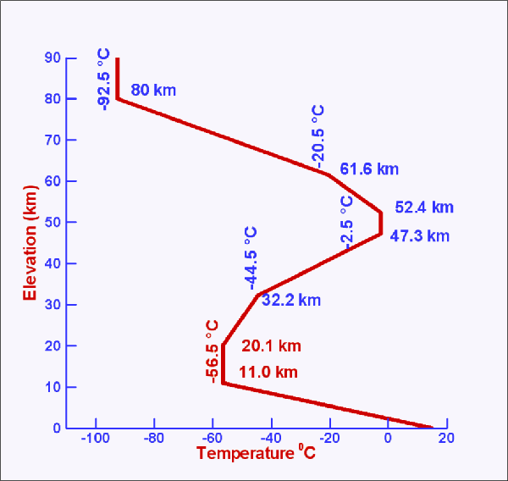
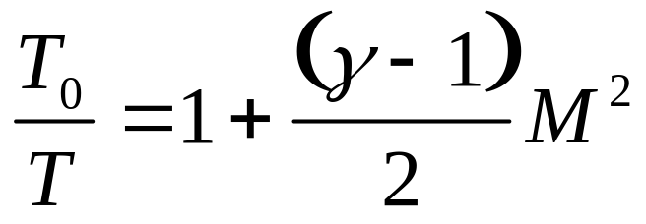
Mach’s Analysis of the Problem
Loss Of Signal at 61.2 km altitude
T∞ ~ 243 K
~18.0 Mach Number

Slide 13
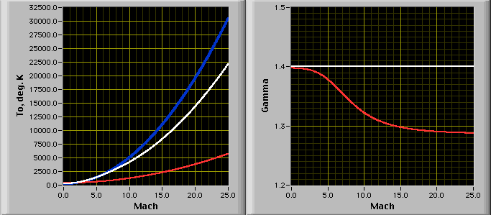
Computation of Stagnation Temperature at High Mach Numbers
Ideal gas Variable Properties Real gas

Slide 14

Rentering Space Craft

Slide 15
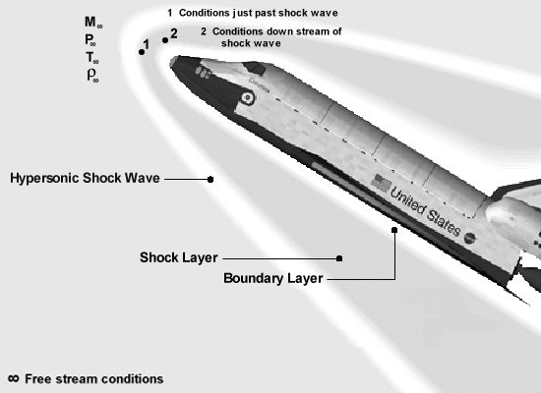
What was the Surface Temperature At Columbia Breakup?

Slide 16
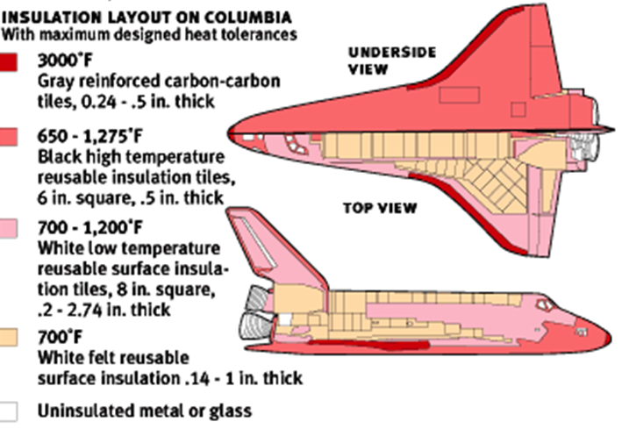
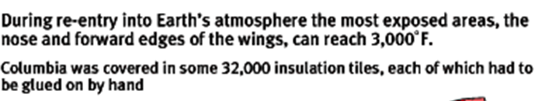

Slide 17
The Cause
Approximately 82 seconds after launch from Kennedy Space Center's LC-39-A, a suitcase-size piece of thermal insulation foam broke off the External Tank (ET), striking Columbia's left wing Reinforced Carbon-Carbon (RCC) panels.
At the time of the foam strike, the orbiter was at an altitude of about 66,000 feet (20 km; 13 mi), traveling at Mach 2.46 (1,870 miles per hour or 840 m/s).
As demonstrated by ground experiments conducted by the Columbia Accident Investigation Board, this likely created a 6-to-10-inch (15 to 25 cm) diameter hole, allowing hot gases to enter the wing when Columbia later reentered the atmosphere.

Slide 18
Stagnation Properties (Perfect Gas)

Slide 19
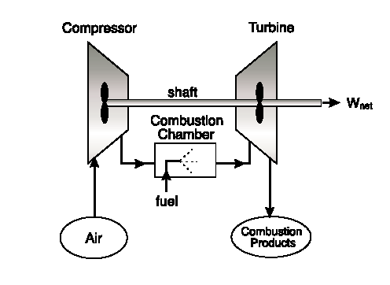

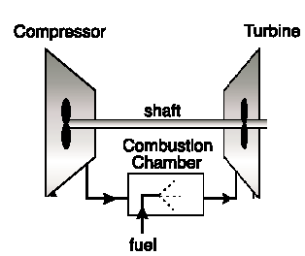

The Power plant to A Flying Machine
The birth of Faster Flying Machines
What is the correct measure for A Flying Machines???

Slide 20
World's first operational turbojet engine
Dimensions: 1.48 m long, 0.93 m diameter
Weight: 360 kg
Thrust: 4.4 kN @ 13,000 rpm and 800 km/h
Thrust Specific fuel consumption: 18.0 L/(kgf·h)
Pressure ratio: 2.8:1

Slide 21
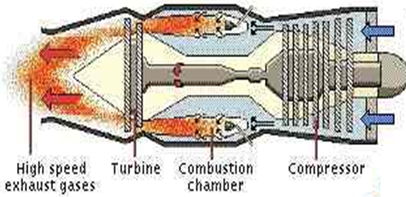
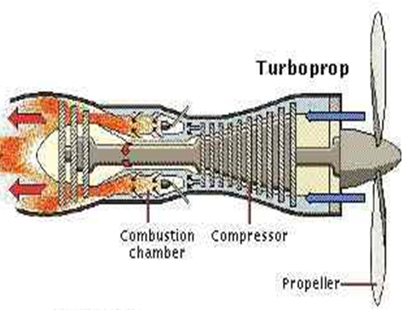
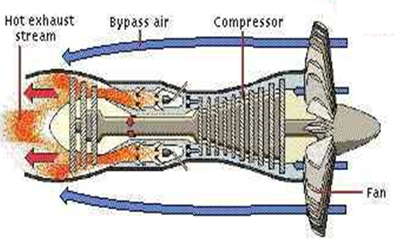
Variation of Turbo Technologies

Slide 22
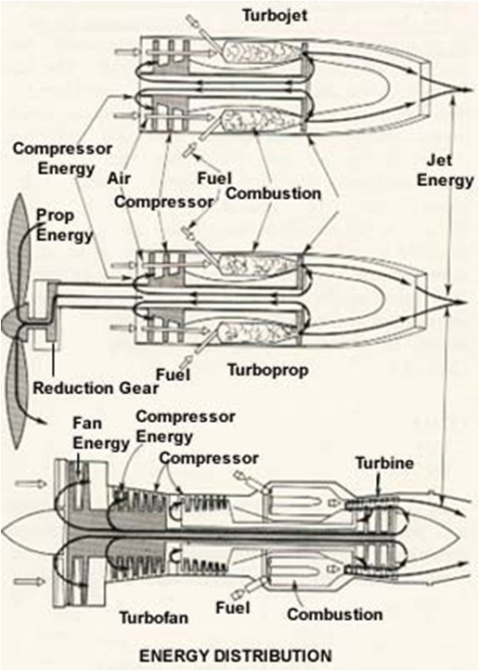
Thermal Energy Management & Conservation

