Slide 1

No Vapour Compression Refrigeration Systems
P M V Subbarao
Professor
Mechanical Engineering Department
I I T Delhi
Use of Low Quality …

Slide 2

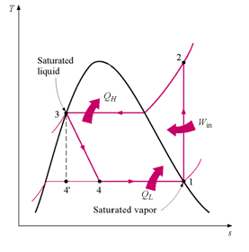
VCR System
Christened as Vapour Compression Refrigeration (VCR) Cycle
How to Conserve Work Consumption for unit Cooling Effect?

Slide 3
Current Trends in Cooling System
Minimization of work Consumption
Efficient Utilization of Non-renewable Natural Resources
Minimal Negative Impacts on Environment & Ecosystems
Maximize Quality of Indoor Environment.
Basic Idea: Instead of depending on control of pressure and temperature of a single component working fluid, use of two-component working fluid and control pressure, temperature and concentration.
Higher DoF systems help in conservation of Work Consumption.

Slide 4
Additional Process Possible in Two Component Working Fluids
Absorption : May be Exothermic Reaction.
Dis-absorption: Obviously Endothermic Reaction.
Adsorption: May be Exthermic Reaction.
Dis-adsorption: Obviously Endothermic Reaction.
Replace Main work transfer processes with Mass transfer Processes.
May require Small amount of work consumption

Slide 5
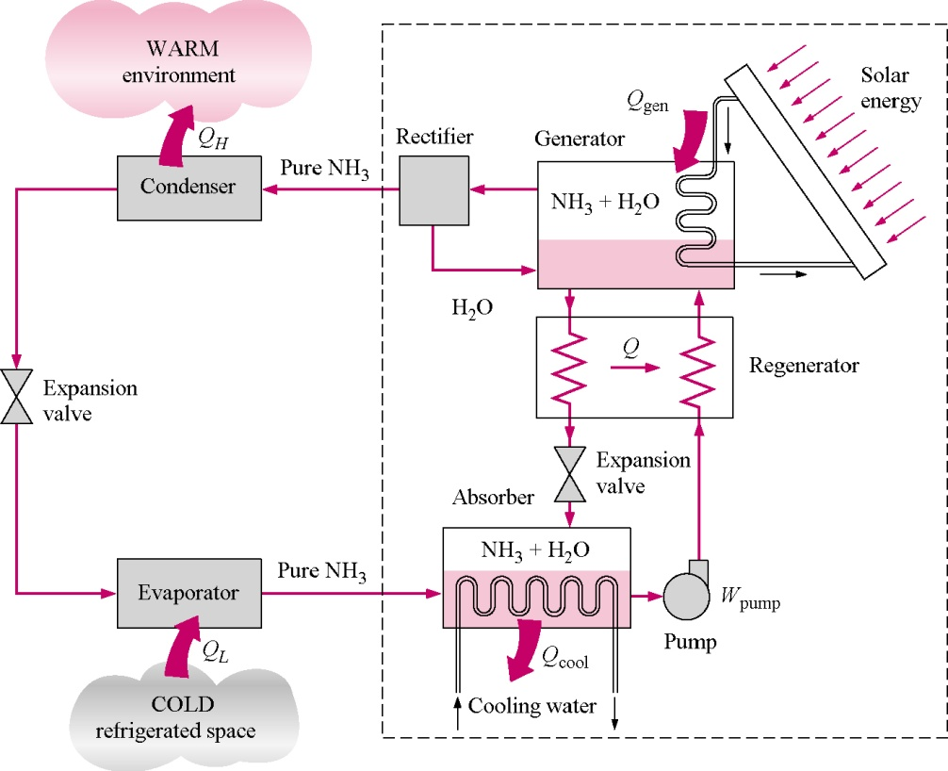

Replacement of Vapor Compression with
Absorption Refrigeration Systems

Slide 6
Compression to Absorption Refrigeration Systems

Slide 7
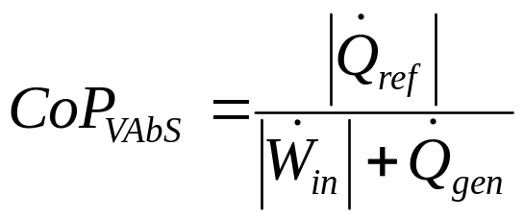
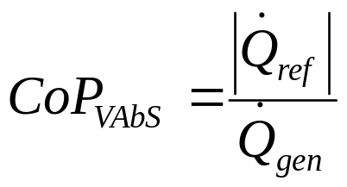
The COP of Vapour Absorption System
The true formula for calculating the COP of Vapour Absorption Refrigeration system is
But for ideal case, the pump work is negligible so the formula becomes CoP

Slide 8
Application of Vapour Absorption Refrigeration system
Electricity is unreliable or load shedding is very frequent.
The places where noise from the compressor can create disturbances. In VARS there is no compressor so very less noise.
Where extra or exhaust heat is easily available. For example, the surplus heat from the power plants can be used or solar energy can be used.

Slide 9
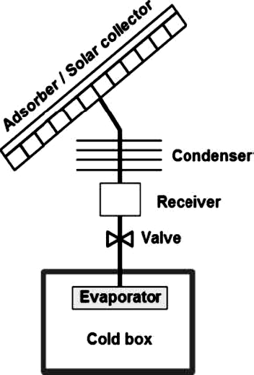
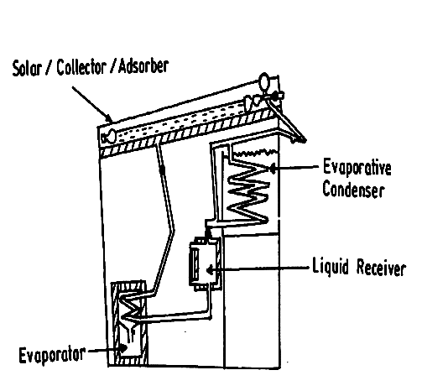
BASIC Adsorption Refrigeration System
Intermittent V Ad S
Continuous V Ad S

Slide 10
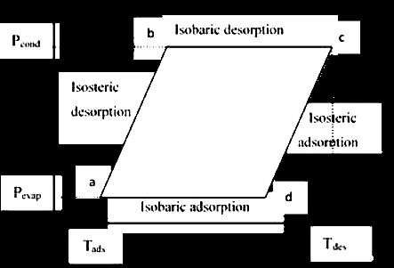
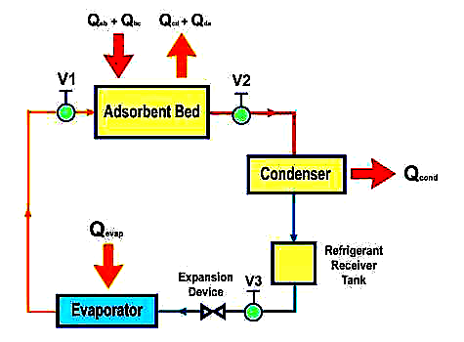
V Ad S Thermodynamic Cycle
Isosteric Process- Constant
Concentration Process
(Achieved by isolating the bed and evaporator)
Processes:
Process (a-b)-Isosteric desorption
Process (b-c)-Isobaric desorption
Process (c-d)-Isosteric adsorption
Process (d-a)-Isobaric adsorption

Slide 11
Working Fluid Pairs
Activated Carbon(AC) fibre and Methanol
  most commonly used working pair
  large adsorption quantity
  lower adsorption heat
  suitable at around 100°C & not suitable above 120°C
  maximum value of X = 45% & disadvantage: requires vacuum inside the system
Activated Carbon(AC) fibre and Ammonia
  same adsorption heat
  suitable at and above 200°C
  small X (0.29 kg/kg) is compensated by large value of latent heat of NH3
  disadvantage: toxicity and pungent odour of ammonia

Slide 12
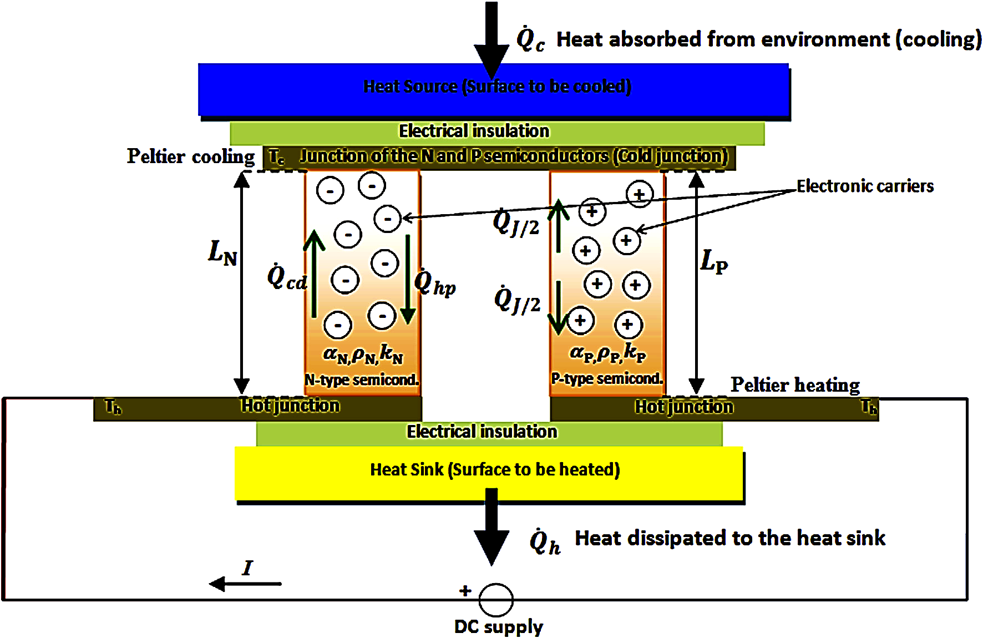
Thermoelectric Refrigeration System

Slide 13
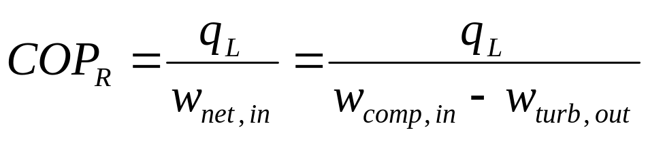
Gas Refrigeration Systems
The gas compression cycle can be used as refrigeration cycle.
The reversed Brayton cycle, which is also known as the gas refrigeration cycle, is used to cool aircraft.
Further Modification this cycle is used to obtain very low (cryogenic) temperatures.
The work output of the turbine can be used to reduce the work input requirements to the compressor.
Thus, the COP of a gas refrigeration cycle is

Slide 14
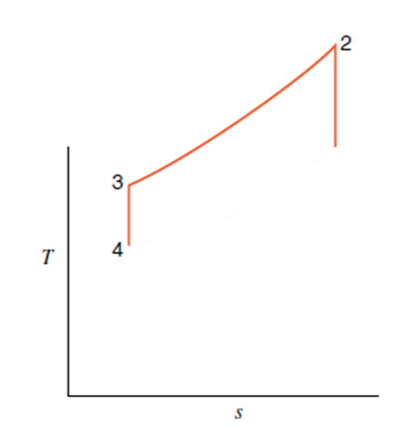
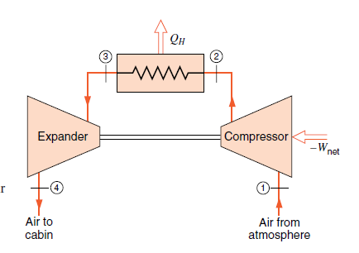
Air Standard Refrigeration Cycle for Aircraft Cooling
1
Human Comfort conditions:
101 kPa & 25°C
Aircraft cruising at 10 km.
Local Ambient conditions:
-49.9° C & 26.5 kPa

Slide 15
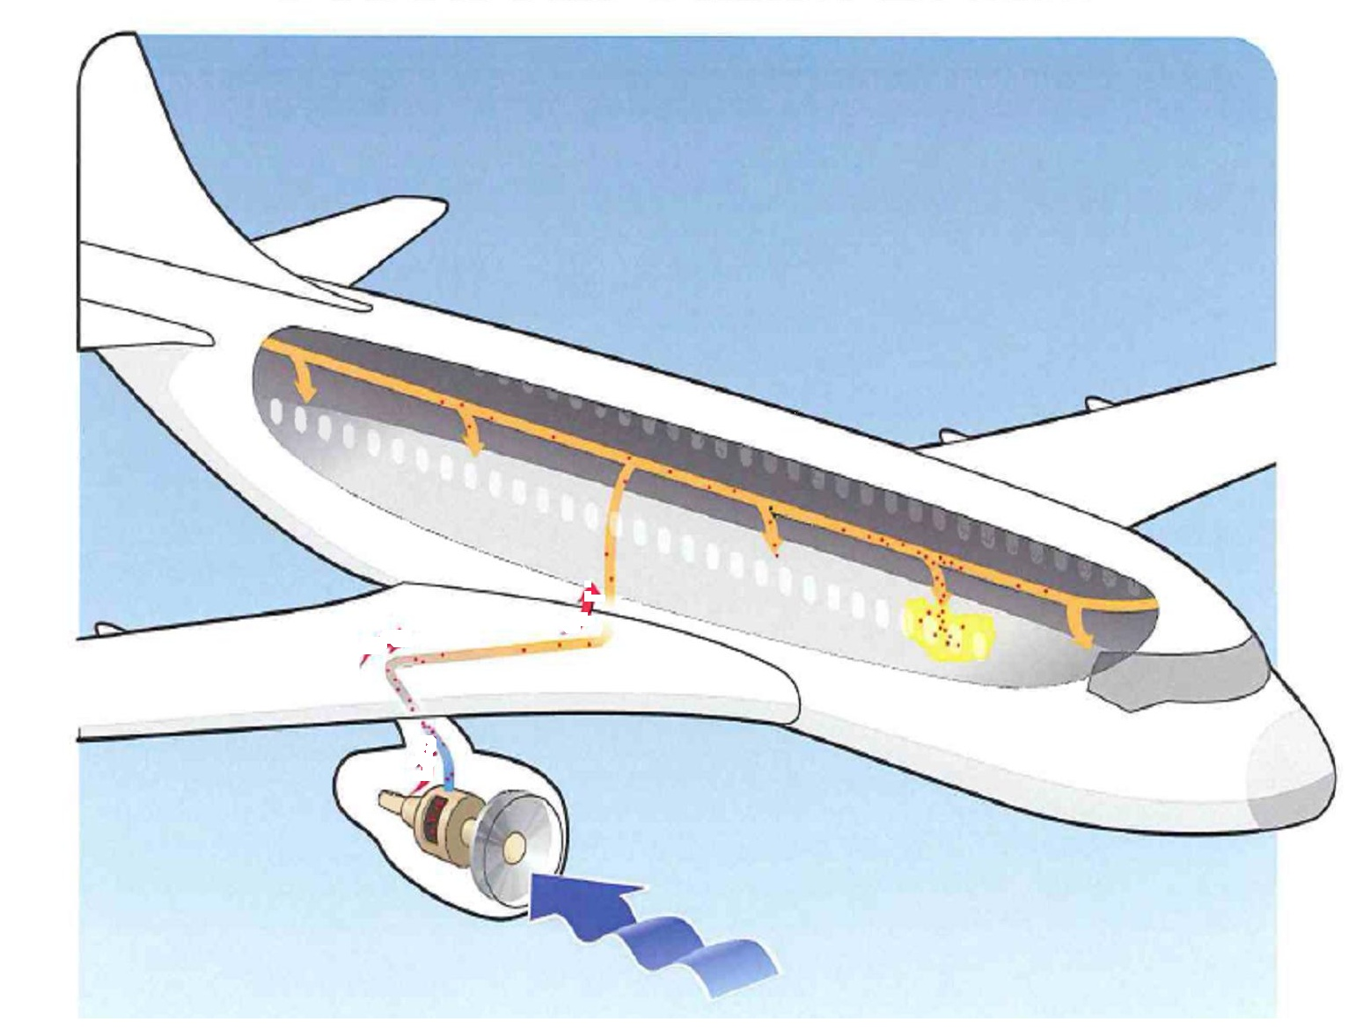
Air Craft Engine Bleed for Refrigeration System

Slide 16

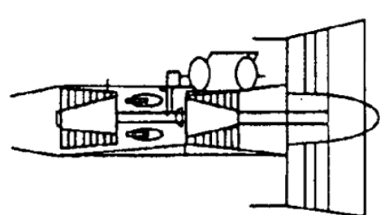
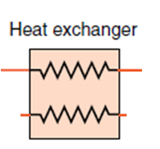
Air Craft Engine Refrigeration System
Air to Cabin

Slide 17
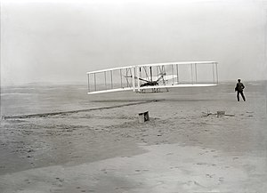
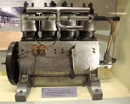
The Shocking News
The shocking news on 17th December 1903.
Four Cylinder Inline12 hp SI engine

Slide 18
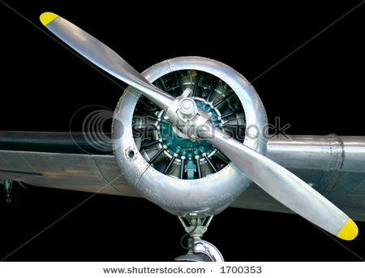
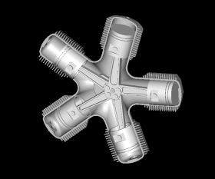
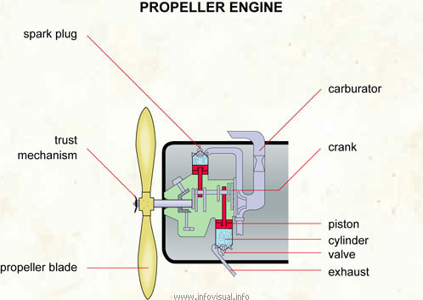
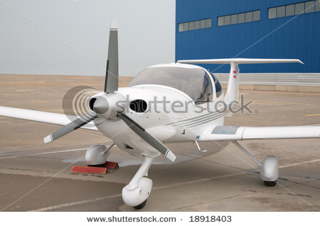
SI Engine for Propulsion
Radial SI Engine

Slide 19
Introduction to Propulsion Systems
Exotic Control Volumes for Flying Fast !!!

Slide 20
History of Early Propulsion Engines
Sir Isaac Newton in the 18th century was the first to theorize that a rearward-channeled explosion could propel a machine forward at a great rate of speed.
This theory was based on his third law of motion.
As the hot air blasts backwards through the nozzle the plane moves forward.
Henri Giffard built an airship which was powered by the first aircraft engine, a three-horse power steam engine.
It was very heavy, too heavy to fly.
In 1874, Felix de Temple, built a monoplane that flew just a short hop down a hill with the help of a coal fired steam engine.

Slide 21
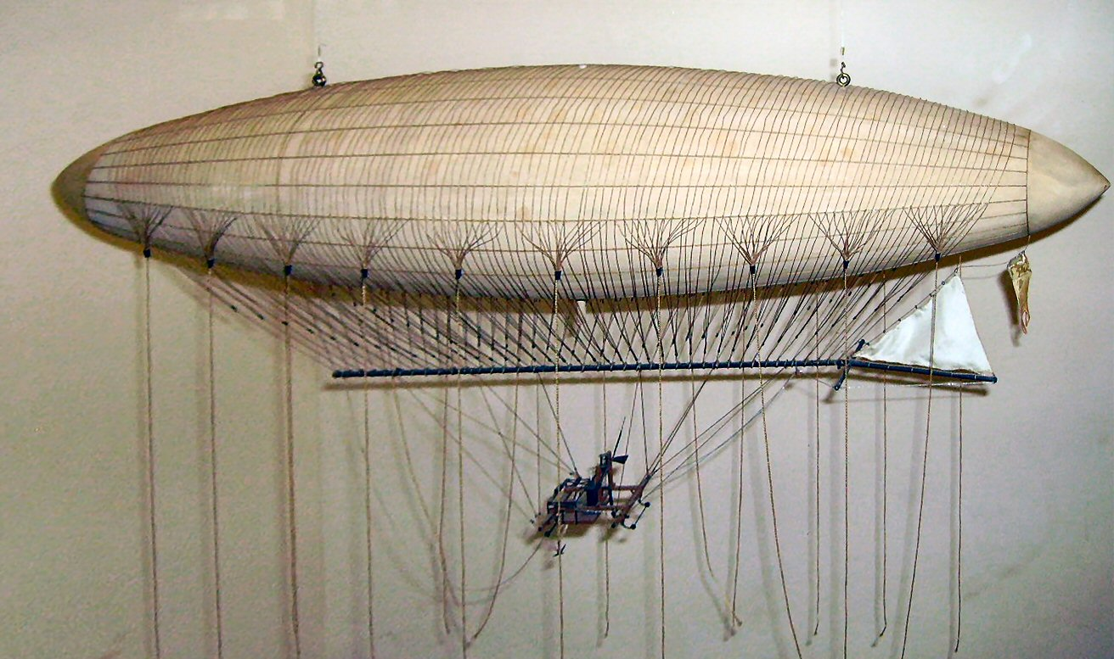
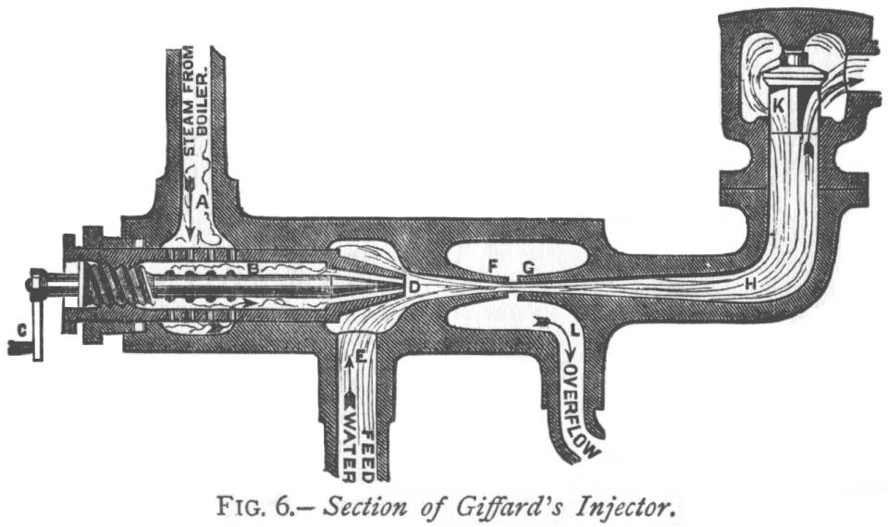
The Dirigible:1852

Slide 22
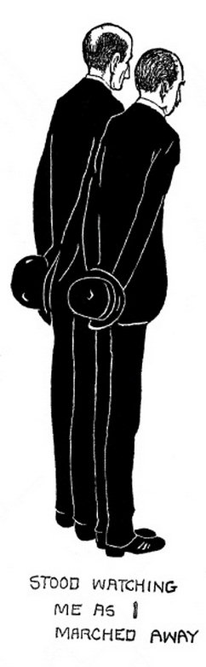
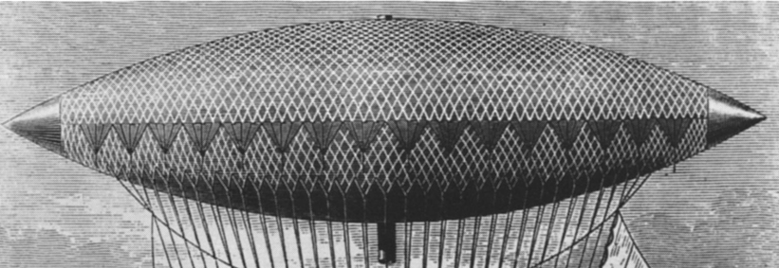
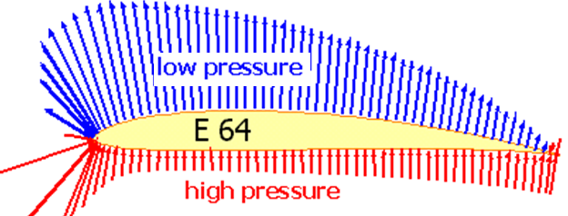
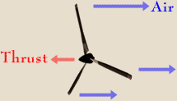

A Ship Can’t Fly : Wright Brothers
“It’s a flying machine,” said Wilbur.
“The name we prefer is ‘flyer,’” said Orville.
Action to generate Lift
Action to generate Propulsion

Slide 23
The Ideal Artifical Horse
1824: Sadi Carnot, identified several fundamental ideas that would be incorporated in an internal combustion engines:
  He noted that air compressed by a ratio of 15 to 1 would be hot enough (200°C) to ignite dry wood.
    Is it pressure ratio or volume ratio???
    He recommended compressing the air before combustion.
  3. Fuel could then be added by "an easily invented injector".
  4. Carnot realized that the cylinder walls would require cooling to permit continuous operation. Later, Diesel thought he could avoid this, but found out the hard way.
  5. He noted that usable heat would be available in the exhaust, and recommended passing it under a water boiler.

Slide 24
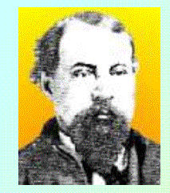
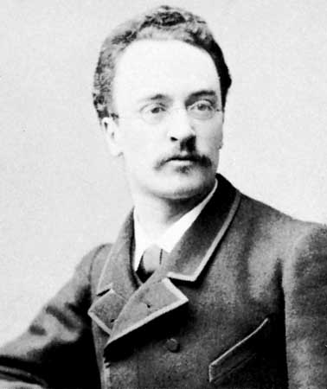
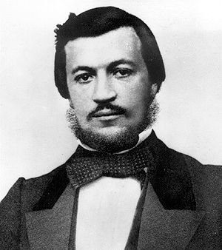
Engines with two in One Fluid : Best Suited for Motive Power
George Brayton
Nicolaus A. Otto
Rudolf Diesel

Slide 25
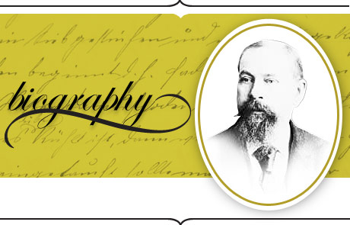
The Brayton Engine
Brayton turbines (invented in 1872) in their earlier uses were in a Providence, RI streetcar and an off-rail omnibus in Pittsburgh, PA.
In the end, the Brayton engine eventually was seen as inferior to the later developed Otto, which relied on a four-stroke piston system.
But few can deny Brayton's impact on the progression to today's modern automobile.

Slide 26
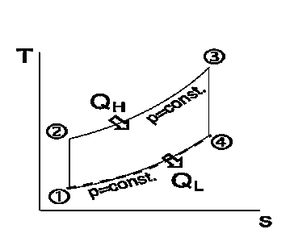
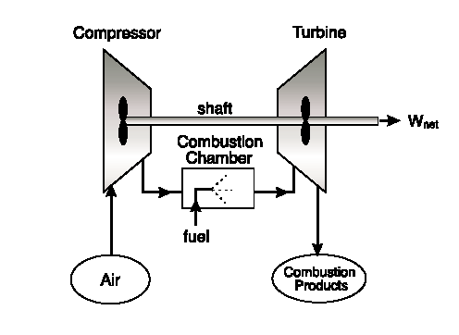
Brayton Cycle for Power Generation
This could not beat the efficiency of Steam turbine power plants

Slide 27
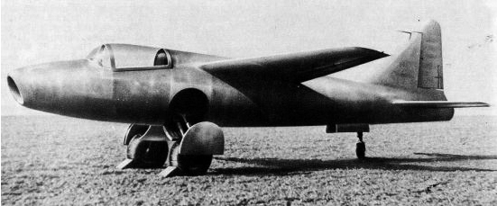
First turbojet-powered aircraft – Ohain’s engine on He 178
The world’s first aircraft to fly purely on turbojet power, the Heinkel He 178.
Its first true flight was on 27 August, 1939.

