Slide 1

Energy Systems for Exotic Extra-somatic Needs of Urban Humans
P M V Subbarao
Professor
Mechanical Engineering Department
I I T Delhi
Inverse Designs of Basic Energy Systems …

Slide 2

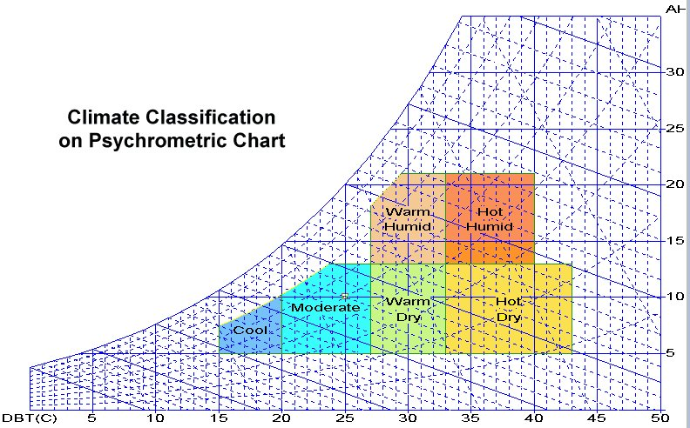
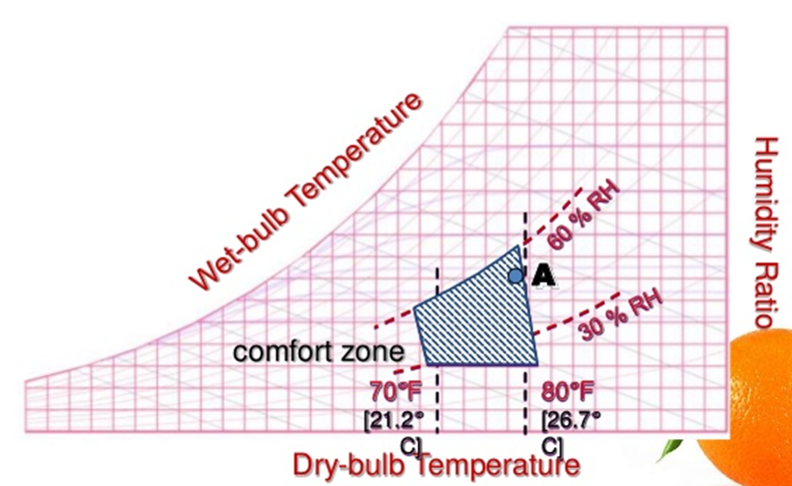
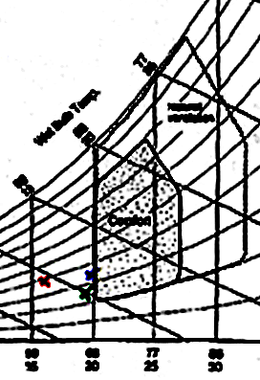
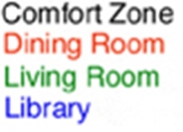
Conditioning of Ambient Atmosphere

Slide 3
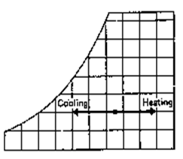
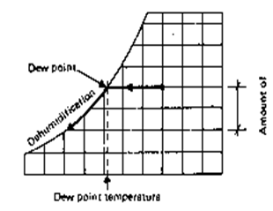
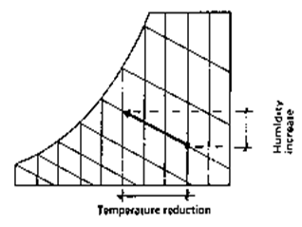
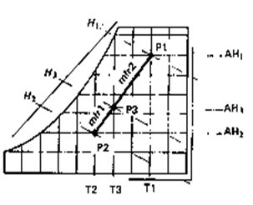
Energy Intensive Psychrometric Processes
Sensible Heating or Cooling
Dehumidification
Humidification & Cooling
Humidification & heating

Slide 4
Another Extra-somatic Knowhow: Shelf Life of Food
Many micro-organisms live on the same food as humans.
Our battle is to get the food before the micro-organisms.
In this battle the micro-organisms are well placed – size so small they are ever present in the atmosphere.
Any food exposed to atmosphere at ordinary temperature – appropriate organisms will start to grow.
They consume the food like animal – absorbing what they like and rejecting the remainder.
Rejected remainder is often toxic – leading to food poisoning.

Slide 5
Enhancement of Shelf Life of Food
Micro-organisms can be divided in three groups – moulds, yeast and bacteria.
Each type of micro-organisms has its own environment of temperature, atmosphere (gaseous composition and humidity) and food for optimum growth.
Water is required by everyone.
Hence drying can also lead to food preservation.
Control of micro-organisms by subjecting them to low temperature is basis of refrigerated carriage of foodstuffs.
Below –8⁰C no growth or reproduction of micro-organisms occurs.

Slide 6


Identification on Negative Cycle
: An Inverse of Rankine Cycle
Flue gases
3
1
1
1kg
2sv
3
8
2sl
T
7
6
2sv
2
8
1kg
5
2sl
1
4
7
f
T
e
Cooling water
Ambient Cooling Water/air
S
s
6
3
5
Frozen Food or Chilled Water
e
f
1
2
s
S

Slide 7
The Necessity (mother) Delivered a Dangerous Baby
Three American corporations launched collaborative research to develop a less dangerous method of refrigeration; their efforts lead to the discovery of Freon.
In just a few years, compressor refrigerators using Freon would became the standard for almost all home kitchens.
Only decades later, would people realize that these chlorofluorocarbons endangered the ozone layer of the entire planet.
Can’t throw the technology at any cost, but change working fluids…..

Slide 8
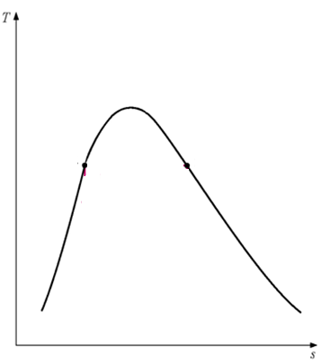
Hardware Feasibility of the reversed Rankine cycle for Refrigeration ?
Very costly to expand the liquid using a turbine with very low or negligible power output!?!
May become negative under irreversible conditions.
Cheaper to have irreversible expansion through an expansion valve.

Slide 9
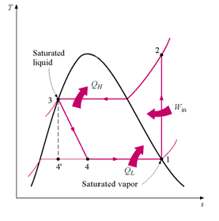
Simplified Hardware Designs for Development of Inverse Domestic Energy Systems
Christened as Vapour Compression Refrigeration (VCR) Cycle

Slide 10
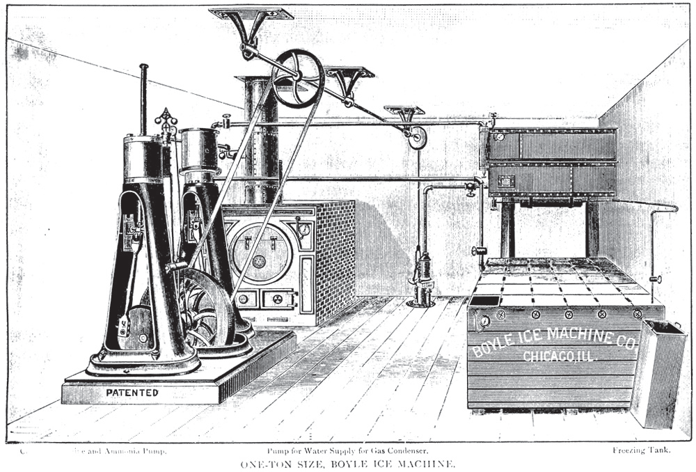
Steam Engine to Drive Reciprocating Compressor

Slide 11
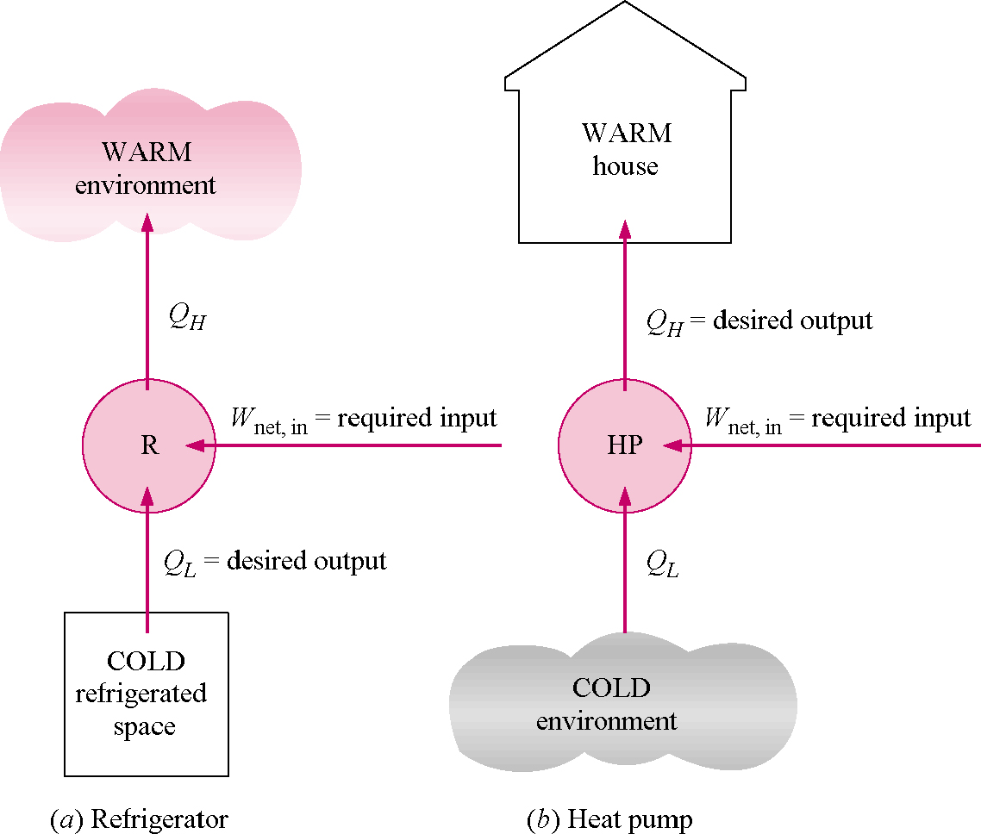
Two Way use of VCR Cycle

Slide 12
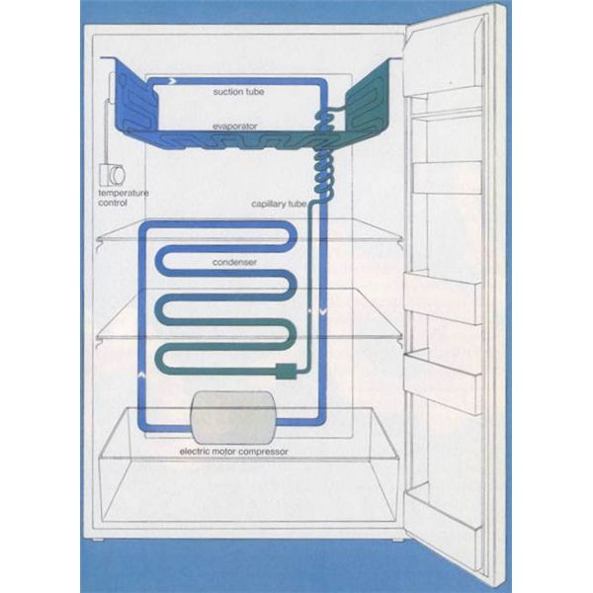
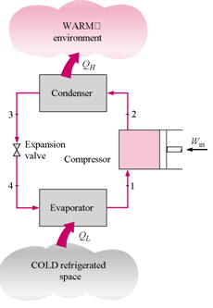
Thermodynamics of Ideal VCR Cycle
Ideal Vapor-Compression Refrigeration Cycle
Process Description
1-2 Isentropic compression
2-3 Constant pressure heat rejection in the condenser
3-4 Throttling in an expansion valve
4-1 Constant pressure heat addition in the evaporator

Slide 13
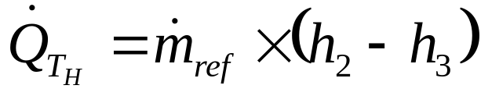
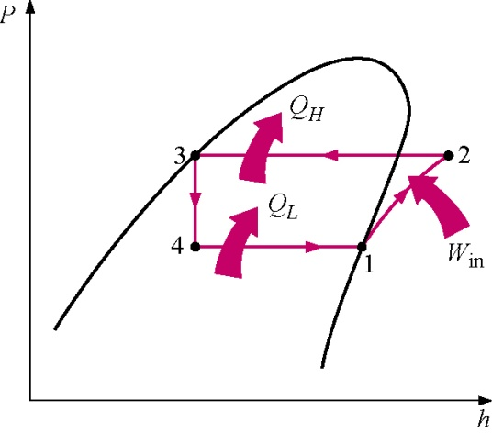
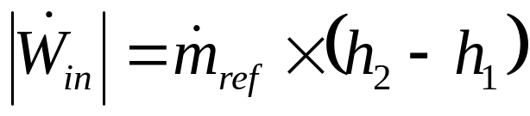
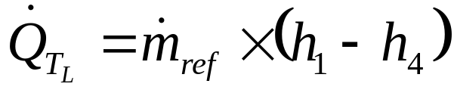
The P-h diagram
It is another convenient diagram often used to illustrate the Capacity of refrigeration cycle.
Rate of Heat delivered to surroundings:
Rate of Work Input:
Rate of Heat removal from Refrigerated space:

Slide 14
Units of Refrigeration Capacity
Ton of Refrigeration (TR):
Ton of Refrigeration (abbreviated as TR) is an important historical unit of refrigeration capacity.
Originally 1 TR was defined as the rate of heat transfer required to make 1 ton of ice per day from water at 0ºC.
American Society of Heating, Refrigerating and Airconditioning Engineers (ASHRAE) defines 1 TR as equivalent to a refrigeration capacity of 3516.85 W.
Tons of Refrigeration or simply Tons is often used as a general term to indicate the capacity or size of the refrigeration plant.
Thus 1 TR air conditioner has a refrigeration capacity of 3516.85 W at the prescribed temperatures.

Slide 15
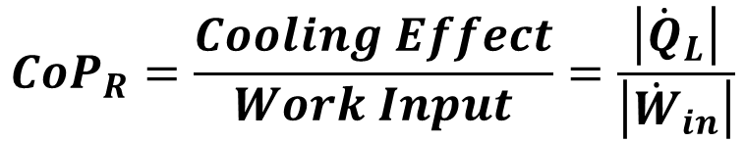
Performance of Refrigerator
The performance of a refrigerator is defined as Coefficient of Performance (CoP).
Energy Efficiency Ratio (EER) :
The EER is the ratio of the cooling capacity (in British thermal units [Btu] per hour) to the power input (in watts).

Slide 16
The Working Fluid : Refrigerant
Refrigerants are those fluids, which are used as working fluids, for example in vapour compression refrigeration systems.
Refrigeration effect depends upon a substance called the refrigerant, which can readily be converted from liquid into a vapour (evaporation) and also from a vapour into a liquid (condensation) within a narrow range of pressures.

Slide 17
REFRIGERANTS
Halocarbon based
Non-Halocarbon based
Ethane based
Methane based
CFCs
HCFCs
HFCs
Primary
Secondary
Pure
Blended
Azeotropic
Near Azeotropic
Zeotropic

Slide 18
Generations of Refrigerants
First Generation 1830-1930s ex: CO₂; NH₃; HCs;SO₂ etc. usefulness of volatile compounds
Second Generation: 1931-1990s ex: CFCs; HCFCs; safety & durability
Third Generation; 1990-2010s ex: HCFCs and HFCs; Ozone Layer protection
Fourth Generation; 2010 onwards ex: Pure & Blended HCs; Global warming; high CoP.

Slide 19
Refrigerant selection criteria
Selection of refrigerant for a particular application is based on the following requirements:
Environmental and safety properties
Thermodynamic and thermo-physical properties, and
Economics

Slide 20
Environmental properties
The important environmental properties are:
Ozone Depletion Potential (ODP)
Global Warming Potential (GWP)
Total Equivalent Warming Index (TEWI)
Atmospheric Lifetime
Chlorine Leading Potential

Slide 21
Thermodynamic and thermo-physical properties
The requirements are:
Suction pressure: At a given evaporator temperature, the saturation pressure should be above ambient pressure.
Discharge pressure: At a given condenser temperature, the discharge pressure should be as small as possible.
Pressure ratio: Should be as small as possible for compact and low power consumption
4. Latent heat of vaporization: Should be as large as possible so that the required mass flow rate per unit cooling capacity will be small.
5. Isentropic index of compression: Should be as small as possible so that the temperature rise during compression will be small.

Slide 22
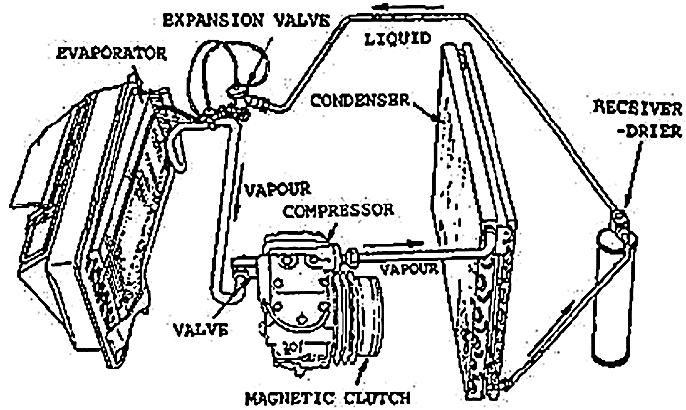
Components of A Refrigeration System

Slide 23
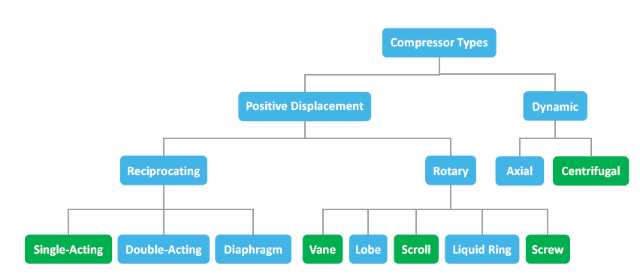
Types of Compressors

Slide 24
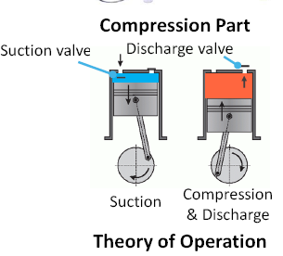
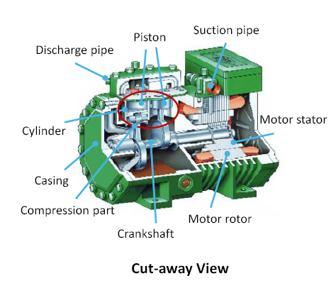
Reciprocating Compressors
A reciprocating compressor is also called a piston compressor.
This compressor adopts the back and forth piston motion in a cylinder synchronized with suction and discharge valves to compress the vaporized refrigerant from a low pressure and temperature to a high pressure and temperature.
The motion of the piston is achieved via a crankshaft which converts motor rotations to piston reciprocations.

Slide 25
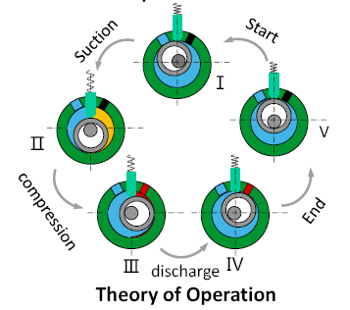
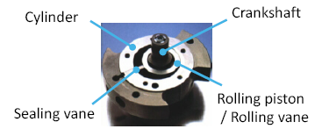
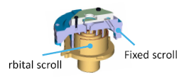
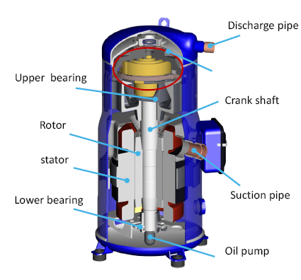
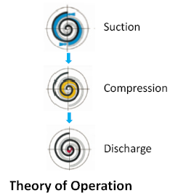
Rotary compressors (Positive Displacement)
Rotary Vane Compressor
Rotary Scroll Compressor

Slide 26
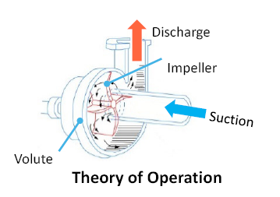
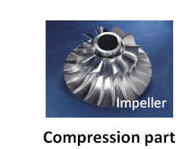
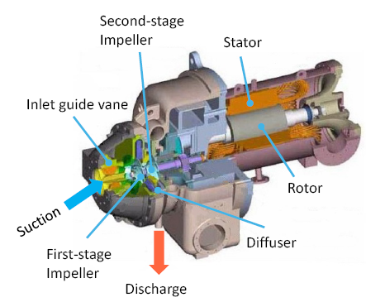
Centrifugal compressor
Largest capacity which can be up to 10,000 tons (35,000 kW) per unit

Slide 27
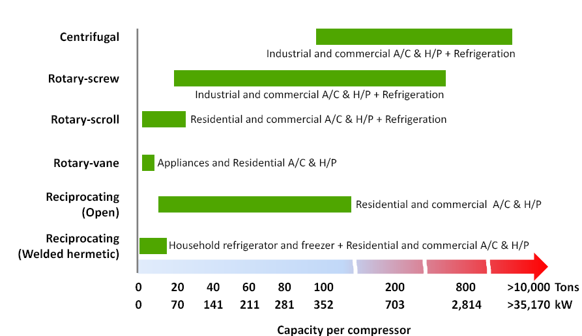
Compressor capacity & Applications

