Slide 1

Kinematics of Fluid Flows
P M V Subbarao
Professor
Mechanical Engineering Department
An Exclusive Framework to Describe Simultaneous Motion of Multitudinous Parcels…

Slide 2



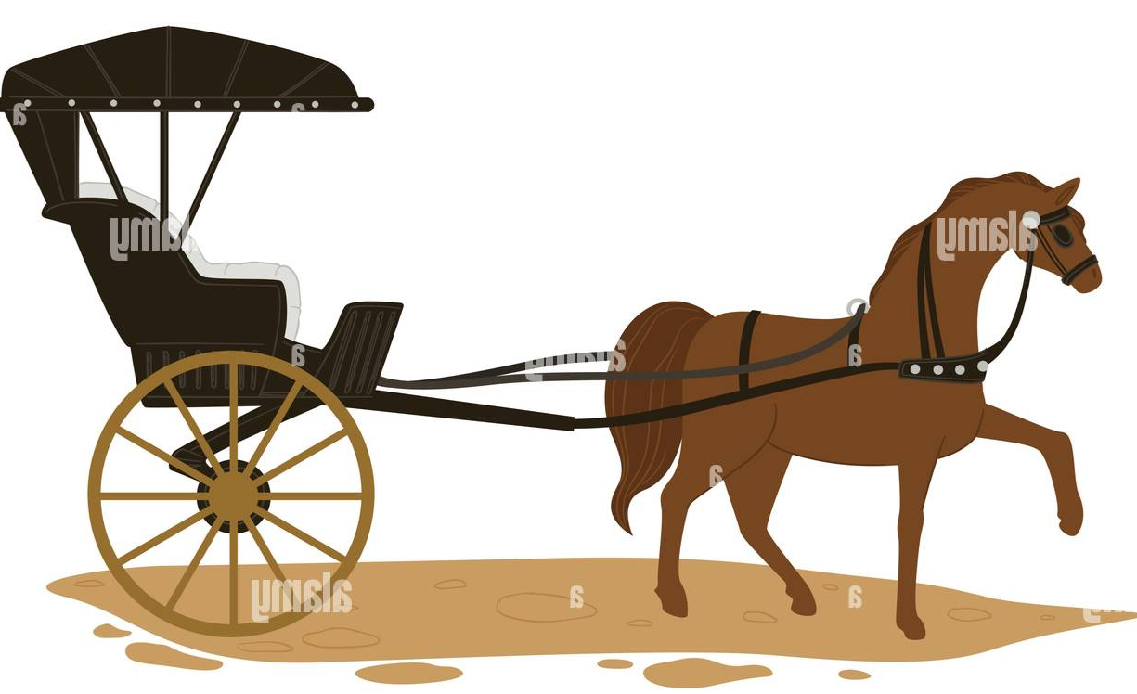
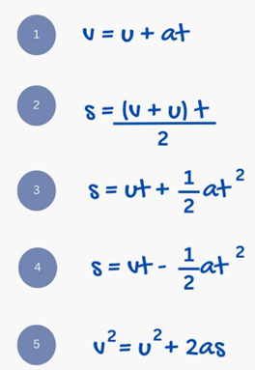

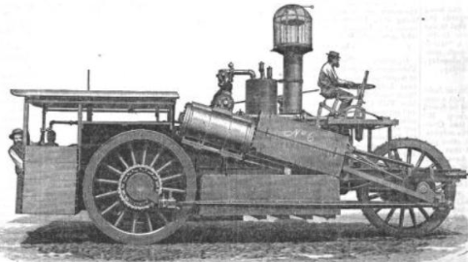

The Traditional SUVAT Kinematics
For constant acceleration
Newtonian mechanics takes a more local "cause-and-effect"/"apply a force, get a reaction" view.
Newtonian mechanics starts with Newton's three laws of motion

Slide 3
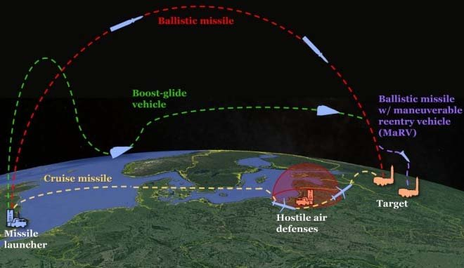
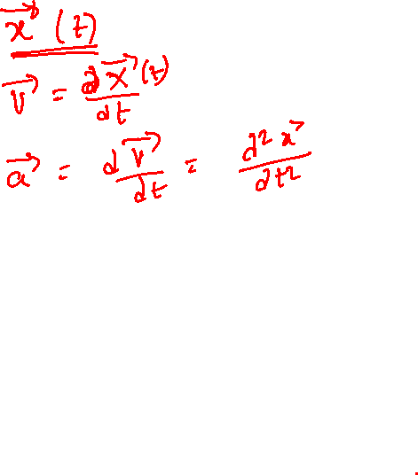
Lagrangian Approach & Kinematic Description of Wayward Objects
Lagrangian mechanics takes a more global "minimize this quantity" view.
Lagrangian mechanics starts with the Principle of Least Action.

Slide 4
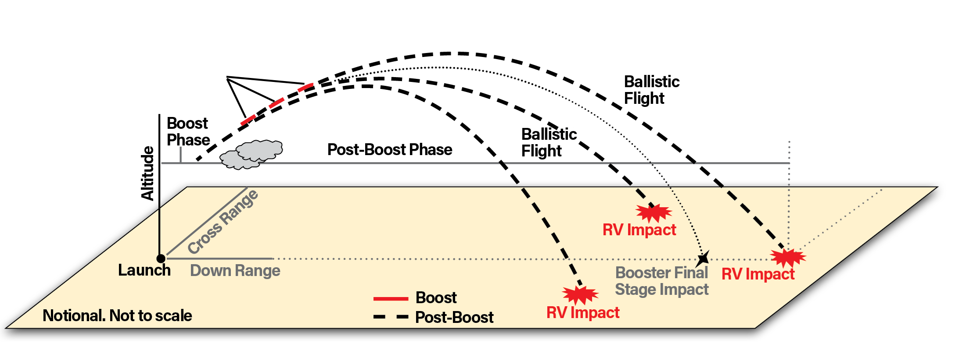
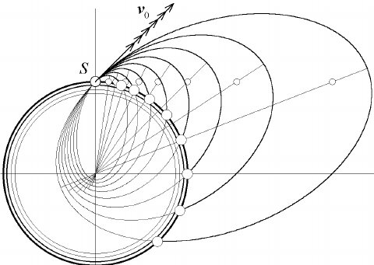
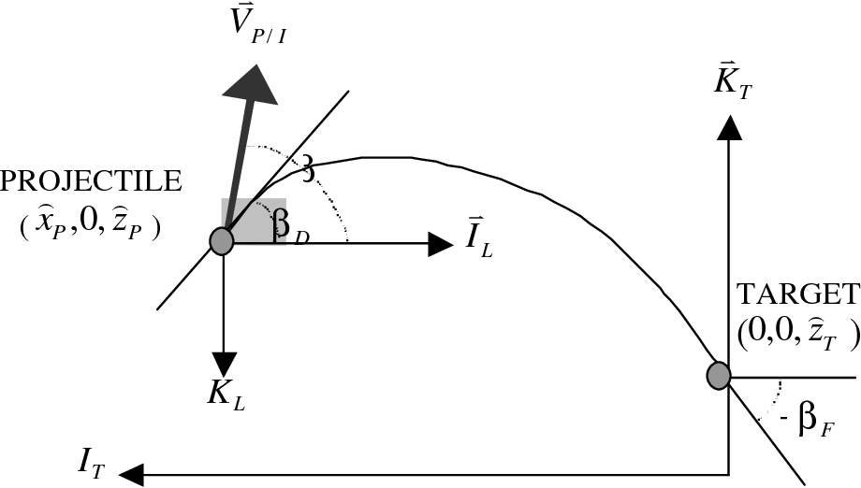
Kinematic Description of Multiple Wayard Objective using Lagrangian Approach

Slide 5
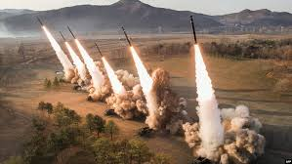
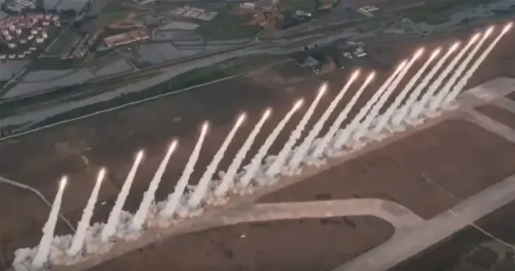
Lagrangian Approach for Ballistic Trajectories of Multiple Missiles

Slide 6
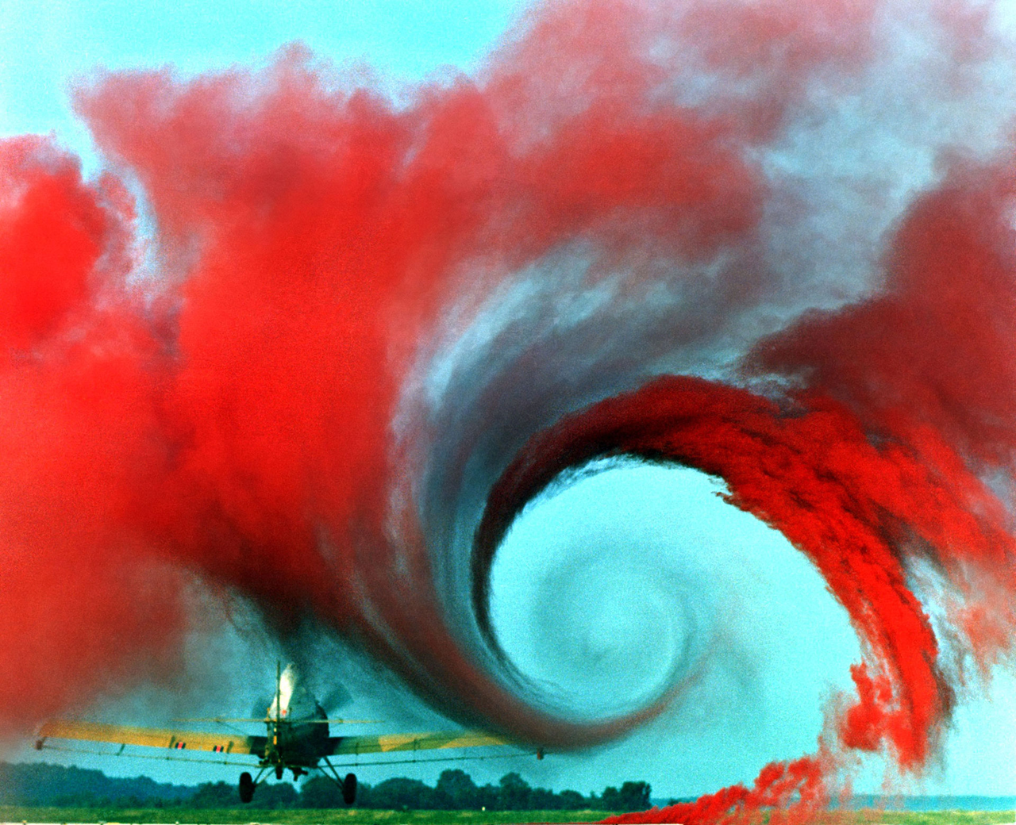
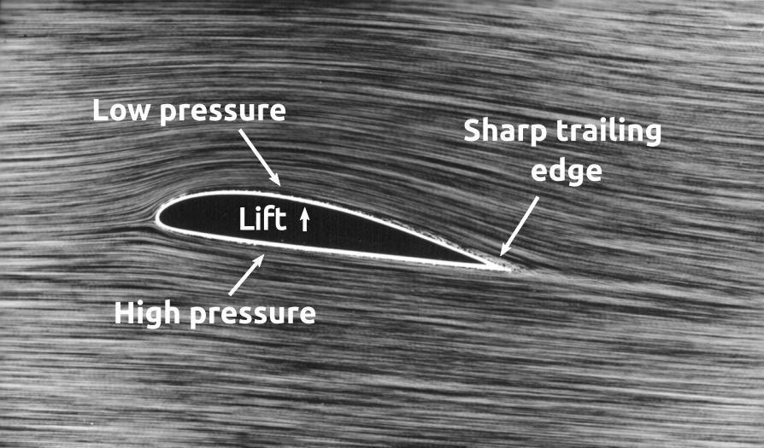
Kinematic Description of Continuously Evolving Fluid Parcels

Slide 7
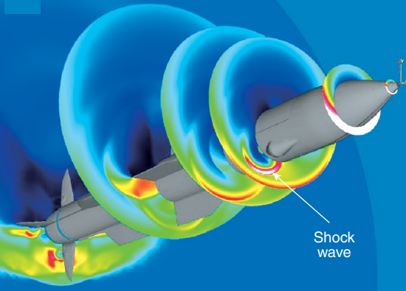
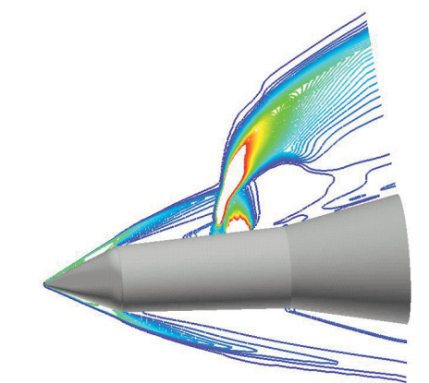
Trajectories of Continuously Evolving Fluid Parcels

Slide 8
Kinematic Properties and Lagrangian Approach
The Lagrangian description is simple to understand.
Conservation of mass and Newton’s laws apply directly to each object.
However, it is computationally expensive to keep track of the trajectories of many objects.
How to describe trajectories of multiple parcels in fluid flow?
The Lagrangian description is used only in Extreme cases of flow fields, where fewer number of foreign particles carried by the base fluid parcels.

Slide 9

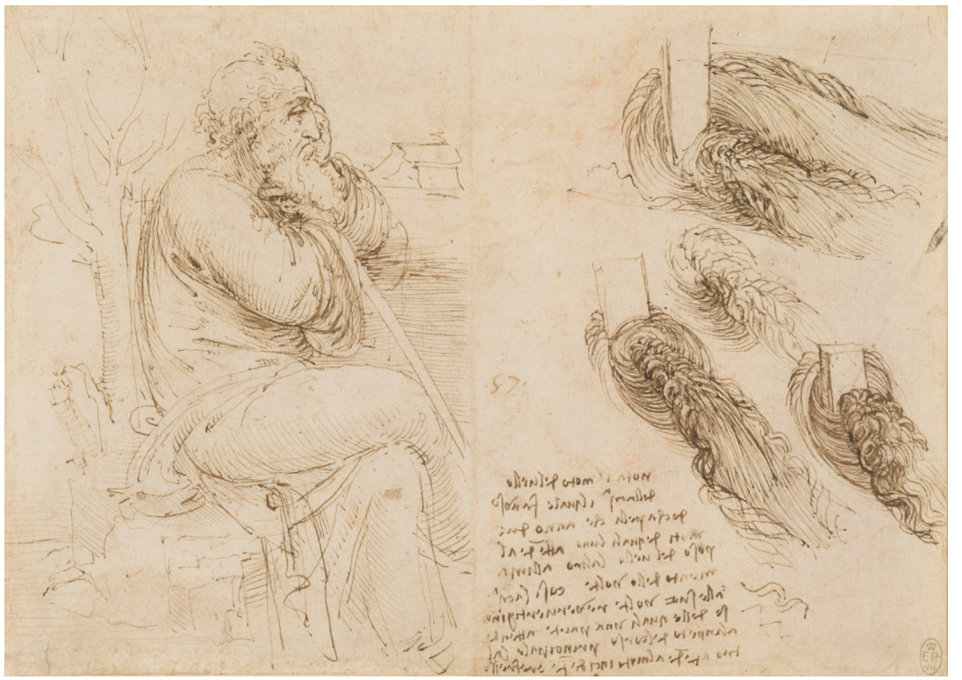

The Art of Describing A Flow Field

Slide 10
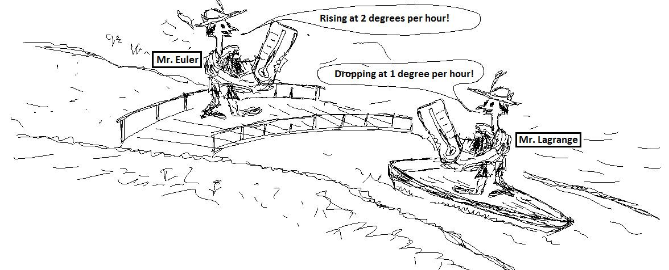
New Perceptions of Describing A Flow Field
Leonhard Euler (1707-1783)
Joseph-Louis Lagrange (1736-1813)

Slide 11
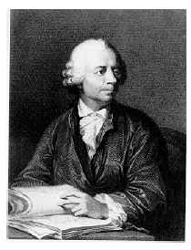
Leonhard Euler
Leonhard Euler (1707-1783) was arguably the greatest mathematician of the eighteenth century.
One of the most prolific writer of all time; his publication list of 886 papers and books fill about 90 volumes.
Remarkably, much of this output dates from the last two decades of his life, when he was totally blind.
Euler's prolific output caused a tremendous problem of backlog: the St. Petersburg Academy continued publishing his work posthumously for more than 30 years.

Slide 12
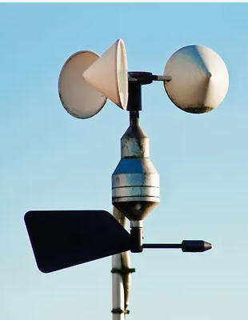
Measurement in Fluid Systems are Eulerian Description of Flow
Rather than following each fluid particle we can record the evolution of the flow properties at every point in space as time varies.
This is the Eulerian description.
It is a field description.
A probe fixed in space is an example of a Eulerian measuring device.
This means that the flow properties at a specified location depend on the location and on time.

Slide 13
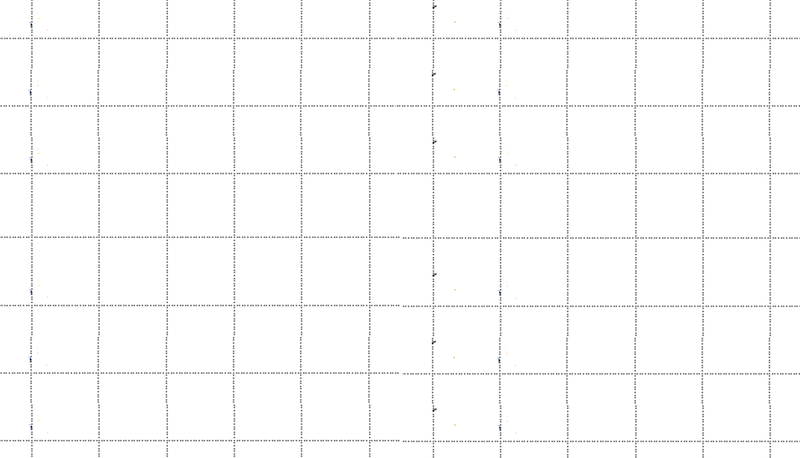
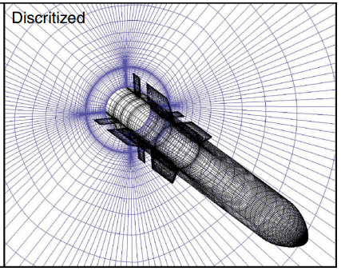
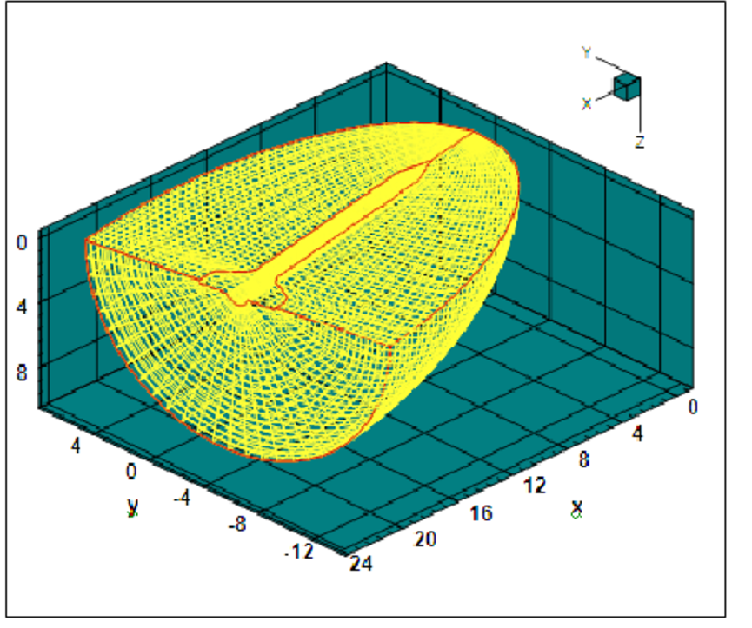
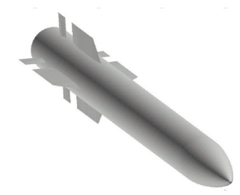
Eulerian Kinematic Description in Cartesian Grid

Slide 14
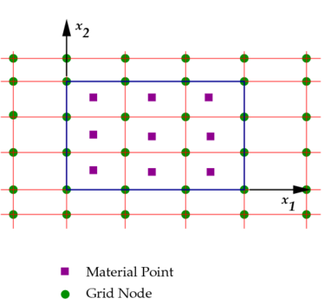
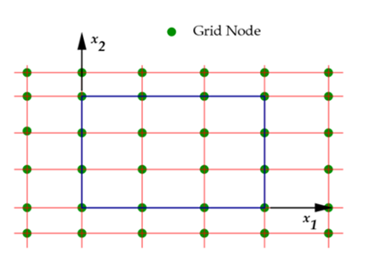
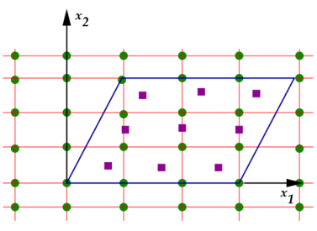
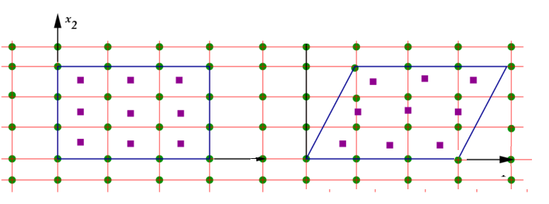
Eulerian Imagination of Obvious Truth
No motion and only Deformation
Translatory Motion and Deformation

Slide 15
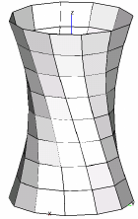
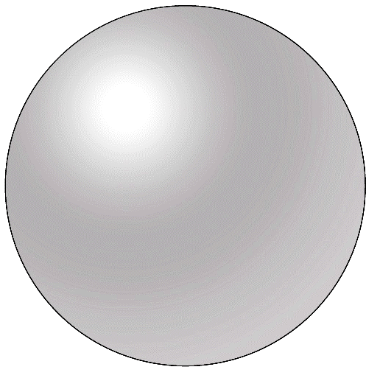
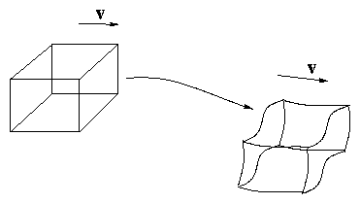

Eulerian Imagination of Obvious Truth in 3D
$$\vec{V_{}}$$
$$\vec{V_{}}$$
$$\vec{V_{}}$$
$$\vec{V_{\dot{}}}$$

Slide 16
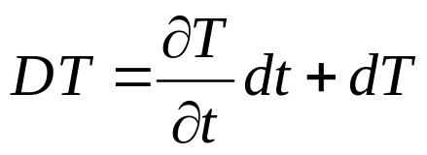
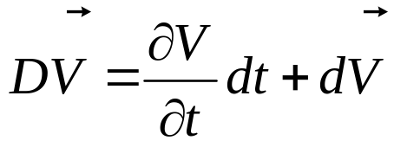
Euler Fluid Paracel & Material Derivatives
A fluid parcel, often called a material element.
Fluid elements are small blobs of fluid that always contain the same material.
They are deformed as they move but they are not broken up.
The temporal and spatial change of the flow/fluid quantities is described most appropriately by the substantial or material derivative.
Generally, the substantial derivative of a flow quantity, which may be a scalar, a vector or a tensor valued function, is given by:
$$D\left(∇Φ\right)=\frac{∂\left(∇Φ\right)}{∂t}dt+d\left(∇Φ\right)$$

Slide 17

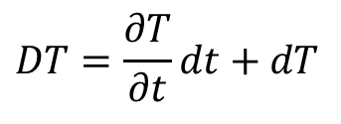
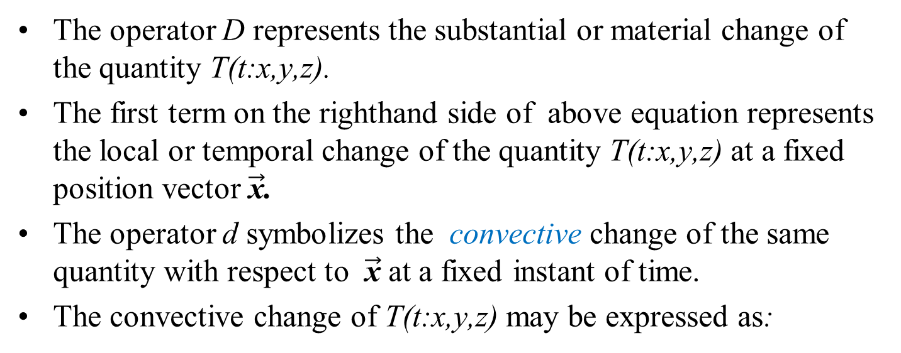

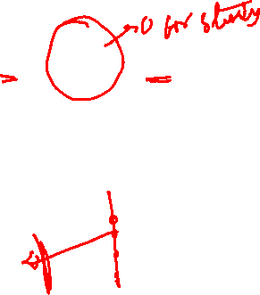
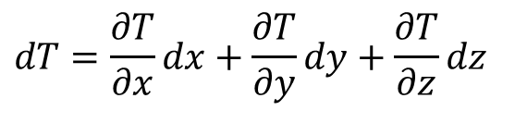
Understanding of Material Derivative of A Scalar Field
$$DT=\frac{∂T}{∂t}dt+dT$$
The operator D represents the substantial or material change of the quantity T(t:x,y,z).
The first term on the righthand side of above equation represents the local or temporal change of the quantity T(t:x,y,z) at a fixed position vector $\vec{\text{x}}$.
The operator d symbolizes the convective change of the same quantity with respect to $\vec{\text{x}}$ at a fixed instant of time.
The convective change of T(t:x,y,z) may be expressed as:
$$dT=\frac{∂T}{∂x}dx+\frac{∂T}{∂y}dy+\frac{∂T}{∂z}dz$$
$$dT=d\vec{x}•∇T$$

Slide 18
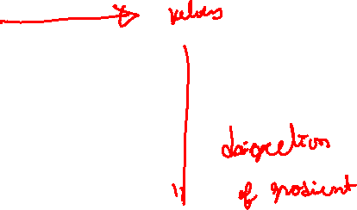
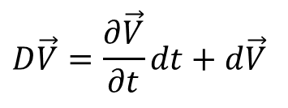
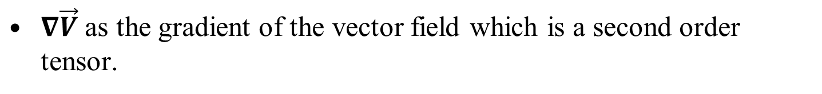
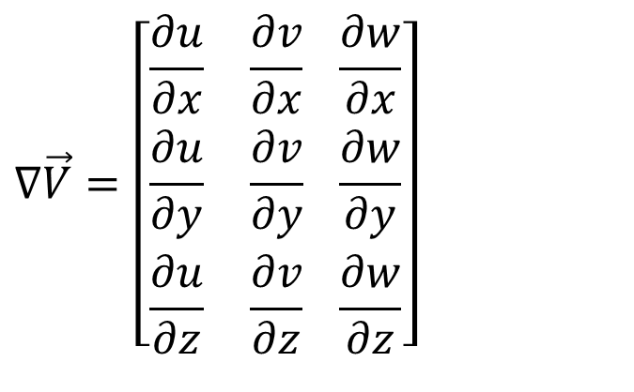
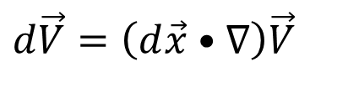
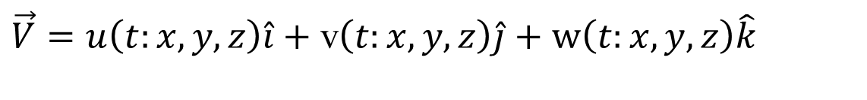
Understanding of Material Derivative of A Vector Field
Eulerian Velocity vector is defined as :
$\vec{V}=u\left(t:x,y,z\right)\hat{i}+$ v$\left(t:x,y,z\right)\hat{j}+\text{w}\left(t:x,y,z\right)\hat{k}$
Sustantial or Material Derivative of Velocity vector is defined as :
$$D\vec{V}=\frac{∂\vec{V}}{∂t}dt+d\vec{V}$$
$$d\vec{V}=\left(d\vec{x}•∇\right)\vec{V}$$
$∇\vec{V}$ as the gradient of the vector field which is a second order tensor.
$$∇\vec{V}=\left[\begin{aligned}&\frac{∂u}{∂x} \frac{∂v}{∂x} \frac{∂w}{∂x} \\ &\frac{∂u}{∂y} \frac{∂v}{∂y} \frac{∂w}{∂y} \\ &\frac{∂u}{∂z} \frac{∂v}{∂z} \frac{∂w}{∂z}\end{aligned}\right]$$

Slide 19
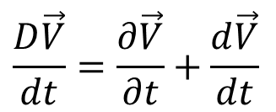
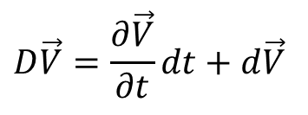
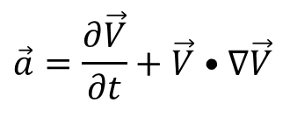
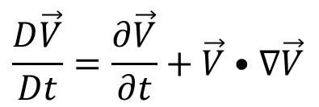
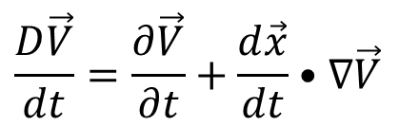
Rate of Change of Material Derivative of A Vector Field
$$D\vec{V}=\frac{∂\vec{V}}{∂t}dt+d\vec{V}$$
Dividing above equation by dt yields the acceleration vector.
$$\frac{D\vec{V}}{dt}=\frac{∂\vec{V}}{∂t}+\frac{d\vec{V}}{dt}$$
$$\frac{D\vec{V}}{dt}=\frac{∂\vec{V}}{∂t}+\frac{d\vec{x}}{dt}•∇\vec{V}$$
The differential dt may symbolically be replaced by Dt indicating the material character of the derivatives.
$$\frac{D\vec{V}}{Dt}=\frac{∂\vec{V}}{∂t}+\vec{V}•∇\vec{V}$$
$$\vec{a}=\frac{∂\vec{V}}{∂t}+\vec{V}•∇\vec{V}$$
Material or substantial acceleration

Slide 20
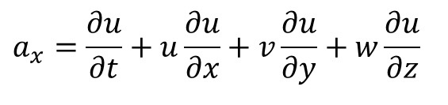
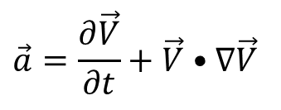
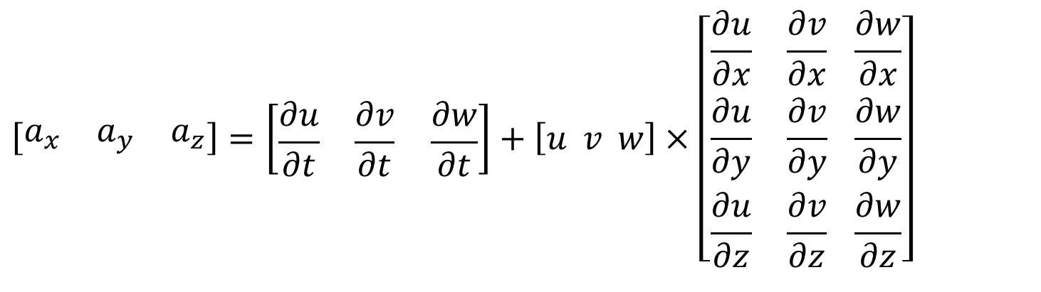
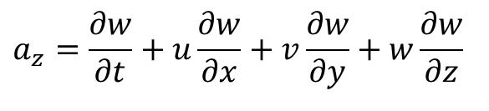

Components of Material Acceleration
$$\vec{a}=\frac{∂\vec{V}}{∂t}+\vec{V}•∇\vec{V}$$
$$a_{x}=\frac{∂u}{∂t}+u\frac{∂u}{∂x}+v\frac{∂u}{∂y}+w\frac{∂u}{∂z}$$
$$a_{y}=\frac{∂v}{∂t}+u\frac{∂v}{∂x}+v\frac{∂v}{∂y}+w\frac{∂v}{∂z}$$
$$a_{z}=\frac{∂w}{∂t}+u\frac{∂w}{∂x}+v\frac{∂w}{∂y}+w\frac{∂w}{∂z}$$
$$\left[\begin{matrix}a_{x} & a_{y} & a_{z}\end{matrix}\right]=\left[\begin{matrix}\frac{∂u}{∂t} & \frac{∂v}{∂t} & \frac{∂w}{∂t}\end{matrix}\right]+\left[u v w\right]×\left[\begin{aligned}&\frac{∂u}{∂x} \frac{∂v}{∂x} \frac{∂w}{∂x} \\ &\frac{∂u}{∂y} \frac{∂v}{∂y} \frac{∂w}{∂y} \\ &\frac{∂u}{∂z} \frac{∂v}{∂z} \frac{∂w}{∂z}\end{aligned}\right]$$

